Slide 1
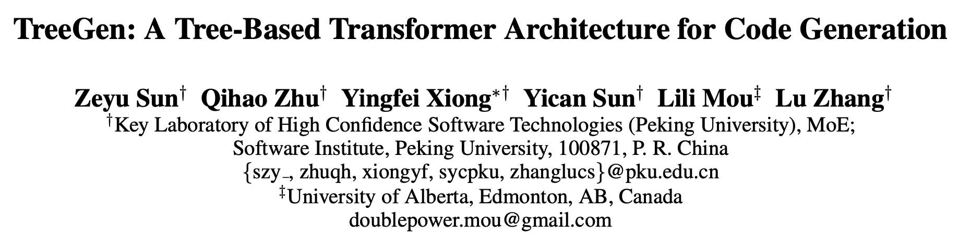
AAAI2020
2020.03.18
Reporter：Zhiyi Fu
Notes:
AAAI2020

Slide 2
OUTLINE
Introduction
Model
Experiments
Conclusion

Slide 3
OUTLINE
Introduction
Model
Experiments
Conclusion

Slide 4
Introduction
Code Generation: NL description —> executable program
TreeGen: NL description —> grammar rule sequence
Many SoTA approaches perform code generation through predicting a sequence of grammar rules, e.g.
A Syntactic Neural Model for General-Purpose Code Generation. Yin, P., and Neubig, G. ACL 2017
Abstract Syntax Networks for Code Generation and Semantic Parsing. Rabinovich, M.; Stern, M.; and Klein, D. ACL 2017
A grammar-based structural cnn decoder for code generation. Sun, Z.; Zhu, Q.; Mou, L.; Xiong, Y.; Li, G.; and Zhang, L. AAAI 2019

Slide 5
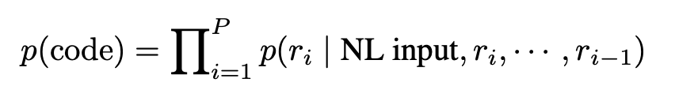

Introduction
Code Generation: NL description —> executable program
TreeGen: NL description —> grammar rule sequence
Given the natural language description and the currently generated partial AST, the model calculates the probabilities of the rules to expand this node
具体说，TreeGen把代码生成任务，转换成了这样一个任务：…
通过预测“产生式”序列（前序），从根节点对程序进行扩张
1
1
Notes:
具体说，TreeGen把代码生成任务，转换成了这样一个任务：…
通过预测“产生式”序列（前序），从根节点对程序进行扩张

Slide 6

Introduction
Main challenges:
Long-dependency problem
Representation of code structures
How TreeGen address those challenges?
Transformer architecture
Structural convolution sub-layer: graph- or tree-based
挑战与解决思路
使用Transformer和Structural Conv来捕获程序特征（尤其是结构特征）
Notes:
挑战与解决思路
使用Transformer和Structural Conv来捕获程序特征（尤其是结构特征）

Slide 7
OUTLINE
Introduction
Model
Experiments
Conclusion

Slide 8
Model
功能视角
A NL reader — encodes the text description
An AST reader (the first several Transformer decoder blocks) — encodes the previously generated partial code (grammar rule sequence)
A decoder (the rest Transformer decoder blocks) — combines the query (expanding node in AST) and the previous two encoders to predict next grammar rule
Notes:
功能视角

Slide 9
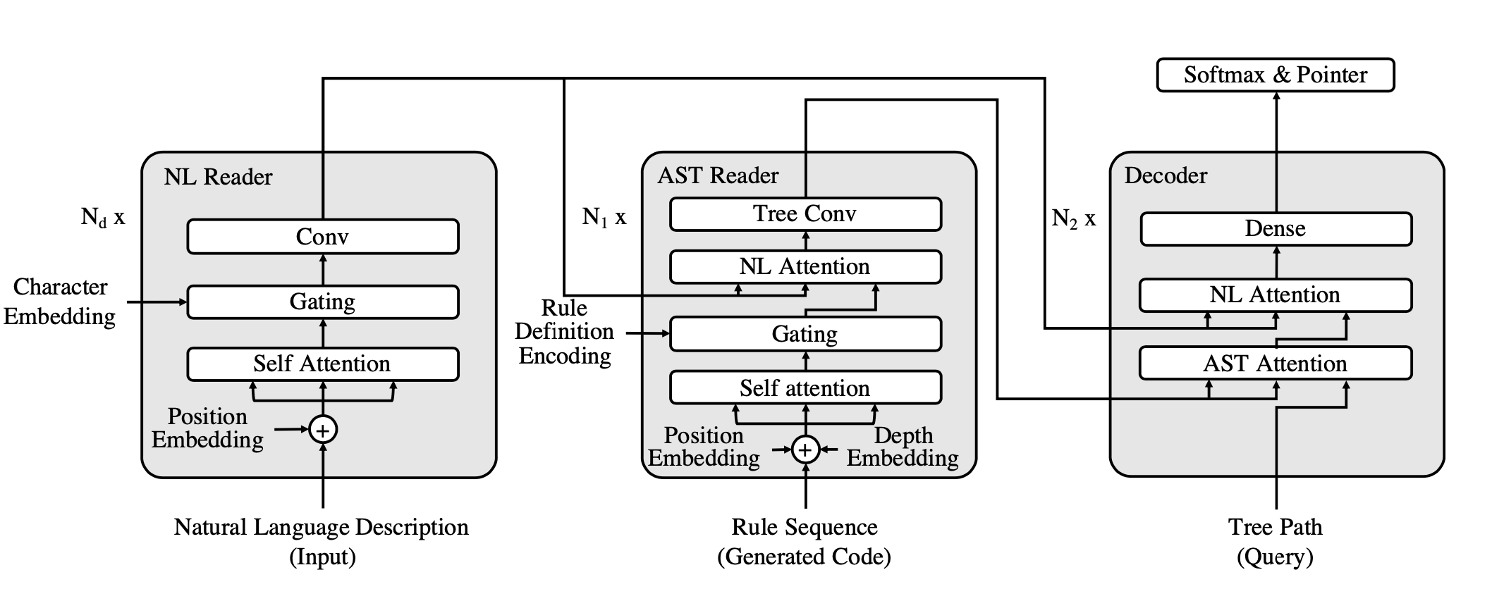
Model — Overview
Notes:
功能视角

Slide 10
Model — Another View
实现视角
An encoder — encodes the text description
A decoder — the first several blocks encode the partial AST, the rest several blocks predict next grammar rule
Notes:
实现视角

Slide 11
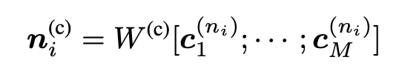
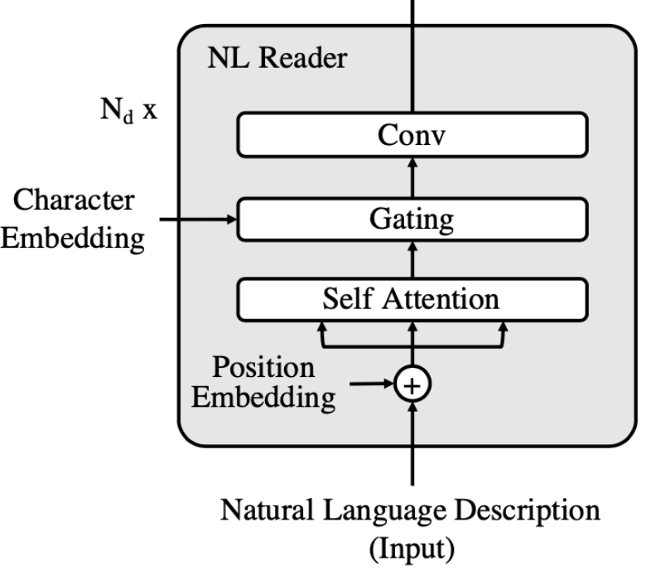


Model — NL Reader
按功能视角的模型模块讲解
第ni个token的字符embeddings concat + 全连接层：每个token的字符数有最大长度，不足的padding
Word embedding
Concatenated character embeddings + FC + LN
Notes:
按功能视角的模型模块讲解
第ni个token的字符embeddings concat + 全连接层：每个token的字符数有最大长度，不足的padding

Slide 12
Model — NL Reader
self-attention就是常规的Transformer的多头注意力，只是position embedding是原版的一个变体，考虑了不同层的差异
每两个子层间都添加一组：残差 + 层归一化
Transformer block here consists of
Self-attention (+RC & LN)
Gating mechanism (+RC & LN)
2*Word convolution (+RC & LN)
Notes:
self-attention就是常规的Transformer的多头注意力，只是position embedding是原版的一个变体，考虑了不同层的差异
每两个子层间都添加一组：残差 + 层归一化

Slide 13

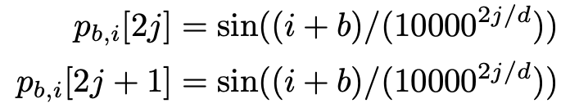
Model — NL Reader
Transformer block here consists of
Self-attention
Gating mechanism
2*Word convolution
b：层数——第几个block
i：index——第几个word
j：维数——哪维
Notes:
b：层数——第几个block
i：index——第几个word
j：维数——哪维

Slide 14






Model — NL Reader
i：第i个token
yi：self-attention对应该词的输出
ni：word encoding，字符embedding的concat + 线性变换
算出权重后，对word encoding和word embedding进行概率线性组合
上面的公式只有两个alpha是标量
Transformer block here consists of
Self-attention
Gating mechanism
2*Word convolution
$$q_{i}=W^{(self)}y_{i}^{(self)}$$
$$k_{i}^{(c)}=W^{(c)}n_{i}^{(c)}$$
$$k_{i}^{(y)}=W^{(y)}y_{i}^{(self)}$$
$$[α_{i}^{(y)},α_{i}^{(c)}]=softmax\{q_{i}^{T}k_{i}^{(y)},q_{i}^{T}k_{i}^{(c)}\}$$
$$h_{i}=[α_{i}^{(y)}v_{i}^{(y)}+α_{i}^{(c)}v_{i}^{(c)}]$$
Notes:
i：第i个token
yi：self-attention对应该词的输出
ni：word encoding，字符embedding的concat + 线性变换
算出权重后，对word encoding和word embedding进行概率线性组合
上面的公式只有两个alpha是标量

Slide 15




Model — NL Reader
Transformer block here consists of
Self-attention
Gating mechanism
2*Word convolution
$$y_{i}^{(conv,0)}=y_{i}^{(gate)}$$
$$seperatableconv+GELU$$
l：卷积层数
w：卷积窗长度/2
Notes:
l：卷积层数
w：卷积窗长度/2

Slide 16

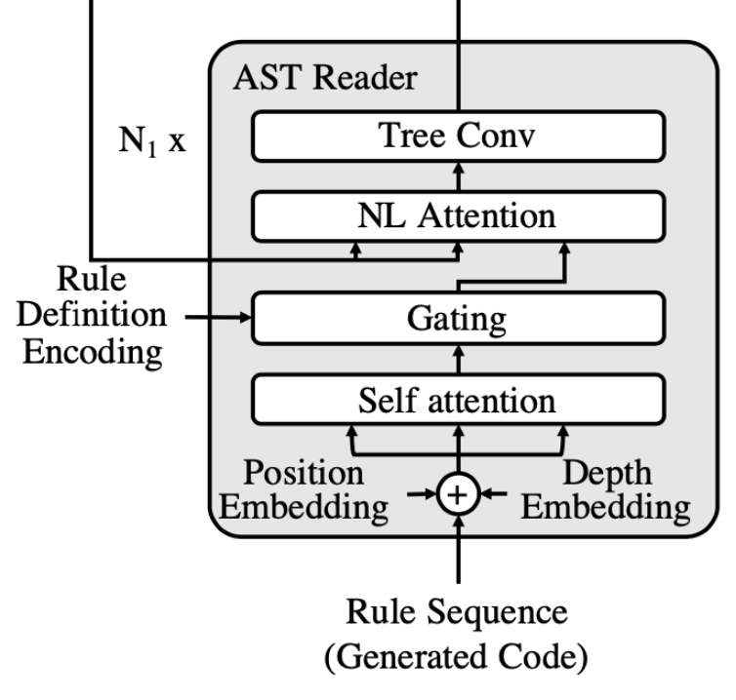


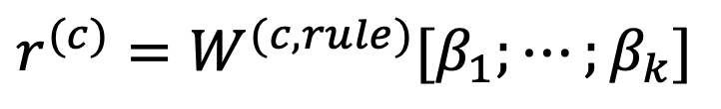
Model — AST Reader
Rule sequence embedding
Rule definition encoding + LN
NL Reader’s output
$$r^{(c)}=W^{(c,rule)}[β_{1};⋯;β_{k}]$$
每层AST Reader Block有三个输入
一个是原子级的（token级的）：Rule ID
一个是序列级的（char级的）：Rule Seq
NL Reader的输出
Notes:
每层AST Reader Block有三个输入
一个是原子级的（token级的）：Rule ID
一个是序列级的（char级的）：Rule Seq
NL Reader的输出

Slide 17


Model — AST Reader
Transformer block here consists of
Self-Attention: $p_{i}+d_{i}+r_{i}$ as input —> $y_{i}^{(ast−self)}$
Gating Mechanism
NL Attention
Tree Convolution
rule sequence：AST上的“grammar rule”的前序序列 => rule embedding
position embedding：规则序列的position embedding
depth embedding：规则序列每个规则里，左节点的父节点rule embedding
Notes:
rule sequence：AST上的“grammar rule”的前序序列 => rule embedding
position embedding：规则序列的position embedding
depth embedding：规则序列每个规则里，左节点的父节点rule embedding

Slide 18


Model — AST Reader
Transformer block here consists of
Self-Attention
Gating Mechanism: $y_{i}^{(ast−g)}$
NL Attention
Tree Convolution
其实还是根据上一层的输出和对应位置的rule content encoding做一个线性变换和概率加权，得到新表示
Notes:
其实还是根据上一层的输出和对应位置的rule content encoding做一个线性变换和概率加权，得到新表示

Slide 19


Model — AST Reader
Transformer block here consists of
Self-Attention
Gating Mechanism
NL Attention: $y_{i}^{(ast−nl)}$
Tree Convolution
实质还是Multi-head Attention，从rule seq到NL Desc的注意力
Notes:
实质还是Multi-head Attention，从rule seq到NL Desc的注意力

Slide 20


Model — AST Reader
这层其实就是我们熟知的TBCNN
公式：L是卷积层数，M是邻接矩阵（ij为1表示j是i的父），kt是卷积窗大小，f激活函数论文中用的是GLUE
在AST Reader的最后，还添加了额外的两层TBCN
Transformer block here consists of
Self-Attention
Gating Mechanism
NL Attention
Tree Convolution: $y_{i}^{(ast)}$
$$Y^{(tconv,l)}=f(W^{(tconv,l)}[Y^{(tconv,l−1)};Y^{(tconv,l−1)}M;⋯;Y^{(tconv,l−1)}M^{kt−1}])$$
$$Y^{(tconv,0)}=[y_{1}^{(att−nl)},y_{2}^{(att−nl)},⋯,y_{P}^{(att−nl)}]$$
Notes:
这层其实就是我们熟知的TBCNN
公式：L是卷积层数，M是邻接矩阵（ij为1表示j是i的父），kt是卷积窗大小，f激活函数论文中用的是GLUE
在AST Reader的最后，还添加了额外的两层TBCN

Slide 21
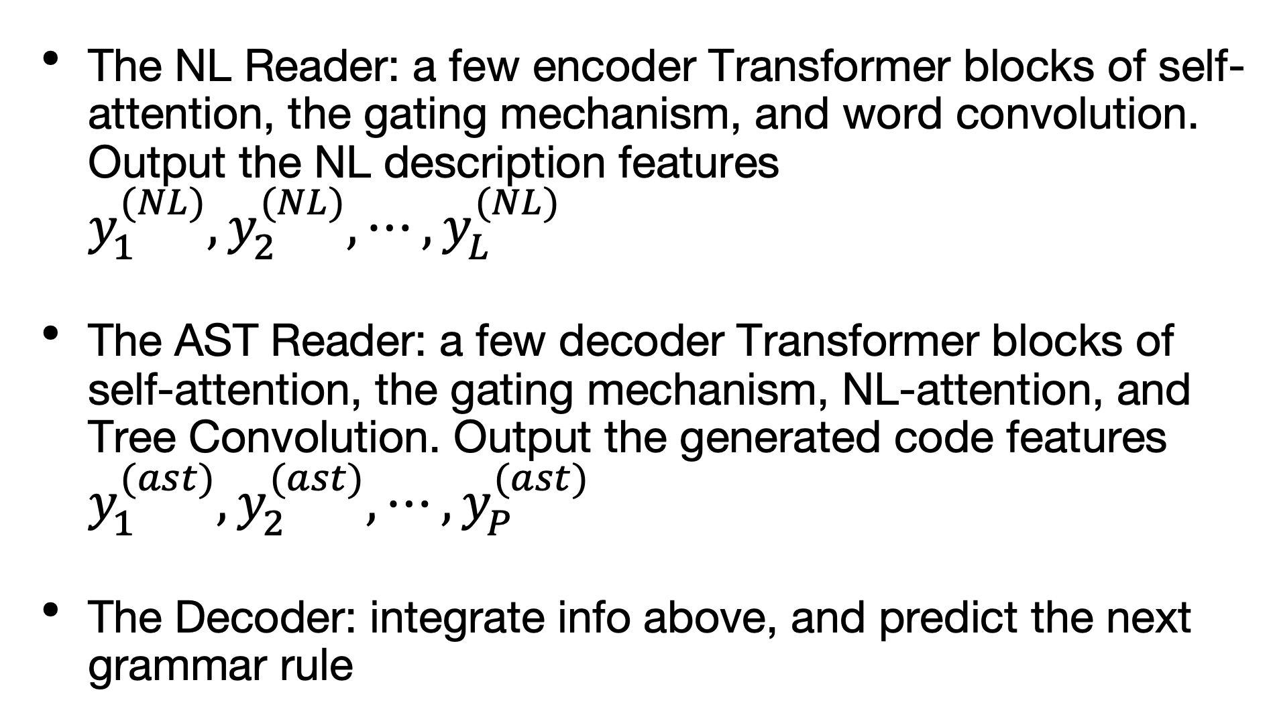
Model — Decoder
The NL Reader: a few encoder Transformer blocks of self-attention, the gating mechanism, and word convolution. Output the NL description features $y_{1}^{(NL)},y_{2}^{(NL)},⋯,y_{L}^{(NL)}$
The AST Reader: a few decoder Transformer blocks of self-attention, the gating mechanism, NL-attention, and Tree Convolution. Output the generated code features $y_{1}^{(ast)},y_{2}^{(ast)},⋯,y_{P}^{(ast)}$
The Decoder: integrate info above, and predict the next grammar rule

Slide 22
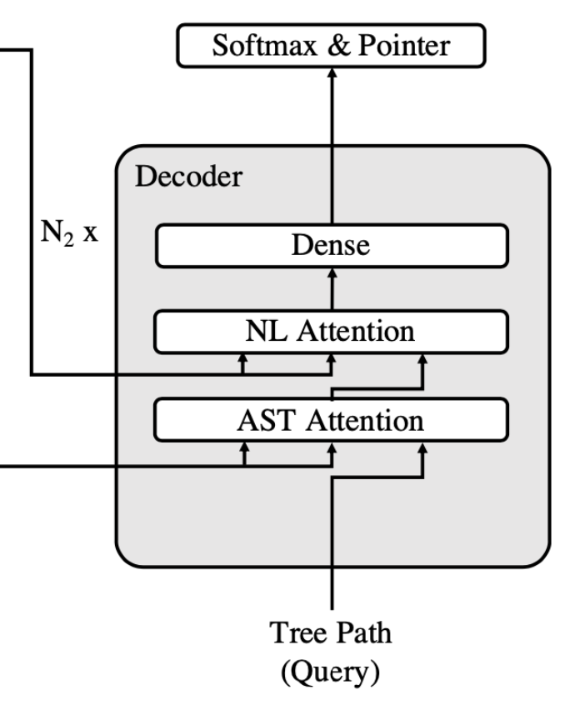


Model — Decoder
Aim at expanding the non-terminal node
Query: represents the node as the path from root to it
$$q_{i}^{(path)}=W^{(path)}[V_{root};⋯;V_{i}]$$

Slide 23


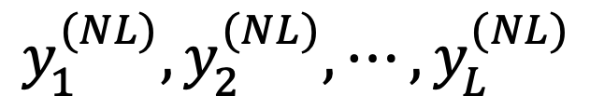
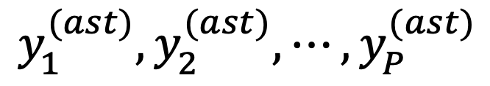
Model — Decoder
AST Attention: $f_{i}^{(tree)}$
NL Attention
FC(GLUE) + FC
NL PointerNet
$$y_{1}^{(NL)},y_{2}^{(NL)},⋯,y_{L}^{(NL)}$$
$$y_{1}^{(ast)},y_{2}^{(ast)},⋯,y_{P}^{(ast)}$$

Slide 24
Model — Decoder
AST Attention
NL Attention
FC(GLUE) + FC
NL PointerNet
$$y_{1}^{(NL)},y_{2}^{(NL)},⋯,y_{L}^{(NL)}$$
$$y_{1}^{(ast)},y_{2}^{(ast)},⋯,y_{P}^{(ast)}$$
把上一层的输出当成queries，继续进行attention，整合自然语言描述信息
Notes:
把上一层的输出当成queries，继续进行attention，整合自然语言描述信息

Slide 25

Model — Decoder
AST Attention
NL Attention
FC(GLUE) + FC
NL PointerNet
$$y_{1}^{(NL)},y_{2}^{(NL)},⋯,y_{L}^{(NL)}$$
$$y_{1}^{(ast)},y_{2}^{(ast)},⋯,y_{P}^{(ast)}$$
然后在重复N2个这样的block之后，最终的输出用于过softmax进行预测。
Notes:
然后在重复N2个这样的block之后，最终的输出用于过softmax进行预测。

Slide 26

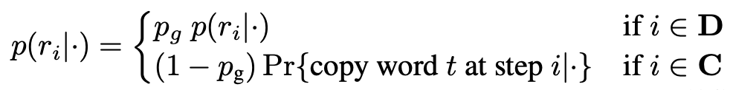
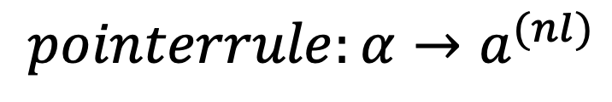
Model — Decoder
我们都知道pointerNet是从已有的信息中copy一个出来，这里就是从自然语言描述中取一个token
又因为decoder预测的目标是一个grammar rule，所以写成。。。
而在预定义类别的softmax和开放式的pointer之间，是通过一个门控机制来组合概率分布的，繁琐，略
AST Attention
NL Attention
FC(GLUE) + FC
NL PointerNet (+ Beam Search)
$$y_{1}^{(NL)},y_{2}^{(NL)},⋯,y_{L}^{(NL)}$$
$$pointerrule:α→a^{(nl)}$$
Notes:
我们都知道pointerNet是从已有的信息中copy一个出来，这里就是从自然语言描述中取一个token
又因为decoder预测的目标是一个grammar rule，所以写成。。。
而在预定义类别的softmax和开放式的pointer之间，是通过一个门控机制来组合概率分布的，繁琐，略

Slide 27
OUTLINE
Introduction
Model
Experiments
Conclusion

Slide 28
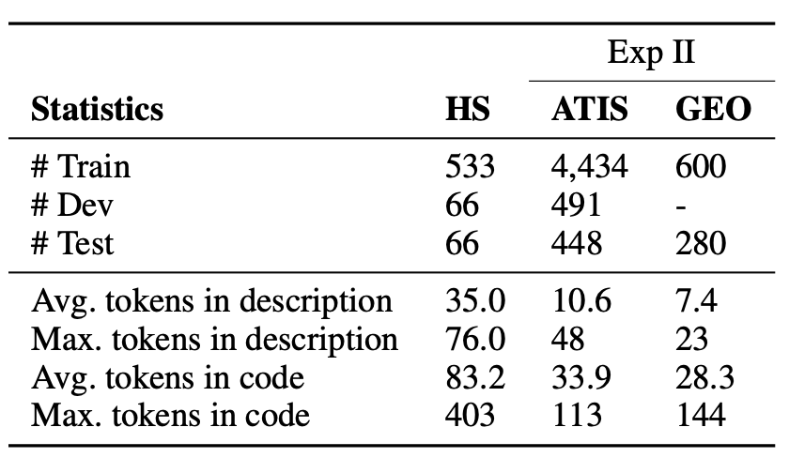
Experiments — Dataset
Python: HearthStone
Semantic Parsing: ATIS, GEO

Slide 29
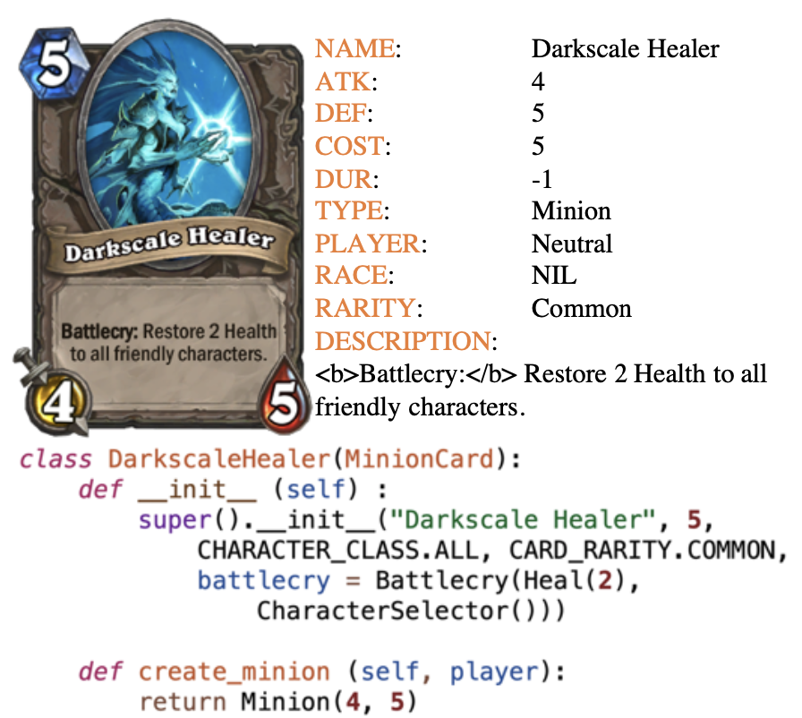
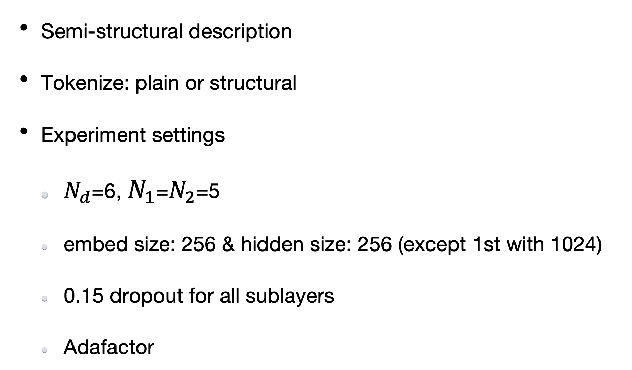
Experiments — HS
Semi-structural description
Tokenize: plain or structural
Experiment settings
$N_{d}$=6, $N_{1}$=$N_{2}$=5
embed size: 256 & hidden size: 256 (except 1st with 1024)
0.15 dropout for all sublayers
Adafactor
后者把每一条属性当成一个token
Notes:
后者把每一条属性当成一个token

Slide 30
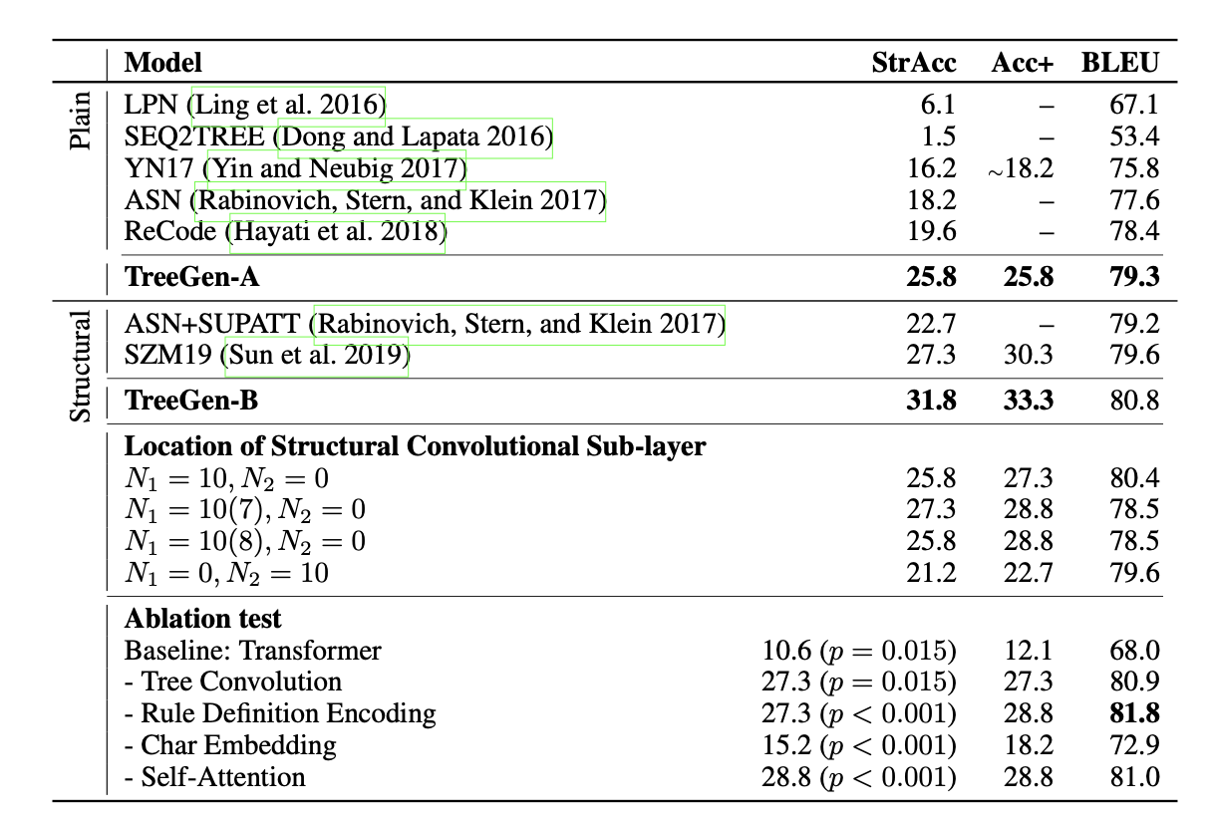
Experiments — HS
StrAcc：token序列完全一致
Acc+：在StrAcc的基础上允许变量重命名（抹除变量名差异）
TreeGen 18s/epoch
CNN 180s/epoch
RNN 49s/epoch
TreeGen-A：TreeGen with plain tokenization
Notes:
StrAcc：token序列完全一致
Acc+：在StrAcc的基础上允许变量重命名（抹除变量名差异）
TreeGen 18s/epoch
CNN 180s/epoch
RNN 49s/epoch

Slide 31
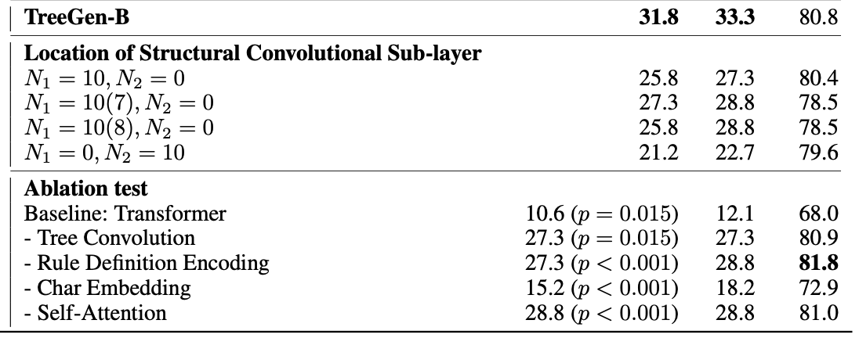
Experiments — HS
Location of structural convolution sublayer
Ablation study
小结论1：不是每层都加TBCN就最好，但至少加了比完全不加好
小结论2：不一定acc高bleu就高
小结论3：字符能提供大量信息
Notes:
小结论1：不是每层都加TBCN就最好，但至少加了比完全不加好
小结论2：不一定acc高bleu就高
小结论3：字符能提供大量信息

Slide 32
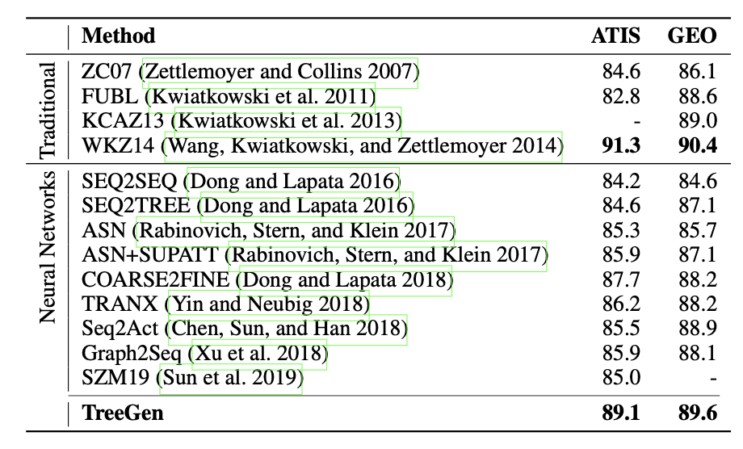
Experiments — Semantic Parsing
WKZ14是传统方法，使用了大量模版，虽然在这两个数据集上效果好但是难泛化
Metrics: tree exact match accuracy
Same settings with HS except hidden/embed size: 128
Notes:
WKZ14是传统方法，使用了大量模版，虽然在这两个数据集上效果好但是难泛化

Slide 33
OUTLINE
Introduction
Model
Experiments
Conclusion

Slide 34
Conclusion
Structural information helps a lot
Utilizing "word" and its "composition" after more fine-grained segmentation simultaneously makes effect
Tree-based Convolution slides to ancestors, maybe we could let conv window go down to the subtree or slide in both directions at the same time? More like a graph

Slide 35
THANKS！

