Slide 1
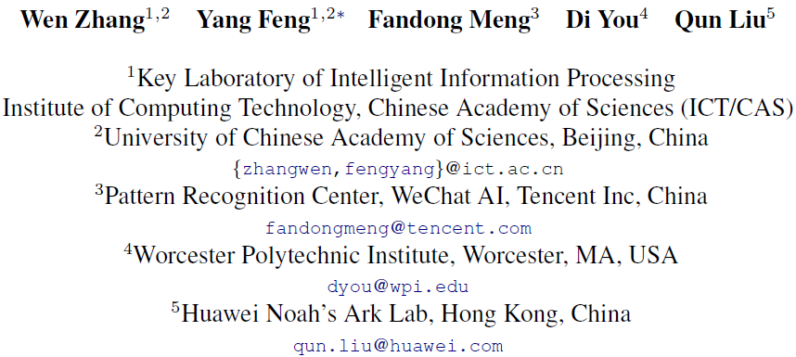
Bridging the Gap between Training and Inference for Neural Machine Translation

Slide 2
Introduction
NMT training: the ground truth words are used as context
Inference: the entire sequence is generated by the resulting model on its own
The predicted words at training and inference are drawn from different distributions
Exposure bias

Slide 3
Introduction
Overcorrection
reference: We should comply with the rule.
cand1: We should abide with the rule.
cand2: We should abide by the law.
cand3: We should abide by the rule. (Overcorrection recovery)

Slide 4
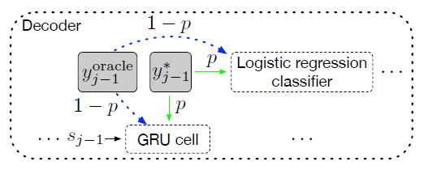

Approach
Select an oracle word $y_{j−1}^{oracle}$ (at word level or sentence level) at the $\left\{j−1\right\}$-th step.
Sample from the ground truth word $y_{j−1}^{∗}$ with a probability of $p$ or from the oracle word $y_{j−1}^{oracle}$ with a probability of $1−p$.

Slide 5
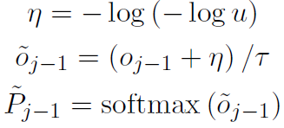

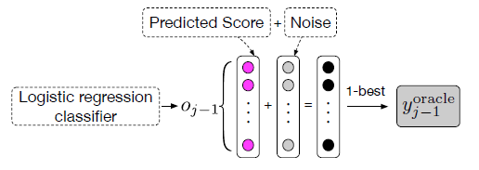

Oracle Word Selection
Word-level Oracle (WO)
Direct way: pick the word with the highest probability
Acquire more robust word-level oracles: Gumbel noise

Slide 6

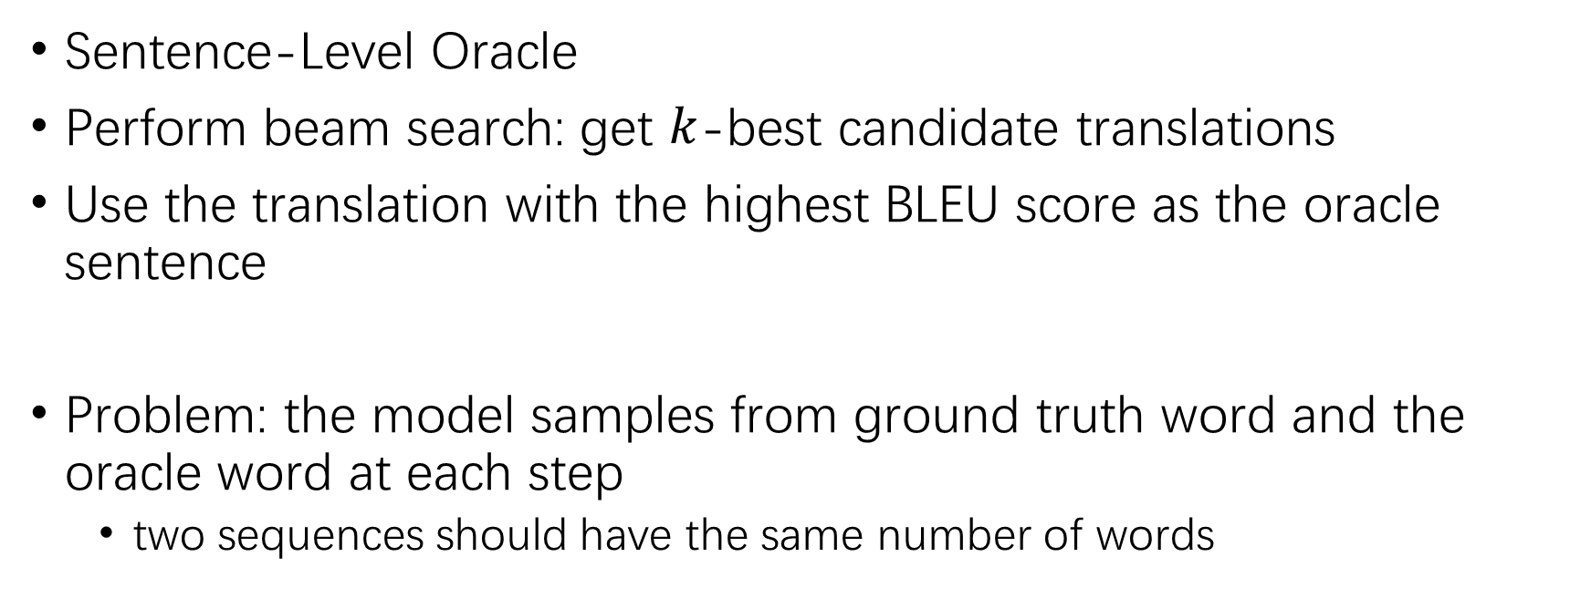
Sentence-Level Oracle
Sentence-Level Oracle
Perform beam search: get $k$-best candidate translations
Use the translation with the highest BLEU score as the oracle sentence
Problem: the model samples from ground truth word and the oracle word at each step
two sequences should have the same number of words

Slide 7
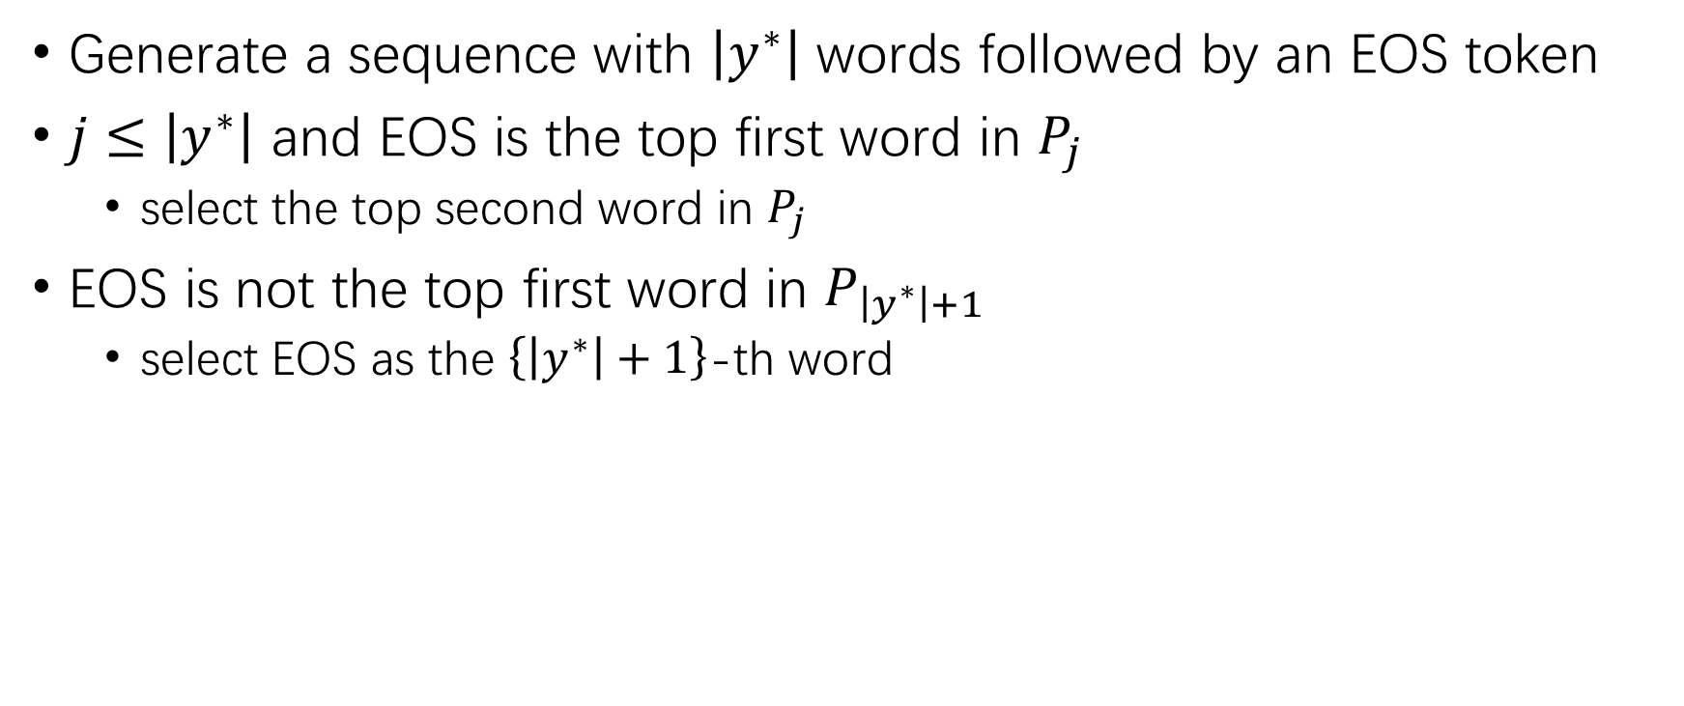
Force Decoding
Generate a sequence with $\left|y^{∗}\right|$ words followed by an EOS token
$j≤\left|y^{∗}\right|$ and EOS is the top first word in $P_{j}$
select the top second word in $P_{j}$
EOS is not the top first word in $P_{\left|y^{∗}\right|+1}$
select EOS as the $\left\{\left|y^{∗}\right|+1\right\}$-th word

Slide 8

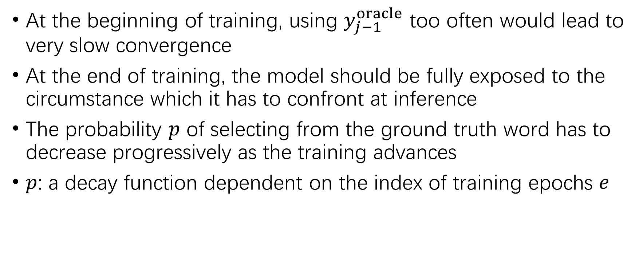
Sampling with Decay
At the beginning of training, using $y_{j−1}^{oracle}$ too often would lead to very slow convergence
At the end of training, the model should be fully exposed to the circumstance which it has to confront at inference
The probability $p$ of selecting from the ground truth word has to decrease progressively as the training advances
$p$: a decay function dependent on the index of training epochs $e$

Slide 9
Experiments
Data
NIST Chinese → English (Zh → En)
WMT’14 English → German (En → De)
Models:
RNNSearch (decoder: 2 GRUs)
Transformer

Slide 10
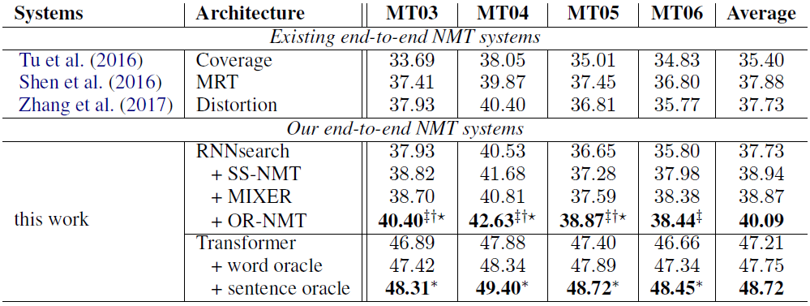
Results on Zh → En Translation

Slide 11
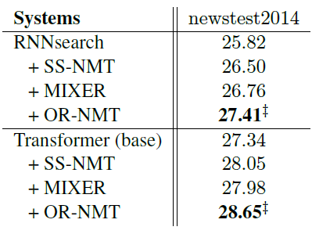
Results on En → De Translation

Slide 12
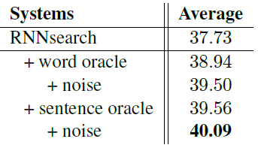
Factor Analysis

Slide 13
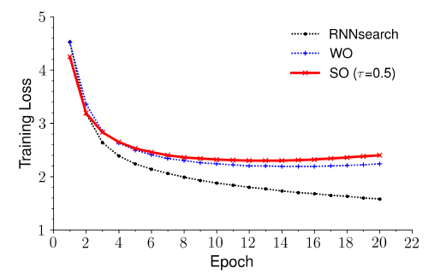
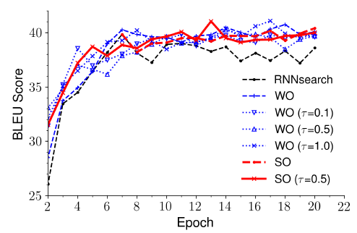
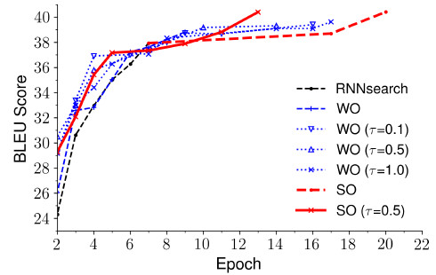
About Convergence
Training loss curves on Zh → En translation with different factors
BLEU scores on the validation set on the Zh → En translation task
BLEU scores on the MT03 test set on the Zh → En translation task

Slide 14
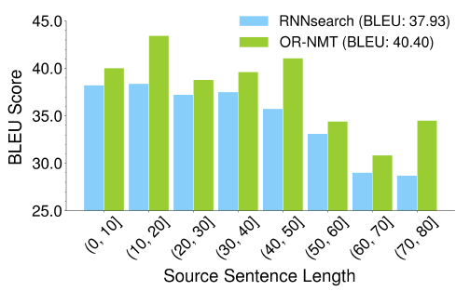
About Length
BLEU scores of generated translations on the MT03 test set with respect to the lengths of the source sentences

