Slide 1
Code Generation with Idioms
王文翰
2019.10.9

Slide 2
Papers
Iyer, S., Cheung, A., & Zettlemoyer, L. (2019). Learning Programmatic Idioms for Scalable Semantic Parsing.
Shin, R., Allamanis, M., Brockschmidt, M., & Polozov, O. (2019). Program Synthesis and Semantic Parsing with Learned Code Idioms.

Slide 3
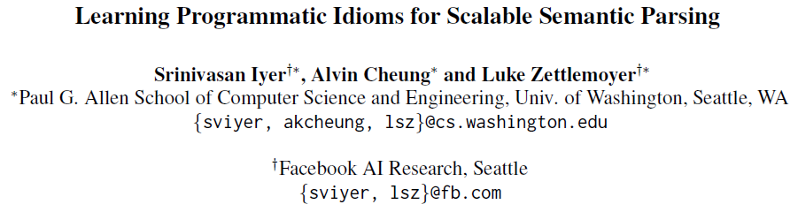

Slide 4
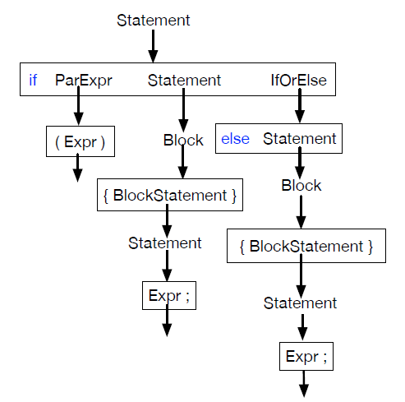
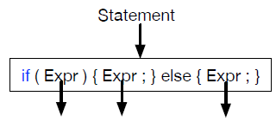
Code Idiom
Frequently recurring subtrees of program (parse trees)
11 rules!
Notes:
Programmers typically start with a high-level plan of the major structures required

Slide 5
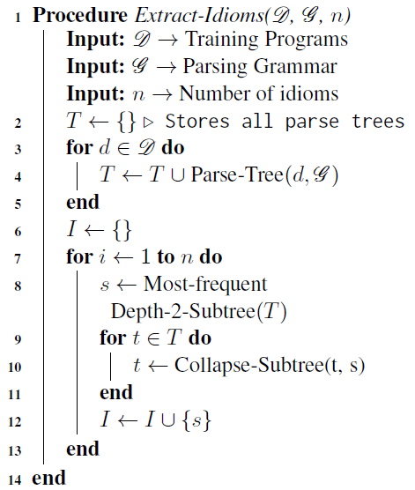
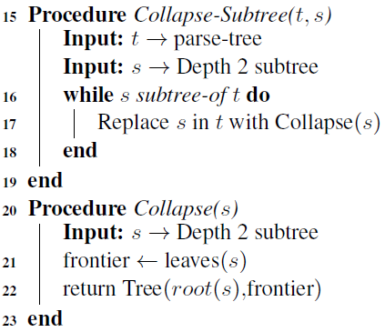
Idiom Extraction
Notes:
类似bpe

Slide 6
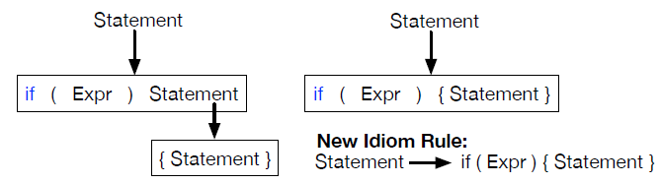
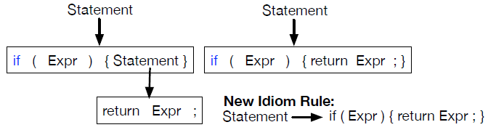
Idiom Extraction

Slide 7
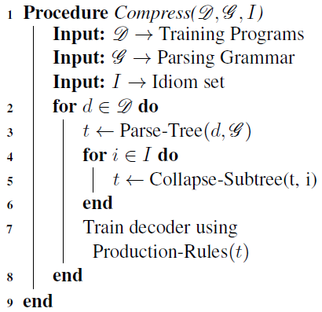
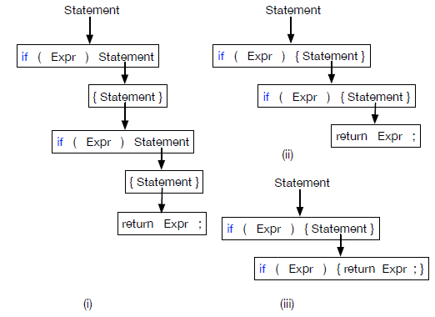
Model training with Idioms

Slide 8
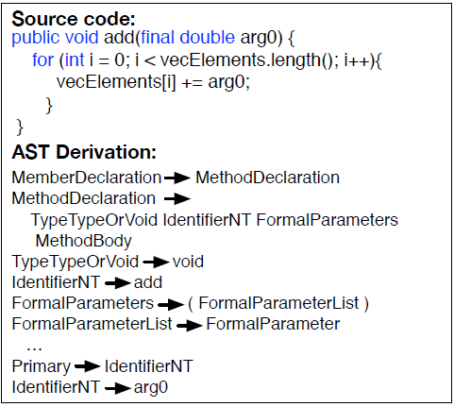
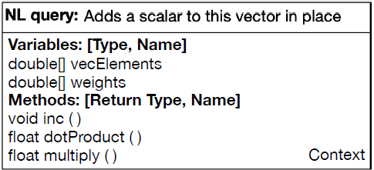
Experimental Setup
Task: CONCODE

Slide 9
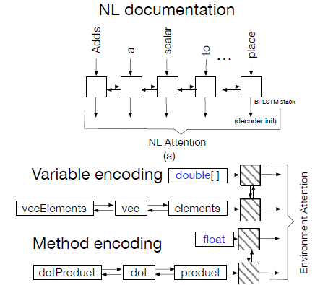
Baseline Model
The approach of Iyer et al. (2018) with three major modifications
Use BPE on all NL tokens, identifier names and types
RNN contextualizes the subtokens of identifiers -> average
Consolidate their three separate RNNs into a shared RNN

Slide 10
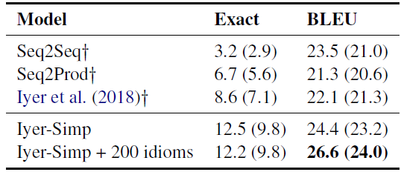
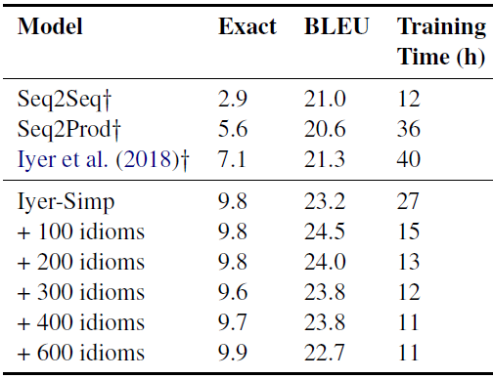
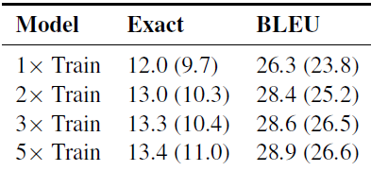
Results
Results on the test (validation) set
Significant improvements in training speed makes training on large amounts of data possible.

Slide 11
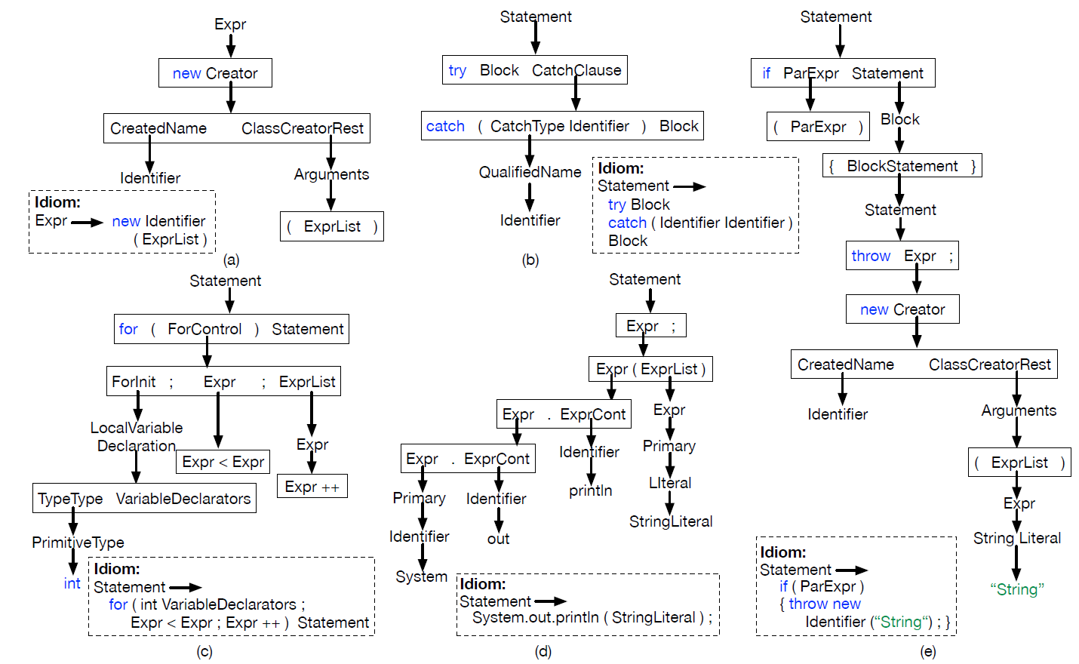

Slide 12
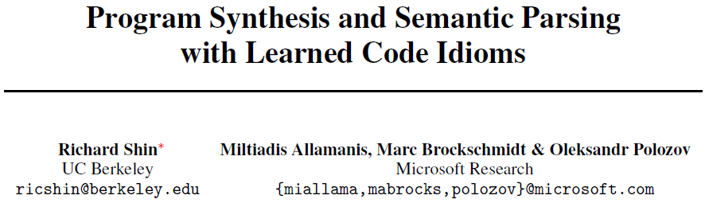

Slide 13
References
[1] Allamanis, M., & Sutton, C. (2014, November). Mining idioms from source code. In Proceedings of the 22nd ACM SIGSOFT International Symposium on Foundations of Software Engineering (pp. 472-483). ACM.
[2] Allamanis, M. Learning Natural Coding Conventions.
[3] Allamanis, M., Barr, E. T., Bird, C., Devanbu, P., Marron, M., & Sutton, C. (2018). Mining semantic loop idioms. IEEE Transactions on Software Engineering, 44(7), 651-668.

Slide 14
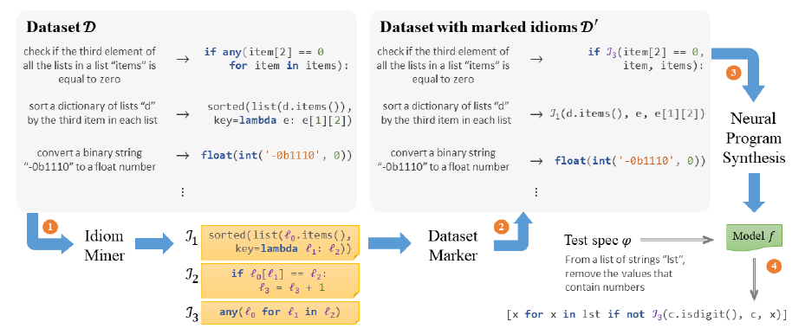
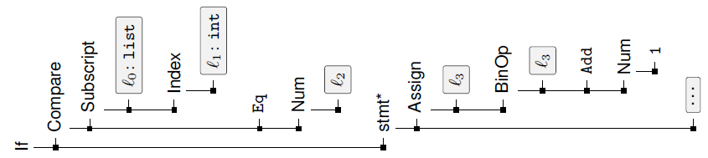

PATOIS: overview

Slide 15
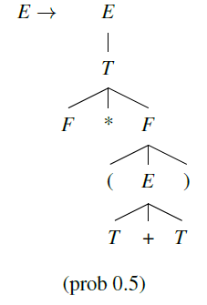
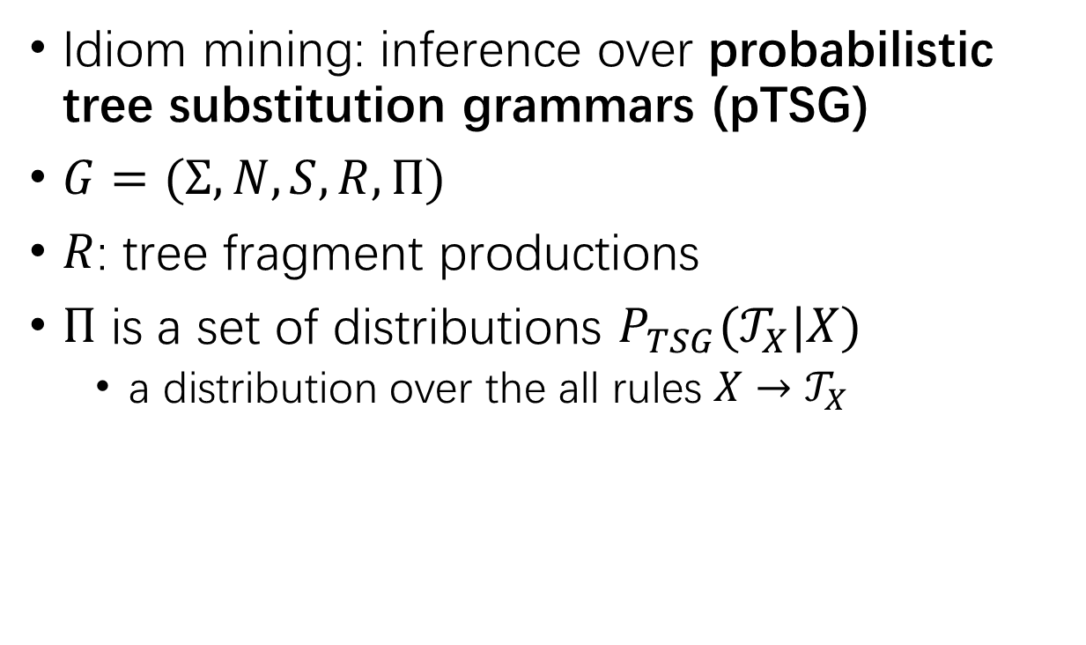
Mining Code Idioms
Idiom mining: inference over probabilistic tree substitution grammars (pTSG)
$G=(Σ,N,S,R,Π)$
$R$: tree fragment productions
$Π$ is a set of distributions $P_{TSG}(𝒯_{X}|X)$
a distribution over the all rules $X→𝒯_{X}$

Slide 16

Mining Code Idioms
$𝒢_{0}$: pTSG with no fragment rules
Infer a pTSG $𝒢_{1}$ extends $𝒢_{0}$ using nonparametric Bayesian methods

Slide 17
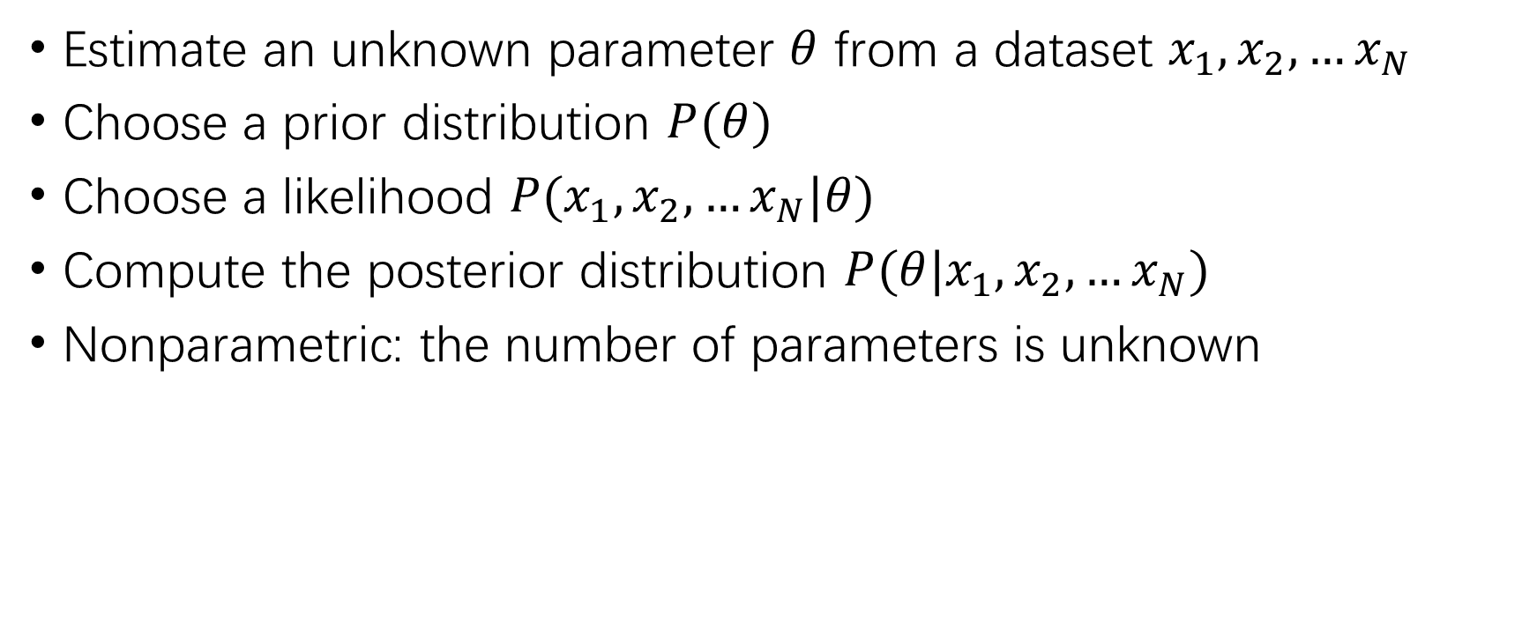
Background: Nonparametric Bayesian Methods
Estimate an unknown parameter $θ$ from a dataset $x_{1},x_{2},…x_{N}$
Choose a prior distribution $P(θ)$
Choose a likelihood $P(x_{1},x_{2},…x_{N}|θ)$
Compute the posterior distribution $P(θ|x_{1},x_{2},…x_{N})$
Nonparametric: the number of parameters is unknown

Slide 18
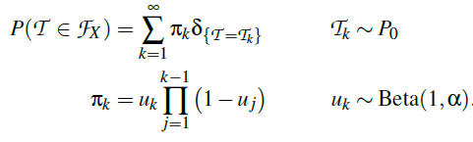
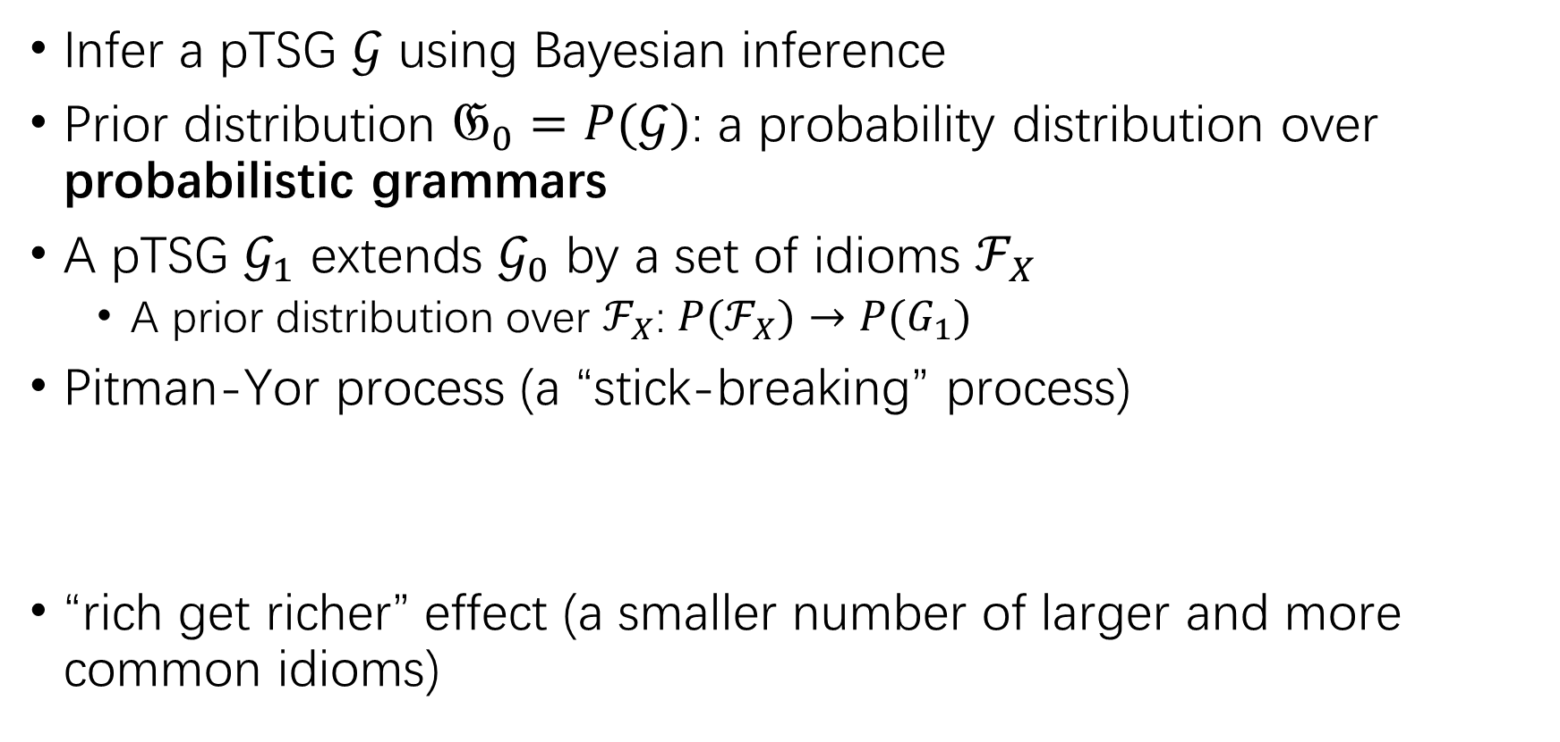
Learning TSGs
Infer a pTSG $𝒢$ using Bayesian inference
Prior distribution $𝔊_{0}=P(𝒢)$: a probability distribution over probabilistic grammars
A pTSG $𝒢_{1}$ extends $𝒢_{0}$ by a set of idioms $ℱ_{X}$
A prior distribution over $ℱ_{X}$: $P(ℱ_{X})→P(G_{1})$
Pitman-Yor process (a “stick-breaking” process)
“rich get richer” effect (a smaller number of larger and more common idioms)

Slide 19
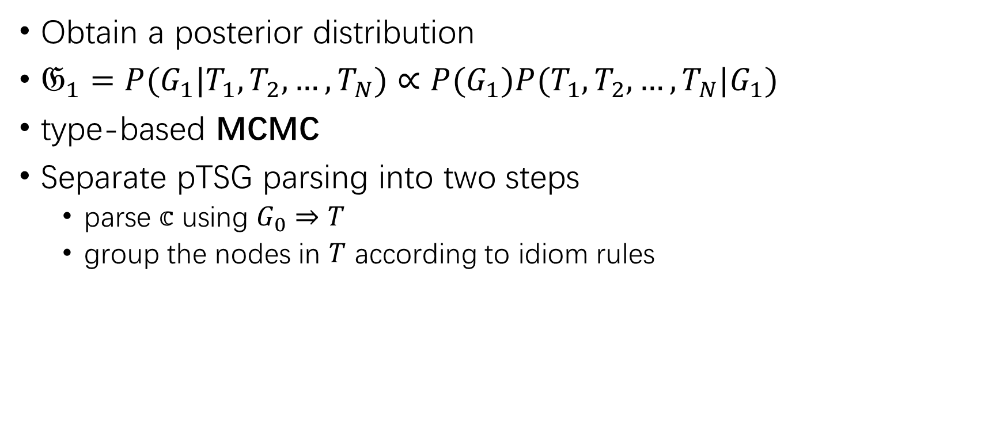
Inference
Obtain a posterior distribution
$𝔊_{1}=P(G_{1}|T_{1},T_{2},…,T_{N})∝P(G_{1})P(T_{1},T_{2},…,T_{N}|G_{1})$
type-based MCMC
Separate pTSG parsing into two steps
parse $𝕔$ using $G_{0}⇒T$
group the nodes in $T$ according to idiom rules

Slide 20

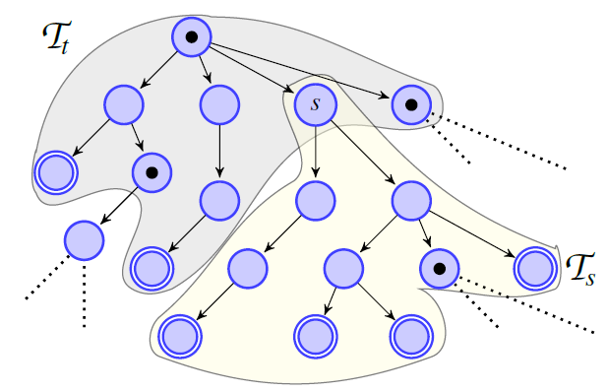




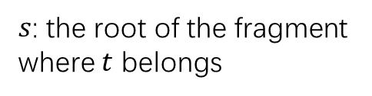
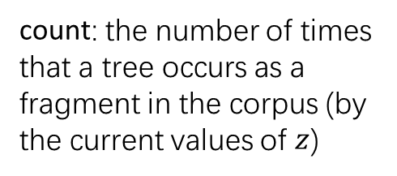
Inference
Binary variables $z_{s}$ for each node $s$
$s$ is the root of a new fragment $(z_{s}=1)$
$s$ is part of the same fragment as its parent $(z_{s}=0)$
$s$: the root of the fragment where $t$ belongs
$h$: the root of the fragment
count: the number of times that a tree occurs as a fragment in the corpus (by the current values of $z$)

Slide 21
Idiom Ranking
Not all sampled idioms are useful for synthesis
Rank by coverage and expressivity

Slide 22



Using Idioms in Program Synthesis
a set of common idioms
extend the grammar with new operators
Direct approach: replace every occurrence of with a new operator
Challenges:
Not allow learning from the idiom definitions
Idiom occurrences overlap (greedy rewriting discarded as many as 75% potential idiom occurrences!)

Slide 23
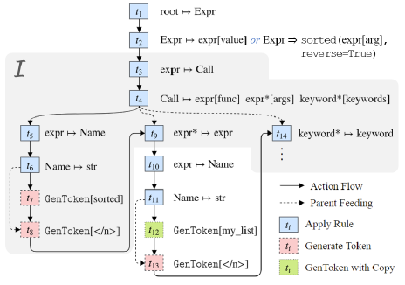


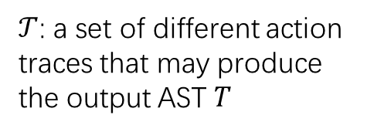
Training to Emit Idioms
Action: production/terminal
Maximize
Idiom occurrences overlap and cause combinatorial explosion
apply Jensen’s inequality
$𝒯$: a set of different action traces that may produce the output AST $T$

Slide 24



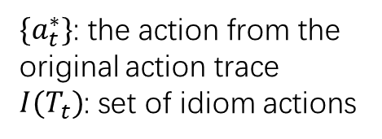
Training to Emit Idioms
$\{a_{t}^{∗}\}$: the action from the original action trace
$I(T_{t})$: set of idiom actions
Encourage the model to emit either the original AST action for this timestep or any applicable idiom

Slide 25
Training to Emit Idioms
Training: additionally allow a valid production, with no change to further decoding
Inference: unrolls I on the fly by teacher-forcing

Slide 26
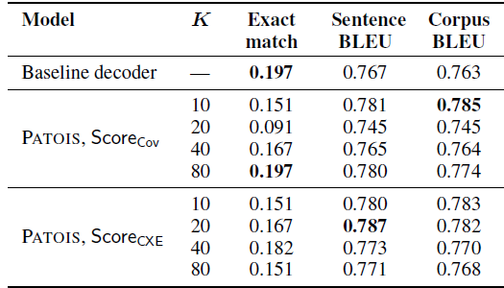
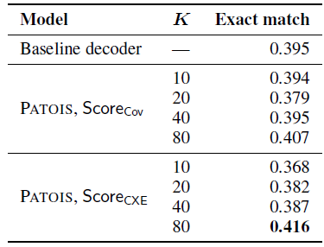
Evaluation
Datasets: Hearthstone and Spider
Dev results on HearthStone
Dev results on Spider

Slide 27
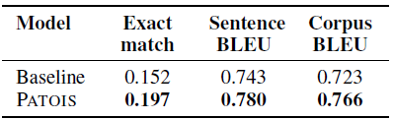
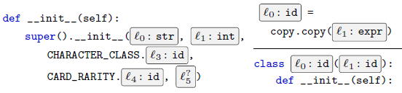
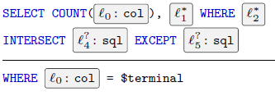
Evaluation
Test results on HearthStone
Mined idioms

