Slide 1
Seq2Seq Adversary
张煌昭 zhang_hz@pku.edu.cn

Slide 2
Outline
Adversarial examples for seq2seq
AdvGen algorithm
Seq2Sick algorithm
Recent work

Slide 3
Adversarial Examples for Seq2Seq
Original example
Input: 我喜欢这部电影。
Model output: I like this movie.
Adversarial example (non-overlapping attack)
Input: 我爱看这部电影。
Model output: Totally me anyhow organic.
Adversarial example (Targeted keywords attack)
Input: 我爱看这部电影。
Keywords: horrible, this.
Model output: This room is horrible.

Slide 4
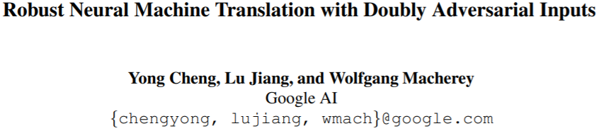
Review: AdvGen (ACL2019)

Slide 5
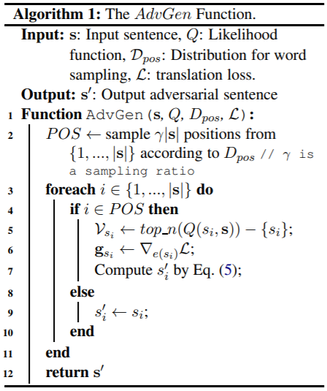
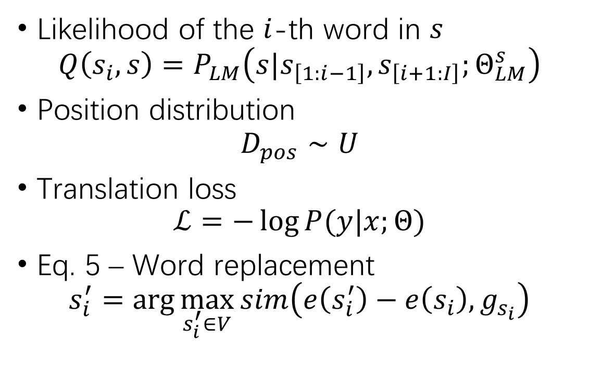
AdvGen Adversarial Attack
Likelihood of the $i$-th word in $s$
$$Q\left(s_{i}, s\right)=P_{LM}\left(s|s_{\left[1:i−1\right]},s_{\left[i+1:I\right]};Θ_{LM}^{s}\right)$$
Position distribution
$$D_{pos}∼U$$
Translation loss
$$ℒ=−\log{P(y|x;Θ)}$$
Eq. 5 – Word replacement
$$s_{i}^{′}=\arg{\max_{s_{i}^{′}∈V}{sim\left(e\left(s_{i}^{′}\right)−e\left(s_{i}\right), g_{s_{i}}\right)}}$$

Slide 6
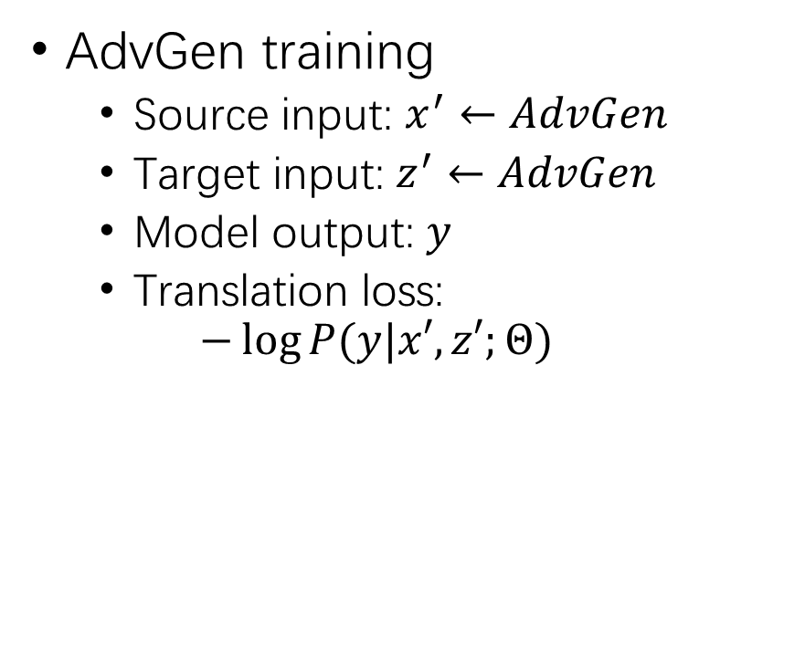
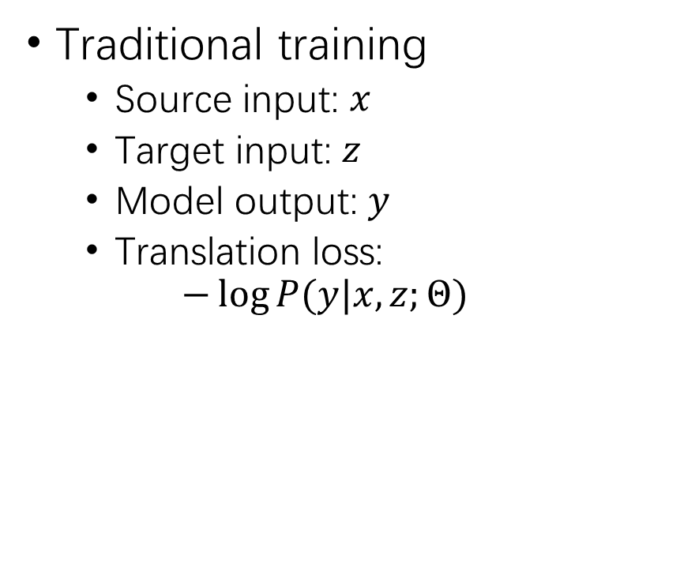
AdvGen Adversarial Training
Traditional training
Source input: $x$
Target input: $z$
Model output: $y$
Translation loss:
$$−\log{P(y|x,z;Θ)}$$
AdvGen training
Source input: $x^{′}←AdvGen$
Target input: $z^{′}←AdvGen$
Model output: $y$
Translation loss:
$$−\log{P(y|x′,z′;Θ)}$$

Slide 7
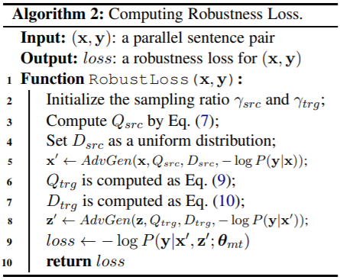
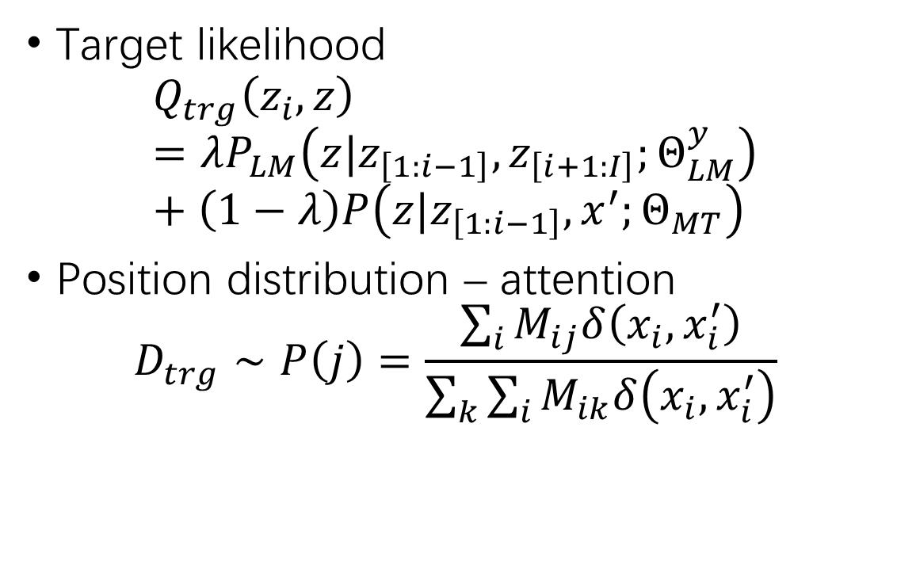
AdvGen Adversarial Training (2)
Target likelihood
$$Q_{trg}\left(z_{i}, z\right)=λP_{LM}\left(z|z_{\left[1:i−1\right]},z_{\left[i+1:I\right]};Θ_{LM}^{y}\right)+\left(1−λ\right)P\left(z|z_{\left[1:i−1\right]},x^{′};Θ_{MT}\right)$$
Position distribution – attention
$$D_{trg}∼P\left(j\right)=\frac{\sum_{i}{M_{ij}δ\left(x_{i},x_{i}^{′}\right)}}{\sum_{k}{\sum_{i}{M_{ik}δ\left(x_{i},x_{i}^{′}\right)}}}$$

Slide 8
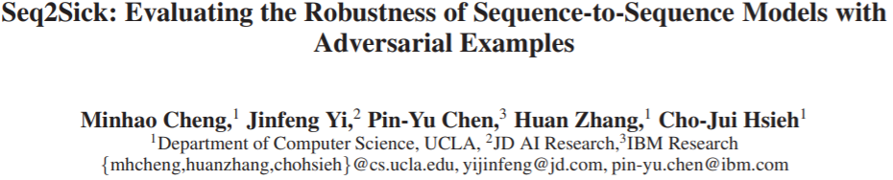
Seq2Sick (AAAI2020)

Slide 9
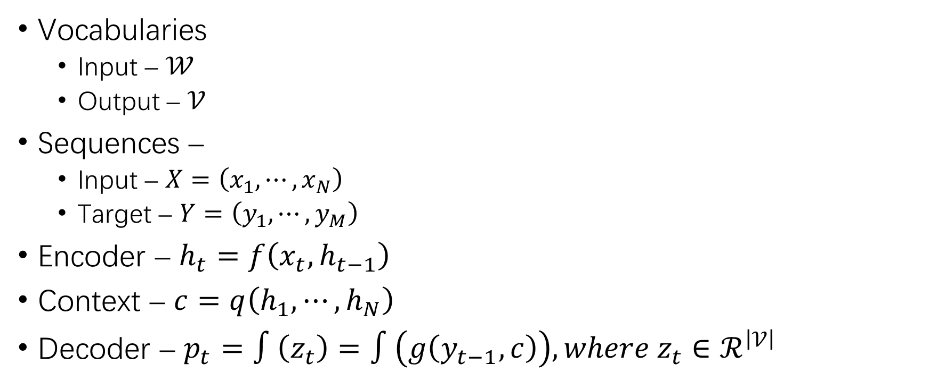
Notations
Vocabularies
Input – $𝒲$
Output – $𝒱$
Sequences –
Input – $X=\left(x_{1},⋯,x_{N}\right)$
Target – $Y=\left(y_{1},⋯,y_{M}\right)$
Encoder – $h_{t}=f\left(x_{t},h_{t−1}\right)$
Context – $c=q\left(h_{1},⋯,h_{N}\right)$
Decoder – $p_{t}=∫\left(z_{t}\right)=∫\left(g\left(y_{t−1},c\right)\right), where z_{t}∈ℛ^{\left|𝒱\right|}$

Slide 10
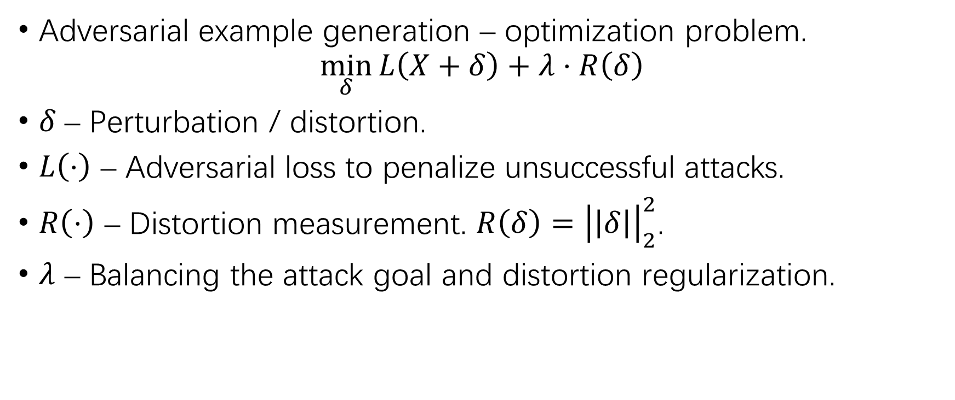
Problem Definitions
Adversarial example generation – optimization problem.
$$\min_{δ}{L\left(X+δ\right)+λ⋅R\left(δ\right)}$$
$δ$ – Perturbation / distortion.
$L\left(⋅\right)$ – Adversarial loss to penalize unsuccessful attacks.
$R\left(⋅\right)$ – Distortion measurement. $R\left(δ\right)={\left|\left|δ\right|\right|}_{2}^{2}$.
$λ$ – Balancing the attack goal and distortion regularization.

Slide 11
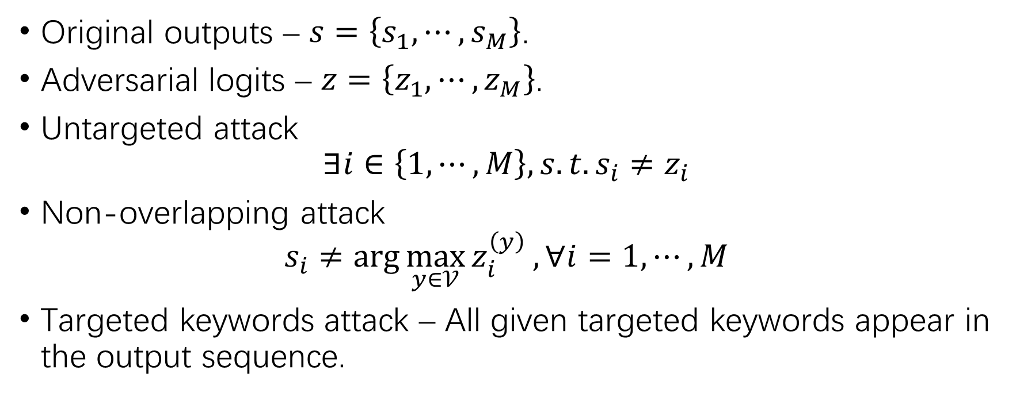
Problem Definitions (2)
Original outputs – $s=\left\{s_{1},⋯,s_{M}\right\}$.
Adversarial logits – $z=\left\{z_{1},⋯,z_{M}\right\}$.
Untargeted attack
$$∃i∈\left\{1,⋯,M\right\}, s.t. s_{i}≠z_{i}$$
Non-overlapping attack
$$s_{i}≠\arg{\max_{y∈𝒱}{z_{i}^{\left(y\right)}}}, ∀i=1,⋯,M$$
Targeted keywords attack – All given targeted keywords appear in the output sequence.

Slide 12
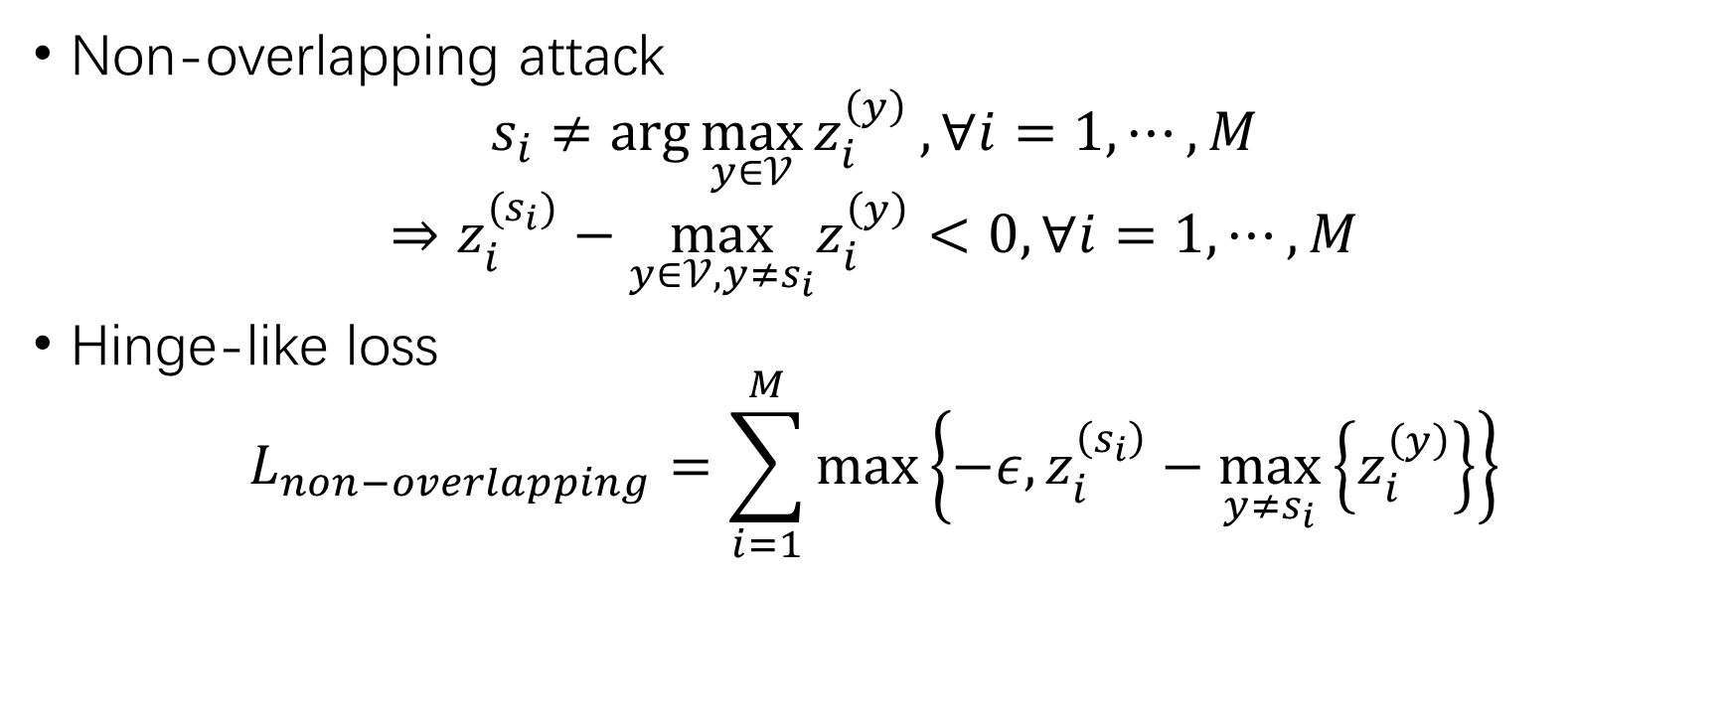
Optimization Objective
Non-overlapping attack
$$s_{i}≠\arg{\max_{y∈𝒱}{z_{i}^{\left(y\right)}}},∀i=1,⋯,M$$
$$⇒z_{i}^{(s_{i})}−\max_{y∈𝒱,y≠s_{i}}z_{i}^{\left(y\right)}<0,∀i=1,⋯,M$$
Hinge-like loss
$$L_{non−overlapping}=\sum_{i=1}^{M}{\max\left\{−ε,z_{i}^{\left(s_{i}\right)}−\max_{y≠s_{i}}\left\{z_{i}^{\left(y\right)}\right\}\right\}}$$

Slide 13
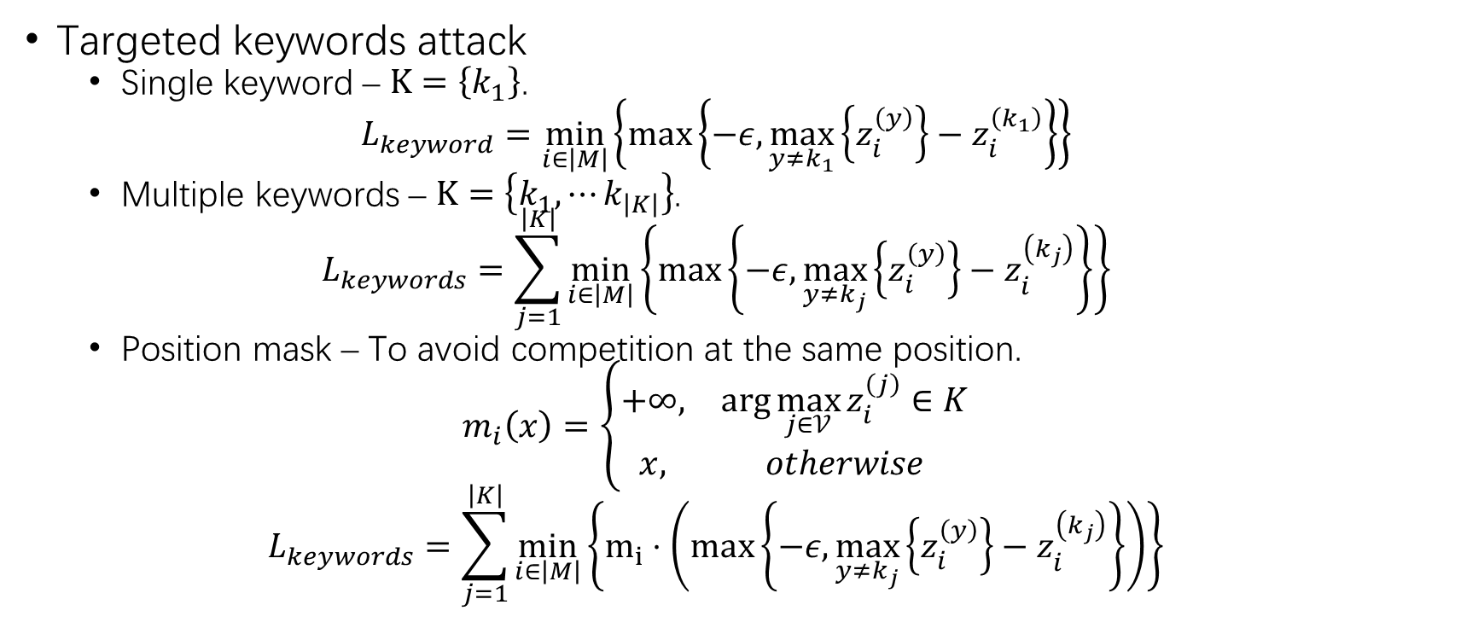
Optimization Objective (2)
Targeted keywords attack
Single keyword – $K=\left\{k_{1}\right\}$.
$$L_{keyword}=\min_{i∈\left|M\right|}\left\{\max\left\{−ε,\max_{y≠k_{1}}\left\{z_{i}^{\left(y\right)}\right\}−z_{i}^{\left(k_{1}\right)}\right\}\right\}$$
Multiple keywords – $K=\left\{k_{1},⋯k_{\left|K\right|}\right\}$.
$$L_{keywords}=\sum_{j=1}^{\left|K\right|}{\min_{i∈\left|M\right|}\left\{\max\left\{−ε,\max_{y≠k_{j}}\left\{z_{i}^{\left(y\right)}\right\}−z_{i}^{\left(k_{j}\right)}\right\}\right\}}$$
Position mask – To avoid competition at the same position.
$$m_{i}\left(x\right)=\left\{\begin{matrix}+∞, & \arg{\max_{j∈𝒱}{z_{i}^{\left(j\right)}}∈K} \\ x, & otherwise\end{matrix}\right.$$
$$L_{keywords}=\sum_{j=1}^{\left|K\right|}{\min_{i∈\left|M\right|}\left\{m_{i}⋅\left(\max\left\{−ε,\max_{y≠k_{j}}\left\{z_{i}^{\left(y\right)}\right\}−z_{i}^{\left(k_{j}\right)}\right\}\right)\right\}}$$

Slide 14
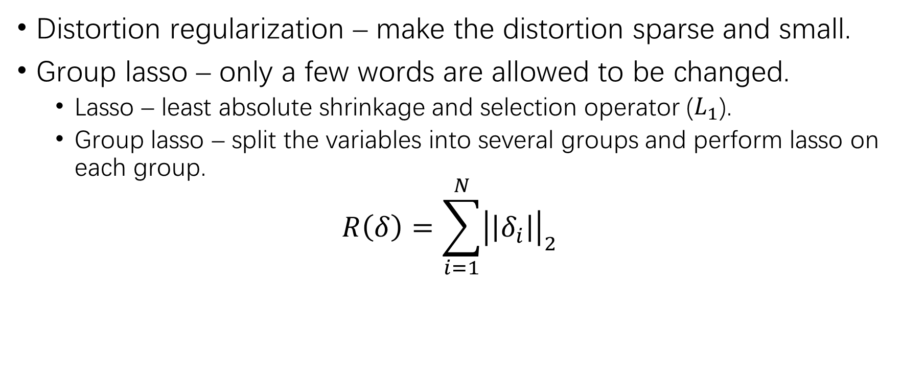
Distortion Regularization
Distortion regularization – make the distortion sparse and small.
Group lasso – only a few words are allowed to be changed.
Lasso – least absolute shrinkage and selection operator ($L_{1}$).
Group lasso – split the variables into several groups and perform lasso on each group.
$$R\left(δ\right)=\sum_{i=1}^{N}{{\left|\left|δ_{i}\right|\right|}_{2}}$$

Slide 15
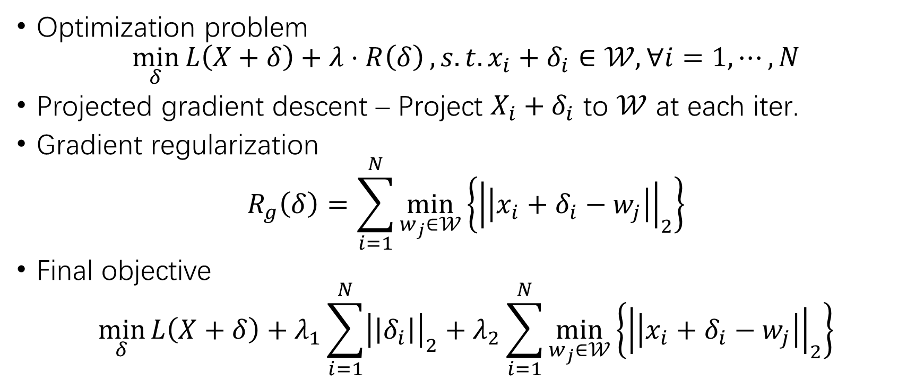
Discrete Space
Optimization problem
$$\min_{δ}{L\left(X+δ\right)+λ⋅R\left(δ\right)},s.t. x_{i}+δ_{i}∈𝒲, ∀i=1,⋯,N$$
Projected gradient descent – Project $X_{i}+δ_{i}$ to $𝒲$ at each iter.
Gradient regularization
$$R_{g}\left(δ\right)=\sum_{i=1}^{N}{\min_{w_{j}∈𝒲}\left\{{\left|\left|x_{i}+δ_{i}−w_{j}\right|\right|}_{2}\right\}}$$
Final objective
$$\min_{δ}{L\left(X+δ\right)+λ_{1}\sum_{i=1}^{N}{{\left|\left|δ_{i}\right|\right|}_{2}}+λ_{2}\sum_{i=1}^{N}{\min_{w_{j}∈𝒲}\left\{{\left|\left|x_{i}+δ_{i}−w_{j}\right|\right|}_{2}\right\}}}$$

Slide 16
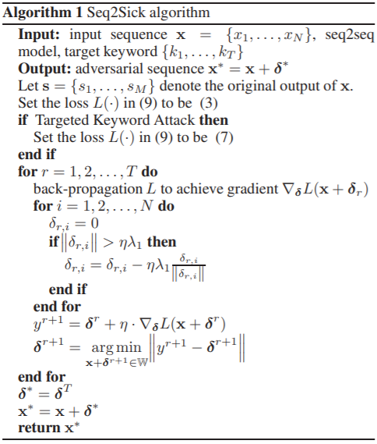
Seq2Sick Algorithm
Use proximal operator to optimize the group lasso regularization
Projected gradient descent

Slide 17
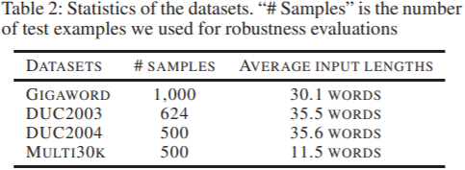
Experiment Setup
Datasets
Text summarization – DUC2003, DUC2004, Gigaword
Machine translation – WMT’16
Seq2Seq models
Word-level LSTM encoder
Word-based attention decoder

Slide 18
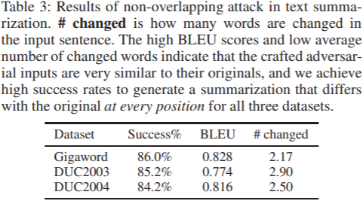
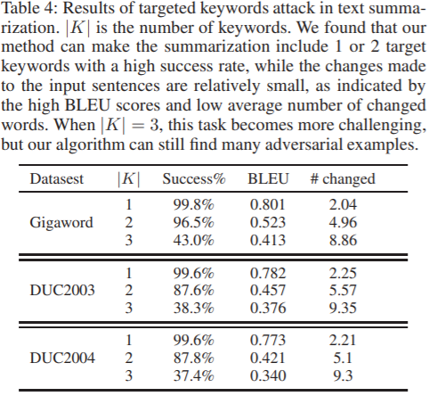
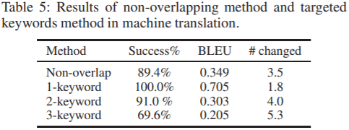
Experimental Results

Slide 19
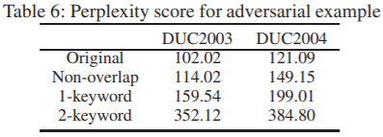
Experimental Results (2)
Syntactic quality – PPL.
Semantic quality – DeepAI’s online sentiment analysis API.
2.2% adversarial examples have different semantic meaning.

Slide 20
Reflections...
Pros
Good problem definition.
Good loss design.
Utilizing group lasso for distortion regularization.
…
Cons
No baseline.
Only replacement perturbation.
Irrelevant to the title (“robustness”)
Irrelevant to the proposed problem (“Seq2Seq vs. CNN”)
…

Slide 21
Recent Work
Universal Modifier (tentative name)
Gradient-based UID rename;
Statement insertion/deletion;
…
Greedy attacker – Iterative generation
Generate multiple candidates;
Test against the victim model.

Slide 22
Recent Work (2)
OJ104 classification
LSTM
Test accuracy – 95.7%
ATK-UID accuracy – 7.9%
ATK-STMT accuracy – 16.0%
ASTNN
Test accuracy – 97.97%
ATK-UID accuracy – 0.8%

Slide 23

THANK YOU!

