Slide 2
INTRODUCTION
Bug fixing: target error patterns in specific codebases or specific bug types
HOPPITY: an end-to-end approach including localizing bugs, predicting the types of fixes, and generating patches
Deal with bugs that are more complex and semantic in nature
Require adding or removing statements from a program

Slide 3
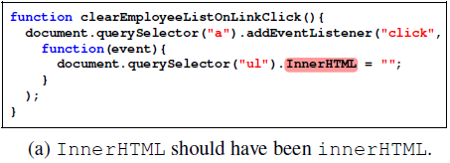
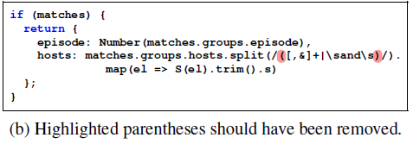
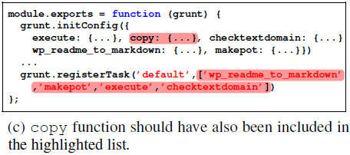
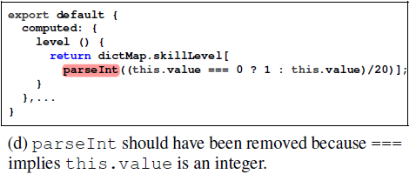
MOTIVATING EXAMPLES
Javascript bugs

Slide 4
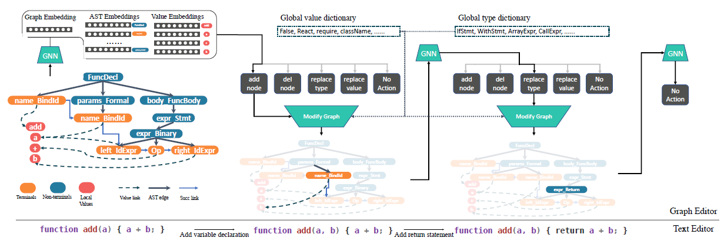
MODEL
Structured prediction by a sequence of graph transformations

Slide 5
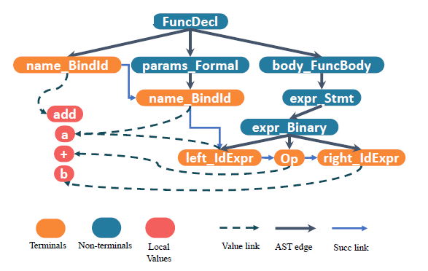

PROGRAM REPRESENTATION
Connect the leaf nodes with SuccToken edges
Add value nodes that store the actual content of the leaf nodes
provide a name-independent strategy for code representation
Graph Isomorphism Network (GIN)

Slide 6
ONE-STEP GRAPH EDIT
Five types of operators
adding a node (ADD), deleting a node (DEL), replace a node value (REP_VAL), replace a node type (REP_TYPE) and stop (NO_OP)
Low-level primitives
Location: locates a specific position in the source code
pointer network
Value: assigns a value for a leaf node
choose from either the values appearing in the current file or a collection of global values
Type: assigns the type for non-terminal nodes in an AST
utilize the AST grammar checker to prune the output space

Slide 7
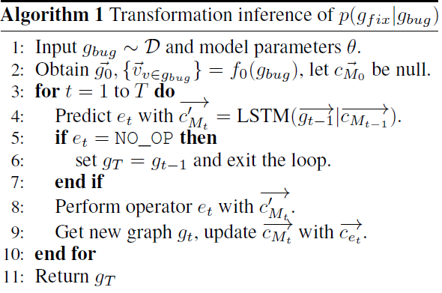

GRAPH TRANSFORMATION

Slide 8
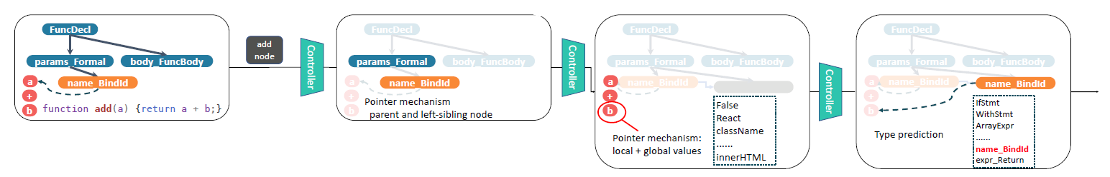

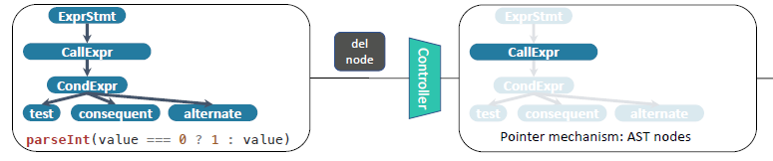
ONE-STEP GRAPH EDIT
Location
Value
Type
ADD
DEL

Slide 9
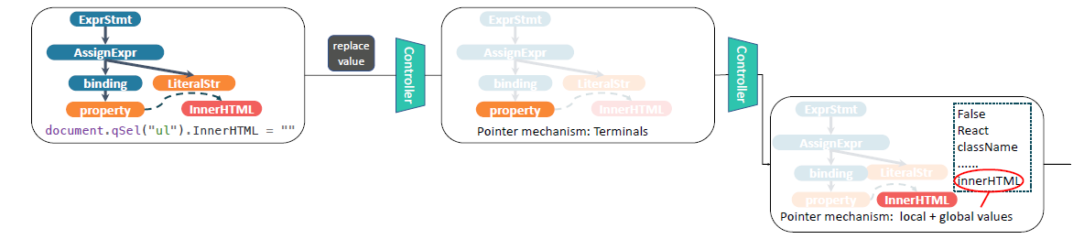
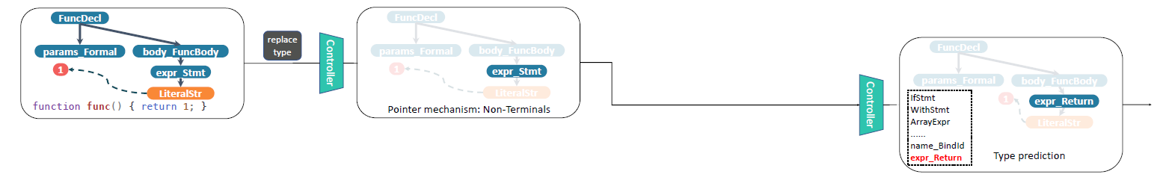
ONE-STEP GRAPH EDIT
Location
Value
Type
REP_VAL
REP_TYPE

Slide 10
EXPERIMENTS
Dataset
OneDiff with precisely one edit
ZeroOneDiff with zero and one edit
ZeroOneTwoDiff with zero, one or two edits
BASELINES
GGNN (Allamanis et al. 2018)
SequenceR (Chen et al. 2018)
TAJS: a static analysis tool for Javascript

Slide 11
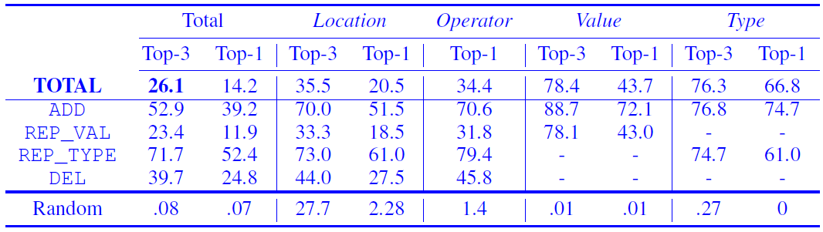
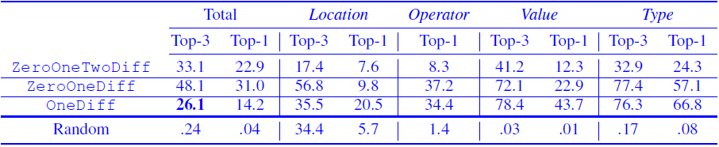
Evaluation of model on the OneDiff dataset: accuracy (%).
Additional experiments on ZeroOneDiff and ZeroOneTwoDiff

Slide 12
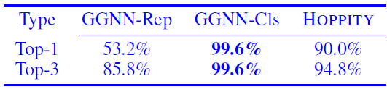
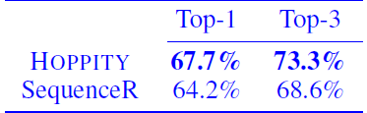
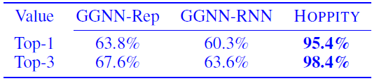
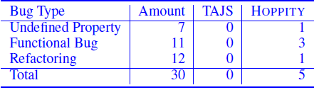
EXPERIMENTS
REP_TYPE accuracies with location+op.
Overall OneDiff accuracy with location.
REP_VAL accuracies with location+op.
Comparison with TAJS.

