Slide 1
Forward Gradient Learning
Zhang Huangzhao
zhang_hz@pku.edu.cn

Slide 2
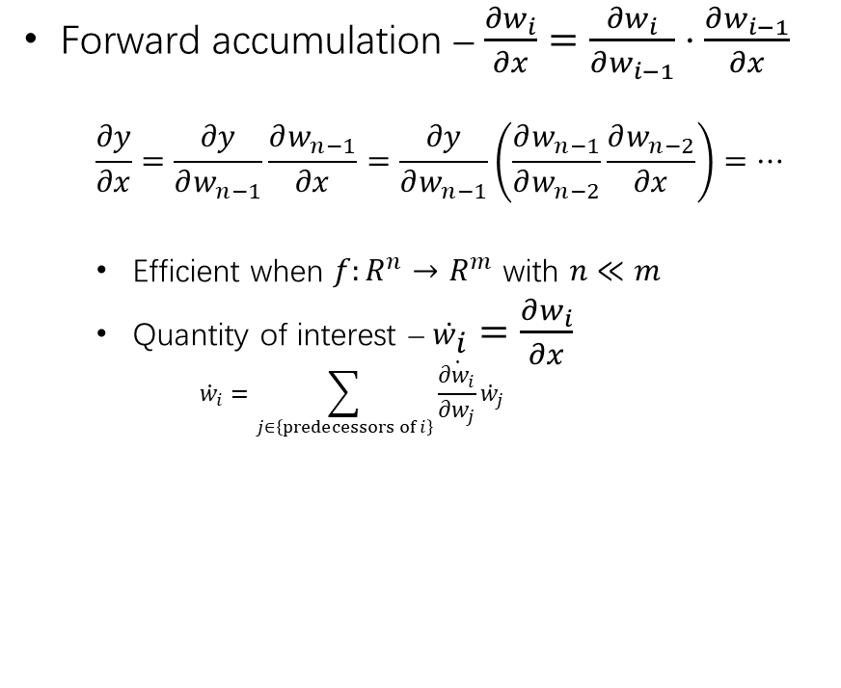
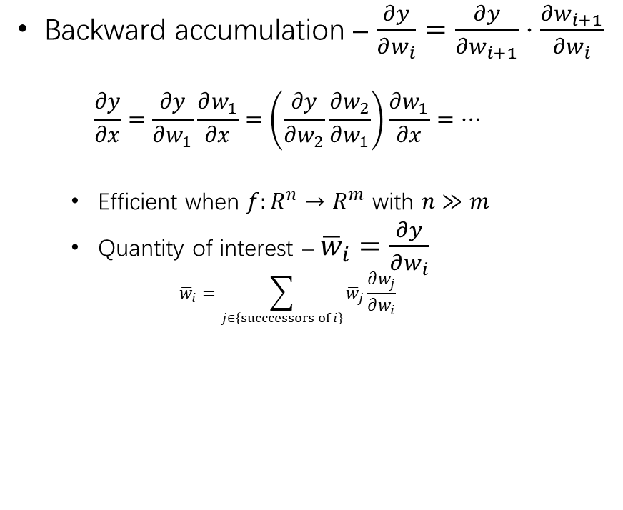
Forward & Reverse Accumulation
Forward accumulation – $\frac{∂w_{i}}{∂x}=\frac{∂w_{i}}{∂w_{i−1}}⋅\frac{∂w_{i−1}}{∂x}$
$$\frac{∂y}{∂x}=\frac{∂y}{∂w_{n−1}}\frac{∂w_{n−1}}{∂x}=\frac{∂y}{∂w_{n−1}}\left(\frac{∂w_{n−1}}{∂w_{n−2}}\frac{∂w_{n−2}}{∂x}\right)=⋯$$
Efficient when $f:R^{n}→R^{m}$ with $n≪m$
Quantity of interest – ${\dot{w}}_{i}=\frac{∂w_{i}}{∂x}$
$${\dot{w}}_{i}=\sum_{j∈\left\{predecessors of i\right\}}{\dot{\frac{∂w_{i}}{∂w_{j}}}{\dot{w}}_{j}}$$
Backward accumulation – $\frac{∂y}{∂w_{i}}=\frac{∂y}{∂w_{i+1}}⋅\frac{∂w_{i+1}}{∂w_{i}}$
$$\frac{∂y}{∂x}=\frac{∂y}{∂w_{1}}\frac{∂w_{1}}{∂x}=\left(\frac{∂y}{∂w_{2}}\frac{∂w_{2}}{∂w_{1}}\right)\frac{∂w_{1}}{∂x}=⋯$$
Efficient when $f:R^{n}→R^{m}$ with $n≫m$
Quantity of interest – ${\overline{w}}_{i}=\frac{∂y}{∂w_{i}}$
$${\overline{w}}_{i}=\sum_{j∈\left\{succcessors of i\right\}}{{\overline{w}}_{j}\frac{∂w_{j}}{∂w_{i}}}$$

Slide 3
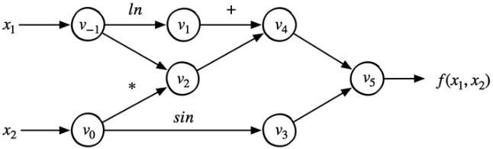
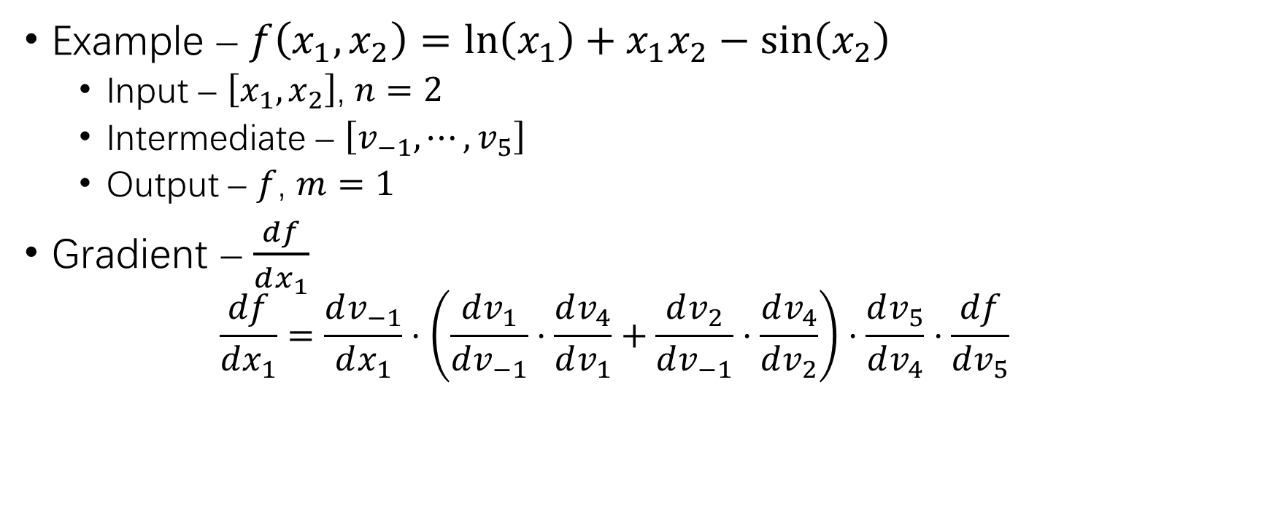
Forward & Reverse Accumulation (2)
Example – $f\left(x_{1},x_{2}\right)=\ln\left(x_{1}\right)+x_{1}x_{2}−\sin\left(x_{2}\right)$
Input – $\left[x_{1},x_{2}\right]$, $n=2$
Intermediate – $\left[v_{−1},⋯,v_{5}\right]$
Output – $f$, $m=1$
Gradient – $\frac{df}{dx_{1}}$
$$\frac{df}{dx_{1}}=\frac{dv_{−1}}{dx_{1}}⋅\left(\frac{dv_{1}}{dv_{−1}}⋅\frac{dv_{4}}{dv_{1}}+\frac{dv_{2}}{dv_{−1}}⋅\frac{dv_{4}}{dv_{2}}\right)⋅\frac{dv_{5}}{dv_{4}}⋅\frac{df}{dv_{5}}$$

Slide 4



Forward & Reverse Accumulation (3)
Forward accumulation – ${\dot{v}}_{i}=\frac{δv_{i}}{δx_{1}}$
$\frac{df}{dx_{1}}\left(x_{1}=2,x_{2}=5\right)= ?$
Compute $v_{i}$ and ${\dot{v}}_{i}$ at the same time
Forward Primal Trace | Forward Derivative Trace
$v_{−1}=x_{1}=2$, $v_{0}=x_{2}=5$ | ${\dot{v}}_{−1}={\dot{x}}_{1}=1$, ${\dot{v}}_{0}={\dot{x}}_{2}=0$
$$v_{1}=\ln{v_{−1}}=\ln{2}$$ | $${\dot{v}}_{1}=\frac{{\dot{v}}_{−1}}{v_{−1}}=\frac{1}{2}$$
$$v_{2}=v_{−1}×v_{0}=2×5$$ | $${\dot{v}}_{2}={\dot{v}}_{−1}×v_{0}+{\dot{v}}_{0}×v_{−1}=1×5+0×2$$
$$v_{3}=\sin{v_{0}}=\sin{5}$$ | $${\dot{v}}_{3}={\dot{v}}_{0}×\cos{v_{0}}=0×\cos{5}$$
$$v_{4}=v_{1}+v_{2}=0.693+10$$ | $${\dot{v}}_{4}={\dot{v}}_{1}+{\dot{v}}_{2}=0.5+5$$
$$v_{5}=v_{4}−v_{3}=10.693+0.959$$ | $${\dot{v}}_{5}={\dot{v}}_{4}−{\dot{v}}_{3}=5.5−0$$
$$f=v_{5}=11.652$$ | $$\dot{f}={\dot{v}}_{5}=5.5$$
$$f\left(x_{1},x_{2}\right)=\ln\left(x_{1}\right)+x_{1}x_{2}−\sin\left(x_{2}\right)$$

Slide 5


Forward & Reverse Accumulation (4)
Forward accumulation – ${\overline{v}}_{i}=\frac{δf}{δv_{i}}$
$\frac{df}{dx_{1}}\left(x_{1}=2,x_{2}=5\right)= ?$
Forward pass +reverse pass
Forward Primal Trace | Reverse Derivative Trace
$v_{−1}=x_{1}=2$, $v_{0}=x_{2}=5$ | $${\overline{v}}_{−1}={\overline{v}}_{2}×v_{0}+\frac{{\overline{v}}_{1}}{v_{−1}}=5.5$$
$$v_{1}=\ln{v_{−1}}=\ln{2}$$ | $${\overline{v}}_{0}={\overline{v}}_{3}×\cos{v_{0}}+{\overline{v}}_{2}×v_{−1}=1.716$$
$$v_{2}=v_{−1}×v_{0}=2×5$$ | $${\overline{v}}_{1}={\overline{v}}_{4}×1=1$$
$$v_{3}=\sin{v_{0}}=\sin{5}$$ | $${\overline{v}}_{2}={\overline{v}}_{4}×1=1$$
$$v_{4}=v_{1}+v_{2}=0.693+10$$ | $${\overline{v}}_{3}={\overline{v}}_{5}×\left(−1\right)=−1$$
$$v_{5}=v_{4}−v_{3}=10.693+0.959$$ | $${\overline{v}}_{4}={\overline{v}}_{5}×1=1$$
$$f=v_{5}=11.652$$ | $$\overline{f}={\overline{v}}_{5}=1$$
$$f\left(x_{1},x_{2}\right)=\ln\left(x_{1}\right)+x_{1}x_{2}−\sin\left(x_{2}\right)$$

Slide 6
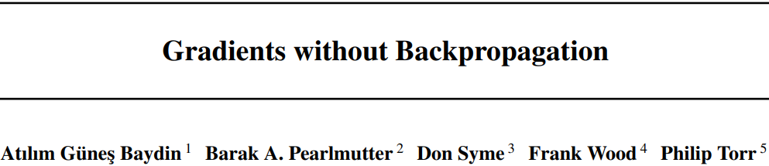

Slide 7


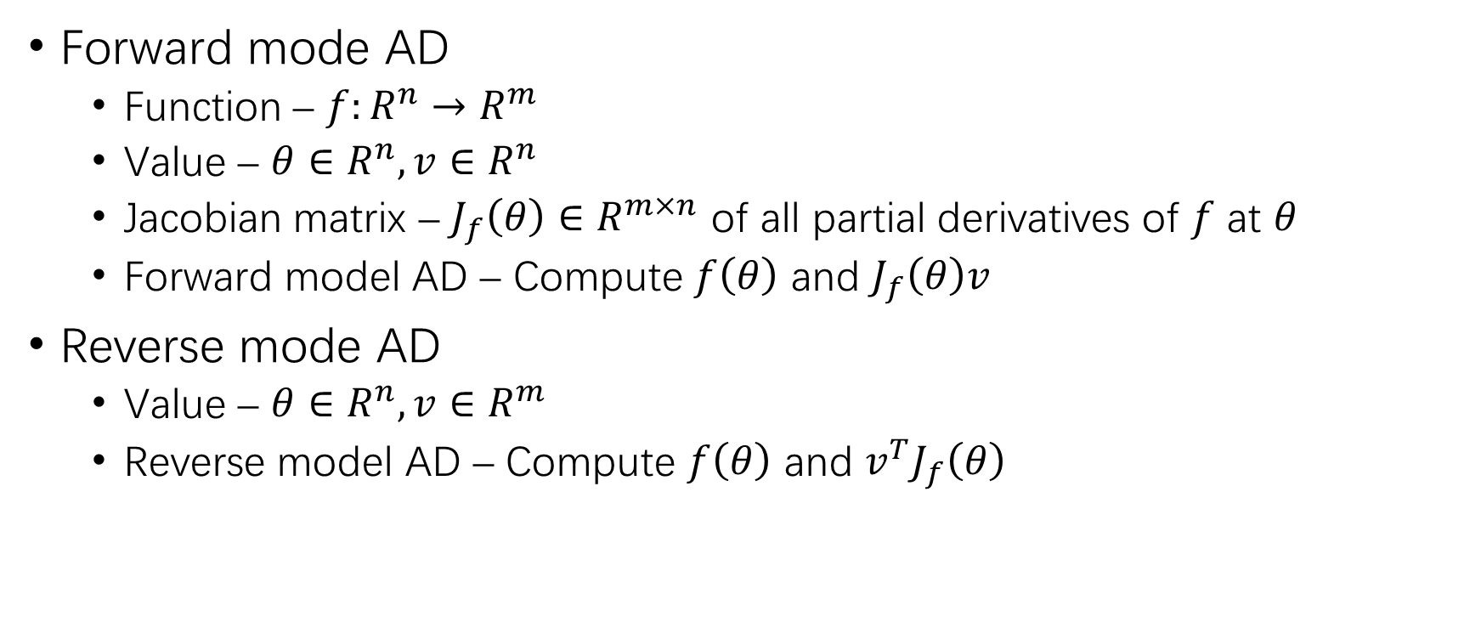
Automatic Differentiation
Forward mode AD
Function – $f:R^{n}→R^{m}$
Value – $θ∈R^{n}, v∈R^{n}$
Jacobian matrix – $J_{f}\left(θ\right)∈R^{m×n}$ of all partial derivatives of $f$ at $θ$
Forward model AD – Compute $f\left(θ\right)$ and $J_{f}\left(θ\right)v$
Reverse mode AD
Value – $θ∈R^{n}, v∈R^{m}$
Reverse model AD – Compute $f\left(θ\right)$ and $v^{T}J_{f}\left(θ\right)$

Slide 8
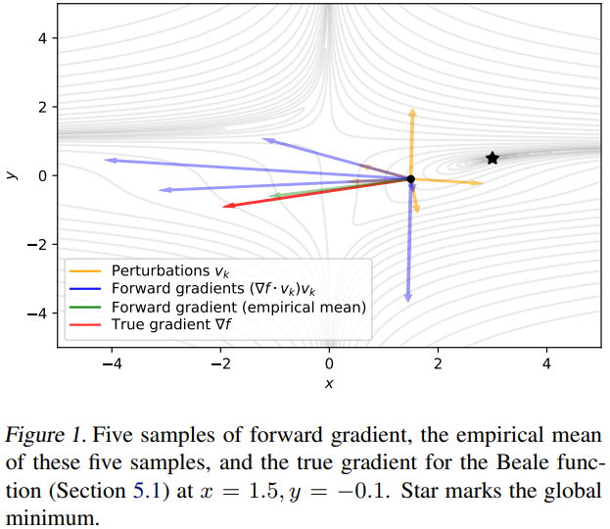
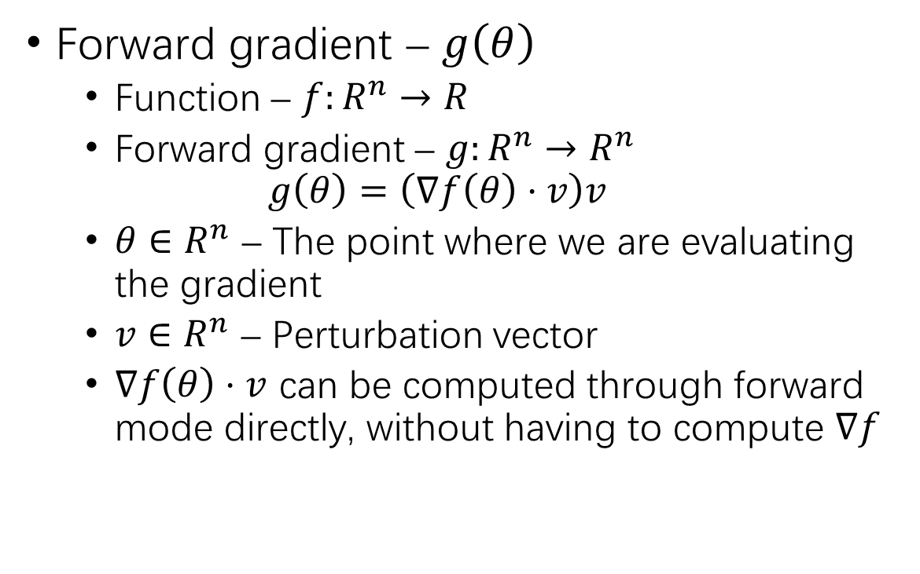
Forward Gradient
Forward gradient – $g\left(θ\right)$
Function – $f:R^{n}→R$
Forward gradient – $g:R^{n}→R^{n}$
$$g\left(θ\right)=\left(∇f\left(θ\right)⋅v\right)v$$
$θ∈R^{n}$ – The point where we are evaluating the gradient
$v∈R^{n}$ – Perturbation vector
$∇f\left(θ\right)⋅v$ can be computed through forward mode directly, without having to compute $∇f$

Slide 9
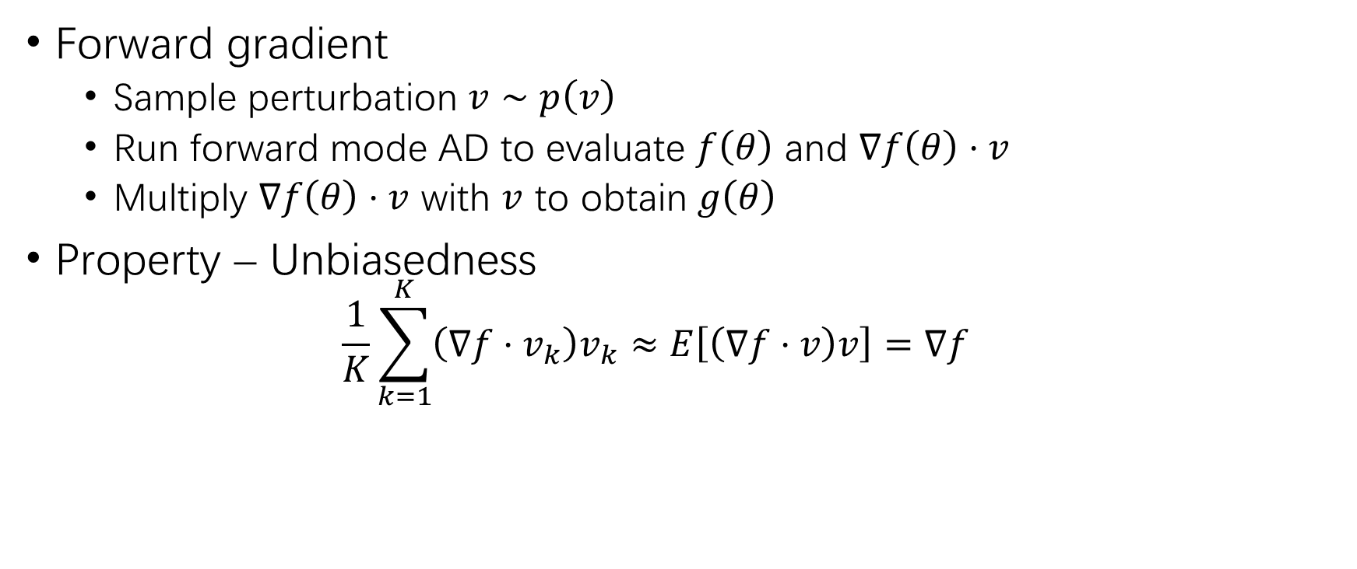
Forward Gradient (2)
Forward gradient
Sample perturbation $v∼p\left(v\right)$
Run forward mode AD to evaluate $f\left(θ\right)$ and $∇f\left(θ\right)⋅v$
Multiply $∇f\left(θ\right)⋅v$ with $v$ to obtain $g\left(θ\right)$
Property – Unbiasedness
$$\frac{1}{K}\sum_{k=1}^{K}{\left(∇f⋅v_{k}\right)v_{k}≈E\left[\left(∇f⋅v\right)v\right]}=∇f$$

Slide 10
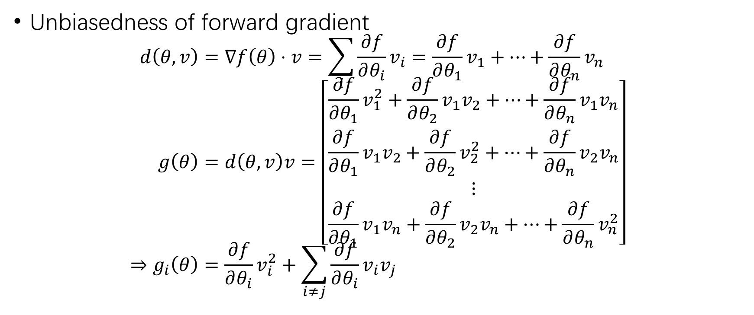
Forward Gradient (3)
Unbiasedness of forward gradient
$$d\left(θ,v\right)=∇f\left(θ\right)⋅v=\sum_{i}{\frac{∂f}{∂θ_{i}}v_{i}}=\frac{∂f}{∂θ_{1}}v_{1}+⋯+\frac{∂f}{∂θ_{n}}v_{n} \\ g\left(θ\right)=d\left(θ,v\right)v=\left[\begin{aligned}\frac{∂f}{∂θ_{1}}v_{1}^{2}+\frac{∂f}{∂θ_{2}}v_{1}v_{2}+⋯+\frac{∂f}{∂θ_{n}}v_{1}v_{n} \\ \frac{∂f}{∂θ_{1}}v_{1}v_{2}+\frac{∂f}{∂θ_{2}}v_{2}^{2}+⋯+\frac{∂f}{∂θ_{n}}v_{2}v_{n} \\ ⋮ \\ \frac{∂f}{∂θ_{1}}v_{1}v_{n}+\frac{∂f}{∂θ_{2}}v_{2}v_{n}+⋯+\frac{∂f}{∂θ_{n}}v_{n}^{2}\end{aligned}\right] \\ ⇒g_{i}\left(θ\right)=\frac{∂f}{∂θ_{i}}v_{i}^{2}+\sum_{i≠j}{\frac{∂f}{∂θ_{i}}v_{i}v_{j}}$$

Slide 11
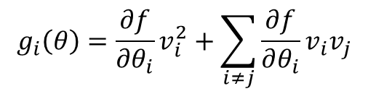
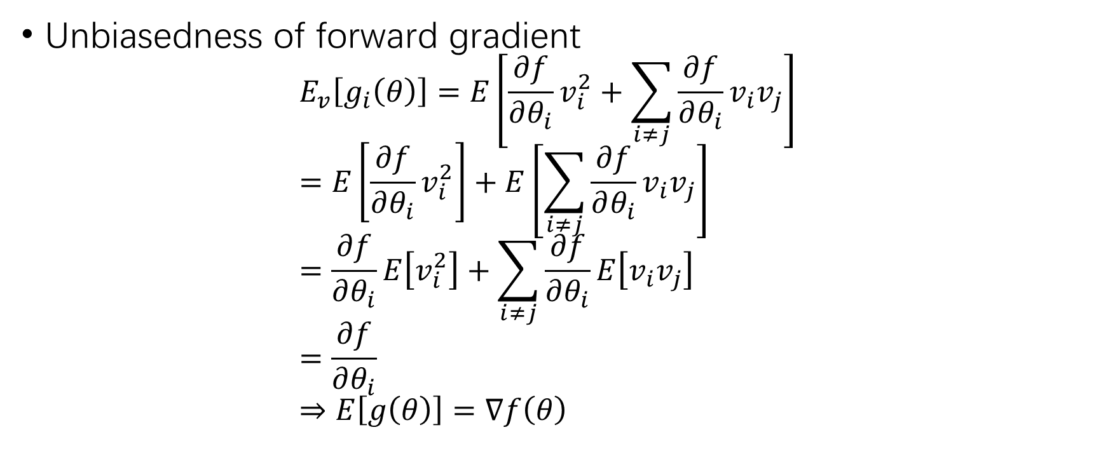
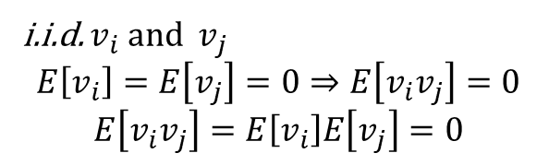
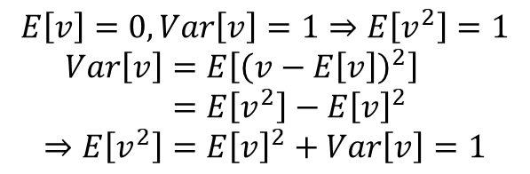
Forward Gradient (4)
$$g_{i}\left(θ\right)=\frac{∂f}{∂θ_{i}}v_{i}^{2}+\sum_{i≠j}{\frac{∂f}{∂θ_{i}}v_{i}v_{j}}$$
Unbiasedness of forward gradient $E_{v}\left[g_{i}\left(θ\right)\right]=E\left[\frac{∂f}{∂θ_{i}}v_{i}^{2}+\sum_{i≠j}{\frac{∂f}{∂θ_{i}}v_{i}v_{j}}\right]$ $=E\left[\frac{∂f}{∂θ_{i}}v_{i}^{2}\right]+E\left[\sum_{i≠j}{\frac{∂f}{∂θ_{i}}v_{i}v_{j}}\right]$ $=\frac{∂f}{∂θ_{i}}E\left[v_{i}^{2}\right]+\sum_{i≠j}{\frac{∂f}{∂θ_{i}}E\left[v_{i}v_{j}\right]}$ $=\frac{∂f}{∂θ_{i}}$ $⇒E\left[g\left(θ\right)\right]=∇f\left(θ\right)$
$$E\left[v\right]=0, Var\left[v\right]=1⇒E\left[v^{2}\right]=1$$
$$Var\left[v\right]=E\left[{\left(v−E\left[v\right]\right)}^{2}\right] \\ =E\left[v^{2}\right]−E{\left[v\right]}^{2} \\ ⇒E\left[v^{2}\right]=E{\left[v\right]}^{2}+Var\left[v\right]=1$$
i.i.d. $v_{i}$ and $v_{j}$
$$E\left[v_{i}\right]=E\left[v_{j}\right]=0⇒E\left[v_{i}v_{j}\right]=0$$
$$E\left[v_{i}v_{j}\right]=E\left[v_{i}\right]E\left[v_{j}\right]=0$$

Slide 12
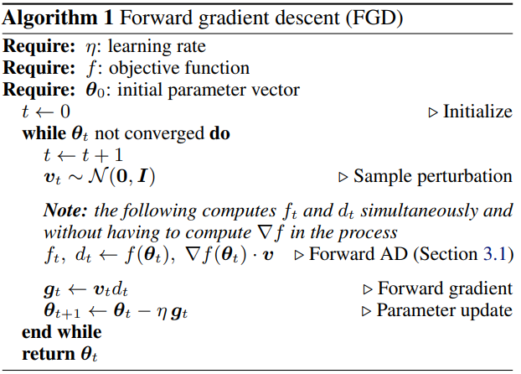

Forward Gradient Descent
$p\left(v\right)$
Independent components
Zero mean & unit variance

Slide 13
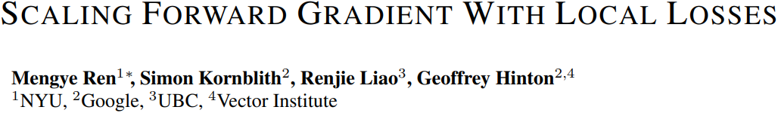

Slide 14
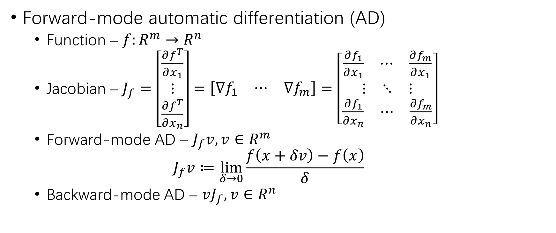
Forward Gradient Learning
Forward-mode automatic differentiation (AD)
Function – $f:R^{m}→R^{n}$
Jacobian – $J_{f}=\left[\begin{aligned}\frac{∂f^{T}}{∂x_{1}} \\ ⋮ \\ \frac{∂f^{T}}{∂x_{n}}\end{aligned}\right]=\left[\begin{matrix}∇f_{1} & ⋯ & ∇f_{m}\end{matrix}\right]=\left[\begin{aligned}\begin{matrix}\frac{∂f_{1}}{∂x_{1}} & ⋯ & \frac{∂f_{m}}{∂x_{1}}\end{matrix} \\ \begin{matrix}⋮ & ⋱ & ⋮\end{matrix} \\ \begin{matrix}\frac{∂f_{1}}{∂x_{n}} & ⋯ & \frac{∂f_{m}}{∂x_{n}}\end{matrix}\end{aligned}\right]$
Forward-mode AD – $J_{f}v, v∈R^{m}$
$$J_{f}v≔\lim_{δ→0}{\frac{f\left(x+δv\right)−f\left(x\right)}{δ}}$$
Backward-mode AD – $vJ_{f}, v∈R^{n}$

Slide 15

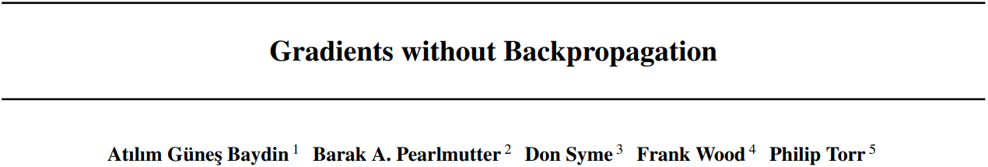
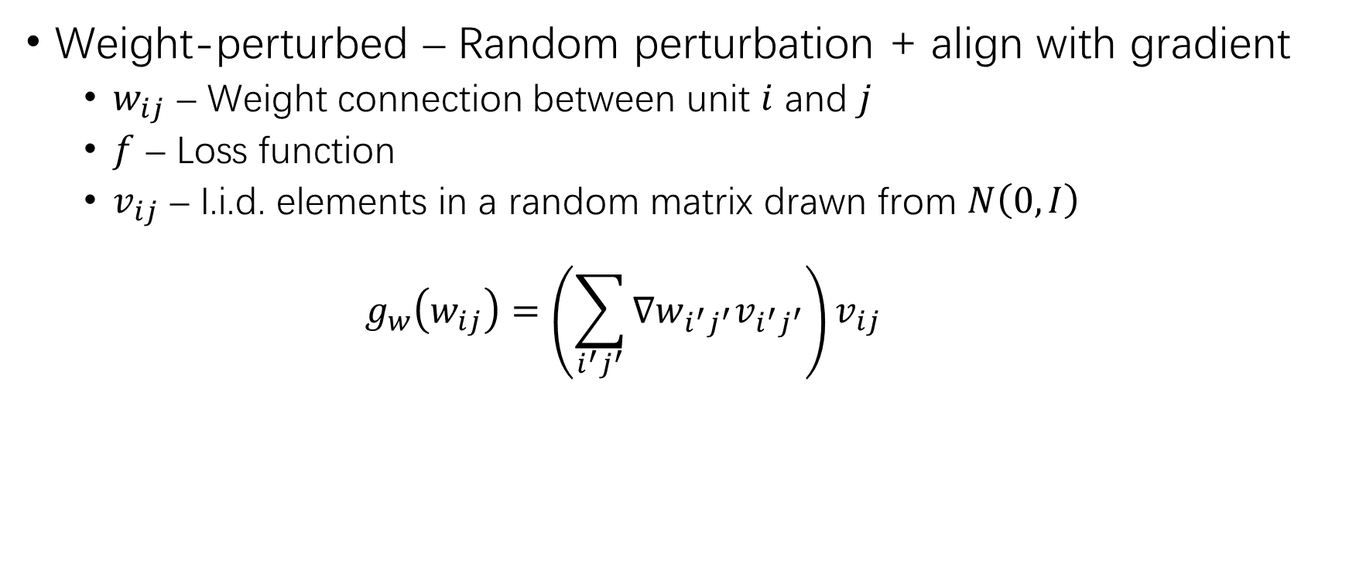
Forward Gradient
Weight-perturbed – Random perturbation + align with gradient
$w_{ij}$ – Weight connection between unit $i$ and $j$
$f$ – Loss function
$v_{ij}$ – I.i.d. elements in a random matrix drawn from $N\left(0,I\right)$
$$g_{w}\left(w_{ij}\right)=\left(\sum_{i^{′}j^{′}}{∇w_{i^{′}j^{′}}v_{i^{′}j^{′}}}\right)v_{ij}$$

Slide 16
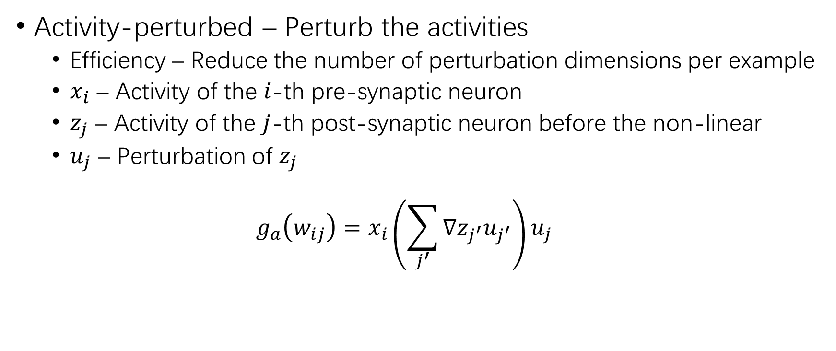
Forward Gradient (2)
Activity-perturbed – Perturb the activities
Efficiency – Reduce the number of perturbation dimensions per example
$x_{i}$ – Activity of the $i$-th pre-synaptic neuron
$z_{j}$ – Activity of the $j$-th post-synaptic neuron before the non-linear
$u_{j}$ – Perturbation of $z_{j}$
$$g_{a}\left(w_{ij}\right)=x_{i}\left(\sum_{j^{′}}{∇z_{j^{′}}u_{j^{′}}}\right)u_{j}$$

Slide 17
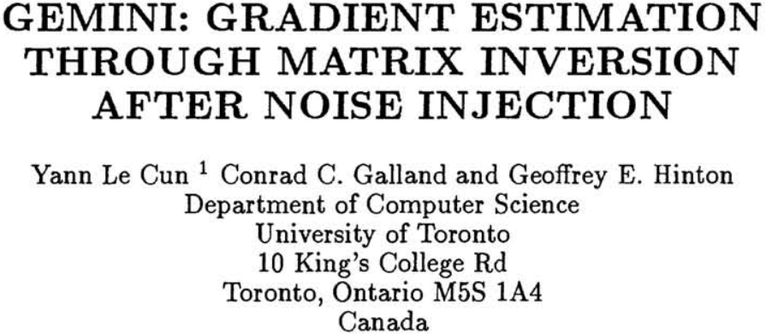
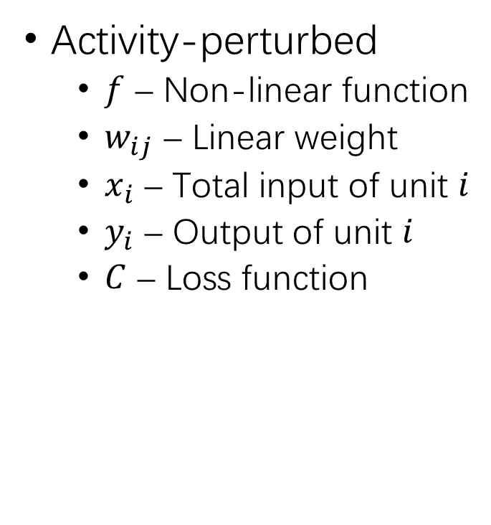
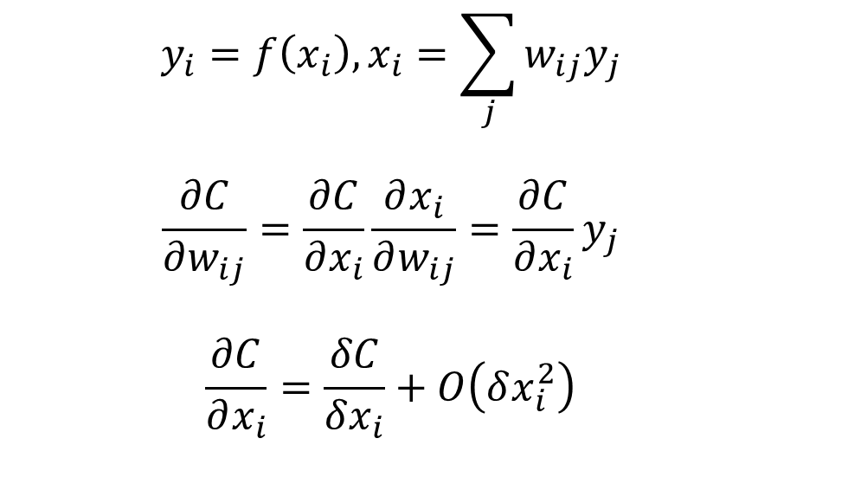
Forward Gradient (3)
Activity-perturbed
$f$ – Non-linear function
$w_{ij}$ – Linear weight
$x_{i}$ – Total input of unit $i$
$y_{i}$ – Output of unit $i$
$C$ – Loss function
$$y_{i}=f\left(x_{i}\right), x_{i}=\sum_{j}{w_{ij}y_{j}}$$
$$\frac{∂C}{∂w_{ij}}=\frac{∂C}{∂x_{i}}\frac{∂x_{i}}{∂w_{ij}}=\frac{∂C}{∂x_{i}}y_{j}$$
$$\frac{∂C}{∂x_{i}}=\frac{δC}{δx_{i}}+O\left(δx_{i}^{2}\right)$$

Slide 18
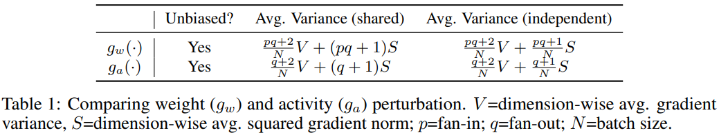
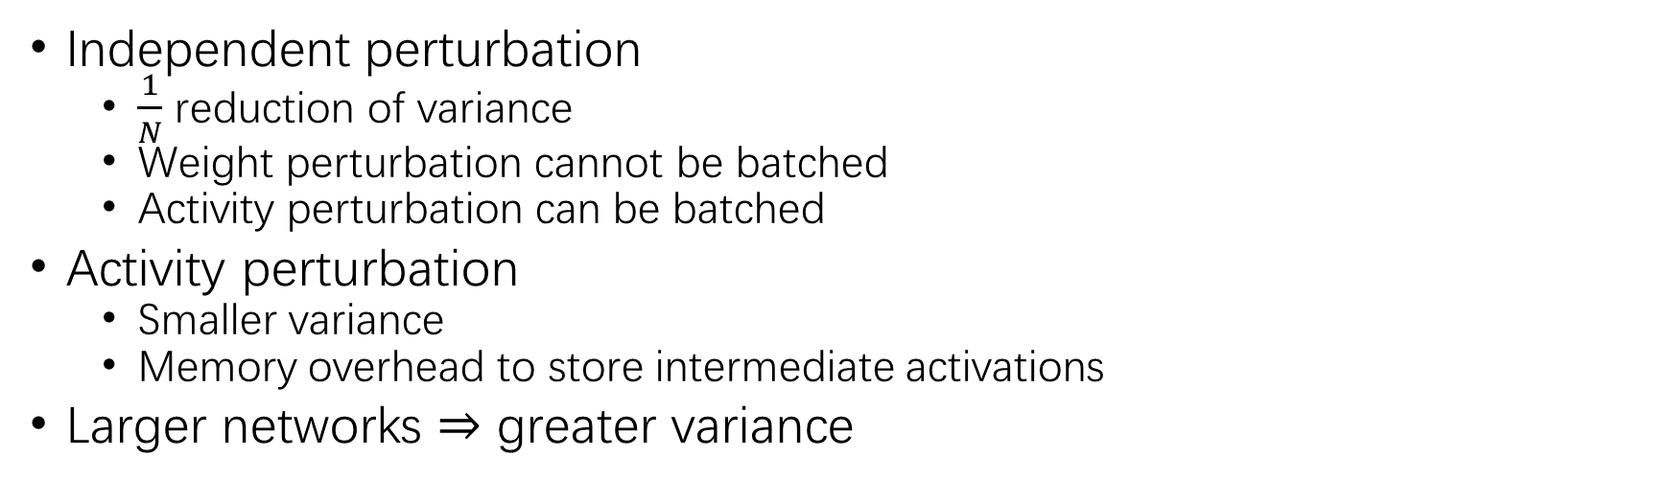

Forward Gradient (4)
$$g_{w}\left(w_{ij}\right)=\left(\sum_{i^{′}j^{′}}{∇w_{i^{′}j^{′}}v_{i^{′}j^{′}}}\right)v_{ij}$$
$$g_{a}\left(w_{ij}\right)=x_{i}\left(\sum_{j^{′}}{∇z_{j^{′}}u_{j^{′}}}\right)u_{j}$$
Independent perturbation
$\frac{1}{N}$ reduction of variance
Weight perturbation cannot be batched
Activity perturbation can be batched
Activity perturbation
Smaller variance
Memory overhead to store intermediate activations
Larger networks $⇒$ greater variance

Slide 19
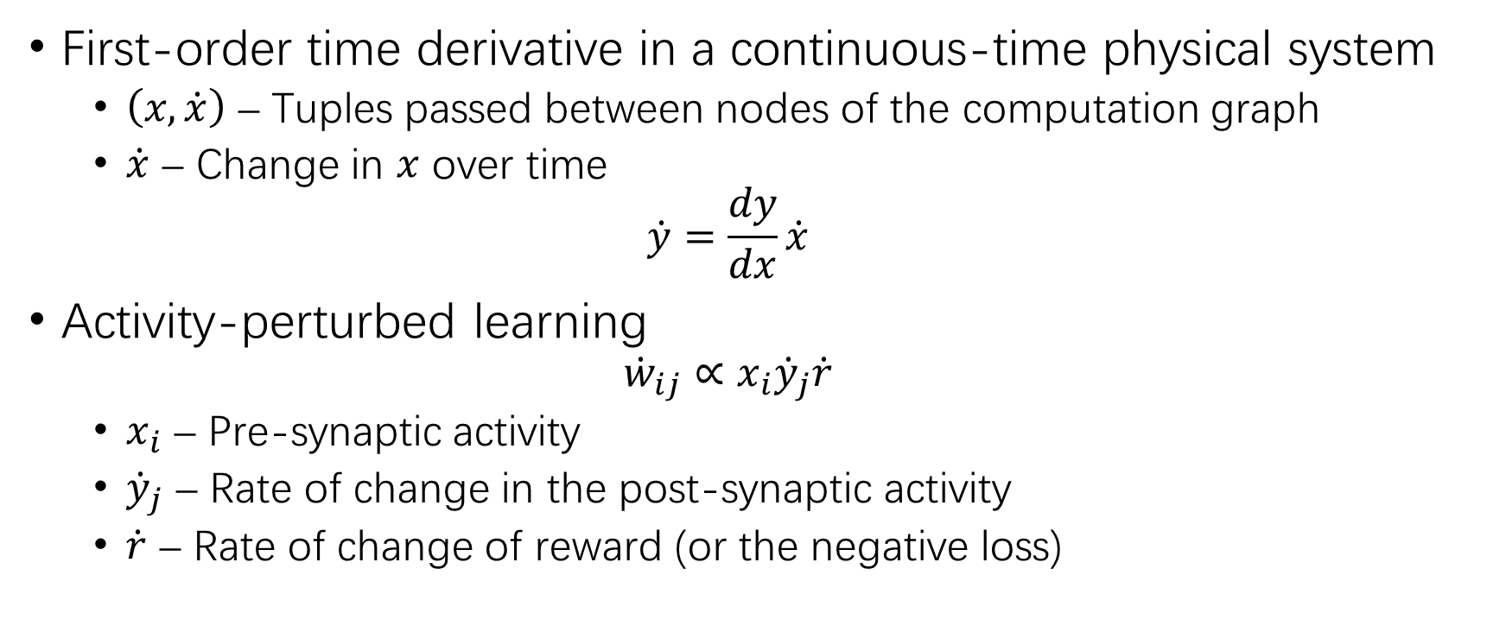
Continuous-Time Rate-Based Models
First-order time derivative in a continuous-time physical system
$\left(x,\dot{x}\right)$ – Tuples passed between nodes of the computation graph
$\dot{x}$ – Change in $x$ over time
$$\dot{y}=\frac{dy}{dx}\dot{x}$$
Activity-perturbed learning
$${\dot{w}}_{ij}∝x_{i}{\dot{y}}_{j}\dot{r}$$
$x_{i}$ – Pre-synaptic activity
${\dot{y}}_{j}$ – Rate of change in the post-synaptic activity
$\dot{r}$ – Rate of change of reward (or the negative loss)

Slide 20
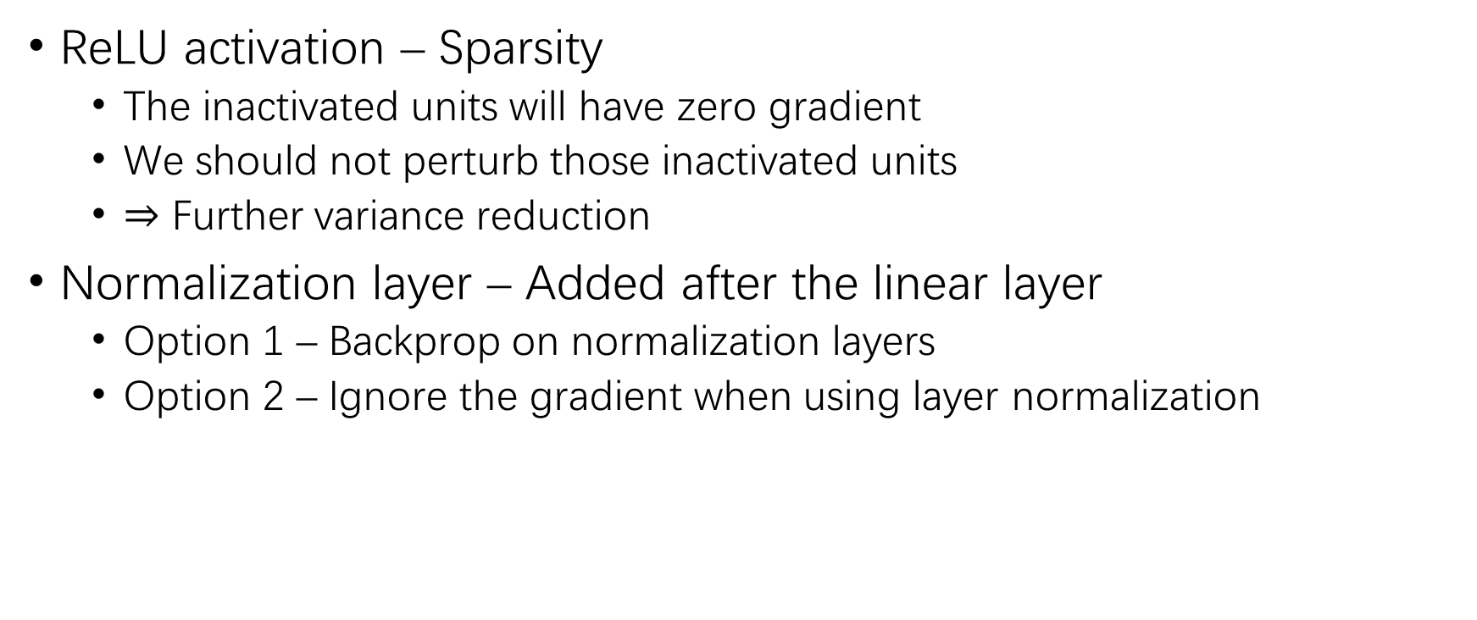
Activation & Normalization
ReLU activation – Sparsity
The inactivated units will have zero gradient
We should not perturb those inactivated units
$⇒$ Further variance reduction
Normalization layer – Added after the linear layer
Option 1 – Backprop on normalization layers
Option 2 – Ignore the gradient when using layer normalization

Slide 21
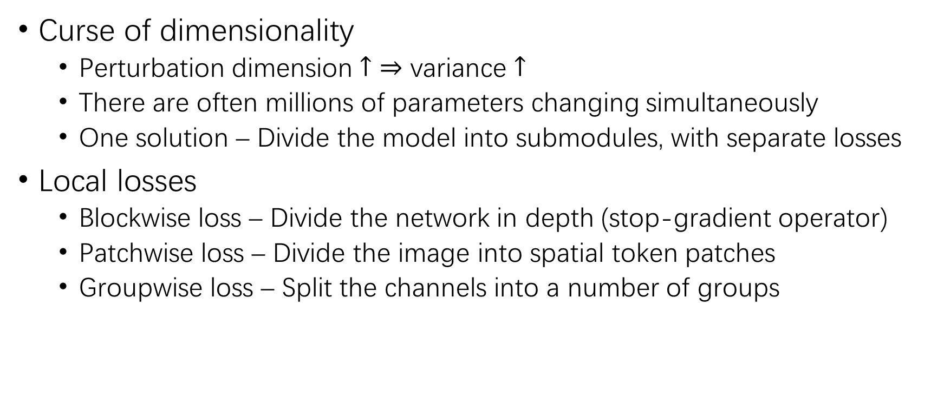
Scaling with Local Losses
Curse of dimensionality
Perturbation dimension $↑$ $⇒$ variance $↑$
There are often millions of parameters changing simultaneously
One solution – Divide the model into submodules, with separate losses
Local losses
Blockwise loss – Divide the network in depth (stop-gradient operator)
Patchwise loss – Divide the image into spatial token patches
Groupwise loss – Split the channels into a number of groups

Slide 22
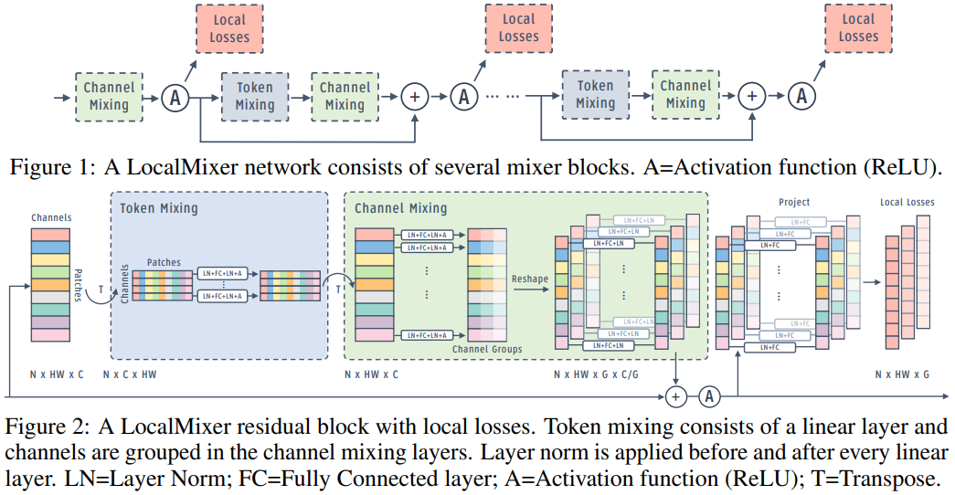
Scaling with Local Losses (2)
Blockwise
Patchwise
Groupwise

Slide 23
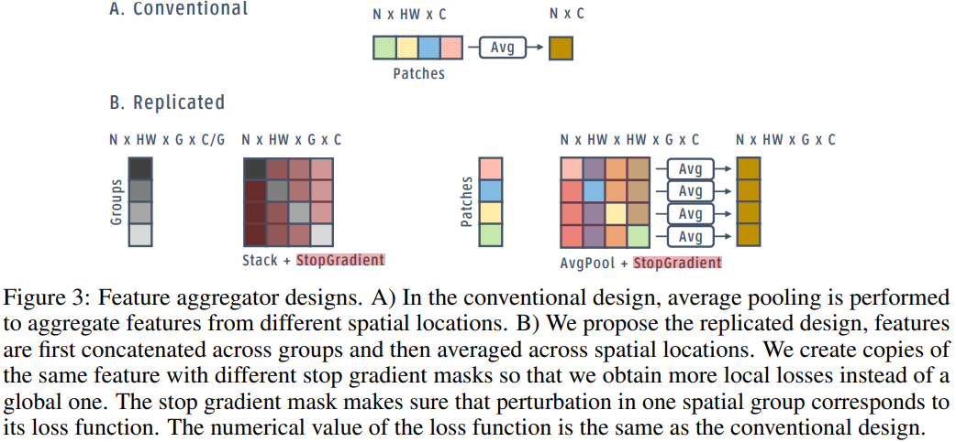
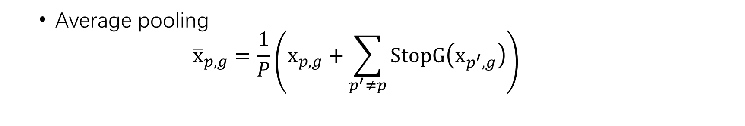
Scaling with Local Losses (3)
Feature aggregator
Gather information from groups and patches before local loss
Replicated design
$$x_{p,g}=\left[StopG\left(x_{p,1},⋯,x_{p,g−1}\right),x_{p,g},StopG\left(x_{p,g+1},⋯,x_{p, G}\right)\right]$$
Average pooling
$${\overline{x}}_{p,g}=\frac{1}{P}\left(x_{p,g}+\sum_{p^{′}≠p}{StopG\left(x_{p^{′},g}\right)}\right)$$

Slide 24
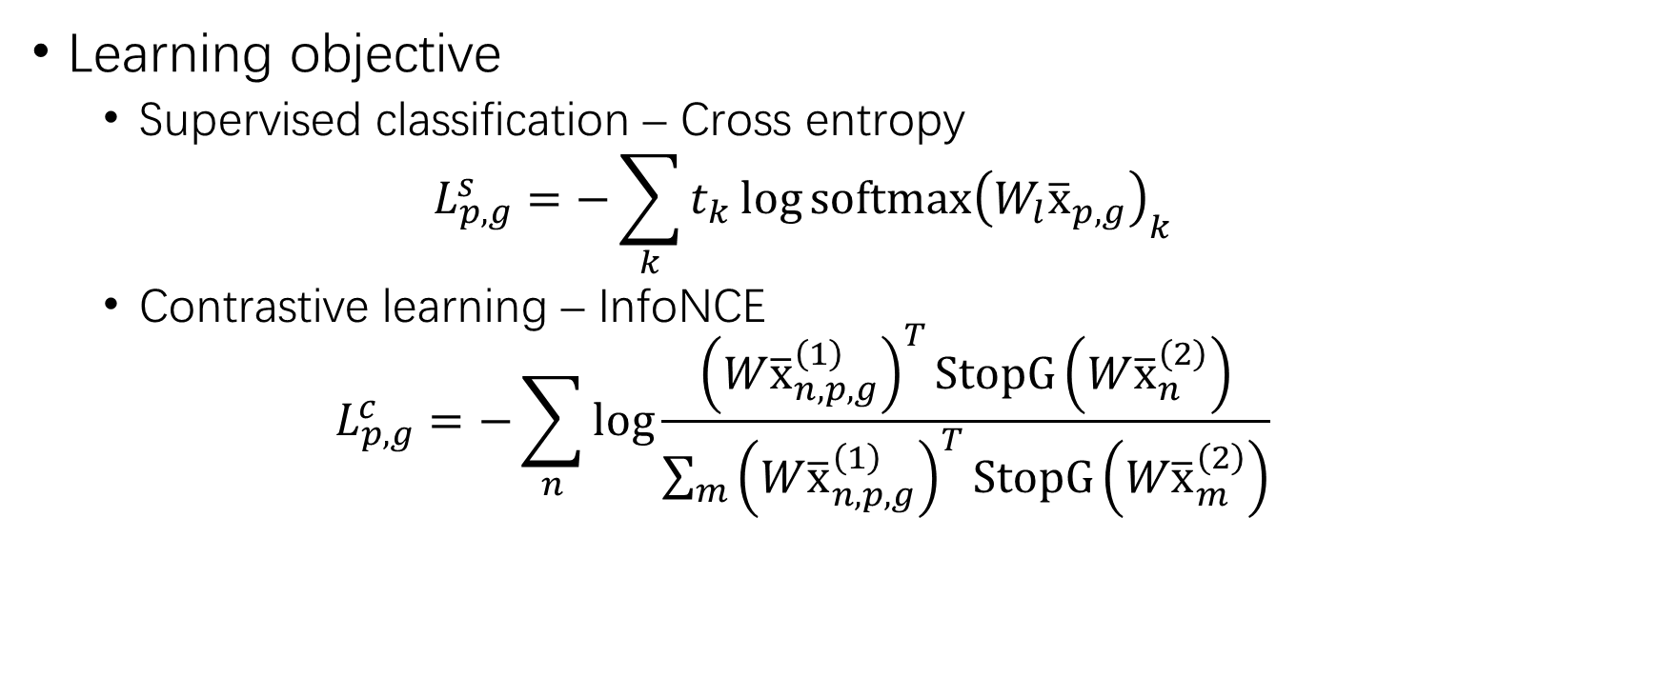
Scaling with Local Losses (4)
Learning objective
Supervised classification – Cross entropy
$$L_{p,g}^{s}=−\sum_{k}{t_{k}\log{softmax{\left(W_{l}{\overline{x}}_{p,g}\right)}_{k}}}$$
Contrastive learning – InfoNCE
$$L_{p,g}^{c}=−\sum_{n}{\log{\frac{{\left(W{\overline{x}}_{n,p,g}^{\left(1\right)}\right)}^{T}StopG\left(W{\overline{x}}_{n}^{\left(2\right)}\right)}{\sum_{m}{{\left(W{\overline{x}}_{n,p,g}^{\left(1\right)}\right)}^{T}StopG\left(W{\overline{x}}_{m}^{\left(2\right)}\right)}}}}$$

Slide 25
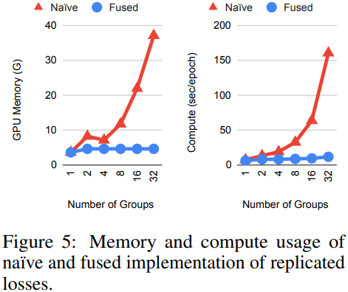
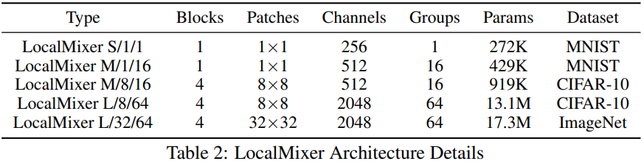
LocalMixer
Architecture
Block – Token mixing + channel mixing
Shallow module – Full connection
Local loss – Linear projector/classification layer at the end of each block
Fused implementation – Share replicated losses
Update – Laster layer backprop + others forward gradient

Slide 26
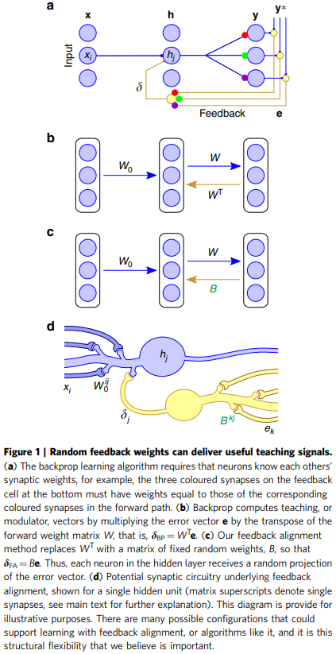
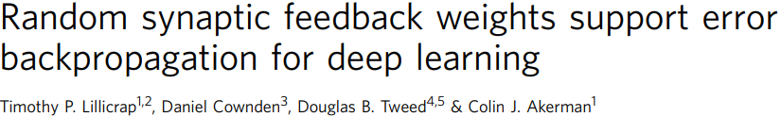
Experiment Setup
Baseline
BP – Backprop
L-BP – Local losses with backprop, without stop-gradient
LG-BP – L-BP with stop-gradient in between blocks
FA – Feedback alignment
L-FA & LG-FA
FG – Forward gradient
FG-W & LG-FG-W
FG-A & LG-FG-A
Proposed

Slide 27
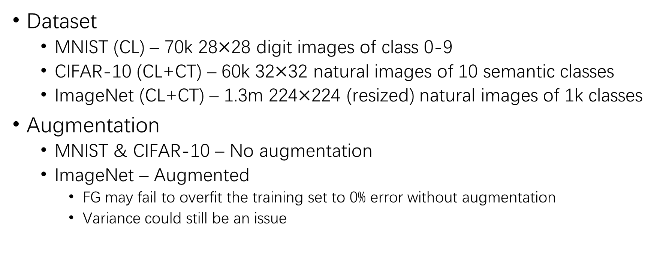
Experiment Setup (2)
Dataset
MNIST (CL) – 70k 28$×$28 digit images of class 0-9
CIFAR-10 (CL+CT) – 60k 32$×$32 natural images of 10 semantic classes
ImageNet (CL+CT) – 1.3m 224$×$224 (resized) natural images of 1k classes
Augmentation
MNIST & CIFAR-10 – No augmentation
ImageNet – Augmented
FG may fail to overfit the training set to 0% error without augmentation
Variance could still be an issue

Slide 28
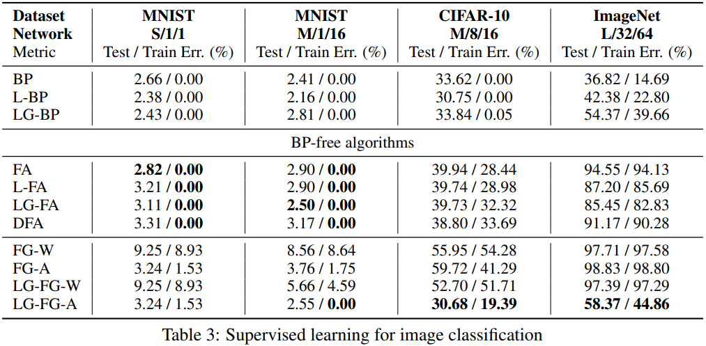
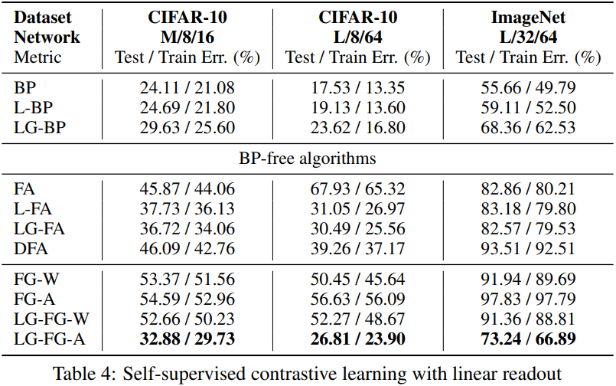
Result
Compared with BP, FG-A can match on MNIST and CIFAR-10
LG-FG-A significantly outperforms FA on ImageNet
FG-A mostly outperforms FG-W

Slide 29
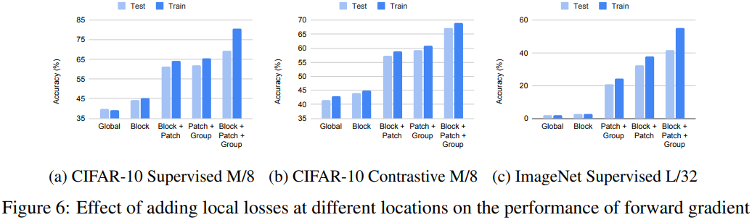
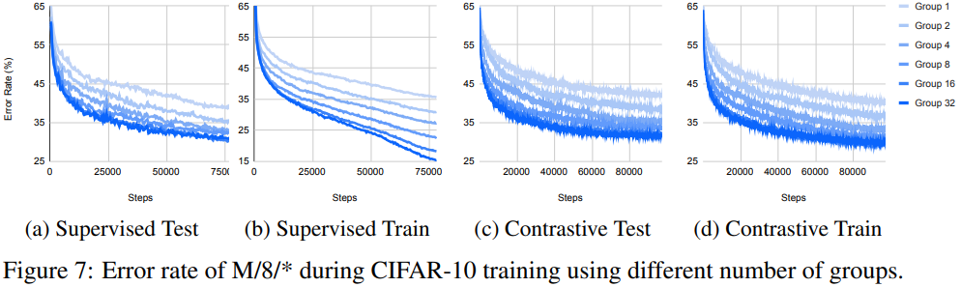
Result (2)
Effect of local losses
Effect of groups

Slide 30
THANK YOU

