Slide 1
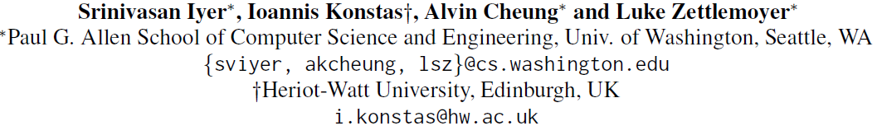
Mapping Language to Code in Programmatic Context

Slide 2
Overview
Background
Task Definition
Models
Encoder
Decoder
CONCODE
Experiments
Results
Error Analysis

Slide 3
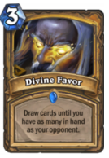
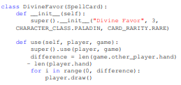

Background
Existing approaches for automatically mapping natural language to executable code have considered limited language or code environments
Assume fixed code templates
(IFTTT)
Fixed context
(Hearthstone)
Autosave your Instagram photos to Dropbox
If Instagram.AnyNewPhotoByYou
Then Dropbox.AddFileFromURL
No context at all
(Django)

Slide 4

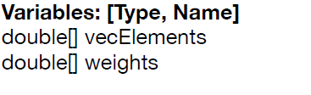
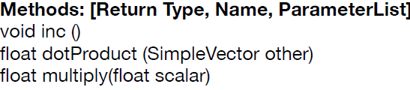
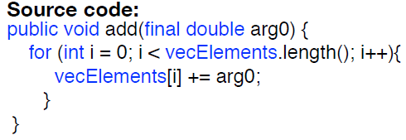
Task Definition
Generating source code from NL documentation, conditioned on the class environment the code resides in

Slide 5
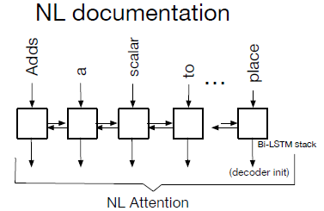

Models
Encoder(NL)
Word embedding:
$$q_{i}=q_{i}I$$
Notes:
Identifier matrix

Slide 6
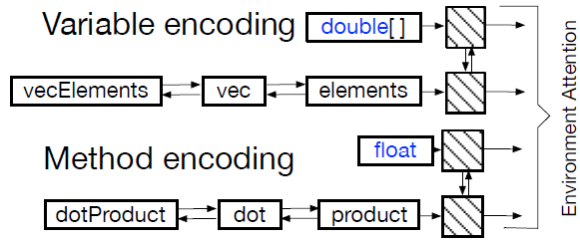




Models
Encoder(variables and methods)
Variable and method names are split based on camel-casing
Notes:
Type matrix

Slide 7
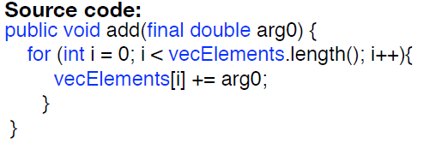
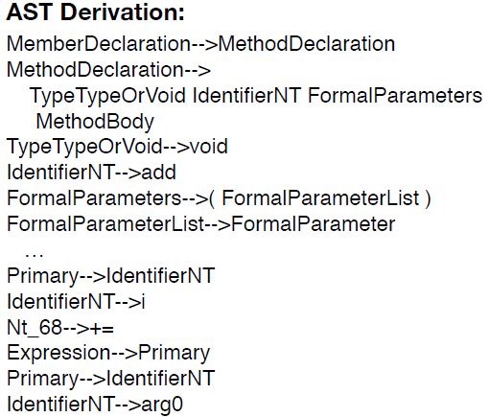

Models
Decoder
Represent the source code to be produced as a sequence of production rules ($a_{t}$ at step $t$)

Slide 8
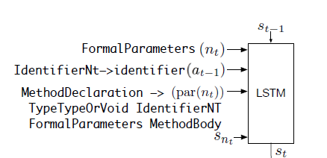

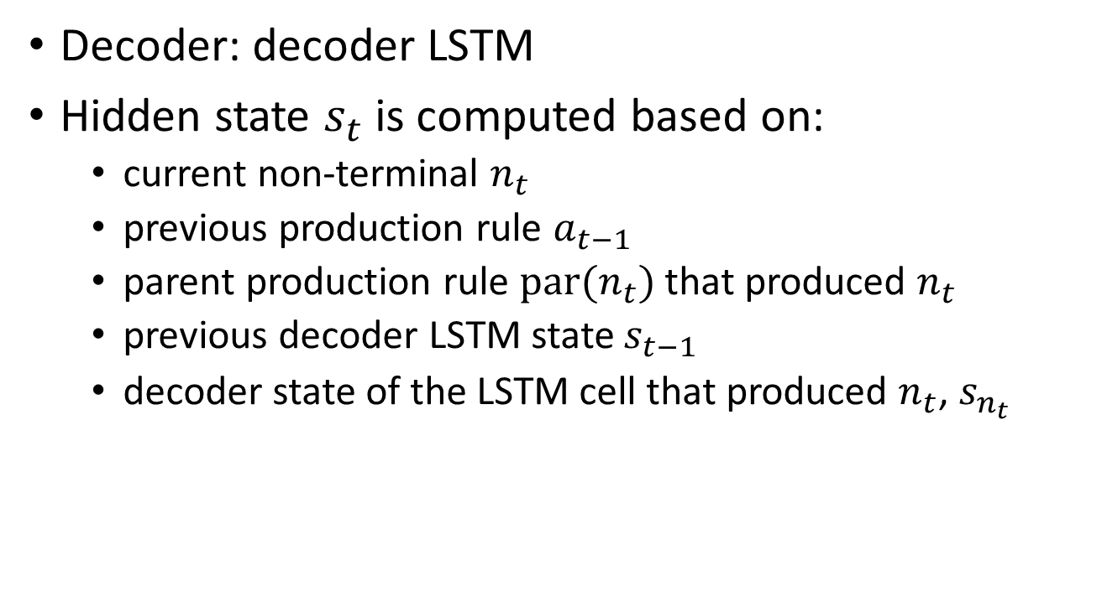
Models
Decoder: decoder LSTM
Hidden state $s_{t}$ is computed based on:
current non-terminal $n_{t}$
previous production rule $a_{t−1}$
parent production rule $par(n_{t})$ that produced $n_{t}$
previous decoder LSTM state $s_{t−1}$
decoder state of the LSTM cell that produced $n_{t}$, $s_{n_{t}}$
Notes:
current non-terminal nt, previous production rule at−, the parent production rule par(nt) that produced nt, the previous decoder LSTM state st−1, and the decoder state of the LSTM cell that produced nt, denoted as snt

Slide 9
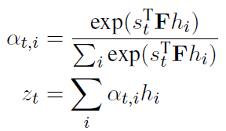
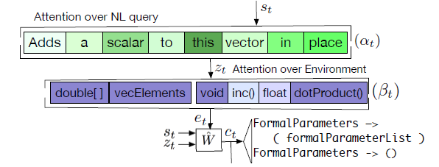

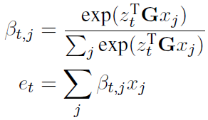

Models
Decoder: two-step Attention

Slide 10

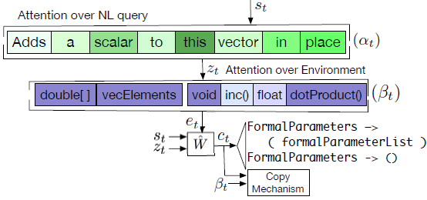

Models
Decoder: supervised Copy Mechanism
copy probability
probability of copying an environment token
$$p\left(x_{j}\right)=β_{t,j}$$

Slide 11
DATASET: CONCODE
Java files from 33,000 repositories
Split into train, development, and test sets based on repository
NL: Javadoc
Target code: method body
Renaming locally defined variables canonically, beginning at loc0
Replace all method names with the word function

Slide 12
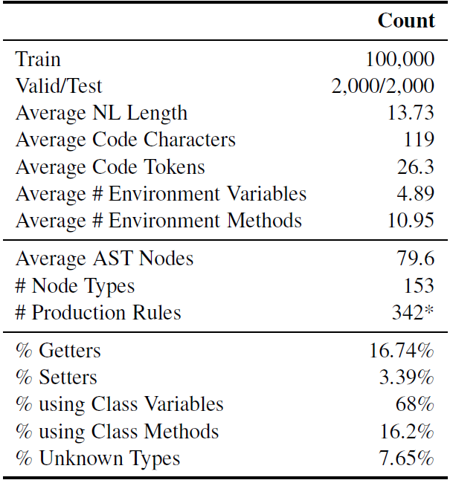
CONCODE

Slide 13
Experiments
Baseline Models
Retrieval: output source code closest in terms of cosine similarity to the NL using a tf-idf representation
Seq2seq: representing the NL and context as a sequence formed by the concatenation of the NL, the variables and the methods
Seq2prod: decoder learns to generate a derivation of the AST of the underlying source code
Notes:
replace UNK tokens in the output with source tokens having the most attention weight
Seq2tree: similar

Slide 14
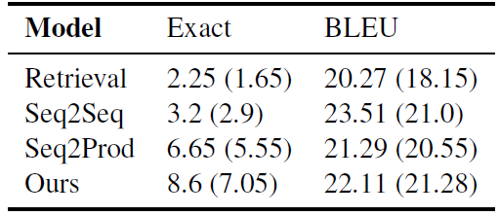
Results
Exact match accuracy and BLEU score on the test (development) set

Slide 15
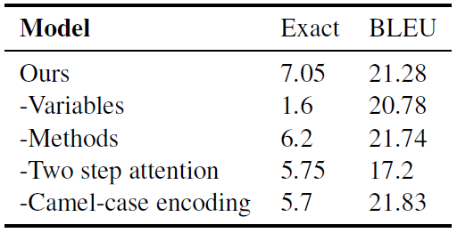
Results
Ablation study on the development set

Slide 16
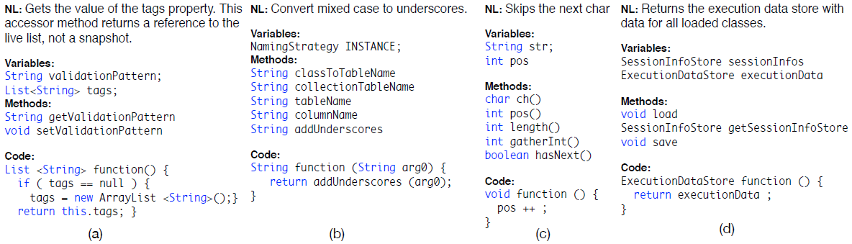
Analysis
Correct output
Notes:
Shows an example output of our model, which produces code structure intermixed with member variables
(b) our model learns to call method addUnderscores (an UNK in the vocabulary) with its correct return type (String).
(d) our model also successfully learns to use a previously unseen type (ExecutionDataStore)
(c) is an example of where the NL does not directly refer to the variable to be used

Slide 17
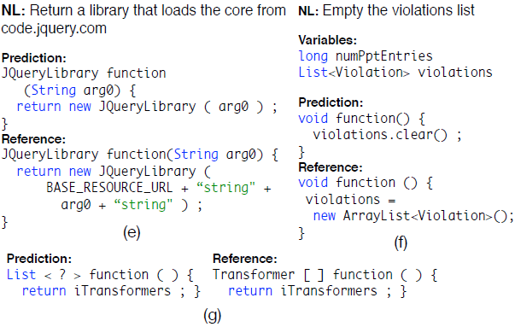
Analysis
Semantically equivalent output
(a better solution!)

Slide 18
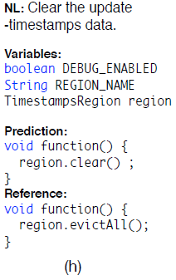
Analysis
The model is unaware of methods that can be called on class members (here evictAll is a member of the TimestampsRegion class)
Requires augmenting the environment with additional member type documentation

Slide 19
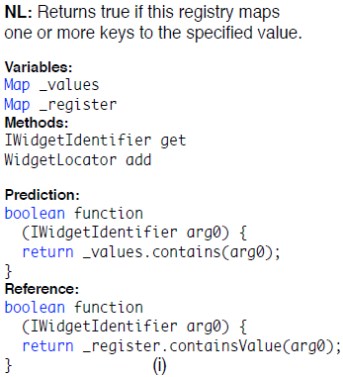
Analysis
Could be improved by better encoder representations
The model is unable to associate the word “registry” with the right elements

Slide 20
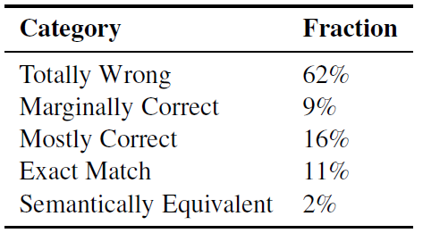
Analysis
A qualitative analysis of 100 predictions on the development set

