Slide 1
Learning to Represent Edits
Pengcheng Yin, Graham Neubig
Carnegie Mellon University
Miltiadis Allamanis, Marc Brockschmidt, Alexander L. Gaunt
Microsoft Research
ICLR 2019
Reporter: LuShuai
2019.3.13

Slide 2
Outline
Introduction to the task
Model
Evaluation

Slide 3
Introduction to the task
Edits are performed in a wide variety of contents. Would it be possible to automatically extract rules from these common edits?
Two questions: i) Can we group semantically equivalent edits together, so that we can automatically recognize common edit patterns? ii) Can we automatically transfer edits from one context to another?
Notes:
自然语言：改论文；代码：优化或修复bug

Slide 4
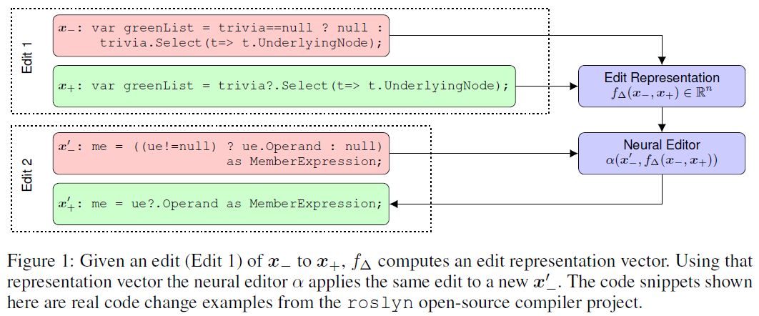
Introduction to the task
Learn to represent and apply edits on discrete sequential or structured data, such as text or source code parse trees
Leave a problem?

Slide 5
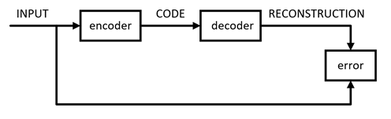
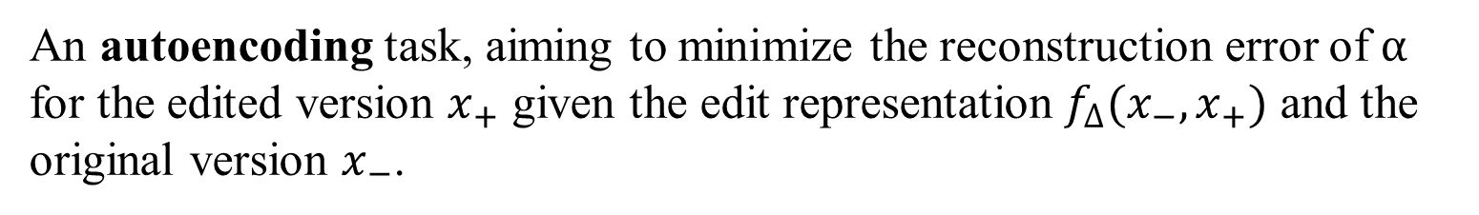


Model
An autoencoding task, aiming to minimize the reconstruction error of $α$ for the edited version $x_{+}$ given the edit representation $f_{∆}(x_{−}, x_{+})$ and the original version $x_{−}$.
$$x_{−}$$
Edit Representation
Neural Editor
$$x_{+}$$
Error

Slide 6

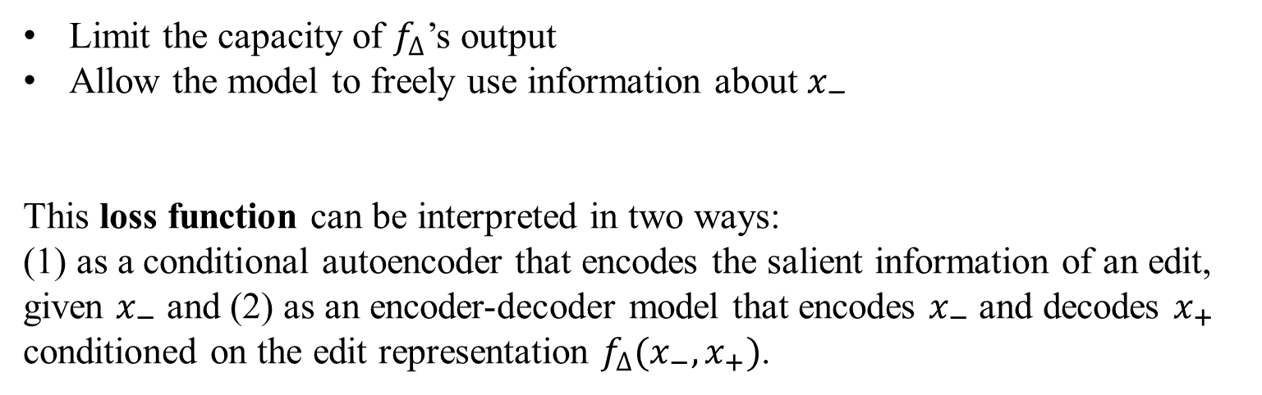
Model
Limit the capacity of $f_{∆}$’s output
Allow the model to freely use information about $x_{−}$
This loss function can be interpreted in two ways:
(1) as a conditional autoencoder that encodes the salient information of an edit, given $x_{−}$ and (2) as an encoder-decoder model that encodes $x_{−}$ and decodes $x_{+}$ conditioned on the edit representation $f_{∆}(x_{−},x_{+})$.

Slide 7
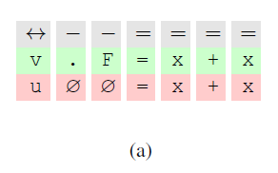
Model – Edit Representation
Sequence Encoding of Edits
use a standard (deterministic) diffing algorithm to compute an alignment of tokens in the two sequences
embedding the three entries in each element of the sequence separately and concatenating their representation
fed into a biLSTM whose final state is our desired edit representation

Slide 8
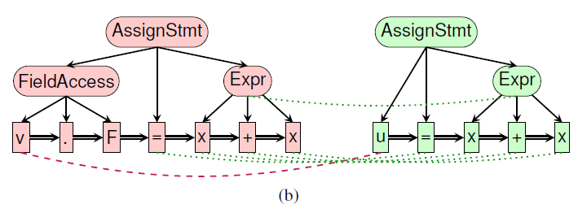
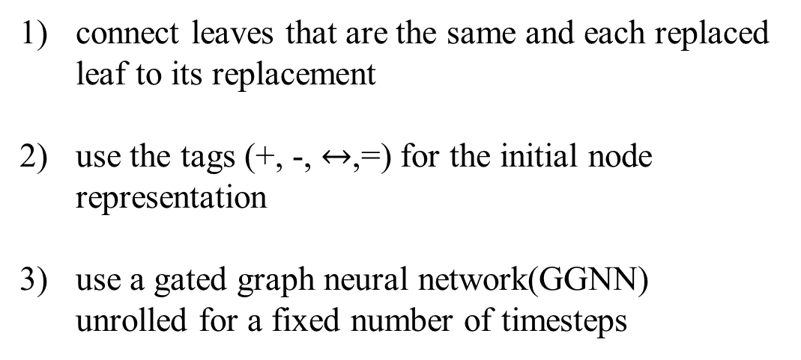
Model – Edit Representation
Graph Encoding of Edits
connect leaves that are the same and each replaced leaf to its replacement
use the tags (+, -, $↔$,=) for the initial node representation
use a gated graph neural network(GGNN) unrolled for a fixed number of timesteps

Slide 9
Model – Neural Editor
Sequence-to-Sequence Neural Editor – for text
A token-level copying mechanism (pointer network)
initial state of decoder: concatenation of encoder output and the edit representation
feed the edit representation as input to the decoder LSTM at each decoding time step
Notes:
尽可能地使用x-的信息，copy

Slide 10
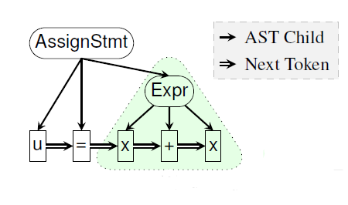
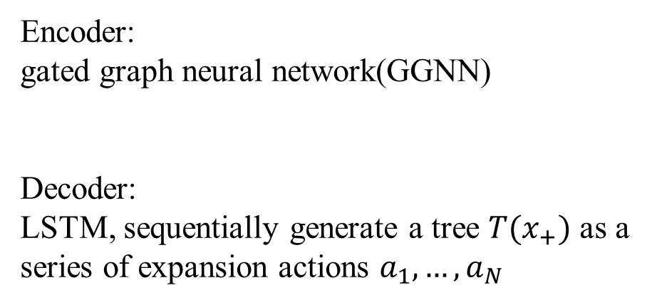
Model – Neural Editor
Graph-to-Tree Neural Editor – for source code
Encoder:
gated graph neural network(GGNN)
Decoder:
LSTM, sequentially generate a tree $T(x_{+})$ as a series of expansion actions $a_{1}, …, a_{N}$

Slide 11
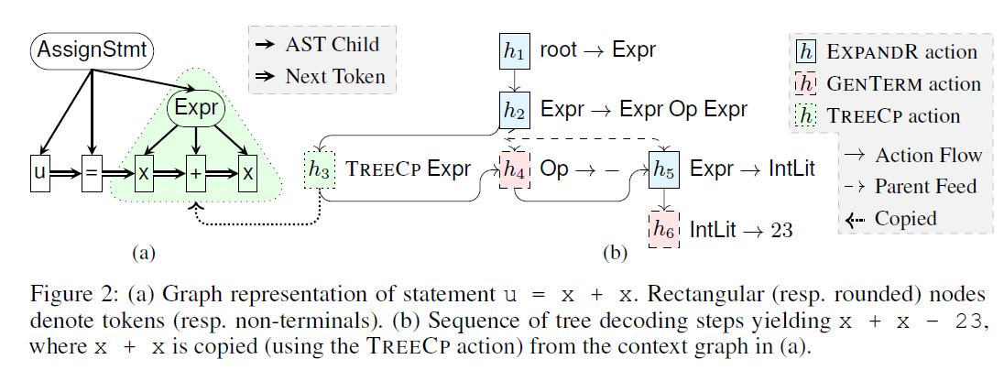
Model – Neural Editor
Graph-to-Tree Neural Editor – for source code

Slide 12
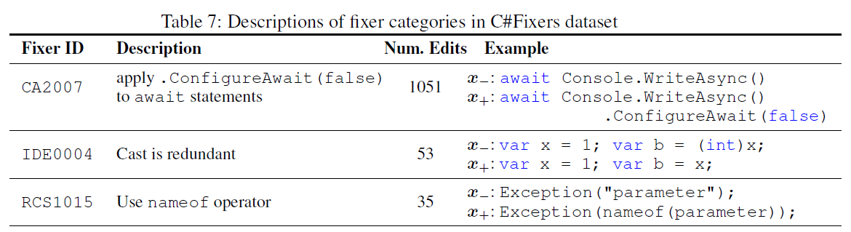
Evaluation
Datasets
Natural Language Edits: WikiAtomicEdits
dataset of pairs of short edits on Wikipedia articles
1040K edits from the English insertion portion
Source Code Edits:
GitHubEdits – 54 C# projects
C#Fixers – a labeled dataset of source code edits by using C# “fixers”

Slide 13
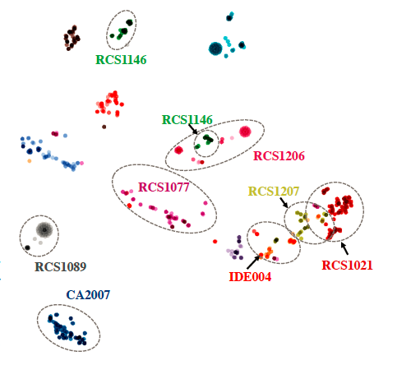

Evaluation
Edit Representation
Visualizing Edits on Fixers Data

Slide 14

Evaluation
Edit Representation
Human Evaluation on Encoding Natural Language WikiAtomicEdits
computed the five nearest neighbors of 200 randomly sampled seed edits from our training set
rated the quality of the retrieved neighbors on a scale of 0 (“unrelated edit”), 1 (“similar edit”) and 2 (“semantically or syntactically same edit”)
discounted cumulative gain(DCG)

Slide 15
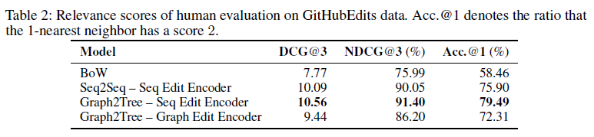
Evaluation
Edit Representation
Human Evaluation on GitHubEdits data

Slide 16
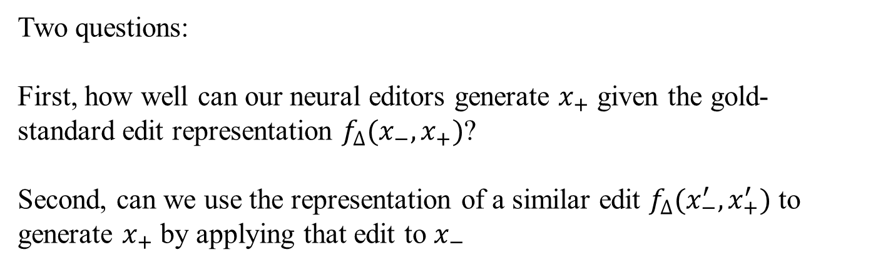
Evaluation
Neural Edits
Two questions:
First, how well can our neural editors generate $x_{+}$ given the gold-standard edit representation $f_{∆}(x_{−},x_{+})$?
Second, can we use the representation of a similar edit $f_{∆}(x_{−}^{′},x_{+}^{′})$ to generate $x_{+}$ by applying that edit to $x_{−}$

Slide 17
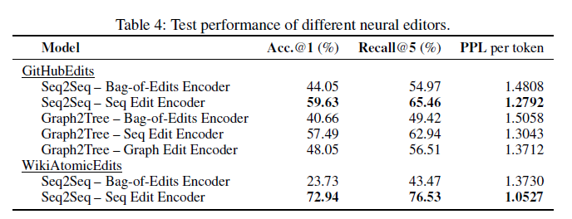
Evaluation
Neural Edits

Slide 18
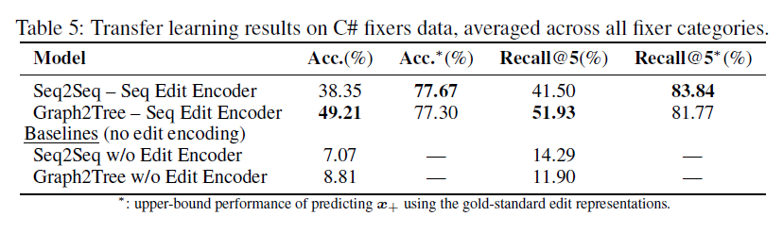
Evaluation
Neural Edits

