Slide 1
GraphCodeBERT: Pre-training Code Representations with Data Flow
Anonymous
ICLR 2021 OpenReview

Slide 2
Pre-trained models for programming language
Model Name | Programming Language | Model Backend
SCELMo | JavaScript | ELMo
CuBERT | Python | BERT Large
CodeBERT | Ruby, Javascript, Go, Python, Java and PHP | BERT Base
Intellicode compose | C#, Python, JavaScript, TypeScript | GPT-2 medium
C-BERT | C | BERT Base
PyMT5 | Python | BART
Only use source code

Slide 3
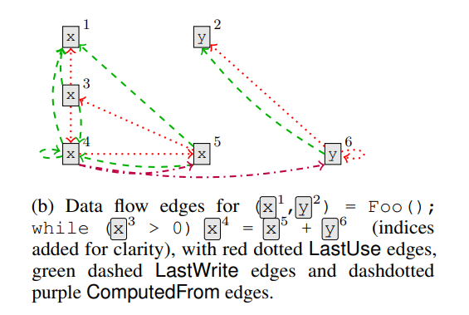
Data Flow
To capture the flow of control and data through a program, we add additional edges connecting different uses and updates of syntax tokens corresponding to variables.
*Learning to Represent Programs with Graphs.
M. Allamanis, M. Brockscmidt, M. Khademi. ICLR 2018

Slide 4
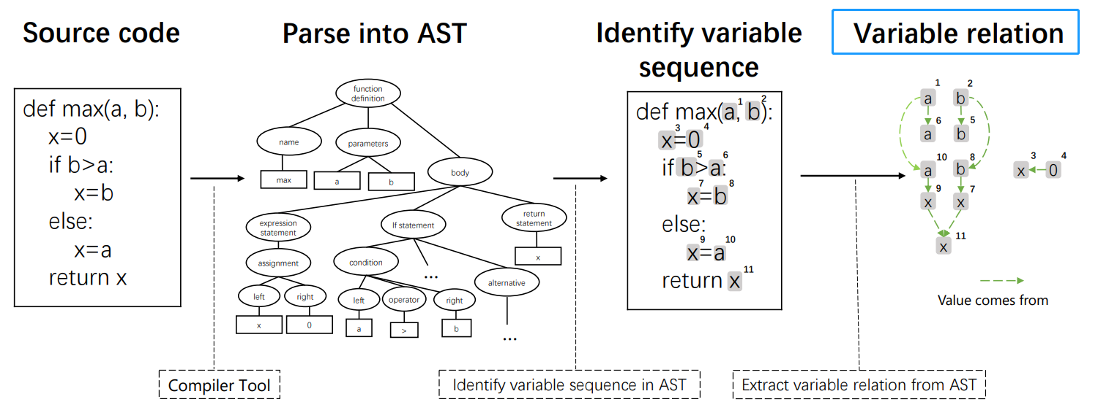
Data Flow
where the value comes from

Slide 5
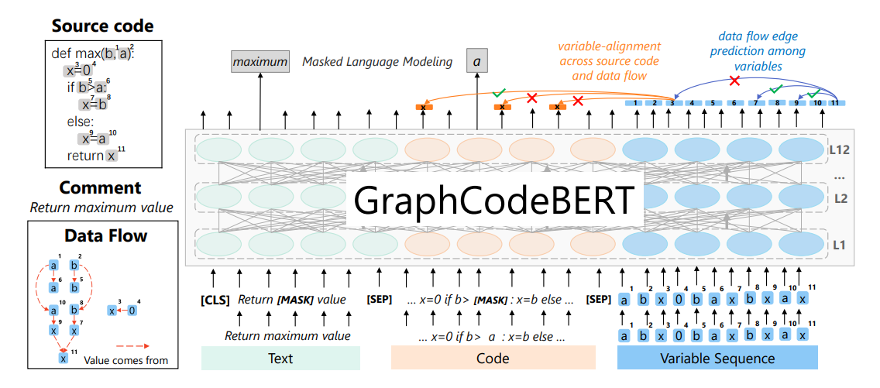
GraphCodeBERT
The model takes source code paired with comment and the corresponding data flow as the input, and is pre-trained using standard masked language modeling (Devlin et al., 2018) and two structure-aware tasks. One structure-aware task is to
predict where a variable is identified from (marked with orange lines) and the other is data flow edges prediction between variables (marked with blue lines).

Slide 6
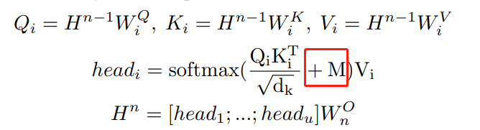
Masked Attention
W: comment
C: source code
E: relation between nodes of the data flow
E’: relation between source code tokens and nodes of the data flow

Slide 7
Pre-trained Tasks
Masked Language Model
Edge Prediction -- “where-the-value-comes-from”
randomly sample 20% of nodes in data flow, mask direct edges connecting these sampled nodes by add an infinitely negative value in the mask matrix, and then predict these masked edges.

Slide 8
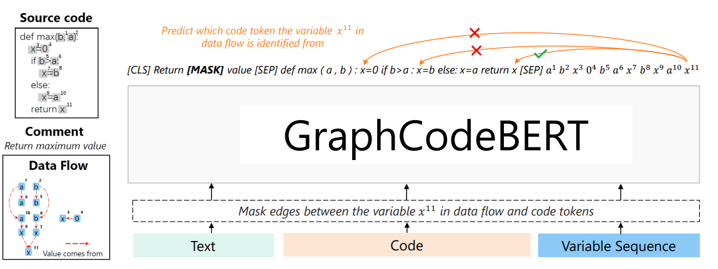
Pre-trained Tasks
Node Alignment
predict edges between code tokens and nodes

Slide 9
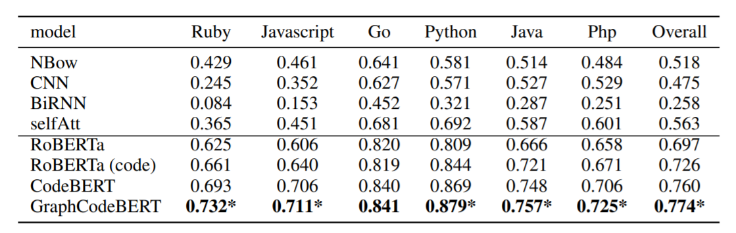
Experiments
Code Search – CodeSearchNet
RoBERTa (code) is pre-trained only on code.

Slide 10
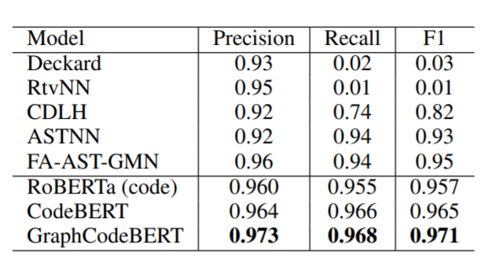
Experiments
Code Clone Detection – BigCloneBench

Slide 11
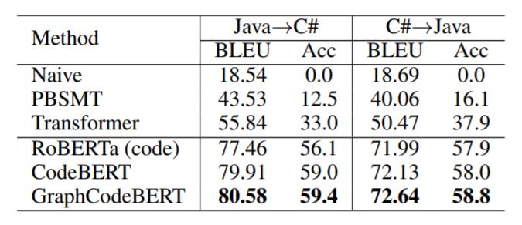
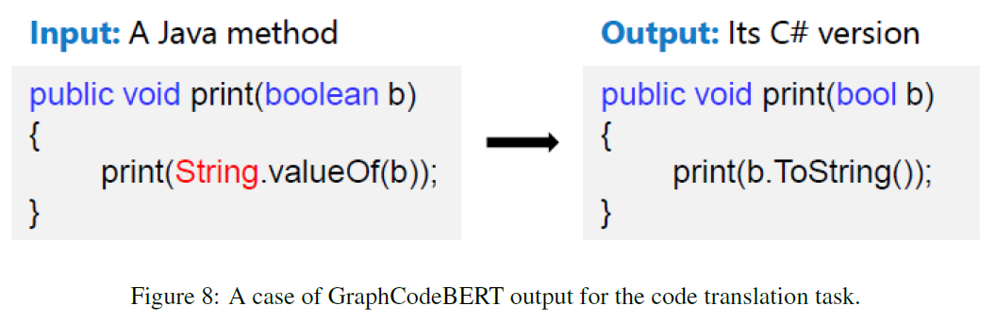
Experiments
Code Translation
Tree-to-tree neural networks for program translation. NIPS 2018

Slide 12
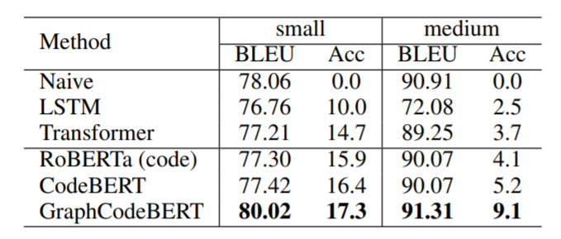
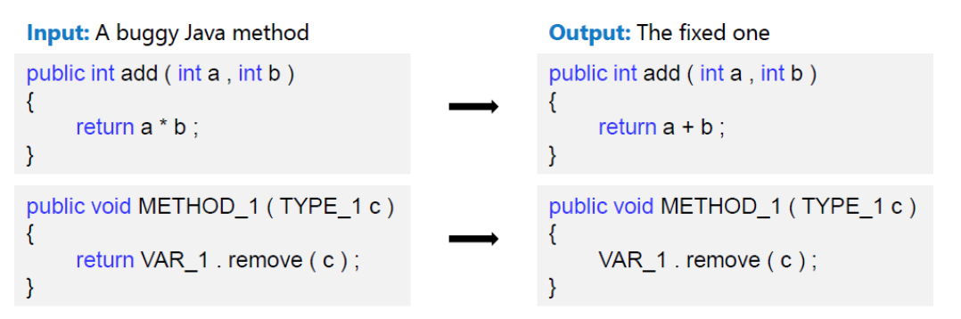
Experiments
Code Refinement
An empirical study on learning bug-fixing patches in the wild via neural machine translation. TOSEM 2019

Slide 13
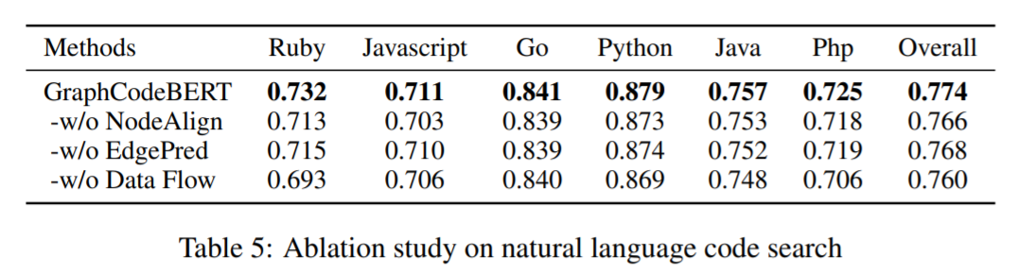
Analysis
Ablation Study

Slide 14
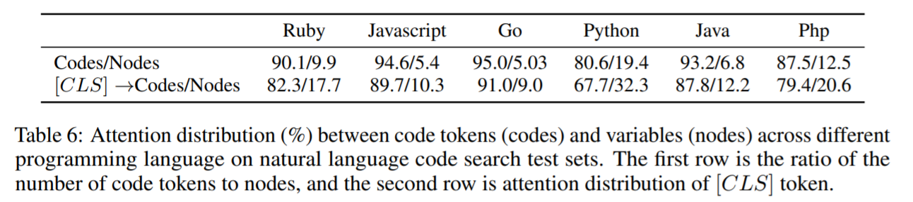
Analysis
Node-vs. Token-level Attention
We see that although the number of nodes account for 5% to 20%, attentions over nodes overwhelm node/code ratio (around 10% to 32%) across all programming languages.

Slide 15
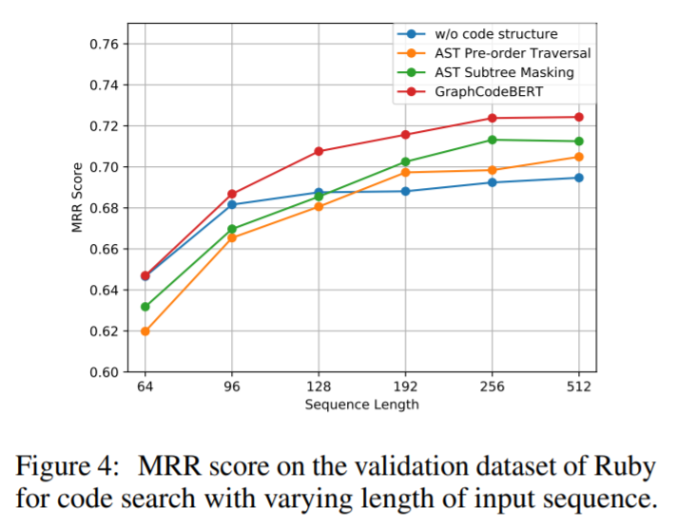
Analysis
Comparison between AST and Data Flow
Tree-structured attention with hierarchical accumulation. ICLR 2019.

Slide 16
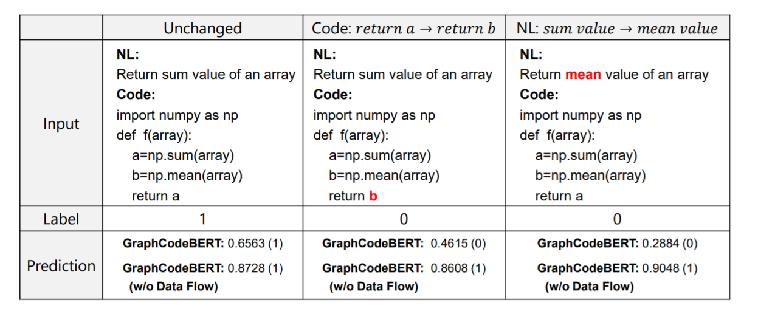
Analysis
Case Study

