Slide 1
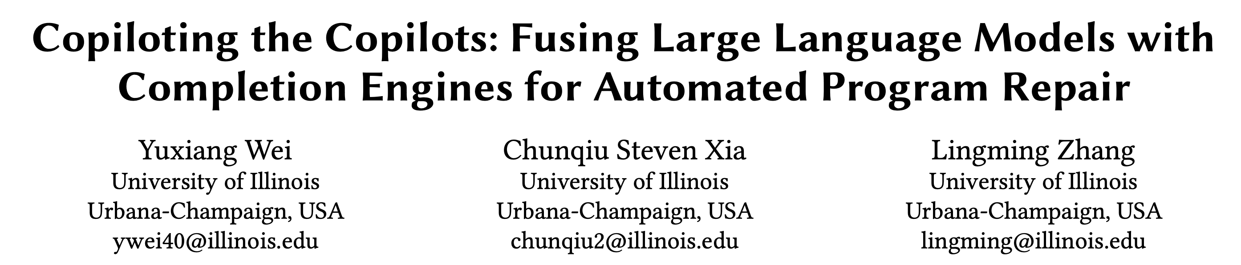
Accepted by FSE 2023
Reporter: Jia Li♂
2023.12.5

Slide 2
Abstract
Motivation
LLMs have shown impressive results in program repair.
Most LLMs ignore the underly semantics constraints, leading to invalid patches (e.g., unreal functions).
Contribution
Repilot
Introducing a static analysis-based completion engine to enhance LLMs
Higher Accuracy, Faster

Slide 3
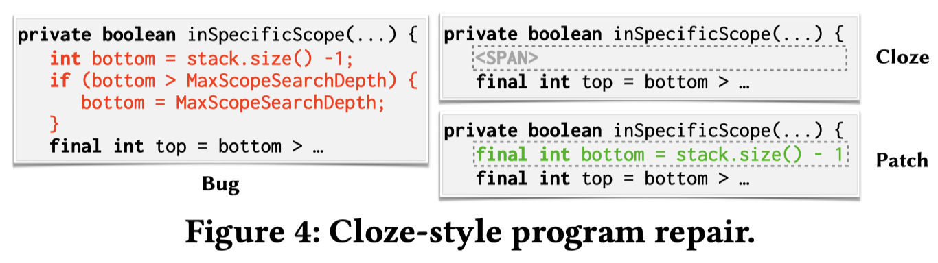
Background
Automatic Program Repair (APR)
Transform a buggy code snippet into a fixed version.
Single-hunk (this paper), Multi-hunk bugs
APR via Large Language Models (LLMs)
A cloze-style (or infilling) task
AlphaRepair (FSE 2022)
Notes:
代码修复的定义；分为单块和多块修复，不是单行/多行
如何利用LLMs来做程序修复，目前的解决方案是通过构造完形填空形式的prompt。
介绍图片

Slide 4
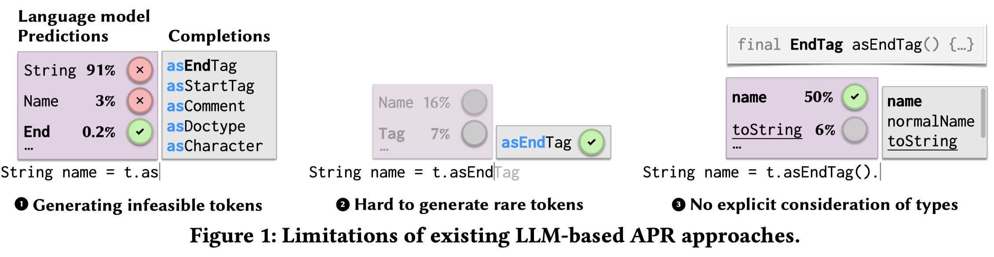
Motivating Examples
Without semantic understanding of the code, LLMs may generate incorrect patches.
Generating infeasible tokens
Hard to generate rare tokens
No explicit consideration of types
Notes:
但是LLMs只是把代码当成普通的文本序列，并没有充分地理解其中的语义。这导致LLMs在程序修复中，容易生成一些不正确的补丁。
分别介绍三类incorrect patches的含义

Slide 5
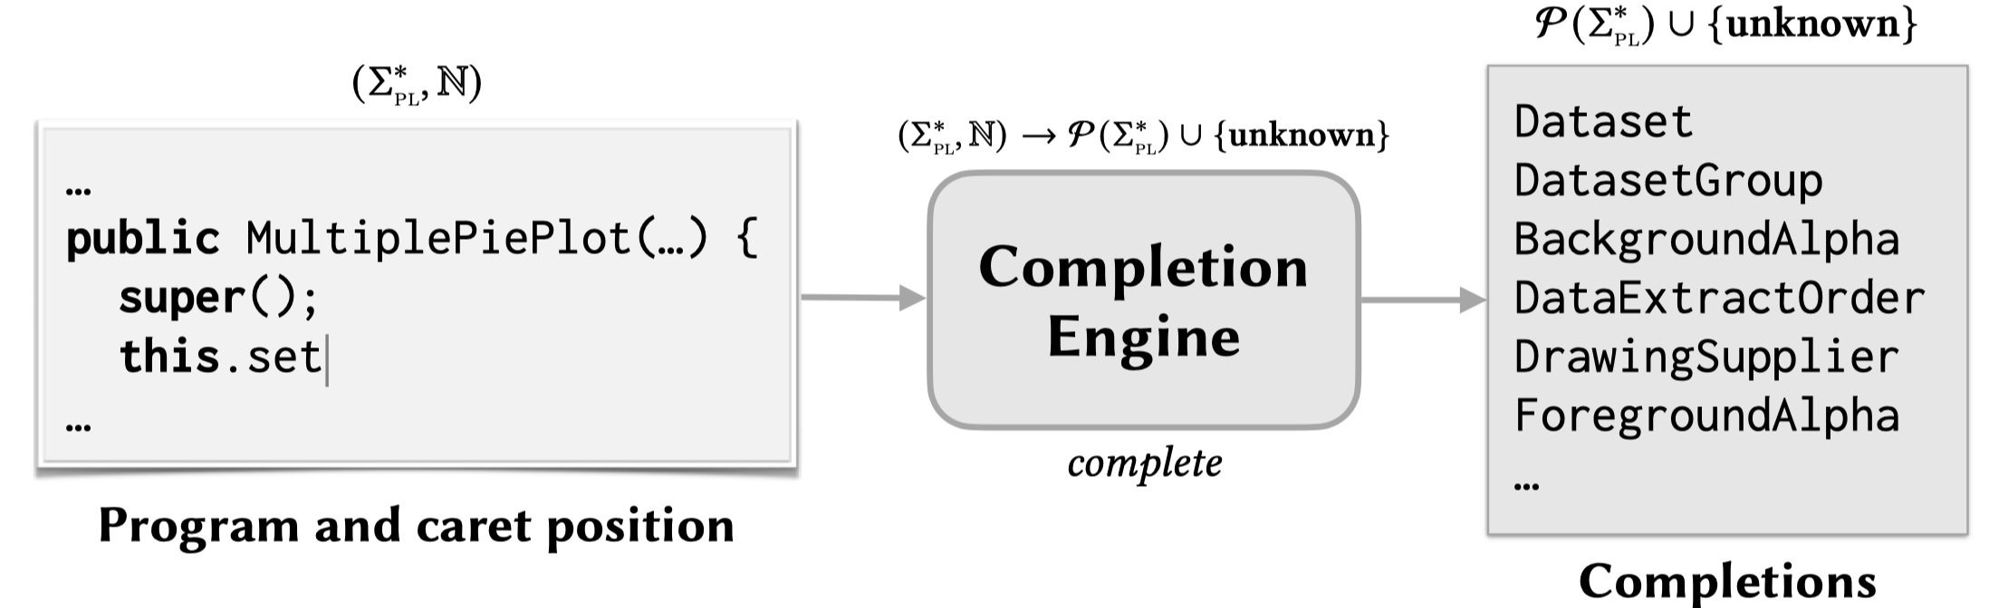
Motivating Examples
A static analysis-based completion engine
Know the global information of the entire project
Output valid suggestions based on a incomplete code snippet
Unknown (e.g., variable declaration)
Plausible suggestions
Notes:
实际上，我们可以利用静态分析技术来获取项目信息。
本文设计了一种基于静态分析的completion engine，它具有以下特性。

Slide 6
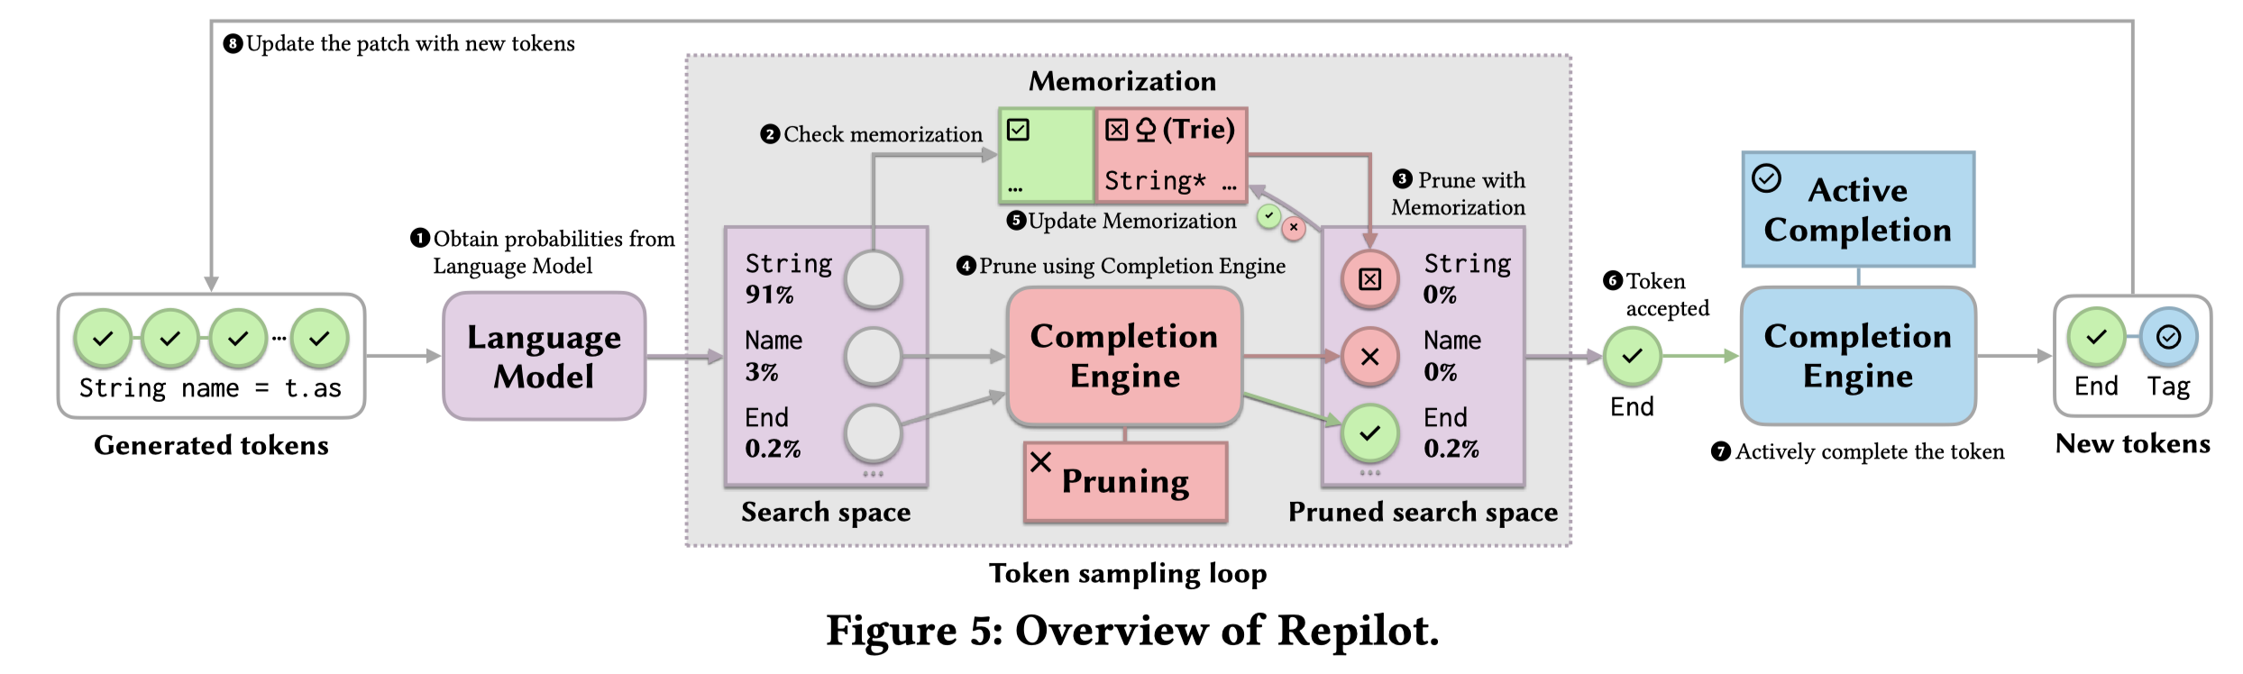
Repilot
Fuse LLMs with Completion Engines
Notes:
本文的idea就是，将LLMs和上述的completion engine融合起来，互相帮助。
介绍整体流程

Slide 7
Repilot
Fuse LLMs with Completion Engines (CE)
CE-Guided Search Space Pruning
Notes:
第一个创新点，基于completion engine对LLMs的输出分布进行裁剪

Slide 8
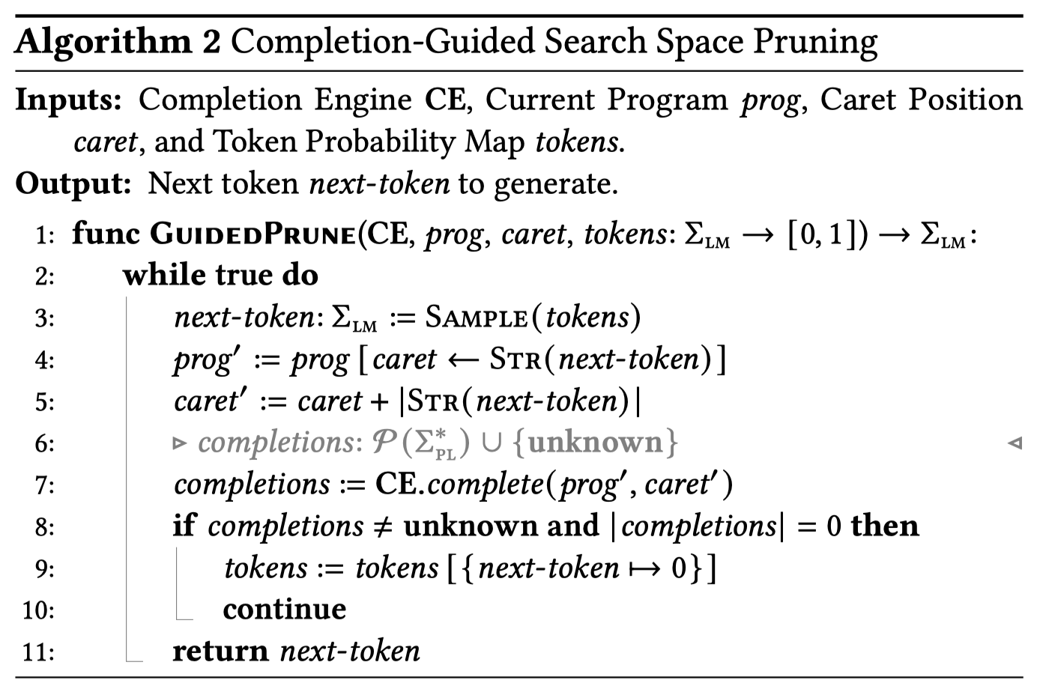
Repilot
CE-Guided Search Space Pruning
Notes:
算法如图所示。
重点解释第8行

Slide 9
Repilot
Fuse LLMs with Completion Engines (CE)
Reject tokens and Accepted tokens
Memorization for Faster Search
Notes:
为了加速裁剪算法，构造了一个记忆模块。用于存放之前已经被接受/拒绝的tokens

Slide 10
Repilot
Fuse LLMs with Completion Engines (CE)
Active Completion for Rare Tokens
Notes:
最后，作者设计了一个active completion来辅助生成一些比较长的、低频的tokens

Slide 11
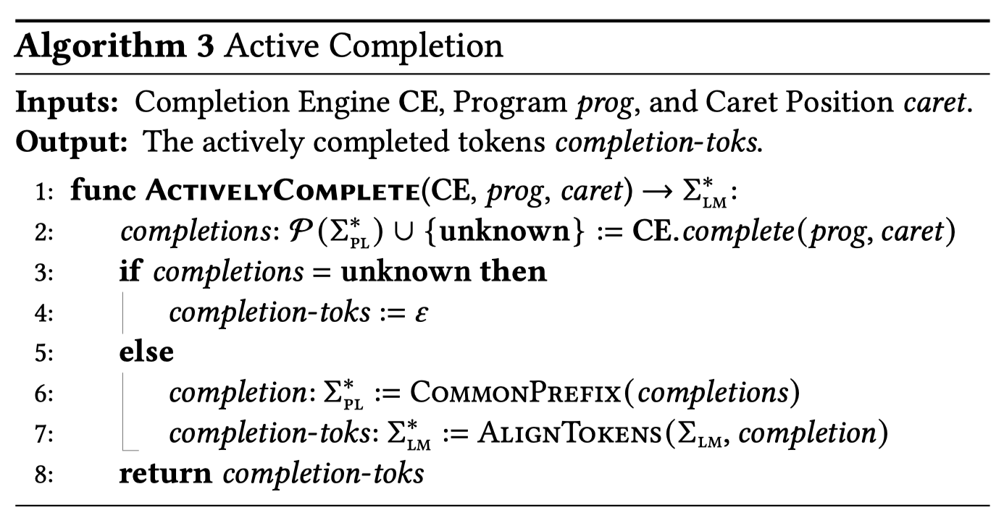
Repilot
Active Completion for Rare Tokens
Notes:
算法如图所示

Slide 12
Experimental Setup
Research questions
RQ1: How does Repilot’s bug ﬁxing capability compare with state-of-the-art APR techniques?
RQ2: How effective is Repilot in improving the compilation rate of patch generation?
RQ3: Are all components of Repilot making positive contributions to its effectiveness?
RQ4: Can Repilot generalize to different subjects of bugs and models?

Slide 13
Experimental Setup
Implementation Detailes
LLMs
CodeT5-large (770M), InCoder (6.7B)
Temperature = 1, sample 5000 times per bugs
Completion Engine
A modified version of the Eclipse JDT Language Server in Java
Datasets
Defect4J 1.2, 138 single-hunk bugs
Defect4J 2.0, 135 single-hunk bugs

Slide 14
Experimental Setup
Baselines
Traditional APR tools
PraPR, Tbar, AVATAR, SimFix, FixMiner, CapGen, JAID, SketchFix, NOPOL, jGenProg, jMutRepair, and jKali
NMT-based APR tools
RewardRepair, Recoder, CURE, CoCoNuT, DLFix, and SequenceR
LLMs-based APR tools
AlphaRepair

Slide 15
Experimental Setup
Evaluation Metrics
Patch compilation rate
The percentage of compilable patches in all generated patches.
Plausible patches
Patches that pass all test cases but may violate the real user intent. (Automatic)
Correct patches
Patches that are semantically equivalent to the developer patch. (Manual)

Slide 16
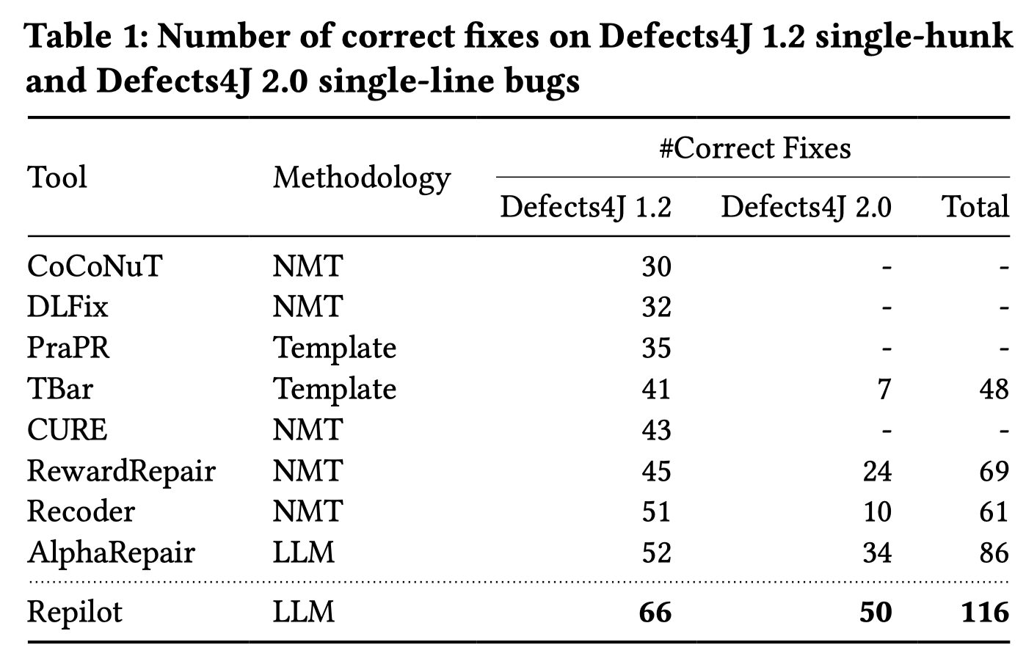
Experimental Results
RQ1: Repilot vs. state-of-the-art APR techniques
Notes:
在三个数据集上，解决的bug数量最多

Slide 17
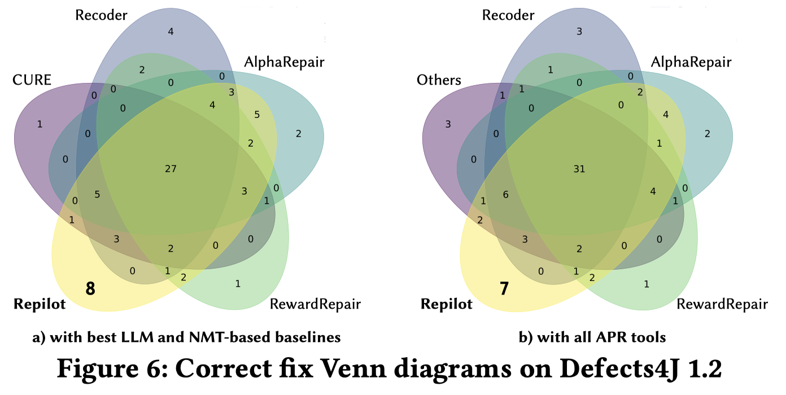
Experimental Results
RQ1: Repilot vs. state-of-the-art APR techniques
Notes:
在两个数据集上，额外解决了新的bugs

Slide 18
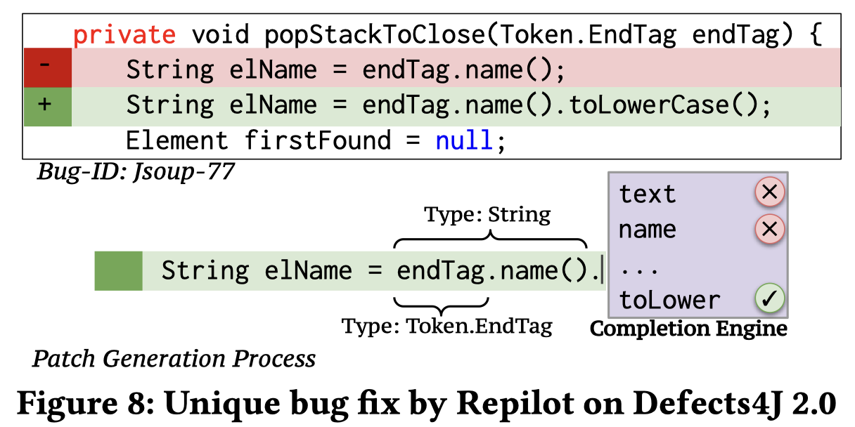
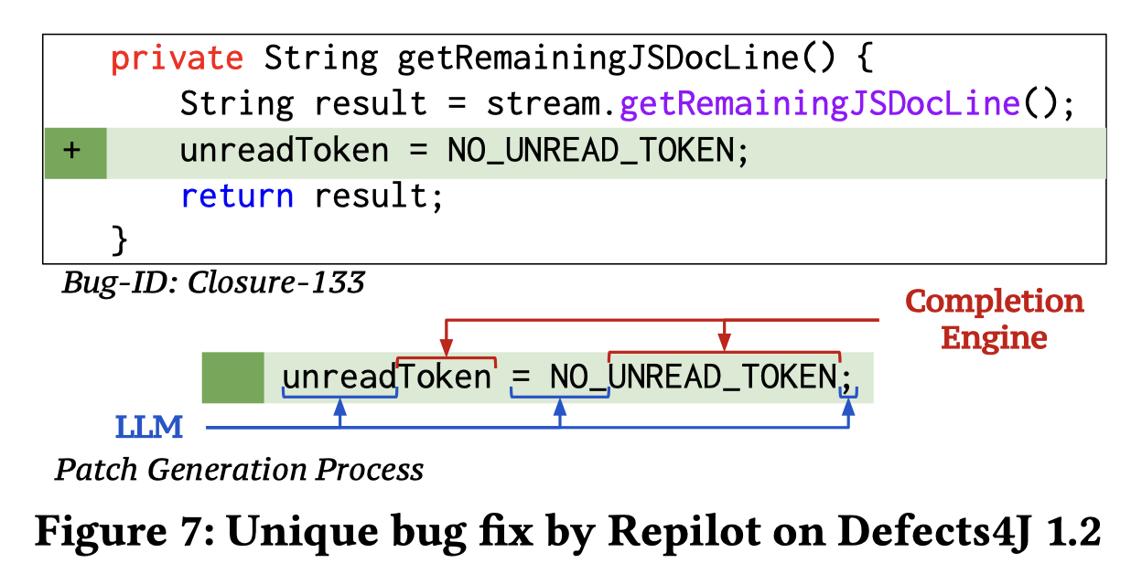
Experimental Results
RQ1: Repilot vs. state-of-the-art APR techniques
Notes:
两个cases展示Repilot的优势。
Figure 8，基于类型信息对LLMs的输出进行约束。
Figure 7，active completion一次性生成一个较长的identifier

Slide 19
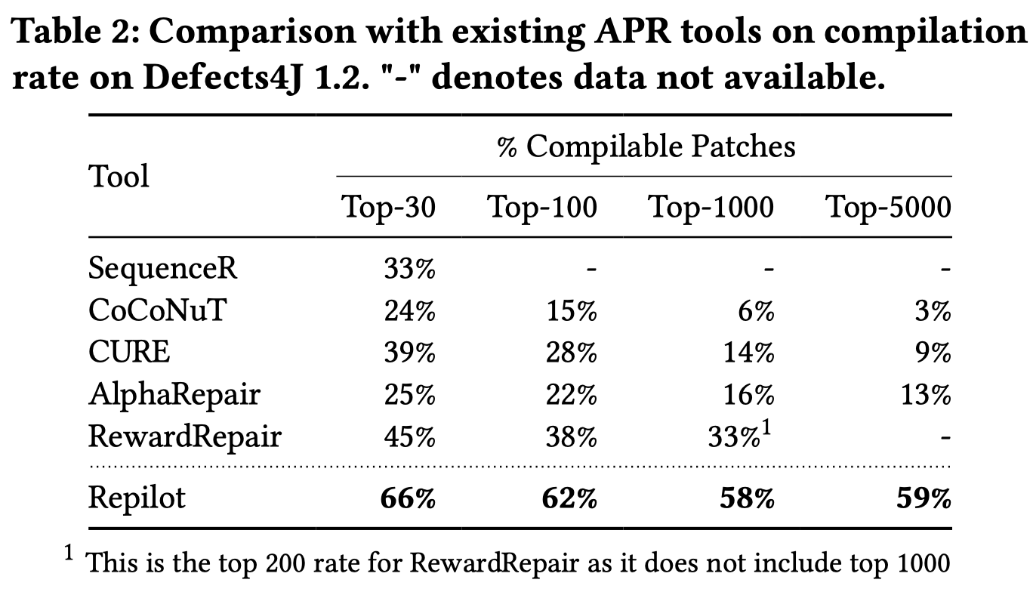
Experimental Results
RQ2: Compilation Rate Analysis
Notes:
生成更多可以通过编译的patches，也是说明：合法的patches更多了

Slide 20
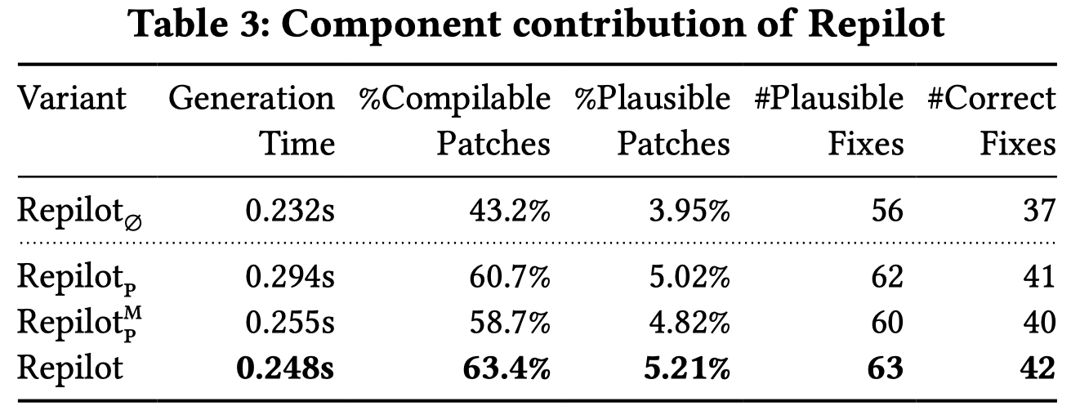
Experimental Results
RQ3: Ablation Study
Original LLMs
+pruning
+pruning+memorization
+pruning+memorization+active completion
Notes:
消融实验。
Pruning显著提升了准确率，也带了额外的计算开销。
Memorization降低了开销。
Active completion进一步提升了准确率

Slide 21
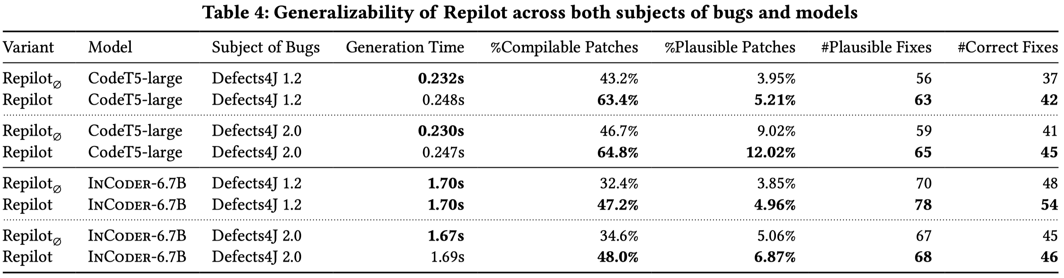
Experimental Results
RQ4: Generalizability
Notes:
在不同的LLMs和数据集上都具有稳定的提升

Slide 22
Conclusion
Advantage
Utilize static analysis techniques to enhance LLMs, obtaining reliable patches
Traditional tools for trivial tokens, LLMs for difficult tokens
Weakness
Lack implementation details of completion engines

