Slide 1
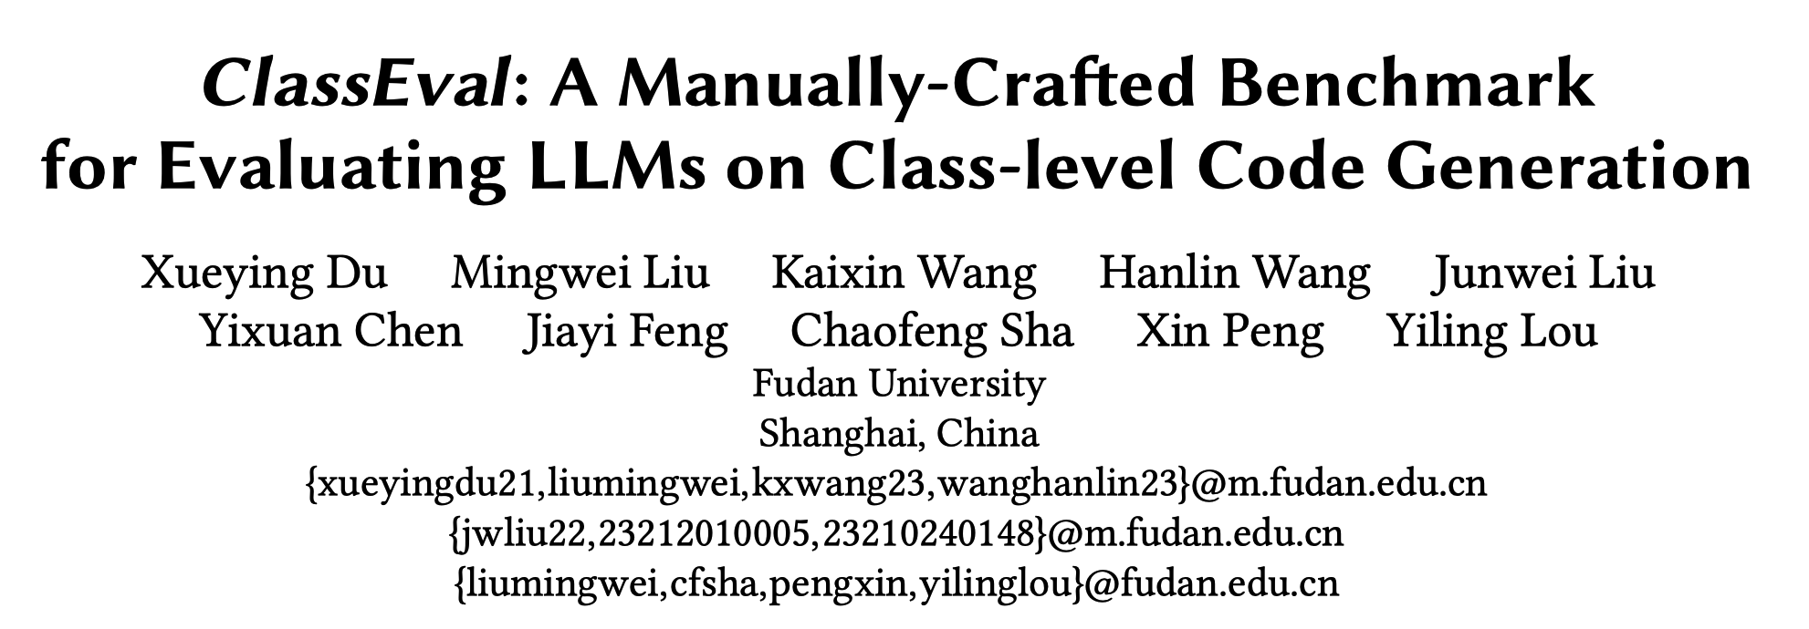
arXiv

Slide 2
Abstract
Motivation
Existing code generation benchmarks focus on standalone function generation.
It is unclear how LLMs perform on generating more complicated code, such as a class.
Contribution
ClassEval, a class-level code generation benchmark containing 100 human-written Python classes.
A large-scale study to evaluate 11 LLMs on class-level code generation.

Slide 3
Motivation
Code Generation
GPT-4, ChatGPT, StarCoder
Evaluation Benchmarks
Function-level benchmarks
Requirement -> A standalone function
HumanEval, MBPP
Limitations
The length of code is short
HumanEval: 11.5 lines and 24.4 tokens on average
The code is standalone
~70% of functions are dependent to other functions in real-world projects

Slide 4
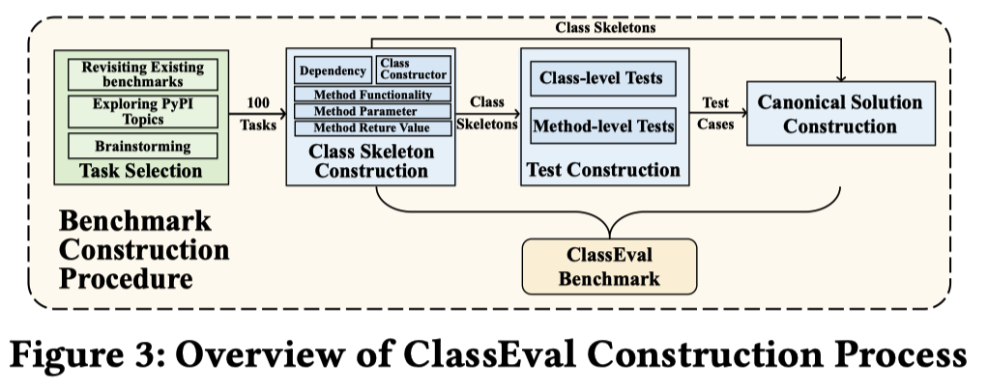
ClassEval
The first class-level code generation benchmark
It takes ~500 person-hours to construct 100 Python coding tasks.
Benchmark Format
Benchmark Construction
Task Selection
Class Skeleton Construction
Test Construction
Canonical Solution Construction
Benchmark Characteristics

Slide 5
ClassEval
The first class-level code generation benchmark
It takes ~500 person-hours to construct 100 Python coding tasks.
Benchmark Format
Benchmark Construction
Task Selection
Class Skeleton Construction
Test Construction
Canonical Solution Construction
Benchmark Characteristics

Slide 6
Benchmark Format
A coding task
A class skeleton describing the target class
A canonical solution, i.e., a standalone class
A test suite
Notes:
Benchmark的基本单元是一个编程任务

Slide 7
ClassEval
The first class-level code generation benchmark
It takes ~500 person-hours to construct 100 Python coding tasks.
Benchmark Format
Benchmark Construction
Task Selection
Class Skeleton Construction
Test Construction
Canonical Solution Construction
Benchmark Characteristics

Slide 8
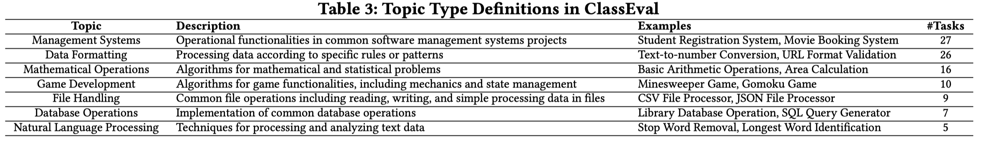
Benchmark Construction – Task Selection
Class-level coding task
A unique class description
Inclusion Sources
Existing benchmarks, e.g., HumanEval, MBPP
PyPI, a community containing many Python software packages
Brainstorming
Exclusion Criteria
Tasks that have complicated dependencies
E.g., Network Programming, GUI Design, …
Finally, authors obtain 100 class-level coding tasks.
Notes:
第一步是挑选合适的编程任务，就是人工地撰写需求，来描述目标类的功能特性。

Slide 9
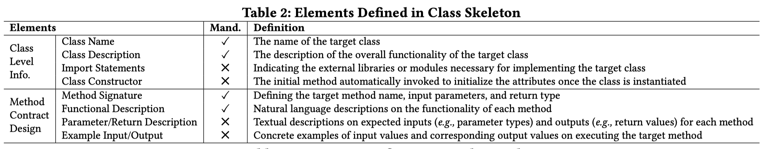
Benchmark Construction – Class Skeleton Construction
Class Skeleton
A structured blueprint for the target class
Class-level and Method-level information
Notes:
之后，作者为每一个编程任务撰写一个skeleton。Skeleton可以看做是目标类的一个结构化蓝图，其中包含了目标类的信息和成员方法的信息。
表2中展示了具体细节。

Slide 10
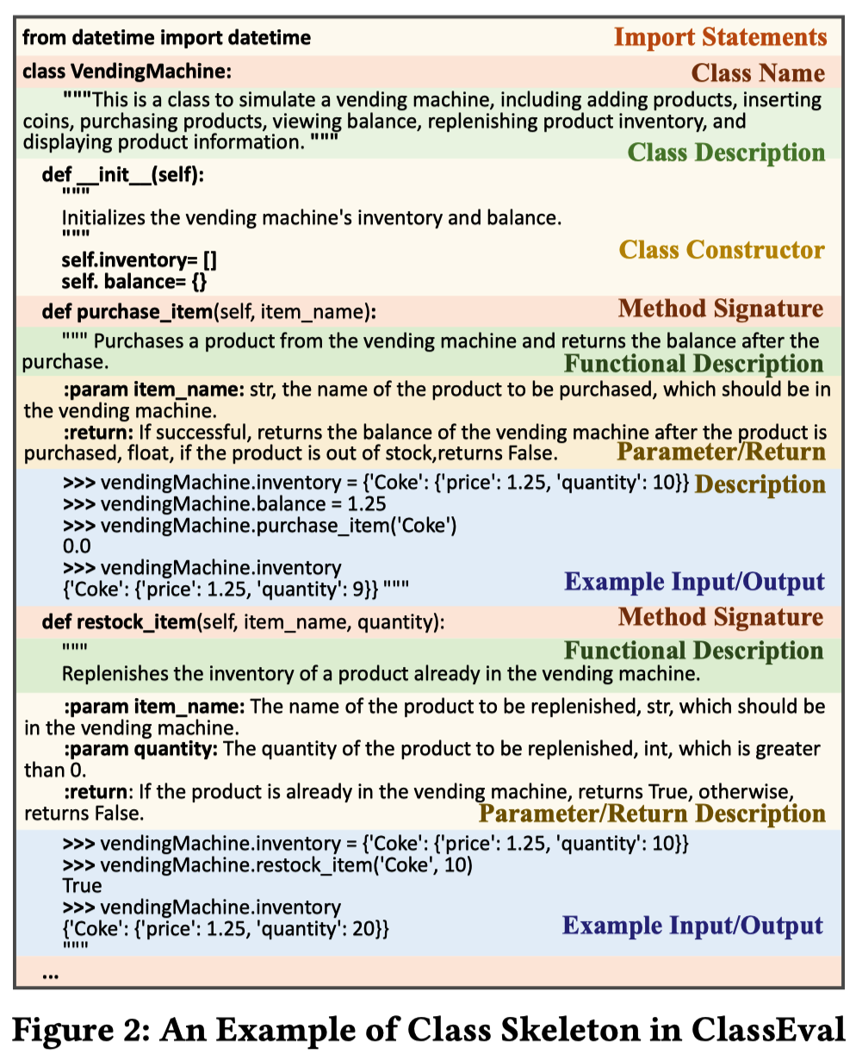
Benchmark Construction – Class Skeleton Construction
A Class Skeleton
A participant for writing class skeletons
The other participant for double-checking skeletons
Finally, authors write a class skeleton for each coding task.
Notes:
图2是一个class skeleton的示例。

Slide 11
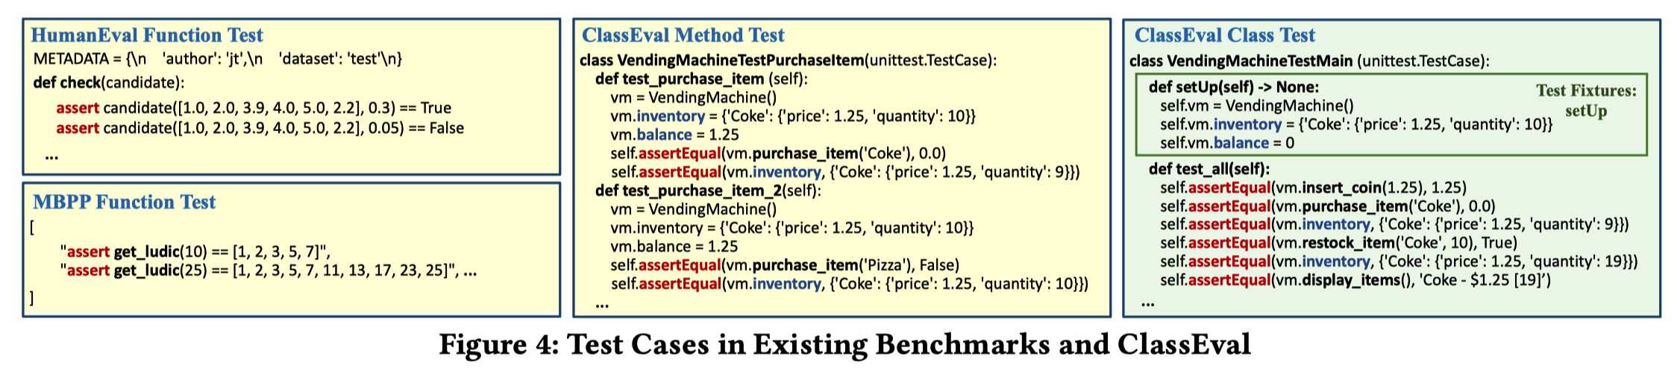
Benchmark Construction – Test Construction
Method-level Tests
Individually check the correctness of each methods in the class
Class-level Tests
Evaluate the correctness of the class by invoking methods sequentially together.
Notes:
Method-level tests聚焦于单独地测试每个成员函数的正确性。Class-level tests在这个基础上进一步考虑了不同函数之间的交互。

Slide 12
Benchmark Construction – Canonical Solution Construction
Four participants manually write the canonical solution for each coding task based on its constructed class skeleton and test cases.

Slide 13
ClassEval
The first class-level code generation benchmark
It takes ~500 person-hours to construct 100 Python programming problems.
Benchmark Format
Benchmark Construction
Task Selection
Class Skeleton Construction
Test Construction
Canonical Solution Construction
Benchmark Characteristics
Notes:
目前主流的代码补全模型都是基于Transformer的。
其中self-attention是关键，但标准的self-attention的时间复杂度比较高，O(n^2)，n是指输入代码的长度。
这导致Transformer很难用于长代码的建模。

Slide 14
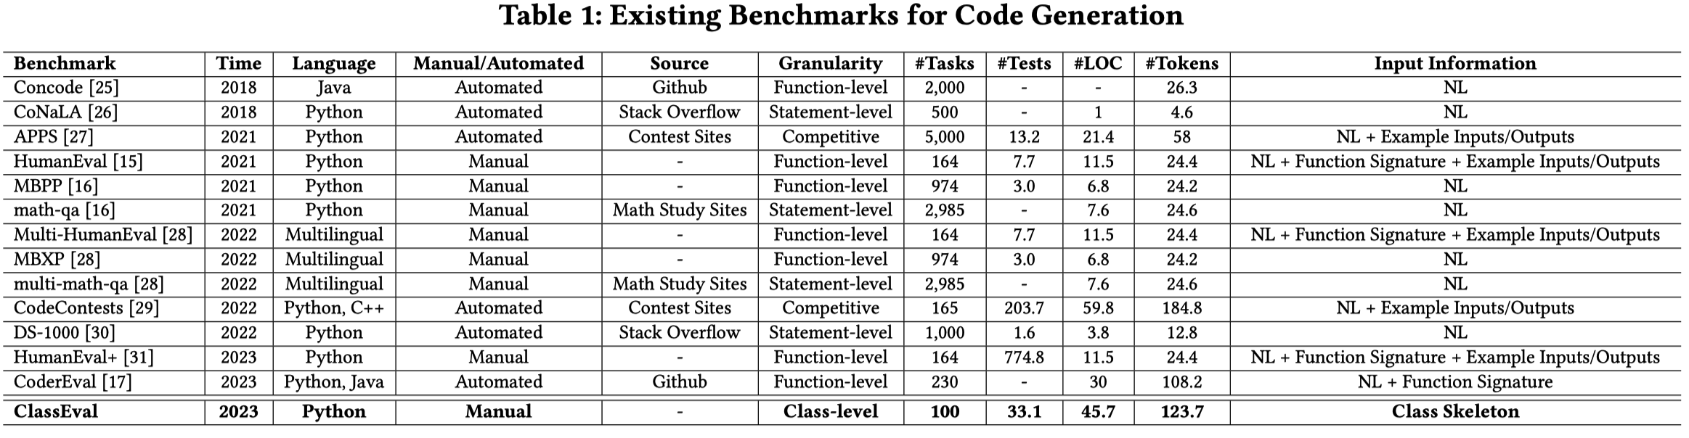
Benchmark Characteristics
Scale
100 Python classes and 412 methods
Notes:
首先是，数据集的规模。
Table 1对比了ClassEval和已有benchmark。
ClassEval的代码更长，更复杂

Slide 15
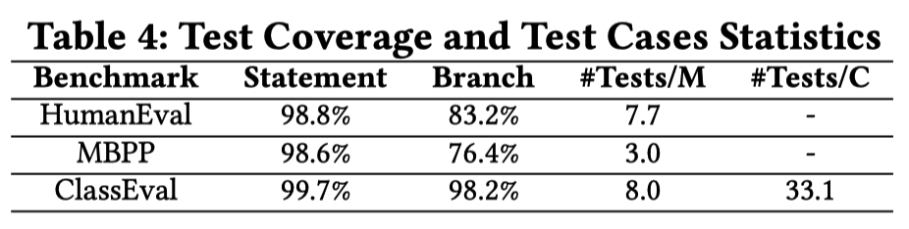
Benchmark Characteristics
Test Sufficiency
Statement-level and Branch-level coverage
#Tests/M: average number of method-level tests
#Tests/C: average number of class-level tests
Notes:
测试数据质量较高。
语句和分支覆盖率都接近100%

Slide 16
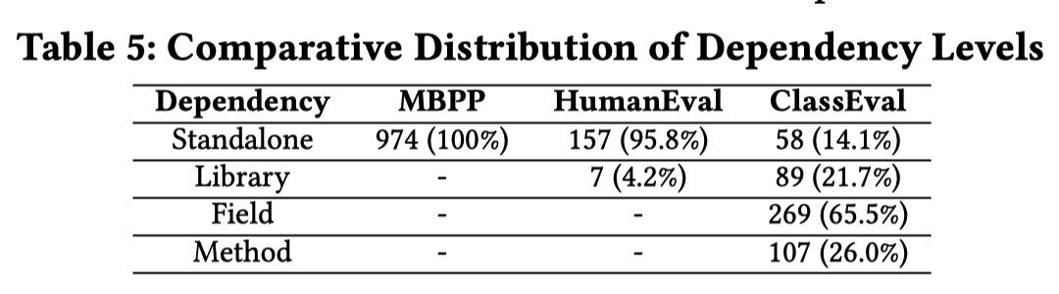
Benchmark Characteristics
Dependency
Library Dependency, where methods rely on external libraries
Field Dependency, where methods depend on class instance variables
Method Dependency, where methods rely on other methods within the same class
Notes:
其中存在多种类型的上下文依赖

Slide 17
Empirical Study
Research Questions
RQ1 (Overall Correctness): how do LLMs perform on class-level code generation?
RQ2 (Generation Strategies): how do different generation strategies perform for LLMs on class-level code generation?
RQ3 (Dependency Generation): how do LLMs perform on generating code dependent to other contexts during class-level code generation?
RQ4 (Bad Case Analysis): what are the common errors during class-level code generation?

Slide 18
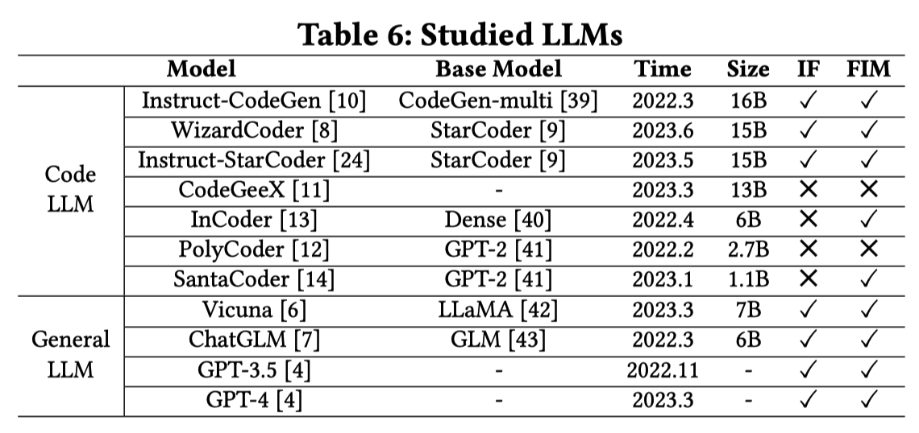
Empirical Study
Studied LLMs
11 LLMs with 1B ~ 20B parameters
Notes:
作者认为低于1B的是小模型，超过20B的过大，计算资源不足

Slide 19
Evaluation Metrics
Method-level Pass@k
A method-level sample is deemed correct if it passes all the method-level test cases.
Class-level Pass@k
A class-level code sample is deemed correct if it passes all the method-level and classlevel test cases

Slide 20
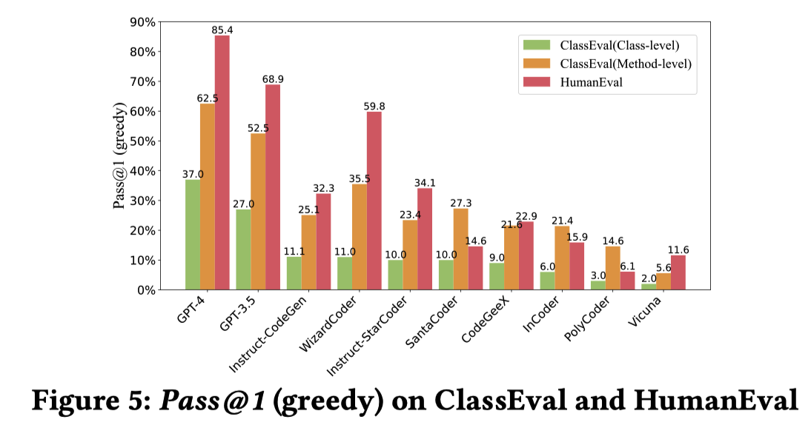
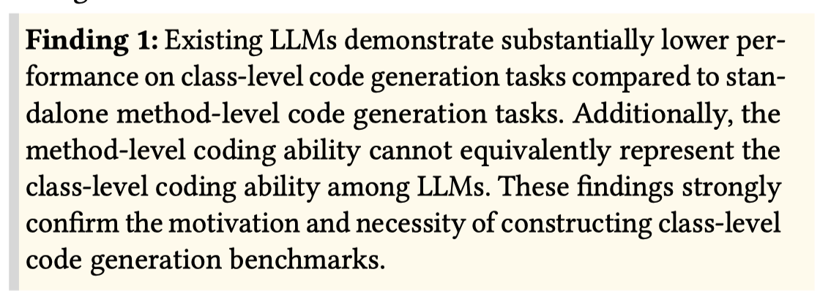
RQ1: Overall Correctness
Notes:
图5展示了不同LLMs在HumanEval和ClassEval上的Pass@1。从这张图上，我们有两点发现：
（1）所有的LLMs在ClassEval上的class-level和function-level准确率都有下降；
Class-level tests效果差，自然是因为需要解决的问题更难。function-level tests上也有下降，this drop could be attributed to the complexity of generating code that depends on other context, which is known to be more challenging than generating standalone code.
（2）此外，function-level上的准确率，并不能反映class-level上的准确率。例如WizardCoder和Instruct-CodeGen…

Slide 21
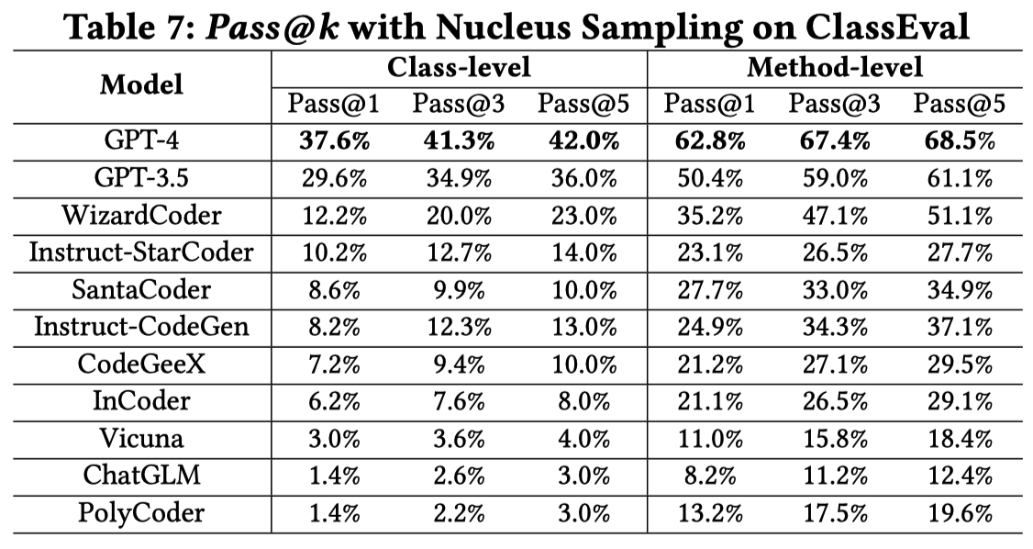
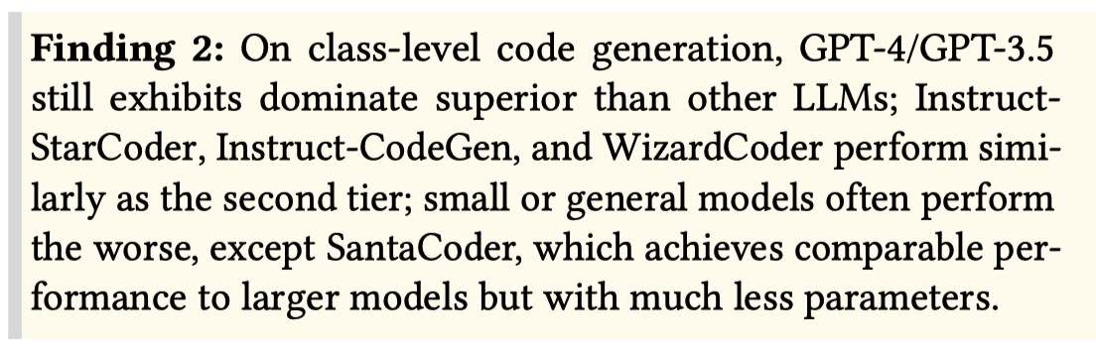
RQ1: Overall Correctness
Notes:
Table 7展示了不同LLMs的Pass@1，3，5。从结果可以看出，GPT-4/GPT-3.5的效果最好，属于第一梯队；之后是WizardCoder、Instruct-StarCoder等指令微调模型；最后是普通的语言模型。

Slide 22
RQ2: Generation Strategies
Holistic Generation
Generate the entire class all at once with the class skeleton as inputs.
Incremental Generation
Generate the class in a method-by-method manner. Each iteration is based on the method bodies that have been generated in previous iterations.
Compositional Generation
Generate the class in a method-by-method manner. Each iteration is independent, without considering the other generated methods.
Notes:
第二个RQ，是探究不同生成策略对准确率的影响。
第一种策略…
第二种策略和第三种策略的不同在于，每次迭代时的输入不同。

Slide 23
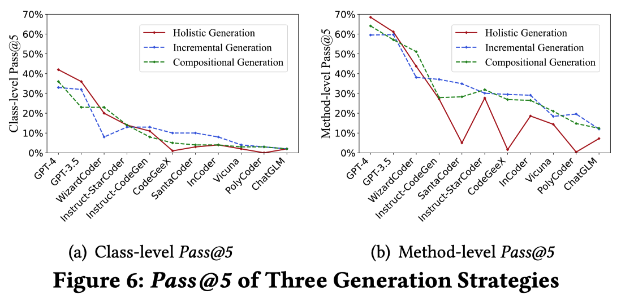
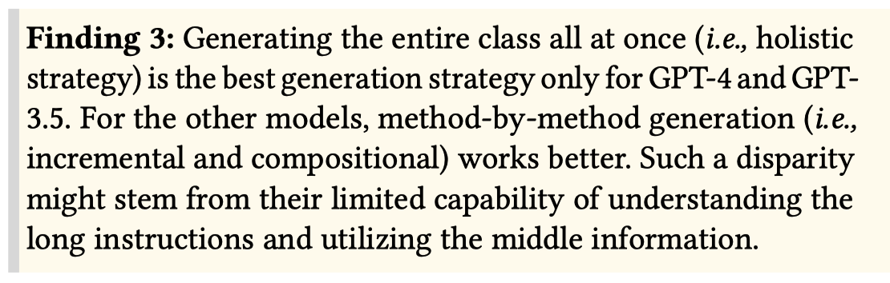
RQ2: Generation Strategies
Notes:
图中展示了不同生成策略的效果。可以看出，对于不同的LLMs来说，最优的生成策略是不同的。
GPT-4/GPT-3.5，一口气生成整个类，效果最好。这可能得益于它们更大的输入窗口，在长代码生成上表现较好。
对于其余的LLMs，method-by-method generation最好。

Slide 24
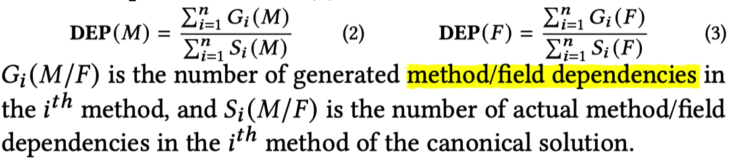
RQ3: Dependency Generation
A evaluation metric – DEP
The percentage of correct dependencies in generated methods
Method dependencies DEP(M) and field dependencies DEP(F)
Notes:
第三个RQ是为了衡量LLMs能否正确地生成代码中的上文依赖。
这里作者衡量的是，field和method依赖，并定义了两个基于Recall的指标

Slide 25
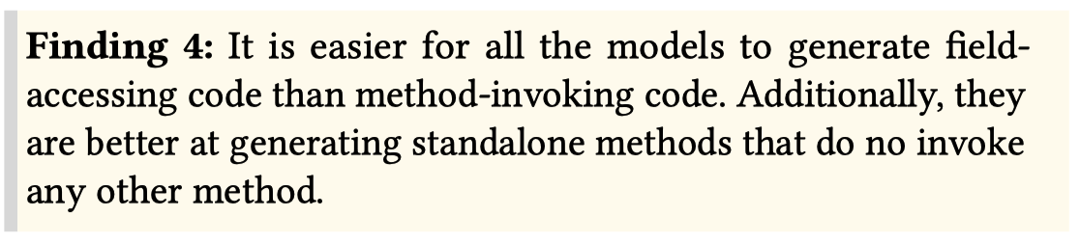
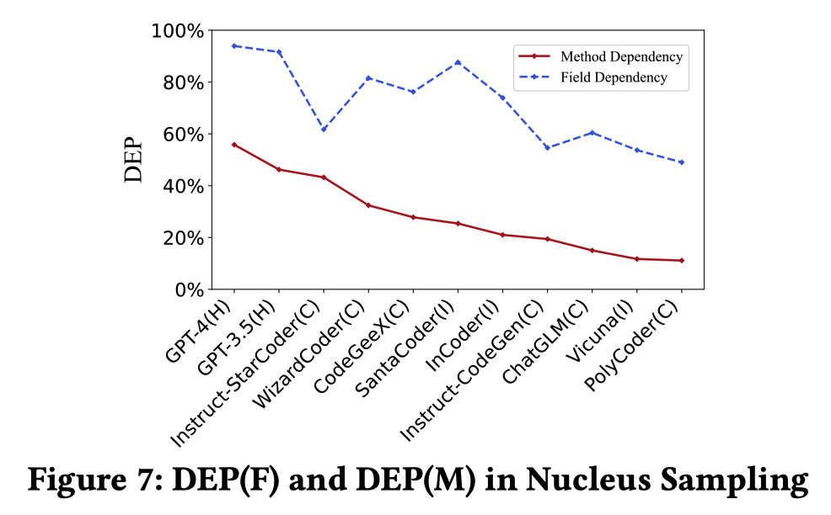
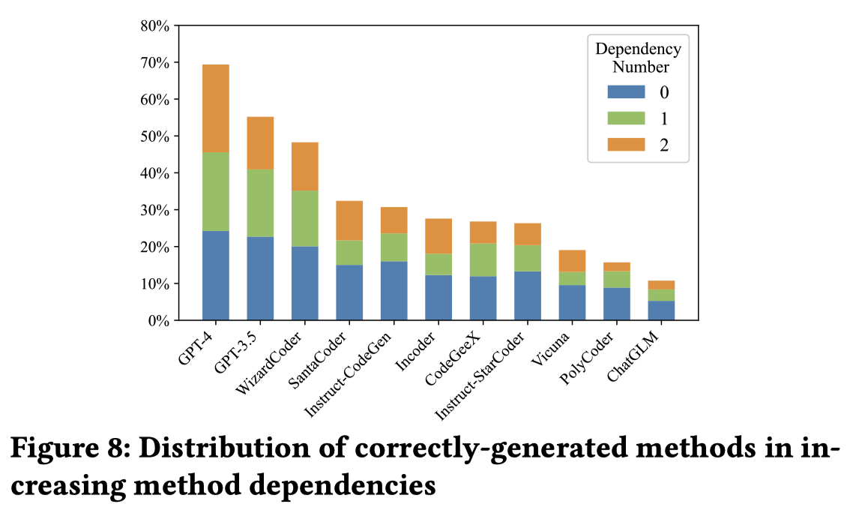
RQ3: Dependency Generation
Notes:
图7展示了不同LLMs在两种依赖上的表现。模型在field依赖上表现都还不错，method依赖相对较低。
图8展示了不同LLMs正确生成的代码中，依赖数据的分布。可以看出，模型还是更擅长生成standalone的代码，基于上文依赖的代码生成有待提升。

Slide 26
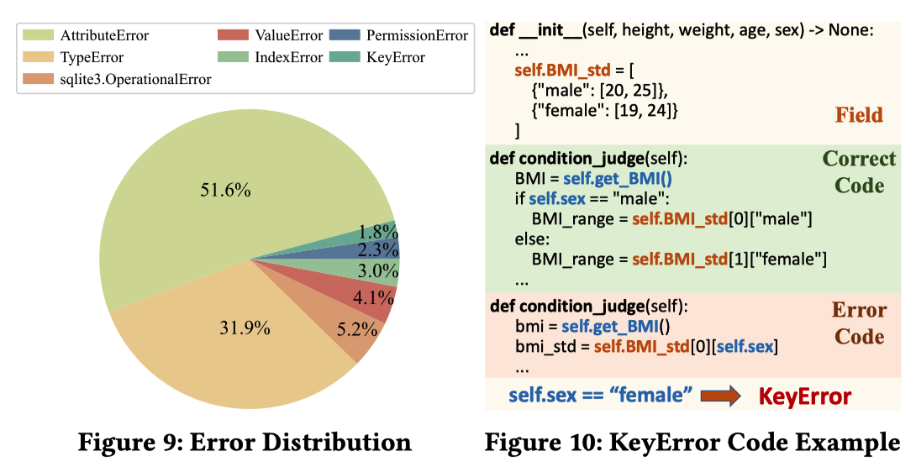
RQ4: Bad Case Analysis
Notes:
最后一个RQ，作者是探究了LLMs在ClassEval上常犯的一些错误，最大的两类错误时：AttributeError和TypeError。
但这里也没有具体说明，这两类错误具体反映了什么问题。只能说明，LLMs在生成代码时对于上下文的理解还需要提升，它们很可能会误解某些变量的类型，或者虚构出一些不存在的属性

Slide 27
Conclusion
The first class-level code generation benchmark – ClassEval
A large-scale empirical study to evaluate LLMs on class-level code generation
Limitation
Limited dependencies
E.g., Dependencies from other classes, other files.

