Slide 1
Adversary – Attack & Training
Zhang Huangzhao, Yuan Pei College

Slide 2
Overview
Adversarial examples
Genetic Attack
Alzantot, Moustafa, et al. "Generating natural language adversarial examples." arXiv preprint arXiv:1804.07998(2018).
HotFlip
Ebrahimi, Javid, et al. "Hotflip: White-box adversarial examples for text classification." arXiv preprint arXiv:1712.06751 (2017).

Slide 3
Adversarial Examples
What are adversarial examples?
Close to the original examples (perturbations or noises);
Mislead the model to give erroneous outputs;
Human beings can hardly distinguish them from the original ones.
Adversarial attack – generating adversarial examples
Black-box attack – the target model is in a black box.
White-box attack – the attacker has full access of the target model.
Adversarial training – enhance performance & robustness

Slide 4
Adversarial Examples (2)
Eg. Adversarial examples for MNIST.
The classification model reaches 95% test accuracy on MNIST easily.
The model classifies the adversarial examples to “1” – “9”, respectively.
Original 0’s
Generation process
Adversarial examples (1-9)
https://github.com/LC-John/Simple-Adversarial-Examples

Slide 5
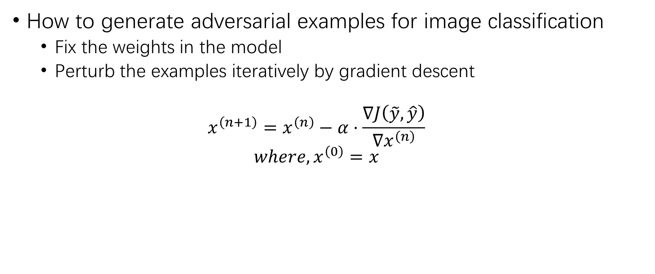
Adversarial Examples (3)
How to generate adversarial examples for image classification
Fix the weights in the model
Perturb the examples iteratively by gradient descent
$$x^{\left(n+1\right)}=x^{\left(n\right)}−α⋅\frac{∇J\left(\tilde{y}, \hat{y}\right)}{∇x^{\left(n\right)}}$$
$$where, x^{\left(0\right)}=x$$

Slide 6
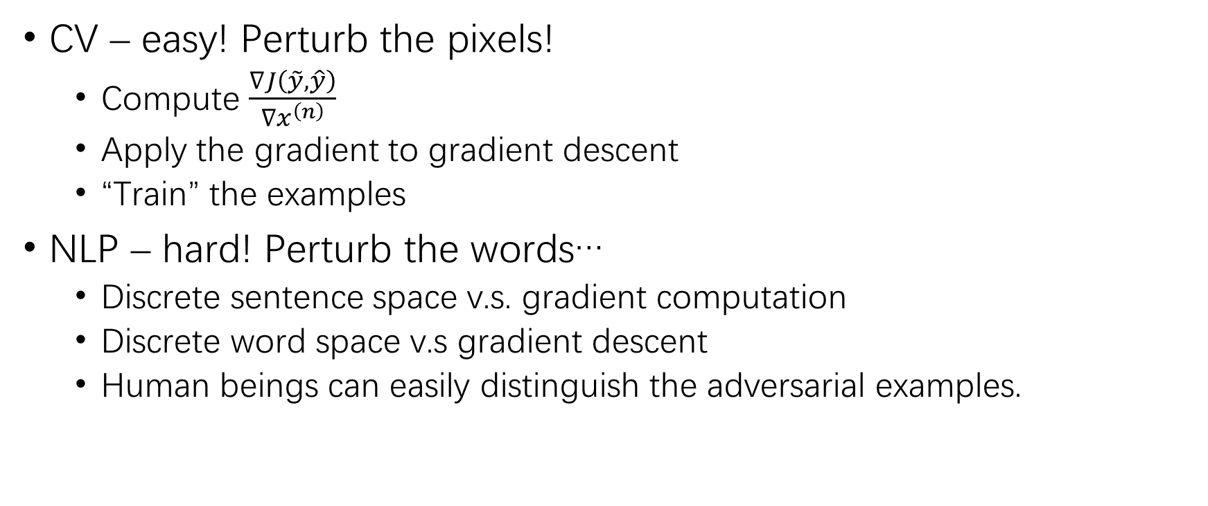
Adversarial Examples (4)
CV – easy! Perturb the pixels!
Compute $\frac{∇J\left(\tilde{y}, \hat{y}\right)}{∇x^{\left(n\right)}}$
Apply the gradient to gradient descent
“Train” the examples
NLP – hard! Perturb the words…
Discrete sentence space v.s. gradient computation
Discrete word space v.s gradient descent
Human beings can easily distinguish the adversarial examples.

Slide 7
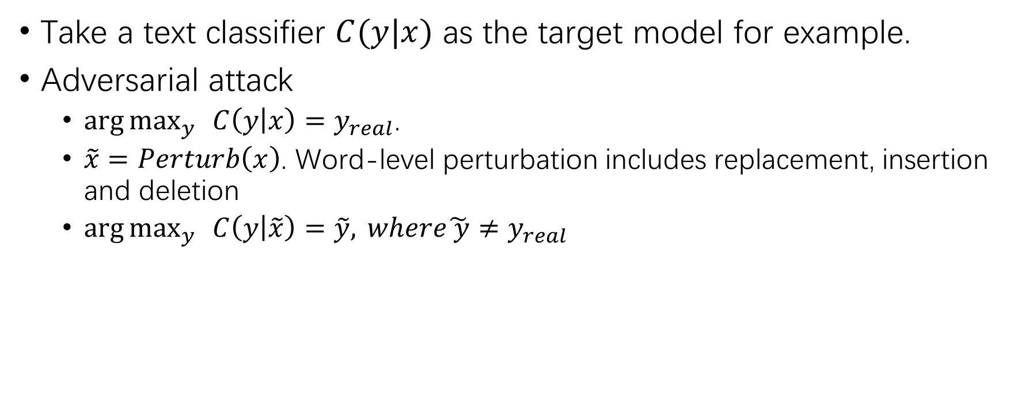
Adversarial Attack for NLP
Take a text classifier $C(y|x)$ as the target model for example.
Adversarial attack
$\arg{\max_{y}{ }}C\left(y | x\right)=y_{real}$.
$\tilde{x}=Perturb\left(x\right)$. Word-level perturbation includes replacement, insertion and deletion
$\arg{\max_{y}{ }}C\left(y | \tilde{x}\right)=\tilde{y}, where\tilde{ y}≠y_{real}$
i
really
love
this
movie
Sentiment
Classifier
<pos> 93%
i
truly
love
this
movie
<pos> 79%
i
truly
love
the
movie
<pos> 63%
i
truly
love
the
film
<neg> 59%

Slide 8
Adversarial Attack for NLP (2)
Black-box attack – eg. Attacking an online spam mail classifier.
The attacker is not allowed to have access to the parameters, the hyper-parameters, even the architecture structures of the target model.
The attacker is only allowed to feed the sentence examples into the target model and receive the output probabilities.
White-box attack
The attacker have full access to the parameters, the hyper-parameters of the target model.
The attacker is allowed to feed the sentence examples into the target model and receive the output probabilities or the gradients of any layer.

Slide 9
Adversarial Training
Procedure
Train a model;
Generate adversarial examples with the training set;
Mix the training examples with the adversarial examples;
Train the target model from scratch on the updated training set.
Goal – modify the classification hyperplane.
Enhance performance – better test accuracies, PPLs, …
Enhance robustness – capable to defend the adversarial attack

Slide 10
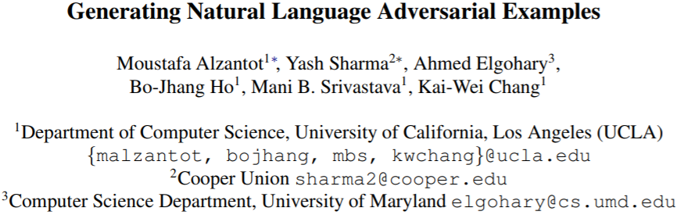
Genetic Attack – Black-Box Attack

Slide 11
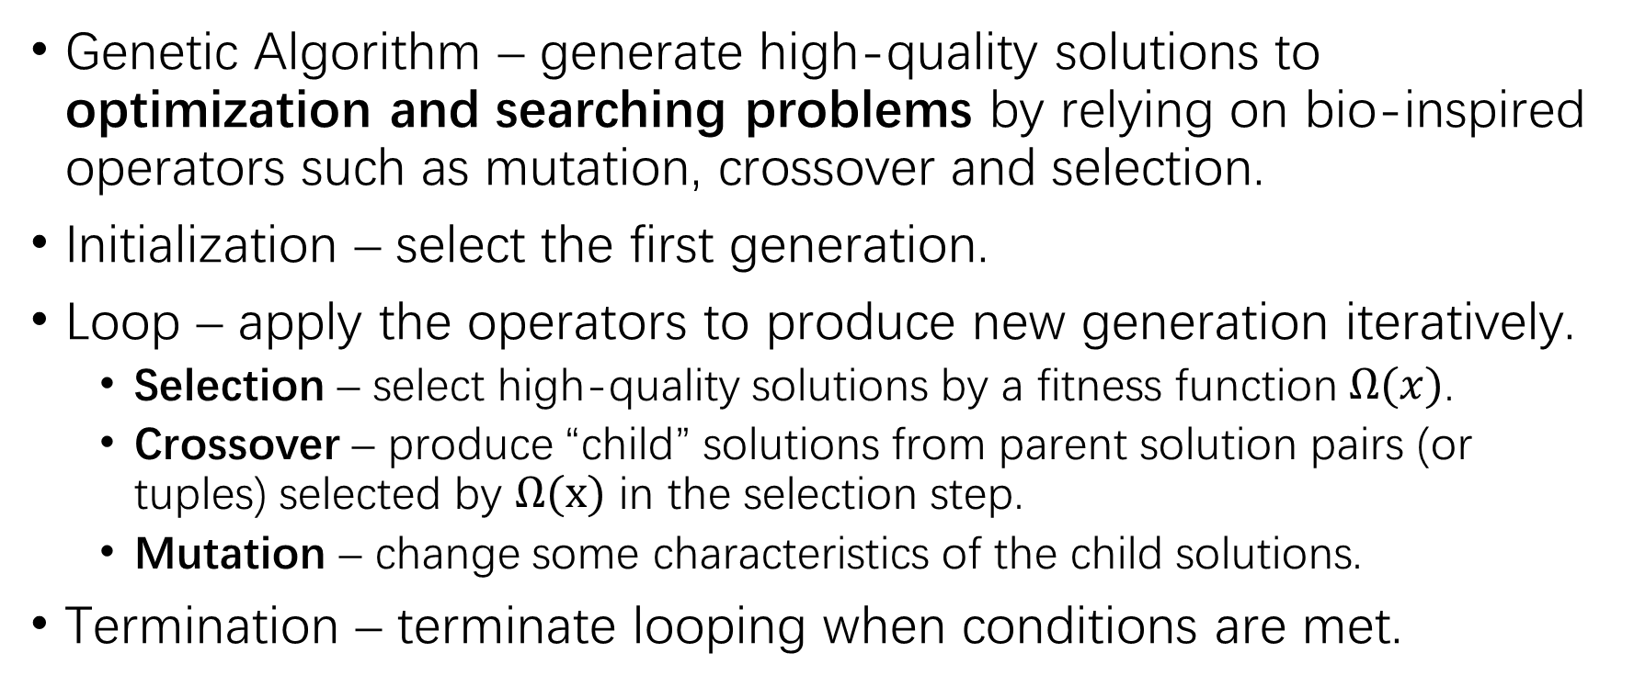
Genetic Algorithm
Genetic Algorithm – generate high-quality solutions to optimization and searching problems by relying on bio-inspired operators such as mutation, crossover and selection.
Initialization – select the first generation.
Loop – apply the operators to produce new generation iteratively.
Selection – select high-quality solutions by a fitness function $Ω(x)$.
Crossover – produce “child” solutions from parent solution pairs (or tuples) selected by $Ω(x)$ in the selection step.
Mutation – change some characteristics of the child solutions.
Termination – terminate looping when conditions are met.

Slide 12
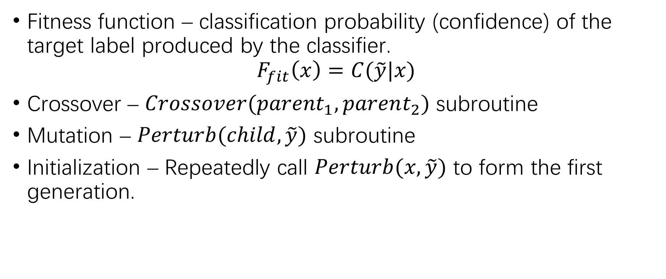
Genetic Attack
Fitness function – classification probability (confidence) of the target label produced by the classifier.
$$F_{fit}\left(x\right)=C(\tilde{y}|x)$$
Crossover – $Crossover({parent}_{1},parent_{2})$ subroutine
Mutation – $Perturb(child, \tilde{y})$ subroutine
Initialization – Repeatedly call $Perturb(x, \tilde{y})$ to form the first generation.

Slide 13

Genetic Attack (2)
$Crossover({parent}_{1},parent_{2})$ subroutine
Randomly select ${parent}_{1}$ and $parent_{2}$ from the population members of the current generation.
Independently sample words from the two parents.
Synthesize the child sentence.

Slide 14

Genetic Attack (3)
$Perturb(child, \tilde{y})$ subroutine
Select the $N$ nearest neighbors as candidates of the selected word according to distance in the GloVe embedding space.
Filter out the top K appropriate candidate words by a language model.
Choose the candidate with the highest fitness score ($C(\tilde{y}|x)$)
i
really
love
this
movie
we
really
love
this
movie
we
you
we
you
we
you
he
he
he
them
them
them
us
us
us
she
she
she

Slide 15
Experimental Results
IMDB sentiment analysis – target classifier reaches 90% accuracy.
Review: This movie had terrible acting, terrible plot, and terrible choice of actors. (Leslie Nielsen ...come on!!!) the one part I considered slightly funny was the battling FBI/CIA agents, but because the audience was mainly kids they didn’t understand that theme.
Label: <Negative>
SNLI textual entailment – target classifier reaches 86%.
Premise: A runner wearing purple strives for the finish line.
Hypothesis: A runner wants to head for the finish line.
Label: <Entailment>

Slide 16
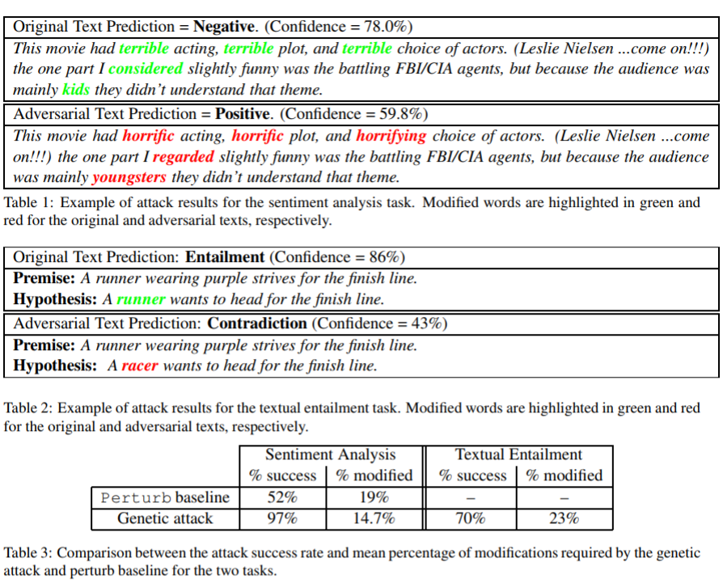
Experimental Results (2)
Adversarial attack results

Slide 17
Experimental Results (3)
Adversarial training results
No performance improvement on IMDB
No robustness improvement on IMDB
…
Nothing works for genetic adversarial training on IMDB…

Slide 18
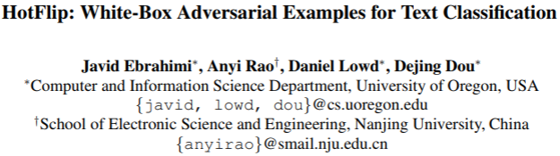
HotFlip – White-Box Attack

Slide 19
HotFlip
HotFlip is a method for generating adversarial examples with character substitutions, insertions and deletions, in order to confuse a character-level classifier

Slide 20
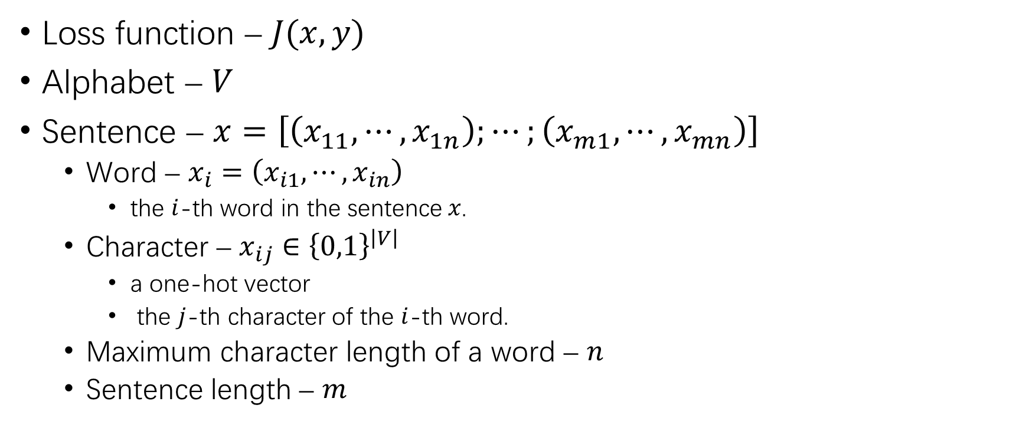
Definitions
Loss function – $J(x, y)$
Alphabet – $V$
Sentence – $x=\left[\left(x_{11},⋯,x_{1n}\right);⋯;\left(x_{m1},⋯,x_{mn}\right)\right]$
Word – $x_{i}=\left(x_{i1},⋯,x_{in}\right)$
the $i$-th word in the sentence $x$.
Character – $x_{ij}∈{\left\{0,1\right\}}^{\left|V\right|}$
a one-hot vector
the $j$-th character of the $i$-th word.
Maximum character length of a word – $n$
Sentence length – $m$

Slide 21
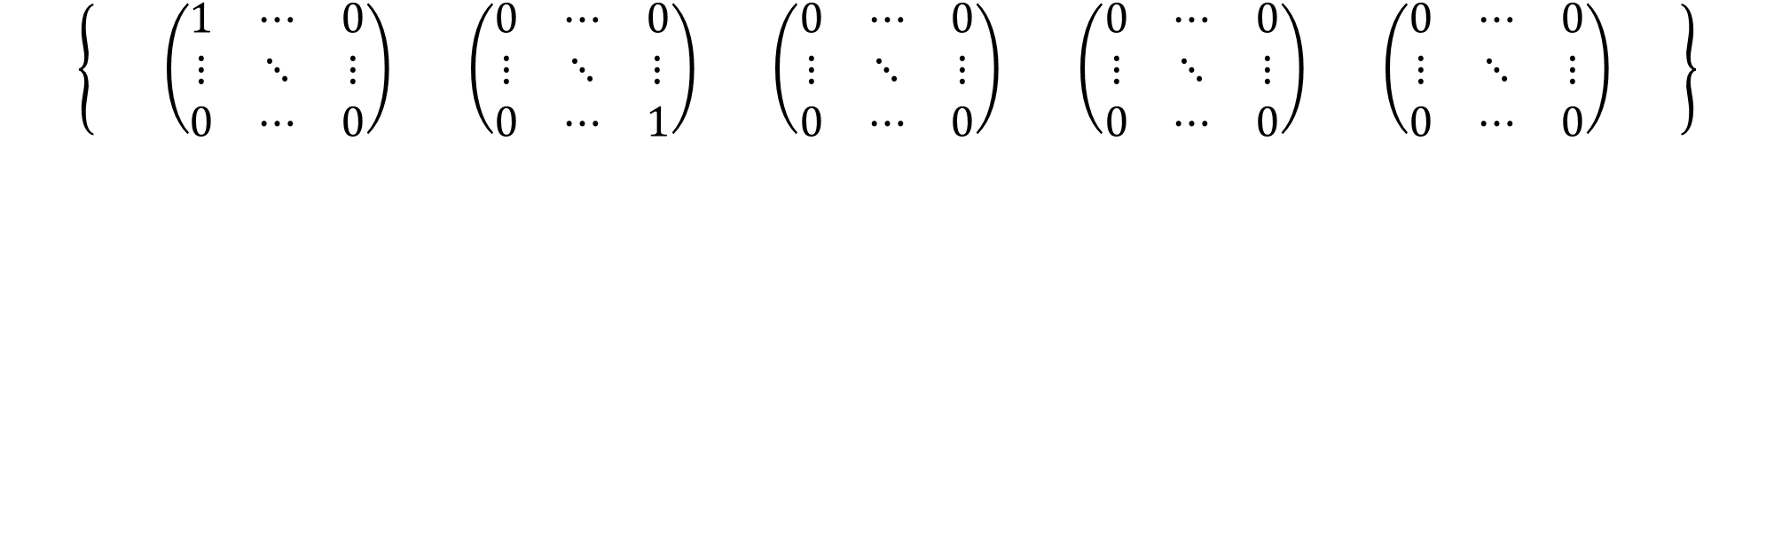
Definitions (2)
i
r
l
t
m
o
$$\left\{ \left(\begin{matrix}1 & ⋯ & 0 \\ ⋮ & ⋱ & ⋮ \\ 0 & ⋯ & 0\end{matrix}\right) \left(\begin{matrix}0 & ⋯ & 0 \\ ⋮ & ⋱ & ⋮ \\ 0 & ⋯ & 1\end{matrix}\right) \left(\begin{matrix}0 & ⋯ & 0 \\ ⋮ & ⋱ & ⋮ \\ 0 & ⋯ & 0\end{matrix}\right) \left(\begin{matrix}0 & ⋯ & 0 \\ ⋮ & ⋱ & ⋮ \\ 0 & ⋯ & 0\end{matrix}\right) \left(\begin{matrix}0 & ⋯ & 0 \\ ⋮ & ⋱ & ⋮ \\ 0 & ⋯ & 0\end{matrix}\right) \right\}$$
e
v
h
o
a
e
i
v
l
s
i
l
e
y

Slide 22
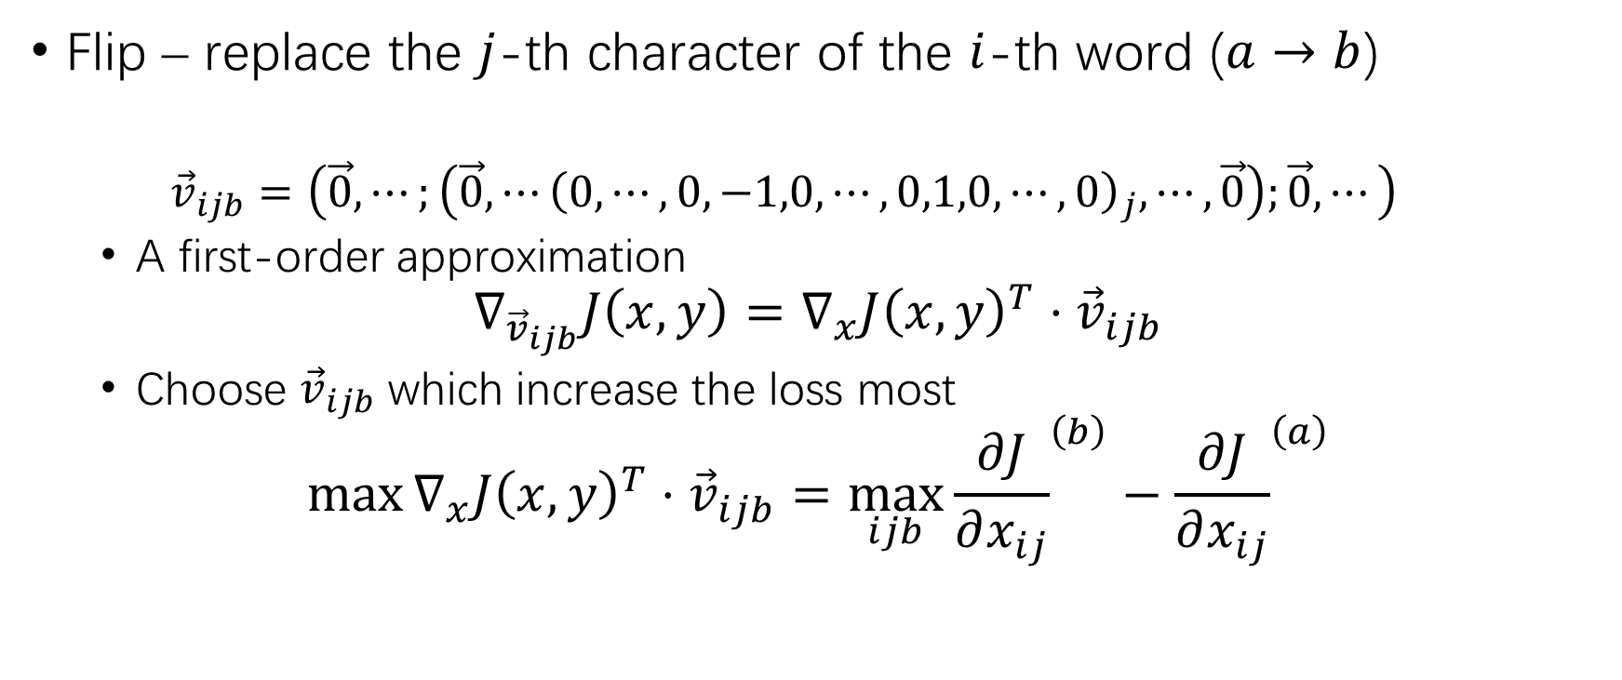
HotFlip (2)
Flip – replace the $j$-th character of the $i$-th word ($a→b$)
$${\vec{v}}_{ijb}=\left(\vec{0},⋯;\left(\vec{0},⋯{\left(0,⋯,0,−1,0,⋯,0,1,0,⋯,0\right)}_{j},⋯,\vec{0}\right);\vec{0},⋯\right)$$
A first-order approximation
$$∇_{{\vec{v}}_{ijb}}J\left(x,y\right)=∇_{x}J{\left(x,y\right)}^{T}⋅{\vec{v}}_{ijb}$$
Choose ${\vec{v}}_{ijb}$ which increase the loss most
$$\max{∇_{x}J{\left(x,y\right)}^{T}⋅{\vec{v}}_{ijb}=\max_{ijb}{{\frac{∂J}{∂x_{ij}}}^{\left(b\right)}−{\frac{∂J}{∂x_{ij}}}^{\left(a\right)}}}$$

Slide 23
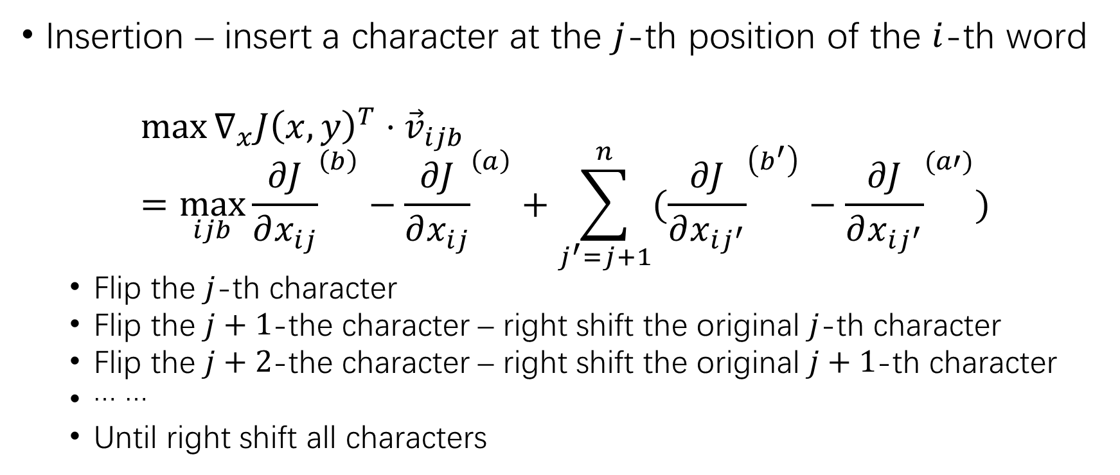
HotFlip (3)
Insertion – insert a character at the $j$-th position of the $i$-th word
$${\max{∇_{x}J\left(x,y\right)}}^{T}⋅{\vec{v}}_{ijb}=\max_{ijb}{{\frac{∂J}{∂x_{ij}}}^{\left(b\right)}−{\frac{∂J}{∂x_{ij}}}^{\left(a\right)}+\sum_{j^{′}=j+1}^{n}{({\frac{∂J}{∂x_{ij^{′}}}}^{\left(b^{′}\right)}−{\frac{∂J}{∂x_{ij^{′}}}}^{(a′)})}}$$
Flip the $j$-th character
Flip the $j+1$-the character – right shift the original $j$-th character
Flip the $j+2$-the character – right shift the original $j+1$-th character
… …
Until right shift all characters

Slide 24
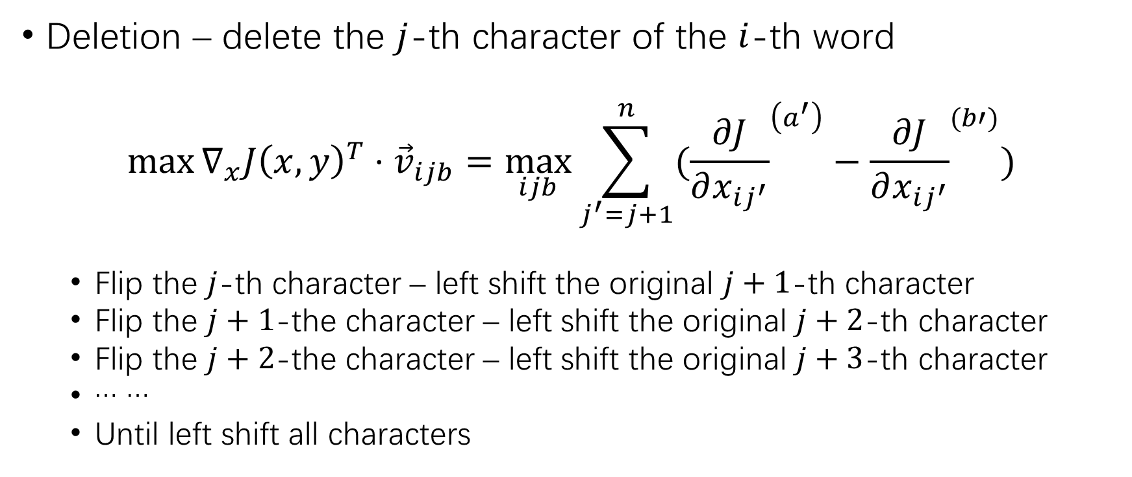
HotFlip (4)
Deletion – delete the $j$-th character of the $i$-th word
$${\max{∇_{x}J\left(x,y\right)}}^{T}⋅{\vec{v}}_{ijb}=\max_{ijb}{\sum_{j^{′}=j+1}^{n}{({\frac{∂J}{∂x_{ij^{′}}}}^{\left(a^{′}\right)}−{\frac{∂J}{∂x_{ij^{′}}}}^{(b′)})}}$$
Flip the $j$-th character – left shift the original $j+1$-th character
Flip the $j+1$-the character – left shift the original $j+2$-th character
Flip the $j+2$-the character – left shift the original $j+3$-th character
… …
Until left shift all characters

Slide 25
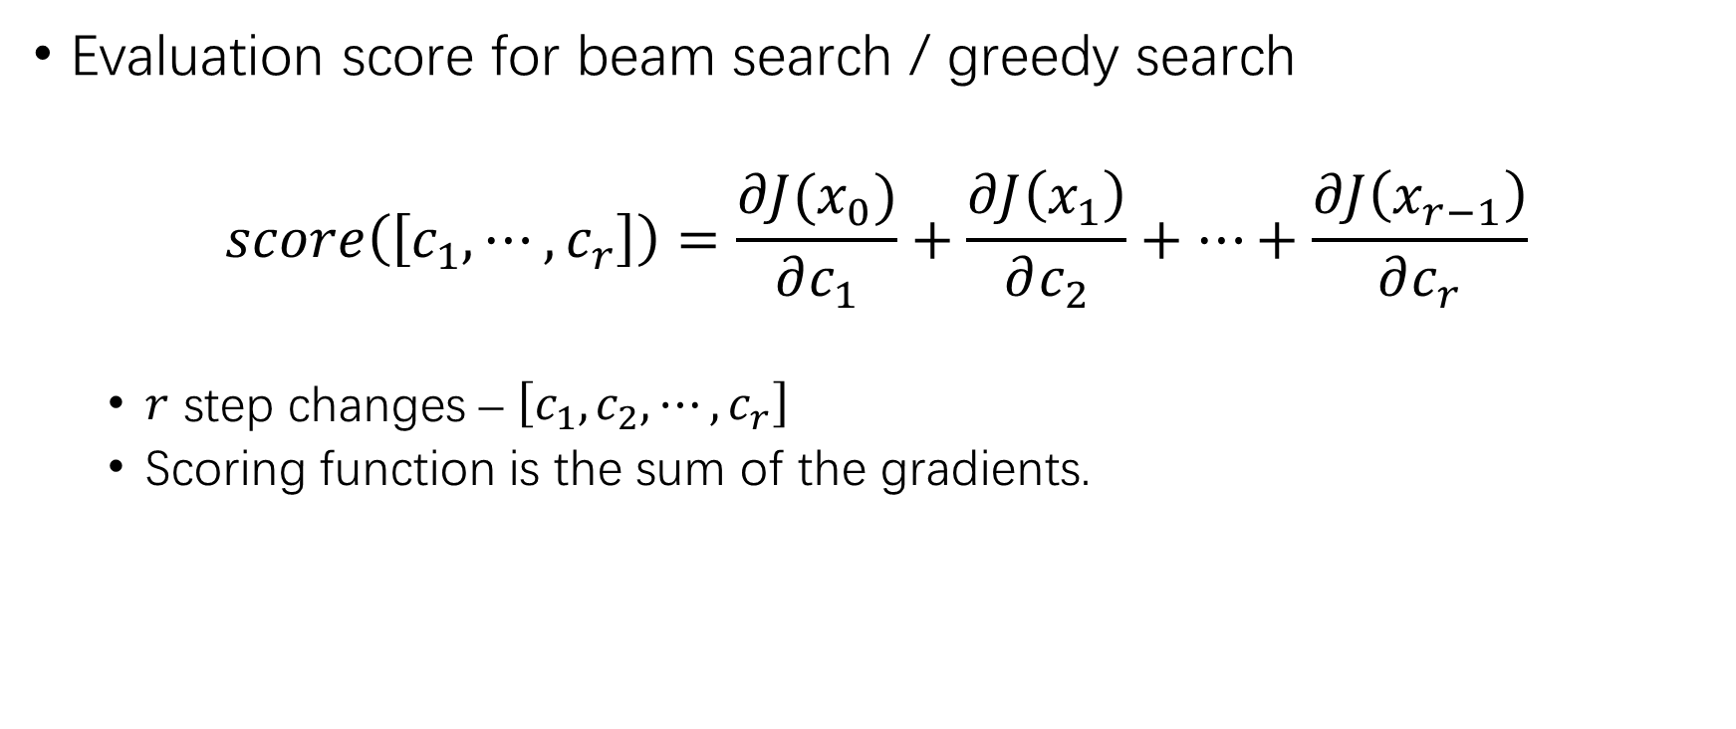
HotFlip (5)
Evaluation score for beam search / greedy search
$$score\left(\left[c_{1},⋯,c_{r}\right]\right)=\frac{∂J(x_{0})}{∂c_{1}}+\frac{∂J\left(x_{1}\right)}{∂c_{2}}+⋯+\frac{∂J\left(x_{r−1}\right)}{∂c_{r}}$$
$r$ step changes – $\left[c_{1},c_{2},⋯,c_{r}\right]$
Scoring function is the sum of the gradients.

Slide 26
Experimental Results
AG’s news dataset – 4 class classification (World, Sports, Besiness, Science/Technology)
CharCNN-LSTM is applied as the target model

Slide 27
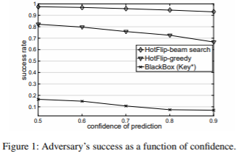
Experimental Results (2)
Adversarial attack results

Slide 28
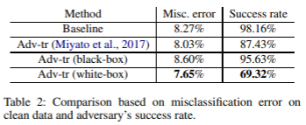
Experimental Results (3)
Adversarial training results

Slide 29
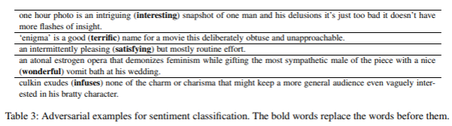
Experimental Results (4)
Word-level HotFlip – 2% successful rate.
Cosine similarity between the two words > threshold.
The two words must have the same POS.
Stop-words are not allowed to be replaced.

Slide 30
Additional
C tokenizer
https://github.com/LC-John/C-Tokenizer
Siton /home1/zhanghz/C-Tokenizer/token input.file output.file
Java tokenizer
https://github.com/LC-John/Java-Tokenizer
Siton /home1/zhanghz/Java-Tokenizer/token input.file output.file

Slide 31
Thank You!

