Slide 1
Data2Vec
Huangzhao Zhang
zhang_hz@pku.edu.cn

Slide 2
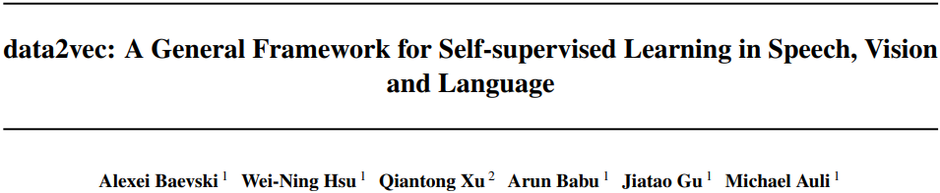

Slide 3
Motivation
Multimodality vs. self-supervision – Specific vs. general
NLP
Modality – Sentence
Self-supervision – Word
Computer vision
Modality – Image
Self-supervision – Patch
Speech processing
Modality – Wave
Self-supervision – Sound unit
…

Slide 4
Motivation
Multimodality vs. self-supervision – Specific vs. general
NLP
Modality – Sentence
Self-supervision – Word
Computer vision
Modality – Image
Self-supervision – Patch
Speech processing
Modality – Wave
Self-supervision – Sound unit
…

Slide 5
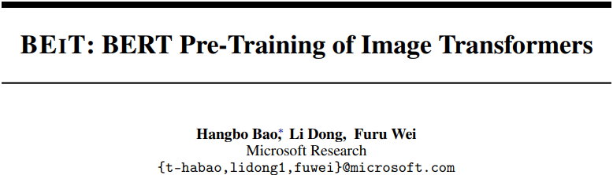
Computer Vision

Slide 6
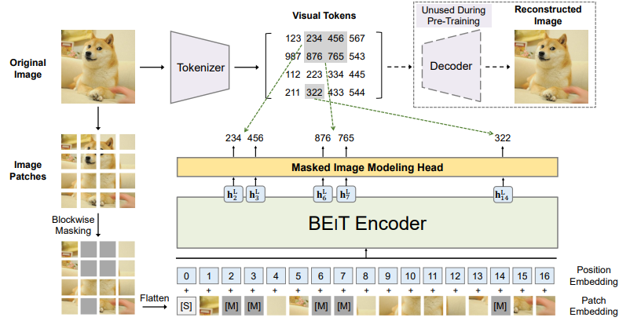

Computer Vision (2)
BEiT
Image – $x∈R^{H×W×C}$
Patch – $x^{p}=\left[x_{1}^{p}⋯x_{N}^{p}\right]∈R^{P×P×C}$
Token – $z=\left[z_{1},⋯,z_{N}\right]∈V^{h×w}$
dVAE – Tokenizer + decoder
Patch $⇒$ Discrete token $⇒$ Reconstructed patch

Slide 7
Motivation
Multimodality vs. self-supervision – Specific vs. general
NLP
Modality – Sentence
Self-supervision – Word
Computer vision
Modality – Image
Self-supervision – Patch
Speech processing
Modality – Wave
Self-supervision – Sound unit
…

Slide 8
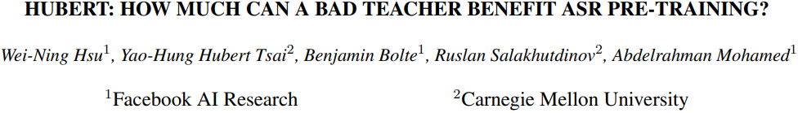
Speech Processing

Slide 9
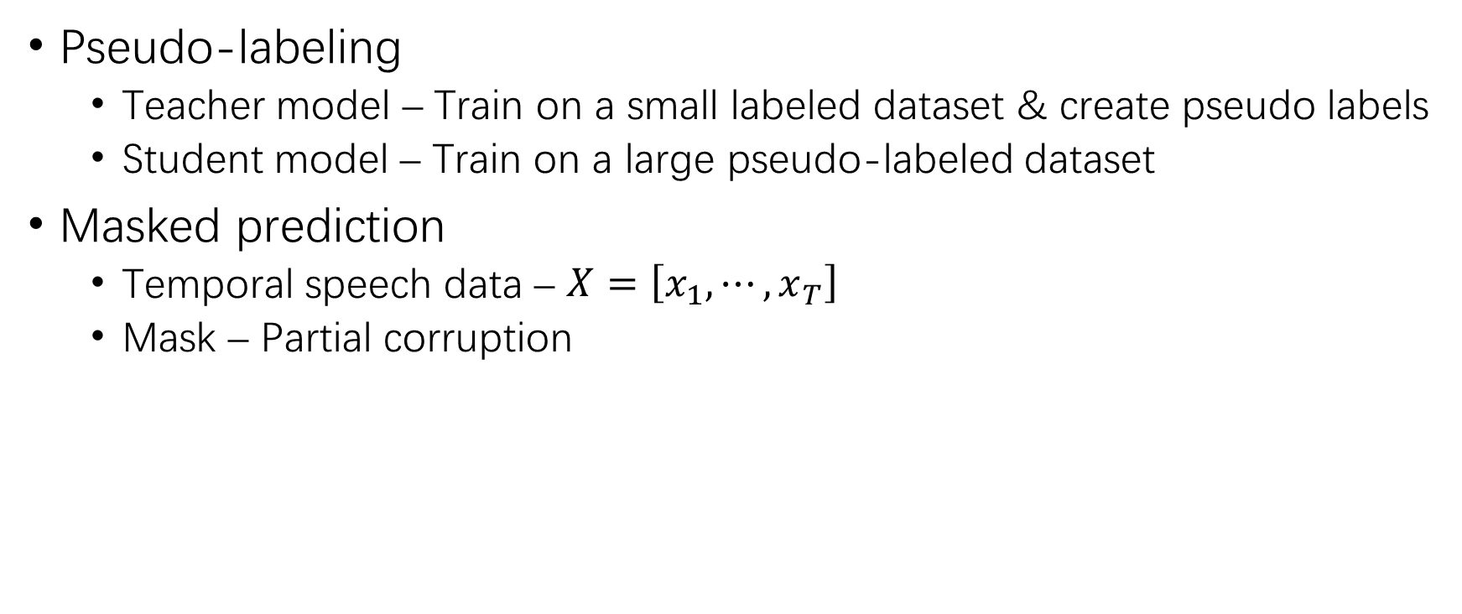
Speech Processing (2)
Pseudo-labeling
Teacher model – Train on a small labeled dataset & create pseudo labels
Student model – Train on a large pseudo-labeled dataset
Masked prediction
Temporal speech data – $X=\left[x_{1},⋯,x_{T}\right]$
Mask – Partial corruption

Slide 10
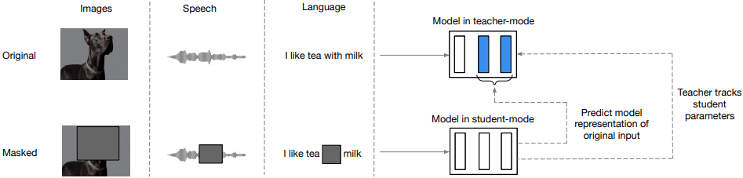
Data2Vec
Self-distillation
Teacher – Build representations of the full input data
Student – Encode a masked version of the input data
Distillation – The student learns the representations according to the teacher

Slide 11
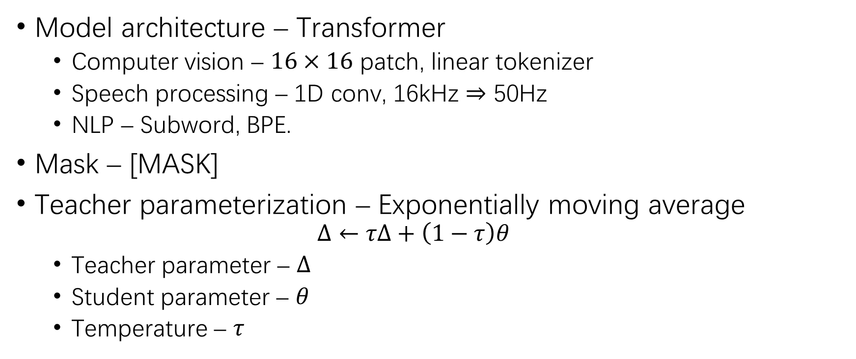
Data2Vec (2)
Model architecture – Transformer
Computer vision – $16×16$ patch, linear tokenizer
Speech processing – 1D conv, 16kHz $⇒$ 50Hz
NLP – Subword, BPE.
Mask – [MASK]
Teacher parameterization – Exponentially moving average
$$Δ←τΔ+\left(1−τ\right)θ$$
Teacher parameter – $Δ$
Student parameter – $θ$
Temperature – $τ$

Slide 12
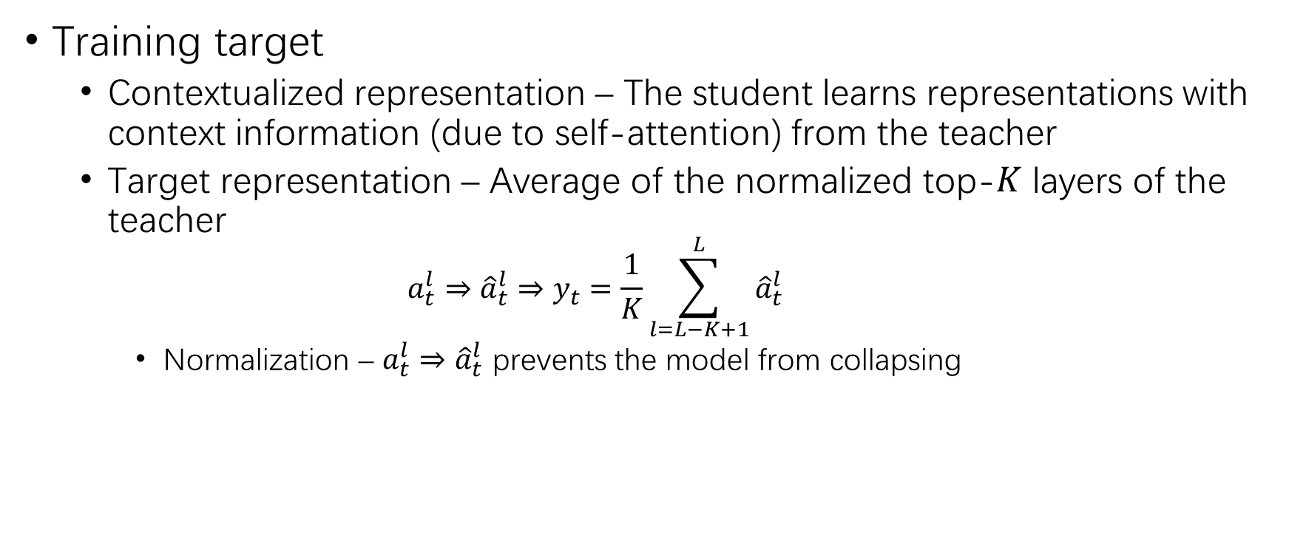
Data2Vec (3)
Training target
Contextualized representation – The student learns representations with context information (due to self-attention) from the teacher
Target representation – Average of the normalized top-$K$ layers of the teacher
$$a_{t}^{l}⇒{\hat{a}}_{t}^{l}⇒y_{t}=\frac{1}{K}\sum_{l=L−K+1}^{L}{{\hat{a}}_{t}^{l}}$$
Normalization – $a_{t}^{l}⇒{\hat{a}}_{t}^{l}$ prevents the model from collapsing

Slide 13
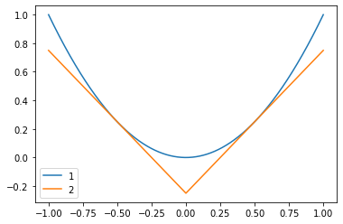
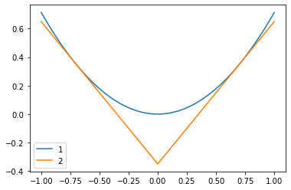

Data2Vec (4)
Objective – Smooth L1 loss
$$L\left(y_{t},f_{t}\left(x\right)\right)=\left\{\begin{matrix}{\frac{1}{2}{\left(y_{t}−f_{t}\left(x\right)\right)}^{2}}/β & \left|y_{t}−f_{t}\left(x\right)\right|≤β \\ \left(\left|y_{t}−f_{t}\left(x\right)\right|−\frac{1}{2}β\right) & otherwise\end{matrix}\right.$$

Slide 14
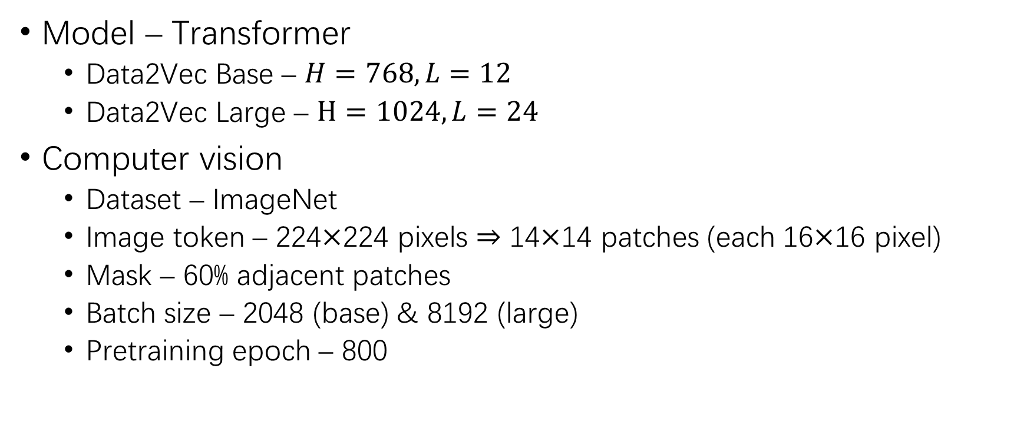
Experimental Setup
Model – Transformer
Data2Vec Base – $H=768,L=12$
Data2Vec Large – $H=1024,L=24$
Computer vision
Dataset – ImageNet
Image token – 224$×$224 pixels $⇒$ 14$×$14 patches (each 16$×$16 pixel)
Mask – 60% adjacent patches
Batch size – 2048 (base) & 8192 (large)
Pretraining epoch – 800

Slide 15
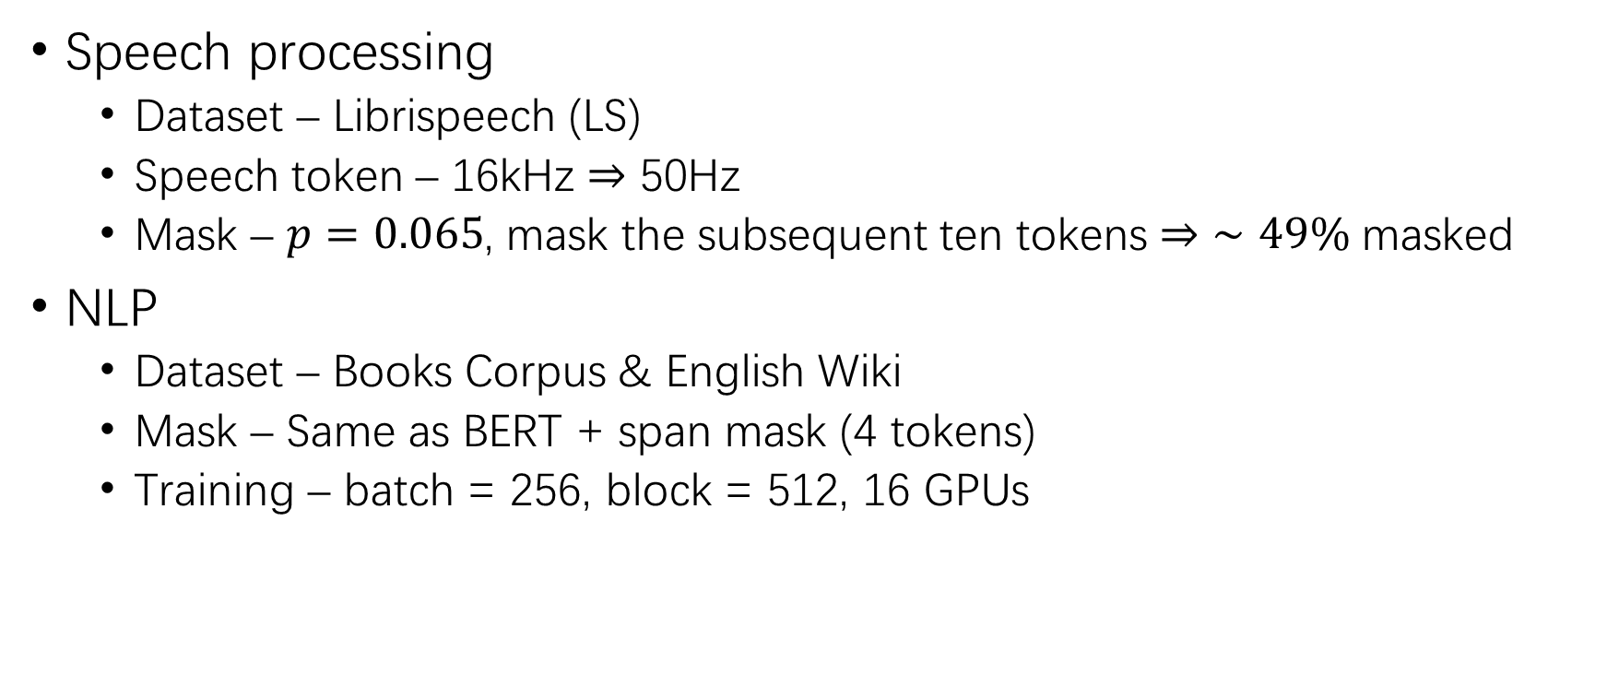
Experimental Setup (2)
Speech processing
Dataset – Librispeech (LS)
Speech token – 16kHz $⇒$ 50Hz
Mask – $p=0.065$, mask the subsequent ten tokens $⇒$ $∼49\%$ masked
NLP
Dataset – Books Corpus & English Wiki
Mask – Same as BERT + span mask (4 tokens)
Training – batch = 256, block = 512, 16 GPUs

Slide 16
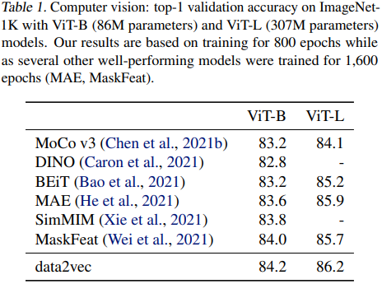
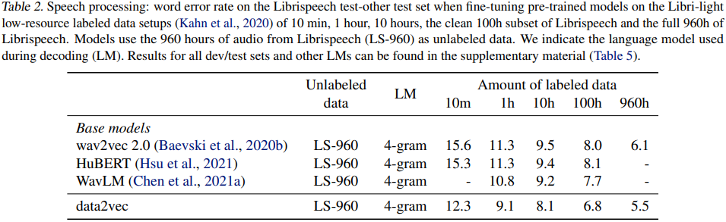
Results
Computer vision – ImageNet-1K
Speech processing – LS

Slide 17
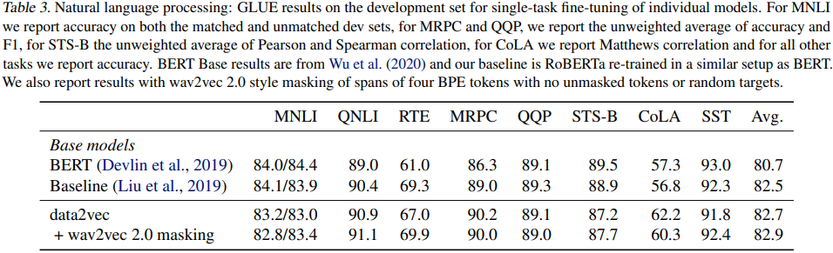
Results (2)
NLP – GLUE
RoBERTa
NLI
Sent Sim
Grammar
Sentiment

Slide 18
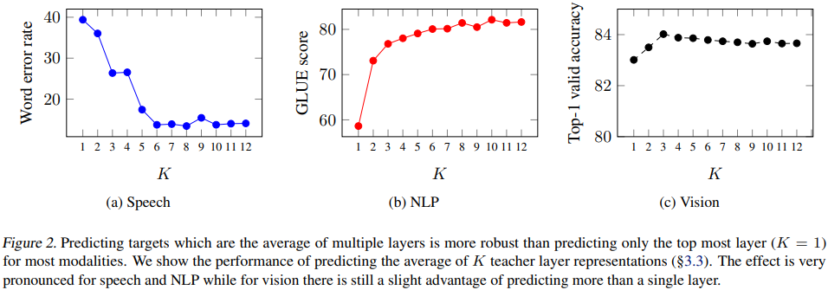
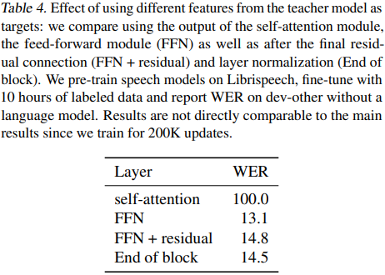

Results (3)
Ablation
Layer averaged target – $K$
Target feature type
WER – Word error rates

Slide 19
THANK YOU!

