Slide 1
Nearest Neighbor Search
Huangzhao Zhang
zhang_hz@pku.edu.cn

Slide 2

Problem
Nearest neighbor search
$$NN\left(x\right)=\arg{\min_{y∈Y}{d\left(x, y\right)}}$$
Query vector – $x∈R^{D}$
Finite set – $Y=\left\{y_{1},⋯,y_{n}\right\}⊂R^{D}$
Distance – $d\left(⋅,⋅\right)$
Brute force complexity – $O\left(nD\right)$

Slide 3
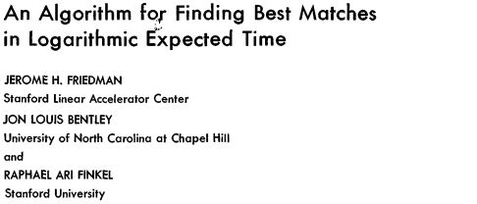
KD-Tree

Slide 4
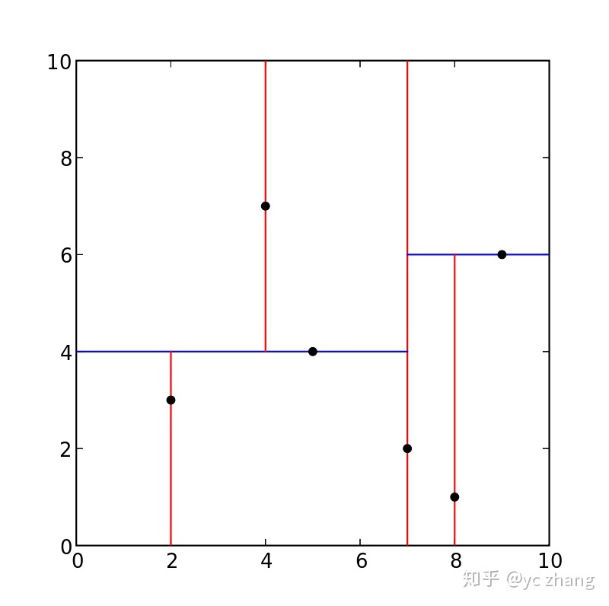
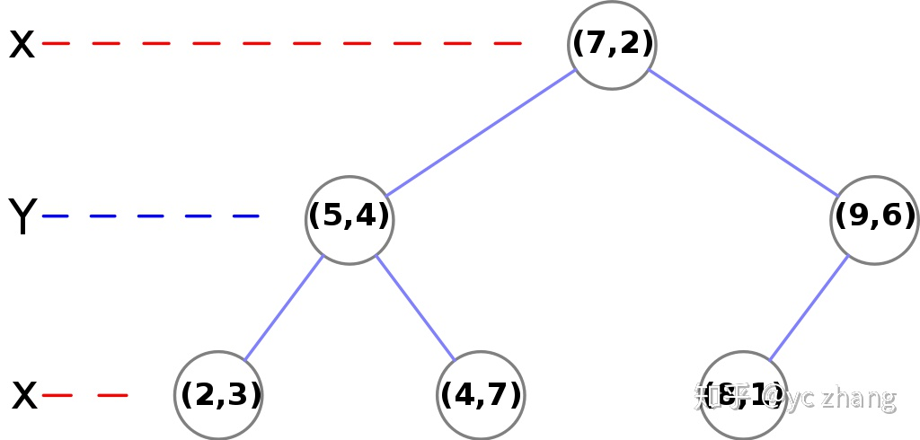
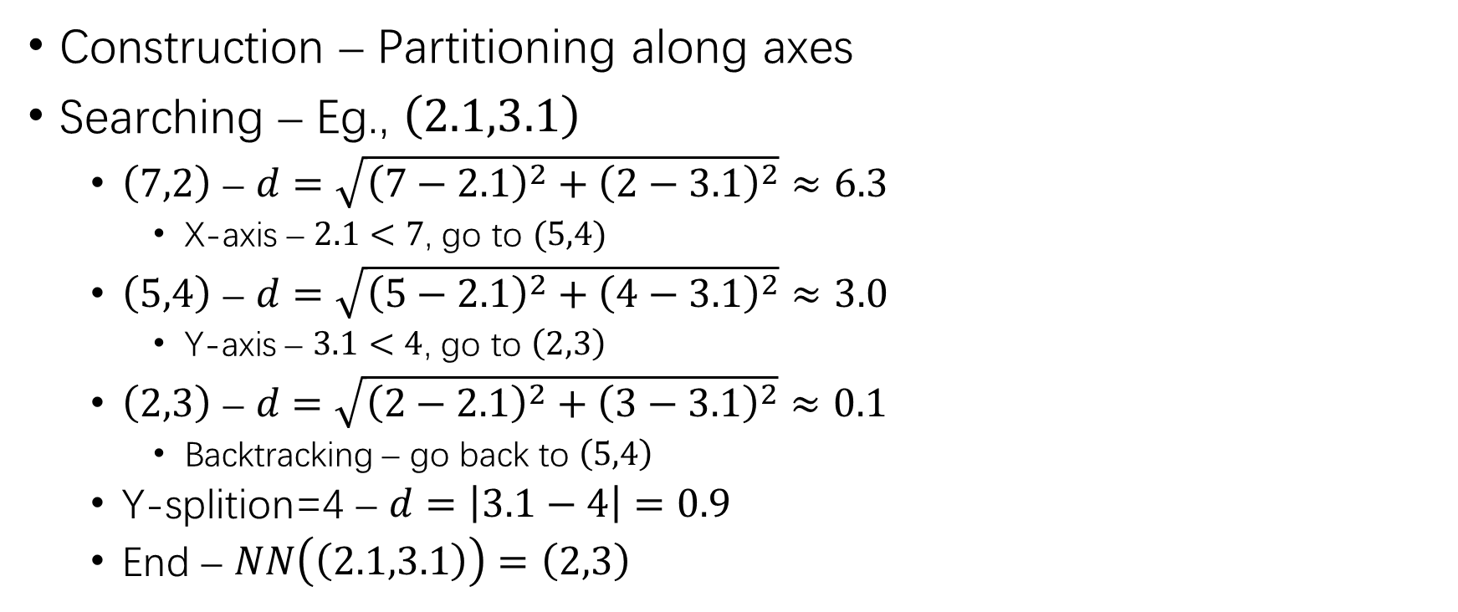
KD-Tree (2)
③
②
②
Construction – Partitioning along axes
Searching – Eg., $\left(2.1,3.1\right)$
$\left(7,2\right)$ – $d=\sqrt{{\left(7−2.1\right)}^{2}+{\left(2−3.1\right)}^{2}}≈6.3$
X-axis – $2.1<7$, go to $(5,4)$
$\left(5,4\right)$ – $d=\sqrt{{\left(5−2.1\right)}^{2}+{\left(4−3.1\right)}^{2}}≈3.0$
Y-axis – $3.1<4$, go to $\left(2,3\right)$
$\left(2,3\right)\text{ – }d=\sqrt{{\left(2−2.1\right)}^{2}+{\left(3−3.1\right)}^{2}}≈0.1$
Backtracking – go back to $\left(5,4\right)$
Y-splition=4 – $d=\left|3.1−4\right|=0.9$
End – $NN\left(\left(2.1,3.1\right)\right)=\left(2,3\right)$
③
①
③

Slide 5
KD-Tree (3)
Curse of dimensionality – For high dimensions, KD-tree turns out to be not more efficient than the brute force exhaustive distance calculation.

Slide 6
Approximate Nearest Neighbor Search
ANN – Find the NN with high probability, instead of probability 1
Locality-Sensitive Hashing
…

Slide 7
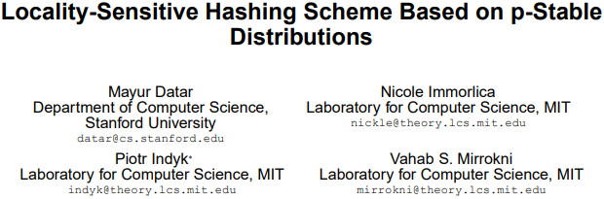

Locality-Sensitive Hashing

Slide 8
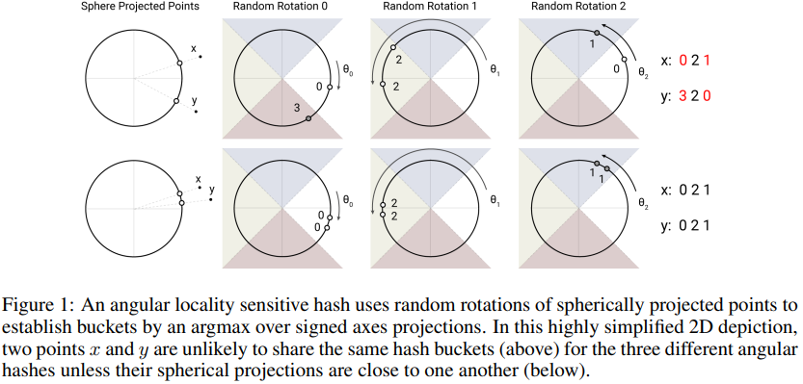
Locality-Sensitive Hashing (2)
LSH – Hash similar items into the same hashing buckets with high probability
Eg., Hashing attention in Reformer
ANN searching – Compute with only items in the same LSH bucket

Slide 9


Slide 10
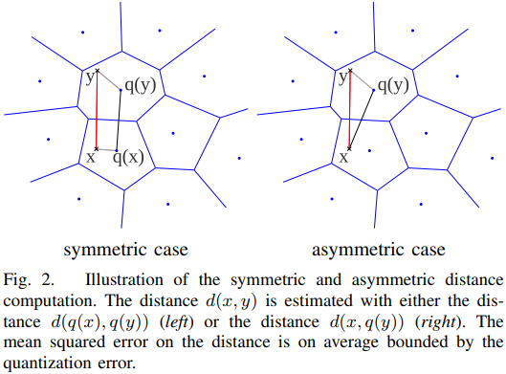
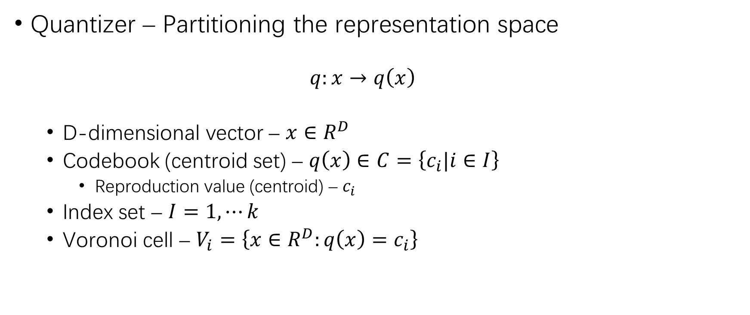
Vector Quantization
Quantizer – Partitioning the representation space
$$q:x→q\left(x\right)$$
D-dimensional vector – $x∈R^{D}$
Codebook (centroid set) – $q\left(x\right)∈C=\left\{c_{i}|i∈I\right\}$
Reproduction value (centroid) – $c_{i}$
Index set – $I=1,⋯k$
Voronoi cell – $V_{i}=\left\{x∈R^{D}:q\left(x\right)=c_{i}\right\}$

Slide 11
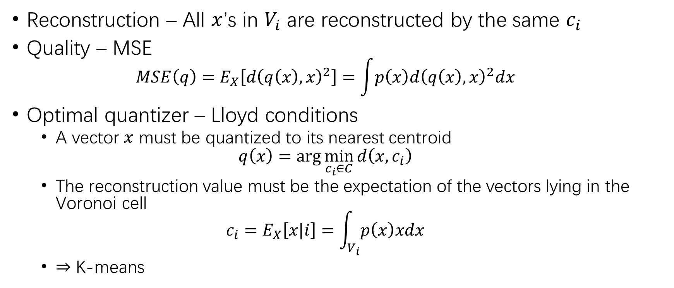
Vector Quantization (2)
Reconstruction – All $x$’s in $V_{i}$ are reconstructed by the same $c_{i}$
Quality – MSE
$$MSE\left(q\right)=E_{X}\left[d{\left(q\left(x\right),x\right)}^{2}\right]=\int{p\left(x\right)d{\left(q\left(x\right),x\right)}^{2}dx}$$
Optimal quantizer – Lloyd conditions
A vector $x$ must be quantized to its nearest centroid
$$q\left(x\right)=\arg{\min_{c_{i}∈C}{d\left(x,c_{i}\right)}}$$
The reconstruction value must be the expectation of the vectors lying in the Voronoi cell
$$c_{i}=E_{X}\left[x|i\right]=\int_{V_{i}}{p\left(x\right)xdx}$$
$⇒$ K-means

Slide 12
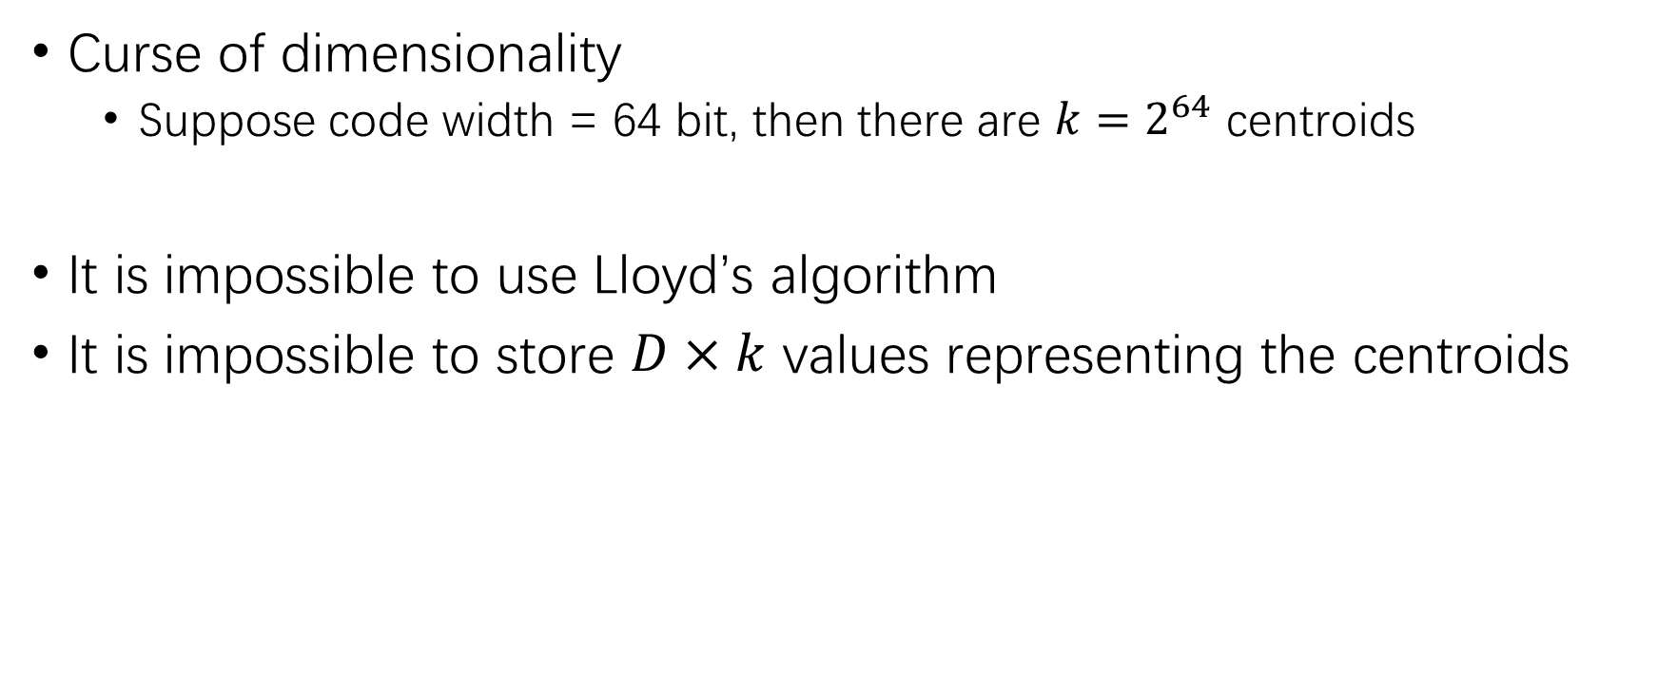
Vector Quantization (3)
Curse of dimensionality
Suppose code width = 64 bit, then there are $k=2^{64}$ centroids
It is impossible to use Lloyd’s algorithm
It is impossible to store $D×k$ values representing the centroids

Slide 13
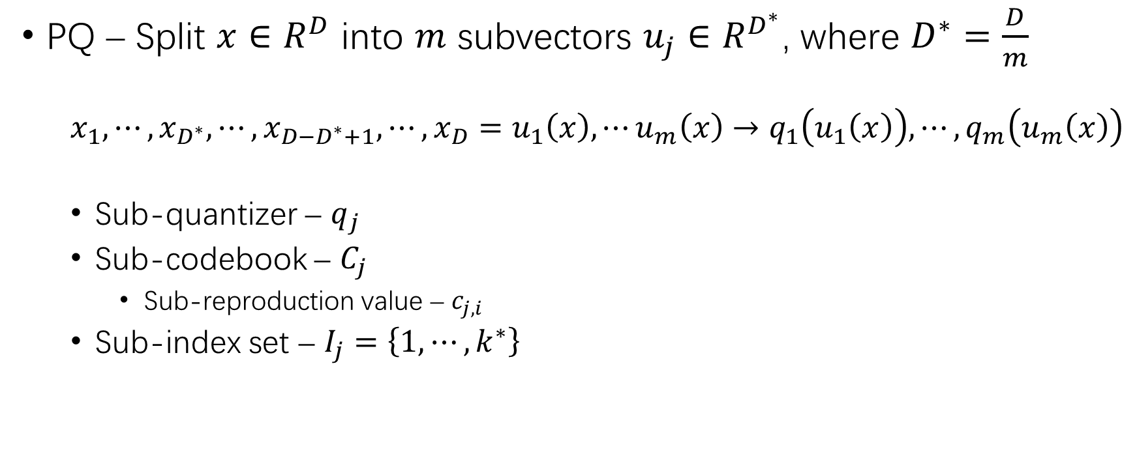
Product Quantization
PQ – Split $x∈R^{D}$ into $m$ subvectors $u_{j}∈R^{D^{∗}}$, where $D^{∗}=\frac{D}{m}$
$$x_{1},⋯,x_{D^{∗}},⋯,x_{D−D^{∗}+1},⋯,x_{D}=u_{1}\left(x\right),⋯u_{m}\left(x\right)→q_{1}\left(u_{1}\left(x\right)\right),⋯,q_{m}\left(u_{m}\left(x\right)\right)$$
Sub-quantizer – $q_{j}$
Sub-codebook – $C_{j}$
Sub-reproduction value – $c_{j,i}$
Sub-index set – $I_{j}=\left\{1,⋯,k^{∗}\right\}$

Slide 14
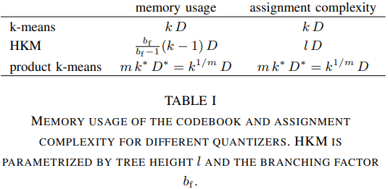
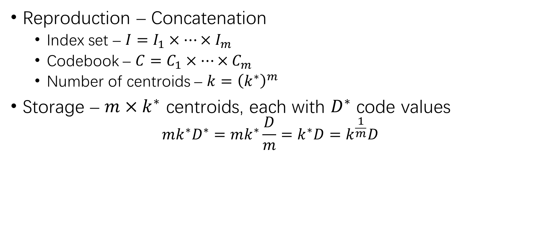
Product Quantization (2)
Reproduction – Concatenation
Index set – $I=I_{1}×⋯×I_{m}$
Codebook – $C=C_{1}×⋯×C_{m}$
Number of centroids – $k={\left(k^{∗}\right)}^{m}$
Storage – $m×k^{∗}$ centroids, each with $D^{∗}$ code values
$$mk^{∗}D^{∗}=mk^{∗}\frac{D}{m}=k^{∗}D=k^{\frac{1}{m}}D$$

Slide 15
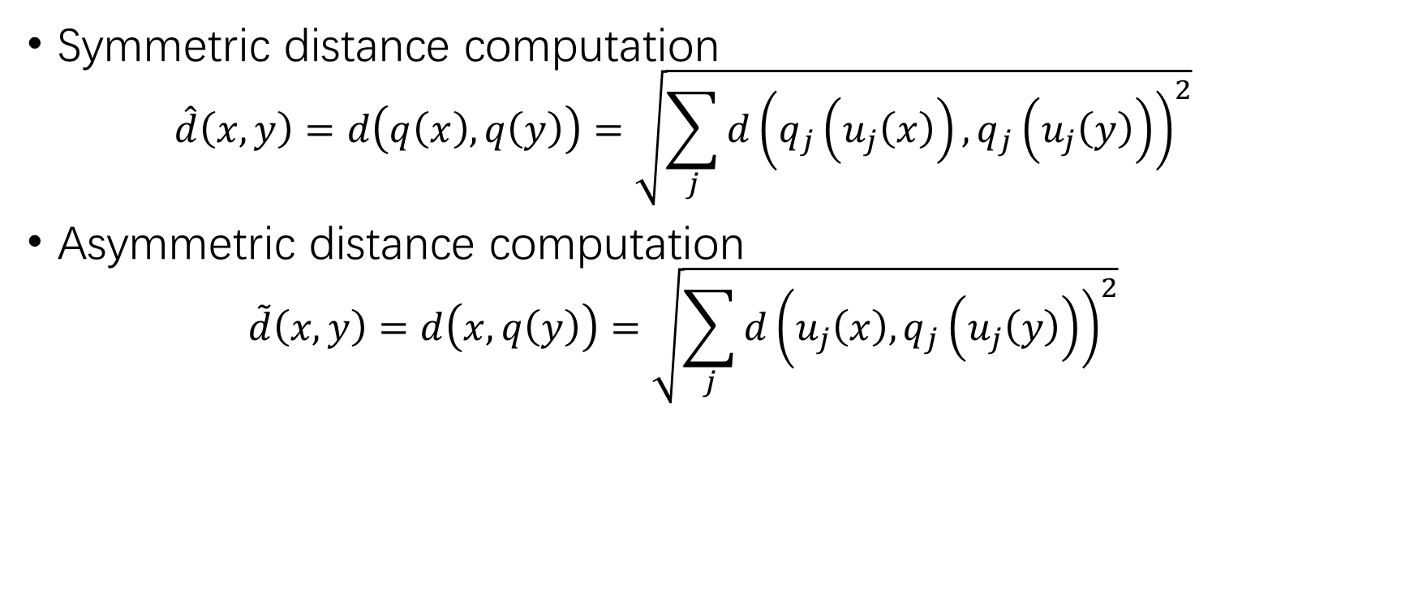
Distance by Quantization
Symmetric distance computation
$$\hat{d}\left(x,y\right)=d\left(q\left(x\right),q\left(y\right)\right)=\sqrt{\sum_{j}{d{\left(q_{j}\left(u_{j}\left(x\right)\right),q_{j}\left(u_{j}\left(y\right)\right)\right)}^{2}}}$$
Asymmetric distance computation
$$\tilde{d}\left(x,y\right)=d\left(x,q\left(y\right)\right)=\sqrt{\sum_{j}{d{\left(u_{j}\left(x\right),q_{j}\left(u_{j}\left(y\right)\right)\right)}^{2}}}$$

Slide 16
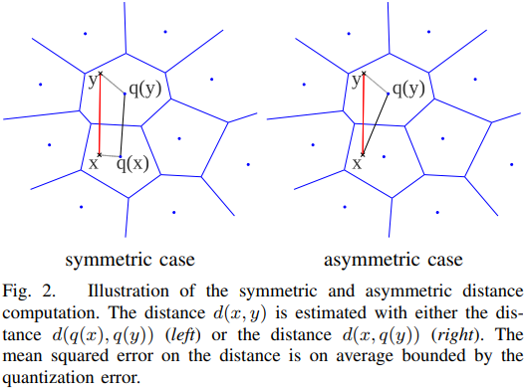
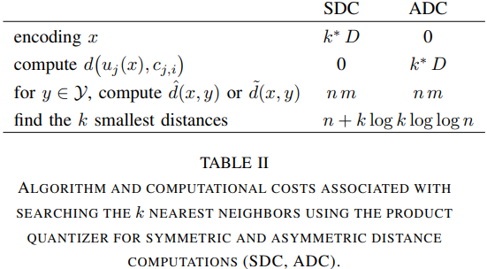

Distance by Quantization (2)
SDC – $\hat{d}\left(x,y\right)=d\left(q\left(x\right),q\left(y\right)\right)$
ADC – $\tilde{d}\left(x,y\right)=d\left(x,q\left(y\right)\right)$

Slide 17
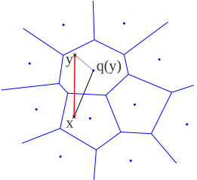
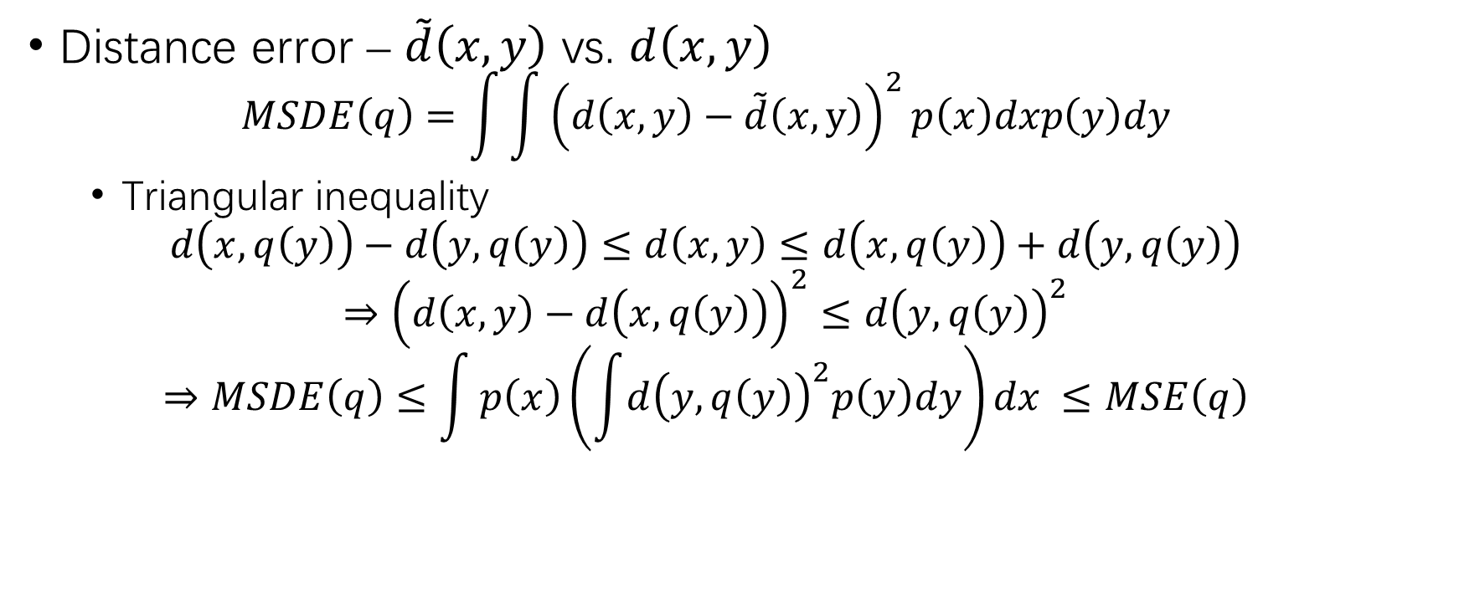
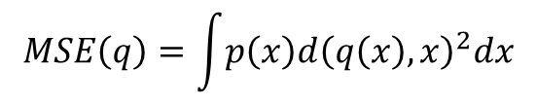
Distance by Quantization (3)
$$MSE\left(q\right)=\int{p\left(x\right)d{\left(q\left(x\right),x\right)}^{2}dx}$$
Distance error – $\tilde{d}\left(x,y\right)$ vs. $d\left(x,y\right)$
$$MSDE\left(q\right)=\int{\int{{\left(d\left(x,y\right)−\tilde{d}\left(x,y\right)\right)}^{2}p\left(x\right)dxp\left(y\right)dy}}$$
Triangular inequality
$$d\left(x,q\left(y\right)\right)−d\left(y,q\left(y\right)\right)≤d\left(x,y\right)≤d\left(x,q\left(y\right)\right)+d\left(y,q\left(y\right)\right)$$
$$⇒{\left(d\left(x,y\right)−d\left(x,q\left(y\right)\right)\right)}^{2}≤d{\left(y,q\left(y\right)\right)}^{2}$$
$$⇒MSDE\left(q\right)≤\int{p\left(x\right)\left(\int{d{\left(y,q\left(y\right)\right)}^{2}p\left(y\right)dy}\right)dx }≤MSE\left(q\right)$$

Slide 18
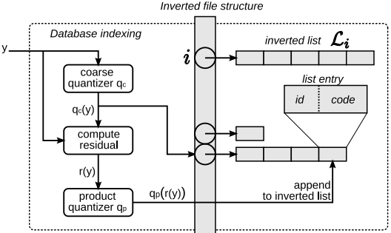

IVFADC
Inverted file with asymmetric distance computation
Besides PQ …
Coarse quantizer – $q_{c}$, with $k^{′}$ centroids
Residual vector – $r\left(y\right)=y−q_{c}\left(y\right)$
Inverted file – $L_{1},⋯L_{k^{′}}$

Slide 19
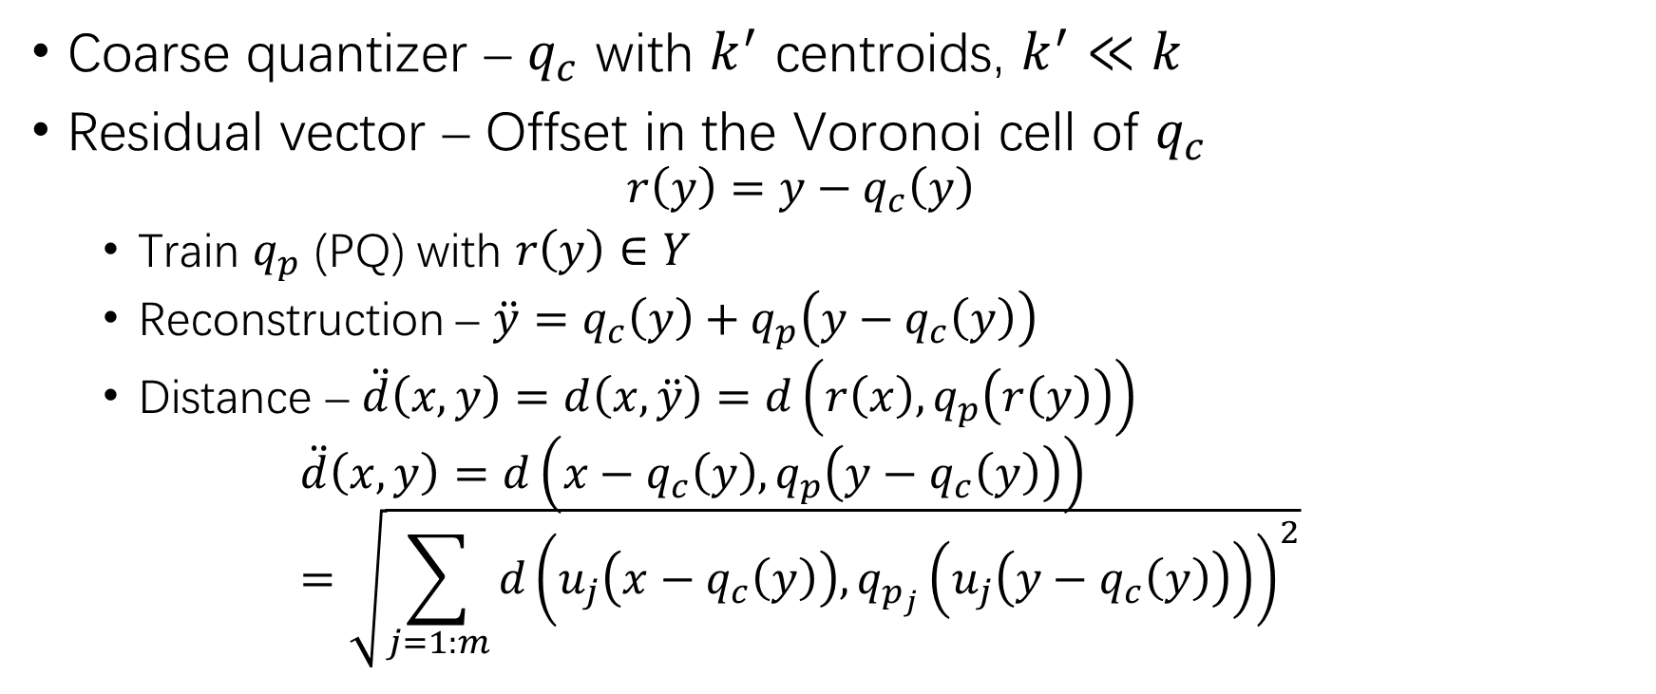
IVFADC (2)
Coarse quantizer – $q_{c}$ with $k^{′}$ centroids, $k^{′}≪k$
Residual vector – Offset in the Voronoi cell of $q_{c}$
$$r\left(y\right)=y−q_{c}\left(y\right)$$
Train $q_{p}$ (PQ) with $r\left(y\right)∈Y$
Reconstruction – $\ddot{y}=q_{c}\left(y\right)+q_{p}\left(y−q_{c}\left(y\right)\right)$
Distance – $\ddot{d}\left(x,y\right)=d\left(x,\ddot{y}\right)=d\left(r\left(x\right),q_{p}\left(r\left(y\right)\right)\right)$
$$\ddot{d}\left(x,y\right)=d\left(x−q_{c}\left(y\right),q_{p}\left(y−q_{c}\left(y\right)\right)\right)=\sqrt{\sum_{j=1:m}{d{\left(u_{j}\left(x−q_{c}\left(y\right)\right),q_{p_{j}}\left(u_{j}\left(y−q_{c}\left(y\right)\right)\right)\right)}^{2}}}$$

Slide 20


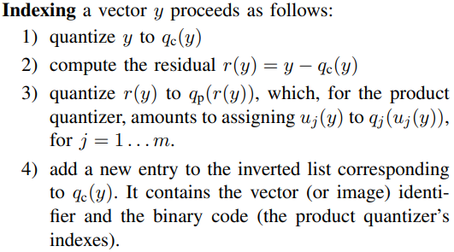

IVFADC (3)
Indexing – Inverted file structure
Dataset to index – $Y=\left\{y_{1},⋯,y_{n}\right\}$
Inverted list – $L_{1},⋯,L_{k^{′}}$
$$L_{i}=\left\{y∈Y:q_{c}\left(y\right)=c_{i}\right\}$$
Entry – Identifier + encoded residual $q_{p}\left(r\left(y\right)\right)$

Slide 21
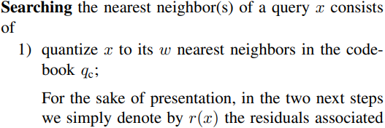
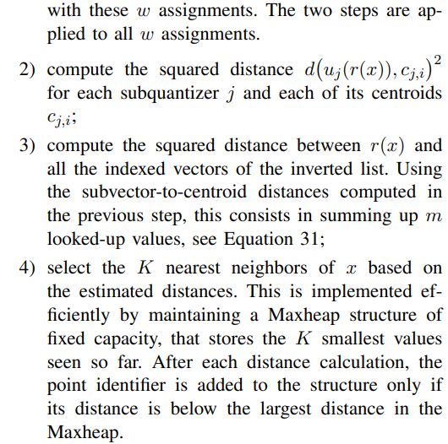
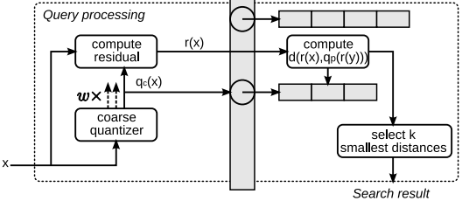

IVFADC (4)
Non-exhaustive NN search
Only scan a subset – $L_{i}$ corresponding to $q_{c}\left(x\right)$
To be more accurate, scan $x$’s $w$ nearest centroids in $q_{c}$

Slide 22
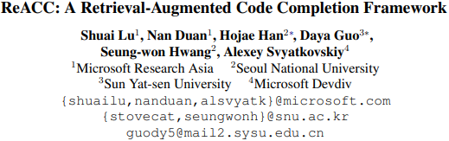

Slide 23
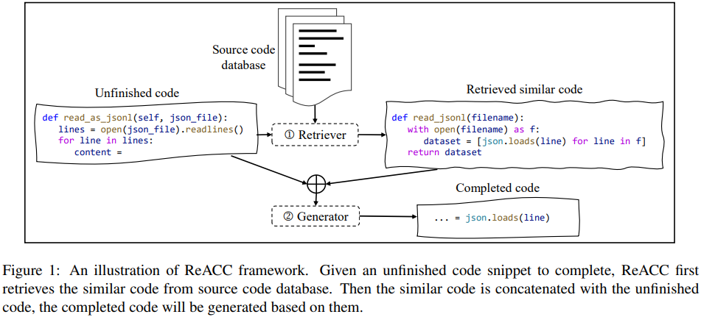
ReACC

Slide 24
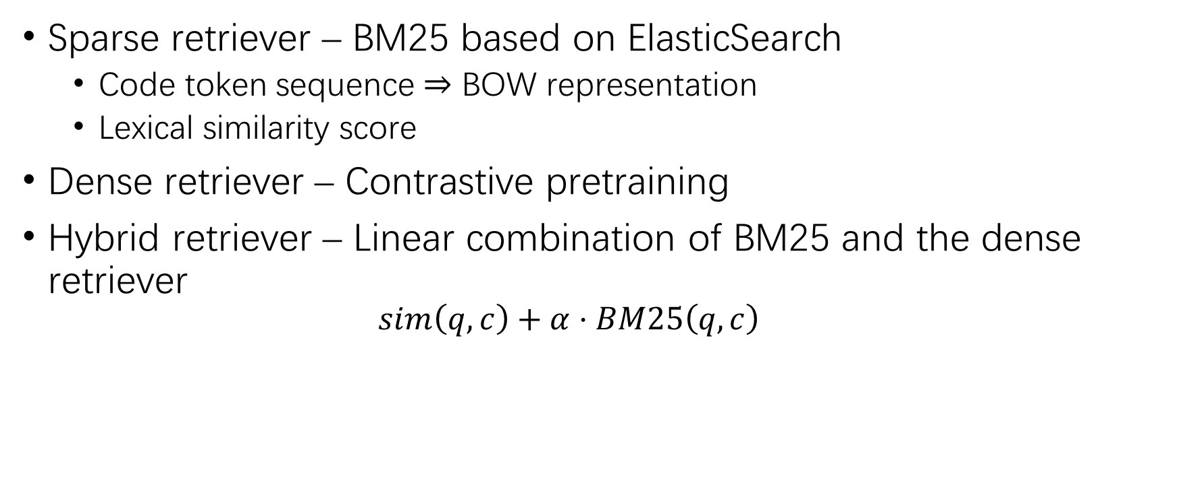
Retriever
Sparse retriever – BM25 based on ElasticSearch
Code token sequence $⇒$ BOW representation
Lexical similarity score
Dense retriever – Contrastive pretraining
Hybrid retriever – Linear combination of BM25 and the dense retriever
$$sim\left(q,c\right)+α⋅BM25\left(q,c\right)$$

Slide 25
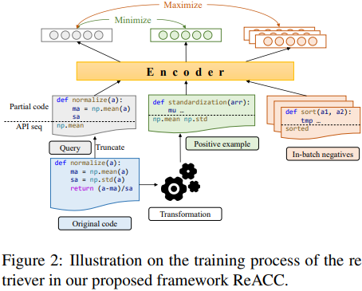
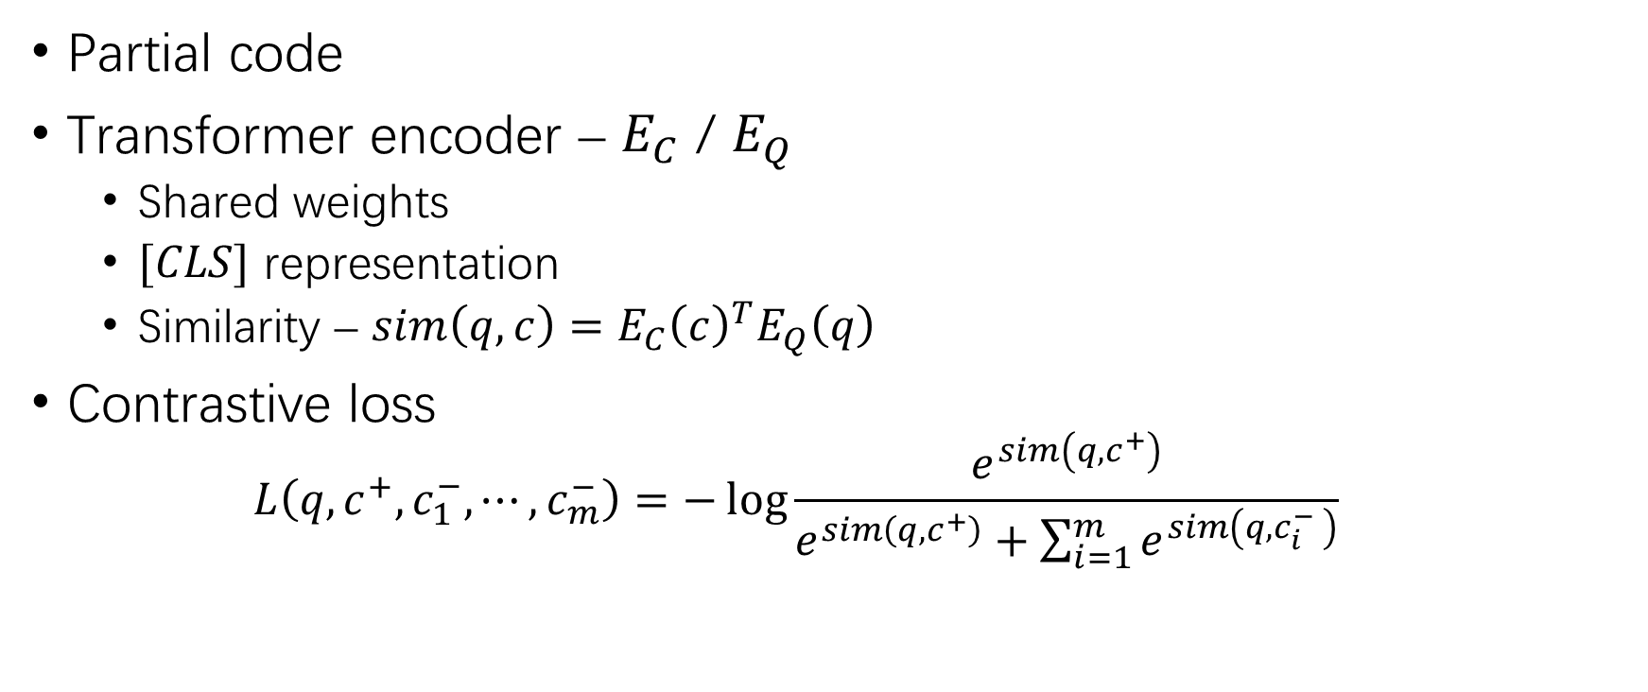
Dense Retriever
Partial code
Transformer encoder – $E_{C}$ / $E_{Q}$
Shared weights
$[CLS]$ representation
Similarity – $sim\left(q,c\right)=E_{C}{\left(c\right)}^{T}E_{Q}\left(q\right)$
Contrastive loss
$$L\left(q,c^{+},c_{1}^{−},⋯,c_{m}^{−}\right)=−\log{\frac{e^{sim\left(q,c^{+}\right)}}{e^{sim\left(q,c^{+}\right)}+\sum_{i=1}^{m}{e^{sim\left(q,c_{i}^{−} \right)}}}}$$

Slide 26
Dense Retriever (2)
Positive pair – Searching semantically equivalent code requires extra code compilation and execution costs
Data augmentation
Identifier renaming – Mask all IDs + GraphCodeBERT top-10 prediction
Dead code insertion – Predefined dead code template set
Input format – Token sequence + API sequence

Slide 27
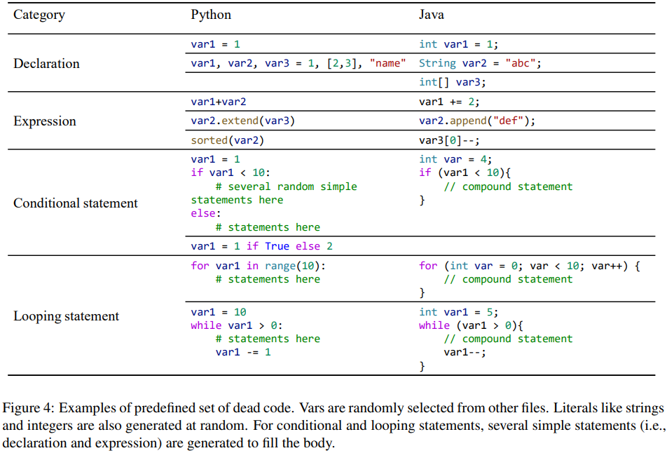
Dense Retriever (3)

Slide 28
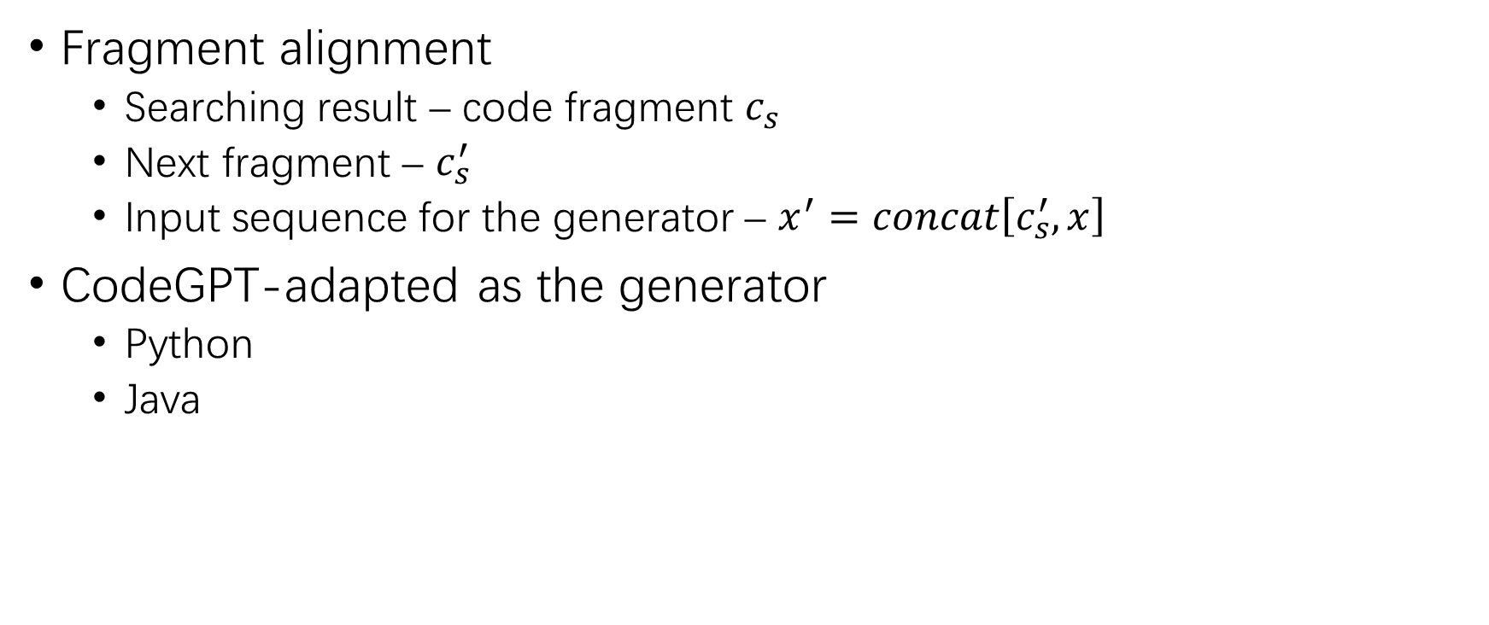
Generator
Fragment alignment
Searching result – code fragment $c_{s}$
Next fragment – $c_{s}^{′}$
Input sequence for the generator – $x^{′}=concat\left[c_{s}^{′},x\right]$
CodeGPT-adapted as the generator
Python
Java

Slide 29
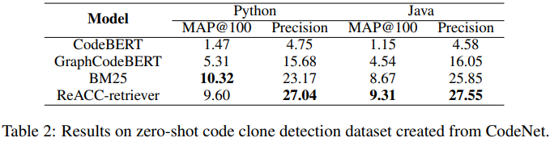
Code Clone Results
Zero-shot on CodeNet Java / Python
BM25 performs well
Semantically related codes are likely to be lexically similar

Slide 30
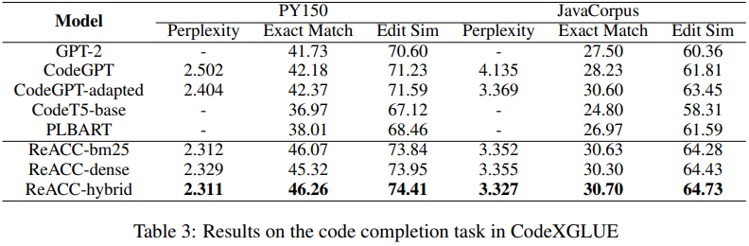
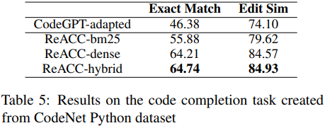
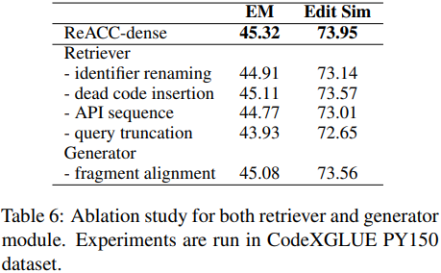
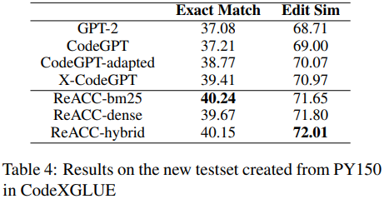
Code Completion Results

Slide 31
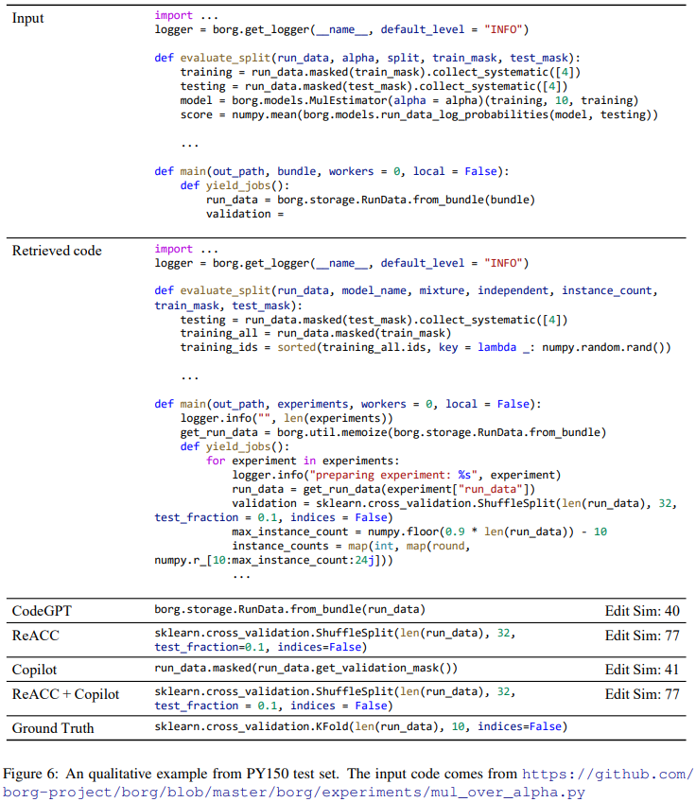
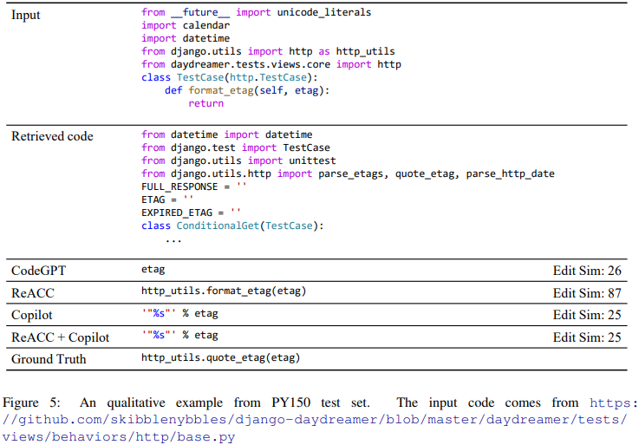
Code Completion Results (2)

Slide 32
THANK YOU!

