Slide 1
Adversarial Attack Detection
Huangzhao Zhang
zhang_hz@pku.edu.cn

Slide 2
Overview
Robust generalization bound – NeurIPs’22
The exponential curse of dimensionality is inescapable
DISP – EMNLP’19
Additional model for adversary detection and fixing
FGWS – EACL’21
Word-frequency-based adversary detection and fixing
WDR – ACL’22
Leave-one-out logits-based adversary detection and fixing

Slide 3
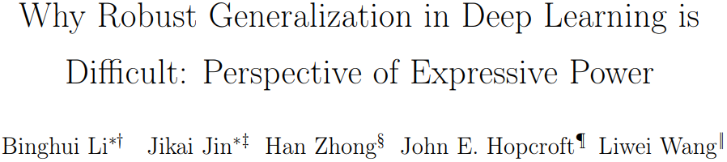

Slide 4
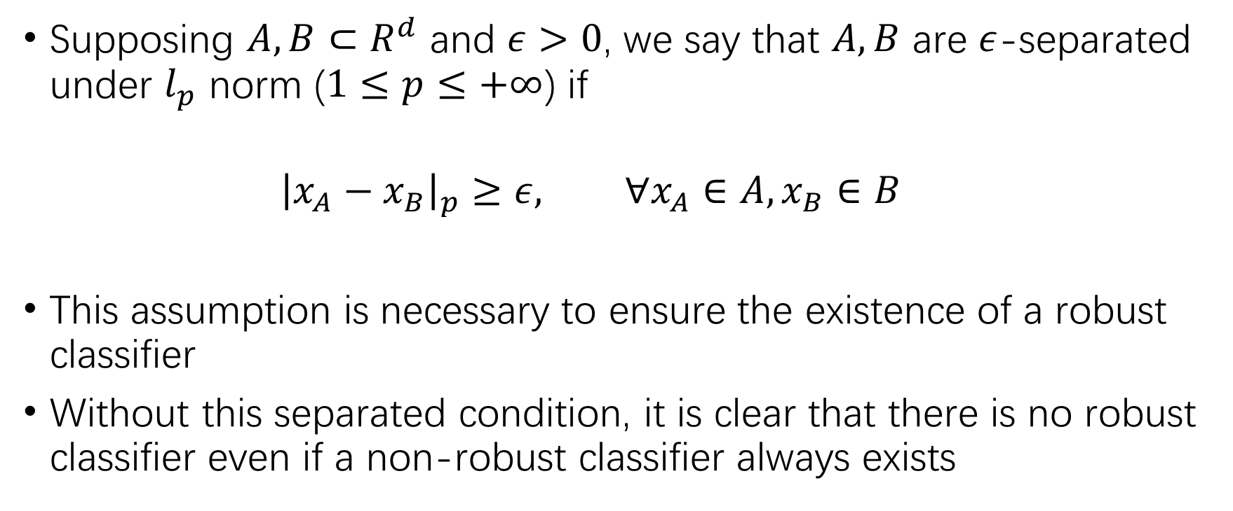
Separated Data & Robust Classifier
Supposing $A,B⊂R^{d}$ and $ε>0$, we say that $A,B$ are $ε$-separated under $l_{p}$ norm ($1≤p≤+∞$) if
$${\left|x_{A}−x_{B}\right|}_{p}≥ε, ∀x_{A}∈A,x_{B}∈B$$
This assumption is necessary to ensure the existence of a robust classifier
Without this separated condition, it is clear that there is no robust classifier even if a non-robust classifier always exists

Slide 5
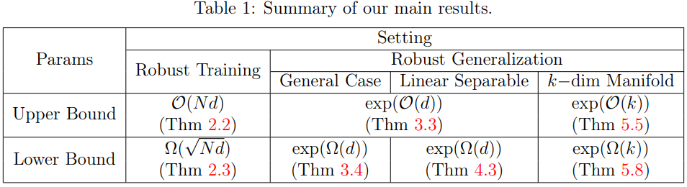
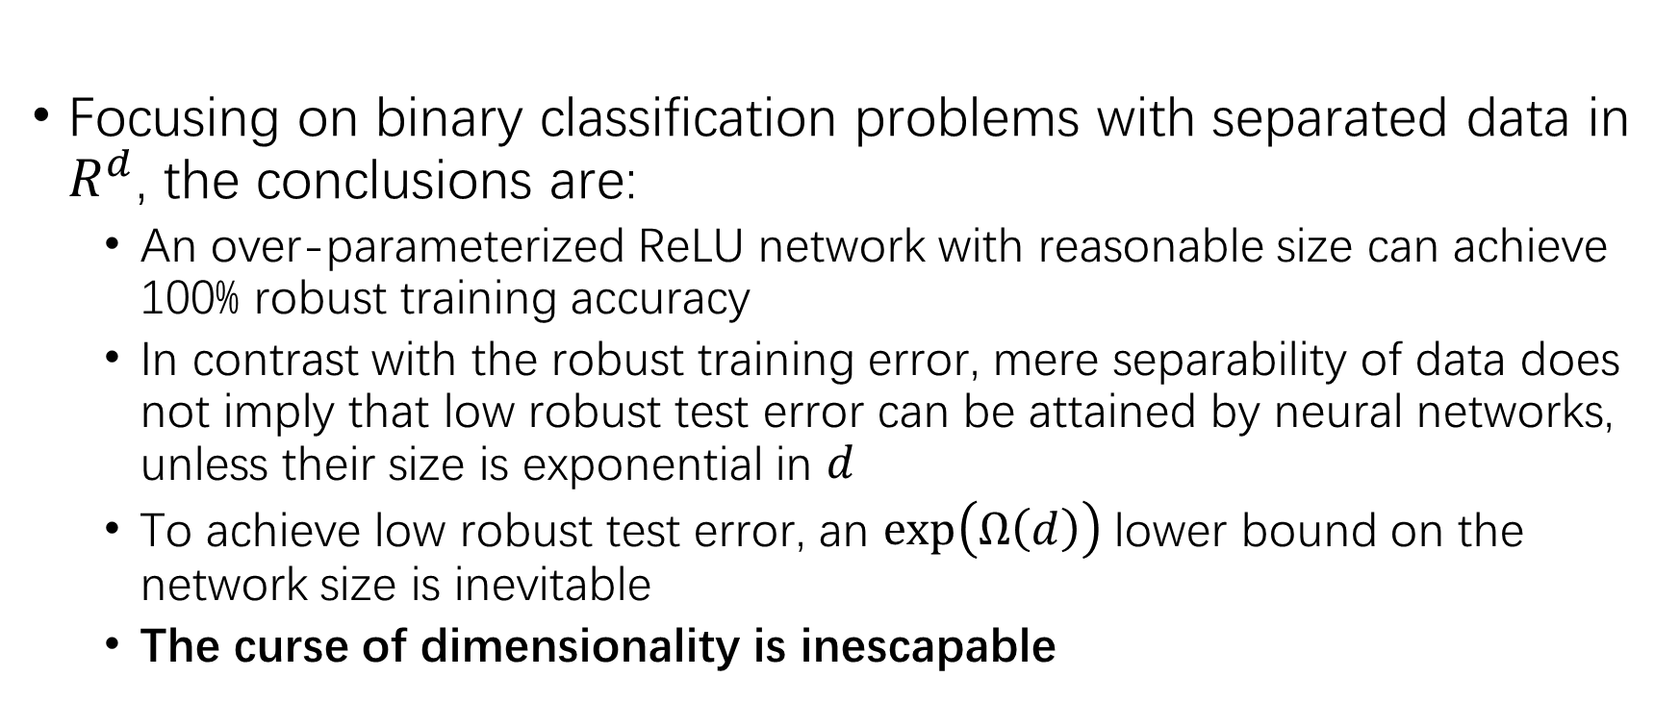
Conclusion
Focusing on binary classification problems with separated data in $R^{d}$, the conclusions are:
An over-parameterized ReLU network with reasonable size can achieve 100% robust training accuracy
In contrast with the robust training error, mere separability of data does not imply that low robust test error can be attained by neural networks, unless their size is exponential in $d$
To achieve low robust test error, an $\exp\left(Ω\left(d\right)\right)$ lower bound on the network size is inevitable
The curse of dimensionality is inescapable

Slide 6
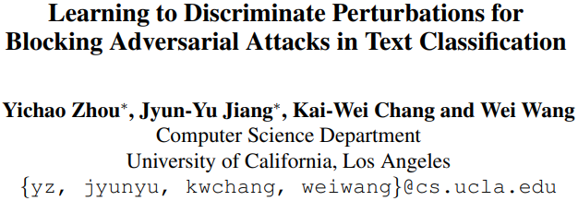

Slide 7
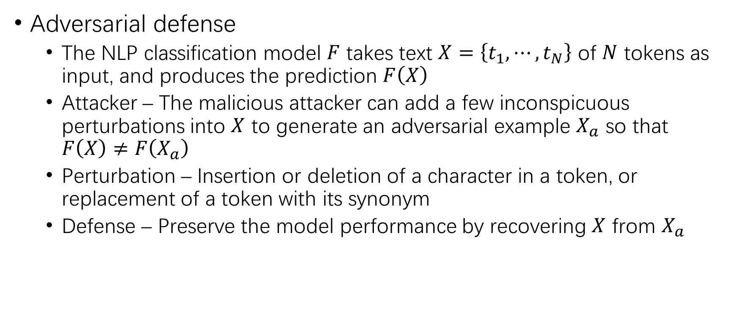
Problem Statement
Adversarial defense
The NLP classification model $F$ takes text $X=\left\{t_{1},⋯,t_{N}\right\}$ of $N$ tokens as input, and produces the prediction $F\left(X\right)$
Attacker – The malicious attacker can add a few inconspicuous perturbations into $X$ to generate an adversarial example $X_{a}$ so that $F\left(X\right)≠F\left(X_{a}\right)$
Perturbation – Insertion or deletion of a character in a token, or replacement of a token with its synonym
Defense – Preserve the model performance by recovering $X$ from $X_{a}$

Slide 8
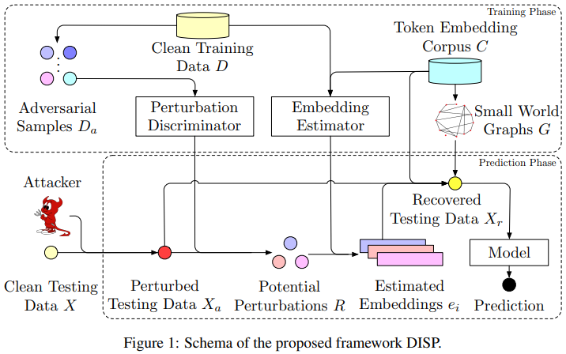
DIScriminate Perturbation
DISP

Slide 9
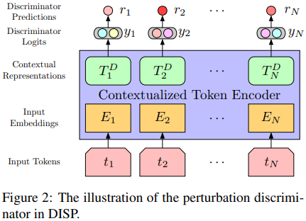
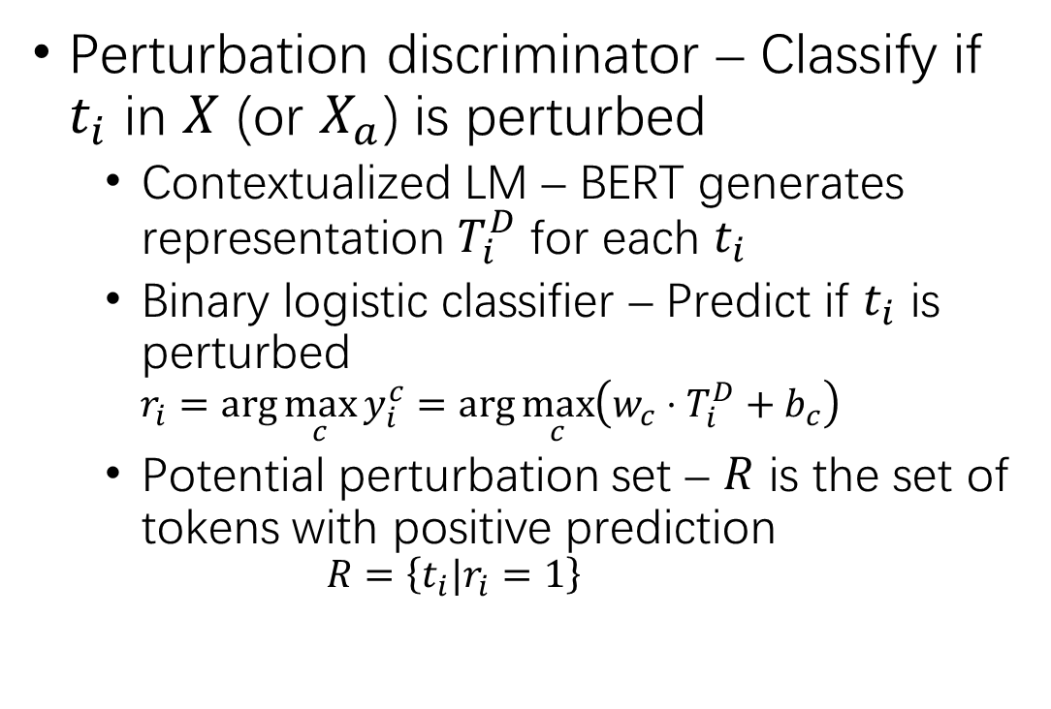
DISP
Perturbation discriminator – Classify if $t_{i}$ in $X$ (or $X_{a}$) is perturbed
Contextualized LM – BERT generates representation $T_{i}^{D}$ for each $t_{i}$
Binary logistic classifier – Predict if $t_{i}$ is perturbed
$$r_{i}=\arg{\max_{c}{y_{i}^{c}}}=\arg{\max_{c}\left(w_{c}⋅T_{i}^{D}+b_{c}\right)}$$
Potential perturbation set – $R$ is the set of tokens with positive prediction
$$R=\left\{t_{i}|r_{i}=1\right\}$$

Slide 10
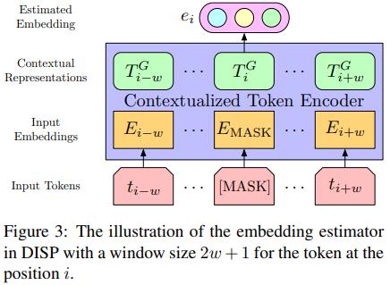
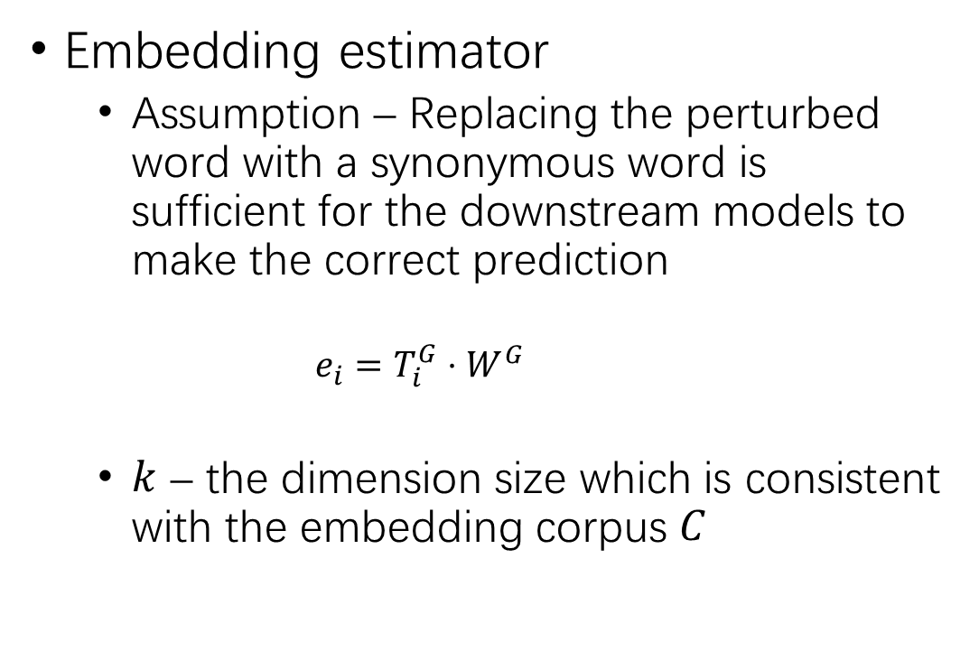
DISP (2)
Embedding estimator
Assumption – Replacing the perturbed word with a synonymous word is sufficient for the downstream models to make the correct prediction
$$e_{i}=T_{i}^{G}⋅W^{G}$$
$k$ – the dimension size which is consistent with the embedding corpus $C$

Slide 11
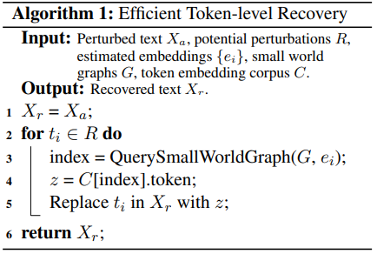

DISP (3)
Token recovery
$k$-NN search – Estimated embedding $⇒$ Recovered token
Hierarchical navigable small world graphs – $O\left(kn\right)⇒O\left(k\log{n}\right)$

Slide 12

DISP (4)
Training & optimization
Perturbation discriminator – Random adversarial example, $CE$
Embedding estimator – $\left(2w+1\right)$-gram MLM, $MSE\left(e_{i},e_{i,origin}\right)$
Hierarchical navigable SWGs – $O\left(kn\log{n}\right)$ one-time construction

Slide 13
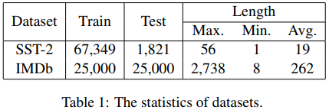
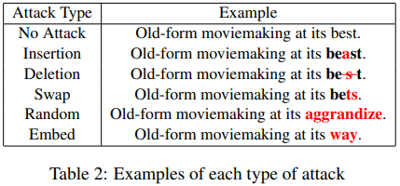
Experimental Setup
Dataset
SST-2 & IMDb
Attack
Character-level – Insertion, deletion, swap (adjacent)
Word-level – random, embed
Subject model
BERT
Baseline
Adversarial data augmentation
Adversarial training
Spelling correction

Slide 14
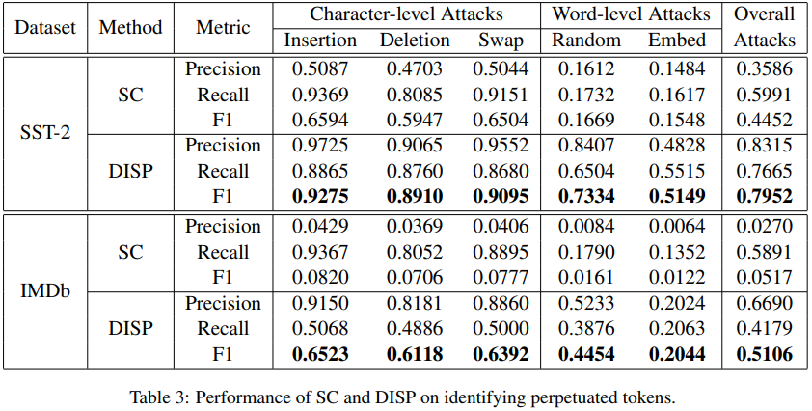
Experimental Result

Slide 15
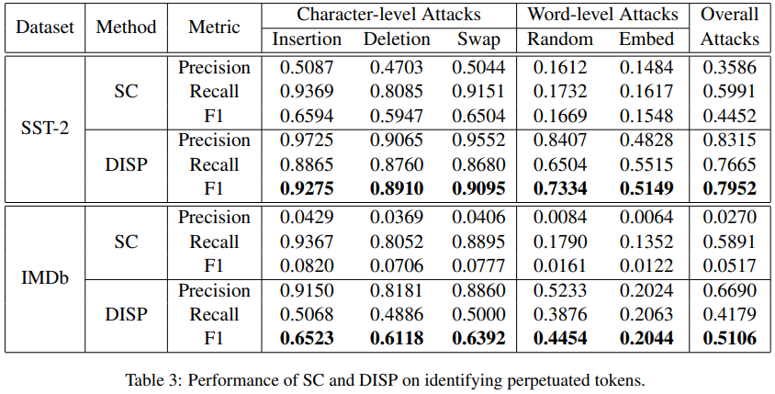
Experimental Result (2)

Slide 16
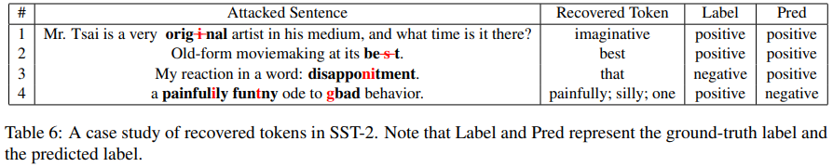
Experimental Result (3)

Slide 17
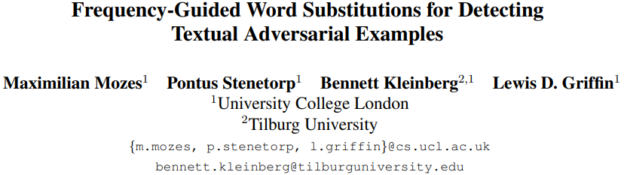

Slide 18
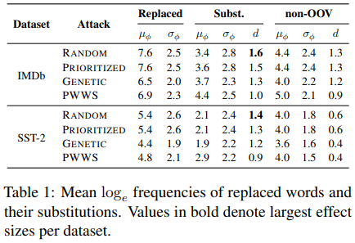
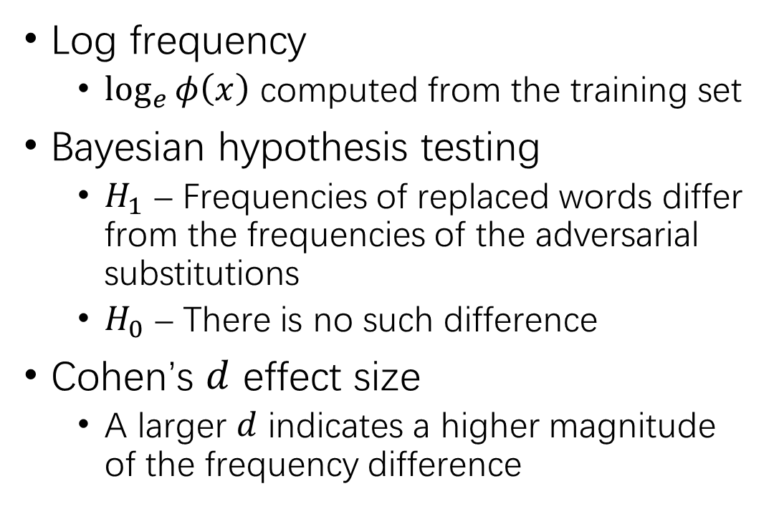
Word Frequency
Log frequency
$\log_{e}{φ\left(x\right)}$ computed from the training set
Bayesian hypothesis testing
$H_{1}$ – Frequencies of replaced words differ from the frequencies of the adversarial substitutions
$H_{0}$ – There is no such difference
Cohen’s $d$ effect size
A larger $d$ indicates a higher magnitude of the frequency difference

Slide 19
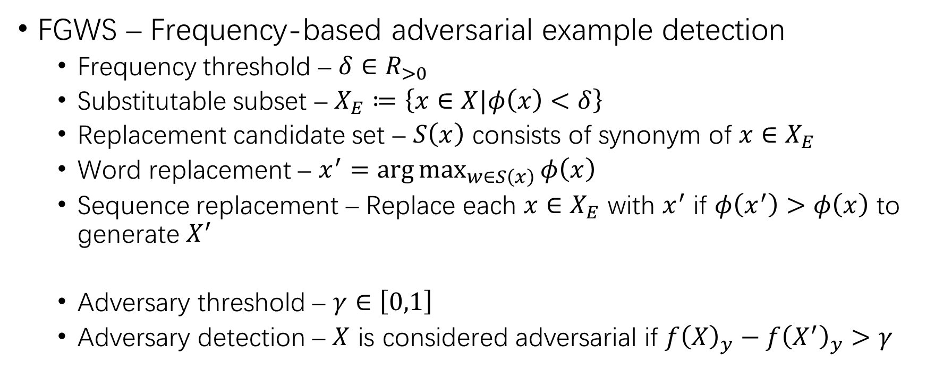
Frequency-Guided Word Substitution
FGWS – Frequency-based adversarial example detection
Frequency threshold – $δ∈R_{>0}$
Substitutable subset – $X_{E}≔\left\{x∈X|φ\left(x\right)<δ\right\}$
Replacement candidate set – $S\left(x\right)$ consists of synonym of $x∈X_{E}$
Word replacement – $x^{′}=\arg{\max_{w∈S\left(x\right)}{φ\left(x\right)}}$
Sequence replacement – Replace each $x∈X_{E}$ with $x^{′}$ if $φ\left(x^{′}\right)>φ\left(x\right)$ to generate $X^{′}$
Adversary threshold – $γ∈\left[0,1\right]$
Adversary detection – $X$ is considered adversarial if $f{\left(X\right)}_{y}−f{\left(X^{′}\right)}_{y}>γ$

Slide 20
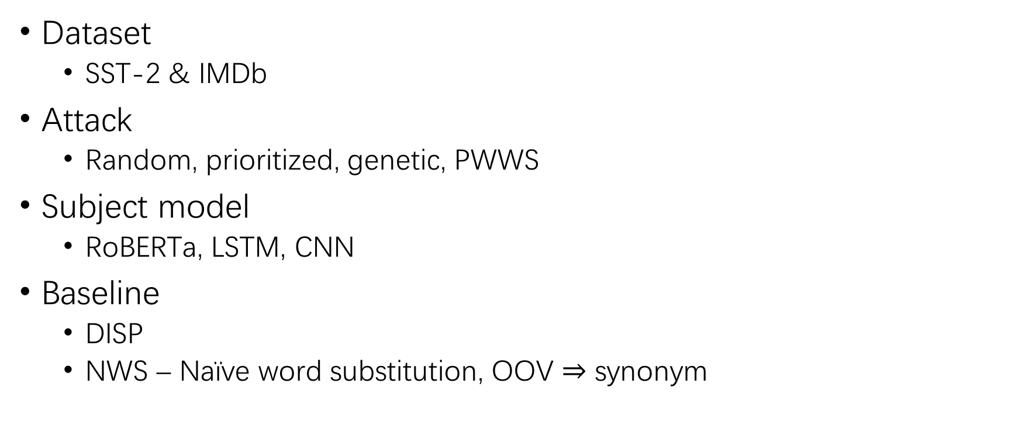
Experimental Setup
Dataset
SST-2 & IMDb
Attack
Random, prioritized, genetic, PWWS
Subject model
RoBERTa, LSTM, CNN
Baseline
DISP
NWS – Naïve word substitution, OOV $⇒$ synonym

Slide 21
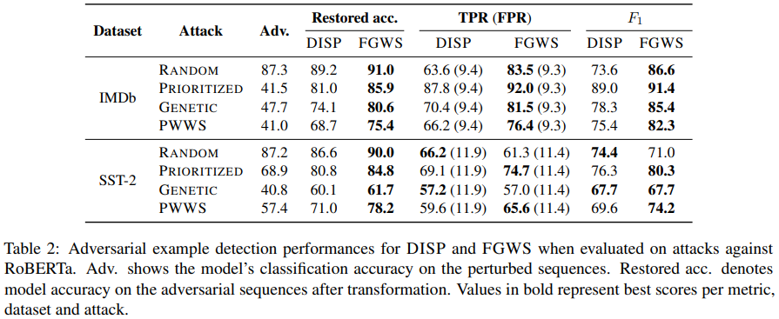
Experimental Result

Slide 22
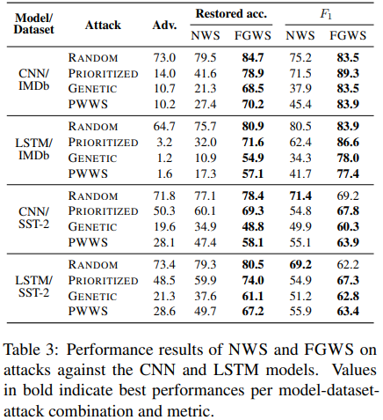
Experimental Result (2)

Slide 23


Slide 24
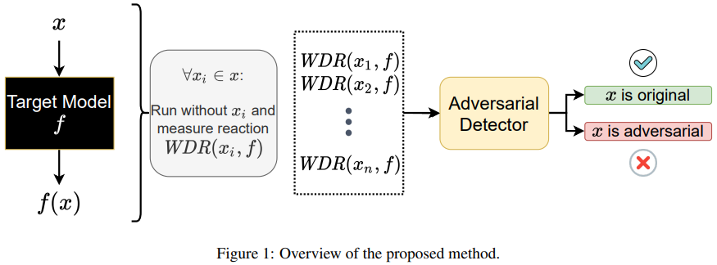
Word-Level Differential Reaction
The model’s reaction to original and adversarial samples is going to differ even if the inputs are similar

Slide 25
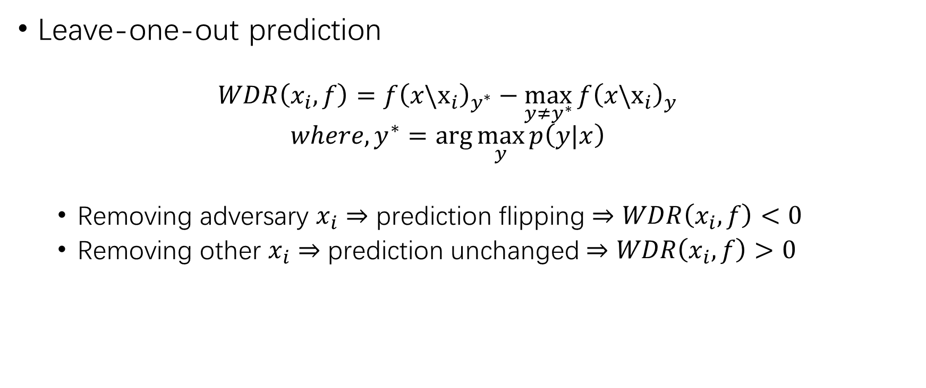
WDR
Leave-one-out prediction
$$WDR\left(x_{i},f\right)=f{\left(x\backslash x_{i}\right)}_{y^{∗}}−\max_{y≠y^{∗}}{f{\left(x\backslash x_{i}\right)}_{y}}$$
$$where, y^{∗}=\arg{\max_{y}{p\left(y|x\right)}}$$
Removing adversary $x_{i}$ $⇒$ prediction flipping $⇒$ $WDR\left(x_{i},f\right)<0$
Removing other $x_{i}$ $⇒$ prediction unchanged $⇒$ $WDR\left(x_{i},f\right)>0$

Slide 26
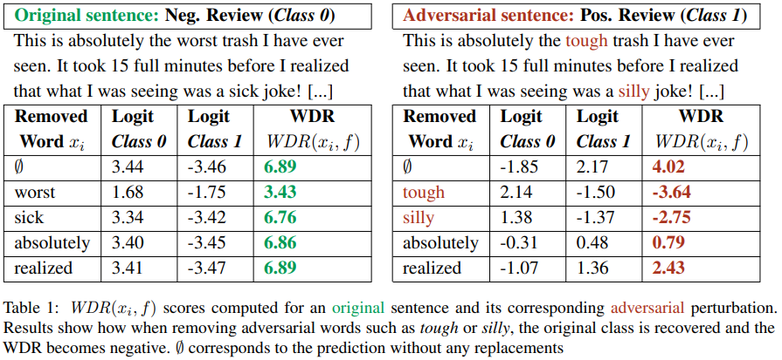
WDR (2)

Slide 27
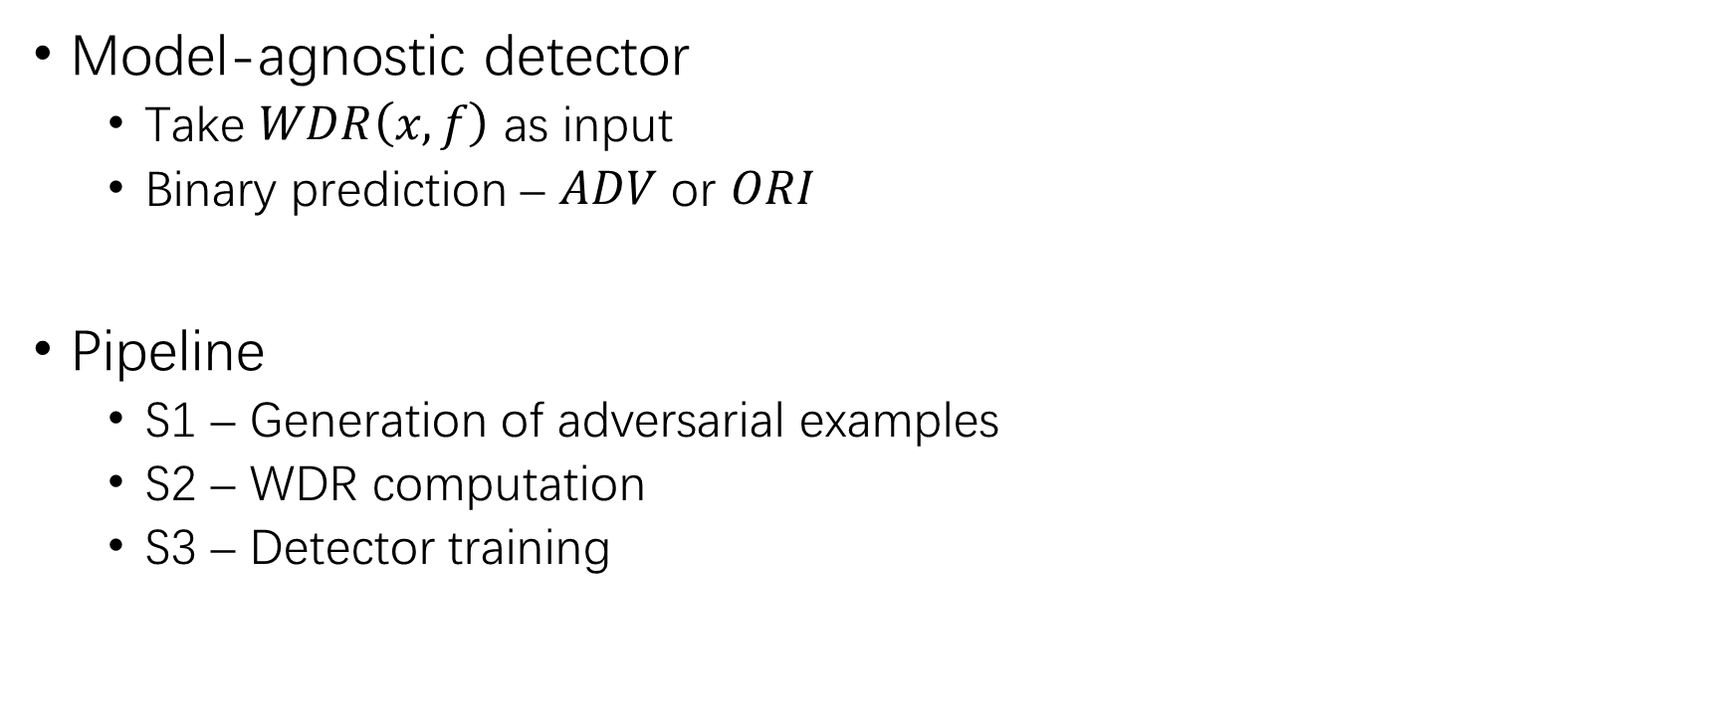
WDR (3)
Model-agnostic detector
Take $WDR\left(x,f\right)$ as input
Binary prediction – $ADV$ or $ORI$
Pipeline
S1 – Generation of adversarial examples
S2 – WDR computation
S3 – Detector training

Slide 28
Experimental Setup
Dataset
Binary sentimental analysis – IMDb, RTMR, & YELP
Topic classification – AG News
Subject model
DistilBERT (mainly), CNN, LSTM, & BERT
Attack algorithm
PWWS, Improved GA (IGA), TextFooler, & BERT-based adversarial example (BAE)

Slide 29
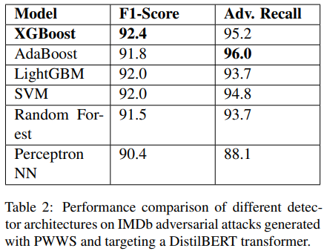
Experimental Result

Slide 30
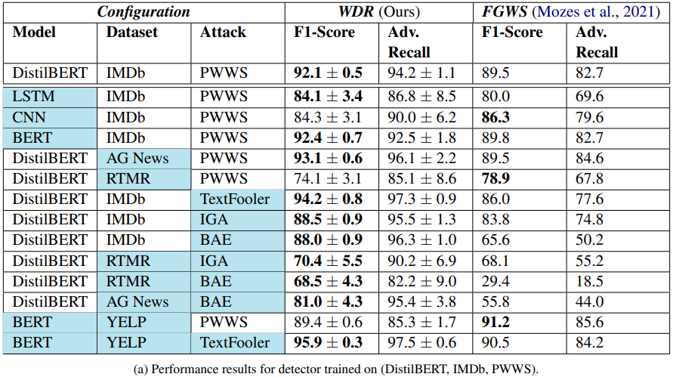
Experimental Result (2)

Slide 31
