Slide 1
Diffusion Models for Adversarial Purification
Huangzhao Zhang
zhang_hz@pku.edu.cn

Slide 2
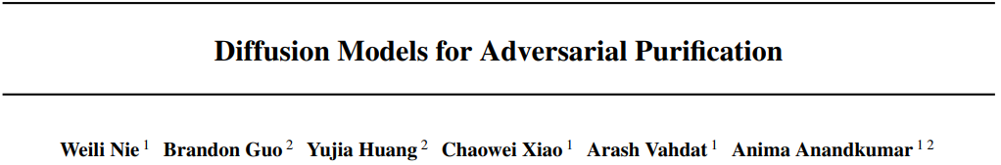

Slide 3
Defending NN against Adversary
Adversarial training
Standard defense – Very effective
Attack dependent
High computational overhead
Adversarial purification
Adopt generative models to purify adversary before classification
Plug-n-play – Without re-training the classifier
Independent from the classifier and the attack algorithm
Rather low performance – mode collapse (e.g., GAN)

Slide 4
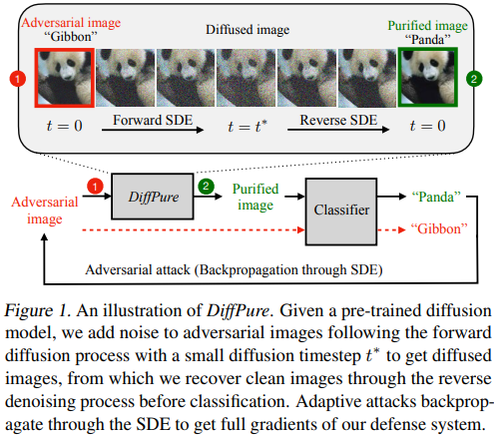
Diffusion Model for Adversarial Purification
Adversary – Noise-like perturbation
Forward process – Add noise
Reverse process – Remove noise

Slide 5
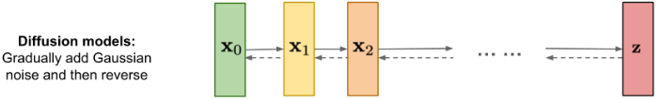
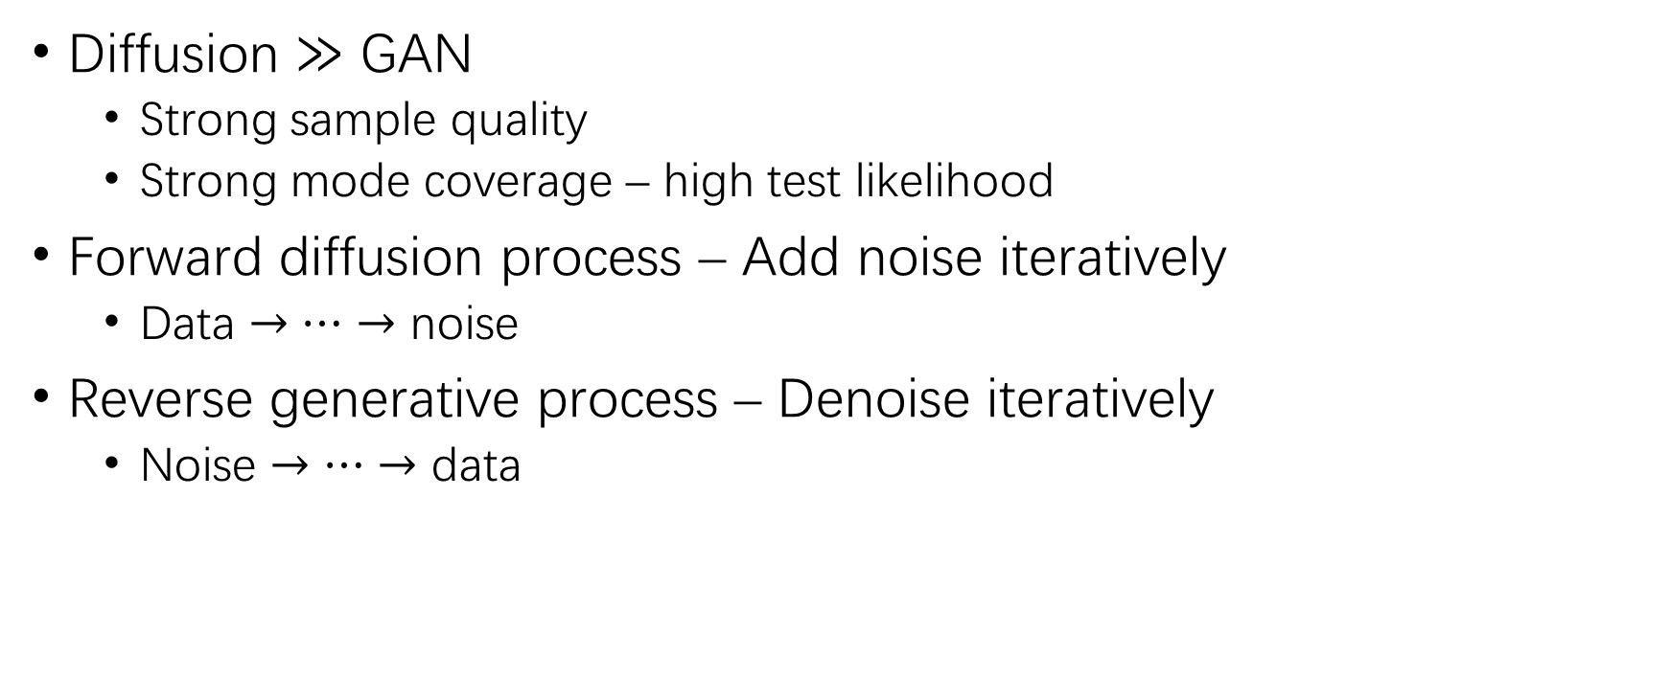
Diffusion Model
Diffusion $≫$ GAN
Strong sample quality
Strong mode coverage – high test likelihood
Forward diffusion process – Add noise iteratively
Data $→⋯→$ noise
Reverse generative process – Denoise iteratively
Noise $→⋯→$ data
Data
Noise

Slide 6


Slide 7
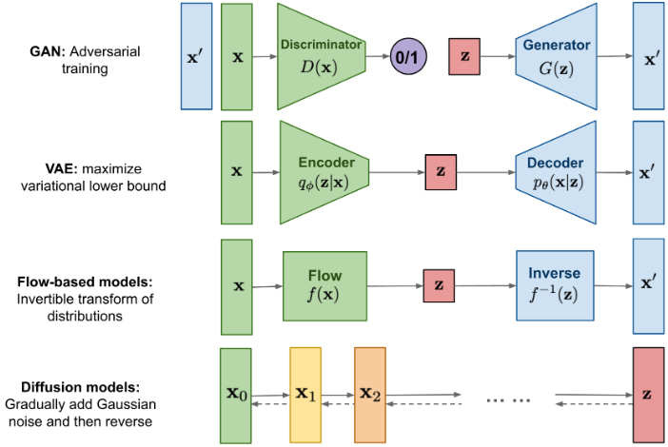
Diffusion V.s. Others
GAN
Unstable training
Less diversity generation
VAE
Rely on a surrogate loss
Flow
Specialized architecture
Diffusion
Fixed procedure
High-dimensional latent

Slide 8
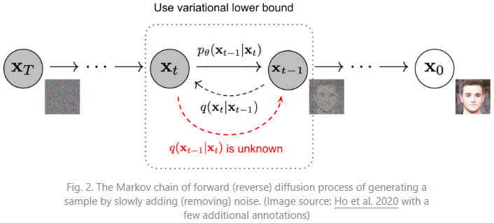
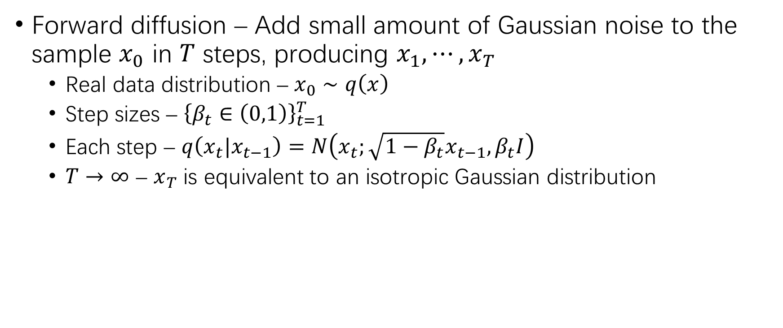
Forward Diffusion Process
Forward diffusion – Add small amount of Gaussian noise to the sample $x_{0}$ in $T$ steps, producing $x_{1},⋯,x_{T}$
Real data distribution – $x_{0}∼q\left(x\right)$
Step sizes – ${\left\{β_{t}∈\left(0,1\right)\right\}}_{t=1}^{T}$
Each step – $q\left(x_{t}|x_{t−1}\right)=N\left(x_{t};\sqrt{1−β_{t}}x_{t−1},β_{t}I\right)$
$T→∞$ – $x_{T}$ is equivalent to an isotropic Gaussian distribution

Slide 9


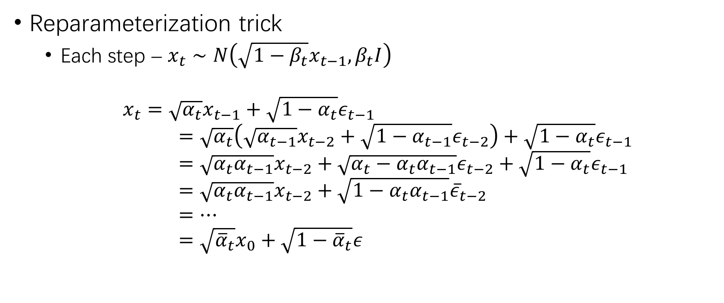
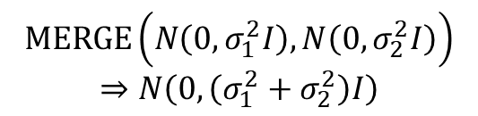


Forward Diffusion Process (2)
Reparameterization trick
Each step – $x_{t}∼N\left(\sqrt{1−β_{t}}x_{t−1},β_{t}I\right)$
$$x_{t}=\sqrt{α_{t}}x_{t−1}+\sqrt{1−α_{t}}ε_{t−1} \\ =\sqrt{α_{t}}\left(\sqrt{α_{t−1}}x_{t−2}+\sqrt{1−α_{t−1}}ε_{t−2}\right)+\sqrt{1−α_{t}}ε_{t−1} \\ =\sqrt{α_{t}α_{t−1}}x_{t−2}+\sqrt{α_{t}−α_{t}α_{t−1}}ε_{t−2}+\sqrt{1−α_{t}}ε_{t−1} \\ =\sqrt{α_{t}α_{t−1}}x_{t−2}+\sqrt{1−α_{t}α_{t−1}}{\overline{ε}}_{t−2} \\ =⋯ \\ =\sqrt{{\overline{α}}_{t}}x_{0}+\sqrt{1−{\overline{α}}_{t}}ε$$
$$α_{t}=1−β_{t}$$
$$ε_{t−1},ε_{t−2},⋯∼N\left(0,I\right)$$
$$MERGE\left(N\left(0,σ_{1}^{2}I\right),N\left(0,σ_{2}^{2}I\right)\right)$$
$$⇒N\left(0,\left(σ_{1}^{2}+σ_{2}^{2}\right)I\right)$$
${\overline{ε}}_{t−2}$ merges $ε_{t−1}$ and $ε_{t−2}$
$${\overline{α}}_{t}=\prod_{i=1}^{t}{α_{i}}$$

Slide 10
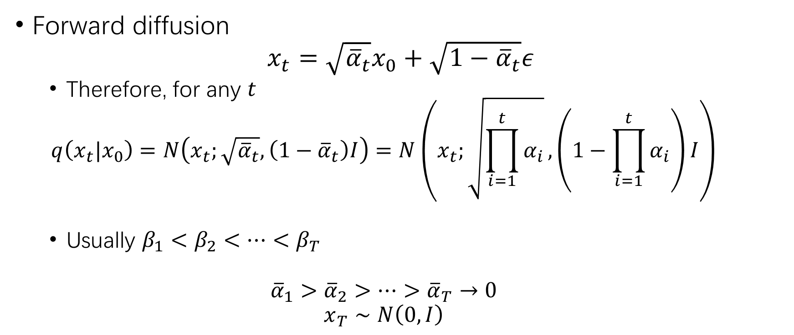
Forward Diffusion Process (3)
Forward diffusion
$$x_{t}=\sqrt{{\overline{α}}_{t}}x_{0}+\sqrt{1−{\overline{α}}_{t}}ε$$
Therefore, for any $t$
$$q\left(x_{t}|x_{0}\right)=N\left(x_{t};\sqrt{{\overline{α}}_{t}},\left(1−{\overline{α}}_{t}\right)I\right)=N\left(x_{t};\sqrt{\prod_{i=1}^{t}{α_{i}}},\left(1−\prod_{i=1}^{t}{α_{i}}\right)I\right)$$
Usually $β_{1}<β_{2}<⋯<β_{T}$
$${\overline{α}}_{1}>{\overline{α}}_{2}>⋯>{\overline{α}}_{T}→0$$
$$x_{T}∼N\left(0,I\right)$$

Slide 11
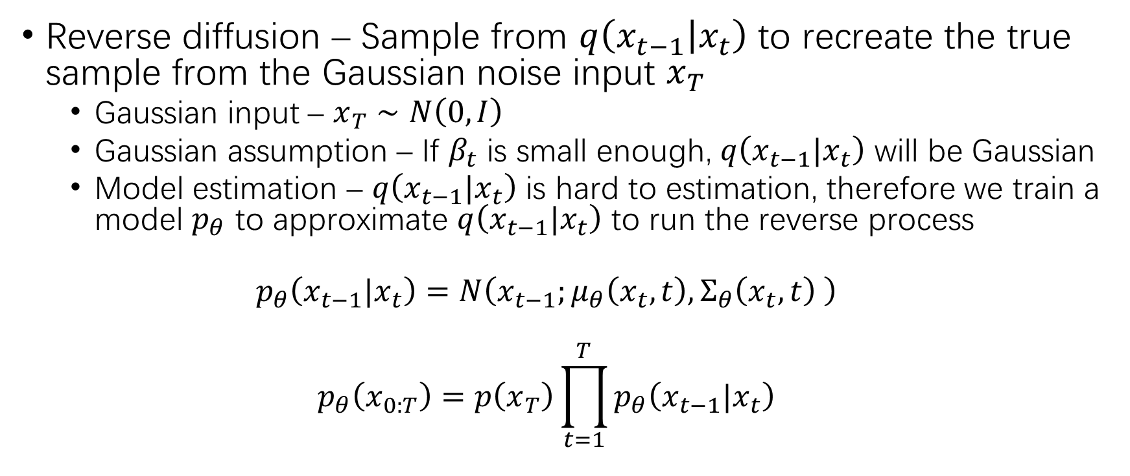
Reverse Diffusion Process
Reverse diffusion – Sample from $q\left(x_{t−1} | x_{t}\right)$ to recreate the true sample from the Gaussian noise input $x_{T}$
Gaussian input – $x_{T}∼N\left(0,I\right)$
Gaussian assumption – If $β_{t}$ is small enough, $q\left(x_{t−1}|x_{t}\right)$ will be Gaussian
Model estimation – $q\left(x_{t−1}|x_{t}\right)$ is hard to estimation, therefore we train a model $p_{θ}$ to approximate $q\left(x_{t−1}|x_{t}\right)$ to run the reverse process
$$p_{θ}\left(x_{t−1}|x_{t}\right)=N\left(x_{t−1};μ_{θ}\left(x_{t},t\right),Σ_{θ}\left(x_{t},t\right) \right)$$
$$p_{θ}\left(x_{0:T}\right)=p\left(x_{T}\right)\prod_{t=1}^{T}{p_{θ}\left(x_{t−1}|x_{t}\right)}$$

Slide 12
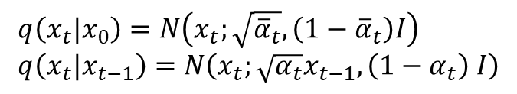
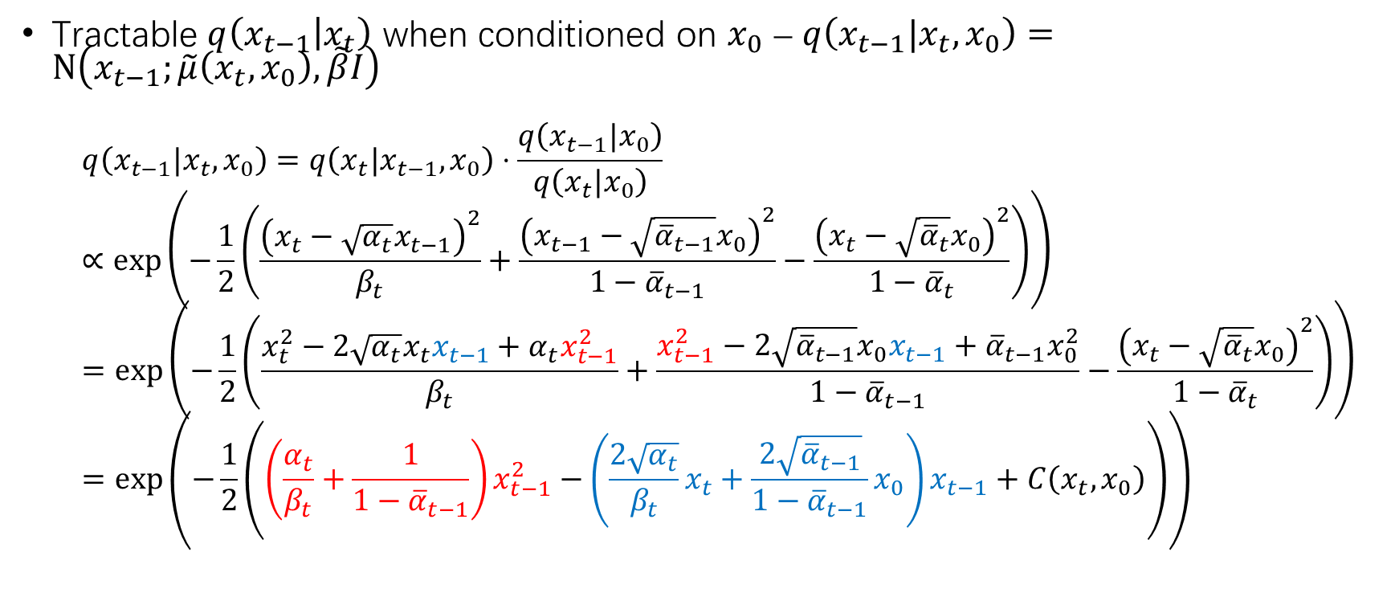
Reverse Diffusion Process (2)
$$q\left(x_{t}|x_{0}\right)=N\left(x_{t};\sqrt{{\overline{α}}_{t}},\left(1−{\overline{α}}_{t}\right)I\right) \\ q\left(x_{t}|x_{t−1}\right)=N\left(x_{t};\sqrt{α_{t}}x_{t−1},\left(1−α_{t}\right) I\right)$$
Tractable $q\left(x_{t−1} | x_{t}\right)$ when conditioned on $x_{0}$ – $q\left(x_{t−1}|x_{t},x_{0}\right)=N\left(x_{t−1};\tilde{μ}\left(x_{t},x_{0}\right),\tilde{β}I\right)$
$$q\left(x_{t−1}|x_{t},x_{0}\right)=q\left(x_{t}|x_{t−1},x_{0}\right)⋅\frac{q\left(x_{t−1}|x_{0}\right)}{q\left(x_{t}|x_{0}\right)}∝\exp\left(−\frac{1}{2}\left(\frac{{\left(x_{t}−\sqrt{α_{t}}x_{t−1}\right)}^{2}}{β_{t}}+\frac{{\left(x_{t−1}−\sqrt{{\overline{α}}_{t−1}}x_{0}\right)}^{2}}{1−{\overline{α}}_{t−1}}−\frac{{\left(x_{t}−\sqrt{{\overline{α}}_{t}}x_{0}\right)}^{2}}{1−{\overline{α}}_{t}}\right)\right)=\exp\left(−\frac{1}{2}\left(\frac{x_{t}^{2}−2\sqrt{α_{t}}x_{t}x_{t−1}+α_{t}x_{t−1}^{2}}{β_{t}}+\frac{x_{t−1}^{2}−2\sqrt{{\overline{α}}_{t−1}}x_{0}x_{t−1}+{\overline{α}}_{t−1}x_{0}^{2}}{1−{\overline{α}}_{t−1}}−\frac{{\left(x_{t}−\sqrt{{\overline{α}}_{t}}x_{0}\right)}^{2}}{1−{\overline{α}}_{t}}\right)\right)=\exp\left(−\frac{1}{2}\left(\left(\frac{α_{t}}{β_{t}}+\frac{1}{1−{\overline{α}}_{t−1}}\right)x_{t−1}^{2}−\left(\frac{2\sqrt{α_{t}}}{β_{t}}x_{t}+\frac{2\sqrt{{\overline{α}}_{t−1}}}{1−{\overline{α}}_{t−1}}x_{0}\right)x_{t−1}+C\left(x_{t},x_{0}\right)\right)\right)$$

Slide 13
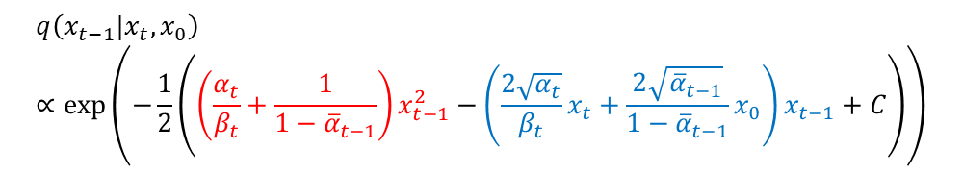
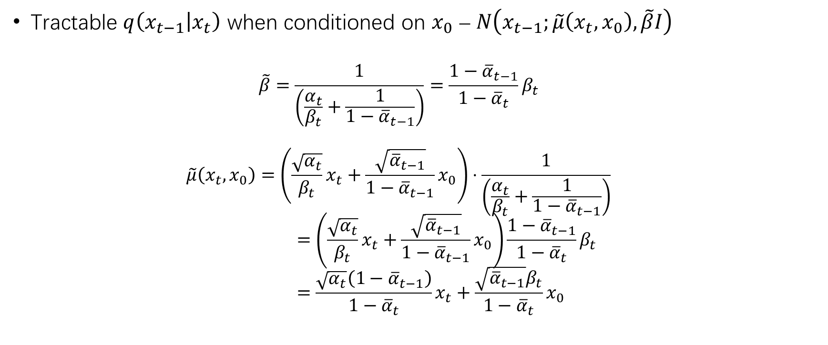
Reverse Diffusion Process (3)
Tractable $q\left(x_{t−1} | x_{t}\right)$ when conditioned on $x_{0}$ – $N\left(x_{t−1};\tilde{μ}\left(x_{t},x_{0}\right),\tilde{β}I\right)$
$$\tilde{β}=\frac{1}{\left(\frac{α_{t}}{β_{t}}+\frac{1}{1−{\overline{α}}_{t−1}}\right)}=\frac{1−{\overline{α}}_{t−1}}{1−{\overline{α}}_{t}}β_{t}$$
$$\tilde{μ}\left(x_{t},x_{0}\right)=\left(\frac{\sqrt{α_{t}}}{β_{t}}x_{t}+\frac{\sqrt{{\overline{α}}_{t−1}}}{1−{\overline{α}}_{t−1}}x_{0}\right)⋅\frac{1}{\left(\frac{α_{t}}{β_{t}}+\frac{1}{1−{\overline{α}}_{t−1}}\right)} \\ =\left(\frac{\sqrt{α_{t}}}{β_{t}}x_{t}+\frac{\sqrt{{\overline{α}}_{t−1}}}{1−{\overline{α}}_{t−1}}x_{0}\right)\frac{1−{\overline{α}}_{t−1}}{1−{\overline{α}}_{t}}β_{t} \\ =\frac{\sqrt{α_{t}}\left(1−{\overline{α}}_{t−1}\right)}{1−{\overline{α}}_{t}}x_{t}+\frac{\sqrt{{\overline{α}}_{t−1}}β_{t}}{1−{\overline{α}}_{t}}x_{0}$$
$$q\left(x_{t−1}|x_{t},x_{0}\right)∝\exp\left(−\frac{1}{2}\left(\left(\frac{α_{t}}{β_{t}}+\frac{1}{1−{\overline{α}}_{t−1}}\right)x_{t−1}^{2}−\left(\frac{2\sqrt{α_{t}}}{β_{t}}x_{t}+\frac{2\sqrt{{\overline{α}}_{t−1}}}{1−{\overline{α}}_{t−1}}x_{0}\right)x_{t−1}+C\right)\right)$$

Slide 14
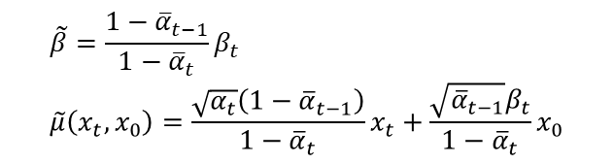
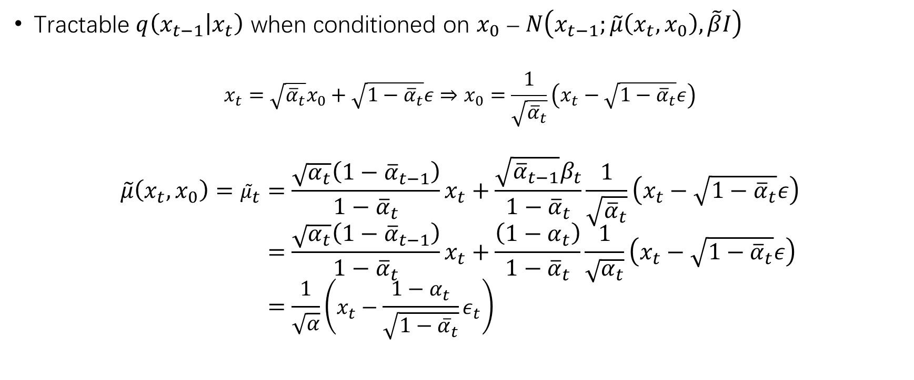

Reverse Diffusion Process (4)
$$\tilde{β}=\frac{1−{\overline{α}}_{t−1}}{1−{\overline{α}}_{t}}β_{t} \\ \tilde{μ}\left(x_{t},x_{0}\right)=\frac{\sqrt{α_{t}}\left(1−{\overline{α}}_{t−1}\right)}{1−{\overline{α}}_{t}}x_{t}+\frac{\sqrt{{\overline{α}}_{t−1}}β_{t}}{1−{\overline{α}}_{t}}x_{0}$$
Tractable $q\left(x_{t−1} | x_{t}\right)$ when conditioned on $x_{0}$ – $N\left(x_{t−1};\tilde{μ}\left(x_{t},x_{0}\right),\tilde{β}I\right)$
$$x_{t}=\sqrt{{\overline{α}}_{t}}x_{0}+\sqrt{1−{\overline{α}}_{t}}ε⇒x_{0}=\frac{1}{\sqrt{{\overline{α}}_{t}}}\left(x_{t}−\sqrt{1−{\overline{α}}_{t}}ε\right)$$
$$\tilde{μ}\left(x_{t},x_{0}\right)={\tilde{μ}}_{t}=\frac{\sqrt{α_{t}}\left(1−{\overline{α}}_{t−1}\right)}{1−{\overline{α}}_{t}}x_{t}+\frac{\sqrt{{\overline{α}}_{t−1}}β_{t}}{1−{\overline{α}}_{t}}\frac{1}{\sqrt{{\overline{α}}_{t}}}\left(x_{t}−\sqrt{1−{\overline{α}}_{t}}ε\right) \\ =\frac{\sqrt{α_{t}}\left(1−{\overline{α}}_{t−1}\right)}{1−{\overline{α}}_{t}}x_{t}+\frac{\left(1−α_{t}\right)}{1−{\overline{α}}_{t}}\frac{1}{\sqrt{α_{t}}}\left(x_{t}−\sqrt{1−{\overline{α}}_{t}}ε\right) \\ =\frac{1}{\sqrt{α}}\left(x_{t}−\frac{1−α_{t}}{\sqrt{1−{\overline{α}}_{t}}}ε_{t}\right)$$
$$\frac{\sqrt{α_{t}}\left(1−{\overline{α}}_{t−1}\right)}{1−{\overline{α}}_{t}}+\frac{\left(1−α_{t}\right)}{1−{\overline{α}}_{t}}\frac{1}{\sqrt{α_{t}}} \\ =\frac{\left(1−{\overline{α}}_{t−1}\right)α_{t}+\left(1−α_{t}\right)}{\left(1−{\overline{α}}_{t}\right)\sqrt{α_{t}}} \\ =\frac{α_{t}−{\overline{α}}_{t} +1−α_{t}}{\left(1−{\overline{α}}_{t}\right)\sqrt{α_{t}}} \\ =\frac{1}{\sqrt{α_{t}}}$$

Slide 15
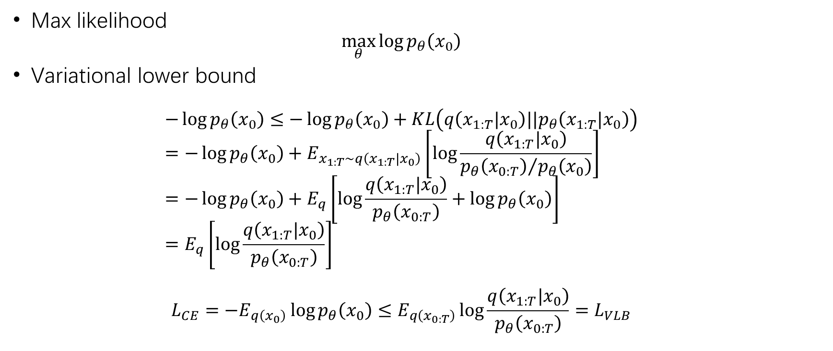
Variational Lower Bound
Max likelihood
$$\max_{θ}{\log{p_{θ}\left(x_{0}\right)}}$$
Variational lower bound
$$−\log{p_{θ}\left(x_{0}\right)}≤−\log{p_{θ}\left(x_{0}\right)+KL\left(q\left(x_{1:T}|x_{0}\right)||p_{θ}\left(x_{1:T}|x_{0}\right)\right)} \\ =−\log{p_{θ}\left(x_{0}\right)}+E_{x_{1:T}∼q\left(x_{1:T}|x_{0}\right)}\left[\log{\frac{q\left(x_{1:T}|x_{0}\right)}{{p_{θ}\left(x_{0:T}\right)}/{p_{θ}\left(x_{0}\right)}}}\right] \\ =−\log{p_{θ}\left(x_{0}\right)}+E_{q}\left[\log{\frac{q\left(x_{1:T}|x_{0}\right)}{p_{θ}\left(x_{0:T}\right)}}+\log{p_{θ}\left(x_{0}\right)}\right] \\ =E_{q}\left[\log{\frac{q\left(x_{1:T}|x_{0}\right)}{p_{θ}\left(x_{0:T}\right)}}\right]$$
$$L_{CE}=−E_{q\left(x_{0}\right)}\log{p_{θ}\left(x_{0}\right)}≤E_{q\left(x_{0:T}\right)}\log{\frac{q\left(x_{1:T}|x_{0}\right)}{p_{θ}\left(x_{0:T}\right)}}=L_{VLB}$$

Slide 16

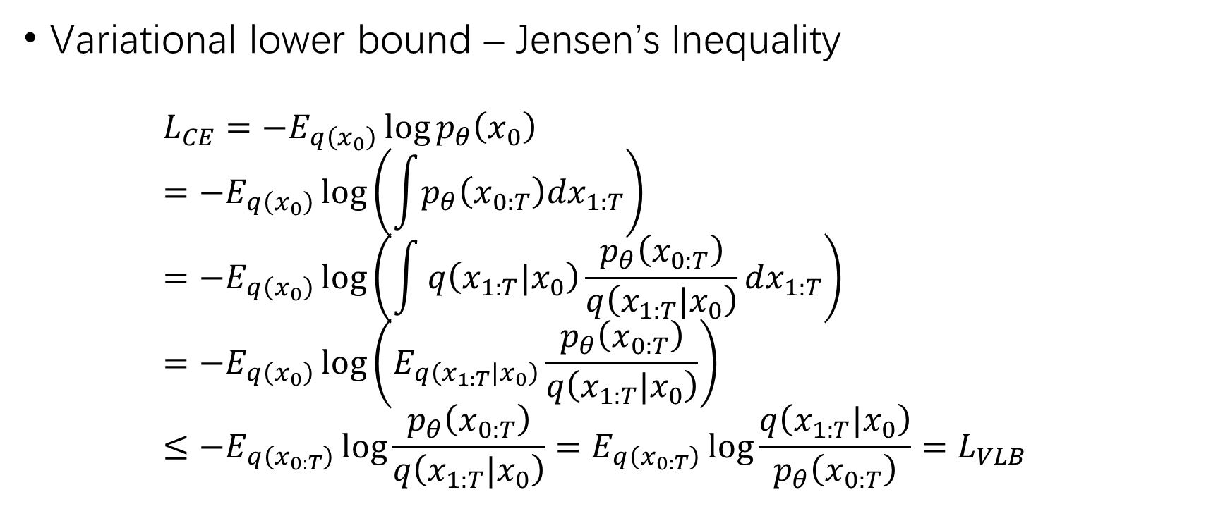
Variational Lower Bound (2)
Variational lower bound – Jensen’s Inequality
$$L_{CE}=−E_{q\left(x_{0}\right)}\log{p_{θ}\left(x_{0}\right)} \\ =−E_{q\left(x_{0}\right)}\log\left(\int{p_{θ}\left(x_{0:T}\right)dx_{1:T}}\right) \\ =−E_{q\left(x_{0}\right)}\log\left(\int{q\left(x_{1:T}|x_{0}\right)\frac{p_{θ}\left(x_{0:T}\right)}{q\left(x_{1:T}|x_{0}\right)}dx_{1:T}}\right) \\ =−E_{q\left(x_{0}\right)}\log\left(E_{q\left(x_{1:T}|x_{0}\right)}\frac{p_{θ}\left(x_{0:T}\right)}{q\left(x_{1:T}|x_{0}\right)}\right) \\ ≤−E_{q\left(x_{0:T}\right)}\log{\frac{p_{θ}\left(x_{0:T}\right)}{q\left(x_{1:T}|x_{0}\right)}}=E_{q\left(x_{0:T}\right)}\log{\frac{q\left(x_{1:T}|x_{0}\right)}{p_{θ}\left(x_{0:T}\right)}}=L_{VLB}$$
$$φ\left(E\left[X\right]\right)≤E\left[φ\left(X\right)\right]$$

Slide 17
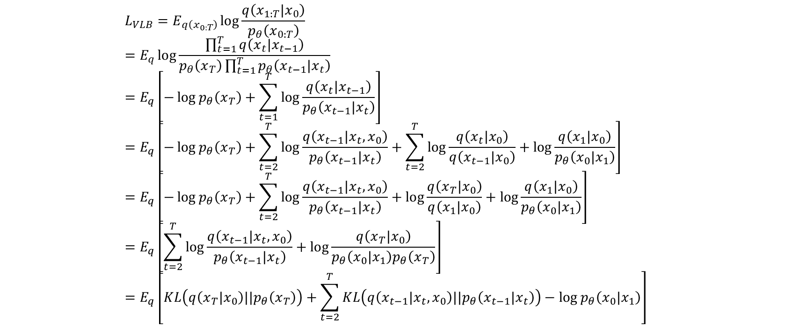
Variational Lower Bound (3)
$$L_{VLB}=E_{q\left(x_{0:T}\right)}\log{\frac{q\left(x_{1:T}|x_{0}\right)}{p_{θ}\left(x_{0:T}\right)}} \\ =E_{q}\log{\frac{\prod_{t=1}^{T}{q\left(x_{t}|x_{t−1}\right)}}{p_{θ}\left(x_{T}\right)\prod_{t=1}^{T}{p_{θ}\left(x_{t−1}|x_{t}\right)}}} \\ =E_{q}\left[−\log{p_{θ}\left(x_{T}\right)}+\sum_{t=1}^{T}{\log{\frac{q\left(x_{t}|x_{t−1}\right)}{p_{θ}\left(x_{t−1}|x_{t}\right)}}}\right] \\ =E_{q}\left[−\log{p_{θ}\left(x_{T}\right)}+\sum_{t=2}^{T}{\log{\frac{q\left(x_{t−1}|x_{t},x_{0}\right)}{p_{θ}\left(x_{t−1}|x_{t}\right)}}}+\sum_{t=2}^{T}{\log{\frac{q\left(x_{t}|x_{0}\right)}{q\left(x_{t−1}|x_{0}\right)}}}+\log{\frac{q\left(x_{1}|x_{0}\right)}{p_{θ}\left(x_{0}|x_{1}\right)}}\right] \\ =E_{q}\left[−\log{p_{θ}\left(x_{T}\right)}+\sum_{t=2}^{T}{\log{\frac{q\left(x_{t−1}|x_{t},x_{0}\right)}{p_{θ}\left(x_{t−1}|x_{t}\right)}}}+\log{\frac{q\left(x_{T}|x_{0}\right)}{q\left(x_{1}|x_{0}\right)}}+\log{\frac{q\left(x_{1}|x_{0}\right)}{p_{θ}\left(x_{0}|x_{1}\right)}}\right] \\ =E_{q}\left[\sum_{t=2}^{T}{\log{\frac{q\left(x_{t−1}|x_{t},x_{0}\right)}{p_{θ}\left(x_{t−1}|x_{t}\right)}}}+\log{\frac{q\left(x_{T}|x_{0}\right)}{p_{θ}\left(x_{0}|x_{1}\right)p_{θ}\left(x_{T}\right)}}\right] \\ =E_{q}\left[KL\left(q\left(x_{T}|x_{0}\right)||p_{θ}\left(x_{T}\right)\right)+\sum_{t=2}^{T}{KL\left(q\left(x_{t−1}|x_{t},x_{0}\right)||p_{θ}\left(x_{t−1}|x_{t}\right)\right)}−\log{p_{θ}\left(x_{0}|x_{1}\right)}\right]$$

Slide 18
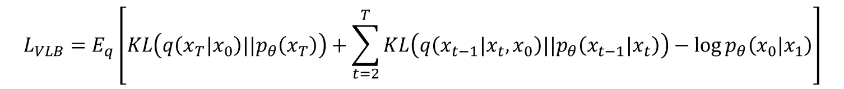

Variational Lower Bound (4)
VLB component – $L_{VLB}=L_{T}+L_{T−1}+⋯+L_{0}$
$L_{T}=KL\left(q\left(x_{T}|x_{0}\right)||p_{θ}\left(x_{T}\right)\right)$ – Constant
$L_{t}=KL\left(q\left(x_{t}|x_{t+1},x_{0}\right)||p_{θ}\left(x_{t}|x_{t+1}\right)\right)$ – Model $q\left(x_{t}|x_{t+1},x_{0}\right)$ with $p_{θ}\left(x_{t}|x_{t+1}\right)$
$L_{0}=−\log{p_{θ}\left(x_{0}|x_{1}\right)}$ – Modeled by a separate discrete decoder
$$L_{VLB}=E_{q}\left[KL\left(q\left(x_{T}|x_{0}\right)||p_{θ}\left(x_{T}\right)\right)+\sum_{t=2}^{T}{KL\left(q\left(x_{t−1}|x_{t},x_{0}\right)||p_{θ}\left(x_{t−1}|x_{t}\right)\right)}−\log{p_{θ}\left(x_{0}|x_{1}\right)}\right]$$

Slide 19
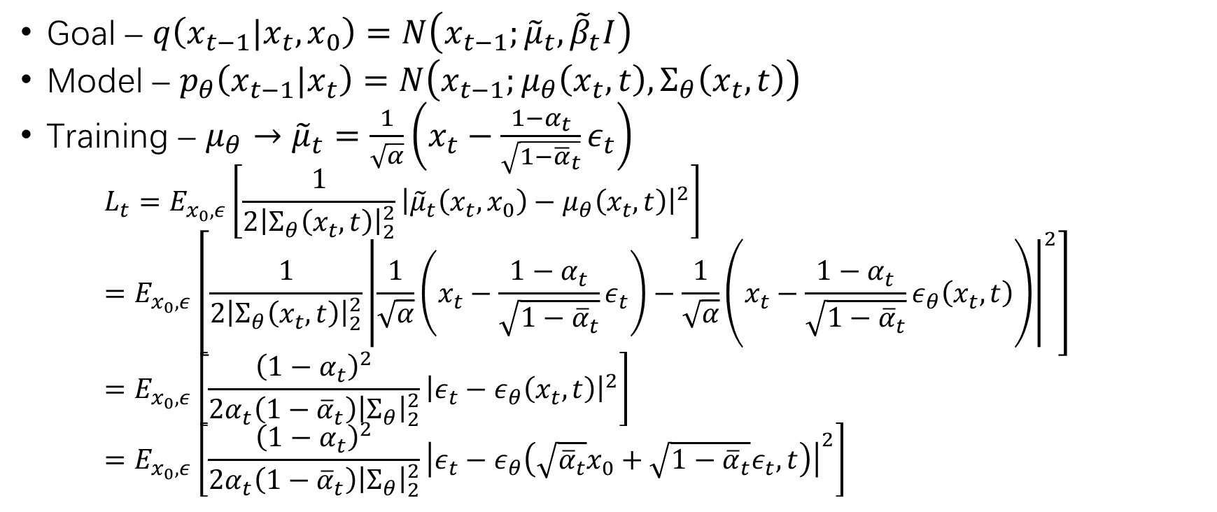


Parameterization of $L_{t}$
Goal – $q\left(x_{t−1}|x_{t},x_{0}\right)=N\left(x_{t−1};{\tilde{μ}}_{t},{\tilde{β}}_{t}I\right)$
Model – $p_{θ}\left(x_{t−1}|x_{t}\right)=N\left(x_{t−1};μ_{θ}\left(x_{t},t\right),Σ_{θ}\left(x_{t},t\right)\right)$
Training – $μ_{θ}→{\tilde{μ}}_{t}=\frac{1}{\sqrt{α}}\left(x_{t}−\frac{1−α_{t}}{\sqrt{1−{\overline{α}}_{t}}}ε_{t}\right)$
$$L_{t}=E_{x_{0},ε}\left[\frac{1}{2{\left|Σ_{θ}\left(x_{t},t\right)\right|}_{2}^{2}}{\left|{\tilde{μ}}_{t}\left(x_{t},x_{0}\right)−μ_{θ}\left(x_{t},t\right)\right|}^{2}\right] \\ =E_{x_{0},ε}\left[\frac{1}{2{\left|Σ_{θ}\left(x_{t},t\right)\right|}_{2}^{2}}{\left|\frac{1}{\sqrt{α}}\left(x_{t}−\frac{1−α_{t}}{\sqrt{1−{\overline{α}}_{t}}}ε_{t}\right)−\frac{1}{\sqrt{α}}\left(x_{t}−\frac{1−α_{t}}{\sqrt{1−{\overline{α}}_{t}}}ε_{θ}\left(x_{t},t\right)\right)\right|}^{2}\right] \\ =E_{x_{0},ε}\left[\frac{{\left(1−α_{t}\right)}^{2}}{2α_{t}\left(1−{\overline{α}}_{t}\right){\left|Σ_{θ}\right|}_{2}^{2}}{\left|ε_{t}−ε_{θ}\left(x_{t},t\right)\right|}^{2}\right] \\ =E_{x_{0},ε}\left[\frac{{\left(1−α_{t}\right)}^{2}}{2α_{t}\left(1−{\overline{α}}_{t}\right){\left|Σ_{θ}\right|}_{2}^{2}}{\left|ε_{t}−ε_{θ}\left(\sqrt{{\overline{α}}_{t}}x_{0}+\sqrt{1−{\overline{α}}_{t}}ε_{t},t\right)\right|}^{2}\right]$$
$$x_{t}=\sqrt{{\overline{α}}_{t}}x_{0}+\sqrt{1−{\overline{α}}_{t}}ε_{t}$$

Slide 20
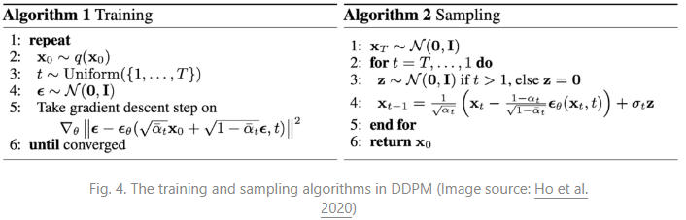
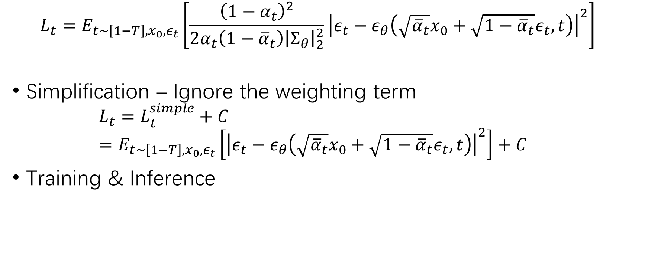

Parameterization of $L_{t}$ (2)
$$L_{t}=E_{t∼\left[1−T\right],x_{0},ε_{t}}\left[\frac{{\left(1−α_{t}\right)}^{2}}{2α_{t}\left(1−{\overline{α}}_{t}\right){\left|Σ_{θ}\right|}_{2}^{2}}{\left|ε_{t}−ε_{θ}\left(\sqrt{{\overline{α}}_{t}}x_{0}+\sqrt{1−{\overline{α}}_{t}}ε_{t},t\right)\right|}^{2}\right]$$
Simplification – Ignore the weighting term
$$L_{t}=L_{t}^{simple}+C \\ =E_{t∼\left[1−T\right],x_{0},ε_{t}}\left[{\left|ε_{t}−ε_{θ}\left(\sqrt{{\overline{α}}_{t}}x_{0}+\sqrt{1−{\overline{α}}_{t}}ε_{t},t\right)\right|}^{2}\right]+C$$
Training & Inference

Slide 21
Done with diffusion model!
Back to adversarial purification…

Slide 22
Diffusion Model for Adversarial Purification
Adversary – Noise-like perturbation
Forward process – Add noise
Reverse process – Remove noise

Slide 23

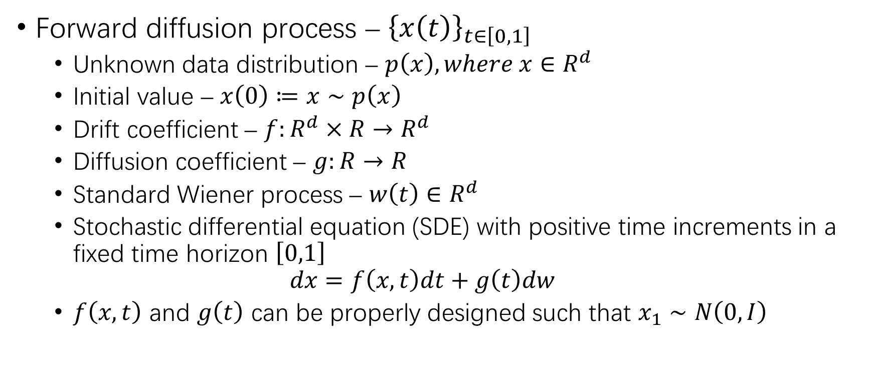
Continuous Time Diffusion Model
Forward diffusion process – ${\left\{x\left(t\right)\right\}}_{t∈\left[0,1\right]}$
Unknown data distribution – $p\left(x\right), where x∈R^{d}$
Initial value – $x\left(0\right)≔x∼p\left(x\right)$
Drift coefficient – $f:R^{d}×R→R^{d}$
Diffusion coefficient – $g:R→R$
Standard Wiener process – $w\left(t\right)∈R^{d}$
Stochastic differential equation (SDE) with positive time increments in a fixed time horizon $\left[0,1\right]$
$$dx=f\left(x,t\right)dt+g\left(t\right)dw$$
$f\left(x,t\right)$ and $g\left(t\right)$ can be properly designed such that $x_{1}∼N\left(0,I\right)$
VP-SDE
$$f\left(x,t\right)≔−\frac{1}{2}β\left(t\right) \\ g\left(t\right)≔\sqrt{β\left(t\right)}$$
Linear time-dependent noise scale
$$β\left(t\right)≔β_{min}+\left(β_{max}−β_{min}\right)t$$

Slide 24
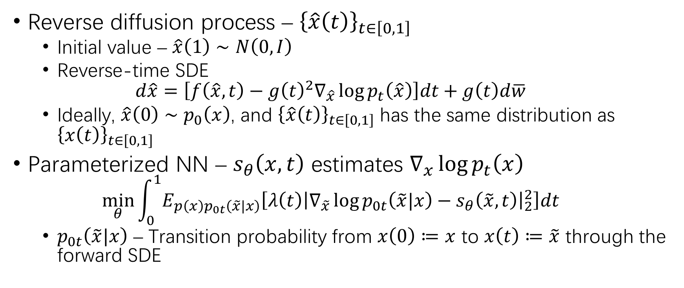
Continuous Time Diffusion Model (2)
Reverse diffusion process – ${\left\{\hat{x}\left(t\right)\right\}}_{t∈\left[0,1\right]}$
Initial value – $\hat{x}\left(1\right)∼N\left(0,I\right)$
Reverse-time SDE
$$d\hat{x}=\left[f\left(\hat{x},t\right)−g{\left(t\right)}^{2}∇_{\hat{x}}\log{p_{t}\left(\hat{x}\right)}\right]dt+g\left(t\right)d\overline{w}$$
Ideally, $\hat{x}\left(0\right)∼p_{0}\left(x\right)$, and ${\left\{\hat{x}\left(t\right)\right\}}_{t∈\left[0,1\right]}$ has the same distribution as ${\left\{x\left(t\right)\right\}}_{t∈\left[0,1\right]}$
Parameterized NN – $s_{θ}\left(x,t\right)$ estimates $∇_{x}\log{p_{t}\left(x\right)}$
$$\min_{θ}{\int_{0}^{1}{E_{p\left(x\right)p_{0t}\left(\tilde{x}|x\right)}\left[λ\left(t\right){\left|∇_{\tilde{x}}\log{p_{0t}\left(\tilde{x}|x\right)}−s_{θ}\left(\tilde{x},t\right)\right|}_{2}^{2}\right]dt}}$$
$p_{0t}\left(\tilde{x}|x\right)$ – Transition probability from $x\left(0\right)≔x$ to $x\left(t\right)≔\tilde{x}$ through the forward SDE

Slide 25
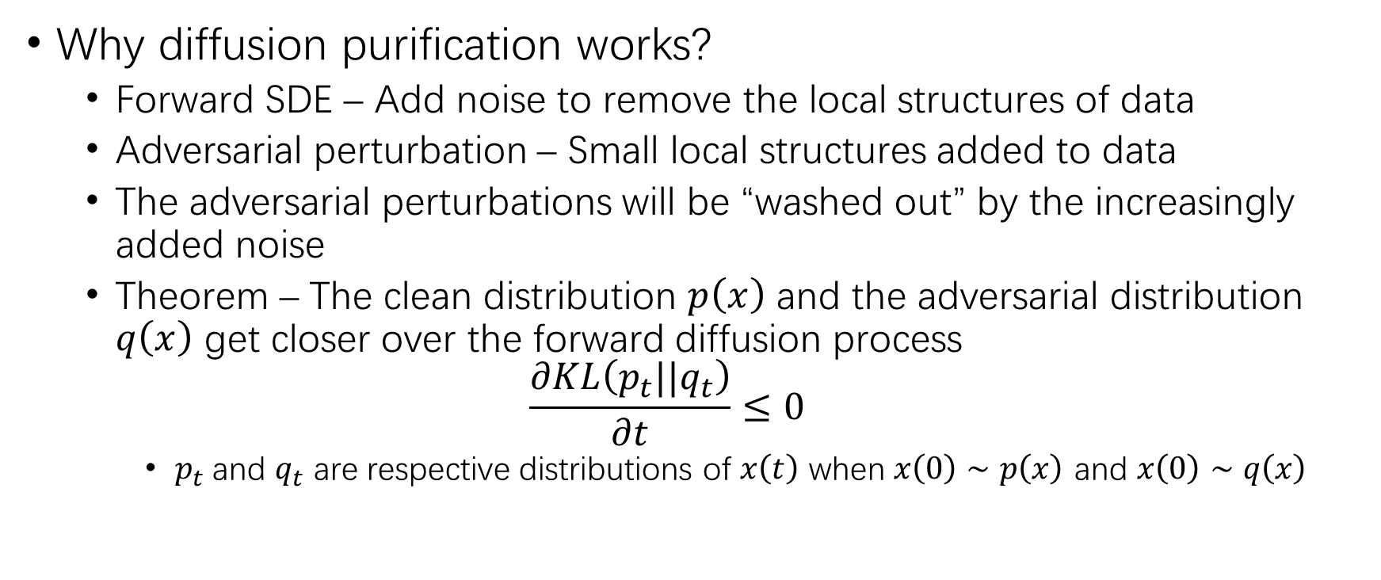
Diffusion Purification
Why diffusion purification works?
Forward SDE – Add noise to remove the local structures of data
Adversarial perturbation – Small local structures added to data
The adversarial perturbations will be “washed out” by the increasingly added noise
Theorem – The clean distribution $p\left(x\right)$ and the adversarial distribution $q\left(x\right)$ get closer over the forward diffusion process
$$\frac{∂KL\left(p_{t}||q_{t}\right)}{∂t}≤0$$
$p_{t}$and $q_{t}$ are respective distributions of $x\left(t\right)$ when $x\left(0\right)∼p\left(x\right)$ and $x\left(0\right)∼q\left(x\right)$

Slide 26
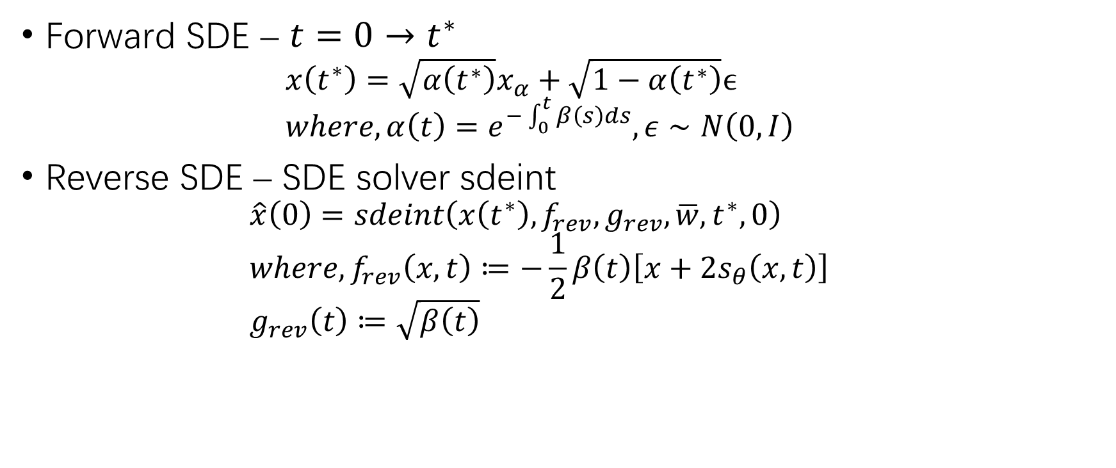
Diffusion Purification (2)
Forward SDE – $t=0→t^{∗}$
$$x\left(t^{∗}\right)=\sqrt{α\left(t^{∗}\right)}x_{α}+\sqrt{1−α\left(t^{∗}\right)}ϵ \\ where, α\left(t\right)=e^{−\int_{0}^{t}{β\left(s\right)ds}}, ε∼N\left(0,I\right)$$
Reverse SDE – SDE solver sdeint
$$\hat{x}\left(0\right)=sdeint\left(x\left(t^{∗}\right),f_{rev},g_{rev},\overline{w},t^{∗},0\right) \\ where, f_{rev}\left(x,t\right)≔−\frac{1}{2}β\left(t\right)\left[x+2s_{θ}\left(x,t\right)\right] \\ g_{rev}\left(t\right)≔\sqrt{β\left(t\right)}$$

Slide 27
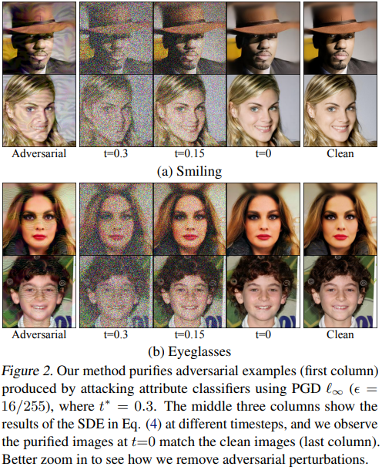
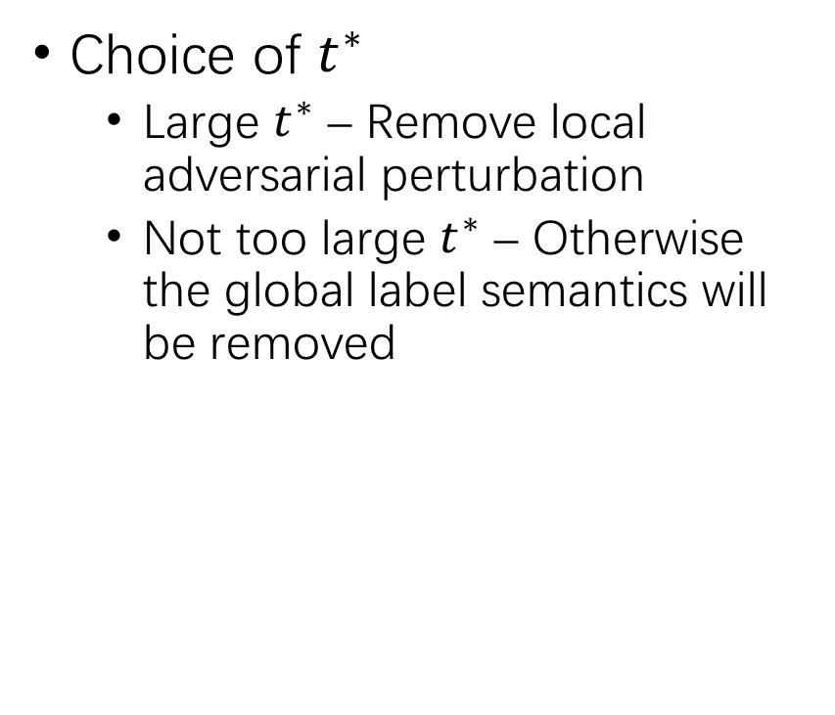
Diffusion Purification (3)
Choice of $t^{∗}$
Large $t^{∗}$ – Remove local adversarial perturbation
Not too large $t^{∗}$ – Otherwise the global label semantics will be removed

Slide 28
. Adaptive Attack to DiffPure
DiffPure v.s. adversarial training
Adaptive attack requires computing full gradients of the defense system
The gradient through the SDE is hard to compute
The gradient through an SDE can be obtained by solving another augmented SDE

Slide 29
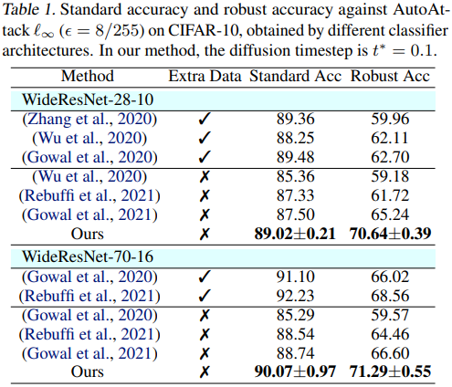
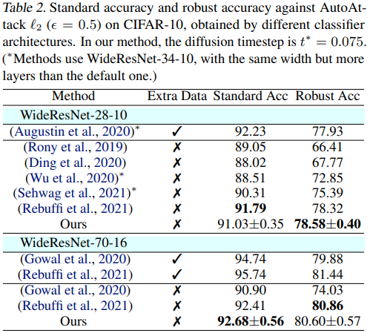
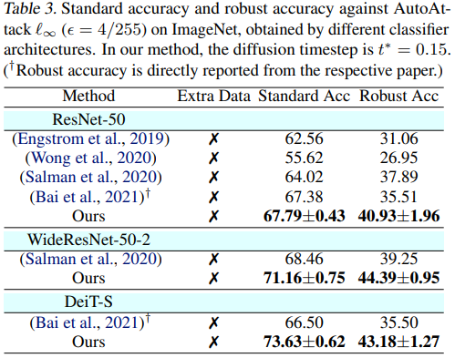
Experimental Result
Comparison with the SOTA adversarial training defense

Slide 30
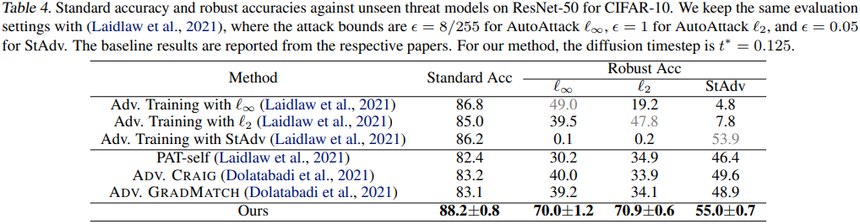
Experimental Result (2)
Defense against unseen threats

Slide 31
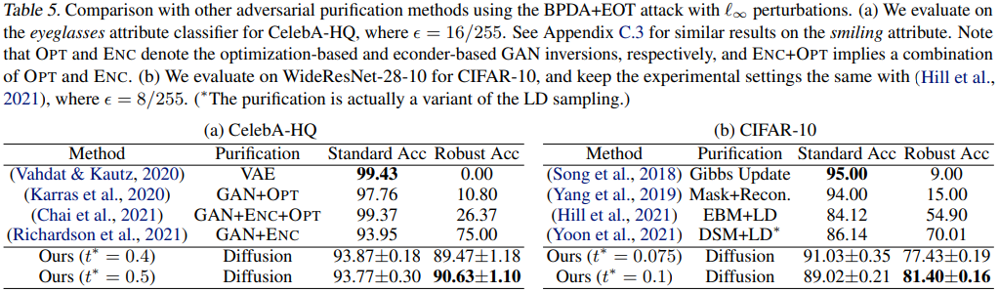
Experimental Result (3)
Comparison with other purification methods

Slide 32
Some Thoughts about Purification...
Text purification
Diffusion – Embedding-level; against synonymous substitution
Sampling – Against word insertion or deletion
Code purification
Attack-related – Remove & MLM
Attack-agnostic – Retelling

Slide 33

THANK YOU!

