Slide 1
Test Assert Generation
Huangzhao Zhang
zhang_hz@pku.edu.cn

Slide 2
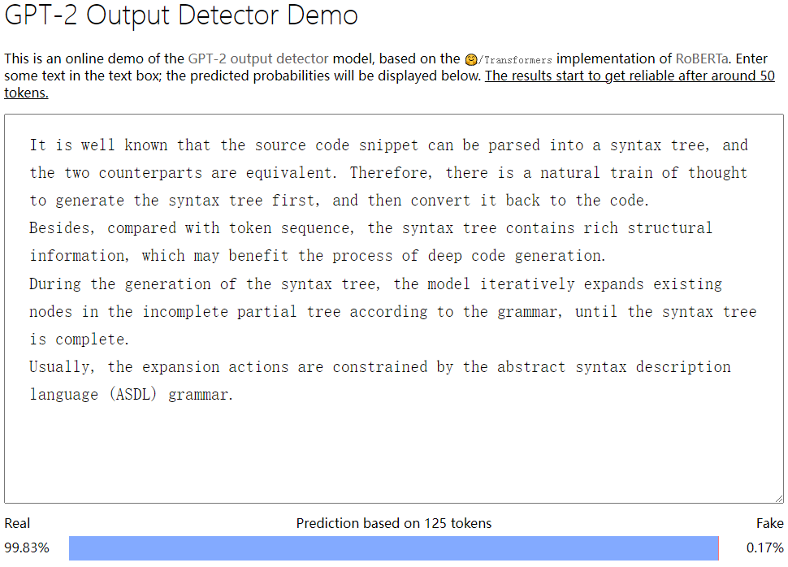
Off-Topic – Synthetic Text Detection
Synthetic Text Detection
Generated by ChatGPT (or other LLM), or by human beings?
GPTZero – https://gptzero.me/
PPL-based detection
GPT2 Output Detector

Slide 3
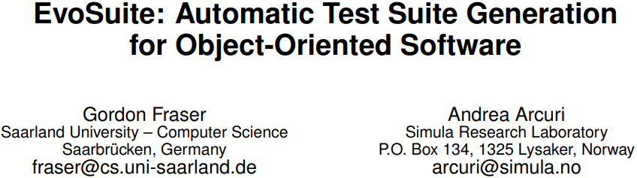

Slide 4
EvoSuite
Deployment – Java
Eclipse plugin
Command line tool
Objective
Whole test suite generation
Mutation-based assertion generation

Slide 5
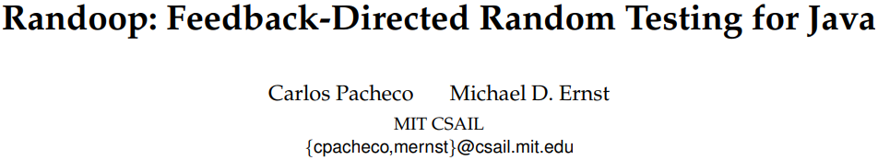

Slide 6
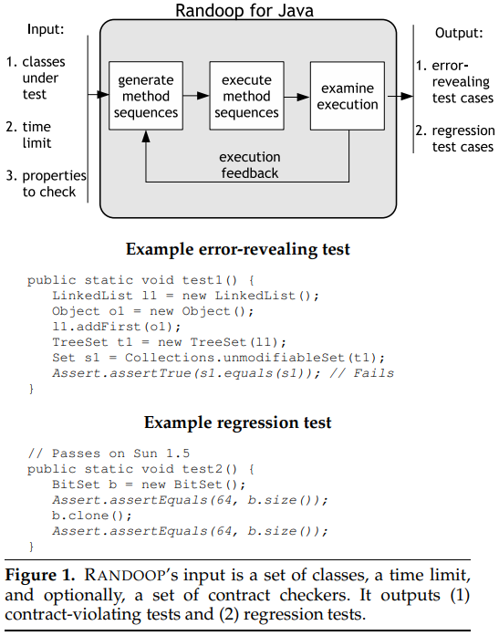
Randoop

Slide 7
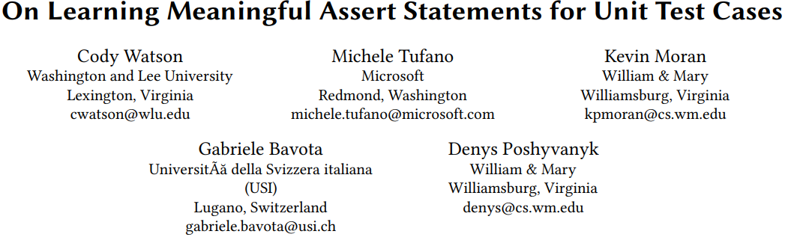
ICSE’20

Slide 8
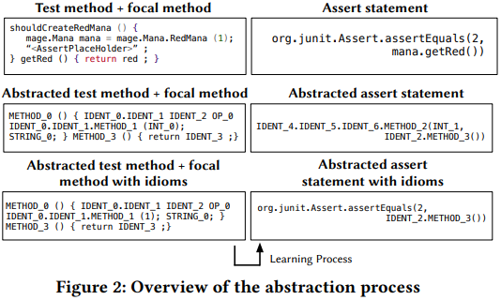
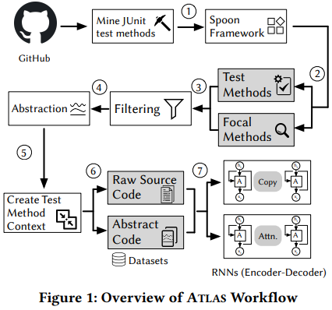
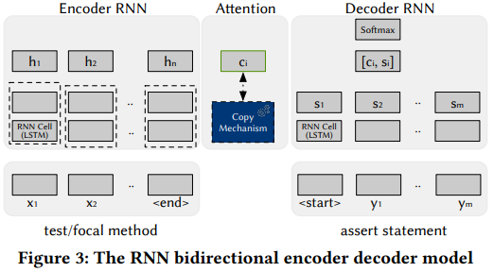
ATLAS

Slide 9
ATLAS – Filtering
Remove test methods with multiple assertions
Remove long test methods (>1,000 tokens)
Remove test methods in which need to generate new tokens (not in the test method nor the focal method)

Slide 10
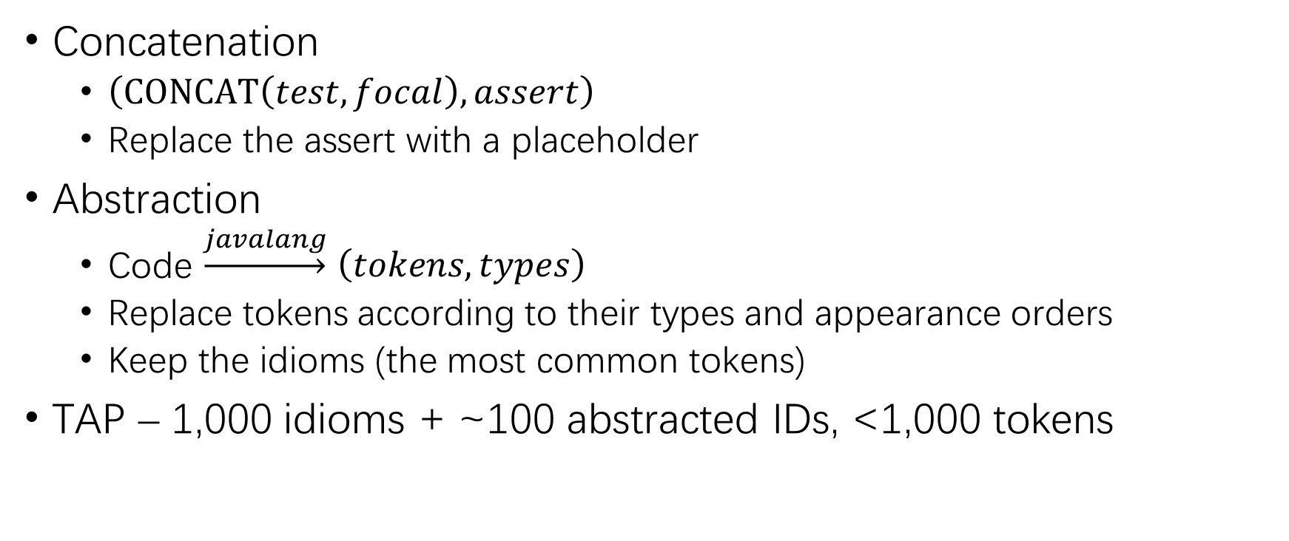
ATLAS – TAP Abstraction
Concatenation
$\left(CONCAT\left(test,focal\right),assert\right)$
Replace the assert with a placeholder
Abstraction
Code $\underset{→}{javalang}$ $\left(tokens,types\right)$
Replace tokens according to their types and appearance orders
Keep the idioms (the most common tokens)
TAP – 1,000 idioms + ~100 abstracted IDs, <1,000 tokens

Slide 11
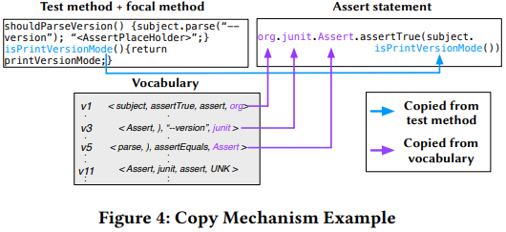
ATLAS – Seq2seq
2-layer LSTM encoder
2-layer LSTM decoder
Attention and copy

Slide 12
Experimental Setup
Dataset
Abstracted – (126,477 train + 15,809 dev + 15,810 test) TAPs
Raw – (150,523 train + 18,816 dev + 18,815 test) TAPs
Baseline
Frequency-based – Top-k most frequent assert as predictions

Slide 13
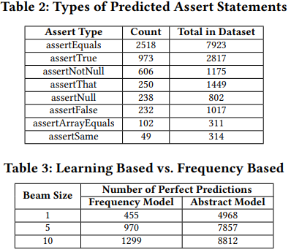
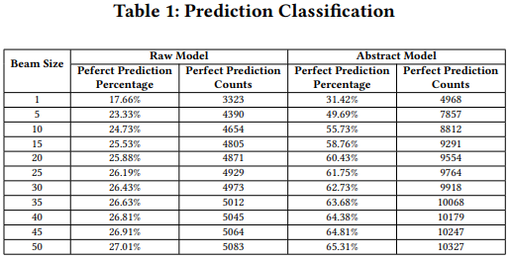
Experimental Results

Slide 14
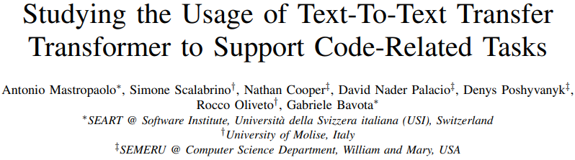
ICSE’21

Slide 15
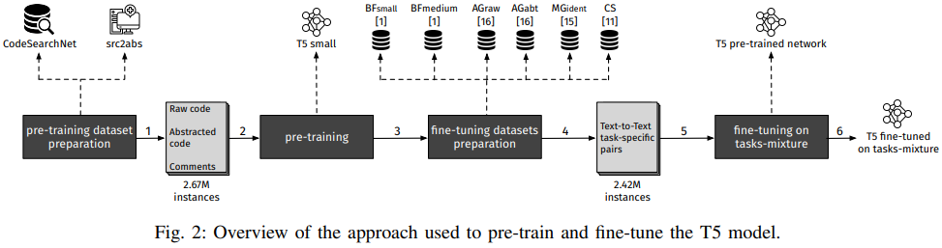
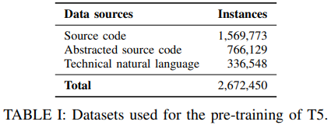
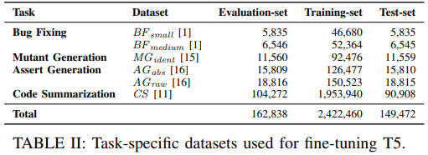
T5

Slide 16
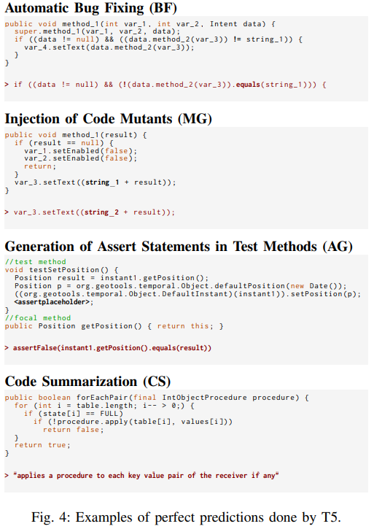
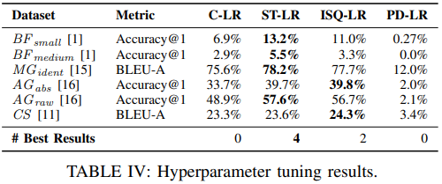
Results

Slide 17
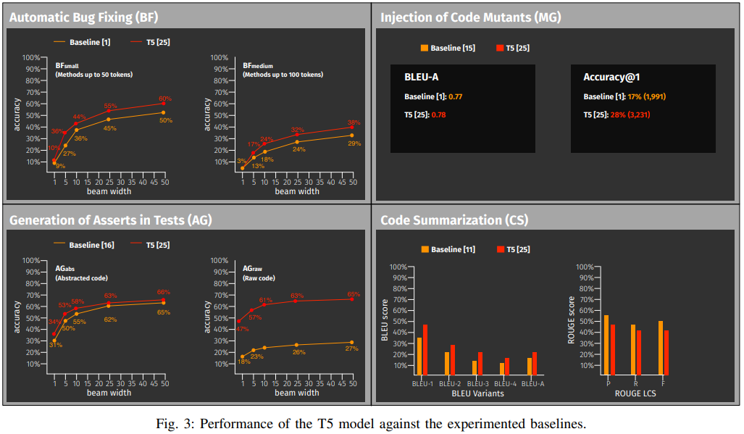
Results (2)

Slide 18
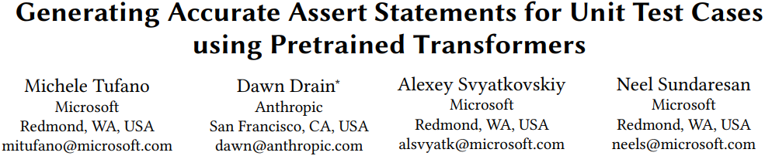
AST@ICSE’22

Slide 19
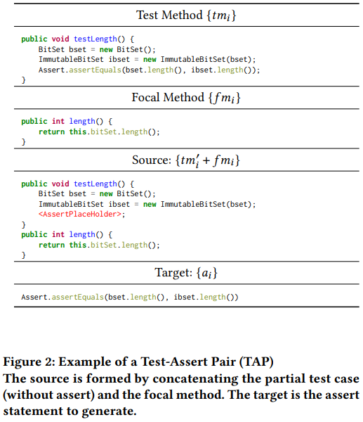
TAP
Without abstraction

Slide 20
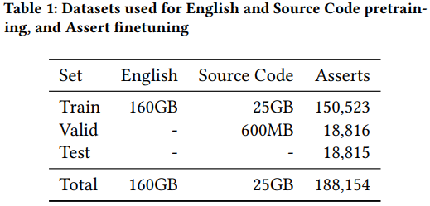
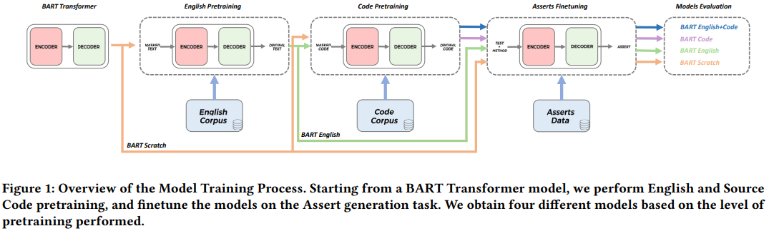
BART
English pretraining – RoBERTa corpus
Code pretraining – Java data crawled from GitHub + CSN dev

Slide 21
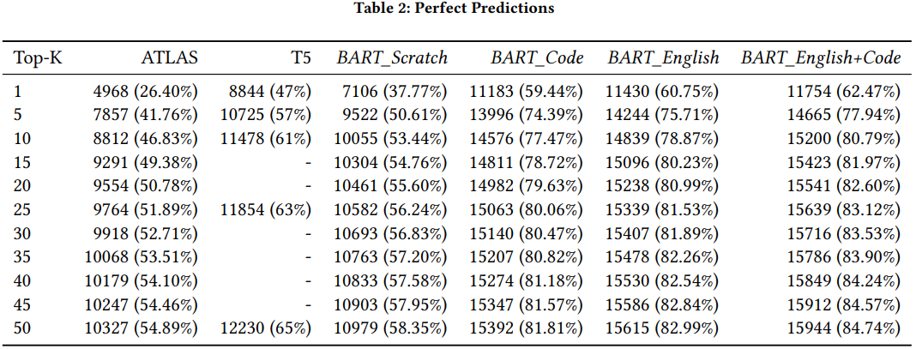
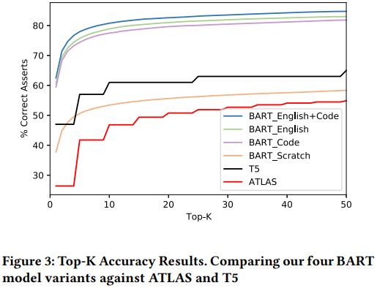
Results

Slide 22
THANK YOU!

