Slide 1
Fine-tuning vs. RAG for Large Language Models
Reporter: Jia Li♂
2024.6.11

Slide 2
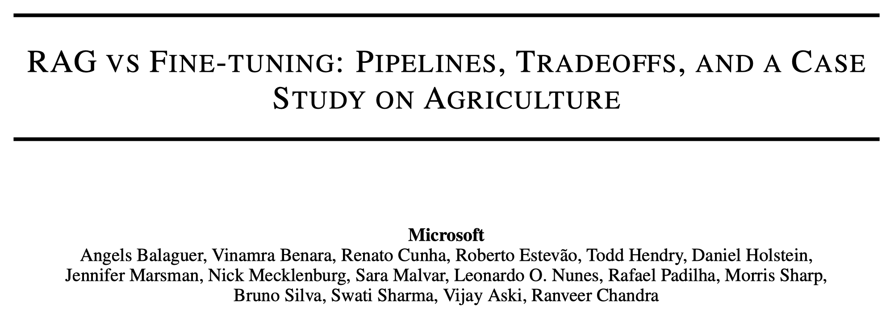
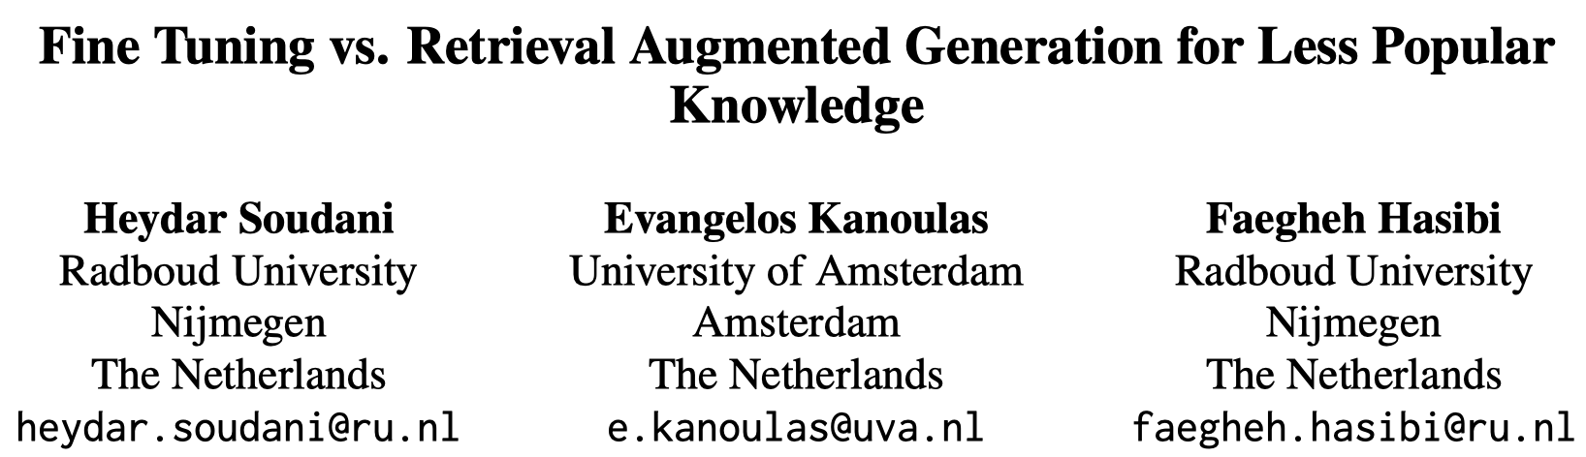
Abstract
Retrieval-Augmented Generation (RAG) and Fine-Tuning (FT) stand out as two prominent approaches for adapting LLMs to specific domains.
FT vs. RAG on question answer
30 Jan 2024 (arXiv)
7 Mar 2024 (arXiv)

Slide 4
Introduction
Large Language Models (LLMs) struggle to answer questions in specific domains, e.g., agriculture.

Slide 5
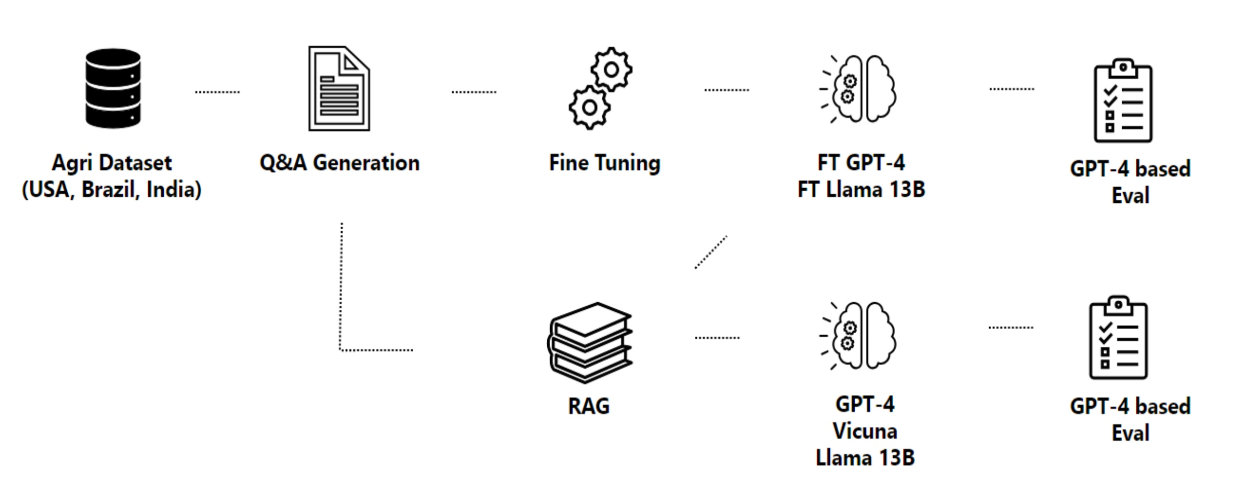
Overview
Fine-tuning
Collect Documents, Generate Training Data, Fine-tuning Models
RAG
Collect Documents, Retrieve Passages, Inference

Slide 6
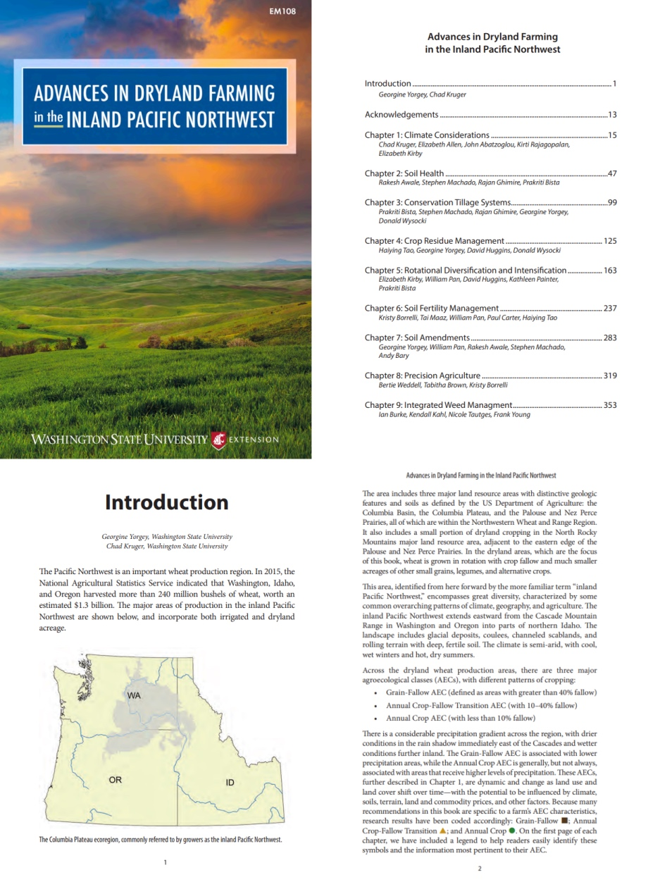
Collect Documents
Washington state-related documents
573 documents
Agricultural and environmental government agencies
Scientific knowledge repositories
Agronomist exams databases

Slide 7
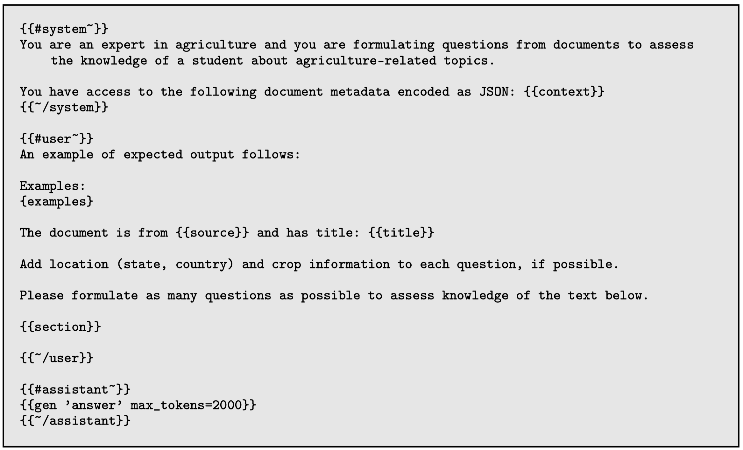
Generate Training Data
Prompting LLMs to generate question-answer pairs

Slide 8
Fine-tuning
Llama 2-13B, Vicuna-13B
Tune all parameters
GPT-4
LoRA
Notes:
具体在用的时候，模型的输入包括…生成对应的补丁…然后使用Test cases去评估生成的补丁…

Slide 9
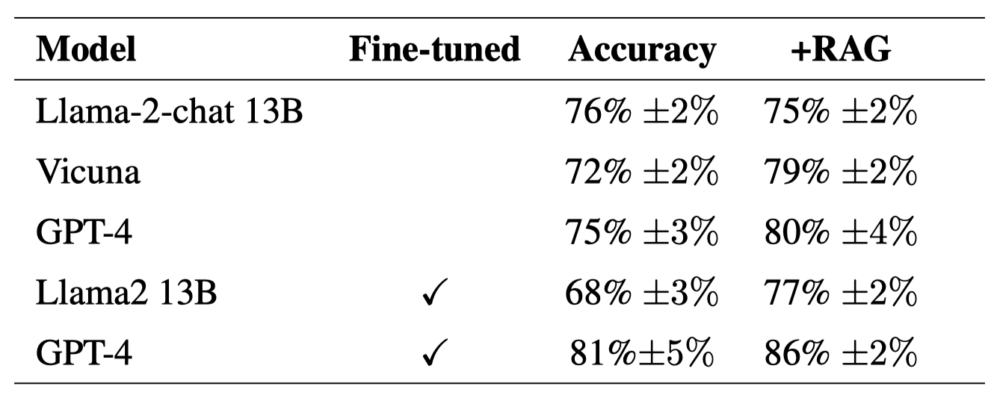
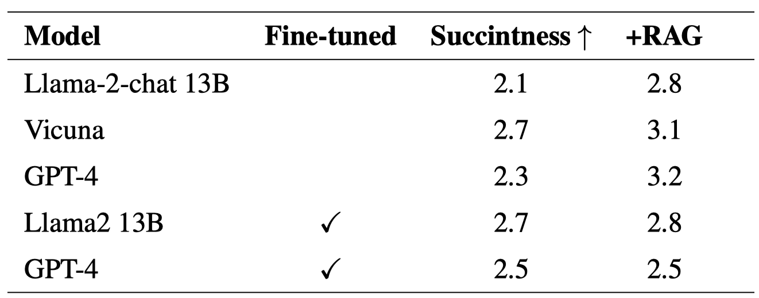
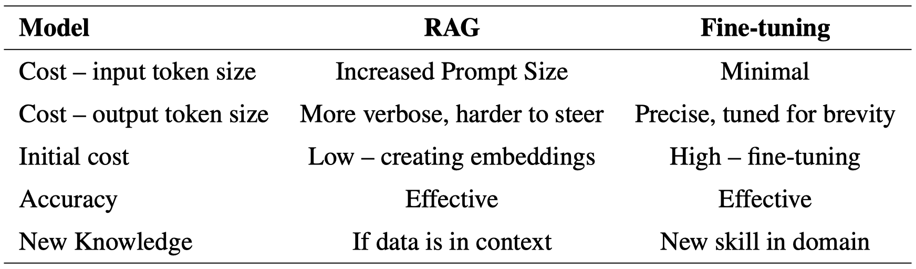
Experiments

Slide 11
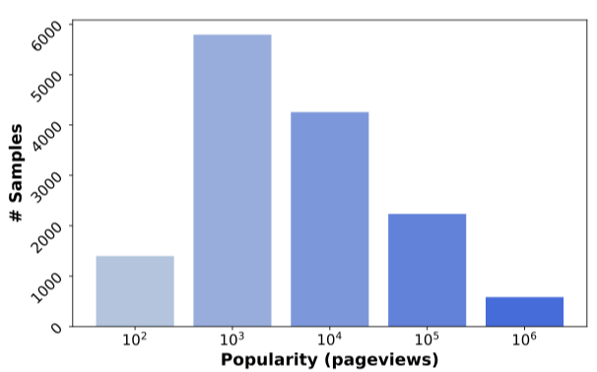
Introduction
Low-popular entities in question answering
Research Questions
What is the effectiveness of RAG and fine-tuning with synthetic data on QA for low-frequency factual knowledge?
Which factors (e.g., the quality of synthetic samples, the model size) affect the downstream performance?

Slide 12
Experimental Setup
Evaluation dataset – PoPQA
A closed-book QA dataset
RAG
Retrieval corpus: Wikipedia pages
Retrieval approach – Top-1 result
BM25, Contriever, DPR
Zero-shot Prompting
Context: <context>. Based on the provided context, answer the question: <question>

Slide 13
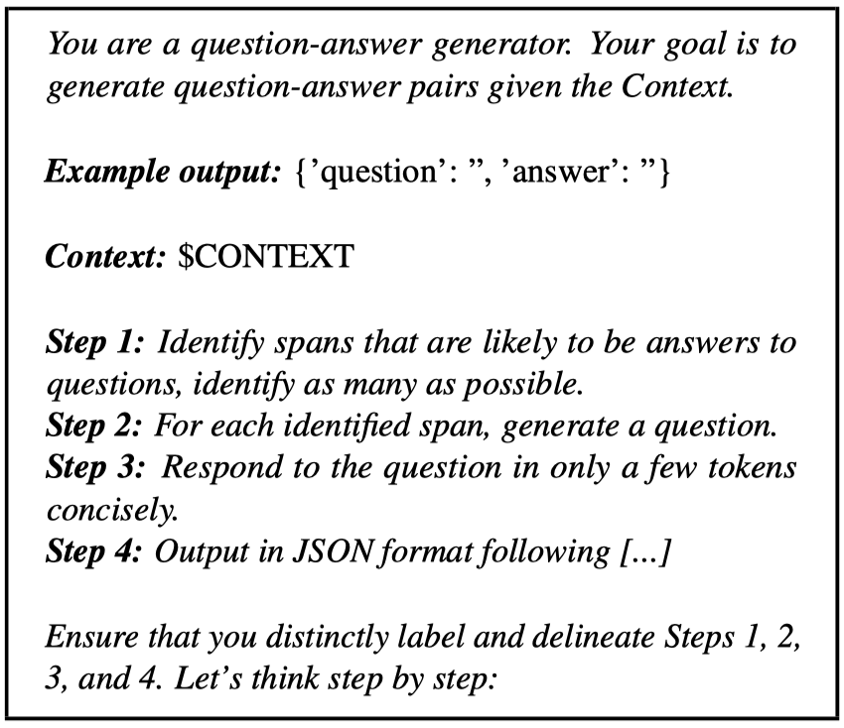
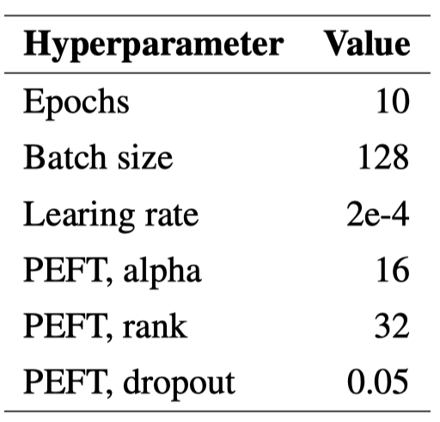
Experimental Setup
Evaluation dataset – PoPQA
A closed-book QA dataset
Fine-tuning
Generate training data
T5 – Specifically trained for QA generation
Prompt – LLMs
Full-parameter FT
PEFT (QLoRA)

Slide 14
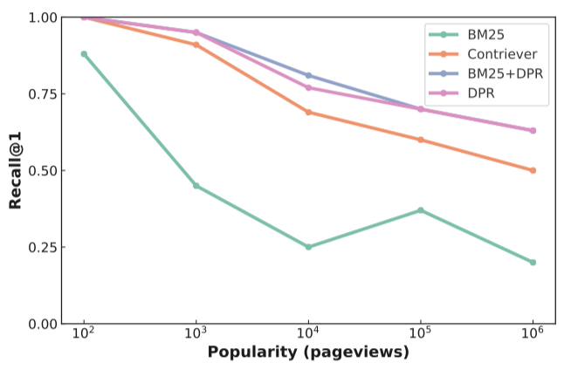
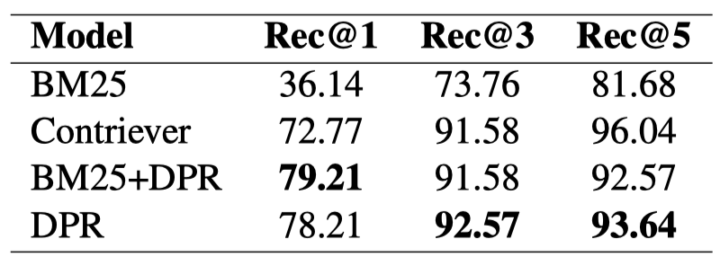
Experiments
The retrieval effectiveness is higher in low popular entities compare to popular entities.
DPR performs best among all retrieval approaches.

Slide 15
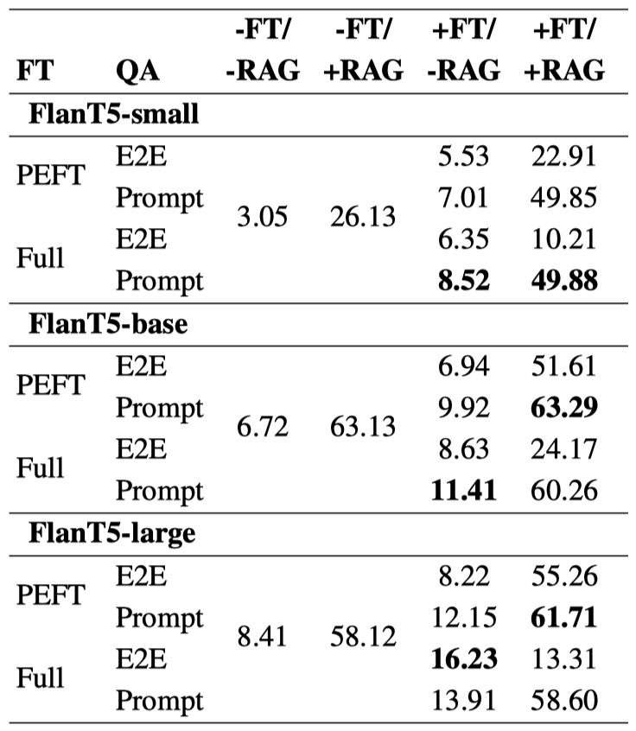
Experiments
Improvements from FT
FT improves accuracy of the base model, but does not reach the effectiveness of RAG on the base model.
Notes:
为什么仅用the next-token head的时候也有效。
之前next-token prediction的学习效率低，可能使模型仅关注部分特征。Multi-token prediction可以迫使模型去预测更远的位置，捕捉到长距离依赖，提升学习效率。

Slide 16
Experiments
Improvements from RAG
FT improves accuracy of the base model, but does not reach the effectiveness of RAG on the base model.
Notes:
为什么仅用the next-token head的时候也有效。
之前next-token prediction的学习效率低，可能使模型仅关注部分特征。Multi-token prediction可以迫使模型去预测更远的位置，捕捉到长距离依赖，提升学习效率。

Slide 17
Experiments
FT + RAG
FT improves accuracy of the base model, but does not reach the effectiveness of RAG on the base model.
The optimal performance is achieved by integrating both FT and RAG, especially in smaller models.
Notes:
为什么仅用the next-token head的时候也有效。
之前next-token prediction的学习效率低，可能使模型仅关注部分特征。Multi-token prediction可以迫使模型去预测更远的位置，捕捉到长距离依赖，提升学习效率。

Slide 18
Discussion
Full-parameter FT vs. PEFT
Without RAG, full-parameter FT is better.
With RAG, PEFT is better.
The quality of training data
Prompt > E2E
Notes:
为什么仅用the next-token head的时候也有效。
之前next-token prediction的学习效率低，可能使模型仅关注部分特征。Multi-token prediction可以迫使模型去预测更远的位置，捕捉到长距离依赖，提升学习效率。

Slide 19
Insight
Fine-tuning and RAG both can improve the performance of LLMs in specific domains.
Fine-tuning
Synthetic data from raw domain-specific documents
Learning domain-specific entities
RAG
Recall relevant contexts in external corpus
Generally, RAG performs better than fine-tuning
Higher inference budgets and verbo outputs
Notes:
为什么仅用the next-token head的时候也有效。
之前next-token prediction的学习效率低，可能使模型仅关注部分特征。Multi-token prediction可以迫使模型去预测更远的位置，捕捉到长距离依赖，提升学习效率。

Slide 20
Limitation
Many factors to be explored
The scale of training data / retrieval corpus
An approach to determining FT or RAG
Notes:
为什么仅用the next-token head的时候也有效。
之前next-token prediction的学习效率低，可能使模型仅关注部分特征。Multi-token prediction可以迫使模型去预测更远的位置，捕捉到长距离依赖，提升学习效率。

