Slide 1
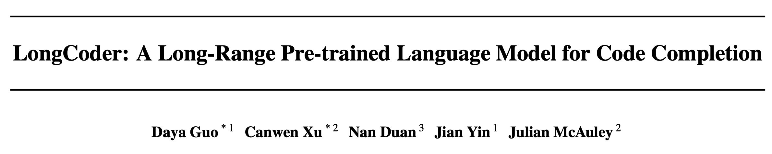
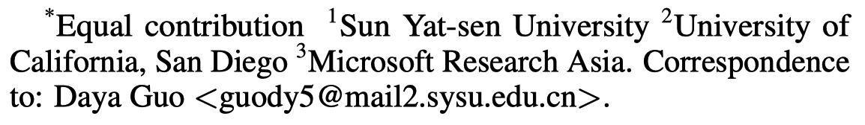
ICML 2023

Slide 2
Abstract
Motivation
41% of Python files in GitHub have a length longer than 1,024 tokens, which highlights the need for long code completion.
Challenge
The computational cost of Transformer grows quadratically with the length of input code.
Contribution
LongCoder, a new Transformer model for long code completion.
Three types of spare attention, motivated by how humans write code.
LCC, a new benchmark for long code completion.

Slide 3
Motivation
Code Completion
Given a unfinished code file, predicting the following code line.
The average length of the input code: 300~400 tokens.
Long Code Completion
Motivation: a statistics on GitHub
The average of a Python file is 1,305 tokens.
41%/24% of files have a length longer than 1,024/2,048 tokens.

Slide 4
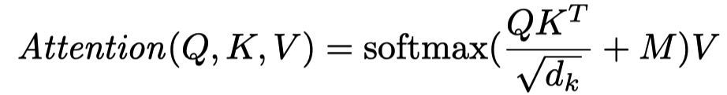
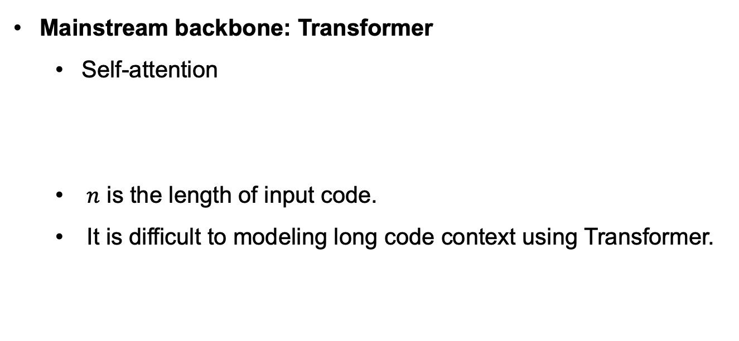

Challenge
Attention map
Mainstream backbone: Transformer
Self-attention
$n$ is the length of input code.
It is difficult to modeling long code context using Transformer.
$$O(n^{2})$$
Notes:
目前主流的代码补全模型都是基于Transformer的。
其中self-attention是关键，但标准的self-attention的时间复杂度比较高，O(n^2)，n是指输入代码的长度。
这导致Transformer很难用于长代码的建模。

Slide 5


LongCoder
A new Transformer for long code completion
Three types of self-attention
Window attention
Bridge attention
Global attention
Attention map
Attention map
$$O(n^{2})$$
$$O(n)$$
Notes:
本文提出了一种新的…
相比于标准的Transformer，LongCoder包含了三种新的自注意力机制，将自注意力机制时间复杂度从…降至…
下面详细说一下这三种注意力机制的原理。

Slide 6
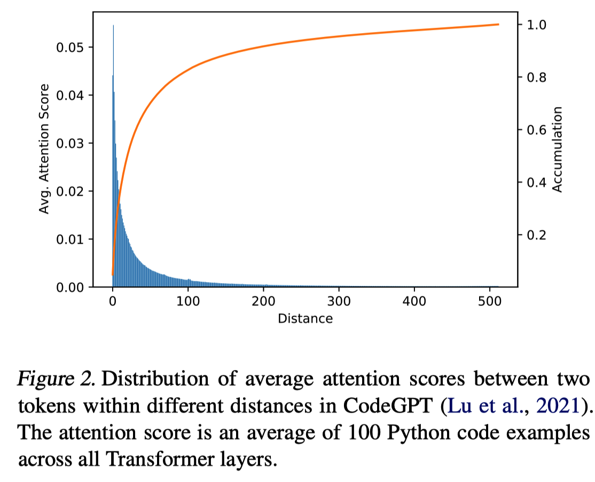
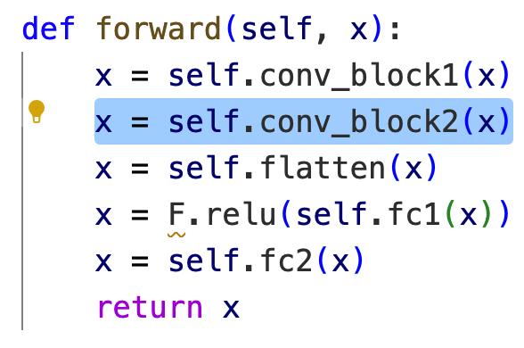
Window Attention
Motivation
Code completion largely relies on local context.
The distribution of average attention scores between two tokens within different distances.
Notes:
第一个是Window attention。

Slide 7
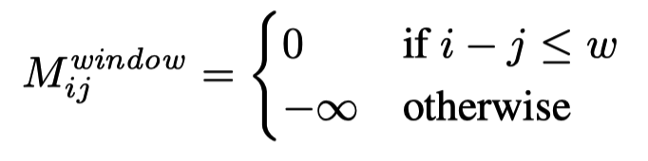
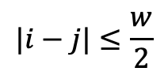


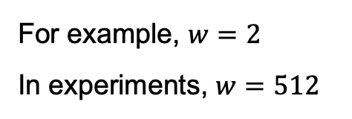
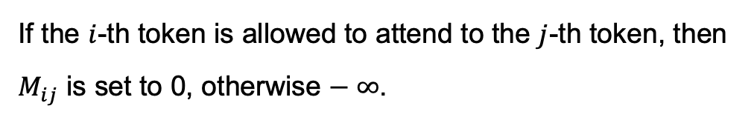

Window Attention
Attention map
$$|i−j|≤\frac{w}{2}$$
If the $i$-th token is allowed to attend to the $j$-th token, then $M_{ij}$ is set to 0, otherwise $− ∞$.
$$j$$
$$i$$
For example, $w=2$
In experiments, $w=512$
$$O(n×w)$$
Notes:
具体来说，window attention就是用一个滑动窗口在输入序列上进行局部的全自注意力机制。

Slide 8
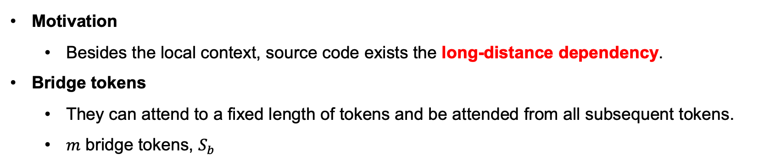

Bridge Attention
Motivation
Besides the local context, source code exists the long-distance dependency.
Bridge tokens
They can attend to a fixed length of tokens and be attended from all subsequent tokens.
$m$ bridge tokens, $S_{b}$
def forward(self, x): [Bridge_token] x = … [Bridge_token] …
$\left\lceil \frac{n}{m}\right\rceil$ tokens
Notes:
除了局部依赖，代码中同样存在长距依赖，例如；调用在5、6行之前定义的一个变量

Slide 9
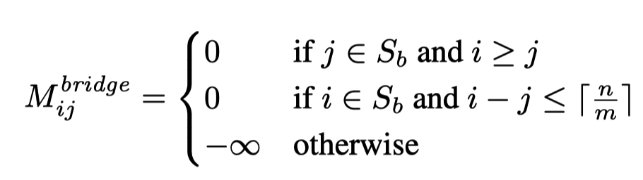
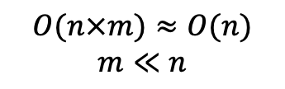

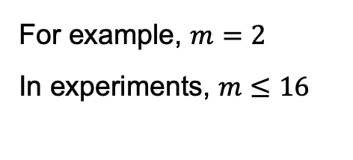
Bridge Attention
Motivation
Besides the local context, source code exists the long-distance dependency.
Bridge tokens
They can attend to a fixed length of tokens and be attended from all subsequent tokens.
$m$ bridge tokens, $S_{b}$
$$j$$
$$i$$
For example, $m=2$
In experiments, $m≤16$
$$O(n×m)≈O(n)$$
$$m≪n$$

Slide 10
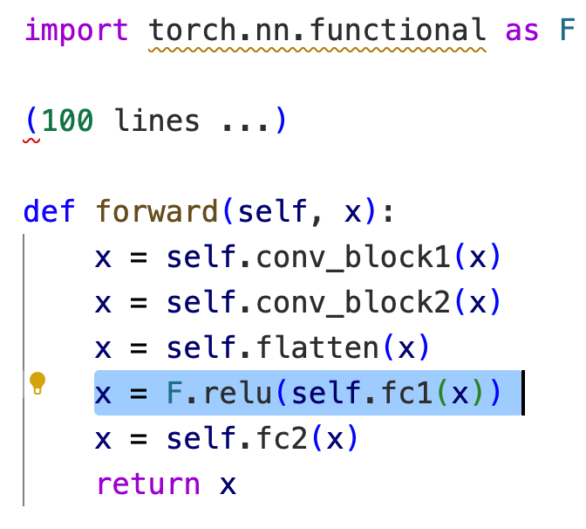
Global Attention
Motivation
Identifiers with the global scope (e.g., package imports, global functions)

Slide 11
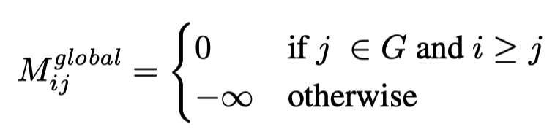
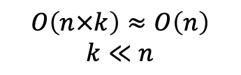
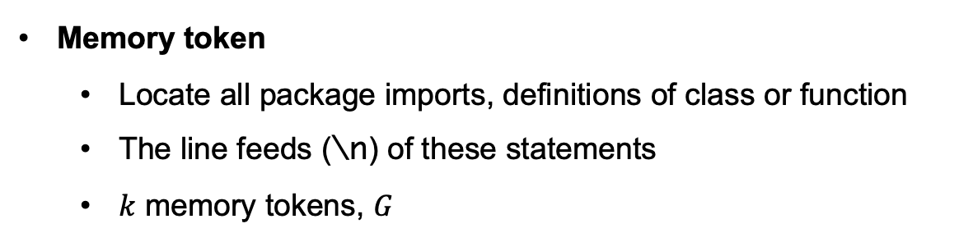

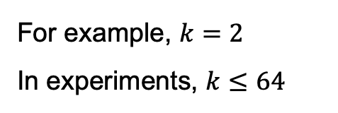

Global Attention
Memory token
Locate all package imports, definitions of class or function
The line feeds (\n) of these statements
$k$ memory tokens, $G$
$$j$$
$$i$$
For example, $k=2$
In experiments, $k≤64$
$$O\left(n×k\right)≈O\left(n\right)$$
$$k≪n$$

Slide 12

LongCoder
Final attention map

Slide 13
Benchmarks
All benchmarks are line-level completion tasks.
Long Code Completion
Long Code Completion (LLC)
RepoBench (arXiv 2023)
Standard Code Completion
CodeXGLUE (Lu et al. NeurIPS 2022)
Notes:
两种评估设置

Slide 14
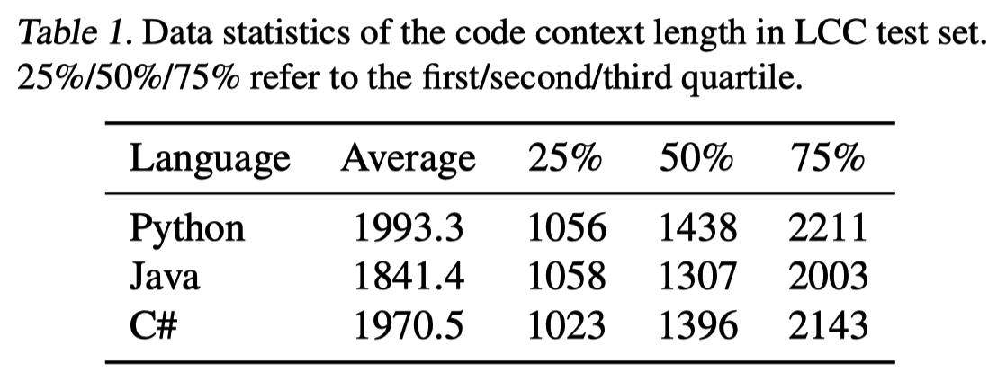
Benchmark - LLC
Long Code Completion Benchmark (LCC)
Source data: github-code from CodeParrot
Preprocess steps
Deduplication
Extract code files whose length is in [512, 10,000].
For each language, select 100k samples for training, 10k for validation, and 10k for testing.

Slide 15
Benchmark - RepoBench
Cross-file Code Completion
In-file context + Cross-file context
Python
51,701 / 6,227 / 6,375
Avg length of input context: 996; Max length of input context: 1,923
Java
64,029 / 8,510 / 6,768
Avg length of input context: 1,147; Max length of input context: 1,923

Slide 16
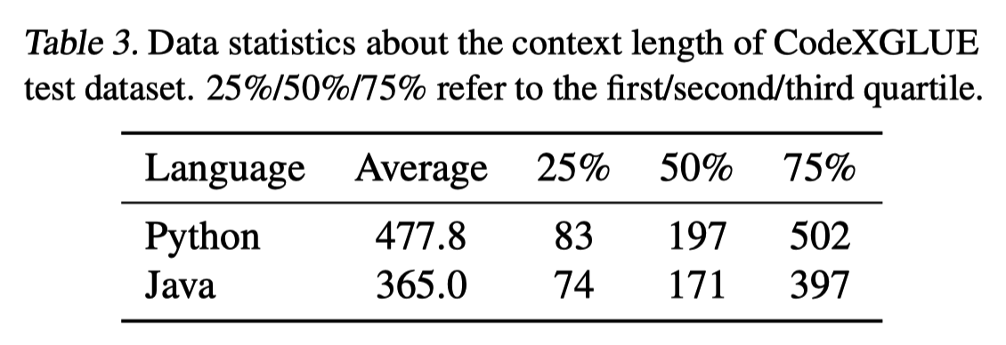
Benchmark - CodeXGLUE
Python
PY150 (Raychev et al., 2016)
Java
JavaCorpus (Allamanis et al., 2013)

Slide 17
Baseline
Non-spare baseline
Transformer
GPT-2
CodeGPT
UniXcoder
OpenAI Codex
Spare baseline
LongFomer
BigBird
LongFomer (arXiv 2020)
(Global+Dilated window attention)
BigBird (NeurIPS 2020)
(Global+Window+Random attention)
Notes:
本文

Slide 18
Evaluation Metric
Exact Match (EM)
Edit Similarity (Edit Sim)
Beam search, maximum generation length 64.
Notes:
评估指标方面…

Slide 19
Training Details
LongCoder and baselines all initialized with the parameters of UniXcoder.
The maximum length of code context
Non-sparse models: 512
Sparse models: 4096
Notes:
评估指标方面…

Slide 20
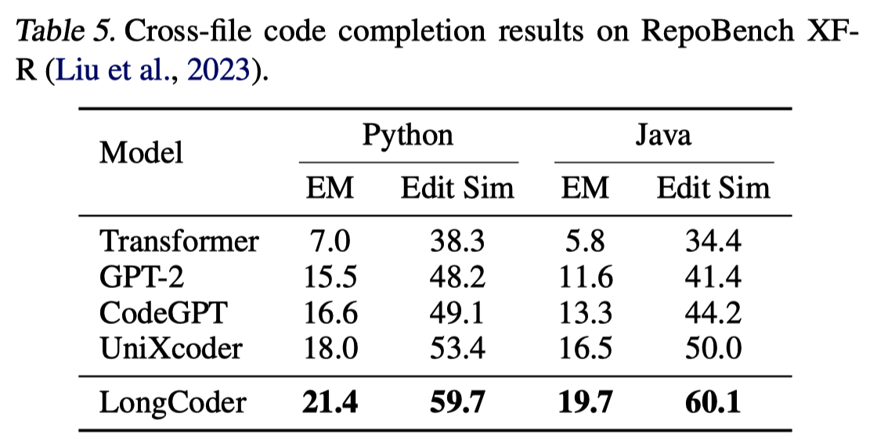
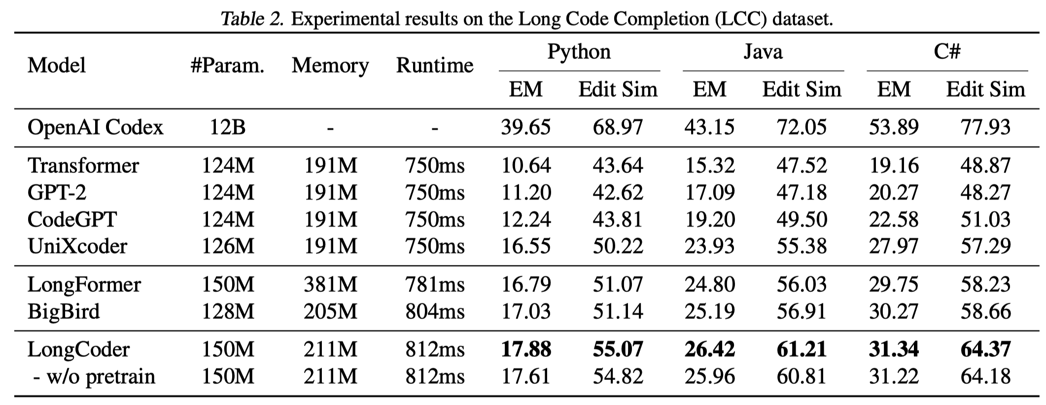
Main Results – Long Code Completion
Notes:
在长代码补全的场景下，longcoder在两个Benchmark上都有提升
比不过Codex，参数量的问题

Slide 21
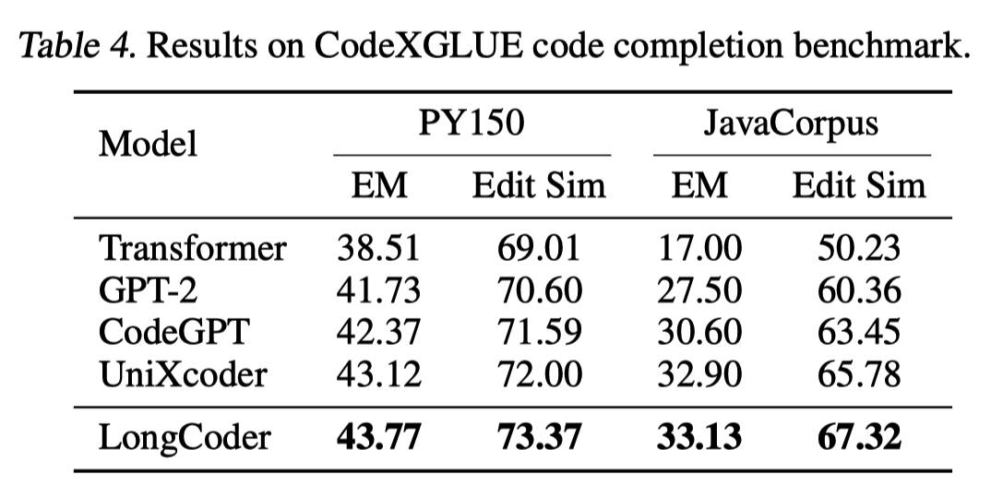
Main Results – Std Code Completion
Notes:
在短代码补全的场景上，也不错

Slide 22
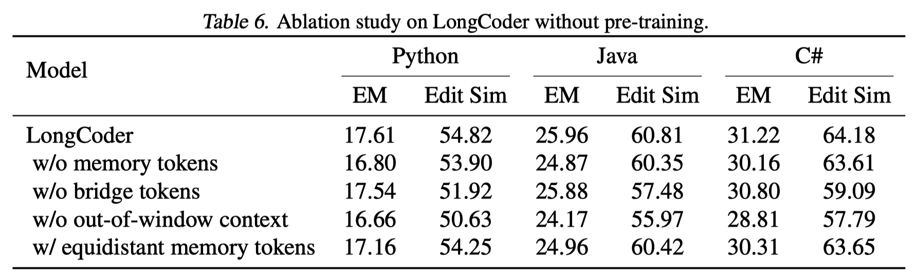
Ablation Study
w/o out-of-window context
Only keeping the last 512 tokens as the input context
w/ equidistant memory tokens
Selecting memory tokens every 64 tokens
Notes:
消融分析
Bridge、memory token的有效性，尤其是memory token
Out-of-window，上下文的重要性
Memory token的挑选

Slide 23
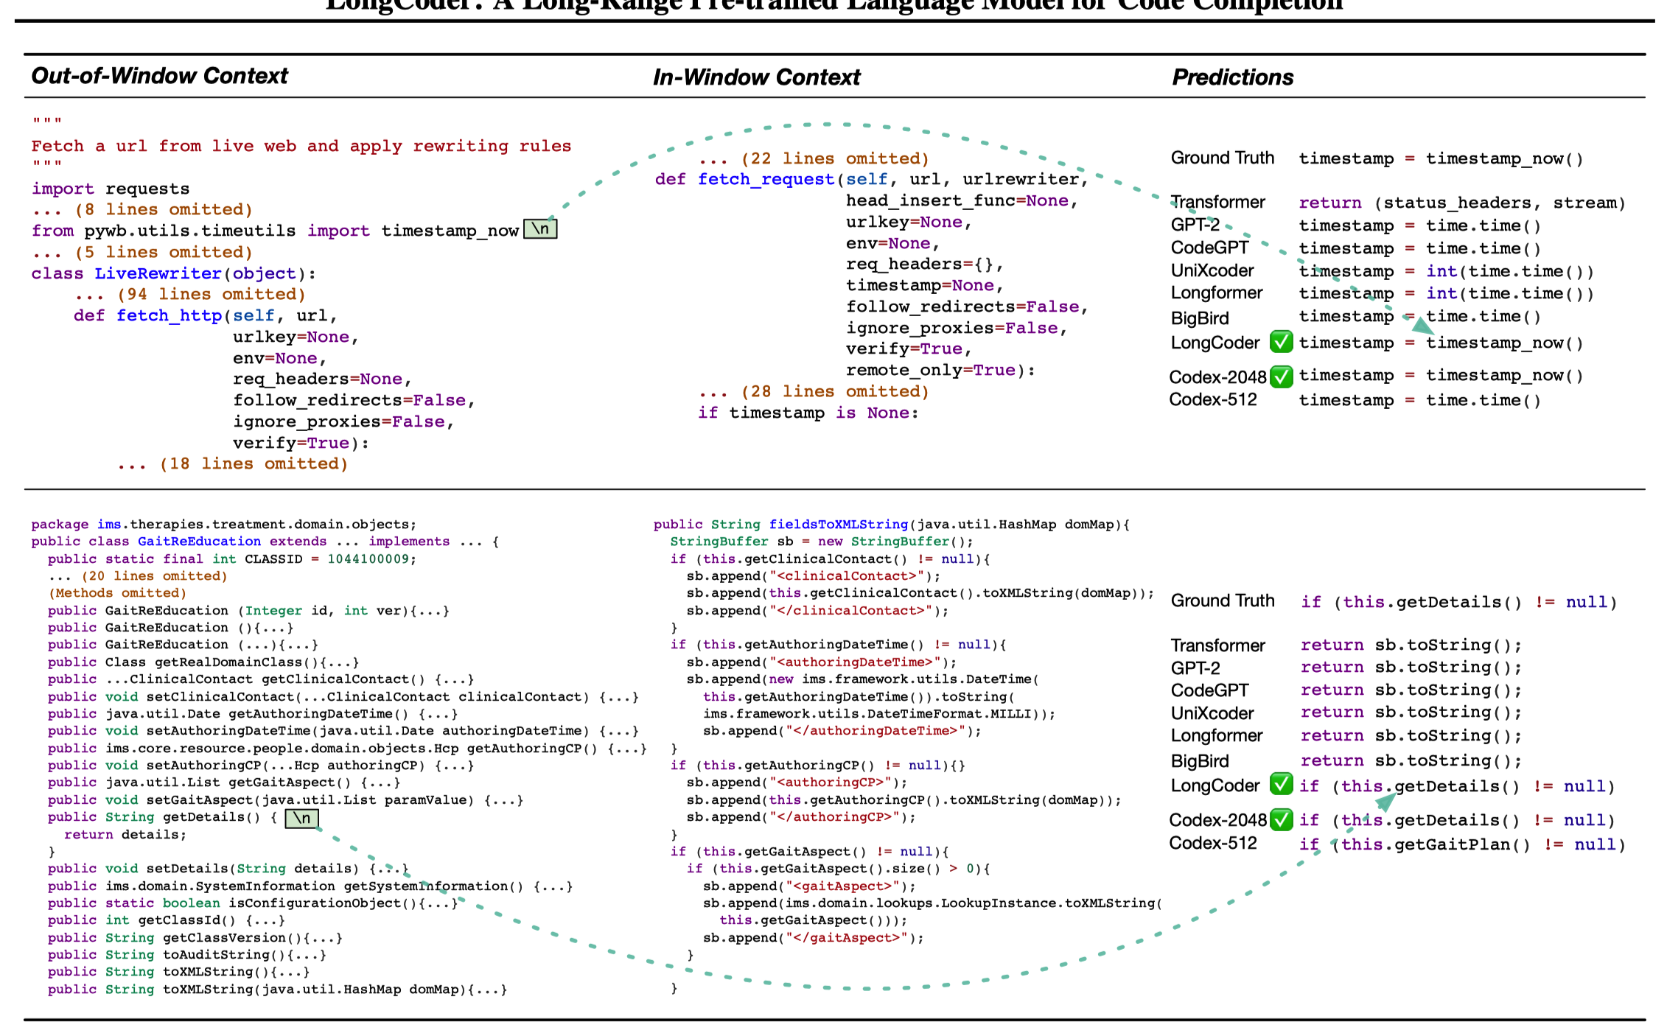
Case Study
Notes:
Global attention的重要性

Slide 24
Conclusion
A novel Transformer model – LongCoder for long code completion.
A new benchmark for long code completion.
Limitation
Small model size
Similar with related studies in NLP
Slight Improvements

