Slide 1
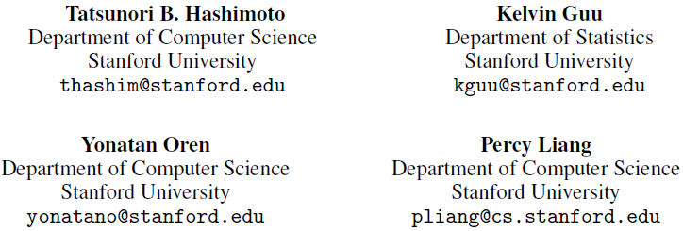
A Retrieve-and-Edit Framework for Predicting Structured Outputs

Slide 2
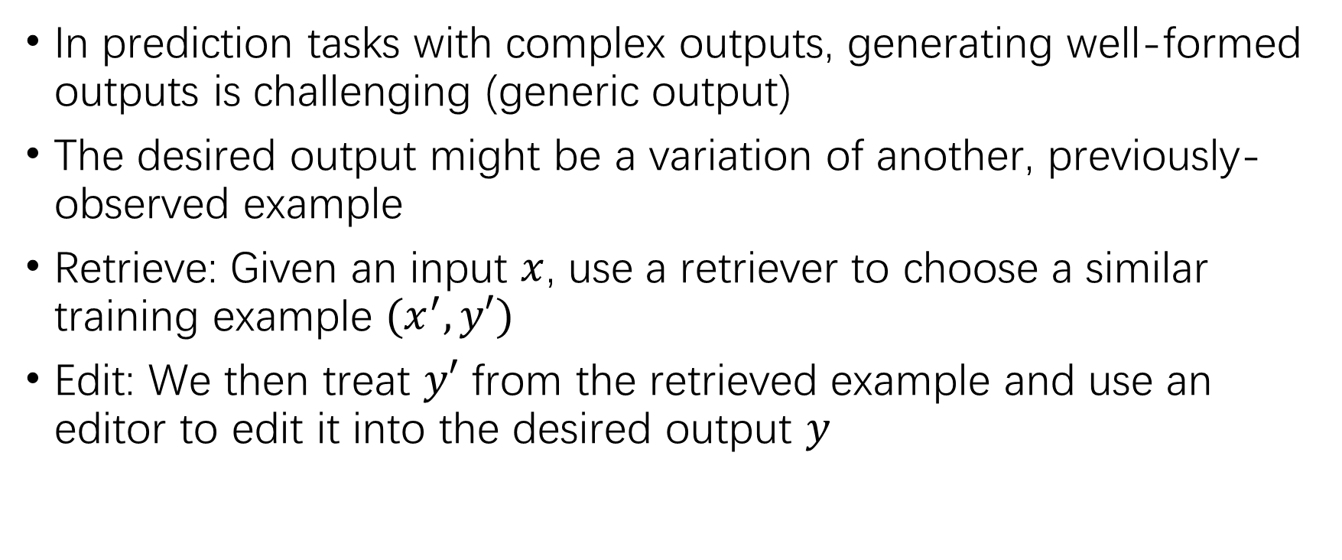
Introduction
In prediction tasks with complex outputs, generating well-formed outputs is challenging (generic output)
The desired output might be a variation of another, previously-observed example
Retrieve: Given an input $x$, use a retriever to choose a similar training example $(x^{′},y′)$
Edit: We then treat $y′$ from the retrieved example and use an editor to edit it into the desired output $y$

Slide 3
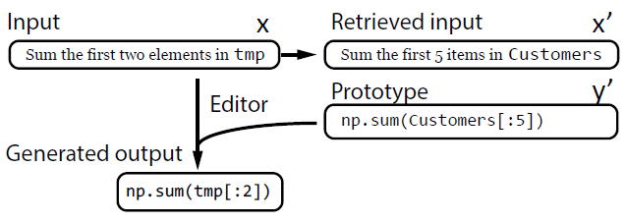



Problem statement
Retrieve-and-edit
Learning task-dependent similarity: two inputs $x$ and $x′$ should be considered similar only if the editor has a high likelihood of editing $y^{′}$ into $y$

Slide 4

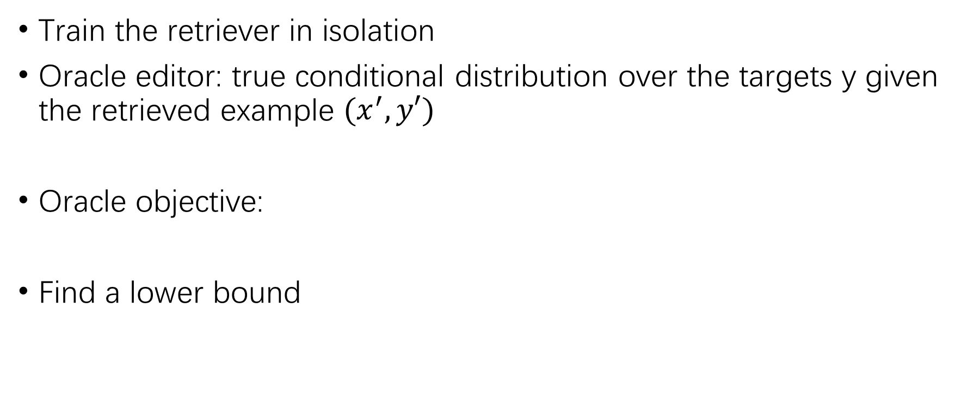
Retriever
Train the retriever in isolation
Oracle editor: true conditional distribution over the targets y given the retrieved example $(x^{′},y′)$
Oracle objective:
Find a lower bound

Slide 5
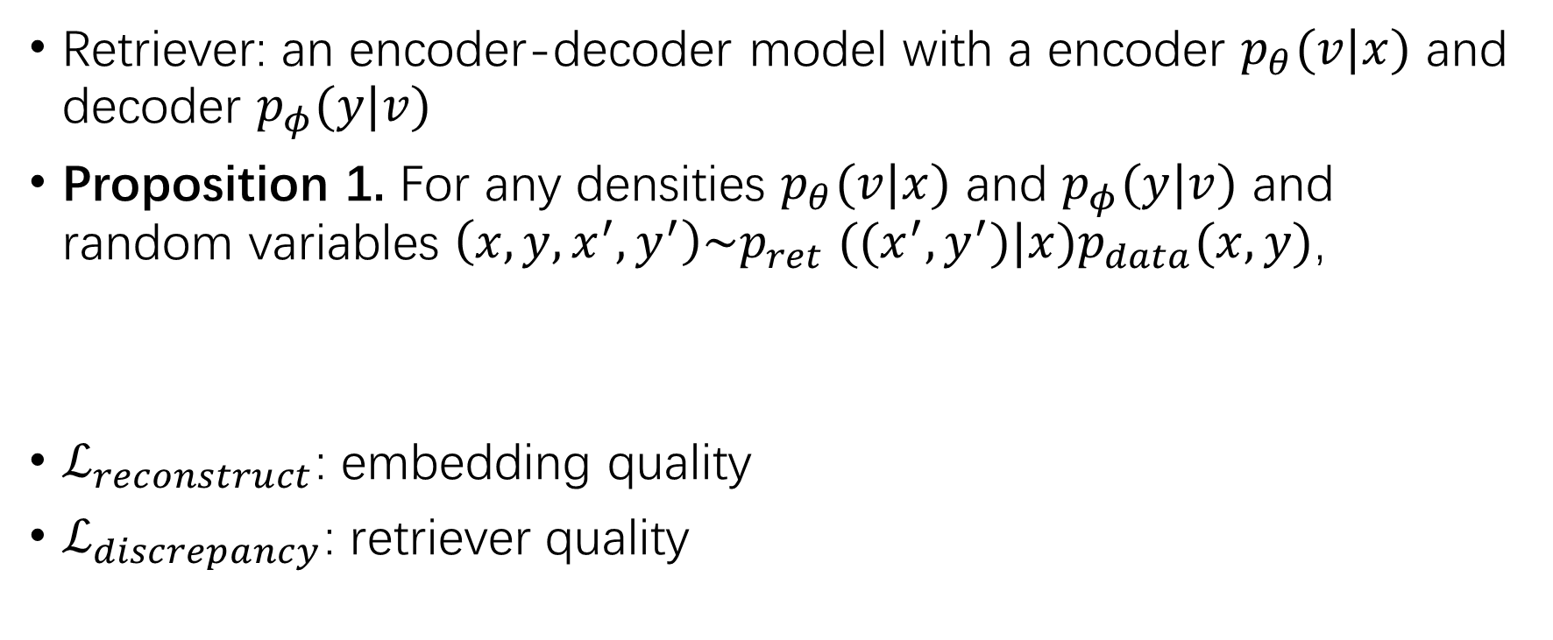
The latent space as a task-dependent metric
Retriever: an encoder-decoder model with a encoder $p_{θ}(v|x)$ and decoder $p_{φ}(y|v)$
Proposition 1. For any densities $p_{θ}(v|x)$ and $p_{φ}(y|v)$ and random variables $\left(x,y,x^{′},y^{′}\right)\sim p_{ret} ((x^{′},y^{′})|x)p_{data}(x,y)$,
$ℒ_{reconstruct}$: embedding quality
$ℒ_{discrepancy}$: retriever quality

Slide 6


Proof of Proposition 1

Slide 7
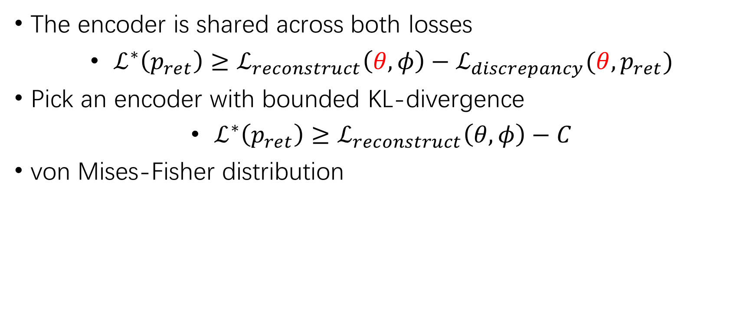
Train the encoder
The encoder is shared across both losses
$ℒ^{∗}\left(p_{ret}\right)≥ℒ_{reconstruct}\left(θ,φ\right)−ℒ_{discrepancy}(θ,p_{ret})$
Pick an encoder with bounded KL-divergence
$ℒ^{∗}\left(p_{ret}\right)≥ℒ_{reconstruct}\left(θ,φ\right)−C$
von Mises-Fisher distribution

Slide 8

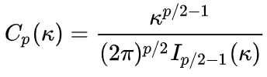








von Mises-Fisher distribution
A distribution over the unit hypersphere governed by a mean parameter $μ$ and a concentration parameter $κ$.
$$I_{α}(x)$$
$$κ=1$$
$$κ=10$$
$$κ=100$$
$$κ→∞$$

Slide 9

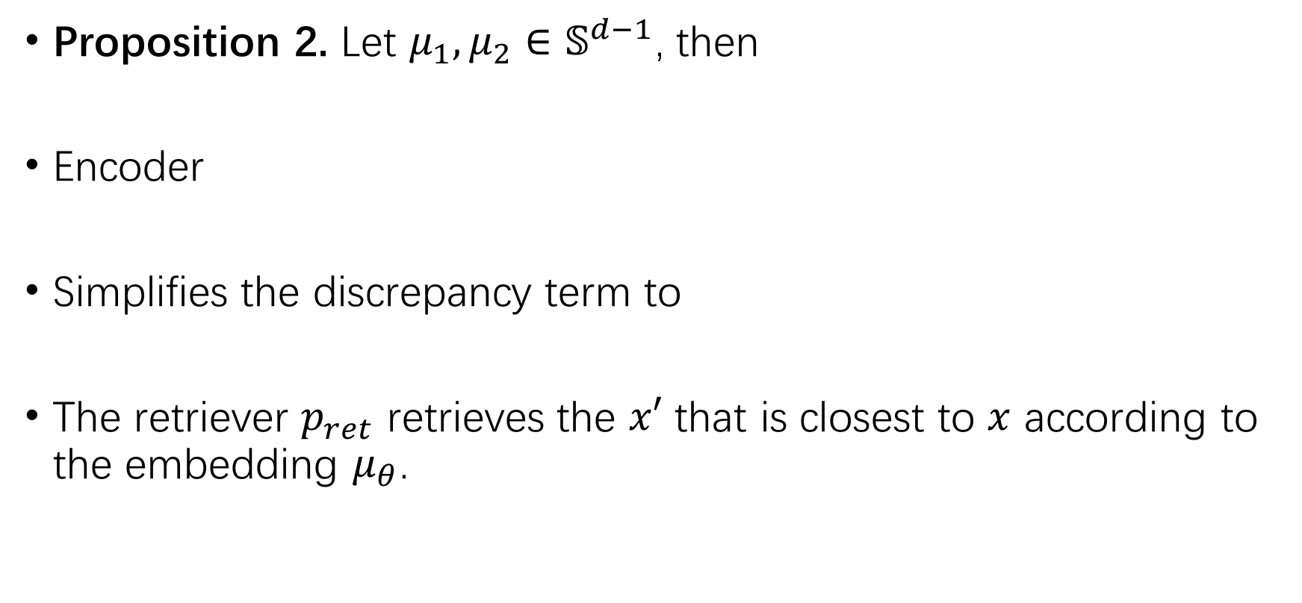
von Mises-Fisher distribution
Proposition 2. Let $μ_{1},μ_{2}∈𝕊^{d−1}$, then
Encoder
Simplifies the discrepancy term to
The retriever $p_{ret}$ retrieves the $x′$ that is closest to $x$ according to the embedding $μ_{θ}$.

Slide 10
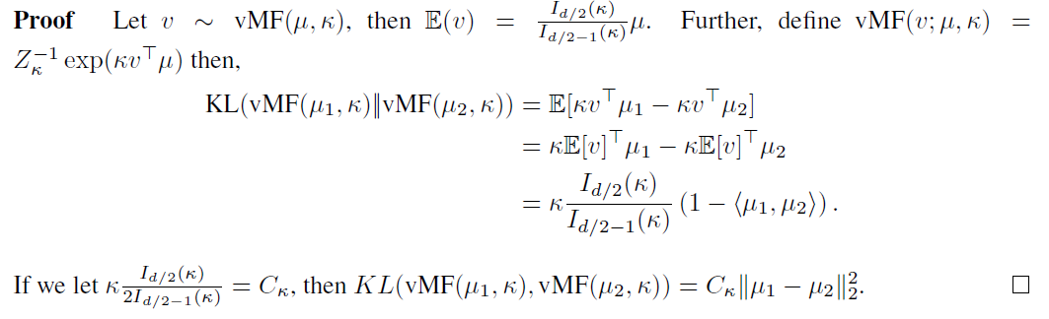
Proof of Proposition 2

Slide 11
Setting the encoder-decoder parameters
Pick a relatively loose lower bound
Analogous to the hyperspherical variational autoencoder

Slide 12

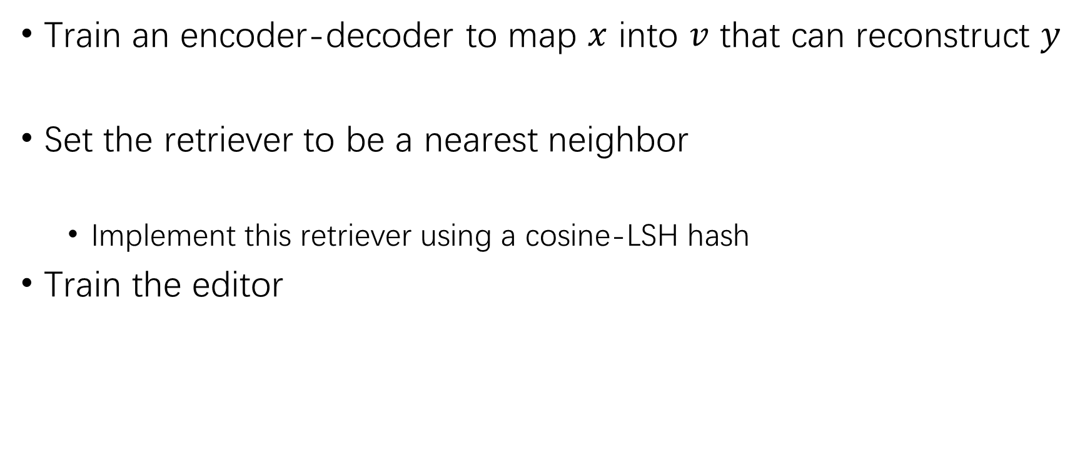
Overall procedure
Train an encoder-decoder to map $x$ into $v$ that can reconstruct $y$
Set the retriever to be a nearest neighbor
Implement this retriever using a cosine-LSH hash
Train the editor

Slide 13
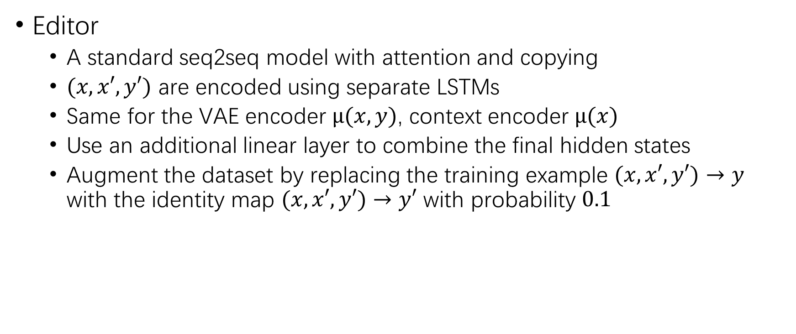
Model details
Editor
A standard seq2seq model with attention and copying
$(x,x′,y′)$ are encoded using separate LSTMs
Same for the VAE encoder $μ(x,y)$, context encoder $μ(x)$
Use an additional linear layer to combine the final hidden states
Augment the dataset by replacing the training example $(x,x′,y′)→y$ with the identity map $(x,x′,y′)→y′$ with probability $0.1$

Slide 14
Experiments
Autocomplete on Python GitHub code
Google Bigquery
retrieving Python code containing at least one block comment with restructured text (reST) formatting
each example consists of four inputs: the block comment, function name, arguments, and a partially written function body
The output is the next token in the function body
SELECT *
FROM [bigquery-public-data:github_repos.files] f JOIN [bigquery-public-data:github_repos.contents] ON f.id = c.id
WHERE
REGEXP_MATCH(c.content,r’"""[\s\S]*?returns:[\s\S]*?"""’)
HAVING RIGHT(f.path,2) = ’py’ AND c.size > 100
LIMIT 5000000
Notes:
删除重复以及过长的程序，剩余约75000条

Slide 15
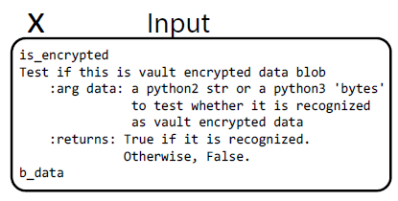

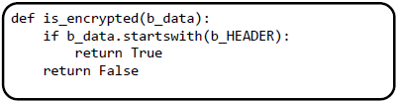
Experiments

Slide 16
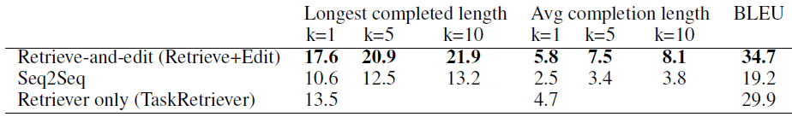
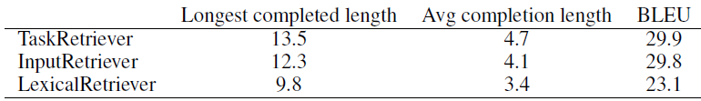
Experiments

Slide 17
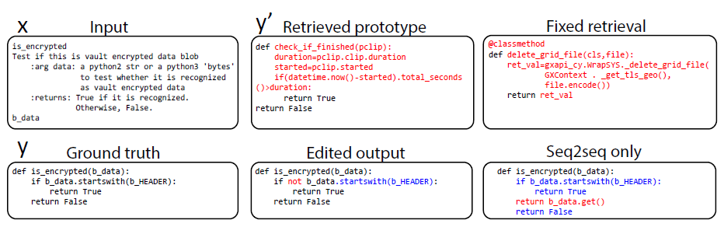
Experiments

Slide 18
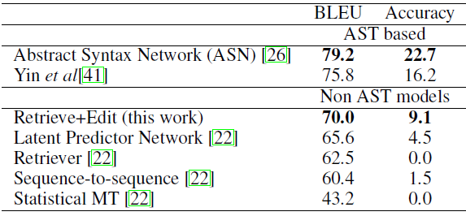
Experiments
Hearthstone cards benchmark

Slide 19
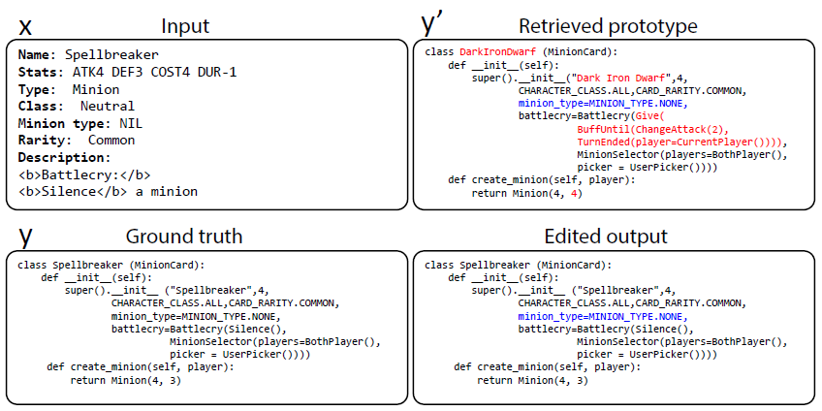
Experiments

