Slide 1
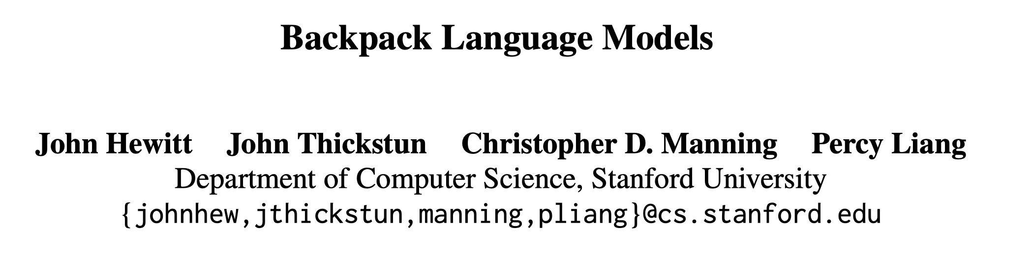
ACL 2023 Outstanding Paper
Reporter: Jia Li♂

Slide 2
Abstract
Motivation
Transformer-based language models are monolithic functions of sequence.
Black box and easy to lose control.
Contribution
Backpack – a new neural architecture
Strong language modeling performance
Good interpretability
Easy to control
Notes:
Transformer的几个缺点：黑盒模型，可解释性较差；在实际使用时很容易失控，生成一些有偏见的文本，我们也很难排查到底是哪里出问题了。
Backpack，一种新的神经网络架构，给语言模型带了一个新思路。实验表明，它具备以下优点：…

Slide 3
Background
Transformer
The mainstream architecture in language modeling
Poor interpretability, Easy to lose control
E.g., gender bias
We need a new neural architecture.

Slide 4
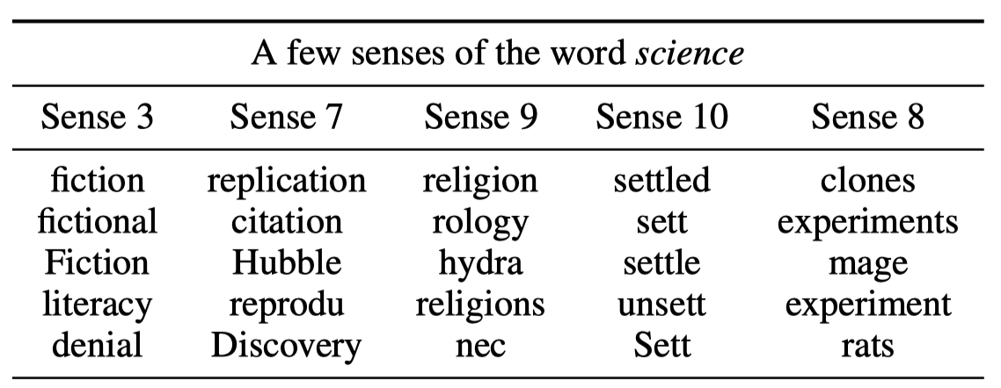
Motivation ①
A word typically contains distinct aspects of meanings
Each word is equipped with a set of non-contextual sense vectors
Notes:
本文的motivation分为两点，第一点..
例如在这个表里，每个Sense vector代表了science这个单词不同方面的含义。既包含科学的不同类型，例如：小说、宗教等等，以及科研过程中的不同方面：实验等

Slide 5
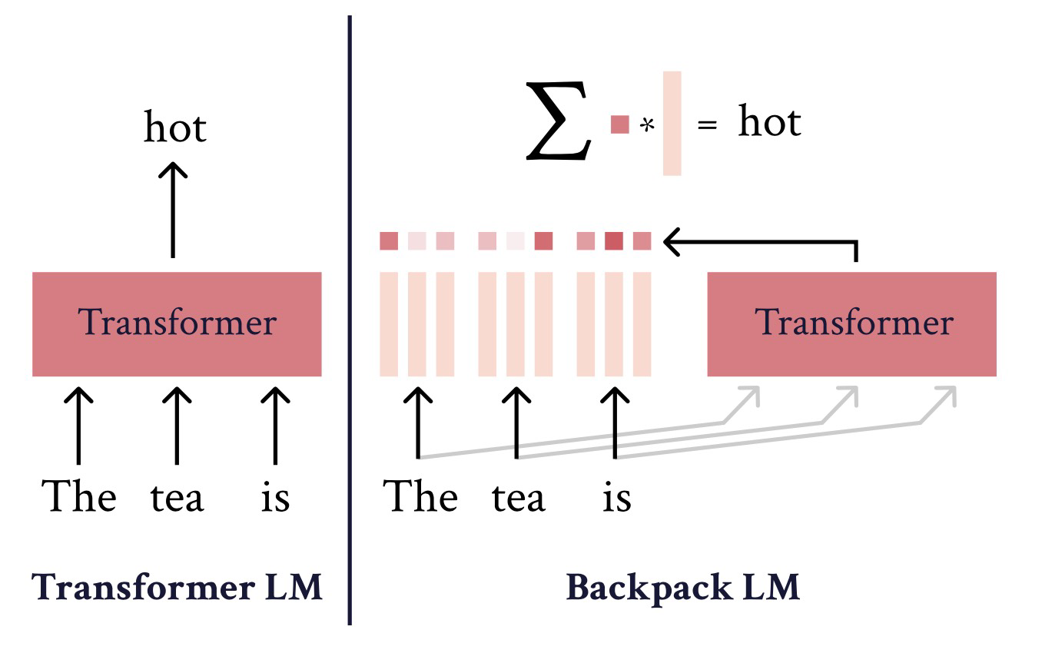
Motivation ②
The meaning of a word in a sequence depends on its contexts.
Each word in a sequence is represented as a linear combination of senses vectors for all words in the sequence.

Slide 6
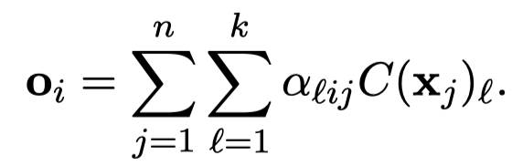





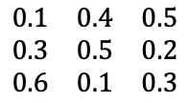




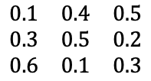

Backpack Architecture
Input: a sequence of symbols $x_{1:n}=\left(x_{1},…,x_{n}\right),x_{i}∈𝒱$
Output: a sequence of Backpack representation $o_{1:n}=\left(o_{1},…,o_{n}\right),o_{i}∈ℝ^{d}$
$$o_{1:n}$$
$$k$$
$$k$$
…
$$\begin{matrix}0.1 & 0.4 & 0.5 \\ 0.3 & 0.5 & 0.2 \\ 0.6 & 0.1 & 0.3\end{matrix}$$
…
$$\begin{matrix}0.1 & 0.4 & 0.5 \\ 0.3 & 0.5 & 0.2 \\ 0.6 & 0.1 & 0.3\end{matrix}$$
$$n×n$$
Sense Vector network
Contextual Weight Network
$$x_{1:n}$$
Notes:
Backpack的整体idea
重点是讲清楚两个网络的role

Slide 7



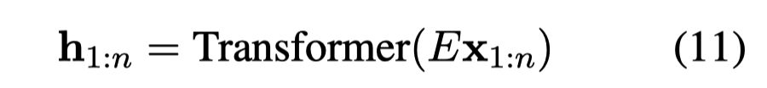



Parameterizing Backpack LMs
Sense vector network
Contextual weight network
We add proper autoregressive masking and some position representation
We can think of $k$ senses as heads.
Notes:
本文给出了backpack的一个实现方案

Slide 8
Parameterizing Backpack LMs
Input: a sequence of symbols $x_{1:n}=\left(x_{1},…,x_{n}\right),x_{i}∈𝒱$
Output: a sequence of Backpack representation $o_{1:n}=\left(o_{1},…,o_{n}\right),o_{i}∈ℝ^{d}$
$$o_{1:n}$$
$$k$$
$$k$$
…
$$\begin{matrix}0.1 & 0.4 & 0.5 \\ 0.3 & 0.5 & 0.2 \\ 0.6 & 0.1 & 0.3\end{matrix}$$
…
$$\begin{matrix}0.1 & 0.4 & 0.5 \\ 0.3 & 0.5 & 0.2 \\ 0.6 & 0.1 & 0.3\end{matrix}$$
$$n×n$$
Word Embedding+FFN
Sense Vector network
Contextual Weight Network
Transformer Encoder
$$x_{1:n}$$

Slide 9
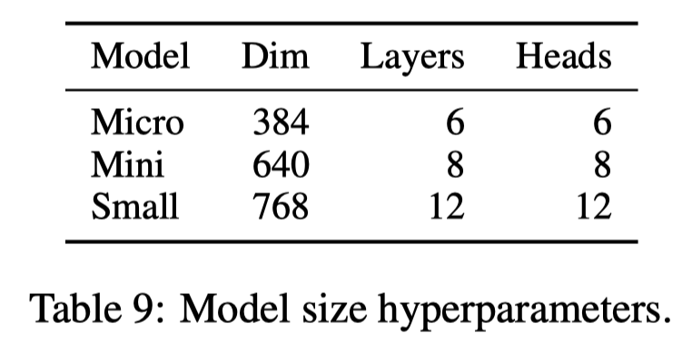
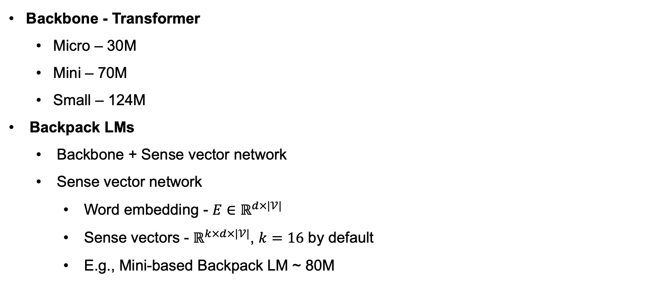
Training Backpack LMs
Backbone - Transformer
Micro – 30M
Mini – 70M
Small – 124M
Backpack LMs
Backbone + Sense vector network
Sense vector network
Word embedding - $E∈ℝ^{d×|𝒱|}$
Sense vectors - $ℝ^{k×d×|𝒱|}$, $k=16$ by default
E.g., Mini-based Backpack LM ~ 80M

Slide 10
Training Backpack LMs
Data
OpenWebText (2019)
A public reconstruction of the WebText corpus used to train GPT-2
Hyperparameters
Batch size – 524,288 tokens, 100k training steps for a total of 52B tokens
Maximum sequence length – 512

Slide 11
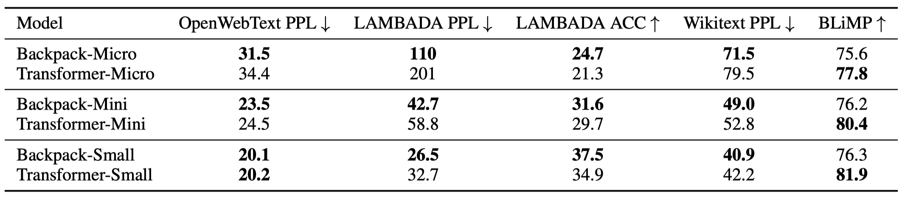
Language Modeling
The capability of backpack LMs in language modeling
Metric - Perplexity
Dataset – OpenWebText, LAMBADA, Wikitext, BLiMP
Backpack LMs are comparable of Transformers.

Slide 12
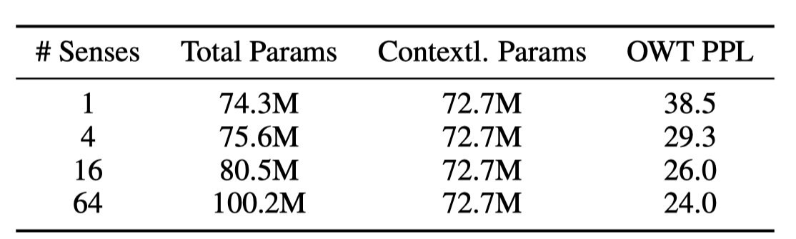
Language Modeling
The impact of the number of sense vectors on language modeling
Mini-sized Backpack LMs trained with 50k steps
More sense vectors bring improvements in language modeling.

Slide 13

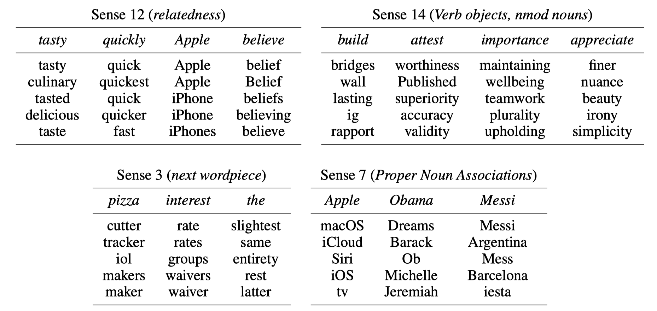
Emergent Structure in Sense Vectors
Trained sense vectors are associated with specific roles.
Pick a sense vector of a word
Compute the similarity of the sense vector and all word embeddings

Slide 14
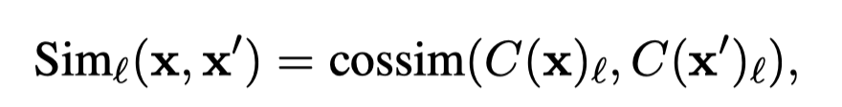
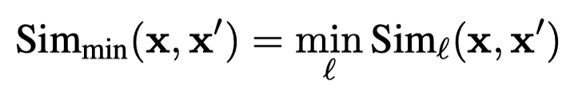
Emergent Structure in Sense Vectors
Lexical Relationship Tests
Predict the similarity between two words
Dataset – SimLex999, SimVerb3500, RG65
How backpack LMs do:

Slide 15
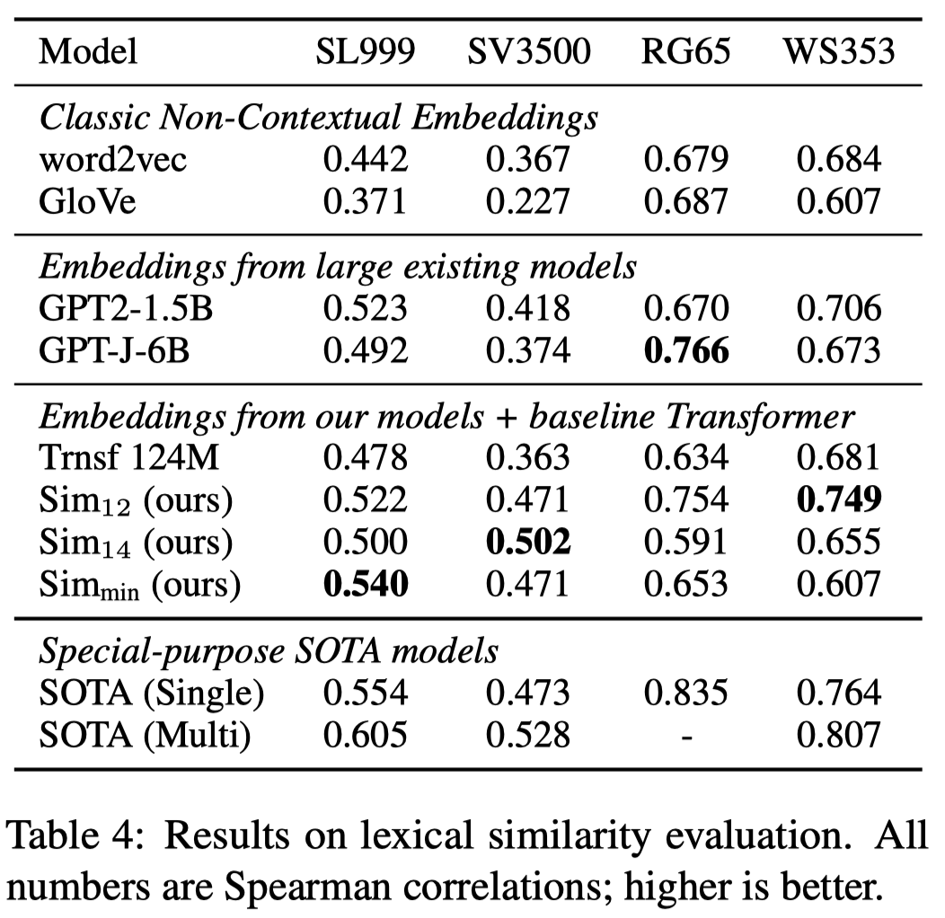
Emergent Structure in Sense Vectors
Backpack LMs perform well across datasets, matching or outperforming embeddings like GPT-2-1.5B and GPT-J-6B (Except GPT-J-6B on RG-65).
Notes:
SOTA模型通常是针对该任务进行了监督训练

Slide 16
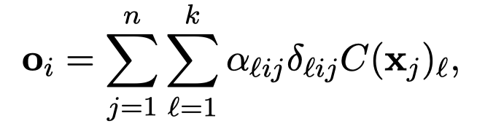
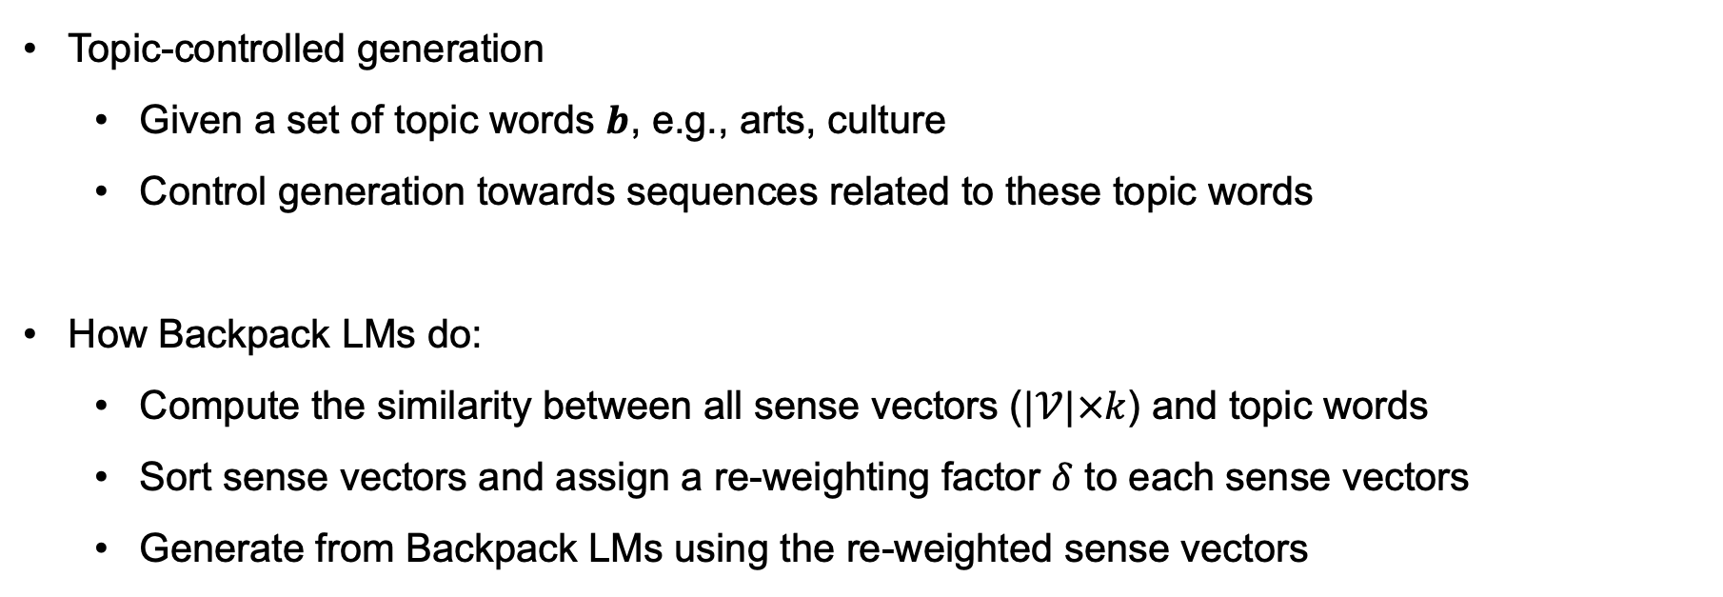
Sense Vectors for Control
Topic-controlled generation
Given a set of topic words $b$, e.g., arts, culture
Control generation towards sequences related to these topic words
How Backpack LMs do:
Compute the similarity between all sense vectors ($|𝒱|×k$) and topic words
Sort sense vectors and assign a re-weighting factor $δ$ to each sense vectors
Generate from Backpack LMs using the re-weighted sense vectors
Notes:
代码修复的定义；分为单块和多块修复，不是单行/多行
如何利用LLMs来做程序修复，目前的解决方案是通过构造完形填空形式的prompt。
介绍图片

Slide 17
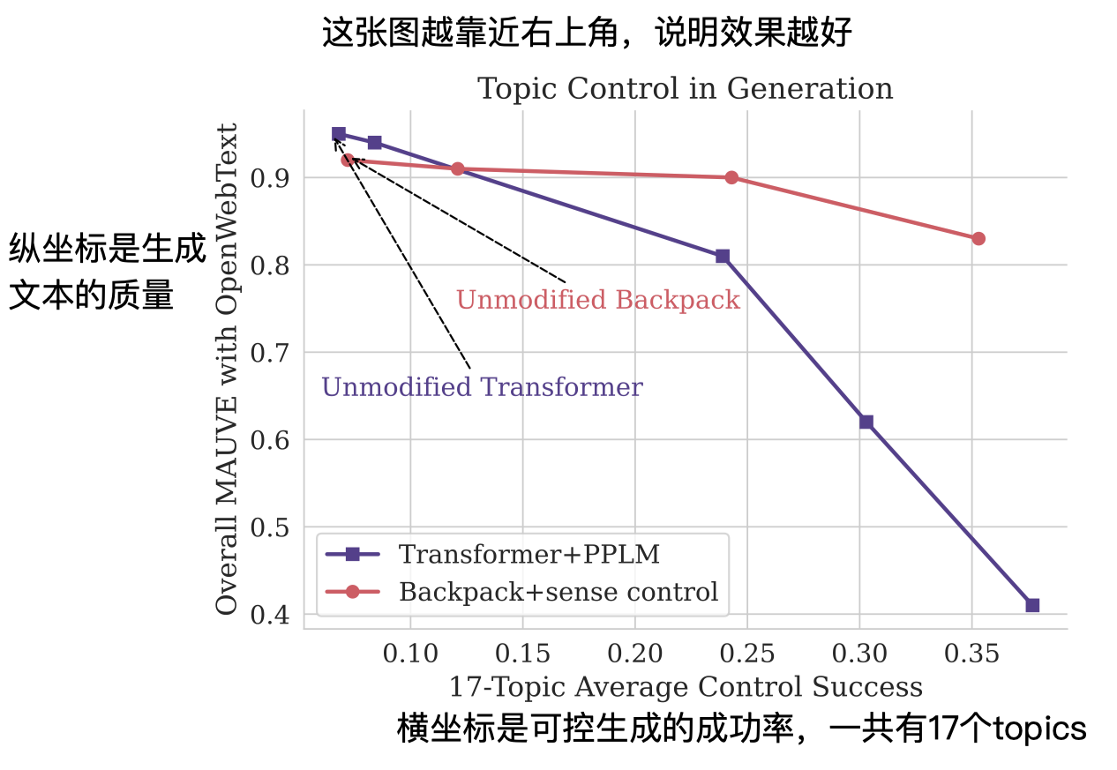
Sense Vectors for Control
Topic-controlled generation
Baseline – PPLM, a gradient-based control decoding
17 sets of topic words, 500 sequences generated by each model
Metrics – Control Success, MAUVE
Notes:
代码修复的定义；分为单块和多块修复，不是单行/多行
如何利用LLMs来做程序修复，目前的解决方案是通过构造完形填空形式的prompt。
介绍图片

Slide 18
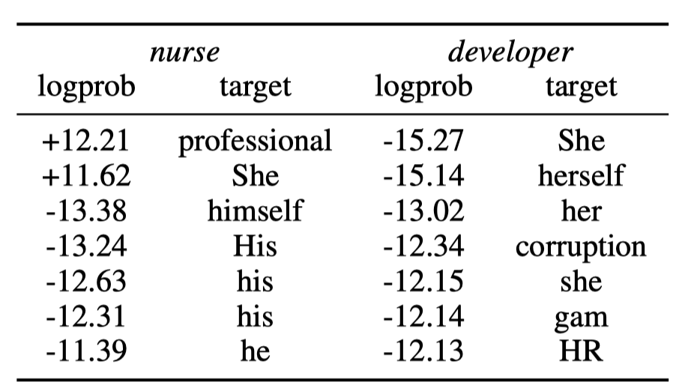
Sense Vectors for Control
Mitigating gender bias
Sense vector 10 - stereotypically gendered profession nouns (nurse, CEO, teacher)
Notes:
代码修复的定义；分为单块和多块修复，不是单行/多行
如何利用LLMs来做程序修复，目前的解决方案是通过构造完形填空形式的prompt。
介绍图片

Slide 19
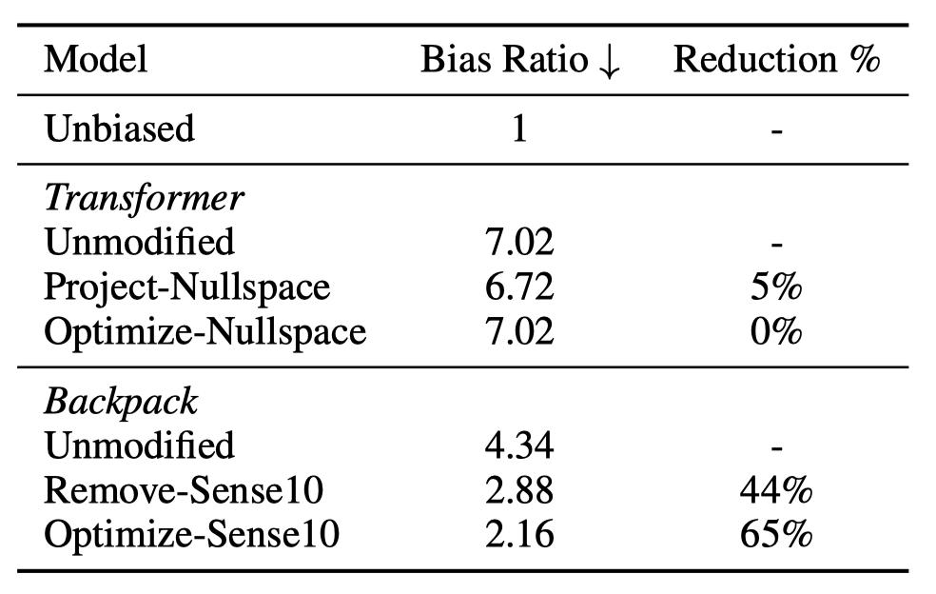
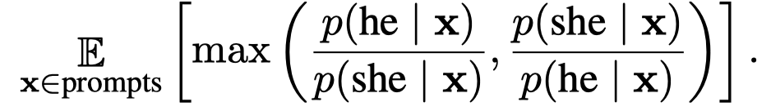
Sense Vectors for Control
Mitigating gender bias
Dataset – WinoBias, e.g., My CEO said that __.
Evaluate models on the bias of probabilities of him vs her as follows
Notes:
代码修复的定义；分为单块和多块修复，不是单行/多行
如何利用LLMs来做程序修复，目前的解决方案是通过构造完形填空形式的prompt。
介绍图片

Slide 20
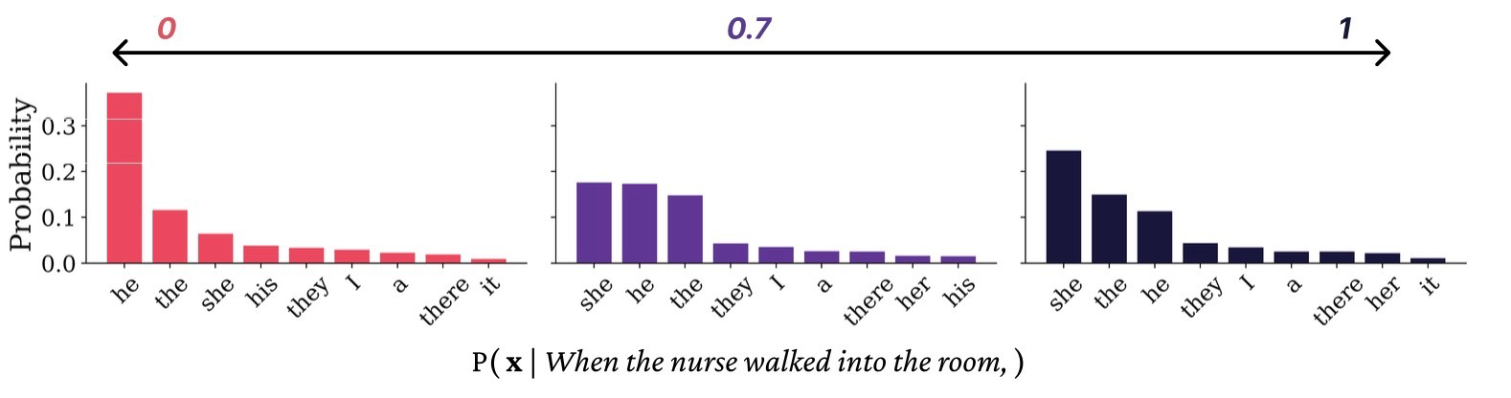
Sense Vectors for Control
Mitigating gender bias
Dataset – WinoBias, e.g., My CEO said that __.
Evaluate models on the bias of probabilities of him vs her as follows
Notes:
代码修复的定义；分为单块和多块修复，不是单行/多行
如何利用LLMs来做程序修复，目前的解决方案是通过构造完形填空形式的prompt。
介绍图片

Slide 21
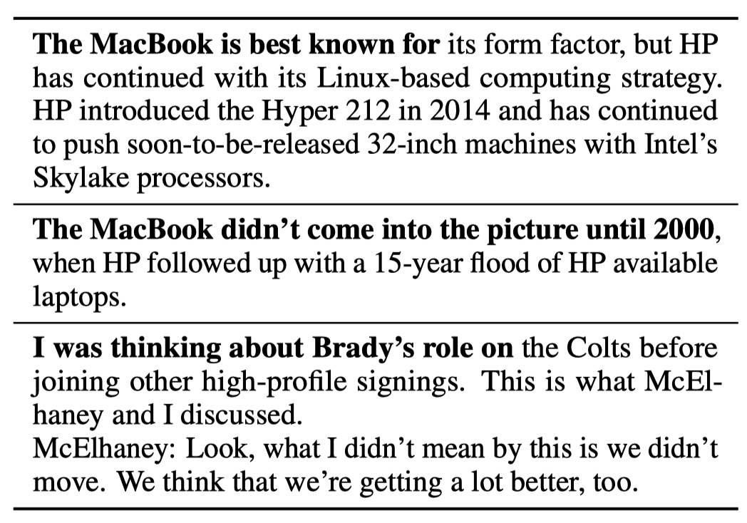
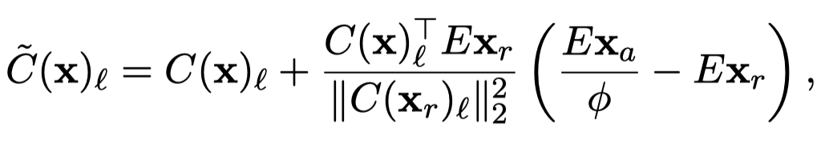
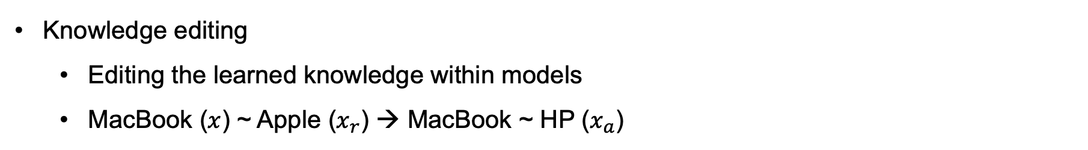
Sense Vectors for Control
Knowledge editing
Editing the learned knowledge within models
MacBook ($x$) ~ Apple ($x_{r}$) → MacBook ~ HP ($x_{a}$)
Notes:
这里如何控制的，没看懂

Slide 22
Discussion
The expressivity of Backpack
An expressive contextual weight network can represent complex functions
Are Backpacks inherently interpretable?
No. But it offers a interface to analyze/control models’ predictions
Why do sense vectors specialize?
A potential reason: the shared FFN for computing sense vectors

Slide 23
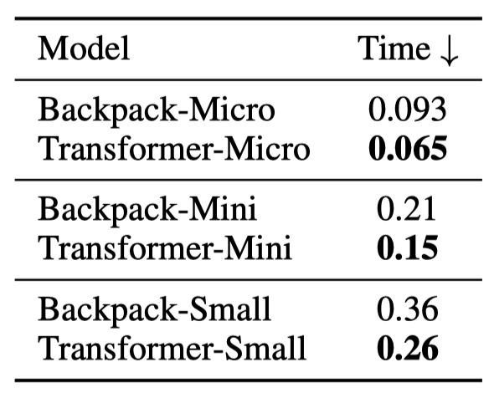
Conclusion
Advantage
Reasonable motivations + Simple architectures
Interesting experiments
Weakness
Contextual weight network
Extra parameters and computational overhead

Slide 24
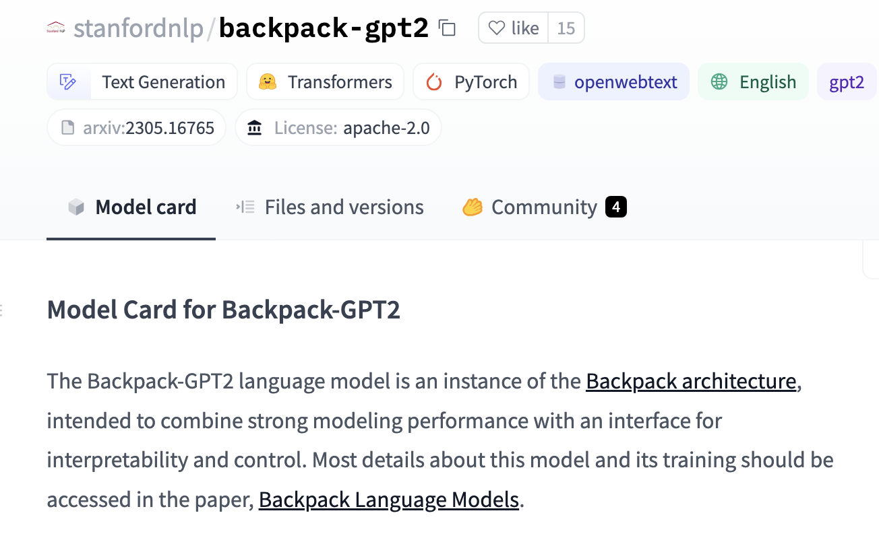
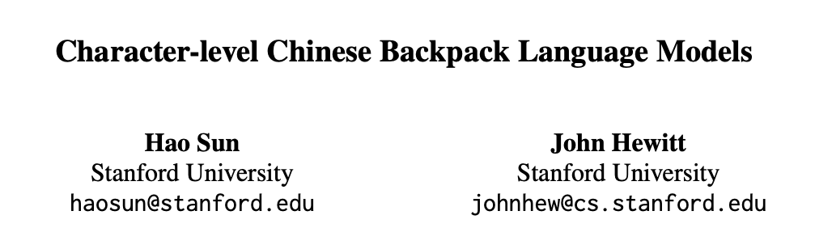
Conclusion

