Slide 1
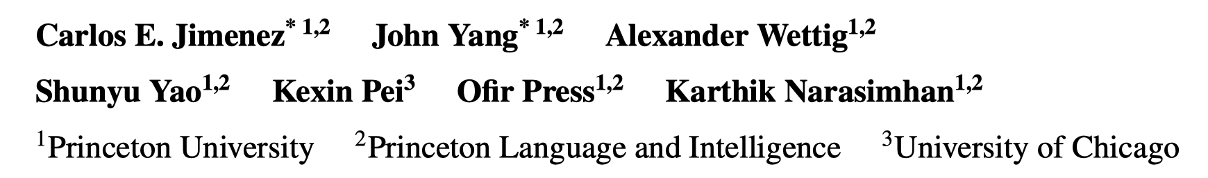
SWE-bench - Can Language Models Resolve Real-World GitHub Issues?
ICLR 2024 (Oral)
Reporter: Jia Li♂

Slide 2
Abstract
Motivation
How to evaluate LLMs in practical software engineering?
Contribution
SWE-bench
An evaluation benchmark drawn from real GitHub issues and pull requests
Evaluation
gpt-3.5, gpt-4, Claude 2
Fine-tuned models, SWE-LLaMa
Interesting insights
Notes:
动机，随着大语言模型的飞速发展，如何评估这些模型的能力？尤其是它们在软件工程任务上的能力
本文的贡献，一个面向解决GitHub Issues的评估基准…

Slide 3
Introduction
Large Language Models (LLMs)
How to evaluation LLMs is an open question.
An ideal benchmark
Real and challenging questions
Easy to evaluate
Coding Tasks
HumanEval, MBPP,…
Too easy problems
Notes:
1、如何评估LLMs，一个理想的评估基准应该是怎么样的
2、Coding Tasks是一个不错的选择，但是现有的评估基准比较简单

Slide 4
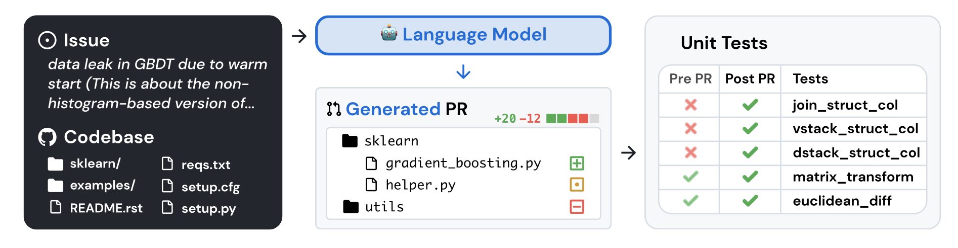
Introduction
SWE-bench
Task: resolve GitHub issues (2,294 issues in total)
Input: a issue (typically a bug report or a feature request), a codebase
Output: a patch describing code changes
Evaluation: Test cases
Notes:
本文提出一个新的，SWE-bench，任务是…
图中展示了基本形式

Slide 5
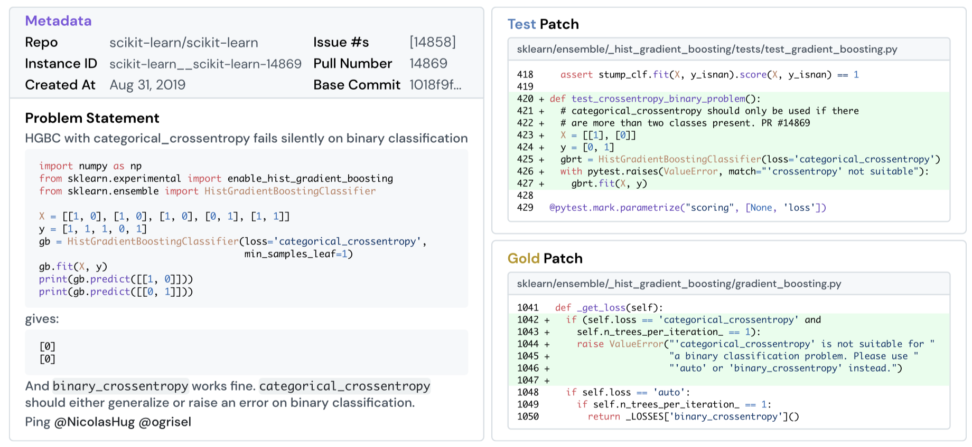
SWE-bench
2,294 samples from 12 popular GitHub projects.
Notes:
共计包含2294条样本，涵盖了12个流行的GitHub项目。
每个样本的构成…

Slide 6
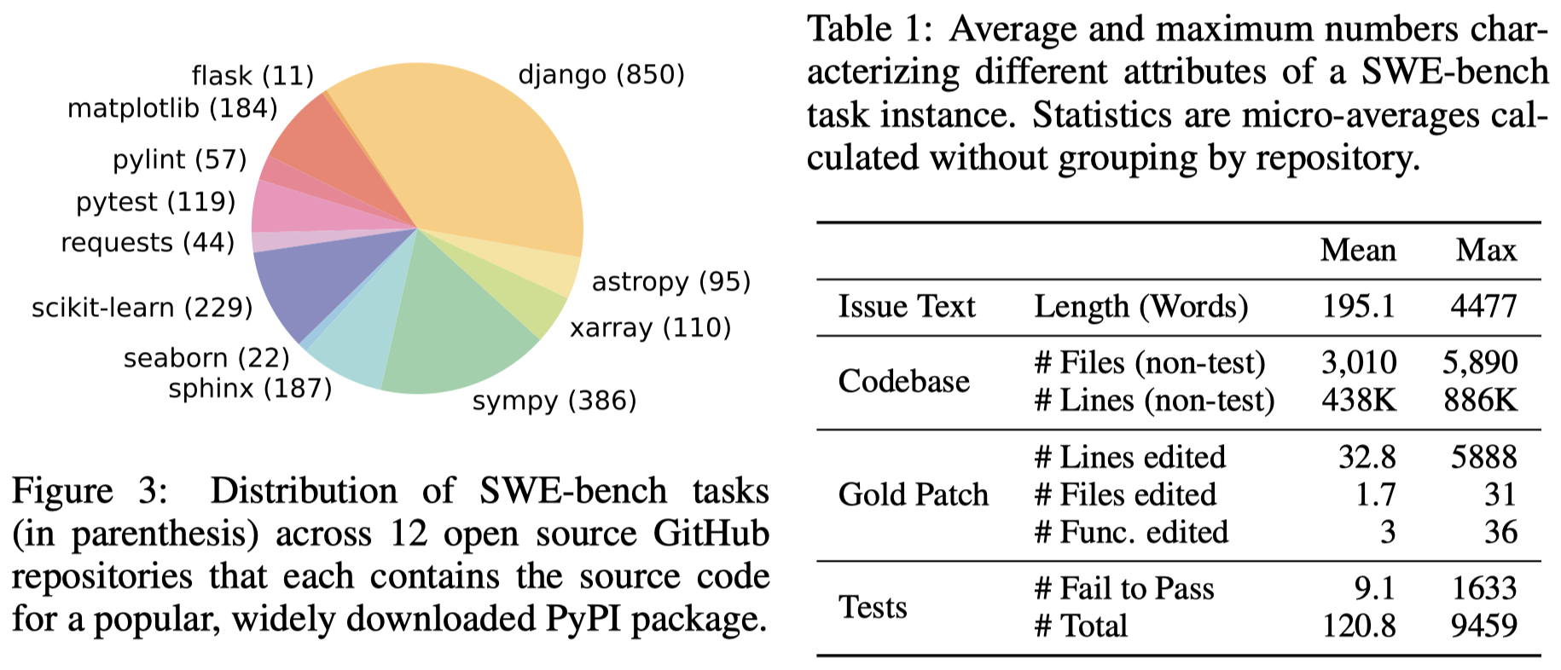
SWE-bench
Notes:
关于benchmark的一些统计数据
项目上样本数据的分布情况、样本长度统计

Slide 7
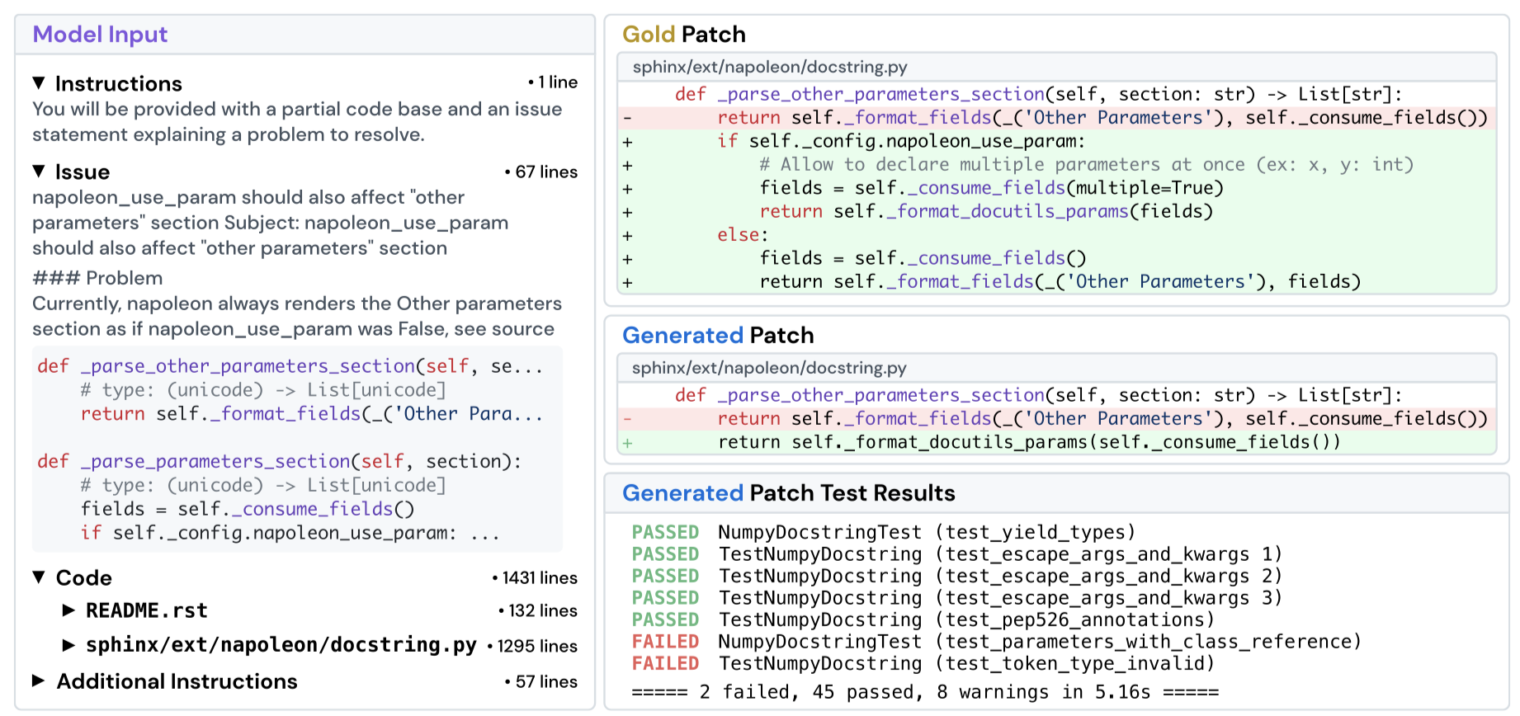
How to Use SWE-bench
Notes:
具体在用的时候，模型的输入包括…生成对应的补丁…然后使用Test cases去评估生成的补丁…

Slide 8
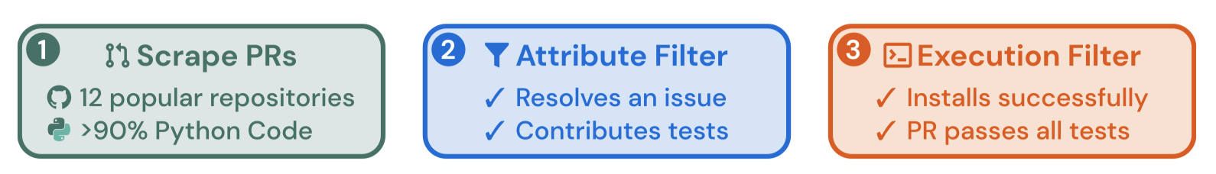
Benchmark Collection
Merged PRs that
(i) resolve issues;
(ii) make changes to tests
2,294 PRs that
(i) have successful tests
90k PRs from 12 popular Python projects on GitHub
Note:
12 projects are selected from a list of the most downloaded PyPI libraries during August 2023.
Successful tests mean tests that fail before the PR and pass after the PR.
Notes:
下面是数据集的收集流程，分为三步

Slide 9
SWE-LLaMa
SWE-bench
Fine-tuned versions of CodeLLaMa-Python-7B and 13B
Training data
19,000 issue-PR pairs from additional 37 projects
Training details
Input format: <instruction> + <issue description> + <relevant files>
Output format: a patch file
Context window: 30,000 tokens
LoRA with 4 epochs
Notes:
除了这个数据集，本文针对这个任务微调了一个模型…

Slide 10
Experiments
Retrieval
Retrieve relevant contexts as inputs
Generation
Generate patches
Notes:
下面做实验，来评估模型解决Issues的能力。
考虑到codebase很长，远远超过了LLMs的上下文窗口。因此，本文分两步来生成补丁，第一步，…

Slide 11
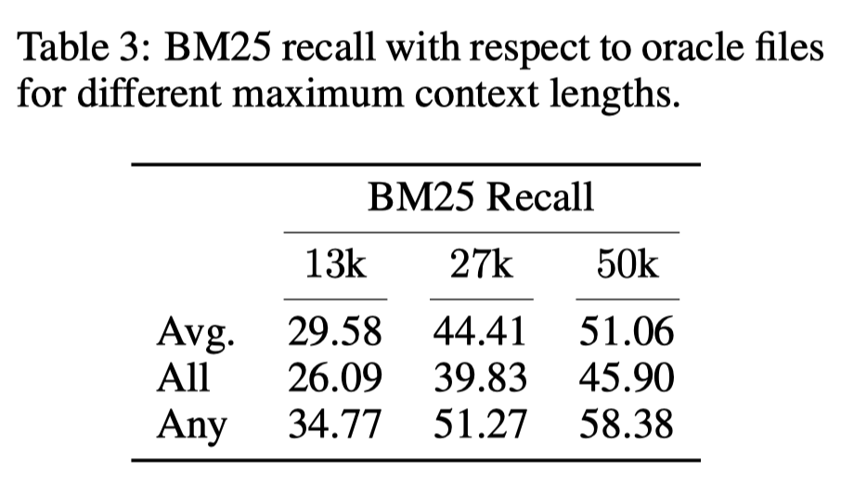
Experiments - Retrieval
Retrieval
Retrieve relevant contexts as inputs
Spare retrieval – BM25
Query: issue description; Key: files in codebases
Oracle retrieval
Modified files in goal patches
How to compute Recall values:
Prediction: a, b, c, d, e
Ground-truth: b, d, f
Avg: 2/3
All: 0
Any: 1
Notes:
本文设计了两种Retrieval场景
结果如右下角所示。可以看到，当上下文窗口为27k时，在40%的样本上，BM25可以检索出所有要修改的文件。

Slide 12
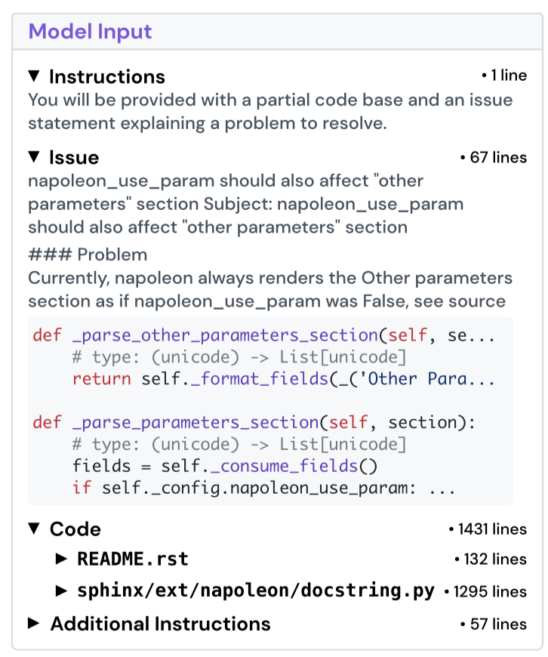
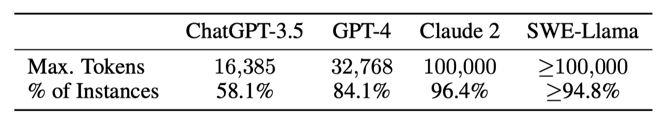
Experiments - Generation
The oracle retrieval setting
Retrieved
files
Notes:
检索之后，我们制作相应的prompt送入LLMs。这里是一个例子。
右表是各个LLMs的上下文窗口大小，以及它能够Cover的样本比例。

Slide 13
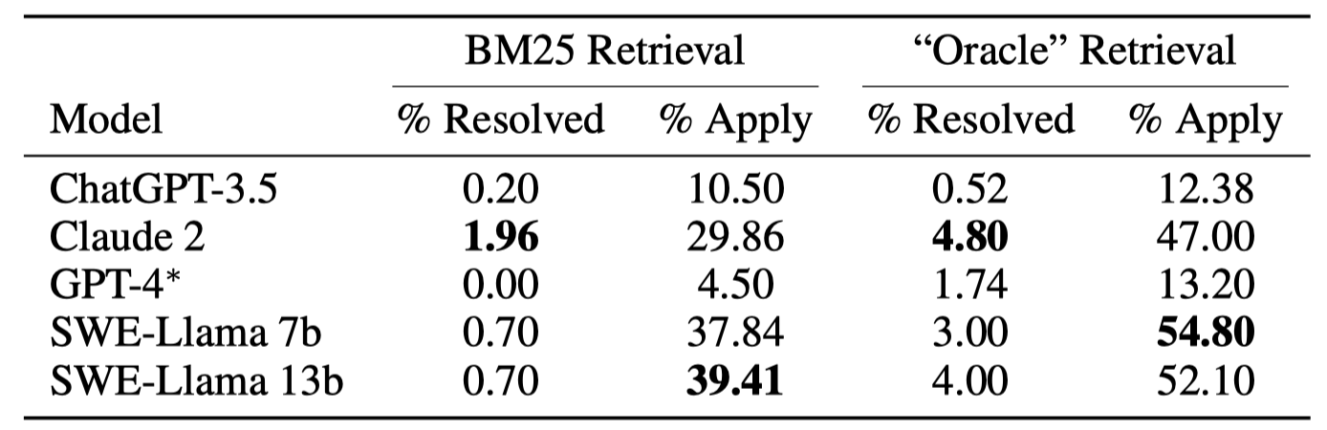
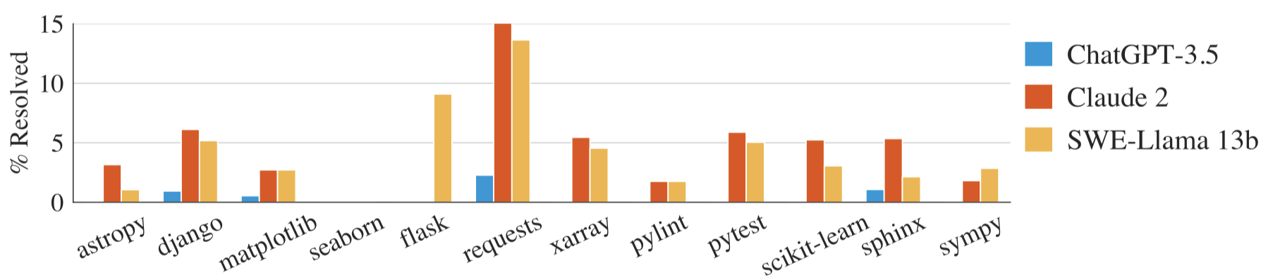
Experiments - Generation
Across the board, models struggle significantly to resolve issues.
Notes:
所有的LLMs解决Issues的能力都很弱。

Slide 14
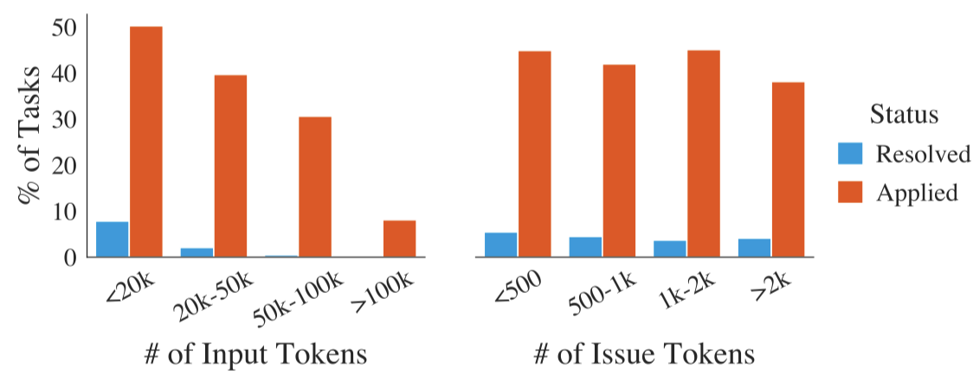
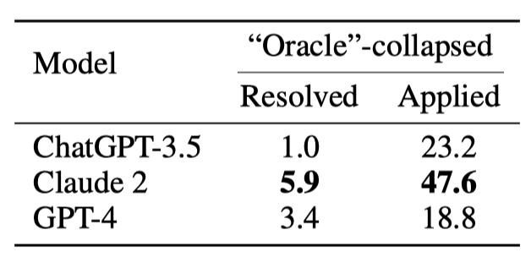
Why LLMs Fail
The presence of images in issues.
Poor abilities in understanding long contexts
Longer inputs lead to lower performance
Oracle-collapsed: only retain code lines to be edited in oracle contexts
Notes:
作者简单探究了为什么LLMs的效果这么差。发现了两个原因…

Slide 15
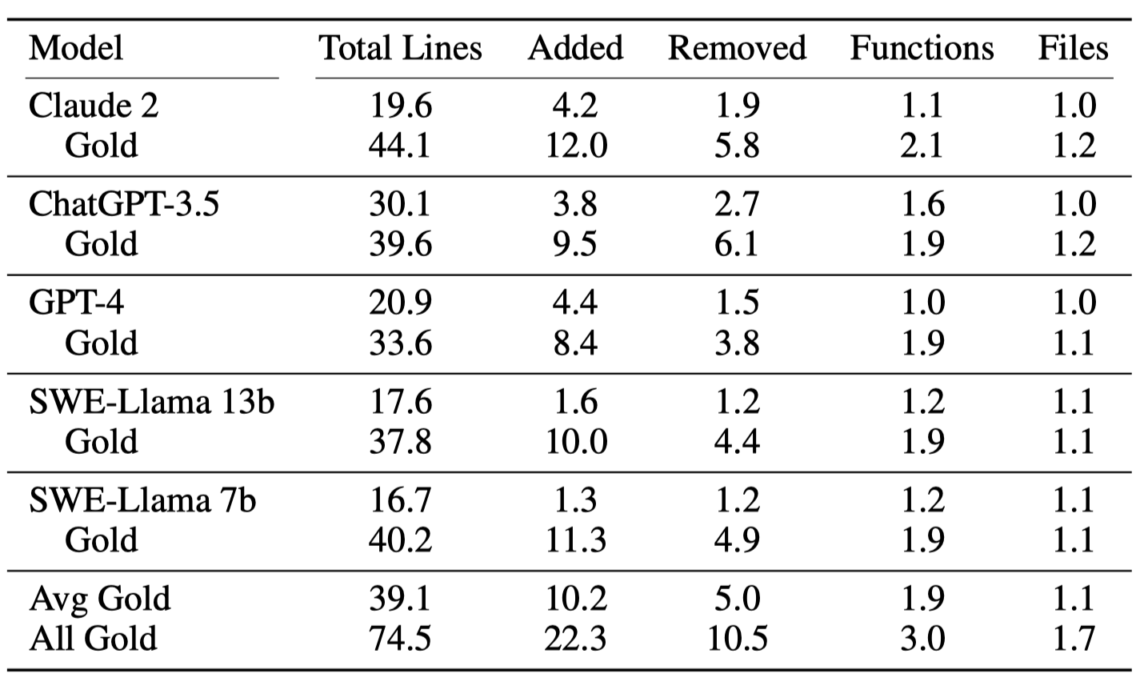
Discussion
Language models tend to generate shorter, simpler edits.

Slide 16
Discussion
Data Leakage
Despite models having been exposed to some version of an repository, they are unlikely to “cheat” to address issues simply by generating a more recent version of the repository.
The collection process does not require human intervention. We can extend SWE-bench with new issues created after LLMs’ training date.

Slide 17
Conclusion
A novel benchmark for evaluating LLMs in real software engineering tasks.
Interesting
Challenging
Inspirational
Shortcomings
Data leakage
Need more experiments

