Slide 1
Process Supervision – Let’s Verify Step by Step
Zhang Huangzhao
zhang_hz@pku.edu.cn

Slide 2
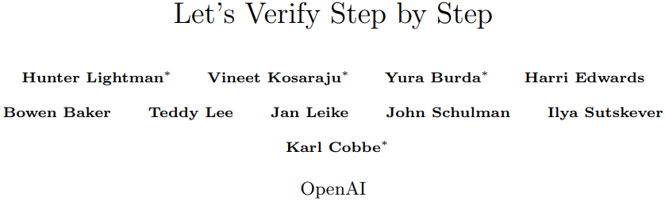

Slide 3
Motivation – Hallucination
Hallucination
LLM reasoning capability vs. hallucination
Hallucinations are particularly problematic in multi-step reasoning
Reward model (RM) – Discriminate desirable output
Reinforcement learning – RLHF, …
Search – Reject sampling, …
Supervision
Outcome-supervised RM – Train RM upon the final result of the COT
Process-supervised RM – Train RM with feedback of each step

Slide 4
Motivation – PRM
Process-supervised reward model
Precise feedback
AI-human alignment
Interpretability
PRM directly rewards models for following human-endorsed COTs

Slide 5
Contribution
Process supervision can be used to train more reliable RMs than outcome supervision in the domain of mathematical reasoning
PRM800K – Step-level human annotated dataset

Slide 6
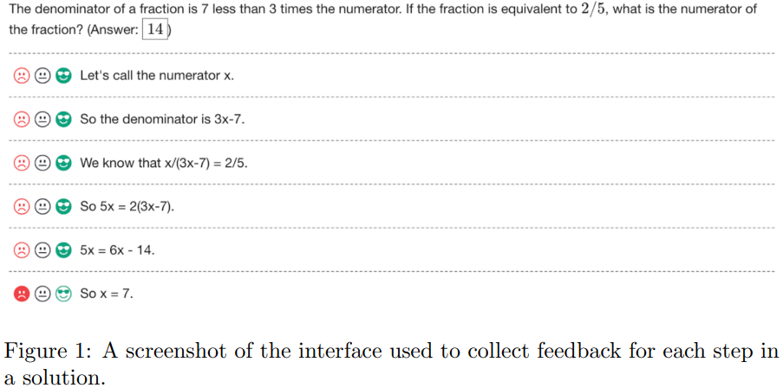
MATH
ORM – No manpower required
PRM – Human annotation

Slide 7
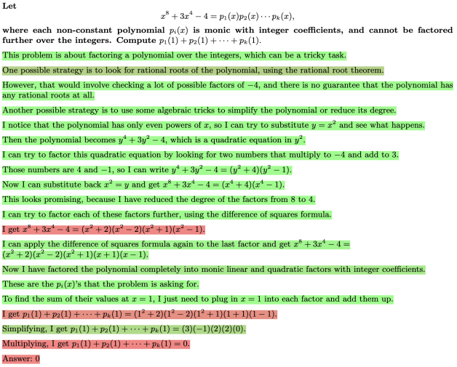
MATH
ORM – No manpower required
PRM – Human annotation

Slide 8
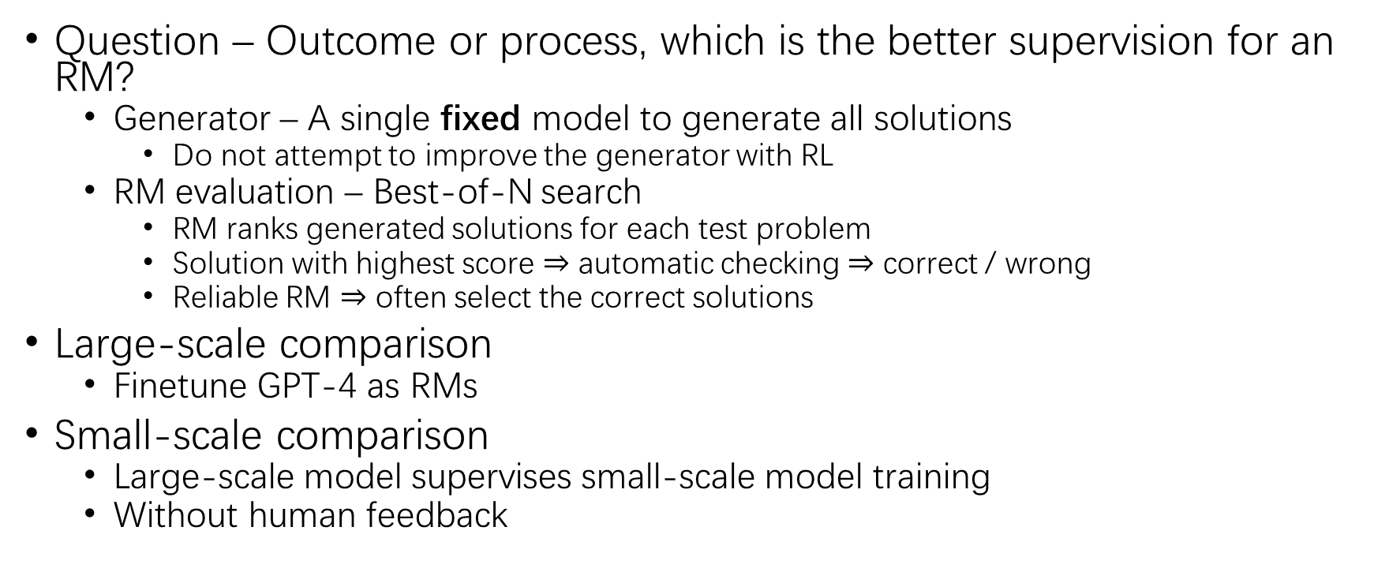
Question – ORM vs. PRM
Question – Outcome or process, which is the better supervision for an RM?
Generator – A single fixed model to generate all solutions
Do not attempt to improve the generator with RL
RM evaluation – Best-of-N search
RM ranks generated solutions for each test problem
Solution with highest score $⇒$ automatic checking $⇒$ correct / wrong
Reliable RM $⇒$ often select the correct solutions
Large-scale comparison
Finetune GPT-4 as RMs
Small-scale comparison
Large-scale model supervises small-scale model training
Without human feedback

Slide 9
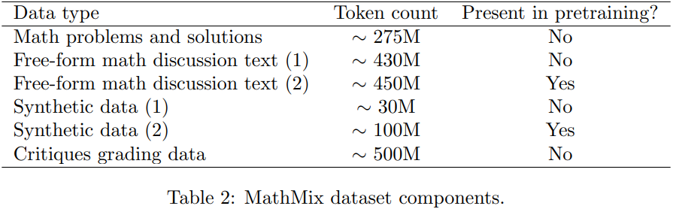
Base Model
Large-scale model – Base GPT-4 model
Next-token pretraining
No RLHF involved yet
Small-scale model – GPT-4-like model
Similar design with GPT-4
200 times less pretraining
Additional pretraining – 1.4B tokens from MathMix
Further math pretraining improves mathematical reasoning capability

Slide 10
Generator & ORM
Generator
Format training – Newline delimited step-by-step format
Dataset – Few-shot generation upon MATH training problems
Filter – Correct final answer
Finetune for one single epoch
Only teach the generator to follow the format
Fixed after format training
ORM
Objective – Predict whether each solution is correct or incorrect
Supervision – Correctness by automatic checking

Slide 11
PRM
Data collection – Human data-labeler
Labeler’s task – Positive, negative or neutral of each step in the solution
Convincing wrong-answer solutions
If the solution makes obvious errors, the human feedback is less valuable
It is preferable to surface solutions that are likely to fool the current best RM
Iteration – PRM retraining
PRM800K – 800k step labels across 75k solutions to 12k problems from MATH
PRM training
Predict the correctness of each step after the last token in each step

Slide 12
PRM (2)
Score
Step score
Solution score – product of the correctness probabilities for each step
Supervision
Supervise only up to the first incorrect step
Additional supervision beyond the first mistake

Slide 13
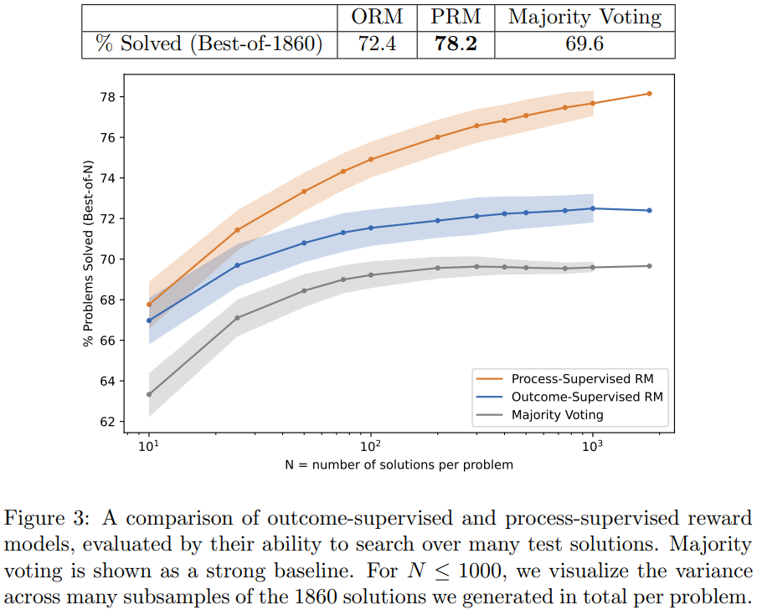
Large-scale Experiment
PRM – Active learning
ORM – 100 samples per problem
ORM cannot be trained on PRM800K
A superset of PRM800K does not improve ORM performance
The best PRM is better than the best ORM
But the training distribution is different between PRM and ORM

Slide 14
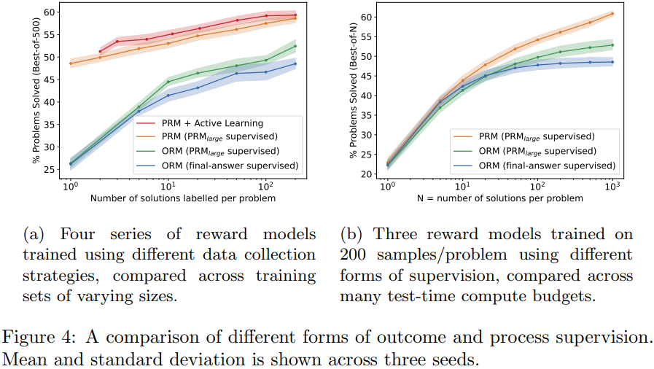
Small-scale Synthetic Experiment
Ablation – Use large-scale PRM to supervise smaller RM

Slide 15
Small-scale Synthetic Experiment (2)
Process vs outcome supervision
Process supervision from PRM_{large}
Outcome supervision from PRM_{large}
Outcome supervision from answer checking
Active learning
Smaller PRM_{selector}
80% wrong-answer
20% remain (right- or wrong-)

Slide 16
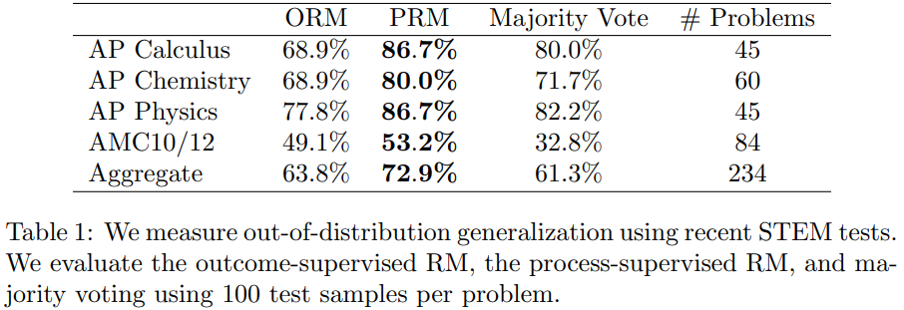
OOD Generalization
STEM – 224 held-out questions

Slide 17
THANK YOU!

