Slide 1
Terraform

Slide 2
Terraform Introduction
1.Terraform is an open-source infrastructure as code software tool that allows users to define and provision data center infrastructure using a declarative configuration language.
2. With Terraform, users can manage infrastructure across various cloud providers, on-premises environments, and even third-party services, enabling consistent and reproducible infrastructure deployments.
3. Terraform uses a concept called "Infrastructure as Code" (IaC), which allows infrastructure to be managed and version-controlled similarly to application code, promoting automation and scalability.

Slide 3
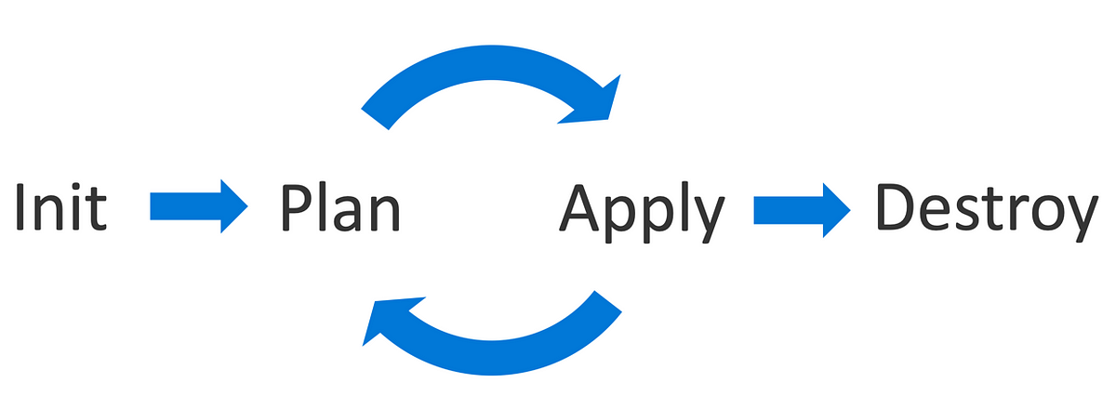
1.The Terraform workflow typically involves three main stages: planning, applying, and destroying. 2. During the planning stage, Terraform generates an execution plan that outlines what actions will be taken to achieve the desired state. 3. The applying stage involves executing the plan to create, update, or delete resources as needed.
Terraform Workflow Overview

Slide 4
Provider “aws" { region = "us-east-1“ access key = "*********** " secret key = “*************” }
Create a file for the provider in terraform.
To create a file for a provider in Terraform, you need to define the provider block in your Terraform configuration file.
Within the provider block, specify the provider type and any required configuration settings, such as access keys or endpoints
After defining the provider block, you can start creating resources within your Terraform configuration file that utilize the specified provider.

Slide 5
resource"awsvpc""demovpc" { cidr block =var.vpc_cidr instance tenancy ="default" tags = { Name = "demo vpc" } } variable "vpc_cidr" { default = "10.0.0.0/16" }
Create a file for the VPC
1.Creating a Virtual Private Cloud (VPC) configuration file typically involves specifying details like the VPC's CIDR block, subnets, route tables, security groups, and other network settings. Here's a basic example of what a VPC configuration file might look like in YAML forma

Slide 6
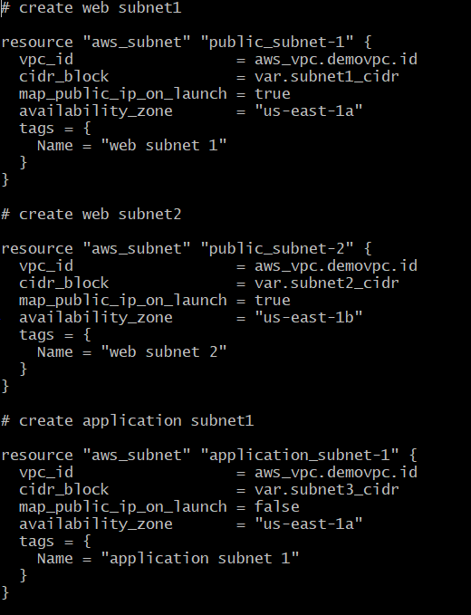
Create a file for the Subnet This example includes details such as the subnet's name, CIDR block, availability zone, associated VPC, route table, security groups, and tags. Make sure to replace placeholder values like VPCID, RouteTableID, and SecurityGroupID with the actual IDs in your environment.

Slide 7
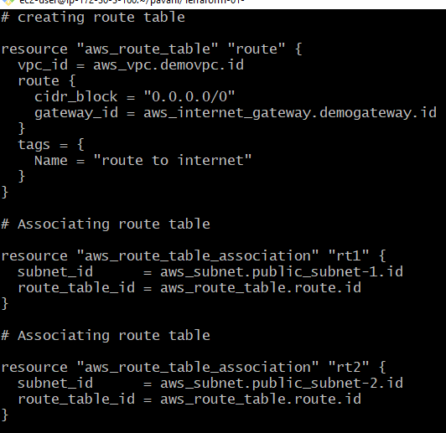
Create a file for the Route table
This configuration includes details such as the route table's name, associated VPC, routes, associated subnets, associations, and tags. Ensure to replace placeholder values like VPCID, InternetGatewayID, SubnetID, and SubnetAssociationID with the actual IDs in your environment.

Slide 8
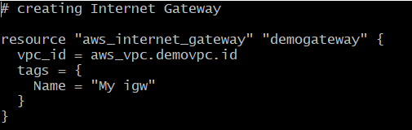
Create a file for the Internet Gateway
1.This configuration file includes details such as the Internet Gateway's name, associated VPC, and tags. Ensure to replace the placeholder value VPCID with the actual VPC ID in your environment.

Slide 9
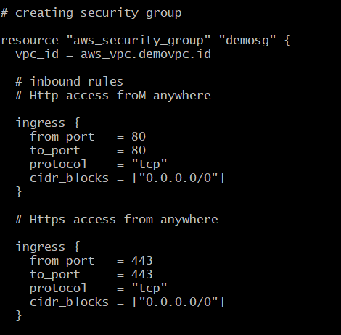
Create a file for the Security group
Aws_security_group is the resource type for creating a security group in AWS.
web_sg is the name of the resource instance.
name and description specify the name and description of the security group.
vpc_id is the ID of the VPC to which the security group belongs.
ingress blocks define inbound rules (allowing traffic into the security group), while egress blocks define outbound rules (allowing traffic out of the security group).
The tags block is used to assign tags to the security group for identification and organization purposes.

Slide 10
Dynamic delivery
Learn to infuse energy into your delivery to leave a lasting impression
One of the goals of effective communication is to motivate your audience
Metric | Measurement | Target | Actual
Audience attendance | # of attendees | 150 | 120
Engagement duration | Minutes | 60 | 75
Q&A interaction | # of questions | 10 | 15
Positive feedback | Percentage (%) | 90 | 95
Rate of information retention | Percentage (%) | 80 | 85

Slide 11
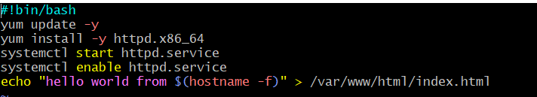
Created a file for User Data

Slide 12
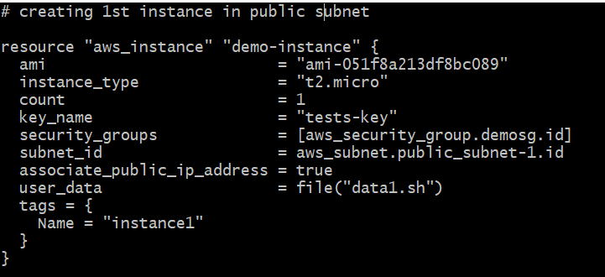
Create a file for the EC2 Instance
Provider "aws" specifies the AWS provider and sets the region.
resource "aws_instance" defines an EC2 instance resource named "example".
ami specifies the ID of the Amazon Machine Image (AMI) to use for the instance.
instance_type specifies the instance type (e.g., t2.micro).
subnet_id specifies the ID of the subnet in which to launch the instance.
key_name specifies the name of the key pair to use for SSH access to the instance.
tags is a map of tags to apply to the instance, providing metadata for organizational purposes.

Slide 13
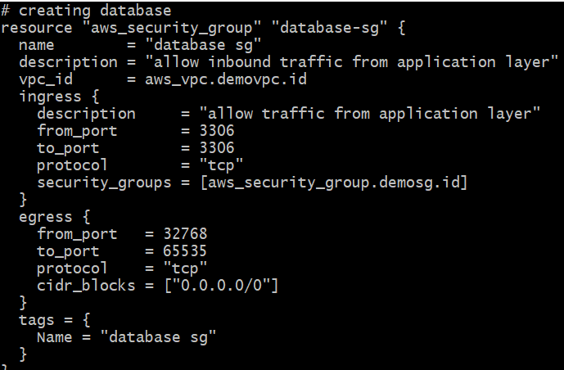
Created a file for Security Group for the Database
provider "aws" specifies the AWS provider and sets the region.
resource "aws_security_group" defines a security group resource named "database_sg" for the database.
name and description specify the name and description of the security group.
vpc_id specifies the ID of the VPC to which the security group belongs.
ingress block defines an inbound rule allowing traffic on port 3306 (MySQL default port) from any source (0.0.0.0/0). Adjust the cidr_blocks to restrict access as needed.
egress block allows all outbound traffic from the security group.
tags block assigns tags to the security group for organizational purposes.
Ensure you replace the placeholder values with appropriate ones for your environment, such as VPC ID and region. Adjust the inbound rule to match the port and source requirements of your database setup.

Slide 14
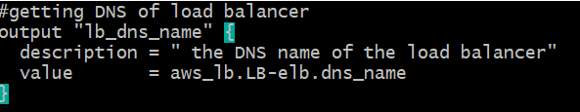
Create a file for the Outputs

Slide 15
resource "aws_db_subnet_group" "default" { name = "new" subnet_ids = [aws_subnet.database_subnet-1.id, aws_subnet.database_subnet-2.id] tags = { Name = "My DB Subnet Group" } } resource "aws_db_instance" "default" { allocated_storage = 10 db_subnet_group_name = aws_db_subnet_group.default.id engine = "mysql" engine_version = "8.0.34" instance_class = "db.t3.micro" multi_az = "true" db_name = "mydb" username = "Dharani" password = "dharani123" skip_final_snapshot = "true" vpc_security_group_ids = [aws_security_group.database_sg.id] }
Create a file for the RDS Instance
provider "aws" specifies the AWS provider and sets the region.
resource "aws_db_instance" defines an RDS instance resource named "example".
identifier specifies the identifier for the RDS instance.
engine specifies the database engine (e.g., mysql, postgres, etc.).
instance_class specifies the instance type for the RDS instance.
allocated_storage specifies the allocated storage in GB.
storage_type specifies the storage type (e.g., gp2, io1, etc.).
username and password specify the master username and password for the RDS instance.
db_subnet_group_name specifies the name of the DB subnet group that the RDS instance belongs to.
vpc_security_group_ids specifies the security group(s) to associate with the RDS instance. Replace sg-12345678 with the actual security group ID(s).
tags block assigns tags to the RDS instance for organizational purposes.
Ensure you replace the placeholder values with appropriate ones for your environment, such as DB subnet group name, security group ID, and region. Adjust other configurations such as engine type, instance class, and storage settings as needed for your use case.

Slide 16
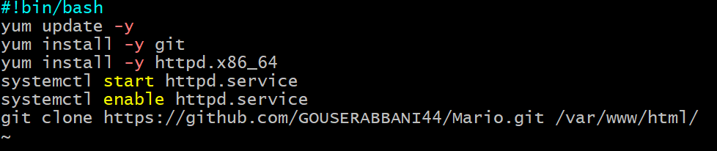
Deploying an Application 1

Slide 17
Deploying an Application 2

Slide 18
THANK YOU

