Slide 1
BRIDGEpersona overview
Sekhar Rangam
Engineering Manager

Slide 2
Agenda
Overview
Capability
Conceptual view
Architecture
Built for any enterprise
Q&A

Slide 3

Enabling Banks & Financial services firms to personalize Next-Best Action
Across digital touch-points
To drive customer engagement & growth

Slide 4
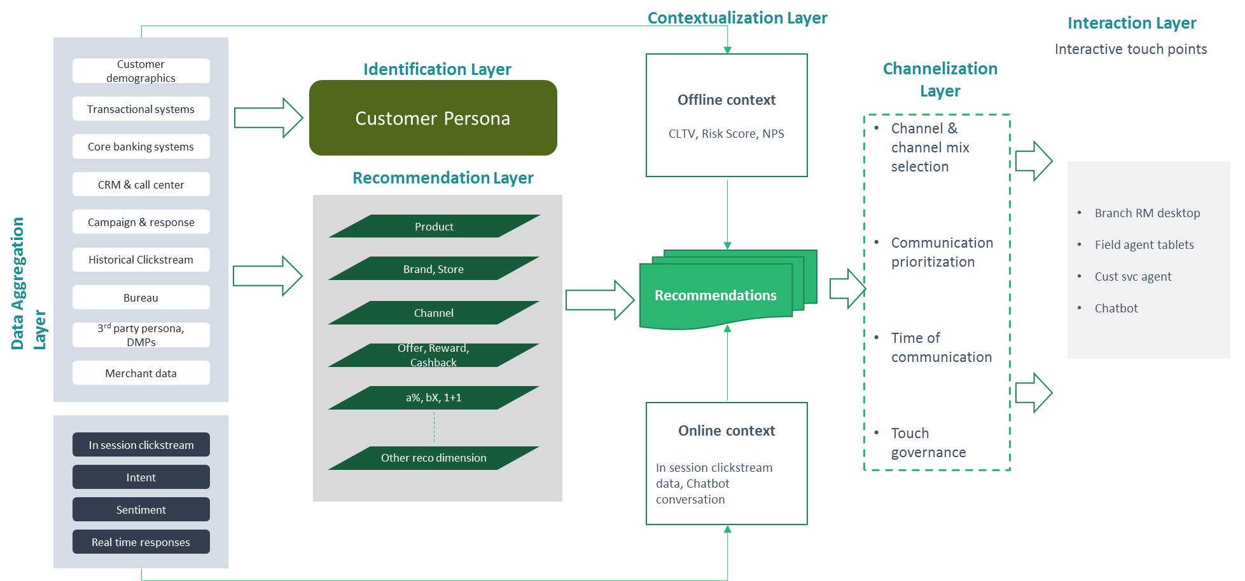
BRIDGEpersona: “selling at the point of service”
CAPABILITY
Recommendations injected to human and bot agents
Product x offer recommendations to known customers
Threaded recommendations on product parameters, offers
Intelligent interruption and recommendation on bots

Slide 5



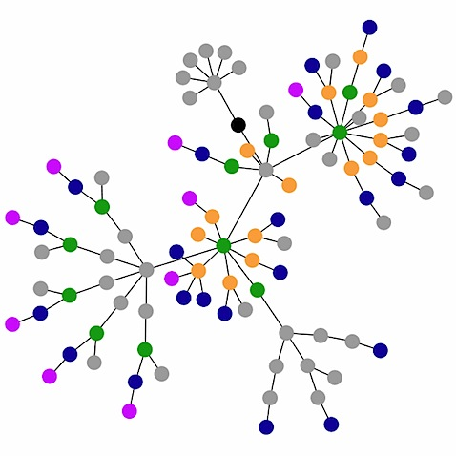


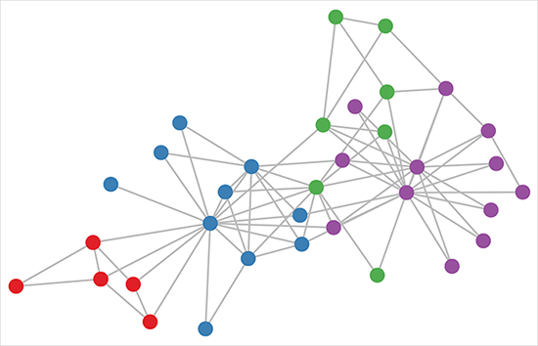
Conceptual view
Data
Feature Generator
Data Model
Consumption
Schema to be created to for
Managing features
Store output
Store feedback
This will help to improve model over time with ease
Customer Information
Customer Features
Demographics
Spend Behaviour
Digital Behaviour
Tenure
Inactivity
Feedback for Learning
Recommendation Algorithm
Customer Graph
Transaction & product
info.
Marketing for Content personalization
ML
Engine
Holiday Offer
Offer Features
Type
Value
Vintage
Frequency
Offer merchant
Response
Cashback
Offer Graph
2000 Rs
Recommendation for customer
Offer information
Recommendation on web portal

Slide 6
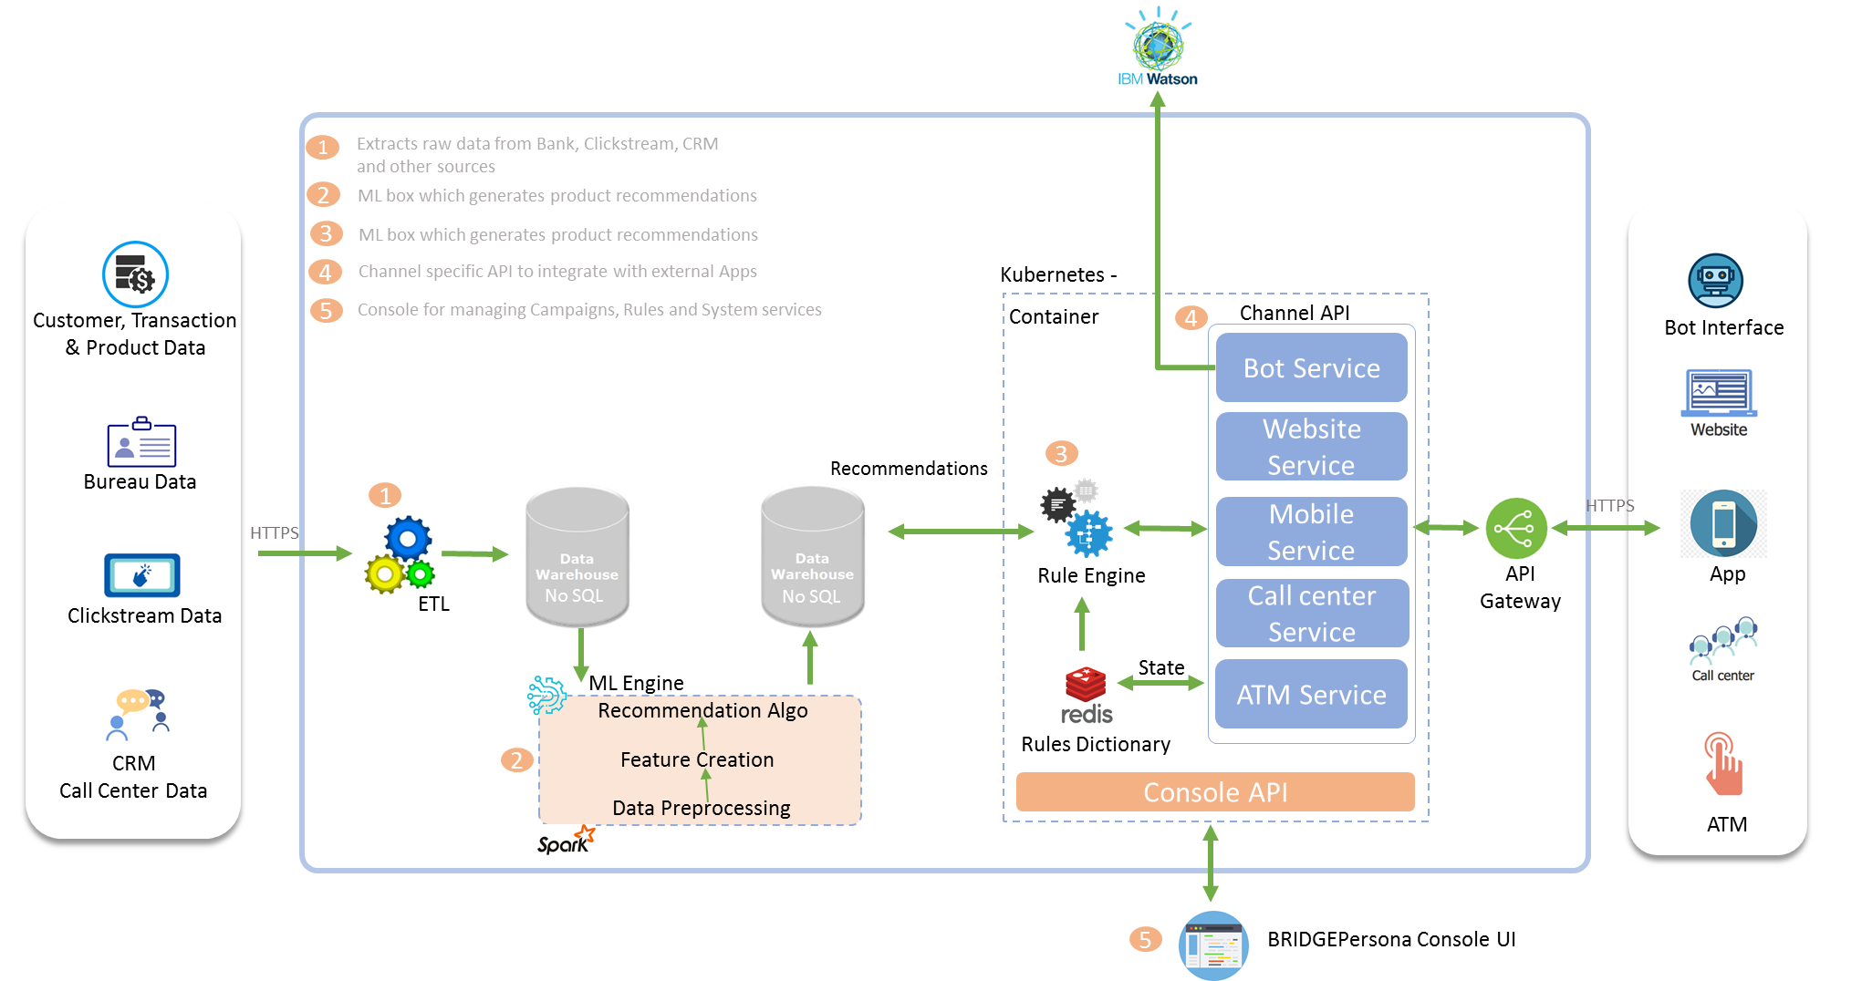
Architecture

Slide 7
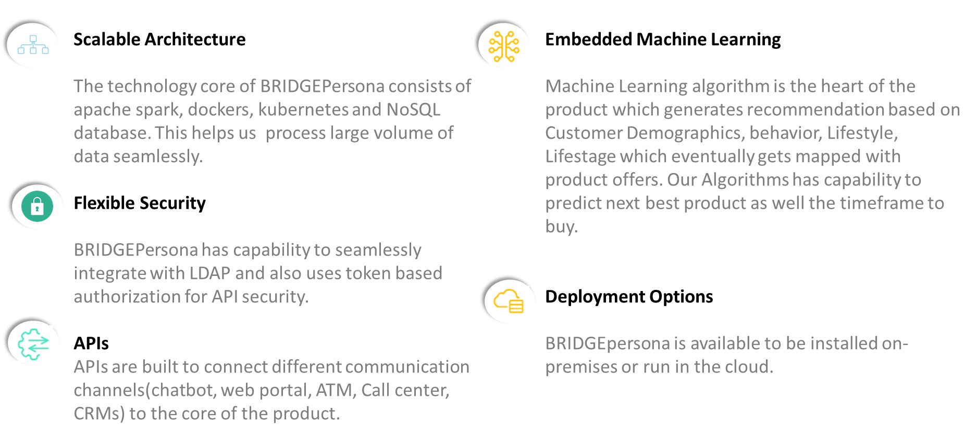
Built for any enterprise

Slide 8
BRIDGEpersona vision: “synchronous personalization for digital financial services brands”
RECOMMENDATIONS ON WEB, APP
Personalization on interactive channels
Proactive recommendations on inbound channels
Event-triggered responses to browsing behaviour & web engagement history
Content personalization
Synchronize recommendations across channels
Wave 2
RECOMMENDATIONS TO AGENTS
Selling at the point-of-service
RECOMMENDATIONS ON OUTBOUND CHANNELS
Engagement along customer journeys
Mobile
Social
Web
Wave 1
RM apps
Email
Reactive personalization on inbound channels
Wave 3
Proactive recommendations on outbound channels
Recommendations into Bots, agent systems – product & offer
Hand-offs to manual processes - escalations
Sync recommendation execution and campaign objectives
Customer support agents
SMS/ text
Customer journeys and events
Trigger content, product and offer personalization across journeys
Channel mix, sequencing for cross-channel synchronous engagement
Chatbots
Customer
Call centres
Awareness
Consideration
Purchase

Slide 9
Q&A

Slide 10
Thank you.
Sekhar Rangam
Engineering Manager
sekhar.rangam@bridgei2i.com
M: +91-9916919145
www.bridgei2i.com

