Slide 1


M.SOMA SEKHAR
BABU
KEY LOGGER AND SECURITY

Slide 2

KEY LOGGER AND SECURITY

Slide 3
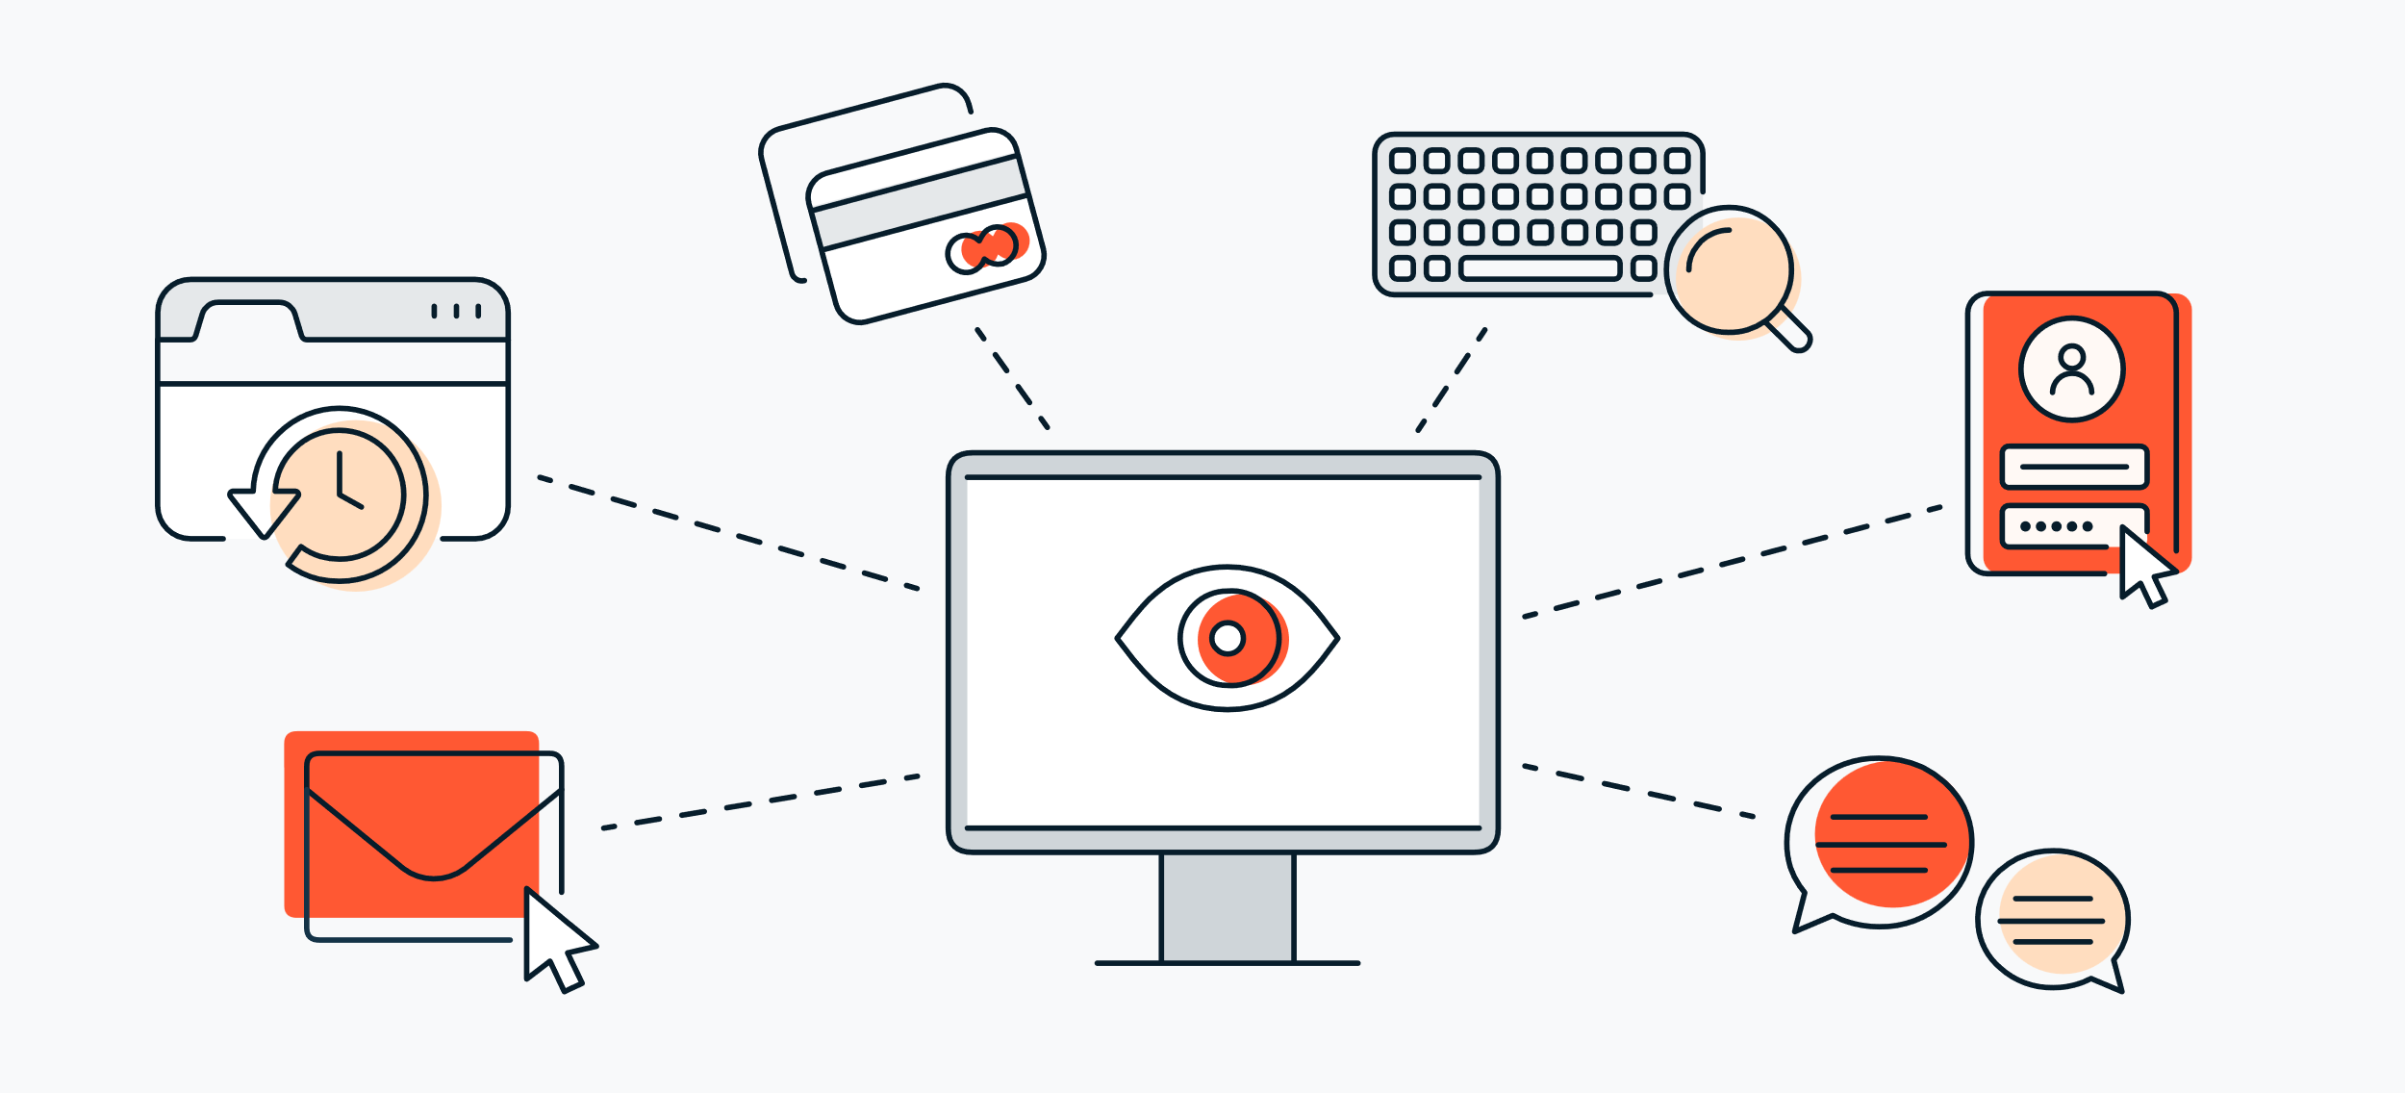


AGENDA
Introduction to Key Logger And Security
Problem Statement
Overview Of The Project
Who are the end users?
Solution And Its Value Proposition
The “WOW” Factor In Our Solution
Modelling Approaches
Results
3/21/2024 Annual Review

Slide 4
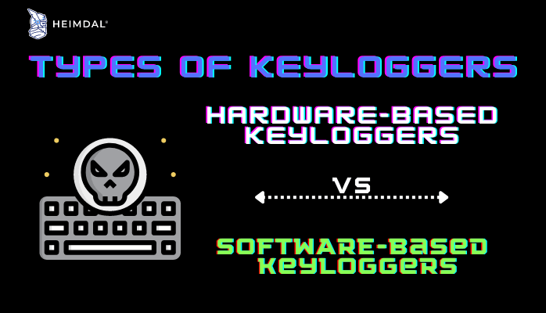
Introduction To Key Logger And
Security
Key loggers also known as keystroke loggers, may be defined as the recording of the key pressed on a system and saved it to a file, and the that file is accessed by the person using this malware. Key logger can be software or can be hardware. Working: Mainly key-loggers are used to steal password or confidential details such as bank information etc. First key-logger was invented in 1970’s and was a hardware key logger and first software key-logger was developed in 1983.
Types of Keyloggers
1. Software keyloggers
2. Hardware keyloggers

Slide 5

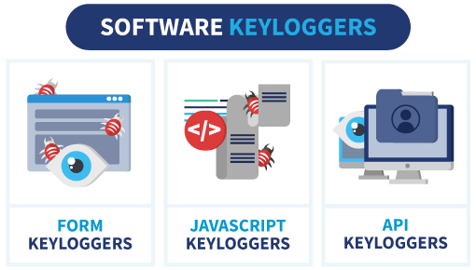
PROBLEM STATEMENT
Problem Statement - It's challenging to covertly install a hardware keylogger on another person's device. To tackle this issue, We are therefore using a software keylogger that can be remotely installed on a person's PC to resolve this problem.

Slide 6

PROJECT OVERVIEW
Keylogging is the action of capturing and recording keys struck on a keyboard. A keylogger is a program which captures and monitors all keylogs. Keyloggers can be both in the form of a built software program or directly downloaded onto a hardware module.
Build a keylogger in python which logs keys, gathers computer information, network information, gets the clipboard content, records the user microphone, and take screenshots of a computer screen.

Slide 7
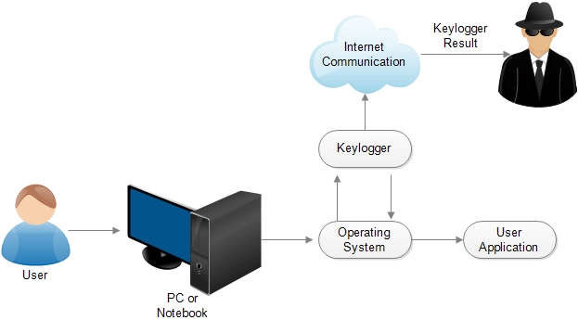

WHO ARE THE END USERS?
Malicious users
Cybercriminals may use keyloggers to steal passwords, login credentials, and other sensitive information, such as financial data or personally identifiable information. They may also use the information to blackmail their victims.
Legitimate users
Parents may use keyloggers to monitor their children's screen time or internet usage. Companies may use keyloggers to monitor employee productivity and ensure compliance with policies like data leak prevention and cybersecurity. IT departments may also use keyloggers to troubleshoot issues with computers and networks. Microsoft also built a keylogger into Windows 10 to improve typing and writing services.

Slide 8

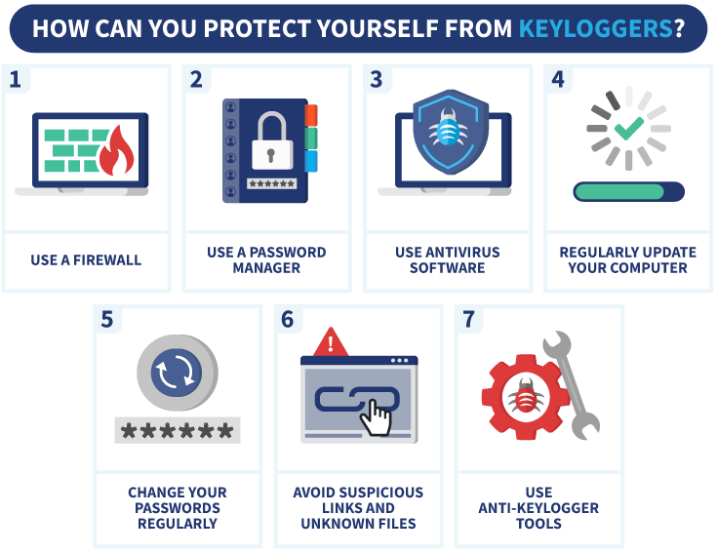
YOUR SOLUTION AND ITS VALUE PROPOSITION
  The Solution For Keylogger is :

Slide 9

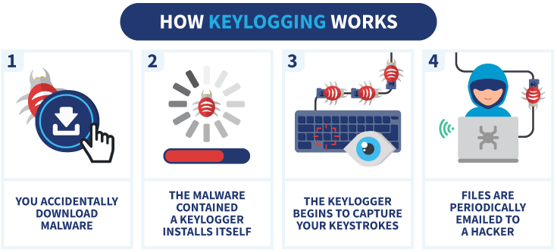
THE WOW IN YOUR SOLUTION
Use Security Software:
Install reputable antivirus and anti-malware software that can help detect and prevent keyloggers. Or, outsource your security via a managed detection and response provider.
3/21/2024 Annual Review
9

Slide 10
MODELLING
  Event Capture:
    Start capturing key events when the "Start" button is pressed.
    Log key press and release events.
  Initialization:
    Set up the main GUI window.
    Initialize global variables for key logging.
  Data Logging:
    Continuously update text and JSON log files with captured key events.
  Stop Logging:
    Stop capturing key events when the "Stop" button is pressed.
    Update the GUI status to indicate the keylogger is stopped.
10

Slide 11
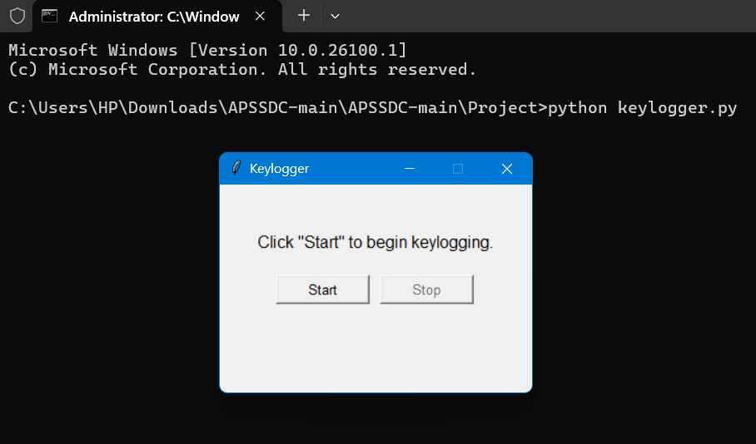
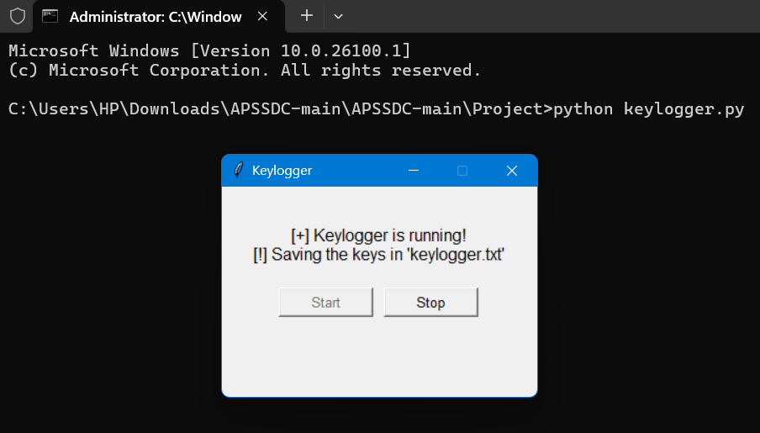
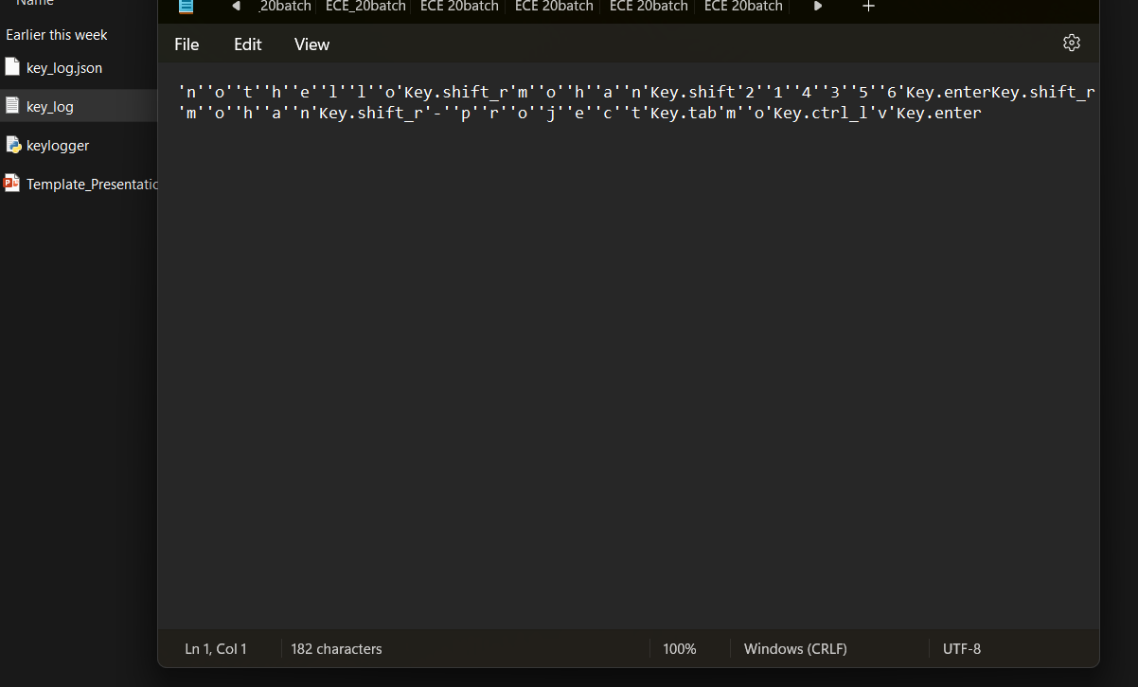
RESULTS
11

Slide 12
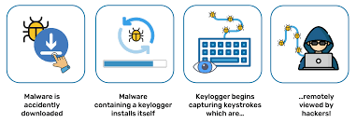
RESULTS
Key logger record keystrokes.
Only dedicated protection can detect that a keylogger is being used for spy purposes.
Legitimate use monitor employee activity.
Be conscious what installed in the computer.

Slide 13

Project Link
https://github.com/sekhar333-oc/sekhar-project.git

