Slide 1
Agenda:
What is a String?
Creating Strings
Some common String Class methods
Immutability

Slide 2
What is a String?
Sequence of Characters.
Examples:
“NetFlix”
“How are you doing?”
“What a smile (:”
“Hello, @vts”

Slide 3
Creating Strings
Strings in Java are represented by the String class
Objects of this class are created to store a sequence of characters, which are called strings
Creating String Objects:
Enclose the string literals in quotes
String name = “IBM”
(Crating the string using assignment operator)
Alternative way to create a string:
String n1 = new String(“Jill Jill”);
String n2 = new String(“Jiga Jiga”)

Slide 4
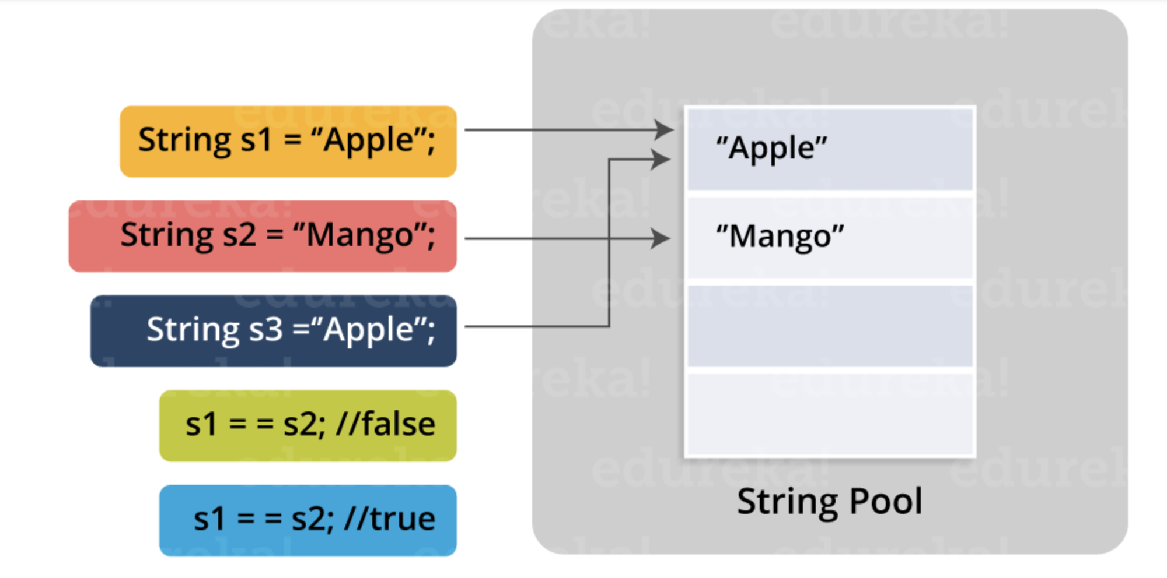

Slide 5
Some of important methods
char charAt(int k):
Returns the character at position k
Example:
String s = “Hello Vts.”;
s.charAt(4) // 0
int length():
Returns the length of the string
String toLowerCase(), String toUpperCase():
Returns string with lower case and uppercase
Example:
String s = “VTS Tech”;
SOP(s.toLowerCase());
Int indexOf(sub):
Returns the index of first occurrence of the specified string
Example:
String s = “How is the Java future”;
SOP(s.indeOf(“Java”));

Slide 6
Immutability
Java Strings are immutable
Once they created, their values can not be changed.
Example:
String s = “Parks”
The values of the s = “Parks” can not be changed, you can not add or delete a character to the same string

