Slide 1

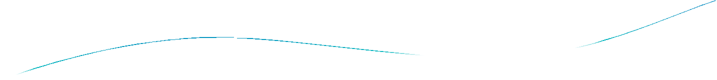


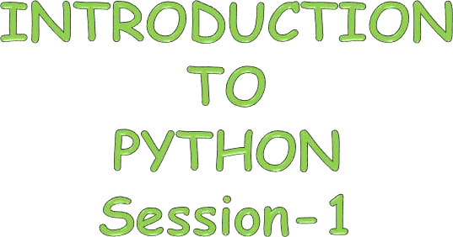


Slide 2

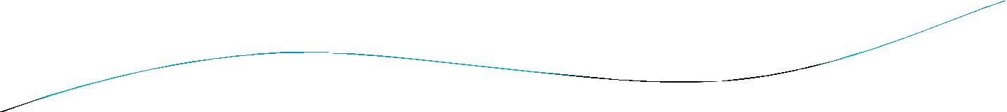
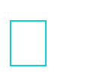
Agenda
What is Python…?
Differences between program and scripting language History of Python
Scope of Python
Why do people use Python? Installing Python IDE
Who uses python today What can I do with python
A Sample Code Python code execution Running Python

Slide 3

What is Python…?
Python is a general purpose programming language that is often applied in scripting roles.
So, Python is programming language as well as scripting language.
Python is also called as Interpreted language

Slide 4
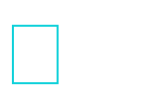
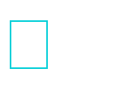
Differences between program and scripting language
Program
a program is executed (i.e. the source is first compiled, and the result of that compilation is expected)
A "program" in general, is a sequence of instructions written so that a computer can perform certain task.
Scripting
a script is interpreted
A "script" is code written in a scripting language. A scripting language is nothing but a type of programming language in which we can write code to control
another software application.

Slide 5

History
Invented in the Netherlands, early 90s by Guido van Rossum Python was conceived in the late 1980s and its implementation was started in December 1989
Guido Van Rossum is fan of ‘Monty Python’s Flying Circus’, this is a famous TV show in Netherlands
Named after Monty Python
Open sourced from the beginning

Slide 6

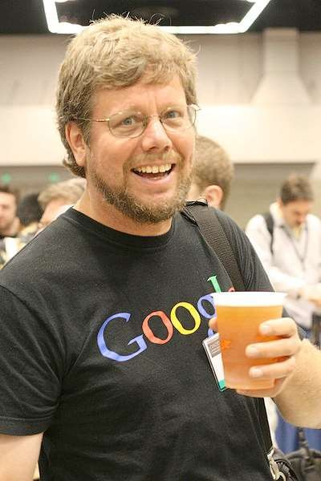
Python’s Benevolent Dictator For Life
“Python is an experiment in how much freedom program-mers need. Too much freedom and nobody can read another's code; too little and expressive-ness is endangered.”
- Guido van Rossum

Slide 7

Why was python created?
"My original motivation for creating Python was the perceived need for a higher level language in the Amoeba [Operating Systems] project.
I realized that the development of system
administration utilities in C was taking too long.
shell
Moreover, doing these things in the Bourne
wouldn't work for a variety of reasons. ...
So, there was a need for a language that would bridge the gap between C and the shell”
- Guido Van Rossum

Slide 8

Scope of Python
Science
- Bioinformatics System Administration
-Unix
-Web logic
-Web sphere
Web Application Development
-CGI
-Jython – Servlets Testing scripts

Slide 9

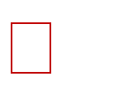
Why do people use Python…?
The following primary factors cited by Python users seem to be these:
Python is object-oriented
Structure supports such concepts as polymorphism, operation overloading, and multiple inheritance.
Indentation
Indentation is one of the greatest future in Python. It's free (open source)
Downloading and installing Python is free and easy Source code is easily accessible

Slide 10

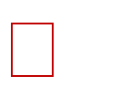
It's powerful
Dynamic typing
Built-in types and tools
Library utilities
Third party utilities (e.g. Numeric, NumPy, SciPy)
Automatic memory management It's portable
Python runs virtually every major platform used today
As long as you have a compatible Python interpreter installed, Python programs will run in exactly the same manner, irrespective of platform.

Slide 11



It's mixable
Python can be linked to components written in other languages easily
Linking to fast, compiled code is useful to computationally intensive
problems
- Python/C integration is quite common
It's easy to use
No intermediate compile and link steps as in C/ C++
Python programs are compiled automatically to an intermediate form called bytecode, which the interpreter then reads
This gives Python the development speed of an interpreter without
the performance loss inherent in purely interpreted languages
It's easy to learn
Structure and syntax are pretty intuitive and easy to grasp

Slide 12

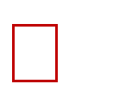
Installing Python
Python is pre-installed on most Unix systems, including Linux and MAC OS X
But for in Windows Operating Systems , user can download from the https://www.python.org/downloads/
- from the above link download latest version of python IDE and install, recent version is 3.4.1 but most of them uses version 2.7.7 only

Slide 13

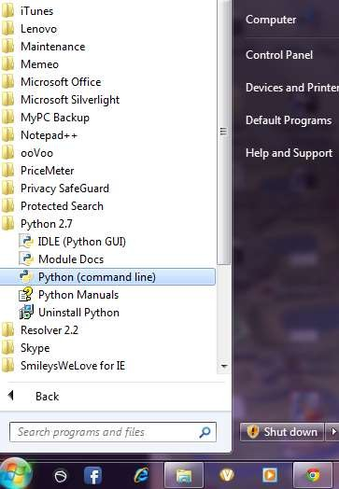
After installing the Python Ver#2.7.7, go to start menu then click on python 2.7 in that one you can select python (command line) it is prompt with >>>

Slide 14

Who uses python today…
Python is being applied in real revenue-generating products by real companies. For instance:
Google makes extensive use of Python in its web search system, and employs Python’s creator.
Intel, Cisco, Hewlett-Packard, Seagate, Qualcomm, and IBM use Python for hardware testing.
ESRI uses Python as an end-user customization tool for its popular GIS mapping products.
The YouTube video sharing service is largely written in Python

Slide 15

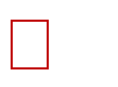
What can I do with Python…?
System programming
Graphical User Interface Programming Internet Scripting
Component Integration Database Programming
Gaming, Images, XML , Robot and more

Slide 16

A Sample Code
x = 34 - 23
y = “Hello” z = 3.45
# A comment. # Another one.
if z == 3.45 or y == “Hello”: x = x + 1
y = y + “ World” print x
print y
# String concat.

Slide 17

Enough to understand the code
Indentation matters to code meaning
Block structure indicated by indentation First assignment to a variable creates it
Variable types don’t need to be declared.
Python figures out the variable types on its own. Assignment is = and comparison is ==
For numbers + - * / % are as expected
Special use of + for string concatenation and % for string formatting (as in C’s printf)
Logical operators are words (and, or, not) not symbols The basic printing command is print

Slide 18

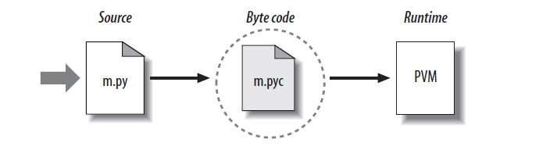
Python Code Execution
Python’s traditional runtime execution model: source code you type is translated to byte code, which is then run by the Python Virtual Machine. Your code is automatically compiled, but then it is interpreted.
Source code extension is .py
Byte code extension is .pyc (compiled python code)

Slide 19

Running Python
Once you're inside the Python interpreter, type in commands at will.
Examples:
>>> print 'Hello world'
Hello world
# Relevant output is displayed on subsequent lines without the >>>
symbol
>>> x = [0,1,2]
# Quantities stored in memory are not displayed by default
>>> x
# If a quantity is stored in memory, typing its name will display it [0,1,2]
>>> 2+3
5

