Slide 1
OOPs
    In
python
^

Slide 2
Object Oriented Programming
❖ Python is an object-oriented programming language.
❖ Python doesn’t force to use the object-oriented paradigm exclusively.
❖ Python also supports procedural programming with modules and functions, so you can select the most suitable programming paradigm for each part of your program.
“Generally, the object-oriented paradigm is suitable when you want to group state (data) and behavior (code) together in handy packets of functionality.”

Slide 3
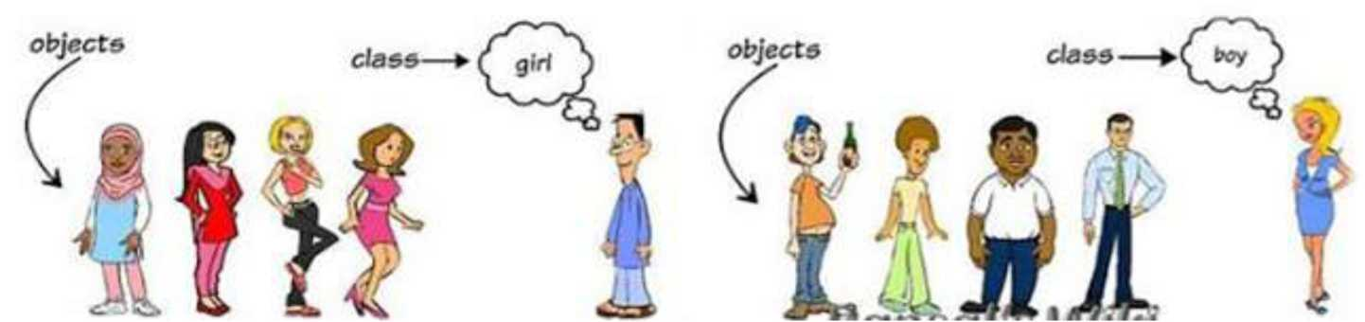
t python
objects
a software item that contains variables and methods

Slide 4
❖ Objects are the basic run-time entities in an object-oriented system.
❖ They may represent a person, a place, a bank account, a table of data or any item that the program must handle.
❖ When a program is executed the objects interact by sending messages to one another.
❖ Objects have two components:
Data (i.e., attributes)
Behaviors (i.e., methods)

Slide 5


classes
binds the member variables and
into a single unit
r

Slide 6
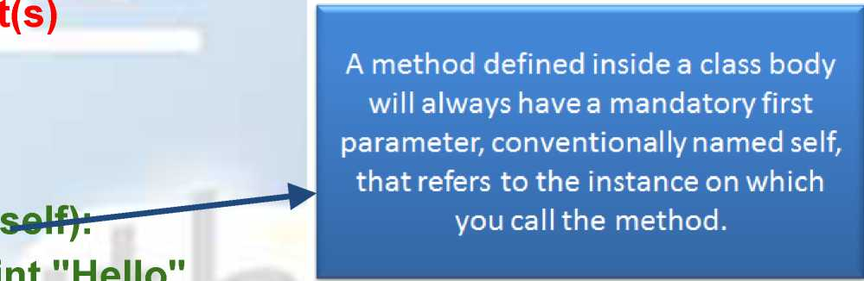
Syntax:
class classname:
statemen
Example:
class myClass:
def hello(
Print(“Hello”
def sum(self):
int_res=100+200 return int res

Slide 7
Creating Instance Objects
Syntax
anInstance=class_name()
Example
classObj=myClass()

Slide 8
Accessing Attributes
Example: classObj.hello() int_sum=classObj.sum() print “The sum is : ”,int_sum
output:
Hello
The sum is : 300

Slide 9
Object Oriented Design focuses on
— Encapsulation:
dividing the code into a public interface, and a private implementation of that interface
— Polymorphism:
the ability to overload standard operators so that they have appropriate behavior based on their context
— Inheritance:
the ability to create subclasses that contain specializations of their parents

Slide 10


inheritance
child class acquires the properties of the parent ass

Slide 11
— Simple Inheritance
Syntax
derived_class( base_class)
— Multiple Inheritance
Syntax
derived_class(base_class[,base_class1][,base_class2
I

Slide 12
Example for Simple Inheritance:
class myClass:
def sum(self):
int_res=100+200 return int_res
class newClass(myClass):
def hello(self):
print "Maya"
classObj=newClass()
classObj.hello()
int_sum=classObj.sum()
print “The sum is : ”,int_sum
output:
Maya
The sum is : 300

Slide 13
Example for Multiple inheritance
class A:
def DisplayA(self):
print (’’Class A” )
class B:
def displayB(self):
print (’Class B”)
class c(A,B):
def displayC(self):
print (“Class C”)
objC=c()
objC.displayA()
objC.displayB()
objC.displayC()
Output:
Class A Class B Class C
Learn best software engineering practices @ www.baabtra.com
Ibaabfcra .com
Mentoring Partner

Slide 14






polymorphism
“Woof’
“Meow'

Slide 15
❖ Uses polymorphism extensively in built-in types.
❖ Here we use the same indexing operator for three different data types.
❖ Polymorphism is most commonly used when dealing with inheritance.
❖ Example:
a = "alfa" # string
b = (1,2, 3, 4) # tuple
c = ['o', 'm', 'e', 'g', 'a'] # list
print a[2]
print b[1]
print c[3]
Output:
f
2
g
Learn best software engineering practices @ www.baabtra.com
Ibaabfcra .com
Mentoring Partner

Slide 16
Two kinds of Polymorphism:
❖ Overloading
- Two or more methods with different signatures
- Python operators works for built-in Classes
❖ Overriding
- Replacing an inherited method with another having the same signature
Learn best software engineering practices @ www.baabtra.com
Ibaabfcra .com
Mentoring Partner

Slide 17
Explanation for Operator Overloading Sample Program
What actually happens is that, when you do pi - p2, Python will
call p1._sub_(p2). Similarly, we can overload other operators
as well. The special function that we need to implement is tabulated below
Operator | Expression | Internally
Addition | p1+p2 | p1._add_(p2)
Subtraction | p1-p2 | p1._sub_(p2)
Multiplication | ^{J} p1*p2 | p1._mul_(p2)
Power | p1**p2 | p1._pow_(p2)
Division | ^p1/p2 | p1._truediv_(p2)
Learn best software engineering practices @ www.baabtra.com
Ibaabfcra .com
Mentoring Partner

Slide 18

Example for Overriding
class Animal:
def_init_(self, name=’’):
self.name = name
def talk(self):
pass
class Cat(Animal):
def talk(self):
print ("Meow!“)
class Dog(Animal):
def talk(self):
Print("Woof!“)
a = Animal()
a.talk()
c = Cat("Missy")
c. talk()
d = Dog("Rocky")
d. talk()
Output:
Meow!
Output:
Meow!
Woof!
i

Slide 19
encapsulation
process of binding data

Slide 20
❖ An important concept in OOP
❖ Data Abstraction is achieved through Encapsulation
❖ Generally speaking encapsulation is the mechanism for restricting the access to some of an object's components, this means, that the internal representation of an object can't be seen from outside of the objects definition.

Slide 21
The following table shows the different behaviour of Public,
Protected and Private Data
Name | Notation | Behaviour
name | Public | can be accessed from inside and outside
_name | Protected | Like a public member, but ' they shouldn’t be directly accessed from outside
__name | Private | Can’t be seen and accessed from outside
Learn best software engineering practices @ www.baabtra.com
Ibaabfcra .com
Mentoring Partner

Slide 22
Example for Public, Private and Protected Data
##public
class A:
def __init__(self,name,age):
self.name = name
self.age = age
a1 = A("jms",24)
print(a1.name)
print(a1.age)
##protected
class B:
def __init__(self,name,age):
self._name = name
self._age = age
a1 = B("ram",28)
print(a1._name)
print(a1._age)
##private
class C:
def __init__(self,name,age):
self.__name = name
self.__age = age
a1 = C("jms",24)
print(a1.__name)
print(a1.__age)

Slide 23


specia
hods
classes in python can implement certain operations with special method names.
Learn best software engineering practices @ www.baabtra.com
Ibaabhra .com
Mentoring Partner

Slide 24
❖ They are also called “Magic Methods”
❖ They are not called directly, but by a specific language syntax
❖ This is similar to what is known as operator overloading in
C++
❖ Contains clumsy syntax, ie., double underscore at the beginning and end
❖ So simplicity_init_() can be read as “dunder init
dunder”
❖ So magic methods also called “Dunder Methods”
I
Ibaabfcra .com
Mentoring Partner
Learn best software engineering practices @ www.baabtra.com

Slide 25
Some special methods are:
1) _init_()
default constructor, when an instance of class is created
2) _str_()
If we print an object then its_str_() method will get
called
3) _len_()
Returns the length of the container
4) _del_()
It destructs the constructors that have created using
_init_()
Learn best software engineering practices @ www.baabtra.com
Ibaabfcra .com
Mentoring Partner

Slide 26
Example for Special Methods
class Book:
def_init_(self, title, author, pages):
print ”A book is created” self.title = title self.author = author self.pages = pages def_str_(self):
return ’’Title:%s , author:%s, pages:%s ” % \ (self.title, self.author, self.pages)
def_len_(self):
return self.pages
def_del_ (self):
print ”A book is destroyed”
book = Book(”Inside Steve’s Brain”, ’’Leander Kahney”, 304) print book print len(book)
del book
Output:
A book is created
Title:Inside Steve’s Brain , author:Leander Kahney, pages:304 304
-A book is destroyed
Learn best software engineering

Slide 27
class Book:
def_init_(self, title, author, pages):
Output:
print ”A book is created” self.title = title self.author = author self.pages = pages def_str_(self):
A book is created
return ’’Title:%s , author:%s, pages:%s ” % \ (self.title, self.author, self.pages)
def_len_(self):
return self.pages
def_del_(self):
Here we call the_init_() method. The
method creates a new instance of a Book
print ”A book is destroyed”
class.
book = Bookf'lnside Steve's Brain", '"tfetnrtfer Kahney", 304)
print book print len(book) del book
i
Ibaabfcra .com
Mentoring Partner
Learn best software engineering practices @ www.baabtra.com

Slide 28
Output:
A book is created Title:Inside Steve’s Brain , author:Leander Kahney, pages:304
class Book:
def_init_(self, title, author, pages):
print ”A book is created” self.title = title self.author = author self.pages = pages
def_str_(self):
return ’’Title:%s , author:%s, pages:%s ” % \ (self.title, self.author, self.pages)
def_len_(self):
return self.pages
def_del_(self):
print ”A book is destroyed”
book = Book(”Inside Steve’s Brain”, ’’Leander Kahney”, 304)
print bool
print len(book) ~ The print keyword calls the str () method.
del book > This method should return an informal string
representation of an object.
j
Ibaabhra .com
Mentoring Partner
Learn best software engineering practices @ www.baabtra.com

Slide 29
class Book: | Output:
def_init_(self, title, author, pages): | A book is created
print ”A book is created” | Title:Inside Steve’s Brain ,
self.title = title | author:Leander Kahney, pages:304
self.author = author | 304
self.pages = pages
def_str_(self):
return ’’Title:%s , author:%s, pages:%s ” % \ (self.title, self.author, self.pages)
def len (self):
return self.pages
def del (self):
print ”A book is destroyed”
book = Book(”Inside Steve’s Brain”, ’’Leander Kahney”, 304)
print book -
print len(boofci
del book
The len() function invokes the_len_()
method. In our case, we print the number of pages of your book.
Learn best software engineering practices @ www.baabtra.com
Ibaabfcra .com
Mentoring Partner

Slide 30

Output:
A book is created Title:Inside Steve’s Brain , author:Leander Kahney, pages:304 304
A book is destroyed
class Book:
def_init_(self, title, author, pages):
print ”A book is created” self.title = title self.author = author self.pages = pages
def_str_(self):
return ’’Title:%s , author:%s, pages:%s ” % \ (self.title, self.author, self.pages)
def_len_(self):
return self.pages
def_del_(self):
print ”A book is destroyed”
book = Book(”Inside Steve’s Brain”, ’’Leander Kahney”, 304)
print book _
print len(book)
del book ^ l^{<c}y^{wor(}l deletes an object It calls the
del_() method.
i
Ibaabfcra .com
Mentoring Partner
Learn best software engineering practices @ www.baabtra.com

Slide 31


odules
sing import statement
j
Ibaabhra .com
Mentoring Partner
Learn best software engineering practices @ www.baabtra.com

Slide 32
❖ A typical Python program is made up of several source files. Each source file corresponds to a module, which packages program code and data for reuse.
❖ Modules are normally independent of each other so that other programs can reuse the specific modules they need.
❖ A module explicitly establishes dependencies upon another module by using import statements.
Learn best software engineering practices @ www.baabtra.com
Ibaabfcra .com
Mentoring Partner

Slide 33
Import Statement
Syntax
import modname [as varname][,...] Example
import MyModule1 import MyModule as Alias
I
Ibaabfcra .com
Mentoring Partner
Learn best software engineering practices @ www.baabtra.com

Slide 34
Import Statement
Syntax
import modname [as varname][,...]
In the simplest and most common case, modname is an identifier, the name of a variable that Python binds to
MyModulel ^ the module object when the MyModule as Alias import statement finishes
Example
import
import
i
Ibaabtra .com
Mentoring Partner
Learn best software engineering practices @ www.baabtra.com

Slide 35


Import Statement
Syntax
import modname [as varname][,...]
Example
looks for the module named MyModule and binds the variable named Alias in the current scope to the module object. varname is always a simple identifier.
import MyModulel import MyModule as Alias
Learn best software engineering practices @ www.baabtra.com
Ibaabhra .com
Mentoring Partner

Slide 36
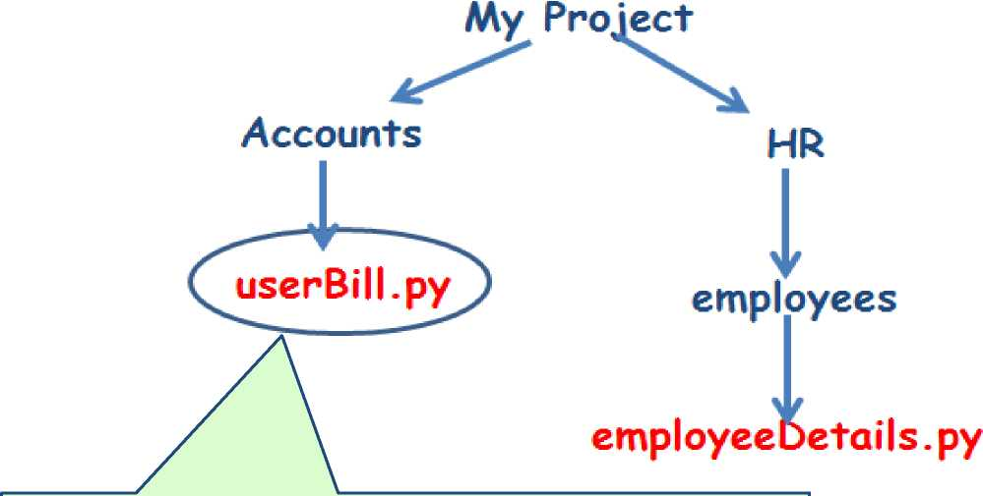
Relative Import Statement
Suppose we are here and we want to import the file employeeDetails.py which resides in a directory as shown
Learn best software engineering practices @ www.baabtra.com
Ibaabfcra .com
Mentoring Partner

Slide 37
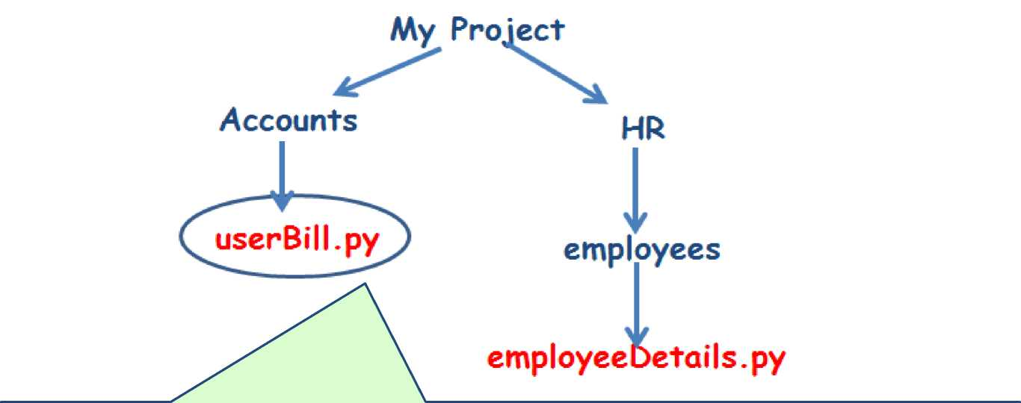

Relative Import Statement
import sys import os
str_current_path = os.getcwd() ## get current working directory str_module_path = str_current_path.replace( ¹ Accounts',‘HR/employees /
)
sys.path.append( str_module_path ) import employeeDetails
Learn best software engineering practices @ www.baabtra.com
Mentoring Partner

Slide 38
Relative Import Statement
— sys.path
A list of strings that specifies the search path for modules
— sys.path.append( module path )
This statement append our module path with the existing list of sys.path, then the import statement search for the module in the module path as we specified.
Learn best software engineering practices @ www.baabtra.com
Ibaabfcra .com
Mentoring Partner

Slide 39
main_()
❖ When the Python interpreter reads a source file, it executes all of the code found in it. But Before executing the code, it will define a few special variables.
❖ For example, if the python interpreter is running a module (the
source file) as the main program, it sets the special_name_
variable to have a value”_main_”.
❖ If this file is being imported from another module,_name_will
be set to the module’s name.
i
Ibaabfcra .com
Mentoring Partner
Learn best software engineering practices @ www.baabtra.com

Slide 40
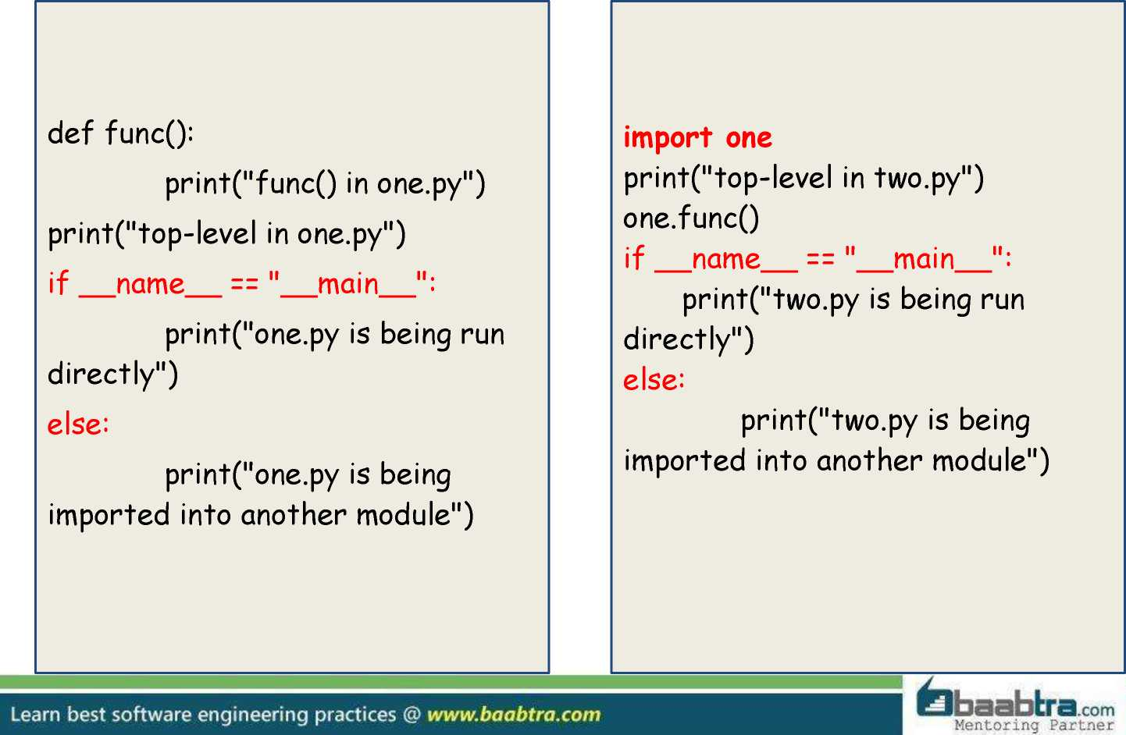
Example
# File one.py # File two.py

Slide 41

Example
# File one.py
# File two.py
def func():
print("func() in one.py")
print("top-level in one.py")
if_name_== "_main_":
print("one.py is being run directly")
else:
print("one.py is being imported into another module")
import one
print("top-level in two.py”) one.func()
if_name_== "_main_":
print("two.py is being run directly") else:
print("two.py is being imported into another module")
When we run one.py Top-level in one.py
One.py is being run directly
Ibaabhra .com
Mentoring Partner

Slide 42

Example
# File one.py
# File two.py
def func():
print("func() in one.py") print("top-level in one.py")
if_name_== ”_main_":
print("one.py is being run directly”)
else:
print("one.py is being imported into another module")
import one
print("top-level in two.py")
one.func()
if name == ” main ":
print("two.py is being run directly")
else:
print("two.py is being imported into another module")
When we run two.py top-level in one.py
one.py is being imported into another module
top-level in two.py
func() in one.py
two.py is being run directly
Learn best software engineering pract
buB.com _tng Partner

