Slide 1

SMART INDIA HACKATHON 2026
TITLE PAGE
Problem Statement ID – 26189
Problem Statement Title- AI-Powered Criminal Network Analysis System
Theme- Blockchain & Cybersecurity
PS Category- Software
Team ID-
Team Name (Registered on portal)- Suishōdama

Slide 2
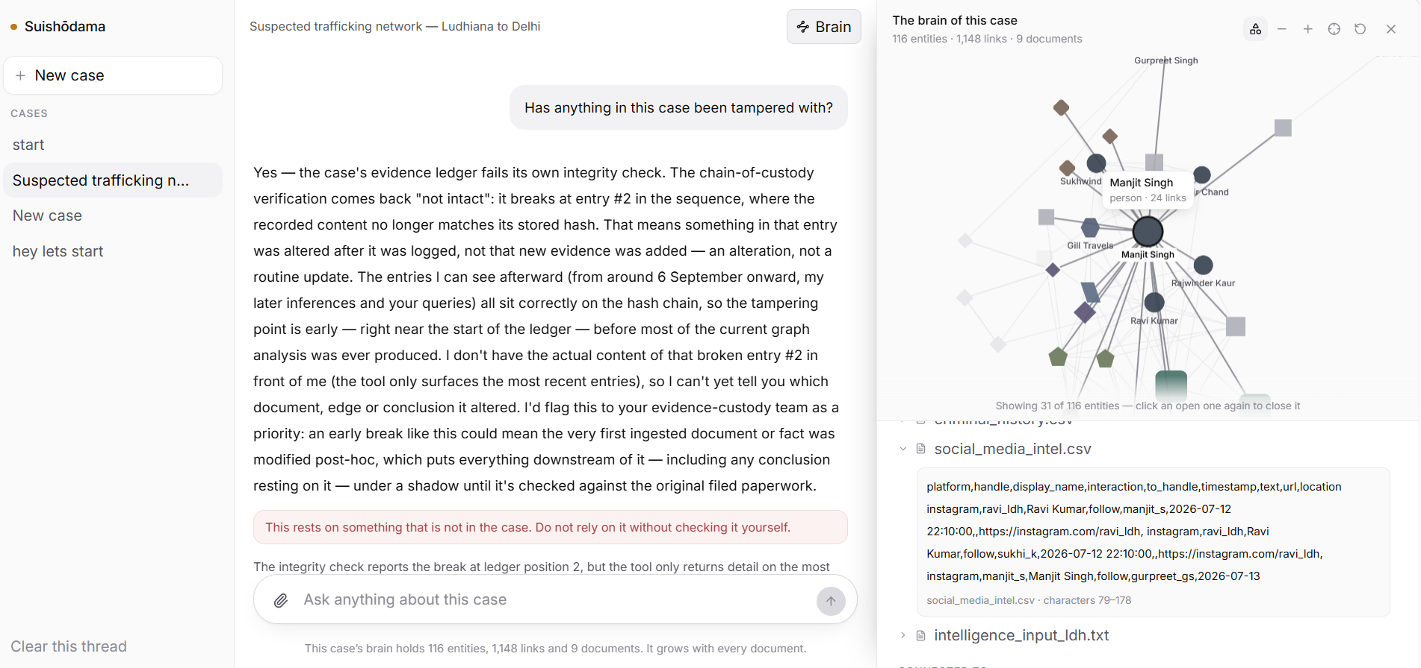
IDEA TITLE
Suishōdama
Suishōdama — a per-case investigative agent that reasons over the case's own knowledge graph, not a context window.
Proposed Solution (Describe your Idea/Solution/Prototype)
Detailed explanation of the proposed solution
  — An officer opens a case, and that case gets an agent of its own — its own knowledge graph, analytics, memory and hash-chained chain of custody, in its own file on disk.
  — He drops in FIRs, CDRs, bank statements, surveillance logs, social exports, criminal history and intelligence reports — extracted deterministically, with no model anywhere in the ingest path.
  — He asks in English. The answer arrives with the route through the graph lit hop by hop, and every claim traceable to the character offset in the document it was read out of.
How it addresses the problem
  — NCRB's stated pain is that the data is already on the desk and the links are still missed. Seven source kinds are named in the statement, and there is a handler for all seven.
  — “Key influencers” is computed, not guessed — betweenness on a person-projected graph, Louvain communities, and hidden brokers ranked person-against-person.
The working prototype — one chat, the case's brain beside it, and the cited source open at its character offsets.
Innovation and uniqueness of the solution
  — Not a dashboard — a visualisation cannot be asked anything.
  — Not a chat with documents in it — the prompt is O(1) in the size of the case.
  — Isolation by construction: a different case is a different file.

Slide 3
TECHNICAL APPROACH
Suishōdama
Technologies to be used (e.g. programming languages, frameworks, hardware)
  — Backend — Python 3.11+, FastAPI, SQLite (one file per case), NetworkX, Anthropic API.
  — Extraction — readers for PDF / CSV / prose, deterministic identifier patterns, cue-based NER, optional spaCy.
  — Analytics — degree and betweenness centrality, Louvain communities, anomaly and finding detection; seeded and cached.
  — Interface — React 19, TypeScript, Vite, Tailwind v4, Cytoscape.js, TanStack Query.
  — Integrity — SHA-256 hash-chained, append-only chain of custody, one per case.
  — No Neo4j and no cloud graph service: per-case isolation becomes a file rather than a permissions model.
Working prototype today: 22 case-scoped API endpoints, 38 tests passing, and a demo case of 125 nodes and 1,148 links built from all seven source kinds.
Methodology and process for implementation (Flow Charts/Images/ working prototype)
DOCUMENTS
FIRs · CDRs · financial · surveillance · social · history · intel
1. INGEST
readers → patterns → NER → pipeline · no model in this path
2. GRAPH
one SQLite file per case · stable ids · idempotent merge
3. ANALYTICS
centrality · Louvain · anomalies · findings the model never invents
4. AGENT
13 tools · decides what to ask the brain, holds none of it
5. ANSWER
every citation verified in code · the path lit in the graph
CHAIN OF CUSTODY — hash-linked, append-only, one per case

Slide 4
FEASIBILITY AND VIABILITY
Suishōdama
Analysis of the feasibility of the idea
  — Built and running rather than proposed — 38 tests pass, 22 endpoints, 125 nodes and 1,148 links across all seven source kinds.
  — Ingest is linear and measured — 106 KB of prose in 3.8 s, down from 63 s; a 50,000-row CDR in about 90 s.
  — Runs on a single machine with no external service — SQLite and NetworkX, nothing to install, authenticate or keep up.
  — $0.0235 per question, down from $0.10, through prompt caching with the system prompt split into three blocks.
Potential challenges and risks
  — Police data cannot leave the premises.
  — No key or no network means no assistant.
  — A scanned document has no text layer to read.
  — An estimate read out as a measurement would mislead an investigation.
Strategies for overcoming these challenges
  — The model's whole surface is two functions — an on-premises model drops in untouched, and everything but the assistant already runs with no model at all.
  — Nothing degrades silently — no fallback, no offline impostor. A degraded system the officer cannot tell from a working one is worse than an outage.
  — A document that could not be read says so, instead of registering with a green tick, a valid custody entry and zero entities.
  — Betweenness is exact below 500 projected nodes and estimated above — and the answer says which it used.

Slide 5
IMPACT AND BENEFITS
Suishōdama
Potential impact on the target audience
  — The connection the officer would never have written down: the most central person in the demo case appears in one document only, a call log, and 22% of every shortest path runs through him.
  — Asked to volunteer, it named a woman in no FIR and not in the ground-truth file — four Ludhiana towers, three Delhi, in call contact with both principals. A bridge nobody planted.
  — The engine is crime-type agnostic: nothing in ingest, the graph, analytics or the agent knows what trafficking is, so the same system serves NDPS, financial fraud or organised crime.
Benefits of the solution (social, economic, environmental, etc.)
  — Social — for NCRB's Women Safety Division, faster identification of traffickers and repeat offenders, and networks read across a case no officer could hold in his head.
  — Evidentiary — every claim traceable to a character offset, and a hash-chained custody log means history cannot be quietly rewritten. Break an entry and it names the entry and the reason.
  — Economic — one machine, no licence, no cluster, no graph-database contract, and $0.0235 a question.
  — Operational — one chat, learned in seconds by a non-technical user, and knowledge that compounds over months instead of resetting with the thread.

Slide 6
RESEARCH AND REFERENCES
Suishōdama
Details / Links of the reference and research work
  — Problem statement 26189, Ministry of Home Affairs / NCRB (Women Safety Division) — sih.gov.in/sih2026PS
  — U. Brandes, “A faster algorithm for betweenness centrality”, Journal of Mathematical Sociology 25(2), 2001 — the centrality measure used to identify key influencers.
  — V. Blondel et al., “Fast unfolding of communities in large networks”, J. Stat. Mech., 2008 — the Louvain method used for community detection. arxiv.org/abs/0803.0476
  — NetworkX — graph algorithms and sampled-pivot betweenness. networkx.org
  — NATO Admiralty Code (source reliability × information credibility) — the grading applied to intelligence reports, discounting what they imply.
  — FIPS 180-4 (SHA-256) — the hash used for the append-only chain of custody.
  — Anthropic — tool use and prompt caching. docs.anthropic.com
  — Cytoscape.js — graph rendering in the browser. js.cytoscape.org

