Slide 1


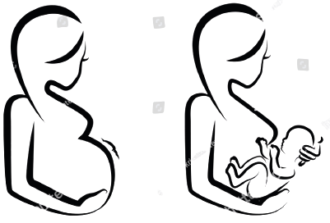

MATERNAL HEALTH RISK
PREDICTIONS DURING PREGNANCY
24th February, 2023

Slide 2
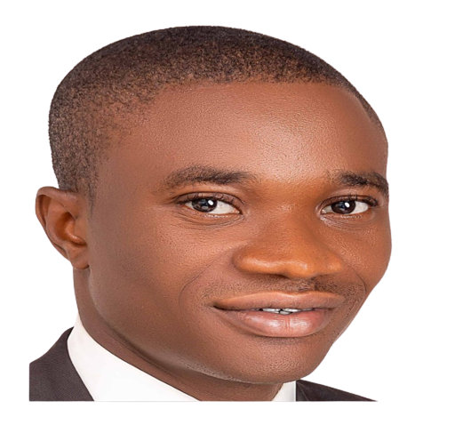

MEET THE TEAM ARIMA
Role | Name
Project Lead | Ravindra Sah
Project Assistant | Hammed Arogundade
Query Analyst | Anchal Sekhri
Contributor | Olamiposi Olatunde
Contributor | Aderonmu Adeniyi
Contributor | Adeoye Adekunle
Contributor | Alimi Rofiat Adetutu
Contributor | Olayinka Akerekan
Contributor | Lateefah Ajadi
Contributor | Muhsin Umar
Contributor | Imokutmfon-abasi Udoh
Contributor | Alimi Rofiat Adetutu
Presenter
Olayinka Akerekan
Presenter
Anchal Sekhri

Slide 3
PROBLEM STATEMENT
According to the most recent data available from the Centers for Disease Control and Prevention (CDC), from 2011-2016, in the most rural counties (which includes areas with populations of less than 50,000 residents), the maternal mortality ratio was 23.8 deaths per 100,000 live births compared to 14.6 in large metropolitan counties (areas with a population over 1 million).
There is a lack of information regarding maternal health care during pregnancy and after delivery, many pregnant women pass away from pregnancy-related illnesses.
Most studies suggest that a lack of prenatal care is mainly a result of socioeconomic factors (low family income and education), access to medical consultations (large distance from the place of residence to the healthcare unit and transportation costs), quality of healthcare, and social support.

Slide 4
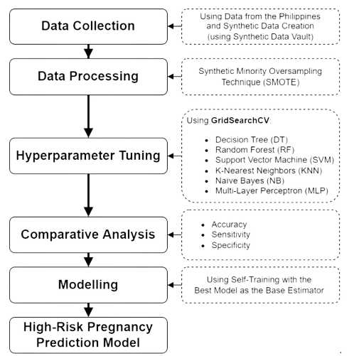
EXISTING SOLUTIONS
Currently pregnant women have to go to hospital to check for health status.
There are few universities who have published research paper on solving the maternal health risk issue by the application of machine learning. for e.g. A Semi-Supervised Machine Learning Approach in Predicting High-Risk Pregnancies in the Philippines by Bulacan State University.
But there are no ML apps deployed for normal user, therefore apart from training different machine learning algorithm we will focus on deployment as well.

Slide 5
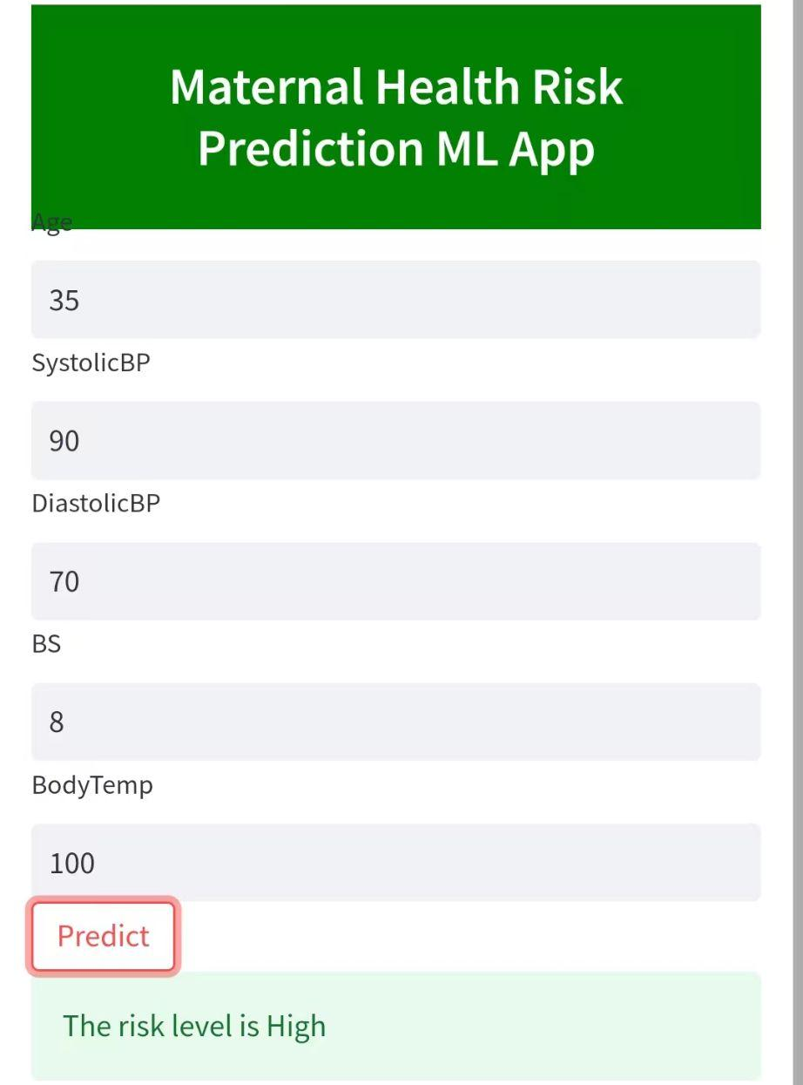
OUR APPROACH
Our Approach is to provide a easy access of a webapp that can predict the health risk levels of pregnant women based on the easily measurable input parameters like Age, Blood Pressure, Body Temperature and Blood Sugar.
We achieved our objective by following ways:
Data Collection
Data Cleaning
Model Training
Deployment
Data is collected from UCI machine learning repository.
We used python programming language and its library like Pandas, Numpy, Seaborn and Matplotlib for data cleaning.
We used scikit learn machine learning classification algorithm like decision trees, randomforest, KNN, ADABoost, etc for evaluation, finally we choose randomforest classifier as our best performing model.
Streamlit

Slide 6
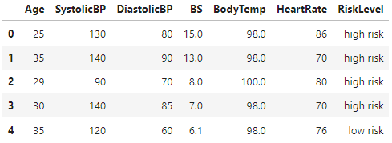
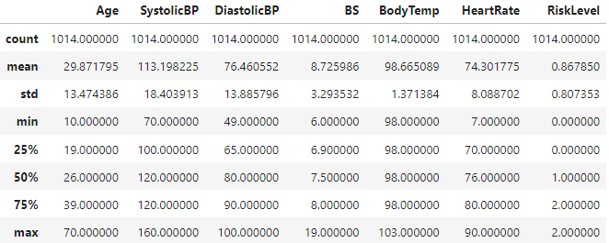
DATASET DESCRIPTION
Total Attributes: 7→1014 rows
Age: Age in years
SystolicBP: Upper value of Blood Pressure in mmHg,
DiastolicBP: Lower value of Blood Pressure in mmHg.
BS: Blood glucose levels are in terms of a molar concentration, mmol/L.
HeartRate: A normal resting heart rate in beats per minute.
Risk Level: Predicted Risk Intensity Level during pregnancy considering the previous attribute.
Target Variable: Risk Level
low-risk: 406
mid-risk: 336
high-risk: 272
Dataset link: https://www.kaggle.com/datasets/csafrit2/maternal-health-risk-data?resource=download

Slide 7
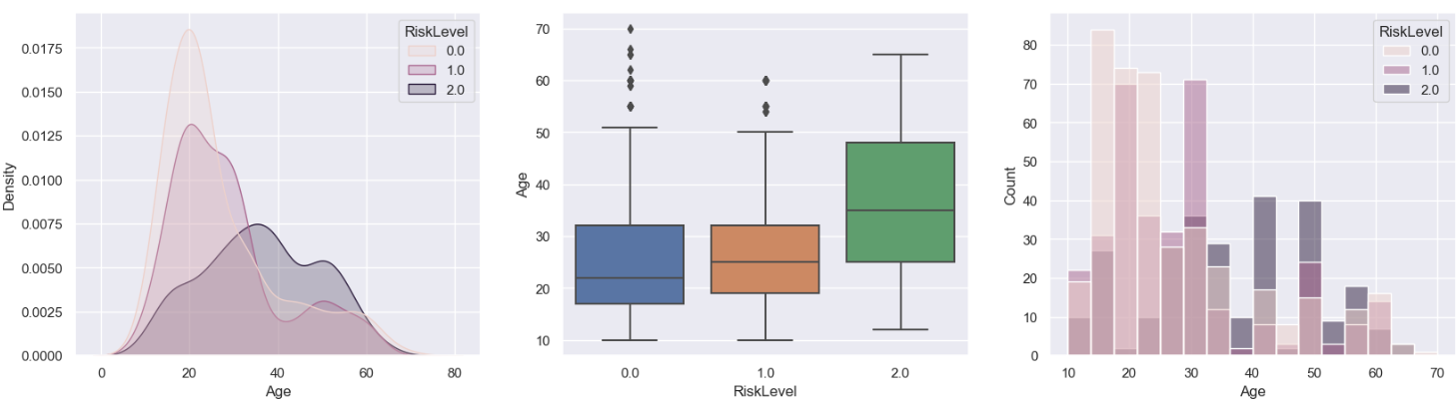
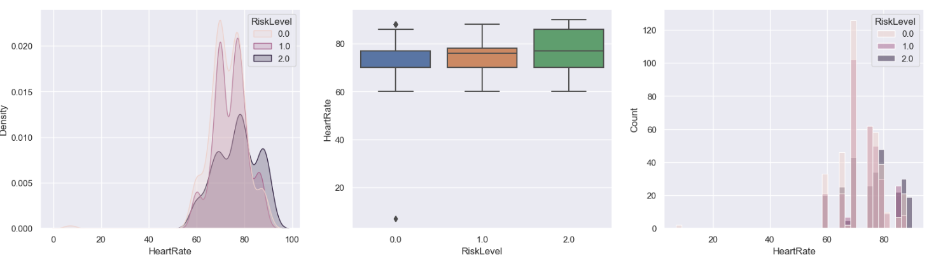
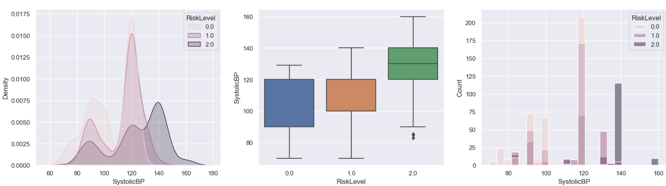
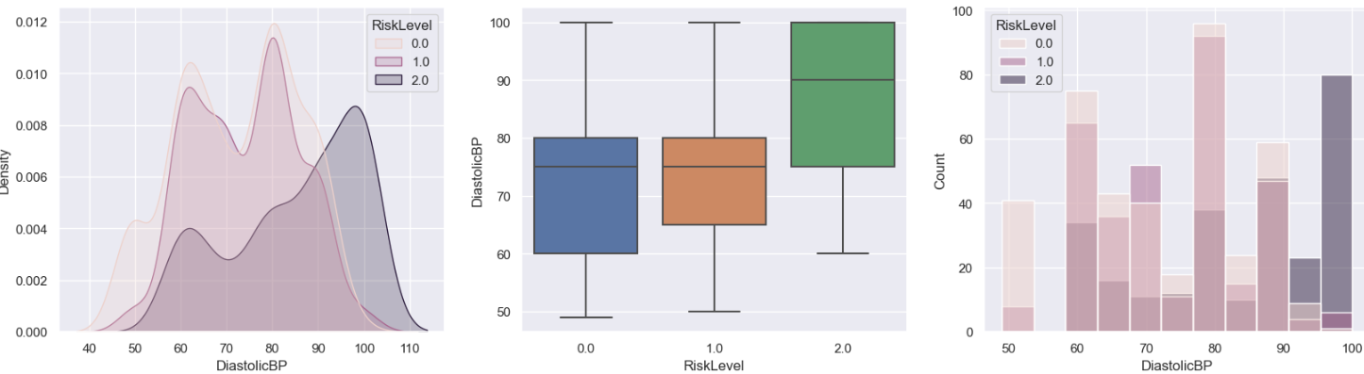
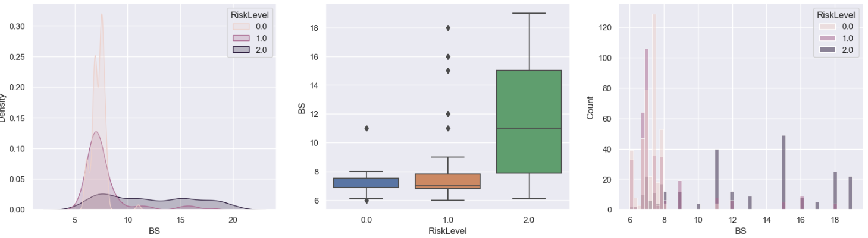
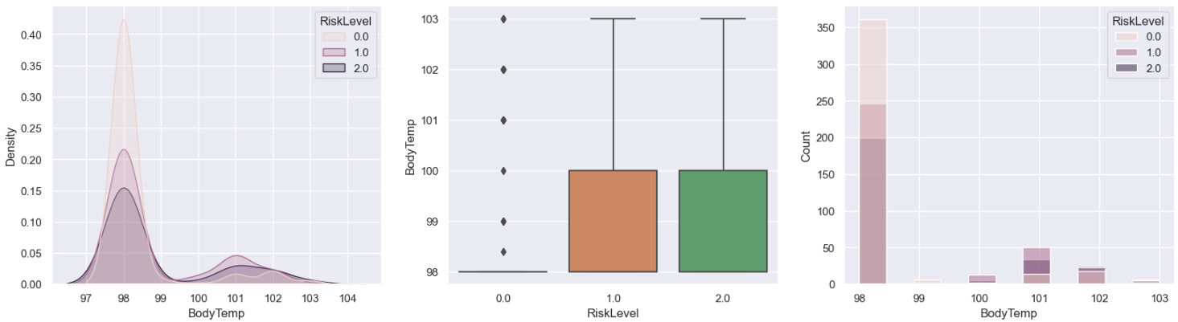
INSIGHTS FROM EDA
Age
Heart Rate
Systolic
BP
Diastolic
BP
Blood Sugar
Body
Temperature

Slide 8
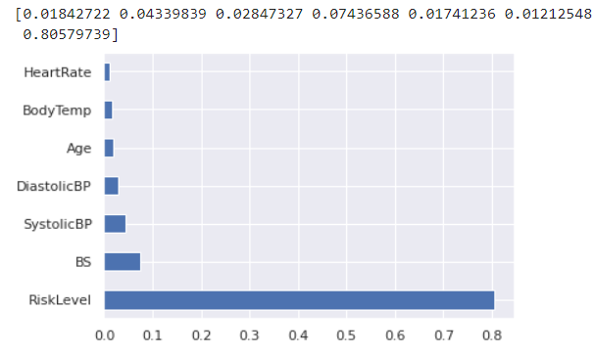
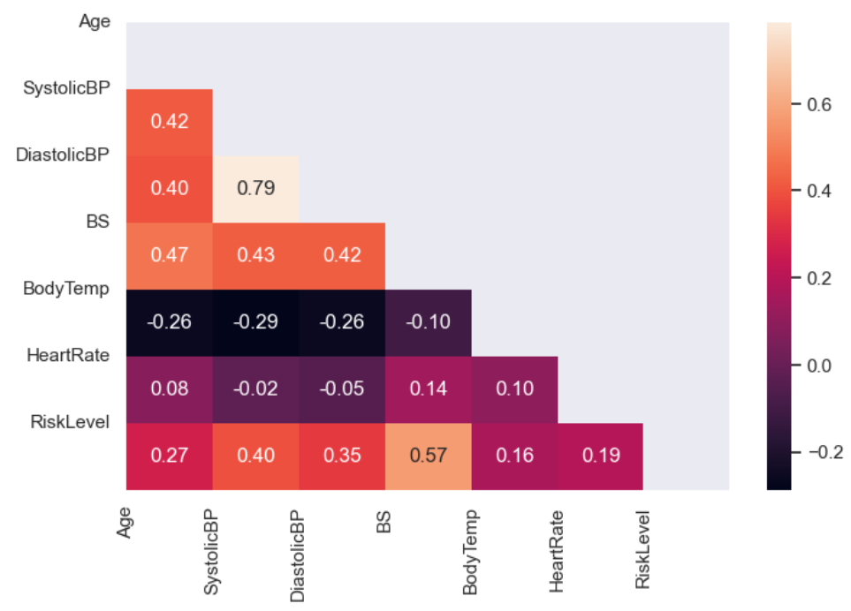
FEATURE ENGINEERING
Outliers Removal
Only the heart rate column has two outlier with value 7. so we removed the entire row.
Feature Selection
Heart rate has a very low correlation of just 0.018 with our target variable, so we drop the entire column before training.

Slide 9
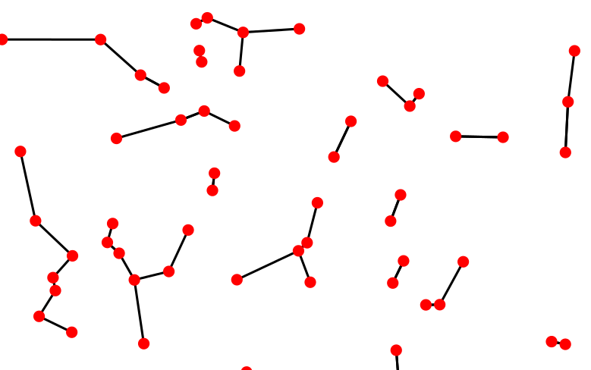
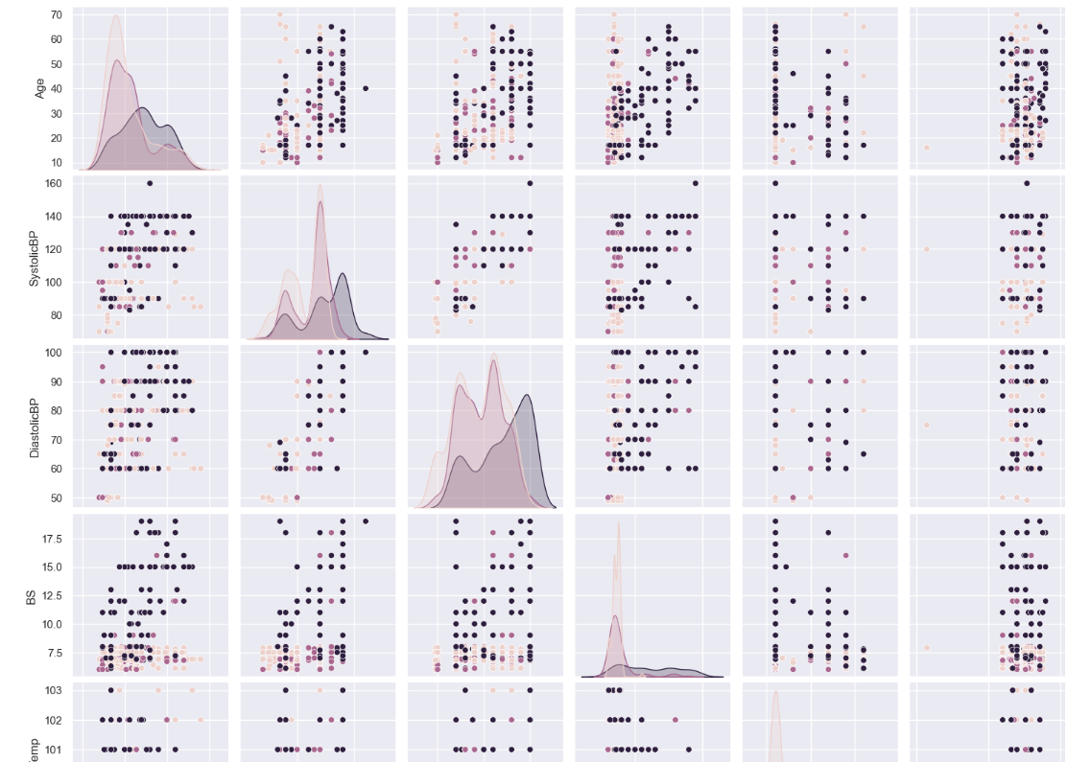
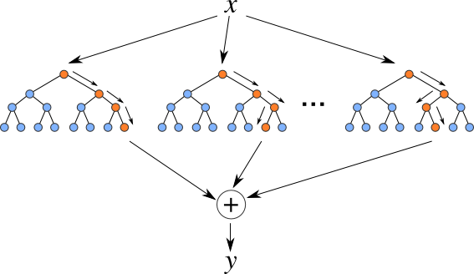
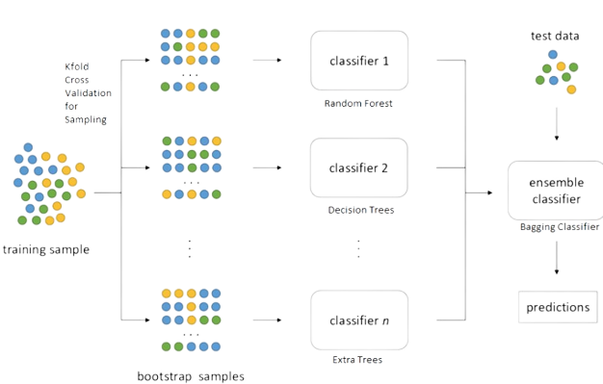
MODEL SELECTION
K-nearest Neighbor
Random Forest Classifier
Bagging Classifier

Slide 10
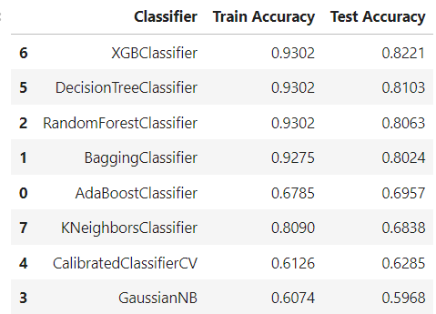
MODEL TRAINING
First, we trained 8 different classification models from the scikit learn library using their base parameters. BaggingClassifier, DecisionTreeClassifier, and Random Forest Classifier performed better than the remaining model so we decided to do hyperparameter tuning of only three models. We did hyperparameter tuning using RandomizedSearchCV, Out of that Random Forest Classifier performs the best.

Slide 11
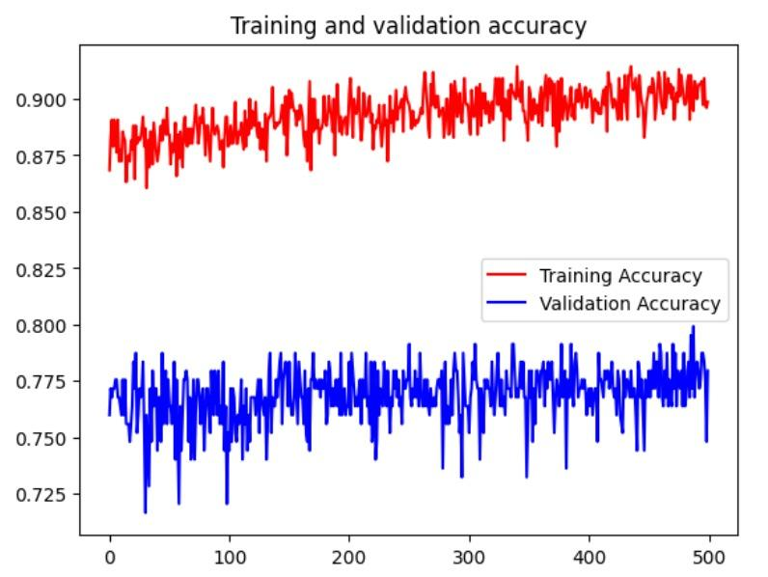
DEEP NEURAL NETWORK
We also trained our datasets with LSTM model with tensorflow and keras. We got the high training accuracy of more than 90% but validation accuracy of just 77%. This is a clear sign of overfitting. Due to very small dataset deep learning network did not perform well, so we decided to go with randomforestclassifier.

Slide 12
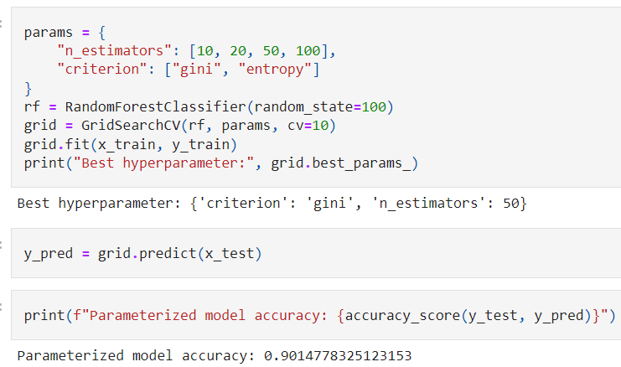
MODEL FINALIZATION
Hyperparameter tuning of RandomForestClassifier
As we see our dataset is very small; just 5 column and 1014 rows to trained, so we tuned our model with GridSearchCV with 10 cross folding. The best parameter we got with criterion is gini and n_estimator is 50. The resultant parameters accuracy is 90%

Slide 13
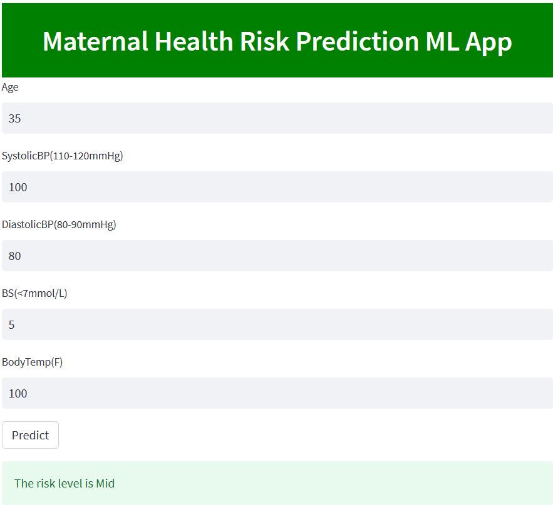
MODEL DEPLOYMENT
Steps for Deployment:
Dump the model using pickel→ create app.py file→requirement.txt→upload in github→ streamlit.io→Deployment
Notes:
remove: heroku

Slide 14
CONCLUSION
There were about 60% duplicates in the dataset, removing the duplicates significantly drop the accuracy. Domain expertise suggest us to trained the datasets with duplicates as many patients can have same instances.
In this way we remove the outliers→select the features→tried 8 different machine learning algorithm along with DNN→ Choose RandomForestClassifier as our best performing model with 90% accuracy.
Our objective is to provide a easy access of health monitoring webapp so as to minimize the risk of women during pregnancy.
PROJECT LINKS:
Github: https://github.com/sekhrianchal6/Arima/blob/main/Arima_Final%20-%20update.ipynb
Project Docs: https://docs.google.com/presentation/d/1B3blWWZeZ7akXssp43JVzV8DQ4xJmII7/edit#slide=id.p10
Webapp:https://lat33fah-deployment-app-d5axv8.streamlit.app/

Slide 15
THANK YOU
FOR THIS GREAT DATA SCIENCE LEARNING EXPERIENCE WITH PEOPLE AROUND THE WORLD
24th February, 2023

