Slide 1
AP13M120-W13
- HV Stress condition for ELMOS’s Used device list
Sep. 30th, 2025
SKKF PE1 Team

Slide 2
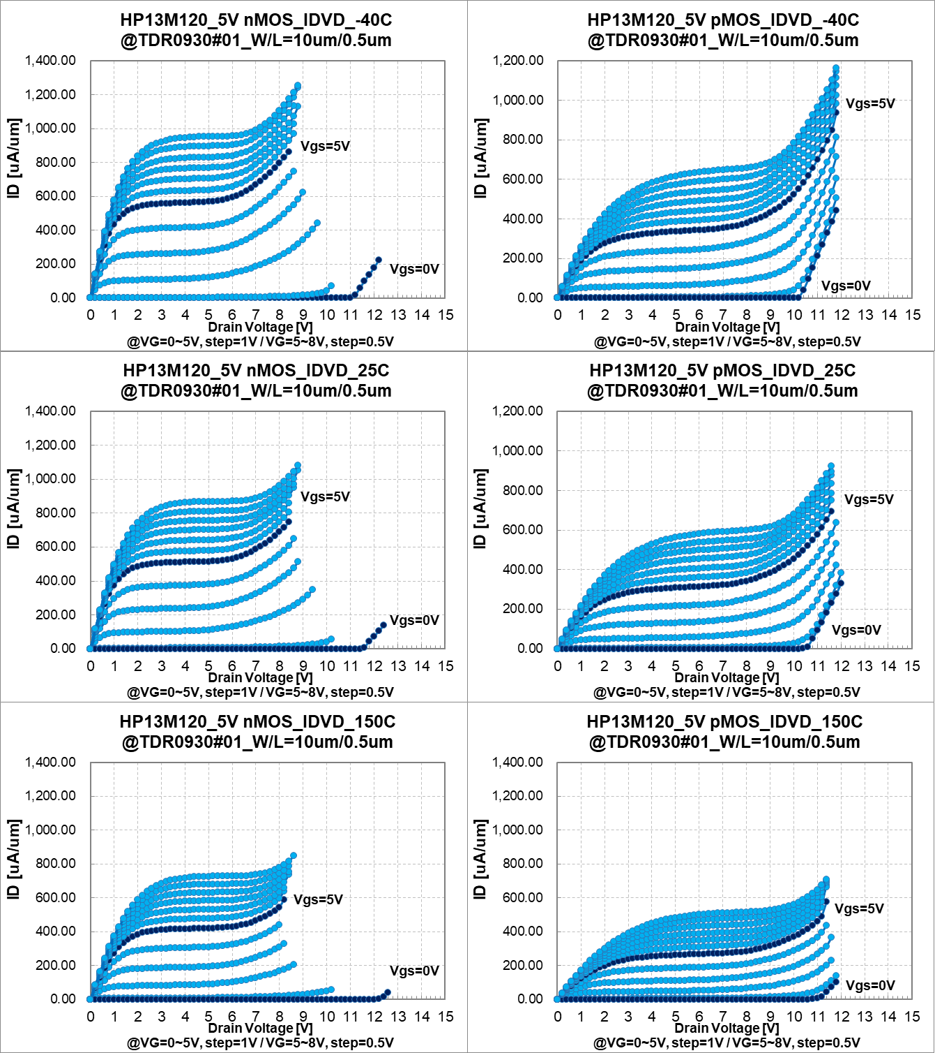
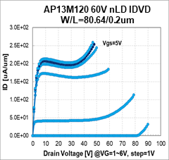
HV stress summary
SKKF guarantees [VG ≤ VOP*160%, VD = each bias on table] for HV stress condition on device level based on a our test result.
To fully ensure the chip-level guarantee, additional chip-level validation may be considered in the future.
Stress condition (Full SOA) – for Logic, pLDMOS & EDMOS
Stress condition (Partial SOA) – nLDMOS
AP13M120 5.0V nMOS IDVD
W/L=10/0.5um
1s SOA :1m SOA * 80%
1ms SOA
1sec stress condition
- VG = 2.4V(@1.5V Gox) / 8.0V(@5V Gox) : VOP*160%
- VD = On BV * 80%
*On BV @ 1ms stress bias
1sec stress condition
- VG = ~ 8.0V(@5V Gox) : VOP*160%
- VD = On BV * 80%
*On BV @ 1ms stress bias
Test result
: Delta characteristic (Vth / Idsat or Idlin) < 2%
Test result
: Delta characteristic (Vth / Idlin) < 2%

Slide 3


HV stress : bias condition
1.5V Logic Transistor
**BVmin=VD(@VG=0V, ID=0.1uA/um)
Device | Device name | Structure | V_{DS_Stress} | V_{GS_stress} | SOA / VBD
1.5V NMOS (W/L=10/0.13um) | xnch_tn, xnchdw_tn xnchdh_tn xnchdh_tnhb xnchdwh_tn |  | 3.2V | 2.4V | VOPmax = 1.65V BVmin = 3.2V
1.5V PMOS (W/L=10/0.13um) | xpch_tn, xpchdw_tn xpchdh_tn xpchdh_tnhb xpchdwh_tn |  | 4.0V | 2.4V | VOPmax = 1.65V BVmin = 4.0V

Slide 4
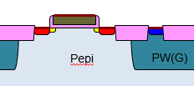

HV stress : bias condition
5.0V Logic Transistor
**BVmin=VD(@VG=0V, ID=0.1uA/um, Off-state)
Device | Device name | Structure | V_{DS_Stress} | V_{GS_stress} | SOA / VBD
5V NMOS (W/L=10/0.5um) | xnch_tk50, xnchdw_tk50 xnchdh_tk50 xnchdh_tk50hb xnchdwh_tk50 |  | 7.0V | 8.0V | VOPmax = 5.5V BVmin = 8.0V
5V PMOS (W/L=10/0.5um) | xpch_tk50, xpchdw_tn xpchdh_tn xpchdh_tnhb xpchdwh_tn |  | 9.0V | 8.0V | VOPmax = 5.5V BVmin = 7.5V
5V Native NMOS (W/L=10/1.6um) | xnch_tk50_na, xnchdh_tk50_na xnchdh_tk50hb_na |  | 7.7V | 8.0V | VOPmax = 5.5V BVmin = 8.0V
5V Dep. NMOS (W/L=1/20um) | xnch_tk50_de, xnchdw_tk50_de xnchdh_tk50_de xnchdh_tk50hb_de xnchdwh_tk50_de |  | 7.0V | 8.0V | VOPmax = 5.5V BVmin = 8.0V

Slide 5
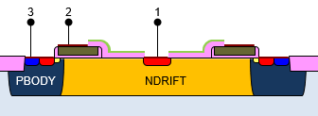
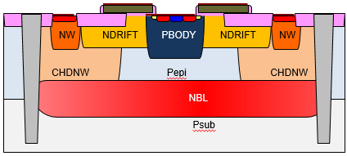
HV stress : bias condition
HV nLDMOS
**BVmin=VD(@VG=0V, ID=0.1uA/um, Off-state)
Device | Device name | Structure | V_{DS_Stress} | V_{GS_stress} | SOA / VBD
20V nLDMOS (W/L=20/0.2um) | xnch_p520 xnchdh_p520 |  | VD1 = 17V VD2 = 18V VD3 = 20V | VG1 = 8.0V VG2 = 7.0V VG3 = 6.0V | VG <2.0V, VD=22V 2.0V< VG <5.5V, VD=18V BVmin = 26V
30V nLDMOS (W/L=80.6/0.2um) | xnchdh3_p530 |  | VD1 = 27V VD2 = 27V VD3 = 28V VD4 = 29V VD5 = 30V | VG1 = 8.0V VG2 = 7.0V VG3 = 6.0V VG4 = 5.0V VG5 = 4.0V | VG <2.0V, VD=34V 2.0V< VG <5.5V, VD=22V BVmin = 40V
45V nLDMOS (W/L=80.6/0.2um) | xnchdh3_p545 |  | VD1 = 31V VD2 = 32V VD3 = 32V VD4 = 33V VD5 = 33V VD6 = 42V VD7 = 53V | VG1 = 8.0V VG2 = 7.0V VG3 = 6.0V VG4 = 5.0V VG5 = 4.0V VG6 = 3.0V VG7 = 2.0V | VG <2.0V, VD=45V 2.0V< VG <5.5V, VD=25V BVmin = 55V
60V nLDMOS (W/L=80.6/0.2um) | xnchdh3_p560 |  | VD1 = 39V VD2 = 39V VD3 = 40V VD4 = 41V VD5 = 42V VD6 = 48V VD7 = 63V | VG1 = 8.0V VG2 = 7.0V VG3 = 6.0V VG4 = 5.0V VG5 = 4.0V VG6 = 3.0V VG7= 2.0V | VG <2.0V, VD=60V 2.0V< VG <5.5V, VD=30V BVmin = 74V

Slide 6
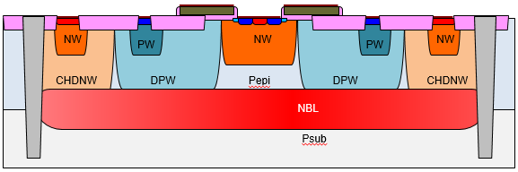
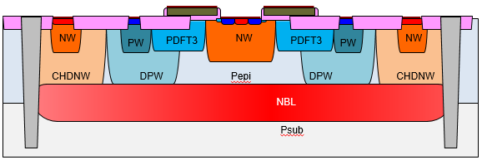
HV stress : bias condition
HV pLDMOS
**BVmin=VD(@VG=0V, ID=0.1uA/um, Off-state)
Device | Device name | Structure | V_{DS_Stress} | V_{GS_stress} | SOA / VBD
45V pLDMOS (W/L=79.8/0.4um) | xpchdh3_p545 |  | 54V | 8.0V | VOPmax (VG=5.5V, VD=45V) Bvmin = 55V
60V pLDMOS (W/L=79.8/0.4um) | xpchdh3_p560 |  | 63V | 8.0V | VOPmax (VG=5.5V, VD=60V) Bvmin = 75V
45V Low Ron pLDMOS (W/L=79.8/0.4um) | TBD |  | 49V | 8.0V | VOPmax (VG=5.5V, VD=45V) Bvmin = 55V

Slide 7
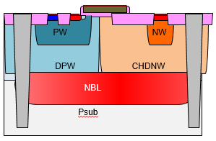
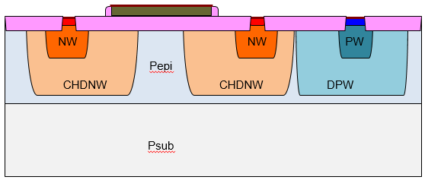
HV stress : bias condition
HV nEDMOS
**BVmin=VD(@VG=0V, ID=0.1uA/um, Off-state)
Device | Device name | Structure | V_{DS_Stress} | V_{GS_stress} | SOA / VBD
12V nEDMOS (W/L=20/2.0um) | xnchdh3_h512 |  | 26V | 8.0V | VOPmax (VG=5.5V, VD=14V) BVmin = 20V
45V nEDMOS (W/L=20/3.0um) | xnchdh3_h545 |  | 56V | 8.0V | VOPmax (VG=5.5V, VD=45V) BVmin = 54V
60V nEDMOS (W/L=20/5.0um) | xnchdh3_h560 |  | 109V | 8.0V | VOPmax (VG=5.5V, VD=60V) BVmin = 75V
STI nEDMOS (W/L=20/20um) | xnch_h5240_sti |  | 70V | 60V | VOPmax (VG=52V, VD=40V) BVmin = 65V

Slide 8
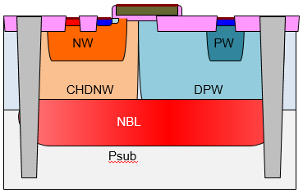
HV stress : bias condition
HV pEDMOS
**BVmin=VD(@VG=0V, ID=0.1uA/um, Off-state)
Device | Device name | Structure | V_{DS_Stress} | V_{GS_stress} | SOA / VBD
45V pEDMOS (W/L=20/1.8um) | xpchdh3_h545 |  | 75V | 8.0V | VOPmax (VG=5.5V, VD=45V) BVmin = 54V
60V pEDMOS (W/L=20/1.8um) | xpchdh3_h560 |  | 80V | 8.0V | VOPmax (VG=5.5V, VD=60V) BVmin = 75V

Slide 9
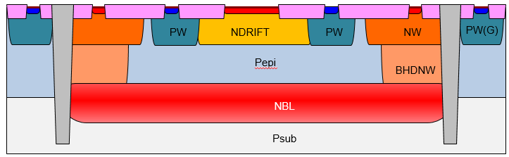
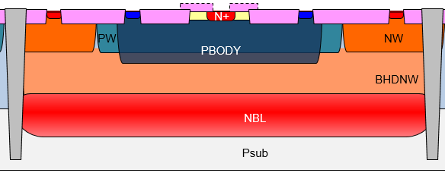
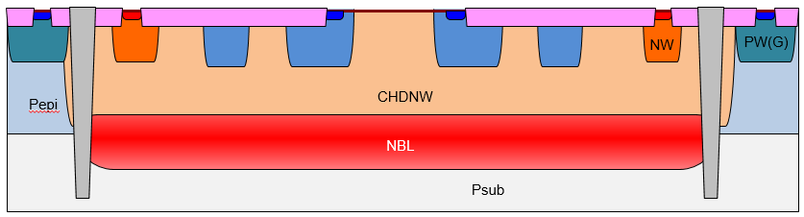
HV stress : bias condition
Option (Diode)
**BVmin=VC(@IC=0.1uA/um, Off-state)
Group | Device name | Structure | V_{_Stress} | V_{_stress} | SOA / VBD
30V Diode (W/L=7/7um) | xndhdio_dh30 |  | VC = 35V | - | VOPmax (VC=30V) BVmin = 37V
Zener diode (Zero mask) (W/L=1.8/2.6um) | zdiozm_s |  | VC = 6.8V | - | VOPmax (VC=5.8V) BVmin = 5.3V
Schottky diode (W/L=5/20um) | sdio |  | VC = 46V | - | VOPmax (VC=40V) BVmin = 48V

Slide 10
HV stress : bias condition
Option (Non-Sal Resistor)
Group | Device name | Structure | V_{_Stress} | V_{_stress} | SOA / VBD
Non Sal N-poly Resistor (W/L=2/100um) | rdnpo_ns (@W/L=2/100um) |  | V1 = 80V | - | VOPmax Current = 0.886mA/um Voltage = 0.375V/um
Non Sal P-poly Resistor (W/L=2/100um) | rdppo_ns (@W/L=2/100um) |  | V1 = 80V | - | VOPmax Current = 1.00mA/um Voltage = 0.272V/um
Non Sal Zero mask 5.2K HR Resistor (W/L=2/100um) | Rdhpoz_ns5p2k (@W/L=2/100um) |  | V1 = 120V | - | VOPmax Current = 0.12mA/um Voltage = 0.62V/um

Slide 11
HV stress : bias condition
Option (Capacitor / BJT)
Group | Device name | Structure | V_{_Stress} | V_{_stress} | SOA / VBD
1.1fF MIM (W/L= 25/25um) | cmim1p1 |  | 35V | - | VOPmax = 14.6V BVmin = 30V
5V Varactor (W/L=30/50um) | cjnm_tk50 cjnmdh_tk50 cjnmdh_tk50hb |  | 8.0V | - | VOPmax = 5.5V BVmin = 8.0V
RLV Vertical NPN BJT (W/L=1.0/4.0um) | xvn1l4h |  | VC = 21.6V @IB=1uA | - | VOPmax = 15V BVmin = 37V
RHV Vertical NPN BJT (W/L=1.2/1.2um) | xvn1p2h |  | VC = 30.4V @IB=1uA | - | VOPmax = 15V BVmin = 25V

