Slide 1
OSC48Mhz -FLL
Richard Morisson 27 February 2026

Slide 2
Summary :
ELMOS Requirement and Definition main parameters
OSC 48M Ramp :Results and Drawbacks
FLL Architecture description and advantages
Optimization Tc_ppm/k equivalent for REQ * C
5imulation Tc_ppm/k Req * C
Description and simulation internal block : Rtimm , OPAMP,VCO
PVT TOP OSC48MFLL Simulations and summary
First draft simulation selectable OSC48MFLL/OSC64MFLL !!

Slide 3
ELMOS MAIN Requirements in KEY FOUNDRY HVT : Design a High Precision 48 Mhz OSCILLATOR with a minimum Error after trimming . I define 3 specification ranges : 1) Specification 1 ( nominal) : Vdd: 1.35 to 1.65 V , Temp :-40 to +160dC , with ERROR <<+/-1% 2) Specification 2 : Vdd: 1.35V to 1.65V , Temp :-55 to +175dC , with ERROR < +/-1% 3) Specification 3 : Vdd: 1.25V to 1.65V , Temp :-55 to +175dC ,with ERROR ≈ +/-1% Design Priorities : 1) Minimizing Error with Robust Design 2) Power Consumption 3) Layout Area
Fout
Fout(max)
Definition ERROR % : Error +/- % = 50( Fout(MAX) –Fout(MIN))/Fout(Average)
Fout measured with three supply voltage and full temperature range .
Two other parameter are also given :
PSRR(dB) = db20 (( Fout(Vdd max)/Fout(Vdd min))-1) /( (Vddmax/Vddmin)-1)
calculated for each temperature step
TC_ppm/K = 1e6 *( Fout(max)-Fout(min))/((Fout(average)* Temp(max)-Temp(min))
Calculated for each Vdd step
Vdd(Max)
Fout(Average))
Vdd(Typ)
Vdd(Min)
Fout(min)
TEMP

Slide 4
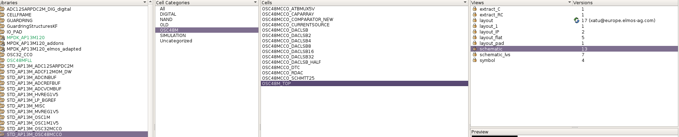
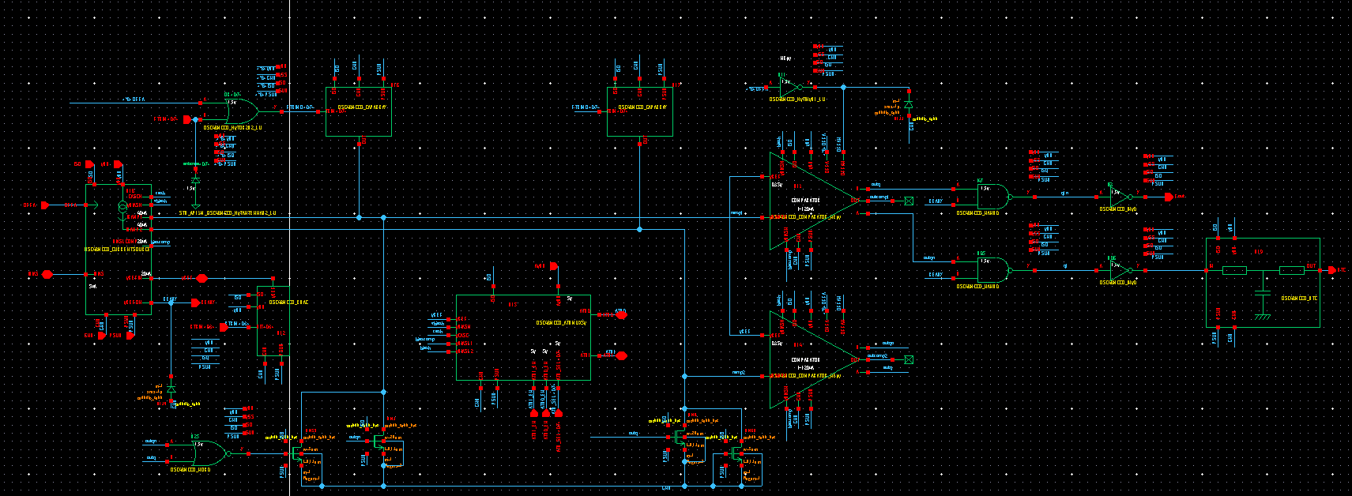
Existing Design in KEY Foundry : OSC48M Architecture Relaxation ramp :

Slide 5
BLOCK DIAGRAM OSC48M
VDD(1.5V)
ISO (5V)
iref
Ready
CURRENT
MIRROR
Irampe irampe
FOSC
VREF
C1
and
icomp
CompJK
IBIAS
(5ua)
0.35V
C2
DTC
CURRENT
MIRROR
and
CompJK
OFFA
Rref
C1
Capacitors
Array
C2
icomp
AVDD
(5V)
ATB_MUX (5V)
ATB0
Trimming
VREF
Trimming
Fosc
ATB1
GND
PSUB
RTRIM<0:3>
FTRIM<0:7>
ATB_SEL<0:7>
ATB0_EN
ATB1_EN

Slide 6
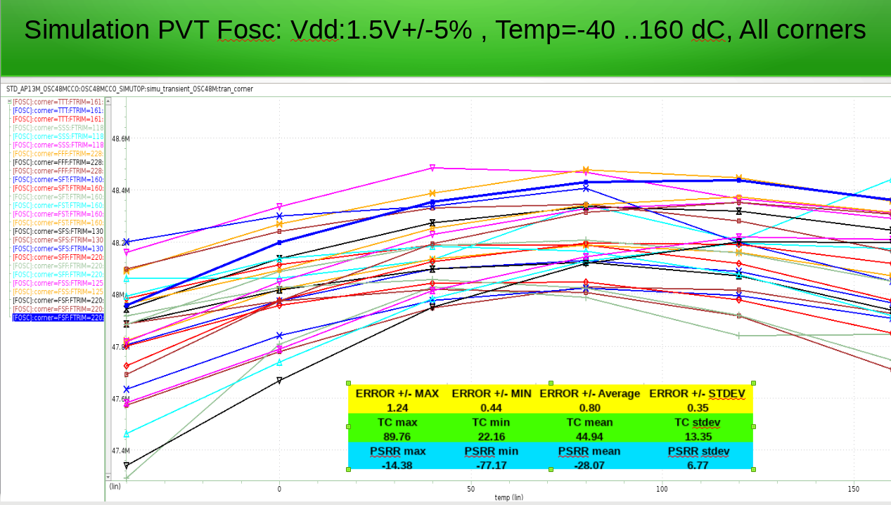
Existing Design in KEY Foundry : OSC48M main result

Slide 7
OSC48M LIMITATIONS : 1) Relaxation based on equivalent Resistance Rref with capacitance C1(or C2): Fosc=1/(2 Rref *C1) (excluding delai comparator) Rref resistance Rdppo_ns ( width=2um) Capacitance : realized with cmom capacitance array ( trimming) as Rref *C1 is not constant versus temperature Fosc will not be constant . 2) second order effect : Comparator delai which is not constant versus temperature and supply Oscillation frequency will be Fosc = 1/(2Rref*C1+2 Td) If Fosc is small << 10 Mhz Td could be neglected here for Fsoc=48Mhz Td will impact PSRR ,Tc_ppm/K and Error +/- %

Slide 8
New Architecture : FLL OSCILLATOR
ATB0
ATB1
VDD (1.5V+/-10%)
ISO
VCCA(5V)
VREF (0.9V)
Bandgap
VREF+IREF
ATB0_EN
OFFA
Cg
ATB1_EN
ATB_MUX
MAX
IRES
VRES
-
+
MIN
ATBSEL<0:7>
Rf
VSC
OPAMP
R
Rf
FTRIM<0:8>
512
+ -
TRIMMING
Fosc
S
C2
Sn
Cf
Cf
nmos5V
nmos5V
VCO
OFFA
START
OFFA
Sn
C1
S
C1
nmos5V
nmos5V
GND
Ready
READY
VCP=3VDD
VDD
6Mhz
12Mhz
24Mhz
48Mhz
96Mhz
48Mhz
Charge
Pump
S
Level
Shift
%2
%2
%2
%2
Sn
Duty
Cycle
DTC
GND
VCP
PSUB
F6M
F12M
F24M
F48M

Slide 9
FLL ARCHITECTURE PRINCIPLE : Steady state loop : VSC(average)=VRES
T=Req*C1
LP
Filter
VCO
(96Mhz)
VRES
VRES
+
-
VCf
VC
VSC
VSC
S=1
Sn=1
Fosc(6Mhz)=1/(2 T)
Divider / 16
Fout=VCf*Kvco
Fosc(48M) ≈ 8/(2*Req*C1) with C2>>C1 , Req will be trimmed to get the proper oscillation frequency

Slide 10
Why FLL ARCHITECTURE ? 1) FLL :Frequency LOCK LOOP Main avantage : it is a closed loop design so internal block delais do not any impact oscillation frequency versus temperature and supply ( no Td impact as previous architecture ramp) . By construction PSRR (dc) should be neglectable 2) Remain the time constant T= Req * C which should be constant versus temperature and supply Vdd . Key Foundry provide a resistance (Rdppo_ns) which coefficient of temperature Tc1 dépend of width ! The goal is to get Res*C with the lowest Tc_ppm/K !

Slide 11
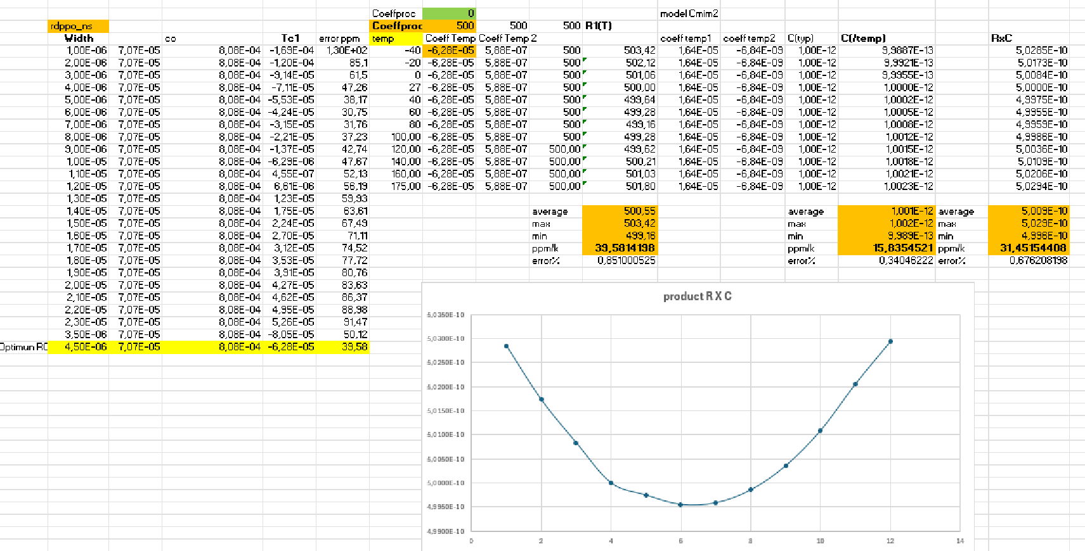
Model Req*C with excell file : optimum width resistance 4.5um Tc_ppm/k (-40..+175dc)= 31.45 !!

Slide 12
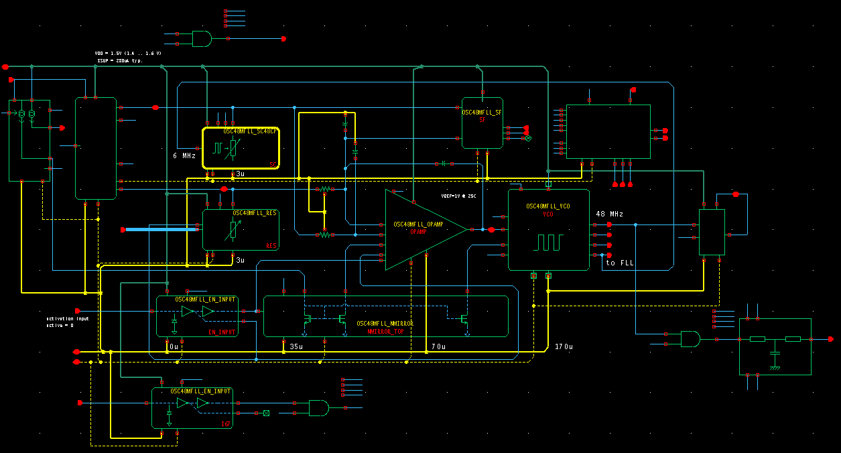
Design OSCM48 FLL
READY
TEST
MIN/MAX
Switch/Cap
LP
Filter
ATB_MUX
Mirror
pmos
Bandgap
Trimm
Res
VCO
OPAMP
Charge
Pump
Mirror nmos
ON/OFF dc
Start OSC
Test
Duty

Slide 13
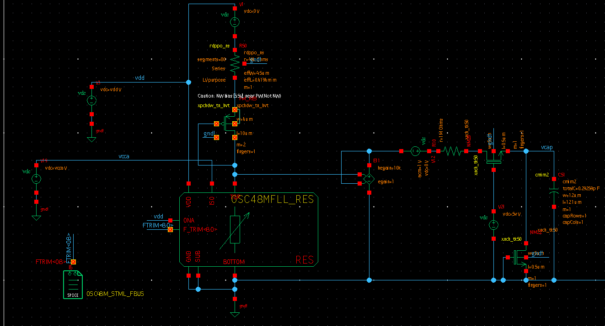
Simulation Validation Time constante :T=Req*C
Emulation Time constant by measuring in DC and AC ;Req and C versus Temperature and VDD
Emulation Switch Cap (AC)
Emulation Req (DC)

Slide 14
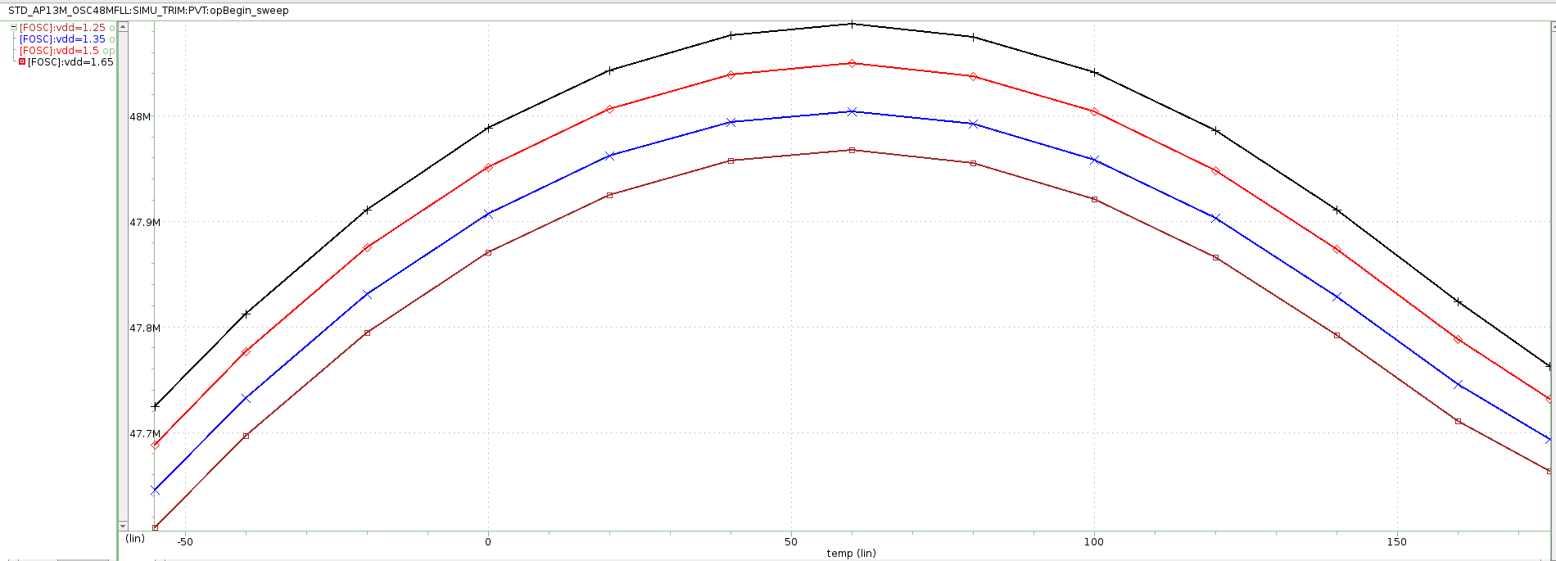
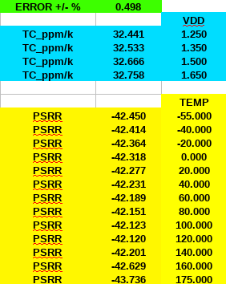
Results simulation , process TTT ( trimmed code to get Fsoc=48Mhz) Temp:-55 to 175dC , Vdd:1.25 to 1.65V
Emulation Switch Cap (AC)
Emulation Req (DC)

Slide 15
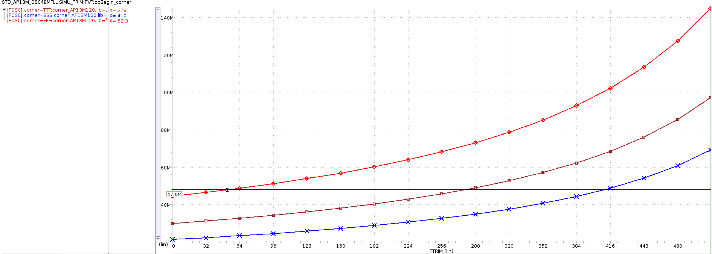
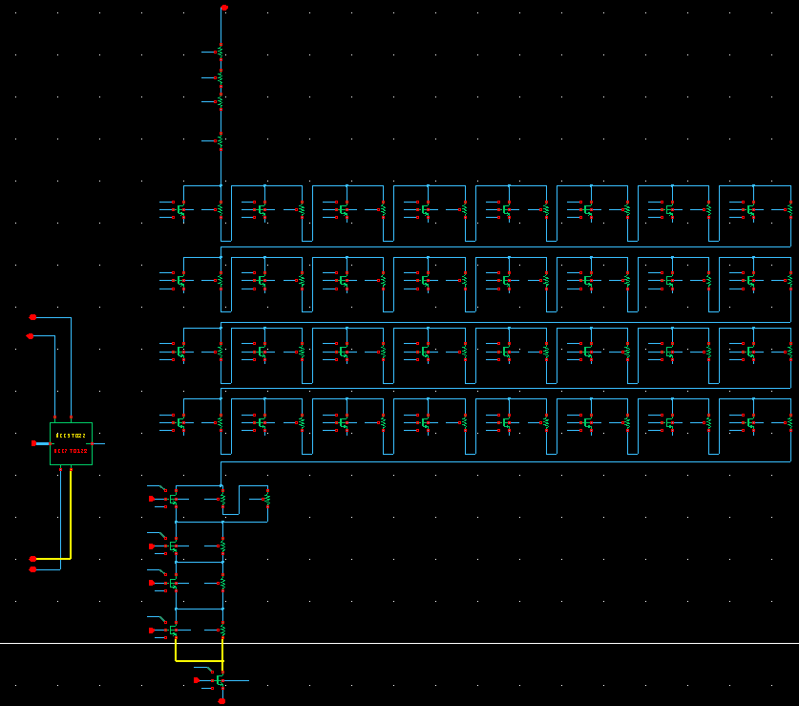
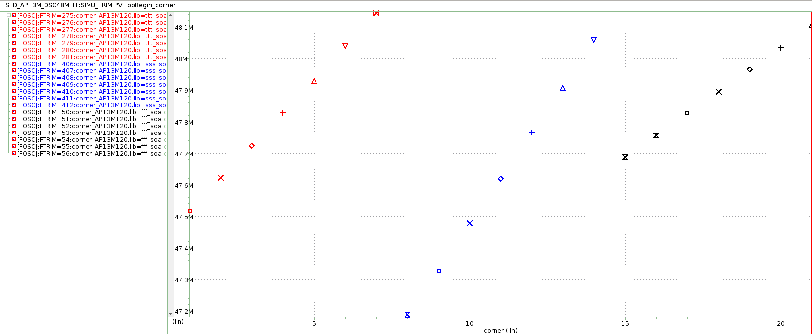
Resistance with trimming 9 bits
Step :32 LSB
Emulation Req (DC)
Step :1 LSB around Fosc=48Mhz
Step : TTT 100khz SSS 130khz, FFF: 70khz

Slide 16
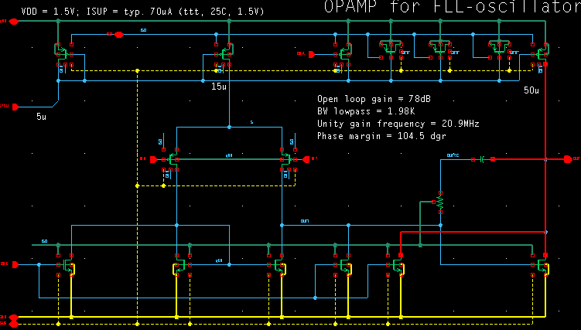
OPAMP :classical two stages OTA
Emulation Req (DC)

Slide 17
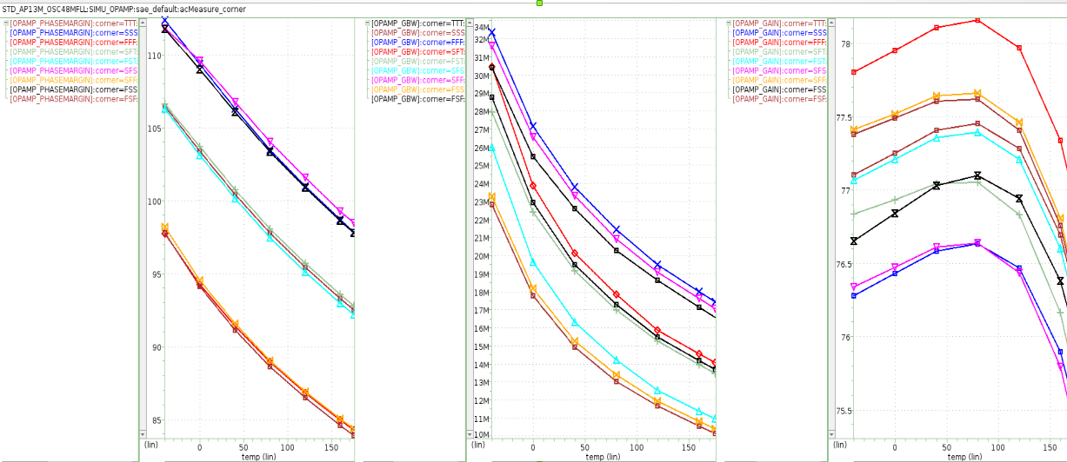
OPAMP Characteristics
Emulation Req (DC)

Slide 18
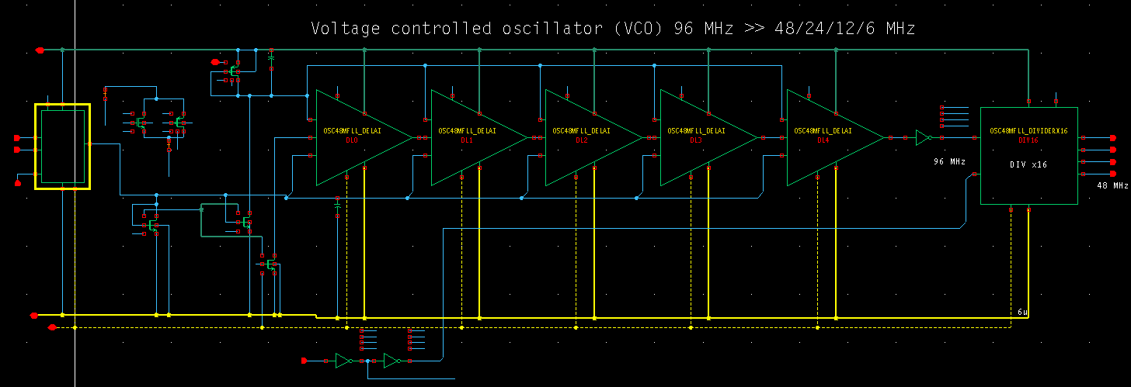
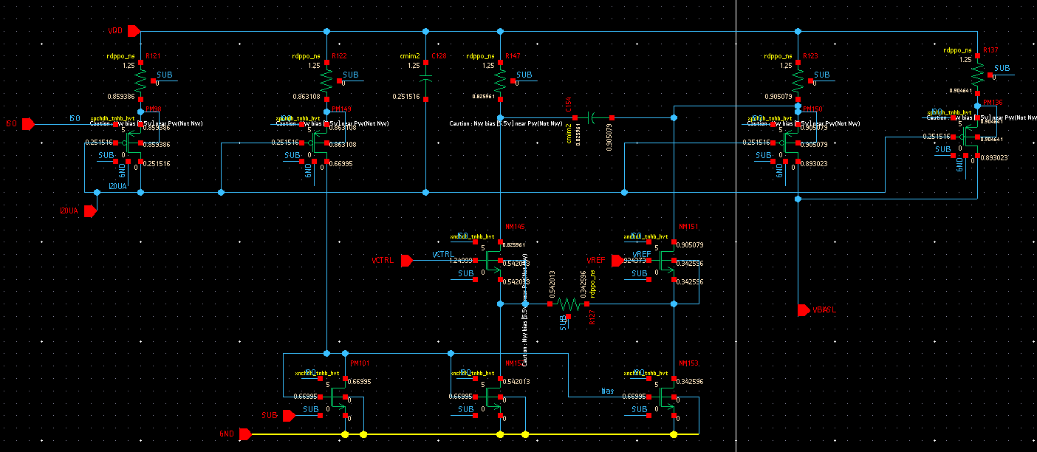
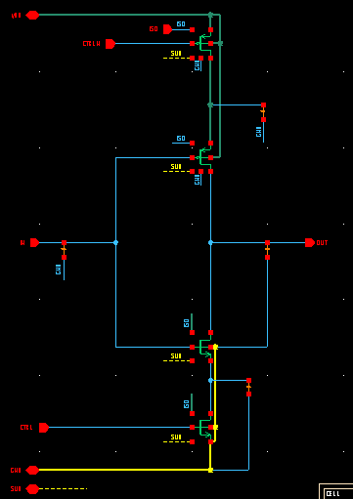
VCO : V/I amplifier loading ring oscillator providing 96Mhz Followed by divider 2 to 16 .
Delay Cell
V/I amplifier
Emulation Req (DC)
V/I amplifier
Delay Cell

Slide 19
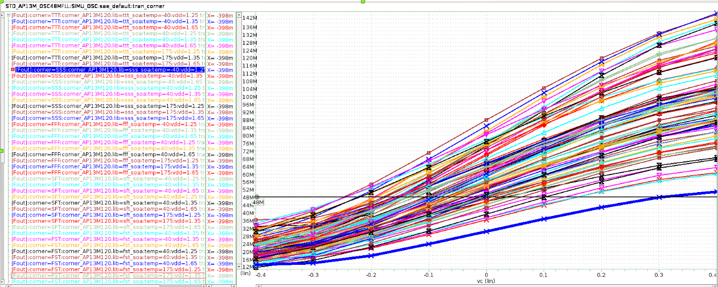
VCO : Simulation PVT results versus Vc (Centered at VREF=0.9V)
Delay Cell
V/I amplifier
Emulation Req (DC)
V/I amplifier
Delay Cell

Slide 20
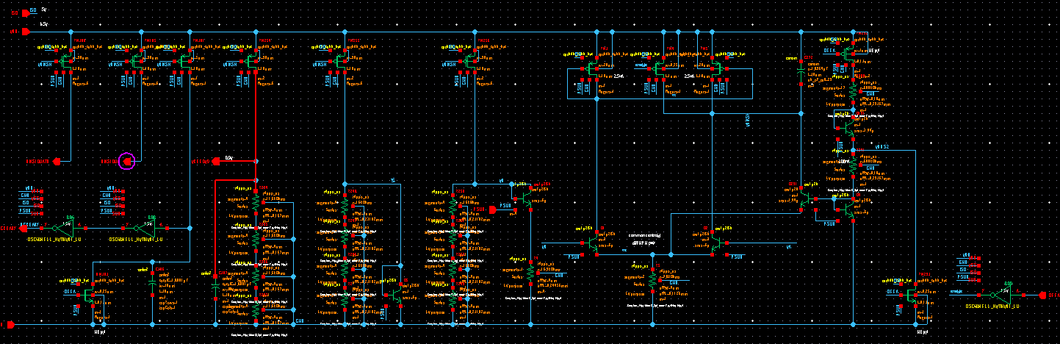
Bandgap:providing current 10uA (VCO,OPAMP) and VREF=0.9V (to VCO) (Reused OSC32MCCO)
V/I amplifier
V/I amplifier
Delay Cell

Slide 21
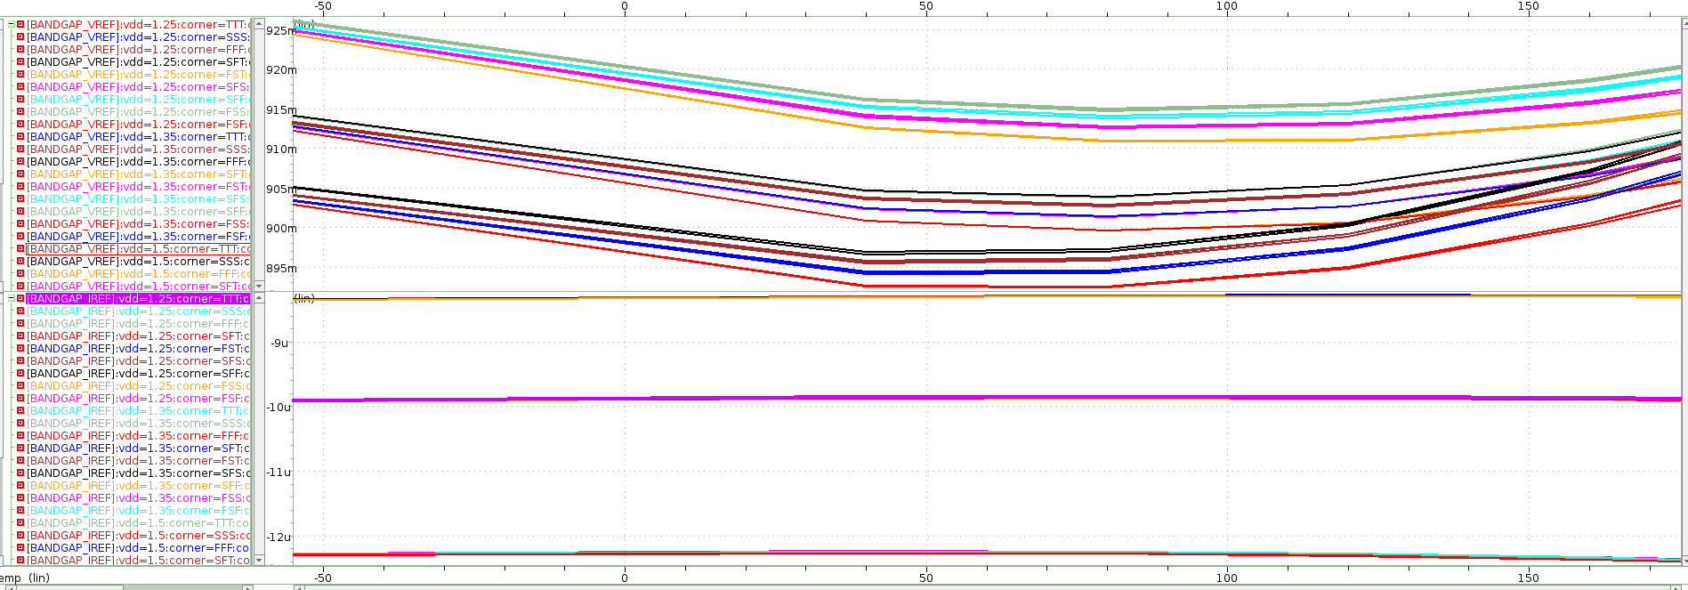
Bandgap simulation results versus PVT :temp-55 to 175, Vdd 1.25 to 1.65 , all corners
V/I amplifier
V/I amplifier
Delay Cell

Slide 22
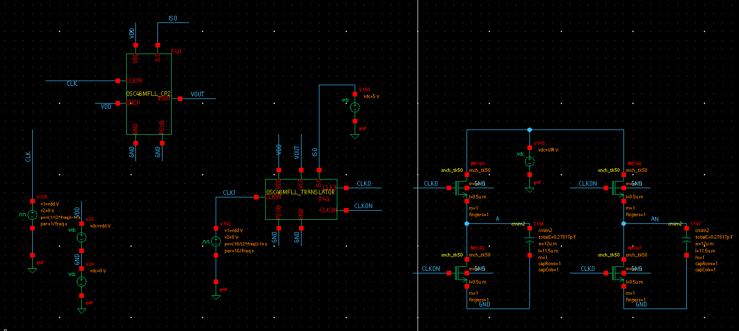
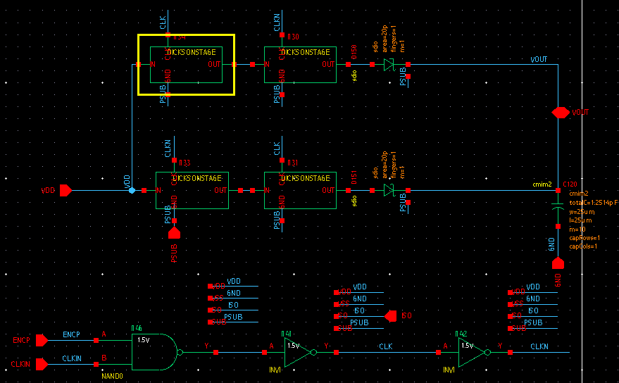
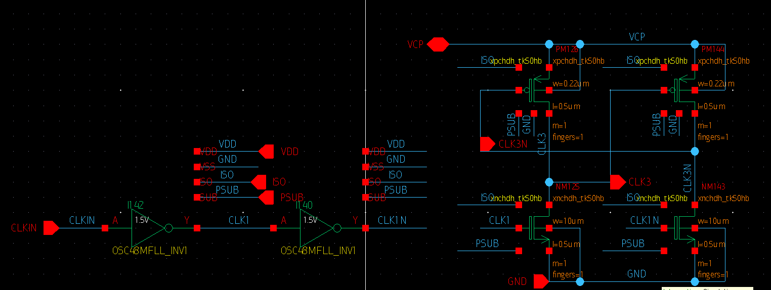
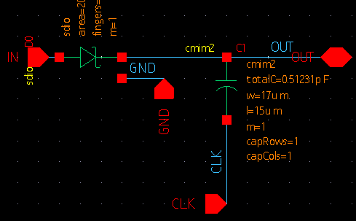
Charge PUMP +Translator : loading Switch Cap : . Why Charge pump ? Reduce RON SWITCH ( REQ=Cste) (switch Vdd=1.25 mos 1.5V don’t work)
Charge Pump
Switch Cap
Two Stages Dickson
V/I amplifier
TRanslator
TRanslator
Dickson
V/I amplifier
Delay Cell

Slide 23
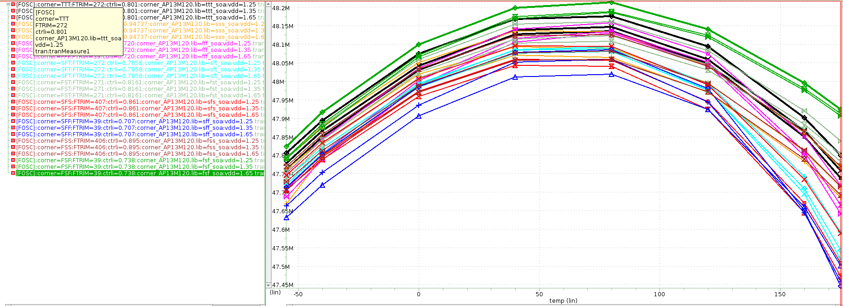
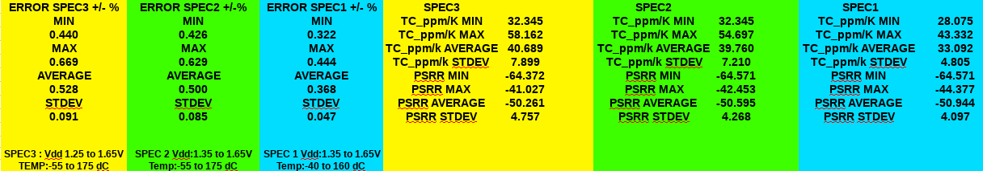
TOP SIMULATION RESULTS VERSUS PVT (Results simulation 28 Feb) All corners trimmed at Vdd=1.5V and Temp=40dC
V/I amplifier
V/I amplifier
Delay Cell

Slide 24
Summary Specification parameter (after trimming)
PARAMETERS | MIN | MAX | AVERAGE | STDEV | COMMENT
FOSC (Mhz) (with Trimming) | 47.44 | 48.212 | 47.91 | 0.174 | SPEC3
I_ON (uA) | 266 | 442 | 332 | 41 | SPEC3
ERROR +/- % | 0.44 | 0.67 | 0.53 | 0.091 | SPEC 3
ERROR +/- % | 0.43 | 0.63 | 0.5 | 0.085 | SPEC 2
ERROR +/- % | 0.332 | 0.444 | 0.368 | 0.047 | SPEC 1
TC_ppm/K | 28 | 43.3 | 33.1 | 4.8 | SPEC1
PSRR (dB) | -64 | -44 | -51 | 4 | SPEC1
Step Trimm (kHz) (around 48Mhz) | 70 | 130 | 100 | 10 | SPEC3
Duty Cycle (48Mhz) | 0.4956 | 0.5054 | 0.499966 | 0.0017 | SPEC3
V/I amplifier
V/I amplifier
Delay Cell

Slide 25
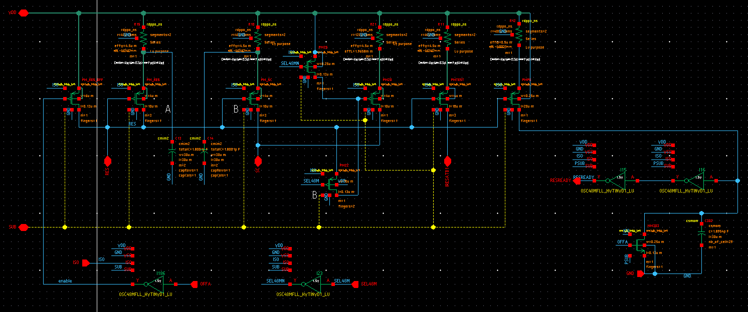
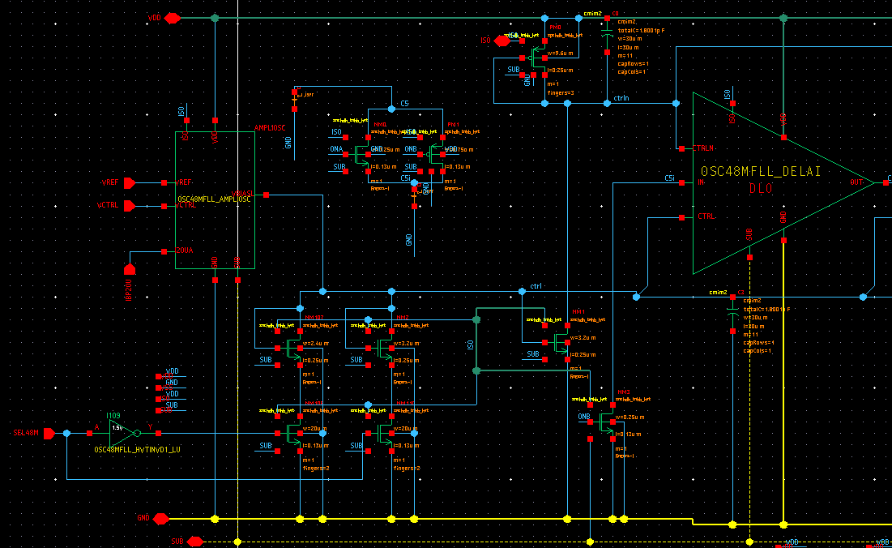
Going to 64 Mhz OSCILLATOR ? Only two small changes : ➔ increasing the current loading the switch cap by 33% ➔ increasing the current in the VCO by 33% These two changes could be easily digitally control (1bit) meaning that the IP could provide 48Mhz and 64Mhz ..with the same trimmed values !!
V/I amplifier
V/I amplifier
Digital Current control for Switch Cap
Digital Current control for VCO (ZOOM)
Delay Cell

Slide 26
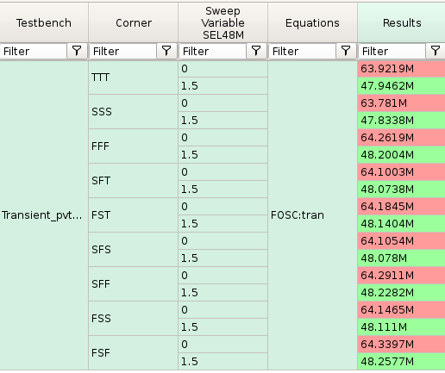
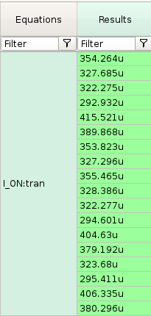
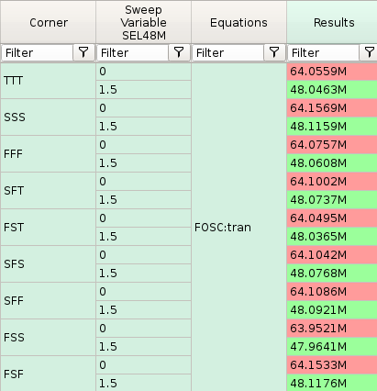
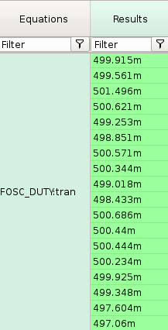
First simulation with bit control SEL48M : All corner (trimmed) , Temp=40dC, Vdd=1.5V
V/I amplifier
V/I amplifier
Delay Cell

