Slide 1
Getting Started with
Ecommerce for Food & Beverage Brands:
Creating Your Channel Strategy
Christie Lee
516-967-8810
christie@nourishingfoodmarketing.com
https://www.nourishingfoodmarketing.com/
https://www.linkedin.com/in/christieslee/

Slide 2










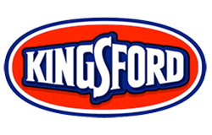
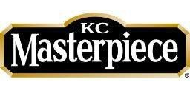
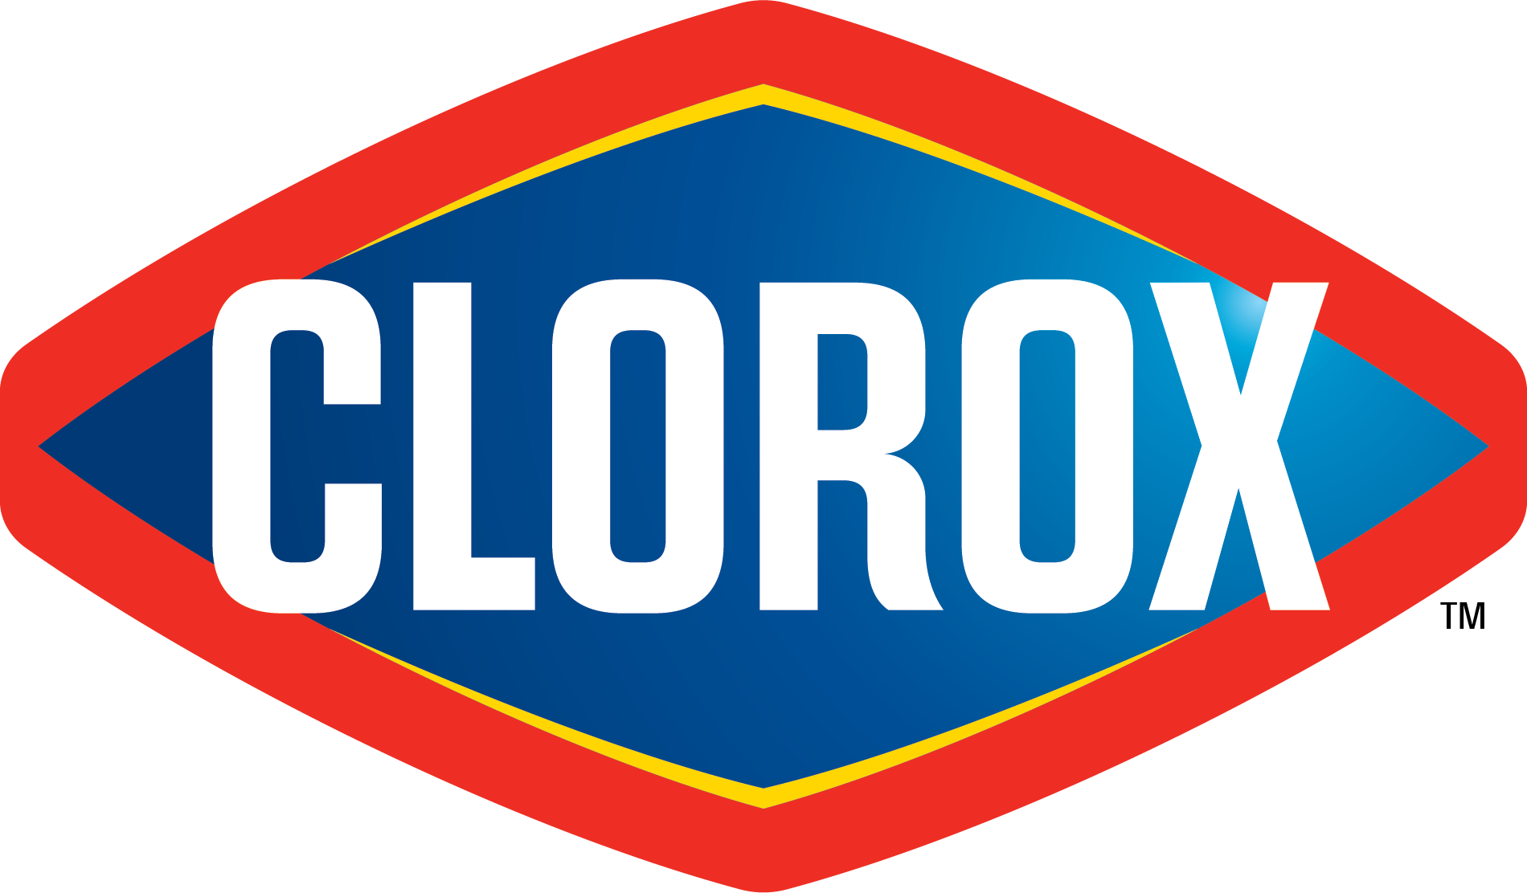
ABOUT US
Nourishing Food Marketing is a action-oriented brand marketing consultancy for food brands that that develops strategies and executes on them.
I blend the thinking of Big Food, from working at Clorox on Americana brands like Hidden Valley Ranch, with the resource-constrained realities of small brands as a former food founder myself (Tiny Hero).
PREVIOUS WORK

Slide 3
FIRST, ESTABLISH YOUR BUSINESS GOALS FOR ENTERING ECOMMERCE

Slide 4
OBJECTIVES AND KEY RESULTS FRAMEWORK
BUSINESS OBJECTIVE
Increase revenue
Increase profit
MARKETING OBJECTIVE
Drive trial of products on Amazon
Increase Average Order Size (AOS) on DTC channel
Decrease DTC Customer Acquisition Cost (CAC)
MARKETING
TACTICS
$3000/mo in Amazon revenue
$40 AOS on DTC channel
<$1 CPC on Facebook/Instagram Digital Marketing
For more on this marketing framework and a step-by-step guide on how to build an effective and efficient Marketing Plan with clear explanations and lots of examples, read my Definitive Guide to Creating a Marketing Plan for Food and Beverage Brands.
Notes:
Important to get clear on objectives and key results so you know what you’re working on and if you’re red, yellow, or green against your goals.

Slide 5
ECOMMERCE LANDSCAPE

Slide 6

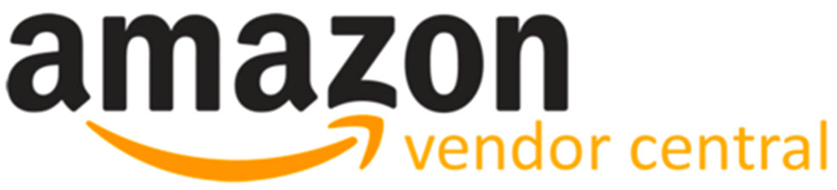

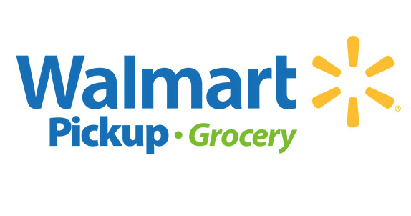


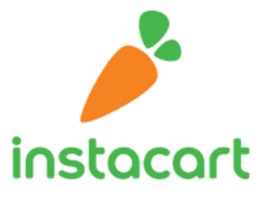

ECOMMERCE LANDSCAPE AND KEY PLAYERS
ONLINE ONLY RETAILERS (MARKETPLACES)
EXTENSION OF GROCERY STORES
MANUFACTURER LED
I’ll talk about these channels in more detail as they are the largest platforms.
Direct to Consumer
Notes:
And just like traditional B&M retailers, online retailers have clear value propositions and target consumers
There are lots of smaller online only retailers, too.
Extension of grocery stores is both click-and collect as well as delivery
Walmart online grocery sales surpass Amazon sales in 2019

Slide 7
FOOD ECOMMERCE SALES ARE SMALL BUT GROWING
2019
16% of retail sales are online and growing quickly (+15% YoY)¹
3% of food and beverage sales are online²
Today
100% increase in online grocery sales in March³
Digital marketing spend is down, leading to 20-50% decreases in CPC (depending on category)
Sources: ¹DigitalCommerce360 ²Edge by Ascential ³DigitalCommerce360

Slide 8
KEY 2019 DRIVERS FOR ECOMMERCE GROCERY GROWTH
Key focus of retailers: in-store grocery sales are flat but online grocery sales are growing 15%
Increased availability of click-and-collect or home delivery services (90% of all households in the US, up from 81% in 2018)
Amazon includes Amazon Fresh and grocery delivery from Whole Foods Market free for Amazon Prime members
Huge push by Walmart across all its online channels, including launching Delivery Unlimited Program ($98/year for grocery deliveries). Walmart is now #1 in online grocery sales!
Source: DigitalCommerce360

Slide 9
SUCCESS IN ECOMMERCE
Make ecommerce a business priority and commit to being in the channel for at least a year. It takes time for online algorithms and flywheels to get going.
Prioritize a channel within the ecommerce landscape. Each channel has its own tradeoffs and takes a lot of time and money to manage.
Create ecommerce-specific products and case packs so your pricing provides value for consumers and gross margin for you.
Have a Marketing Plan and a marketing budget to support your ecommerce sales (similar to trade promotion budgets in brick & mortar)
Understand your costs. Ecommerce is notoriously hard for grocery manufacturers to make money in – you have to have the right volume/cost ratio and scale.
Notes:
Ecomm is crowded and takes just as much time & resources to support as traditional retailer. Amazon & google flywheels take time to get started
Marketing promotions – think of this as your trade promotion budget

Slide 10
AMAZON DEEP DIVE

Slide 11
AMAZON SUMMARY
The Basics | Manufacturer-led portal to sell your products to Amazon customers | >$10M in annual sales unless you’re part of LaunchPad Wholesale sales – sell at a wholesale price
Pricing | Manufacturer-controlled retail pricing Promotions available | Amazon-controlled retail pricing and promotions
Logistics | Fulfilled by Merchant (FBM) or Fulfilled by Amazon (FBA) | Fulfilled By Amazon (FBA)
Cost Structure | 15% commission to Amazon plus FBA costs | Wholesale pricing (mandatory 7-18% for marketing co-op + damage allowance)
Notes:
Amazon has a keyword driven algorithm – text is important. Just as in SEO, decide on the long term keywords to go after and own
Basically need to use FBA to meet timing requirements and “Amazon Prime” badge
Fees are dependent on category

Slide 12
AMAZON TRADEOFFS
+ | Access to millions of Amazon customers Majority of online product searches start on Amazon Amazon provides light customer support (with chargebacks) | Access to millions of Amazon customers Majority of online product searches start on Amazon Amazon takes care of everything and submits POs like a typical retailer
- | Lots of competition You don’t own the customer relationship | Lots of competition High sales hurdle to qualify for the platform You have zero visibility on the consumer buying your product
Notes:
Amazon is first place people go to for product searches - reviews

Slide 13
SUCCEEDING ON AMAZON
Determine an appropriate product size and pricing: recommend aiming for a price over $15 for Grocery
Apply for Amazon Brand Registry so you have control over your product listings
Friends and Family Review Blitz: need 21 reviews for consumers to see you as reputable
90% of consumers don’t go past page 1 so you need to find keywords that you can rank for. Recommend Helium10 Amazon keyword tools
Notes:
Don’t use coupons if possible – venmo people refunds, etc. Amazon knows when you’re discounting product
Keyword ranking push: 2 week launch window – new item

Slide 14
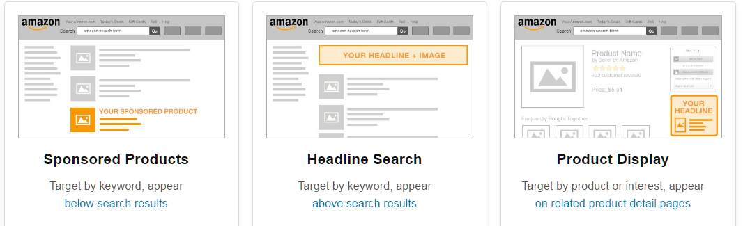
OPTIMIZING AMAZON SALES
Amazon Marketing Services is self-service. Aim for a 20-30% Average Cost of Sales (ACoS)
Automate follow-up emails to customers to ask for reviews and feedback: FeedbackExpress
Notes:
AMS – day part (try timing that works for your brand - only on when people are searching – morning, early evening)
Amazon Media (retargeting on non-Amazon) is a $30k minimum budget

Slide 15
WALMART DEEP DIVE

Slide 16
WALMART SUMMARY
The Basics | Ship-to-home Only shelf-stable products Category Specialists roll up under Walmart buyers, no review cycles Can get on Walmart.com if you’re not on-shelf at Walmart | Click-and-collect and delivery All product types Must be sold in Walmart to be added to this assortment
Pricing | Recommend $6+ MSRP Promos available for non-store shared items or virtual bundles | Mirrors store pricing and promotions No special promotions available on platform
Logistics | Ship to Walmart Fulfillment Centers | Flows through stores
Cost Structure | Wholesale sales

Slide 17
WALMART TRADEOFFS
+ | Largest market share of online grocery sales Leverage Walmart’s logistics prowess Able to join without having Walmart distribution First-party (approved by Walmart Category Specialists) or Third-party (similar to Amazon SellerCentral – apply here) | Largest market share of online grocery sales Leverage Walmart’s logistics prowess
- | Only shelf stable products eligible | Need to be authorized at Walmart B&M stores

Slide 18
OPTIMIZING WALMART.COM SALES
Start with the right product offerings (price point + pack size)
Walmart Media Group provides Display, Sponsored Products, and Homepage Banner opportunities. However, it’s not self-service and requires a $100k minimum spend.
Promos available
Digital marketing directing to Walmart.com product page
Notes:
Walmart Media Group isn’t self-service and is managed by Walmart Media Group. $100k minimum spend

Slide 19
DIRECT TO CONSUMER DEEP DIVE

Slide 20
DIRECT TO CONSUMER SUMMARY
The Basics | Sell on your own website Ability to offer wider product availability, limited edition products, custom variety packs
Pricing | At your discretion, along with promotions
Logistics | Self-fulfill or work with a third-party fulfillment company
Cost Structure | No marketplace fees

Slide 21
DTC TRADEOFFS
+ | Highest gross margin channel Own the consumer relationship Ability to ask for feedback or conduct consumer research Data mining potential Test & Learn quickly
- | Consumer acquisition costs are expensive: $10-100 Logistically challenging
Notes:
Data mining: repeat purchase rate, target consumer demographics, purchasing frequency

Slide 22
SUCCEEDING ON DTC
1
2
3
4
Foundation Building
Nail pricing and product configurations. Set up subscription products.
Smooth website and check-out experience
Connect the dots between Google Analytics, Facebook Pixel, Google Ads
Build target consumer profiles to test: demographics, attitudes, behaviors
Digital Marketing
Campaigns on Google Search, Google Display, and Facebook and Instagram Ads.
Test & Learn campaigns, trying different target consumer profiles, geo-targeting, and messaging
E-mail Marketing
Integrate your DTC offerings into your current content calendar
Create automated drip campaigns to keep consumers engaged
Social Media Promotions
Develop and share social media content and promotions (ie, bonus product or free shipping) for consumers

Slide 23
OPTIMIZING DTC SALES
Start with the right product offerings (price point + pack size)
Adopt a Test & Learn mindset
Track and improve these two key metrics:
Average Order Size (AOS): how much your consumer purchases
Customer Acquisition Cost (CAC): cost to find a new consumer and have them become a purchaser
Notes:
AOS – drive this up since you have fixed costs (pick and pack fees, shipping)
CAC – drive this down – leading indicators are Cost Per Click and Click Through Rate for digital marketing

Slide 24
ECOMMERCE CHANNEL COMPARISON

Slide 25
AMAZON, WALMART, & DTC COMPARISON
ONLINE ONLY RETAILERS (MARKETPLACES)
EXTENSION OF GROCERY STORES
MANUFACTURER LED
I’ll leave these channels out of the comparison because of the high barriers to entry.
Direct to Consumer

Slide 26
AMAZON, WALMART, & DTC COMPARISON
Choosing the right channel for you is dependent on your brand’s business goals, budgets, timelines, internal resources, and product particulars.
Direct to Consumer
Speed to Market | - | o | +
Size of Prize | + | + | o
Management complexity | o | + | +
Barrier to Entry | - | + | +
Potential to Outsource Management | o | + | +
Marketing Potential | o | o | +

Slide 27
REACH OUT FOR MORE EXTRAORDINARY BRAND MARKETING LEADERSHIP
Christie Lee
516-967-8810
christie@nourishingfoodmarketing.com
https://www.nourishingfoodmarketing.com/
https://www.linkedin.com/in/christieslee/

