Slide 1
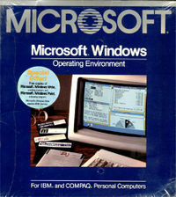
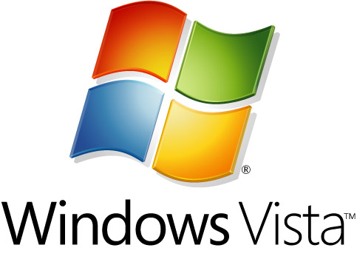

Slide 2

The first independent version of Microsoft Windows, version 1.0, released on November 20, 1985
called Interface Manager

Slide 3
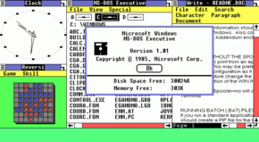
WINDOWS 1

Slide 4
Microsoft Windows version 2 came out on December 9, 1987
Excel and Word for Windows
Versions 2.0x uses the real-mode memory model, which confines it to a maximum of 1 megabyte of memory
Later, two new versions were released: Windows/286 2.1 and Windows/386

Slide 5
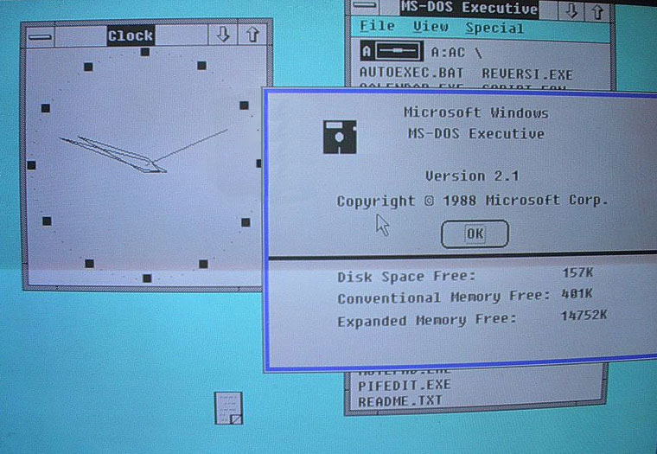
Version 2.0

Slide 6
Microsoft Windows scored a significant success with Windows 3.0, released in 1990
compatible with any Intel processor from the 8086/8088 up to 80286 and 80386.
"multimedia" version, Windows 3.0 with Multimedia Extensions 1.0, was released several months later

Slide 7
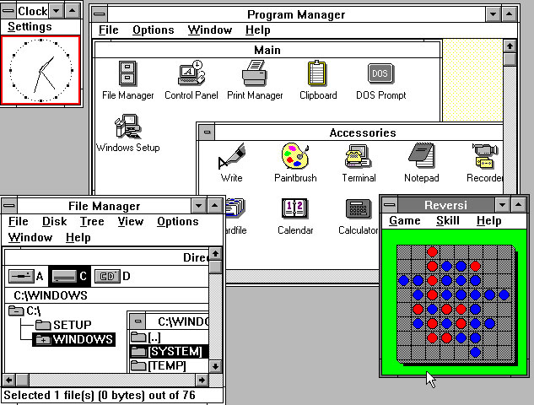
Version 3.0

Slide 8

OS/2 1.0, released in 1987, supported swapping and multitasking and allowed running of DOS executables
This agreement soon however fell apart, and the Microsoft/IBM relationship was terminated.
Microsoft changed the name of its (as yet unreleased) OS/2 3.0 to Windows NT

Slide 9
In response to the impending release of OS/2 2.0, Microsoft developed Windows 3.1,
Windows for Workgroups
July 1992 Windows NT and Windows 3.1's replacement (code-named Chicago), which would unify the two into one operating system

Slide 10

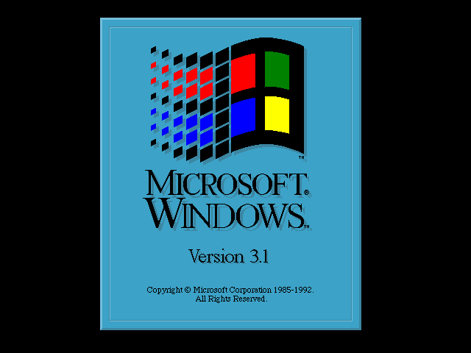
Logo 1992 to 2000

Slide 11
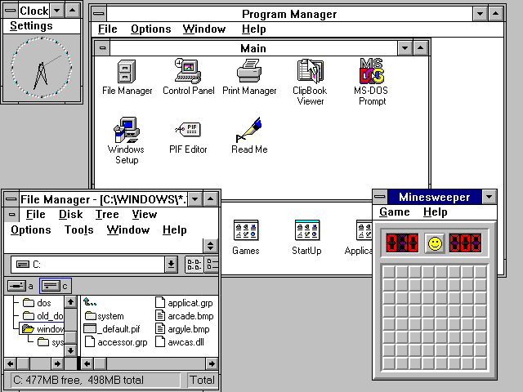
Windows 3.1 workspace

Slide 12
Microsoft marketing adopted Windows 95 as the product name for Chicago when it was released on August 24, 1995
Windows code to 32-bit
Plug and Play

Slide 13
Microsoft released five different versions of Windows 95:
Windows 95 - original release
Windows 95 A - included Windows 95 OSR1 slipstreamed into the installation.
Windows 95 B - (OSR2) included several major enhancements, Internet Explorer (IE) 3.0 and full FAT32 file system support.
Windows 95 B USB - (OSR2.1) included basic USB support.
Windows 95 C - (OSR2.5) included all the above features, plus IE 4.0. This was the last 95 version produced.

Slide 14
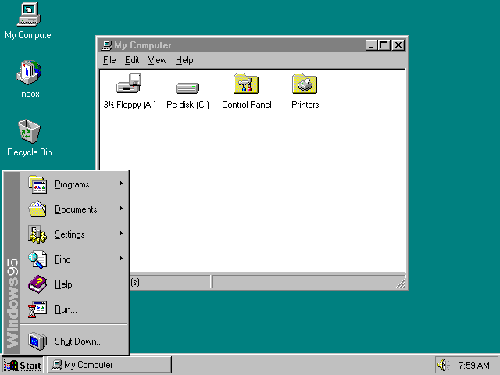



Slide 15
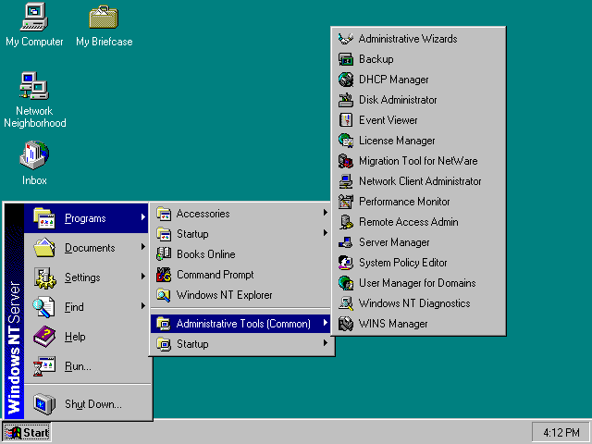
Microsoft released Windows NT 4.0 but it was quite buggy

Slide 16
On June 25, 1998, Microsoft released Windows 98
The USB support
In 1999, Microsoft released Windows 98 Second Edition
Internet Connection Sharing

Slide 17

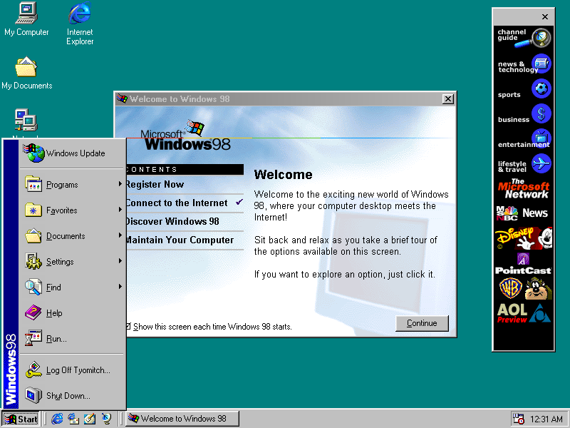

Slide 18
Microsoft released Windows 2000, known during its development cycle as Windows NT 5.0, in February 2000
Active Directory
Windows Server domain
Terminal Services
Windows Media Player
DirectX

Slide 19

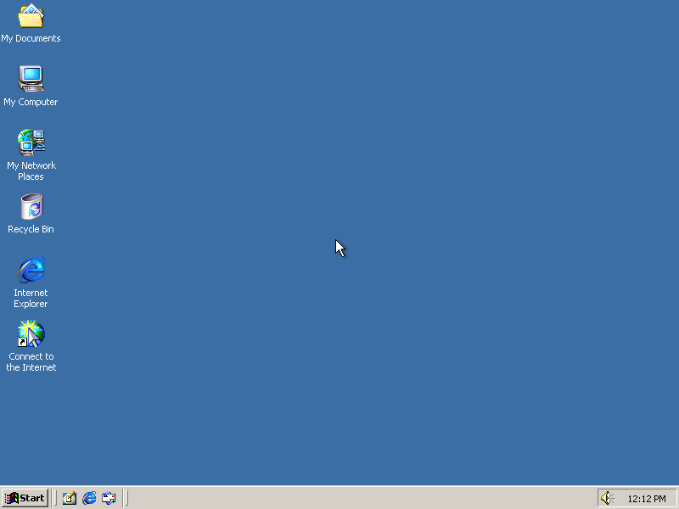

Slide 20
In September 2000, Microsoft introduced Windows Me (Millennium Edition), which upgraded Windows 98
Windows Movie Maker
Mistake Edition (Non Compatible DOS Commands)

Slide 21
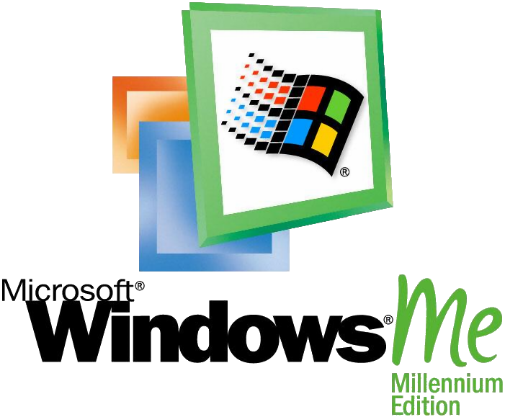
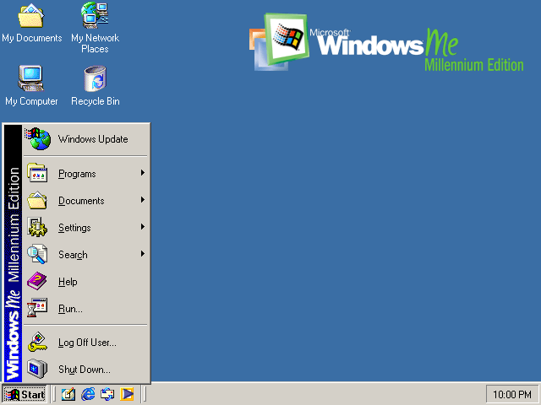

Slide 22
In 2001, Microsoft introduced Windows XP (codenamed "Whistler").
Windows XP Media Center Edition (MCE),
Windows XP Home Edition",
Windows XP Embedded,
Windows XP Tablet PC Edition 2005
Windows XP Professional x64 Edition,
Windows XP 64-bit Edition,

Slide 23
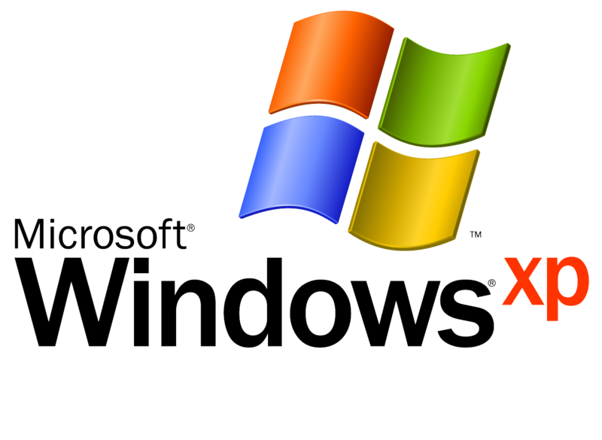
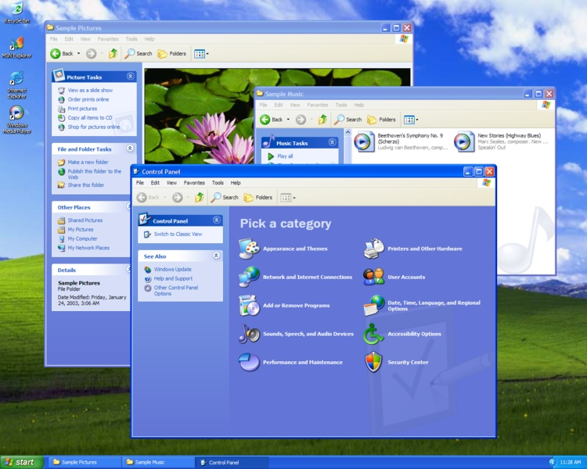

Slide 24
On April 24, 2003 Microsoft launched Windows Server 2003
Manage Your Server" wizard that simplifies configuring a machine
Windows Server 2003 is available in six editions:
Windows Home Server

Slide 25
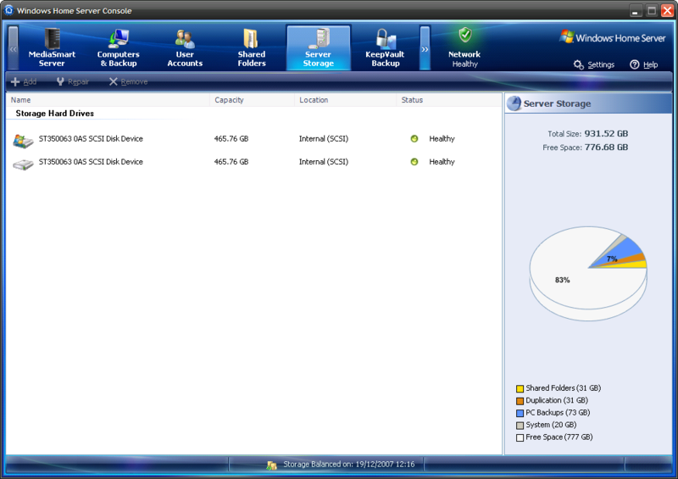
Home Server

Slide 26

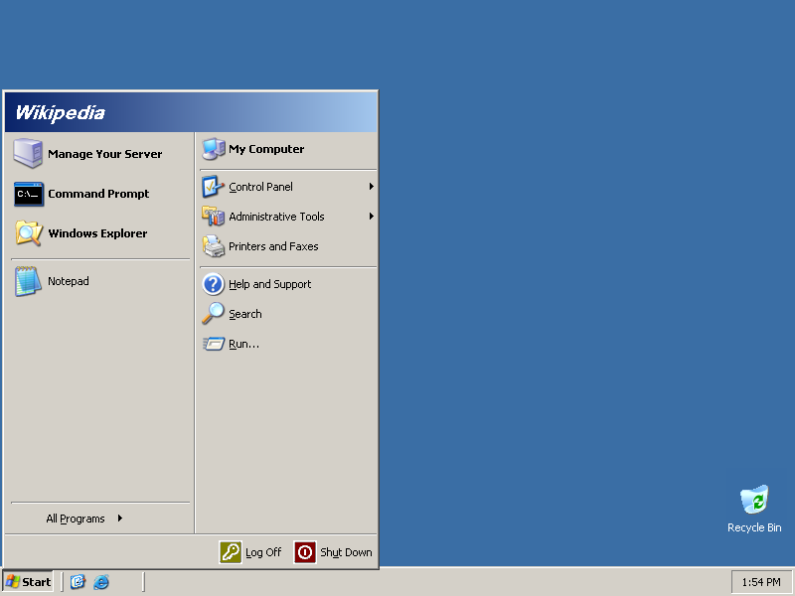

Slide 27
The current client version of Windows, Windows Vista (codenamed Longhorn) was released on November 30, 2006
User Account Control
Windows Aero GUI
new applications
EDITIONS:
Starter (only available in developing countries)
Home Basic
Home Premium
Business
Ultimate
Enterprise

Slide 28
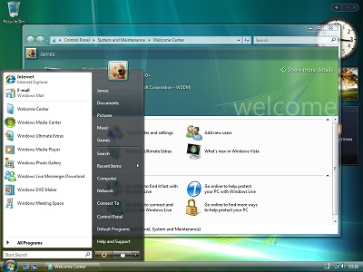

Slide 29
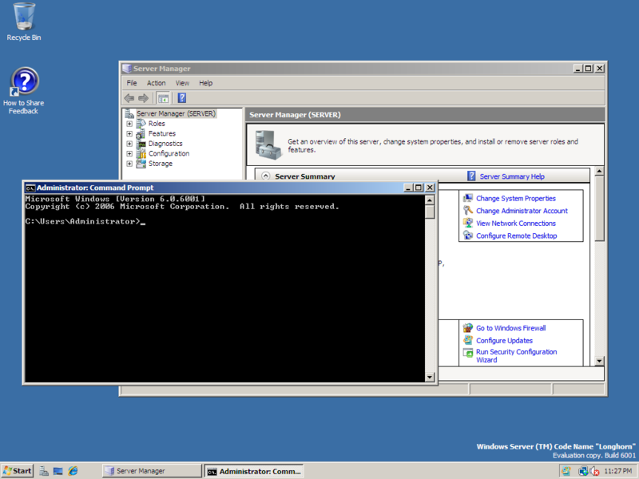
Windows Server 2008, released on February 27, 2008

Slide 30
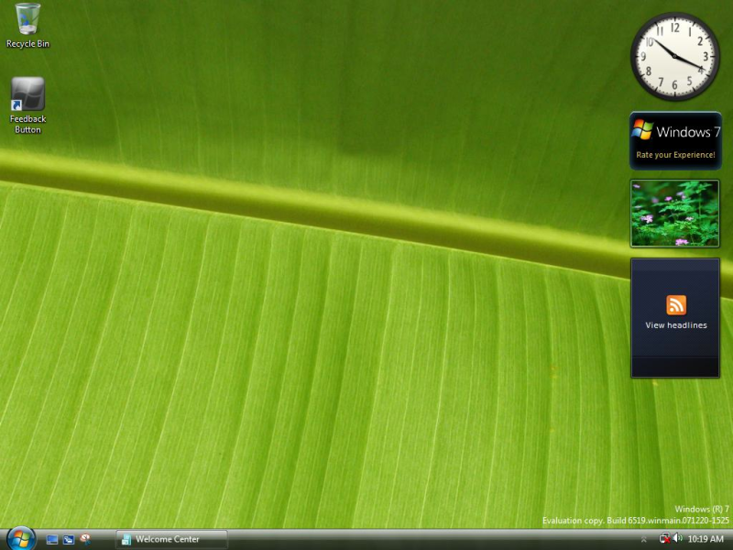
The next major release after Windows Vista is known internally as Windows 7

Slide 31
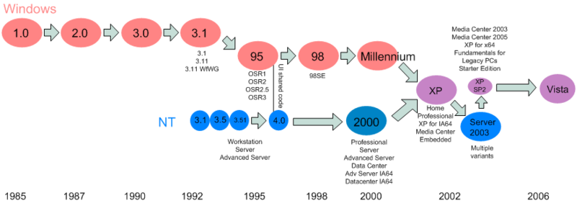
Windows Family Tree

Slide 32
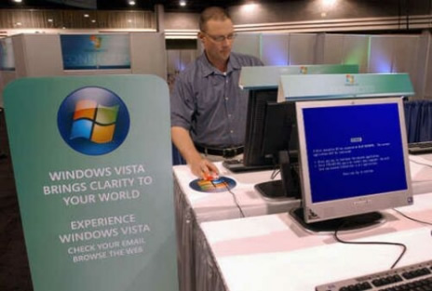

Slide 33
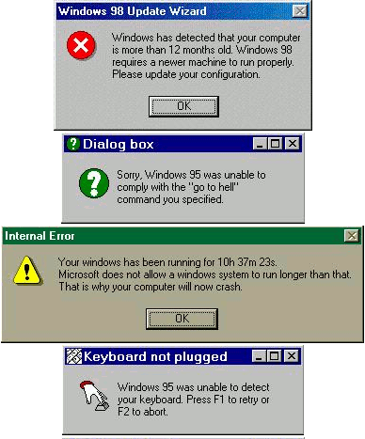

Slide 34
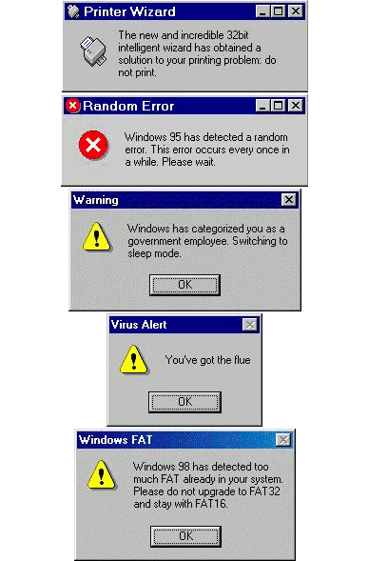

Slide 35

Windows VISTA MOVIE

