Slide 1
[My] Experiences building games in Visual Basic & Flash
Focus on 'cannonball'
Jeanine Meyer
Math Senior Seminar
Notes:
These are my own experiences. Others may have different results

Slide 2
Talk
Describe implementation of a game in Visual Basic and in Flash
  characteristics of games
  cannonball (basis for shoot-em up game)
  features of VB and Flash
  implementations
  compare and reflect

Slide 3
Characteristics of games
event driven / event based programming
  user action
  time
  situation/context
graphical user interface
  dynamic display
  interactions by player
calculation
  geometry
  logic
Notes:
Other computer applications have these, also. These features are growing in significance. There is still banking, but…banking application interface may still involve dynamically generated display. Some functions may be invoked by conditions.

Slide 4
Event-driven programming
contrasted with traditional, procedural programming
  a 'main' program, making calls to subroutines
  fixed flow of control
Event-driven programming has small[er] sections of code invoked in response to something happening
  for example, the 'system' detects an action on the part of the user or a condition detected by a sensor
  various time based events
Notes:
Event driven sometimes associated with object oriented. The main ideas of OO are packaging data with code
(terms are properties with methods). An event is signaled by a message sent by something, perhaps the system to the object. The message is the invocation of the method.

Slide 5
Graphical User Interface = GUI
user/player/client
enters text and also clicks on buttons, uses other input devices
views screen with assortment of graphics (images, text fields, sliders, drop-down lists, etc.)
perhaps also sound, animation…

Slide 6
Calculation in games
2D or 3D spatial relations
logical relations
schematic patterns
scoring
Note: this all applies to one-person games. Computer as player (tic tac toe, chess) means even more calculation!

Slide 7
Computer games
… are not easy applications to implement.
Other application domains are becoming more like games in order to serve user/client/system owners better
  event driven (system more responsive, easier to implement and maintain)
  graphical interface (appeal to users)
  (substantial) value-add calculations

Slide 8
proto-type game: cannonball
Fire cannon, at angle, speed
cannonball travels in parabolic arc
… hits ground or
… hits target
Notes:
not much of a game by itself, but could be the basis of many games.
Note: ballistics is study of projectile motion, that is, motion of objects such as cannonballs. Ballistics was
one of the first applications of computers.

Slide 9
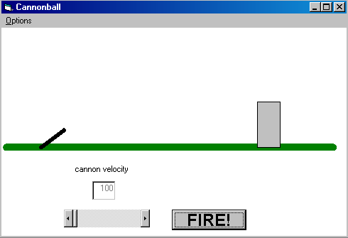
VB
Notes:
VB version: change angle by dragging tip of cannon. Change velocity two ways.

Slide 10
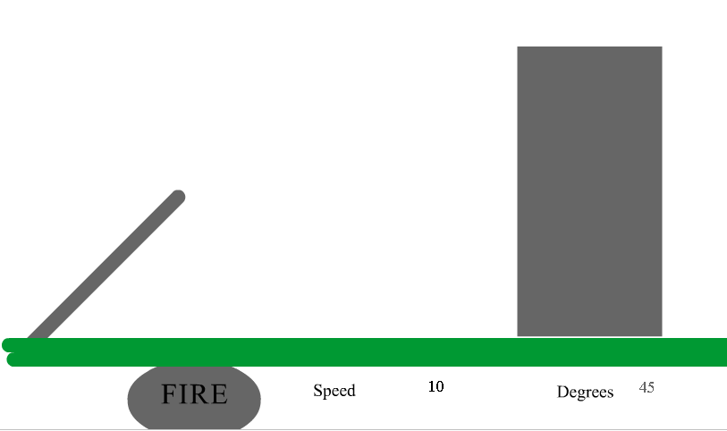
Flash
Notes:
Flash version. Dropped dragging cannon tip, because the initial implementation in VB allowed cannon
to change length.

Slide 11
Language constructs
VB project
  controls (e.g., textboxes, labels, shapes) on form
  events associated with controls
  internal variables
  user-defined procedures (and objects)
Flash movie
  content on stage /frame (time line of frames)
  events associated with buttons, clips, frames
  symbols
    movie clips
      movie clip in movie clips
    buttons
    graphics
  internal variables
  user-defined procedures and objects

Slide 12
Programming Interface
Both have GUI interface.
  You see representation of form/stage as you are designing it.
  Click/Double click element to do something with it.
Flash has Novice/Expert modes for programming
  Novice: fill in the blanks. At some point, more trouble than it is worth, but can help get started.

Slide 13
element | VB | Flash
cannon | line | movie clip
cannonball | shape | movie clip
target | shape | movie clip
ground | line | movie clip
FIRE button | button | button
speed | slider, text field | input text field
angle | (implicit) | input text field
sound | beep | Sound object
Notes:
Element is meant to be a neutral term here. I chose to change how the player would modify speed and angle.

Slide 14
What are the events?
????

Slide 15
Event list (initial)
Player hits FIRE button
incremental passage of time
ball 'hits' ground
ball 'hits' target
player does something indicating a change in speed
player does something to make a change in angle
player moves target
  may be composition of distinct events
Notes:
In VB implementation, changing the angle is implemented via mouse down, mouse move and mouse up.

Slide 16
Common to both
click on FIRE button sets up the motion
at each increment of time: calculate the new position of the ball
  check if ball hits the ground (though this could be different—see next
scope of variables, functions can be an issue.
Notes:
Similarities are greater than differences…though this is debatable.

Slide 17
Differences
Passage of time done by
  Timer event in VB
  Frame actions in Flash
Check to hit target
  calculation in Timer event procedure in VB implementation
  in on clipevent (enterframe) in Flash. Call to hitClip function
Dragging object
  combination MouseDown, MouseMove, MouseUp events in VB
  on clipevent(mouseDown),
  on clipevent(mouseUp) in Flash. Calls to startdrag and stopdrag

Slide 18
VB Private Sub cmdFire_Click()
Dim dblTheta As Double
Dim intV As Integer
formCannonball.Refresh
sngY1 = linCannon.Y1
sngY2 = linCannon.Y2
sngX1 = linCannon.X1
sngX2 = linCannon.X2
dblTheta = Atn(Abs(sngY2 - sngY1) / Abs(sngX2 -sngX1))
intV = Val(txtSpeed.Text)
sngVx = intV * Cos(dblTheta)
sngVy = intV * Sin(dblTheta)
sngTT = 0
shpBall.Top = sngY2 - ballrad
shpBall.Left = sngX2 - ballrad
shpBall.Visible = True
shpTarget.FillColor = &H80FF&
timFlight.Enabled = True
End Sub
What happens when player clicks FIRE button.
Notes:
Visual Basic: what happens when the player clicks the FIRE button (set up of flight)

Slide 19
Flash function firecannon() {
Called when player releases FIRE button
_root.oktofall = 0;
_root.okforsound = true;
_root.zap.setRGB(0x000000);
_root.target1._rotation = _root.origrotation;
_root.target1._y = _root.origy;
_root.inflight = true;
_root.cannon._rotation = - _root.anglein;
_root.ball._x = _root.cannon._x + _root.cannon._width - (.5* _root.ball._width);
_root.ball._y = _root.cannon._y - _root.cannon._height - (.5*_root.ball._height);
_root.angle = _root.anglein * Math.PI/180;
_root.ball._visible = true;
_root.hspeed = Math.cos(_root.angle)*_root.speed;
_root.vspeed1 = -Math.sin(_root.angle)*_root.speed;
_root.vspeed2 = _root.vspeed1;
_root.then = getTimer();
_root.gotoAndPlay("continue"); }
Notes:
Flash routine (set up to be called on(release) of the FIRE button.

Slide 20
VB Private Sub timFlight_Timer()
Dim sngXX As Integer, sngYY As Integer
sngXX = sngVx * sngTT + sngX2
sngYY = 0.5 * g * (sngTT * sngTT) - sngVy *sngTT +sngY2
If hittarget(sngXX, sngYY) Then
Beep
Beep
Beep
shpTarget.FillColor = &HFF&
timFlight.Enabled = False
shpBall.Visible = False
End If
If sngYY > sngGrass - ballrad Then
Beep
sngYY = sngGrass - ballrad
timFlight.Enabled = False
End If
shpBall.Top = sngYY - ballrad
shpBall.Left = sngXX - ballrad
sngTT = sngTT + deltat
End Sub
My function
Invoked at each interval of time, interval set at design time
Notes:
Built-in event that happens when the designated interval has passed.

Slide 21
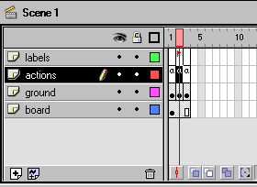
Flash interface: cursor at frame 2 labeled 'continue'
Notes:
This also indicates presence of 'content', that is, graphics. The ground layer holds the ground so that the target
will "sink" behind it.

Slide 22
Flash Frame action at frame 2, labeled 'continue
if (inflight) {
now = getTimer();
elapsed = 12*(now - then)/1000; //units of 12ths of a second
ball._x += hspeed * elapsed;
vspeed1 = vspeed2;
vspeed2 = vspeed1 + gravity* elapsed;
ball._y += elapsed * (vspeed1 + vspeed2)*.5;
if ((ball._y + ball._height) > ground._y) {
inflight = false;
ball._y = ground._y - ball._height;
}
then = now;
}

Slide 23
Flash Frame action at frame 3 (the frame after frame 2….)
if (inflight) {
gotoAndPlay("continue");}
else {
stop();
}

Slide 24
Flash Object actions associated with target instance: checking & acting on ball hitting target
onClipEvent (enterFrame) {
if (this.hitTest(_root.ball)) {
_root.zap.setRGB(0xFF0000);
_root.ball._visible = false;
_root.inflight = false;
if (_root.okforsound) {
_root.soundc.start(0, 1);
_root.okforsound = false; }
if (_root.oktofall<10) {
_root.oktofall += 1;
_root.target1._rotation += 1;
_root.target1._y += .3;
} } }
Notes:
There is more function here: the leaning of the target and a more complex sound.

Slide 25
VB implementation of dragging
Private Sub Form_MouseDown(Button As Integer, Shift As Integer, X As Single, Y As Single)
If closetocannon(X, Y) Then
blnCannonmove = True
Else
blnCannonmove = False
End If
If hittarget(X, Y) Then
blnTargetmove = True
sngDragx = X - shpTarget.Left
sngDragy = Y - shpTarget.Top
Else
blnTargetmove = False
End If
End Sub
Invoked whenever mouse button pressed down

Slide 26
VB Private Sub Form_MouseMove(BusngTTon As Integer, Shift As Integer, X As Single, Y As Single)
If blnTargetmove Then
shpTarget.Left = X - sngDragx
shpTarget.Top = Y - sngDragy
End If
If blnCannonmove Then
linCannon.X2 = X
linCannon.Y2 = Y
End If
End Sub
Private Sub Form_MouseUp(BusngTTon As Integer, Shift As Integer, X As Single, Y As Single)
blnCannonmove = False
blnTargetmove = False
formCannonball.Refresh
End Sub
Notes:
continuation of VB implementation of dragging…

Slide 27
Flash implementation of dragging
onClipEvent (mouseDown) {
if (this.hitTest(_root._xmouse, _root._ymouse)) {
this.startdrag(false);
}
}
onClipEvent(mouseUp) {
stopdrag();
}
Invoked whenever mouse button pressed down, during this movie
Stops all dragging
Notes:
The movie clip event here is the target

Slide 28
Summary
VB provides a more uniform interface to events.
Flash provides more built-in functions (evident even in this application, which did not have complex graphics or any standard animation).
Building games is fun and a great way to learn a programming system.
Notes:
my immediate opinion, based on 5 Flash projects done over break
In Flash, code is all over the place. You can manage this by systematic use of layers plus putting function
definitions in one place, but it is still the case that code gets invoked at several places.

Slide 29
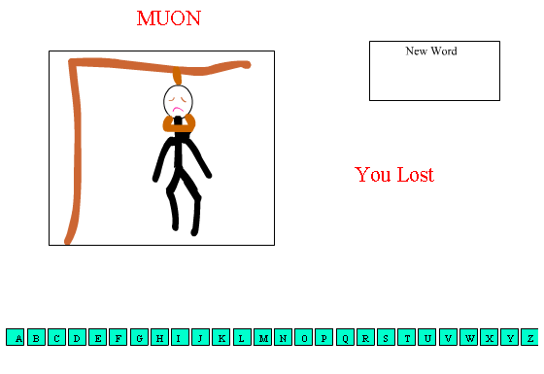
rachel.ns.purchase.edu/~Jeanine/flashlabs.html
rock paper scissors
craps *
bouncing ball *
cannonball *
hangman
memory (concentration) *
  turned out to be more complex: used empty movie clips to do pause; also used objects
* Tutorials

Slide 30
References
Programming Games with Visual Basic 6.0 by Catherine Muir Dwyer & Jeanine Meyer, Course Technology,
ISBN 0-619-03561-7
ActionScript: The Definitive Guide, by Colin Moock, O'Reilly,
ISBN 1-56592-852-0
Notes:
I learned Flash by 1) doing the tutorial that comes with Flash 5, 2) taking an on-line course at barnesandnobleuniversity (redundant with the tutorial) and reading the ActionScript book.

