Slide 1
Solving sudoku: work in progress
ADDITIONAL CHARTS ADDED AFTER SEMINAR
Jeanine Meyer
Purchase College/SUNY
Math/CS Senior Seminar

Slide 2
Outline
sudoku game
general comments on A.I.
Flash application to help player
  does not produce new games
Flash application to solve: in progress

Slide 3
sudoku game
originated in Japan
appears in many newspapers
  The Journal News
built on 'magic squares'
category of problem:
  produce result satisfying set of constraints
  more general problem is: produce a best result (maximize or minimize an objective function) given set of constraints
    For example, integer programming
    Mostly in class NP-complete
    many heuristic techniques available

Slide 4
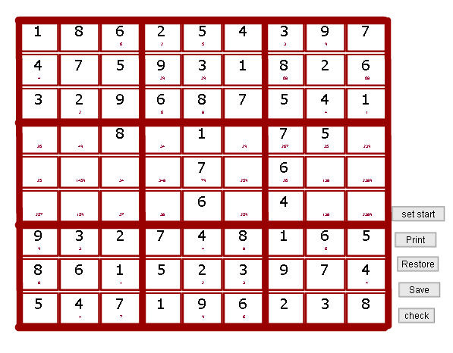

Slide 5
Artificial Intelligence
… applying computers to real-world, perhaps fairly open problems, including games
Chess International Master David Levy's challenge inspired much work in AI and all computing
  1968 bet no computer could beat him in 10 years. He won (played and beat various computer programs. There was at least one draw.)
  1989 Deep Thought beat Levy
  1997 Deep Blue beat the world champion (Gary Kasparov)

Slide 6
AI
The best computer algorithm may not be the human approach.
Chess history
Heuristic is term for methods that may advance the process
My approach to sudoku
  mixture
  may not be the best
  still working on it

Slide 7
Backtracking
General AI technique
Prune, as best as possible, the tree of possible choices/moves
Make a choice
Develop/extend this choice
If it leads to a problem
  backtrack: restore position before making choice
  remove this choice from 'tree'
Repeat

Slide 8
Does backtracking work?
Assuming bad choices are removed to stop being used again, yes!
  finite number of possible moves (though this number could be very large)
    unpopulated board in sudoku has 9 to the 81. How big is that????

Slide 9
Aside on chess
Chess is a game against an opponent, not a puzzle to solve!
Can still consider brute force (by computer program) versus human heuristics
  look of the board
Deep Blue chess program
  uses 'book' of openings (as do most expert chess players)
  middle game is mainly 'look ahead and count material'
  end game uses chess knowledge

Slide 10
How do I play
Examine board and see if there are any immediate fits
  only one number is possible in a position (only-possible spot)
  (more subtle) only one position is available for a particular number in a row, column or 3x3 (only-position)
  (much more subtle) A pair of numbers that are jointly possible in a pair of positions in a row, column or 3x3 must occupy those positions so nothing else is possible
  ????
Put in any such numbers and repeat
If no 'forced' move, guess (try to keep track of guesses), continue and backtrack
  difficult to do unaided.
  Some descriptions of 'beautiful sudoku' claim that guessing should not be required.

Slide 11
You?
Other methods

Slide 12
Notice
Staged implementation
Flash pushbuttons easy way to test out individual features
Modularization important
Aside: recent article in Wall Street Journal on Microsoft needing to bring more discipline to development (reference to need for Lego blocks of programs)

Slide 13
Programs
Much use of arrays
  arrays of arrays
  array of arrays of arrays
Some conversions between numbers 1 to 9 and strings "1", "2", …
stack for save and restore (push and pop)
okay so far coding

Slide 14
set = "";
for (cx=1;cx<=9;cx++){
set=set+cset[r][cx]; } // holds set nums
for (n=1;n<=9;n++) {
sn = String(n);
if (set.indexOf(sn)==-1) // n not set
{count = 0;
for (i=1;i<=9;i++) { //count if possible
if (cposs[r][i].indexOf(sn)>-1)
{fpos = i; count++; } }
if (count==1) { cset[r][fpos]=sn;
namec = "("+r+","+fpos+")";
_root[namec].cellvalue = sn;
cposs[r][fpos] = ""; }
} //ends n not assigned
} //ends looping through numbers n 1 to 9
Code for only-position check for any number n in row r.

Slide 15
Features of first program: helper
enter initial board
print option
check
save and
restore
  Stack (LIFO): last in/first out

Slide 16
Demonstrate helper
Use sudoku1 from source, otherwise use sudoku3
show code
http://newmedia.purchase.edu/~Jeanine/games/sudoku1.fla

Slide 17
Solver: sudoku1
(Done in Flash to build on first. Does use Flash input/output)
Compute possibles
Compute and set from only possibles
Compute and set from only position
Use buttons (can see small type)

Slide 18
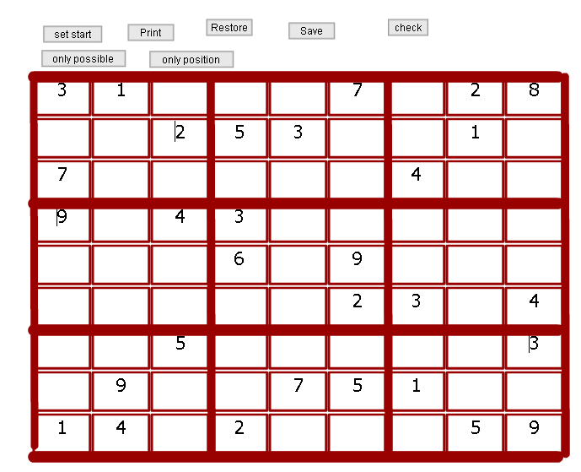
show suduko1 and suduko2

Slide 19
Solver sudoku2
(build on last)
try button keeps track of rounds
Each round
  computes possibles
  compute and set from only possible
  (re-) compute possibles
  compute and set from only position
  checks if done
http://newmedia.purchase.edu/~Jeanine/games/sudoku2.fla

Slide 20
solver: sudoku3
(build on others)
Add guessing
  keep track of badguesses
  guess bad if leads to bad check AND leads to a situation in which there are no more guesses
Add automatic save on guessing and restore on bad guess
Not fully tested…
http://newmedia.purchase.edu/~Jeanine/games/sudoku3.fla

Slide 21
demonstrate sudoku3
Comments
  save and restoring the badguess information is/was a challenge
    do the restore (including restoring badguesses array) and THEN
    if (guesses.length>0) {
    badguesses.push(guesses.pop()); }
  check for no guesses is/was a challenge..
  need a method to handle player guesses

Slide 22
Next
more testing!
add new heuristic??
add saving to file and restore
  facility for Flash to save XML file
add program that
  tries (doround) and keeps trying
  if no changes from trying, guesses
  repeat, checking for being done

Slide 23
Comments
newmedia.purchase.edu/~Jeanine
take link to Flash examples

Slide 24
New heuristics
If a pair of numbers occurs as possibles in just two positions in a row, column or 3x3, then those numbers will occupy those two positions and so all other possibilities must be removed
  A row (col) has a pair occupying two positions within a 3x3, say 12 and 12, then
    Remove 1 or 2 if it occurs in that row (col) outside the 3x3
    Remove the 1 or 2 outside the row(col) in that 3x3
  Calculation done on possibles, so must be followed by other heuristics that produce new settings!
The addition of this heuristic seems to improve success considerably.

Slide 25
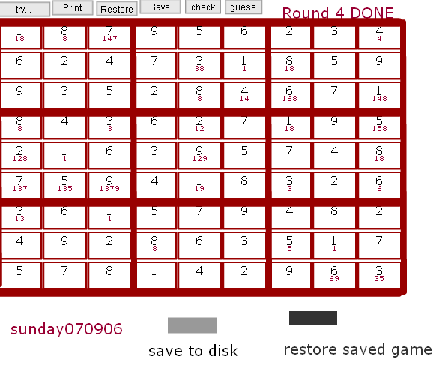
Demonstrate latest: solves this 5 star

Slide 26
Development technique
I added a button (labeled test) that calls a function that takes what has been written in the workspace area (little letters) and then calls… a new function to be tried.
I used this to test the new heuristics directly rather than work to create a sample game.
See the source code in sudoku.fla

Slide 27
Saving to local disk
To support development (and playing), added the following
Name and save a setting using Flash SharedObject

Slide 28
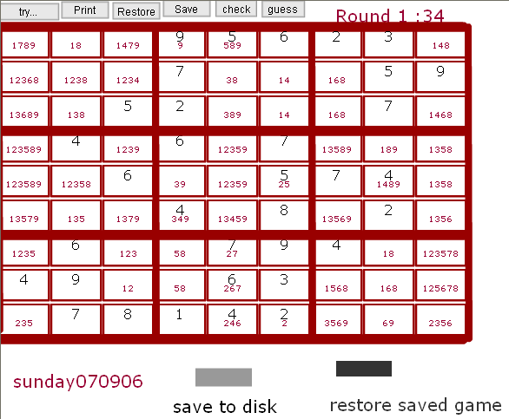
Count
Added the feature to indicate the number of filled cells, in order to see if progress made.

Slide 29
Conclusion…
Some difficulties may arise from desire to combine human/player system with automatic guessing (with backtracking)
The latest set of heuristics solves many puzzles very quickly.
The development task was motivation for several ‘working’ features
Process (working in stages, using buttons to test individual functions) is good model.

