Slide 1
New challenge: cellphones & PDAs
Show homework (majors)
2-phase xml/xsl
Nokia Mobile Toolkit, Openwave
WML, WMLScript, wbmp
XHTML-XP
Homework: download, install & use simulators
Notes:
We will confine ourselves to Nokia Mobile toolkit and Openwave. There are other simulators. If you have a WAP enabled phone, you can call other sites and report to class. rachel.ns.purchase.edu has been made WAP.

Slide 2
2 phase xml/xsl
Use xml file twice (xml file of books)
  produce list of all entries for specific child element (category: author, title, etc.). User then makes choice
  produce all book entries with a child of that name holding that choice (e.g., an author element is 'meyer')

Slide 3
<?xml version="1.0" ?>
<books>
<book>
<author>Agnew</author>
<author>Kellerman</author>
<author>Meyer</author>
<title>Multimedia in the Classroom </title>
<publisher>Allyn and Bacon</publisher>
<year>1996</year>
</book>
<book>…</book> …. </books>

Slide 4
books.xml
chooselists.html
preparelistfix4.xsl
display.js
html giving choices
displayitemsbycat.xsl
html showing books matching choice
Notes:
When the transformations get complex, learn to make and use diagrams!

Slide 5
2-phase
Demonstrate example on website
newmedia.purchase.edu/~Jeanine/interfaces/xmlstuff.html
Examine files
  in phase 1, xsl produces calls to a javascript function called displayitems taking 2 parameters, which leads to xsl transformation using 2 parameters
  in phase2, an <xsl:if> test involves complex condition using the 2 parameters

Slide 6
<xsl:when test="'author'=$whichcat">
<xsl:variable name="list" select="//author[not(.=preceding::author)]"/>
<xsl:for-each select="$list">
<xsl:element name="a">
<xsl:attribute name="href">
javascript:displayitems('<xsl:value-of select="$whichcat"/>','<xsl:value-of select="."/>');
</xsl:attribute>
<xsl:value-of select="."/>
</xsl:element>
<br/>
</xsl:for-each>
</xsl:when>
…
Notes:
In first transformation (preparelistsfix4): There are more <xsl:when> elements, for each type of child node, that is category/way of selecting books

Slide 7
<xsl:for-each select="//book">
<xsl:if test="(($whichcat='author') and author=$whichones)) or
(($whichcat='title') and (title=$whichones)) or
(($whichcat='publisher') and (publisher=$whichones)) or
(($whichcat='year') and (year=$whichones))"> <hr/>
<b><xsl:value-of select="title"/></b> by <br/>
<xsl:for-each select="author">
<xsl:value-of select="."/> <br/>
</xsl:for-each>
Published by <br/>
<xsl:value-of select="publisher"/> in <xsl:value-of select="year"/>
</xsl:if>
</xsl:for-each>
Notes:
In second transformation (displayitemsbycat)

Slide 8
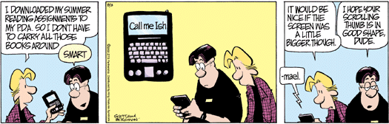
by Jerry Scott & Jim Borgman http://www.kingfeatures.com/features/comics/zits/about.htm
Notes:
FYI: this web site is 2 weeks behind. When I read the comic in the paper, I found it and made a note to myself to check in two weeks.

Slide 9
Reason to do ….
Challenge of very small screen & low bandwidth can help focus on what is important.
Emerging area of activity. Standards still evolving
  WAP: wireless application protocol. Speak of WAP enabled sites. Different protocols than http/tcp/ip.
  Older standard: Wireless Markup Language, with WML Script, wbmp: 2 color images
  Newer standard: XHTML-MP
Notes:
Exercise: any specific interface challenge helps you to better in all interfaces…

Slide 10
Nokia Mobile Internet Toolkit
editors to create & modify WML, WMLScript and wbmp files or XHTML-MP files
simulator to SHOW (run) files
manuals for WML, WMLScript, WAP, push, authentication, XHTML-MP
At Nokia site, there are ways to customize the simulator to different phones.
Notes:
We won't cover all these targets.

Slide 11
OpenWave
Use textpad or other editor to create file

Slide 12
XHTML-MP
good news: XHTML-MP is essentially (x)HTML. Not everything is supported
bad news: you can create inappropriately large documents for small screen browsers using XHTML-MP.
more bad news: requires server-side programming to do what Javascript or wmlscript do.

Slide 13
WML
wml scripts are analogous to the HTML files
  Deck of cards
  XHTML style
The application may use a wmls file. This holds the JavaScript code.
The application may make use of wbmp files. These hold [tiny] images.

Slide 14
Sample programs
You will need to copy all the files of an application to the D drive to run them.
  This is because the simulator creates a new file (called wmlc) and needs to place it somewhere.
To edit data already present in a field, you may need to click on control+(right arrow key over the 6)
  Mortgage program

Slide 15
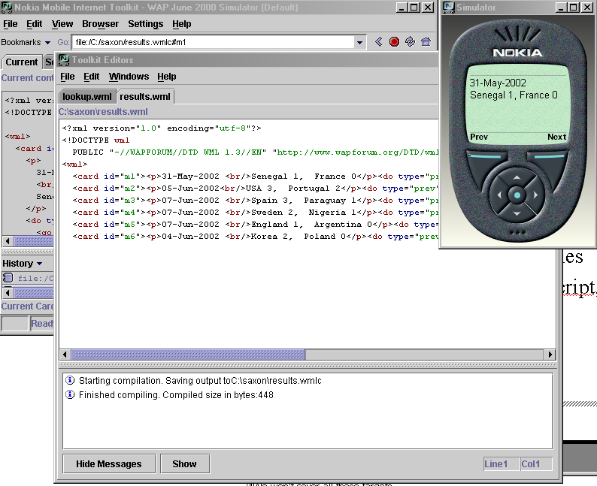
Notes:
Note: the results.wml file was produced using SAXON. We will get to this later.
Screen shots from 3.0. You will probably be downloading 3.1.

Slide 16
Nokia Mobile Internet Toolkit
OpenWave
demos

Slide 17
WML
WML documents are XML documents
  <?xml version="1.0" encoding="utf-8"?>
  <!DOCTYPE wml
  PUBLIC "-//WAPFORUM//DTD WML 1.3//EN" "http://www.wapforum.org/DTD/wml13.dtd">
  <wml>
  …
  </wml>
Notes:
The doctype is the public DTD noted here.

Slide 18
WML elements
WML documents are a deck of card elements.
  Note: the contents of a card can require more than one screen.
Card elements can have ids, titles, other attributes
<card id="result"title="Found!">
The id can be used in href attribute
<go href="#result" />
Also referenced from external WMLScript file.
Card elements can contain text, some formatting, images.
Notes:
This is XHTML and should be familiar.

Slide 19
Example: with labels and actions
<card id="m1">
<p>31-May-2002 <br/>Senegal 1, France 0</p>
<do type="prev" name="next" label="Next"><go href="#m2"/></do>
<do type="options" name="prev" label="Prev"><prev/></do>
</card>
Notes:
The type prev and type options determine where it goes on the simulator.

Slide 20
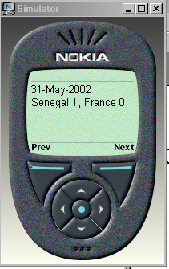
Notes:
Different phones will look different!

Slide 21
lookup example
<card id="start" title="Find office" newcontext="true">
<p>
Select, type in name, click on ok, click on options, select find
<input name="key" type="text"/>
<do type="accept" label="Find">
<go href="find.wmls#lookup('$(key)')"/>
</do>
</p>
</card>
Notes:
Note: the href is a call to a function named lookup, with a parameter key, in the file find.wmls.

Slide 22
<card id="result" title="Found!">
<p align="center">
<big><b>$(key) is in $(location).</b></big>
</p>
<do type="accept" label="Repeat?">
<go href="#start" />
</do>
<do type="home" label="Map" >
<go href="#map" />
</do>
</card>
values returned from script
Notes:
The id result will be cited in the wmlscript.

Slide 23
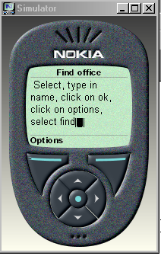
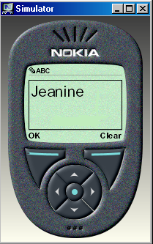
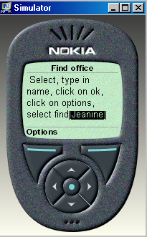
Click Options
Enter name & then click under OK

Slide 24
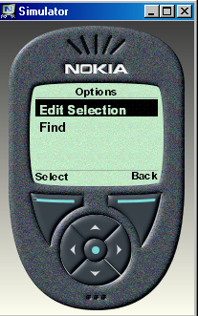
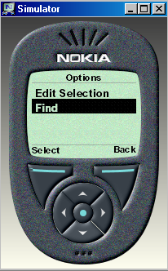
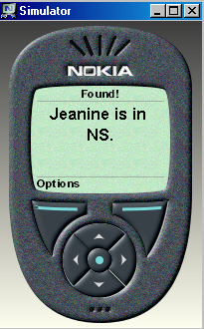
screens appear and are replaced
Click select
Click down arrow
Notes:
The WML code produced this from the code…

Slide 25
in case of duplicates
<card id="dup" title="More than one">
<p>
$(fullnames) <br/>
$(location)
</p>
<do type="accept" label="Repeat?">
<go href="#start" />
</do>
</card>
Notes:
Say you look up "Jon"

Slide 26
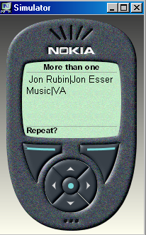
Notes:
You can improve this!

Slide 27
find.wmls
extern function lookup(key) {
var place;
var found;
var dups;
var fn;
fn = "";
dups = false;
place="";
found=false;

Slide 28
if (String.find("Jeanine Meyer",key)>=0) {
fn="Jeanine Meyer";
found = true;
place = "NS";
}
if (String.find("Jon Rubin",key)>=0) {
if (found) {
fn = fn+"|Jon Rubin";
place = place + "|Music";
dups = true;
}
else {
fn="Jon Rubin";
found = true;
place = "Music";
} }
Notes:
Very first check doesn't need to worry about duplicates….

Slide 29
if (String.find("Peter Ohring",key)>=0) {
if (found) {
fn = fn+"|Peter Ohring";
place = place + "|NS";
dups= true;
}
else {
fn="Peter Ohring";
found=true;
place="NS";
}
}
….
Notes:
Other faculty members….

Slide 30
if (dups) {
WMLBrowser.setVar("fullnames",fn);
WMLBrowser.setVar("location",place);
WMLBrowser.go("lookup.wml#dup");
}
else if (found) {
WMLBrowser.setVar("location",place);
WMLBrowser.go("lookup.wml#result");
}
else {
WMLBrowser.go("lookup.wml#nf");
}
}
Notes:
3 different return locations: dup, result, and nf. These are all id's of card elements.

Slide 31
Start of example
<?xml version="1.0" encoding="UTF-8"?>
<!DOCTYPE html PUBLIC "-//WAPFORUM//DTD XHTML Mobile 1.0//EN"
"http://www.wapforum.org/DTD/xhtml-mobile10.dtd">
<head>
<title>Origami</title>
<link rel="stylesheet" href="style.css" type="text/css"/>
</head>

Slide 32
<body>
<img src="bird.gif" alt="" width="60"/>
<br/>
<b><i>Origami models</i></b>
<br clear="all">
….
</body>
</html>

Slide 33
<table> <tr class="blue">
<td>1 <a accesskey="1" href="wiggler.xhtml">Wiggler</a></td> </tr>
<tr> <td>2 <a accesskey="2" class="bluetext" href="wbomb.xhtml">Water bomb</a></td> </tr>
<tr class="blue">
<td>3 <a accesskey="3" href="frogface.xhtml">Frog face</a></td> </tr>
<tr> <td>4 <a accesskey="4" class="bluetext" href="mbox.xhtml">Magazine cover box</a></td> </tr>
<tr class="blue">
<td><p mode="nowrap">5 <a accesskey="5" href="cup.xhtml">
Drinking cup</a></p></td> </tr> </table>

Slide 34
style.css
BODY { color:#006699; font-family: Arial, sans-serif; background-color:#FFFFFF}
TD { font-family: Arial, sans-serif}
.bluetext { color:#006699; }
.blue { color:#000000; background-color:#99CCFF;}

Slide 35
Work session & Homework
Go to forum.nokia.com
  try built-in examples
  make (small) modifications, save under new name, and try out!
Home/office: download & keep experimenting
  need to register
  download Nokia Mobile Internet Toolkit
  download OpenWave
  Experiment
Next class: graphics exercise

