Slide 1
Robotics
Overview of Issues & Concepts
Preview for Spring course
Jeanine Meyer
Mathematics/Computer Science Senior Seminar
September, 2006

Slide 2
Background
Worked at IBM Research in Automation Research
  General research
  Tools (hardware and software) for IBM’s own manufacturing
  [Potential] products
    Box frame robot: 7 degrees of freedom
    Software for outsourced robot: “2 and ½ dof + gripper
      used internally & on Apple’s MAC line
Manufacturing Systems
  Logistics, planning, design

Slide 3
What is a robot?

Slide 4
Robot
Term from Karol Capek’s play RUR (Rossum's Universal Robots), from Czech/Slavic term robota, forced laborer
Isaac Asimov, I, Robot series
Star Wars: R2D2 and CP30
Philip K. Dick, Do Androids Dream of Electric Sheep ( Bladerunner)

Slide 5
Definitions
programmable machine that does human-like work in the physical world
  actuators (including motors)
  sensors
Robot also applies (now) to programs that search the web (‘bots, spiders)

Slide 6
Academic home
Computer science
  Artificial Intelligence (Note: mixed blessing)
  Image recognition
  Computability
Engineering (electrical, mechanical, other)

Slide 7
Manufacturing
What is involved in … making stuff?
  Logistics
    Getting parts, sub-assemblies, materials to the right place to be incorporated / made into products
  Fabrication & construction
  Assembly
  Testing
  Packaging and delivery

Slide 8
Manufacturing (IBM)
Process (semiconductor) factories
  Fabricating chips, boards: chemical processes
  Push boundaries of physics to get smaller & smaller (Yield curve)
Box factories
  Assemble computers, disk drives, etc.
Software
  Publishing process (store on media) & package with printed material
Each involves automation (machines doing human-like work….)

Slide 9
Manufacturing Tradeoff
Think cars, configured computers
Build to stock
  Build certain number of products of given type
  Tends to be cheaper & quicker
  Problem: may be building unwanted product
Build to order
  Build product after it is ordered
  Tends to be less efficient, slower.

Slide 10
Role of robots
As opposed to ‘hard’ automation
More flexible, Data-driven automation, supporting ‘build to order’ or (at least) quicker changes in ‘build to stock’
More adaptible to different environments

Slide 11
Other uses of robots
Besides manufacturing
House work
Hospital (personal care)
Autonomous vehicles
  Space
???

Slide 12
Robot programming
Teleo-operator mode
  Bomb detection, nuclear plants, large-scale construction
  Humans ‘in the feedback loop’
Teach/playback (Tape-recorder) mode
  Painting, soldering
Programming with procedural (or iconic) programs, making use of sensors

Slide 13
Anthropomorphic
Fallacy
The best way for a robot/machine to do a job may not be the way a person or people do a job!
Think about sorting, chess, other….

Slide 14
Example
Consider how people once washed clothes
  River
  Stones
  Crude soaps
So,… think about building a robot to do this task…

Slide 15
Painting cars
Programming done by teach/playback
Effective because of fumes generated by painting and (new[er]) standards for what people can do.

Slide 16
Physical world
Programming must deal with
  Variability
  Continuous phenomena as opposed to discrete
  Dangers
  Interactions
  Time

Slide 17
And…
“We are all grand masters at …putting things on top of other things,….assembly, recognizing many patterns, etc.”
This makes the programming more difficult, not less.

Slide 18
Final comments on manufacturing
Unit of analysis issue: considering just one operation on manufacturing line may lead to ineffective improvements
  Orientation
Need to keep attention to
  Operations
  Logistics/inter- and intra- organization
  People skills
  other
Notes:
Study indicating the USA changed focus periodically.

Slide 19
Course
Lecture, seminar (student papers & presentations) on robots in manufacturing, etc.
Lab work using Lego Mindstorms NXT
  Improvements in semiconductors has led to
    [relatively] cheap motors and
    Touch, sound, light, ultrasonic sensors
    Bluetooth communications
  Iconic language
    conditionals, variables
    MyBlock (macro as opposed to function)
  Compilers for C or VB-like languages becoming available
    ???

Slide 20
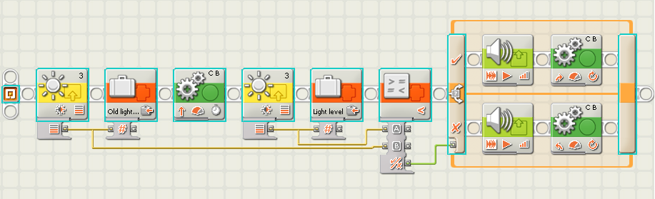
Example: light reading

Slide 21
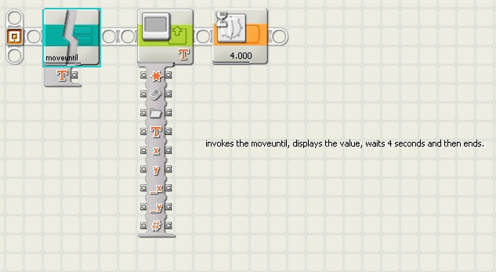
MyBlock~macro call

Slide 22
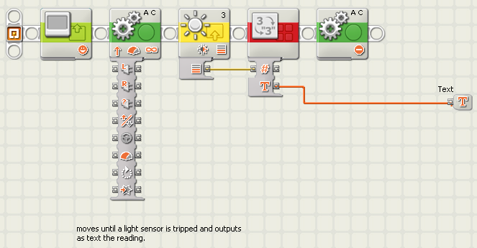
MyBlock definition

Slide 23
Sources
http://www.legoeducation.com
http://mindstorms.lego.com/
http://en.wikipedia.org/wiki/Lego_Mindstorms
Much, much more

Slide 24
Questions and comments?

