Slide 1
Sierpinski's Triangle using Flash
Background
Flash basics
Geometry problem [for you]
Strategy
newmedia.purchase.edu/~Jeanine/sierpinski.html

Slide 2
Background
Waclaw Sierpinski, 1982-1969
Set theory, number theory, topology
Researcher, teacher, editor
http://www-gap.dcs.st-and.ac.uk/~history/Mathematicians/Sierpinski.html
Many other on-line sources
Described triangle in 1916 (preceded definition of fractals)
Notes:
Suffered some during WWII. Many colleagues killed.

Slide 3
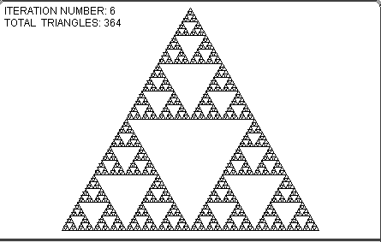
http://www.arcytech.org/java/fractals/sierpinski.shtml
Notes:
Note: the graphic is not 'self-similar'. If you make it bigger, you don't see more detail.

Slide 4
Construction
Cutting out holes in a triangle
Draw (equilaterial) triangle.
Draw new triangle connecting the midpoints of the side of the original triangle. Cut out this triangle.
Continue!
  For each remaining triangle, draw new triangle by connecting midpoints of sides of triangle.
Notes:
Think of making cut-outs.

Slide 5
Fractal
A fractal is the result of a mathematically calculated equation which can be transferred into an image to be shown, generally they are scale-symmetric (you can see a smaller copy of the original as you zoom in).
self-similarity: Any object that is self-similar in a non-trivial manner. An example of trivial self-similarity is a straight line: any line segment looks the same as the whole line when magnified.
A geometric figure or natural object that combines the following characteristics: a) its parts have the same form or structure as the whole, except that they are at a different scale and may be slightly deformed; b) its form is extremely irregular or fragmented, and remains so, whatever the scale of examination; c) it contains "distinct elements" whose scales are very varied and cover a large range.
divergent measure: Any shape that has the unusual property that when you measure its length, area, surface area or volume in discrete finite units (as in the box-counting method), the measured value increases without finite limit as the size of the discrete unit decreases to zero.
http://www.mrob.com/pub/muency/fractaldefinitionof.html
Notes:
Abstract definition involves formalization of measurement.

Slide 6
Exercise in Flash
Flash MX is a tool for producing graphical applications, including animations (and interactions)
Stage
Timeline
  Frames
    ActionScript
    Material on Stage
Symbols
Notes:
Practice in computing animation.

Slide 7
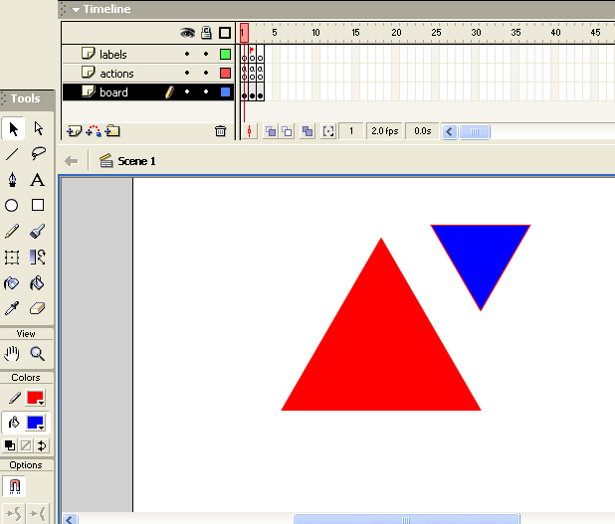
Notes:
Flash interface.

Slide 8
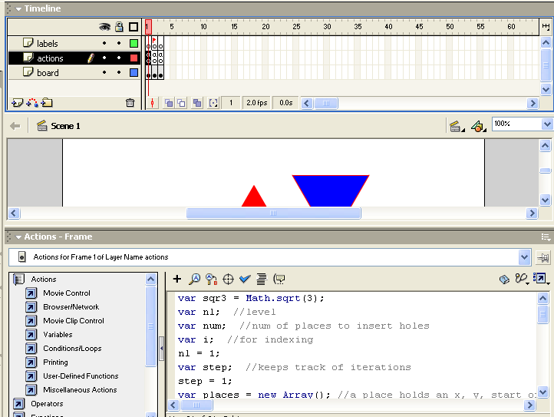
Notes:
Layers on timeline are to clarify distinct components. Here the board holds all graphics, the actions layer holds all code and the labels layer holds the single label for the 2nd frame.

Slide 9
Strategy
Create two symbols (movie clips) consisting of a red triangle and blue triangle, the blue triangle is named 'hole'.
At each iteration, for each triangle, generate copies of the hole of the appropriate size and positioned at the appropriate places.
Use an array (think of it as a list) to hold information on each hole to be made. Take off from the front of the array; add to the end of the array.
  Such a work list is a typical construct. This one is called FIFO (as opposed to LIFO).
Notes:
At each iteration, you place one hole for each triangle.

Slide 10
Flash features
Programmer defined objects
  Use this for what I call a place. A place will be where a next hole is. Includes naming information and also scaling information.
Array, shift (take from the start) and push (add to the end)
  Use for places
Frames for iteration, goToAndPlay, stop
  Continue for a set number of steps. Either goToAndPlay("loop") or stop()
Notes:
An object has properties. This is a way of naming the things I want to save.

Slide 11
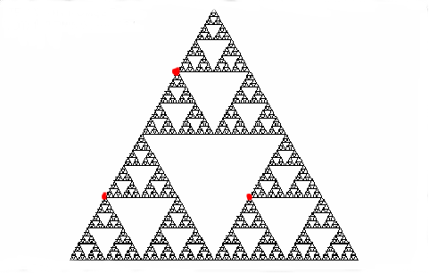
Prepare for next iteration
xp2,yp2
xp1,yp1
xp3, yp3
Need formula in terms of x and y of starred point?
Notes:
Need to compute xp1, yp1, etc. Note that yp1 and yp3 are the same.

Slide 12
Do the calculation
For first case:
  Sides of triangle are each 100. Height is 100 * square root of 3. Calculate coordinates of the 3 points.
Notes:
Do this for one case.

Slide 13
For calculation
Flash (and most other computer applications) have x increasing moving left to right and y increasing moving top to bottom.
Keep the square root of 3 in a variable (sqr3)
A variable called factor indicates the scaling.
Notes:
Will see the sign in the coding.

Slide 14
Flash features, continued
duplicateMovieClip is a method for movie clips.
  hole.duplicateMovieClip(nname, nl++);
Movie clips have x and y positions (origin is upper left corner of stage) and xscale and yscale
_root[nname]._x = xp;
_root[nname]._y = yp;
_root[nname]._xscale =
factor * _root[nname]._xscale;
_root[nname]._yscale =
factor * _root[nname]._yscale;
Notes:
The nl (number of levels) is continuously incremented so no two clips occupy same level.

Slide 15
Flash details
Add 3 place objects to places for each hole created.
Movie clips (all graphics) have a registration point, which is the point that is positioned.
  The original triangle has its registration point the middle of the left side.
  The hole has its registration point the left vertex.
Notes:
I can pick the registration point, so I do it to simplify my coding.

Slide 16
1st frame
var sqr3 = Math.sqrt(3);
var nl =1; //level
var num; //num of places to insert holes
var i; //for indexing
var step =1; //keeps track of iterations
var places = new Array();//x, y, name,factor
var place; var xp; var yp;
var xp1; var xp2; var xp3;
var yp1; var yp2; var yp3;
var nplace1; var nplace2; var nplace3;
var nname; var factor;
Notes:
Declare and initialize variables

Slide 17
First frame continued
function Makeplace(xp, yp,instancename,factor) {
this.xxp = xp;
this.yyp = yp;
this.iinstancename = instancename;
this.ffactor = factor;
}
// start off process: 1st hole to place
place = new Makeplace(200,200,"hole",1.0);
places.push(place);
Notes:
The Makeplace function is what is called a constructor for the programmer defined object called place.

Slide 18
2nd frame (labeled "loop")
num = places.length;
for (i=0; i<num; i++) {
place = places.shift();
xp = place.xxp;
yp = place.yyp;
factor = place.ffactor;
nname = place.iinstancename+i;
hole.duplicateMovieClip(nname,++nl);
_root[nname]._x = xp;
_root[nname]._y = yp;
_root[nname]._xscale = factor*_root[nname]._xscale;
_root[nname]._yscale = factor*_root[nname]._yscale;
Notes:
Create hole at this place, reposition, rescale…

Slide 19
xp1= xp - (25*factor);
xp2 = xp + (25*factor);
xp3 = xp + (75*factor);
yp1 = yp + (25*sqr3*factor);
yp2 = yp - (25*sqr3*factor);
yp3 = yp1;
nplace1 = new Makeplace ( xp1, yp1, nname, .5*factor);
nplace2 = new Makeplace ( xp2, yp2, nname, .5*factor);
nplace3 = new Makeplace ( xp3, yp3, nname, .5*factor);
places.push(nplace1);
places.push(nplace2);
places.push(nplace3);
}
Notes:
For this hole, set up the places for the holes for the next iteration.

Slide 20
3rd frame
if ((++step)>6) {
stop();
}
else {
goToAndPlay("loop");
}
Notes:
The 6 should probably be an input variable set by the player.

Slide 21
Discussion?
Flash is very well suited
  Objects
  Movie clips (to be duplicated)
  Arrays
  Mathematical functions
  Iteration using frames AND calculation
    Not 'cel animation'
  Much more is possible!
Flash source file is at
newmedia.purchase.edu/~Jeanine/sierpinski.fla
Notes:
Use as model to make other fractals.

