Slide 1
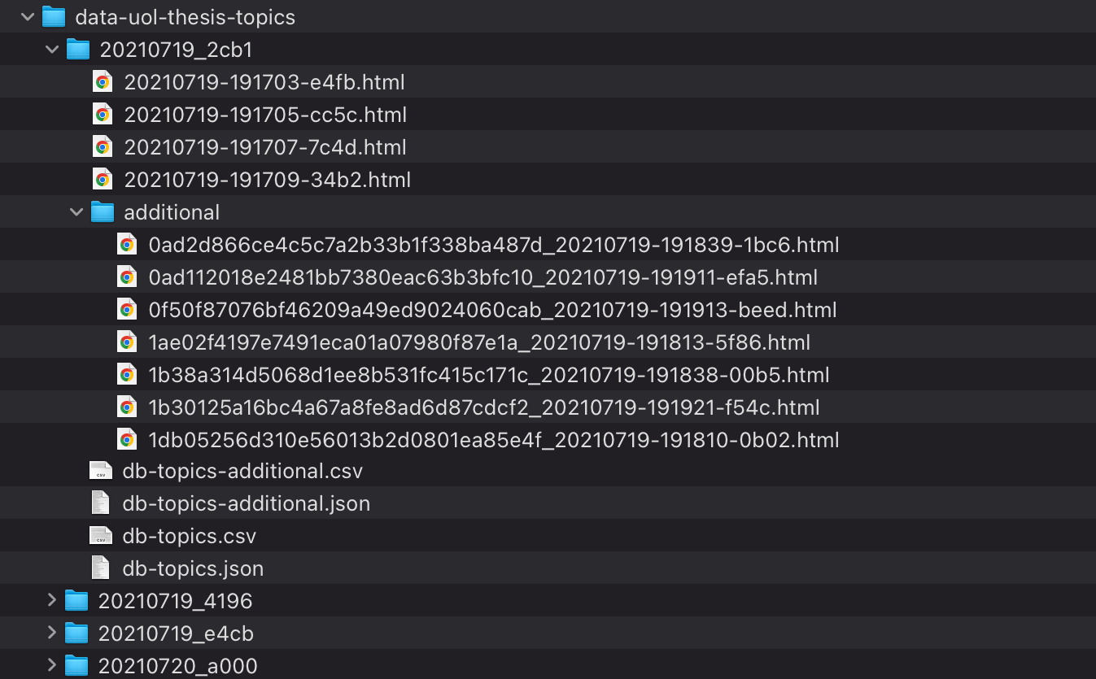
Data for the day, e.g. 2021-07-19
Thesis List page 1 (English)
Thesis List page 1 (German)
Thesis List page 2 (German)
Thesis List page n (German)
Additional data for each thesis topic (detail page)
Thesis Topic Details:
One file per topic
Thesis topic details in CSV/JSON
Thesis topics in CSV/JSON
Equal structure for all other days

