Slide 1
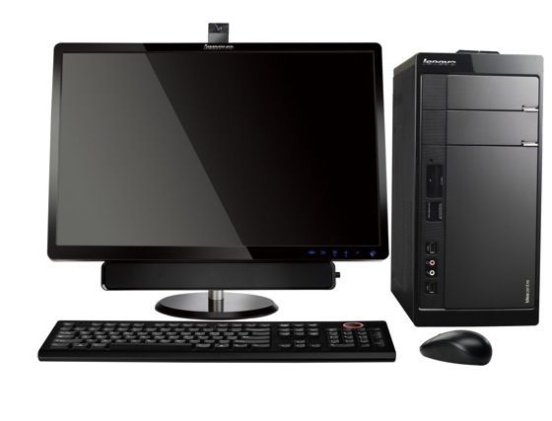
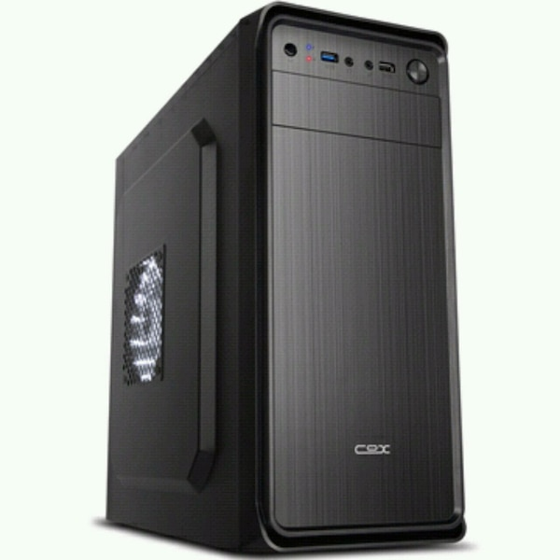
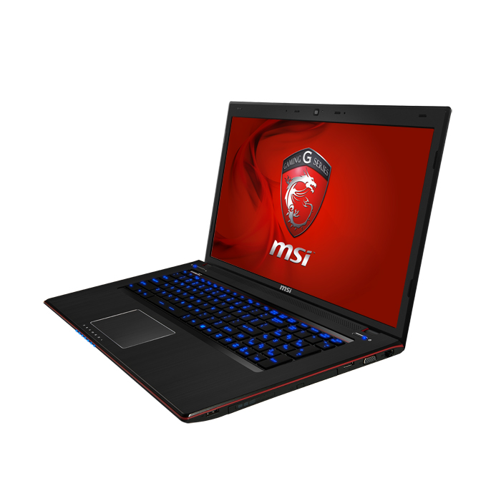
Reactive BackEnd Rest Service
MQTT
MQTT
MBM
IAM
PMS
CI / CD
Kubernetes

Slide 2
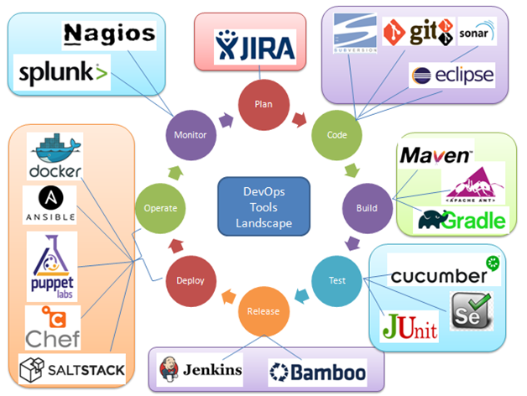

Reactive BackEnd Rest Service

