Slide 1
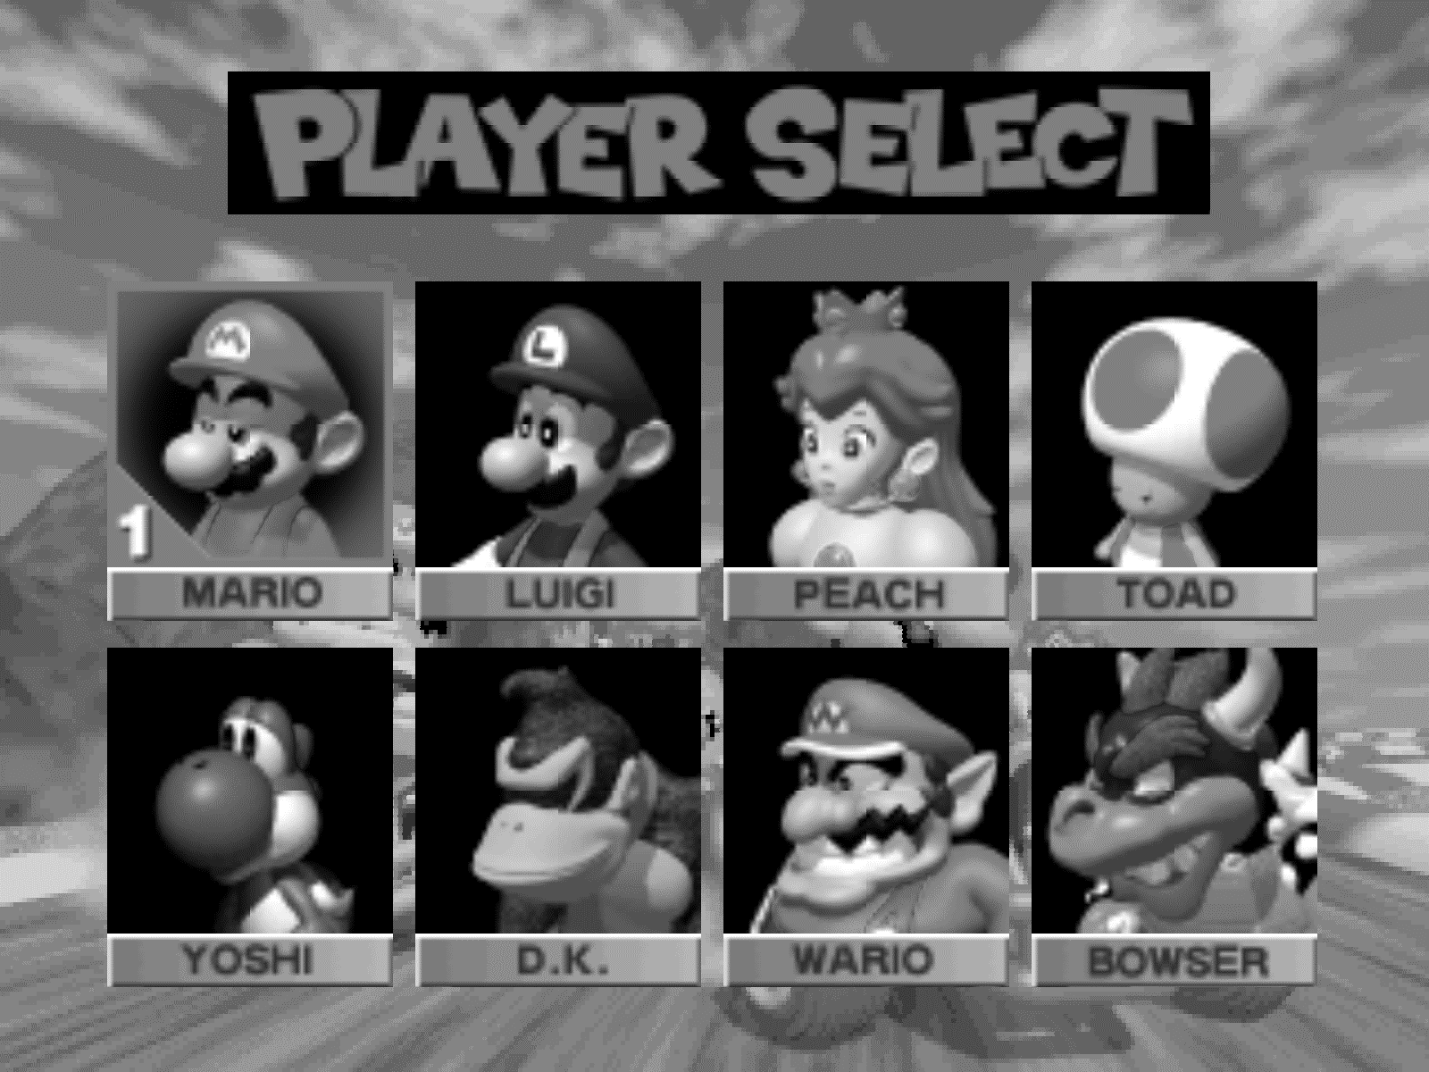
team_kart = {"Kate":"Bowser", "Alex":"Luigi", "Rebecca":"Wario","Torreydactyl":"Toad"} project_title = “supernatural scenes” project = {} #insert objectives project[“objective1”] = “” project[“objective2”] = “” project[“objective3”] = “” project[“objective4”] = “”
team_kart

