Slide 1
Texture Based Scene Change Detection

Slide 2
Features Used
Local Binary Pattern
Spatial co-relation feature
Absolute Sum Local Binary Pattern Histogram Difference

Slide 3
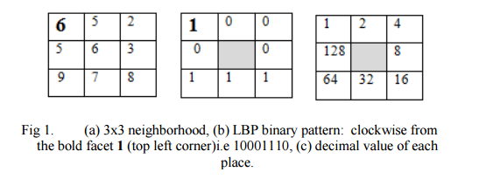
Local Binary Pattern

Slide 4
Spatial Correlation Feature
Spatial correlation of an image can be any feature which is calculated by moving a window over the pixel matrix
The spatial correlation feature of previous matrix is LBPF (xc, yc) = 1+16+32+64=113

Slide 5
Absolute Sum Local Binary Pattern Histogram Difference
This feature is calculated frame by frame
The absolute difference of ASLBPH between two frames is directly proportional to how much the two frames differ.
If the absolute difference crosses a particular threshold, then the frames are completely different.
Applying this logic to two consecutive frames we can detect whether the scene changed or not.

Slide 6
Algorithm
Step 1 : Convert the RGB color frames of the video into gray scale frames
Step 2 : Convert each gray level frame into LBP feature
frame.
Step 3 : Generate LBP feature histogram (LBPFH) from
the LBP feature frames of step2.
Step 4 : Evaluate the absolute sum LBPFH difference of
consecutive frames for all frames.
Step 5 : If for frame t, the difference is greater than set threshold then there is a cut at frame t.

Slide 7
