Slide 1
Project Idea
Selam Tesfamariam
EPPS 6323 – Knowledge Mining

Slide 2
Topic
Friday, March 25, 2021, Georgia Republicans implemented a bill into law to impose new voting restrictions following President Joe Biden’s victory state.
Many emotions around this “Voter Suppression Bill” as it seems to restrict a certain demographic and brings back voting restrictions that essentially is “reviving Georgia's dark past of racist voting laws.” (Stacy Abrams)
Restricts voting difficult for poor voters or those of color
Georgia Governor Brian Kemp states that this bill “expands access”
Many of the provisions of the bill are unpopular, but to hear the voices of the people, we can go to social media
Notes:
https://www.cnn.com/2021/03/25/politics/georgia-state-house-voting-bill-passage/index.html
https://www.washingtonpost.com/politics/2021/04/03/georgia-voting-law-explained/

Slide 3
Georgia voting law (sb 202)
It shrinks the window for voters to request mail ballots
The window to request absentee ballots is going from 6 month to 78 days
Counties and the state can send mail ballot applications only to voters who request them
New voter ID requirements
Voters who cast mail ballots will have to provide one of several forms of identification
A limit on the number of ballot drop boxes during early voting
Shortened early voting in runoff elections
State lawmakers get much more power over county and local elections
A ban on handing out food and water within 150 feet of a polling place
Notes:
https://www.washingtonpost.com/politics/2021/04/03/georgia-voting-law-explained/

Slide 4
Research Statement
Complete a sentiment analysis on the topic of this recent bill
Exploring the data will allow for answering the question of what the emotions are tied to the release of this bill
A more in dept analysis could answer, whether or not this bill will be implemented in other states. It has already been introduced and talked about in Texas as the Texas Republicans begin to pursue new voting restrictions

Slide 5
Method
Unsupervised Analysis to identify patterns found within this topic of tweets
Twitter Developer Account
Explore the hashtags
#STANDWITHPARK
#PROTECTTHEVOTE
#STOPVOTERSUPPRESSION
#KILLTHEBILL
#PROTECTBLACKWOMEN
Explore the Twitter pages of some representatives:
Governor Brian Kemp
Georgia State Representative Park Cannon
Visuals will be presented through appropriate graphs and word clouds

Slide 6
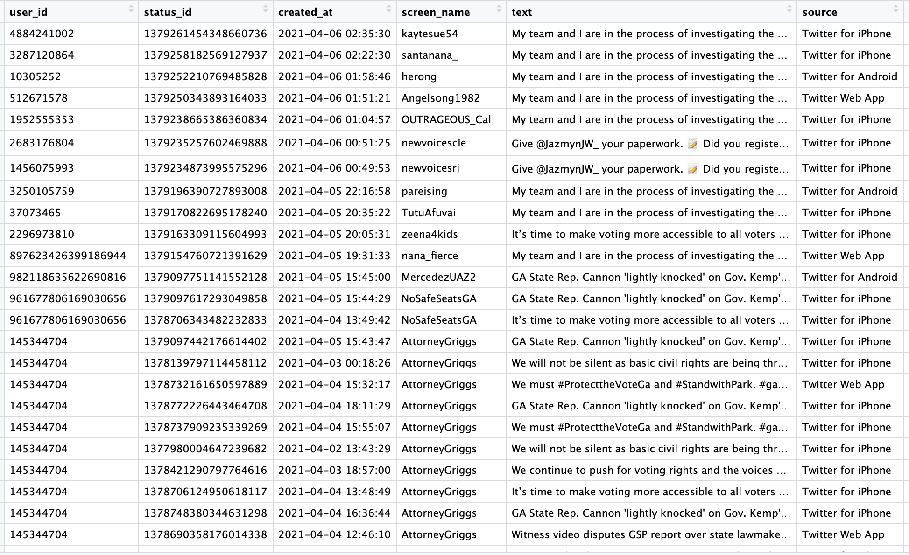
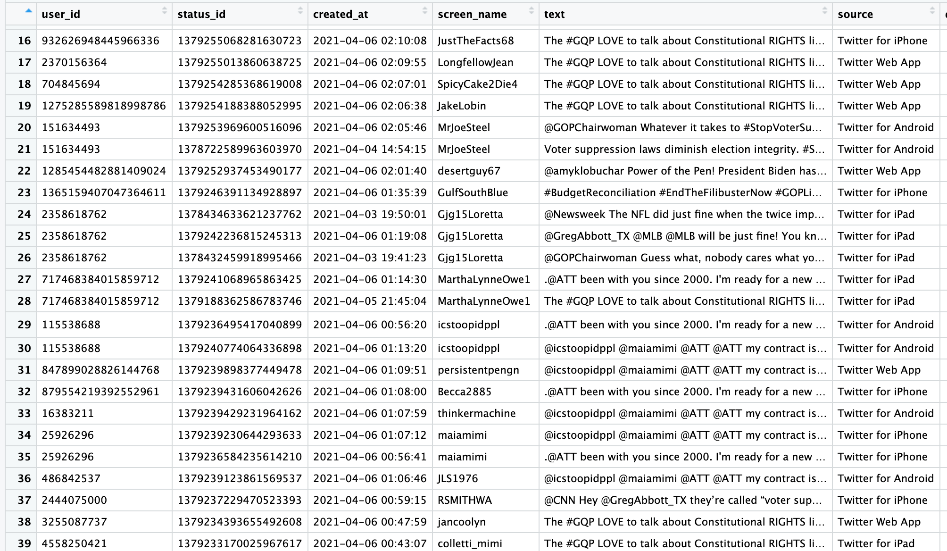
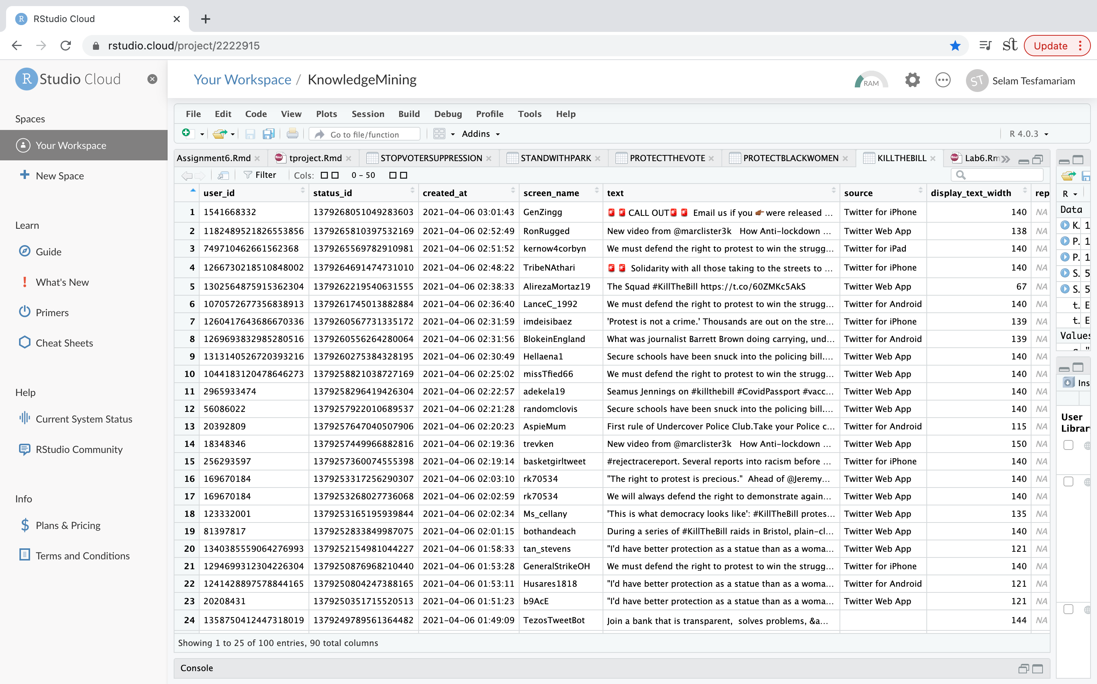
Data
User ID
Status ID
Created at
Screen name
Text
Source
Retweet Count
Favorite Count
Hashtag
URL

Slide 7
Refrences
https://www.washingtonpost.com/politics/2021/04/03/georgia-voting-law-explained/
https://www.cnn.com/2021/03/25/politics/georgia-state-house-voting-bill-passage/index.html
https://www.washingtonpost.com/politics/2021/04/03/georgia-voting-law-explained/

