Slide 1
Bitcoin Price Prediction
Price in next 30 days

Slide 2
Objective of this Project
The objective of this project is to predict the Crypto: Bitcoin with symbol BTC price for the next 30 days based on the historical data.
Below are the questions to be answered in this project.
Is Closing price and Market Cap for Bitcoin healthy?
What will be the price of Bitcoin in next 30 days?
Will there be a dip in Bitcoin price which will enable the investors to accumulate more Bitcoins?

Slide 3
Data Source & Methods used
The data source for this project is the csv files from Kaggle.
The data cleanup in the csv files are done using Python Pandas.
The Closing Price and Market Cap charts are plotted using the MatPlotLy.
The Bitcoin Price Prediction for the next 30 days is done using the Machine Learning - Linear Regression model.

Slide 4
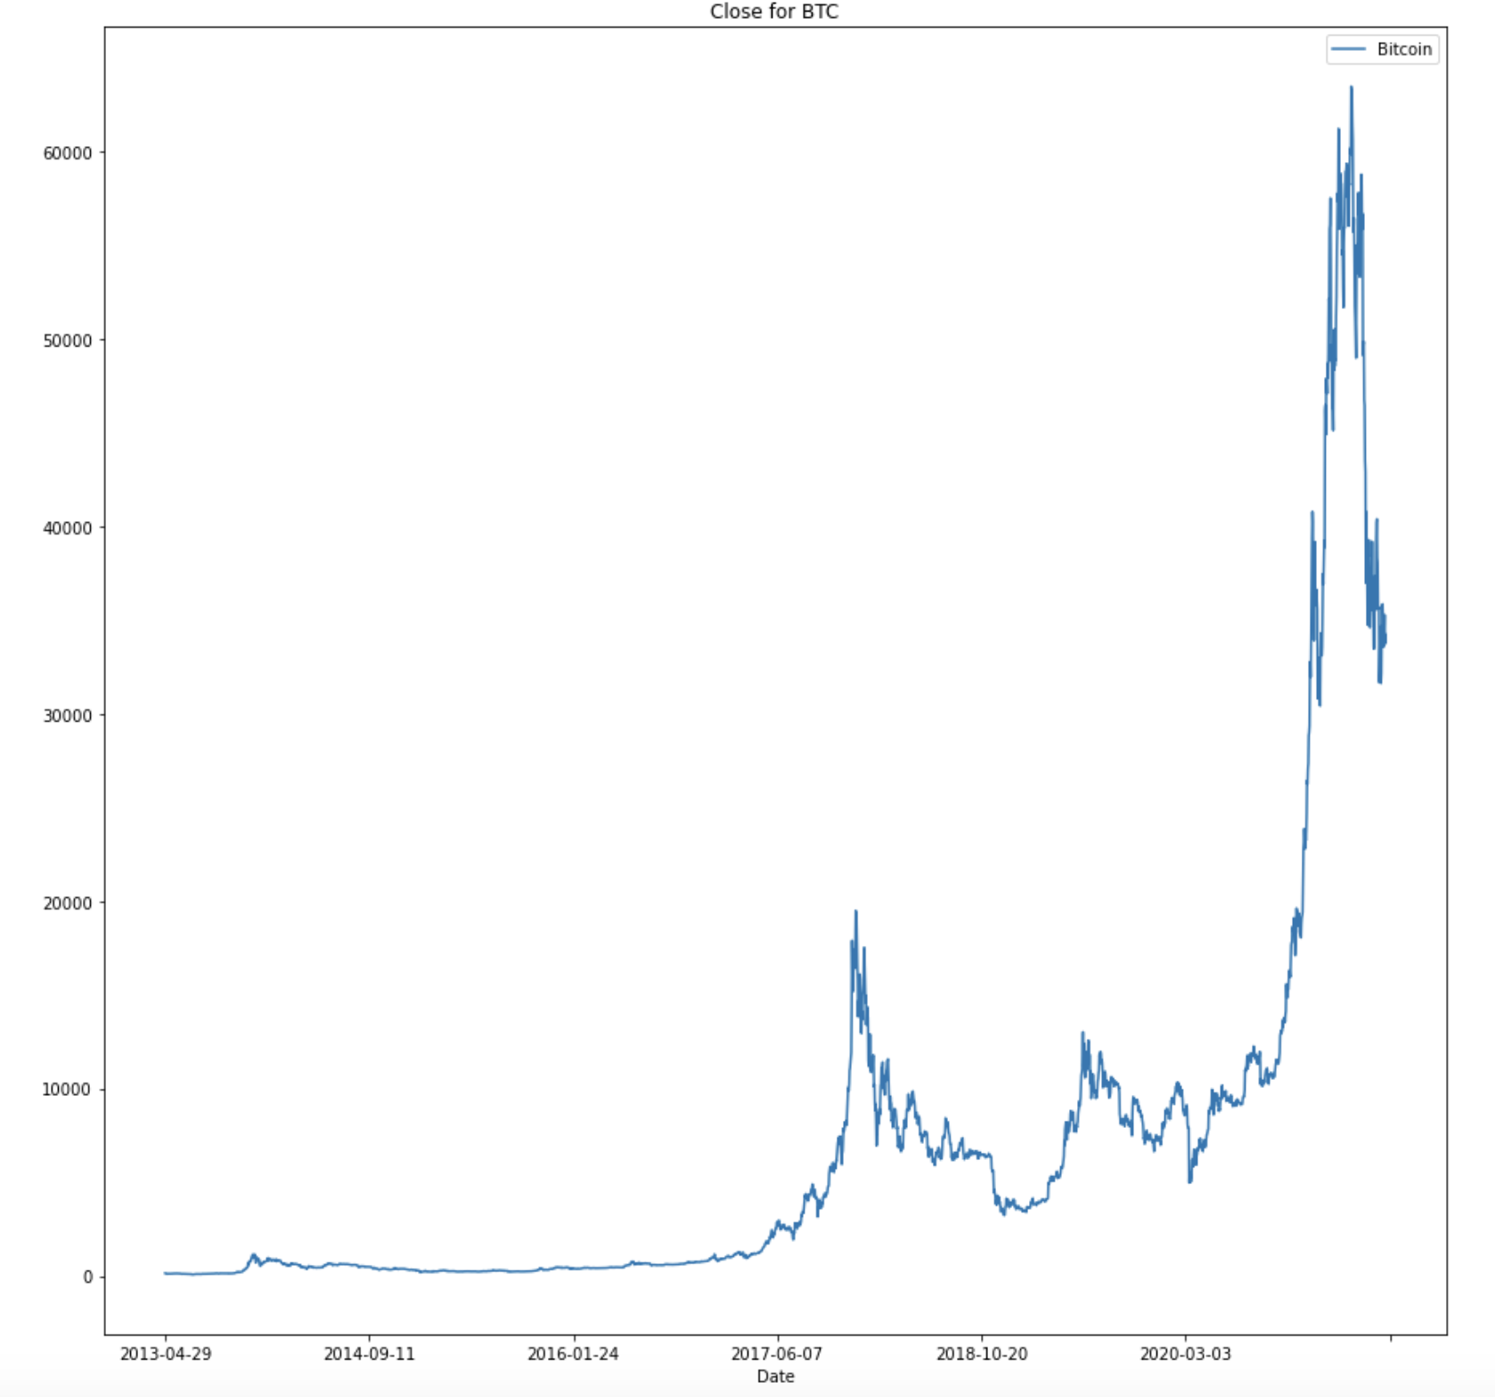
Results:
From the below chart, Closing price of Bitcoin reached more than $60000. However there is a huge drop in price from it's All Time High to just above $30000 within few days interval.

Slide 5
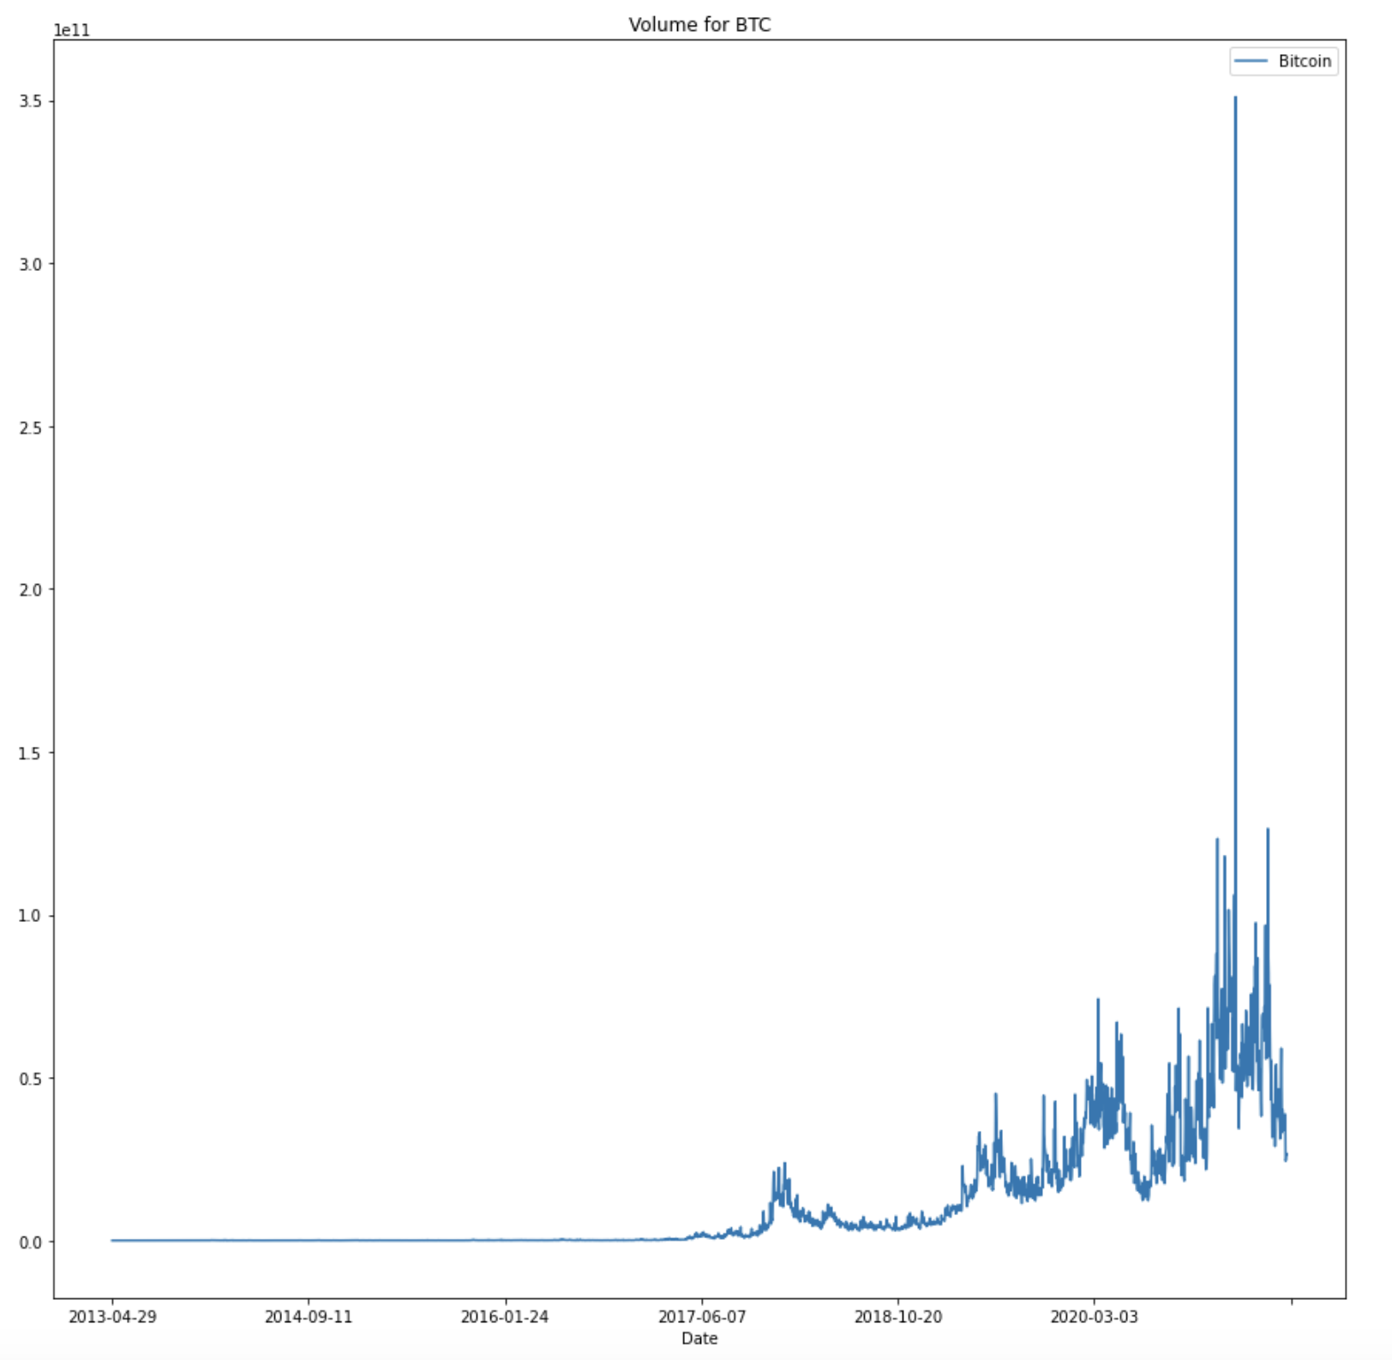
Results:
From the below chart, Market Cap of Bitcoin is healthy based on the graph below which indicates that the Bitcoin price will be bullish.

Slide 6
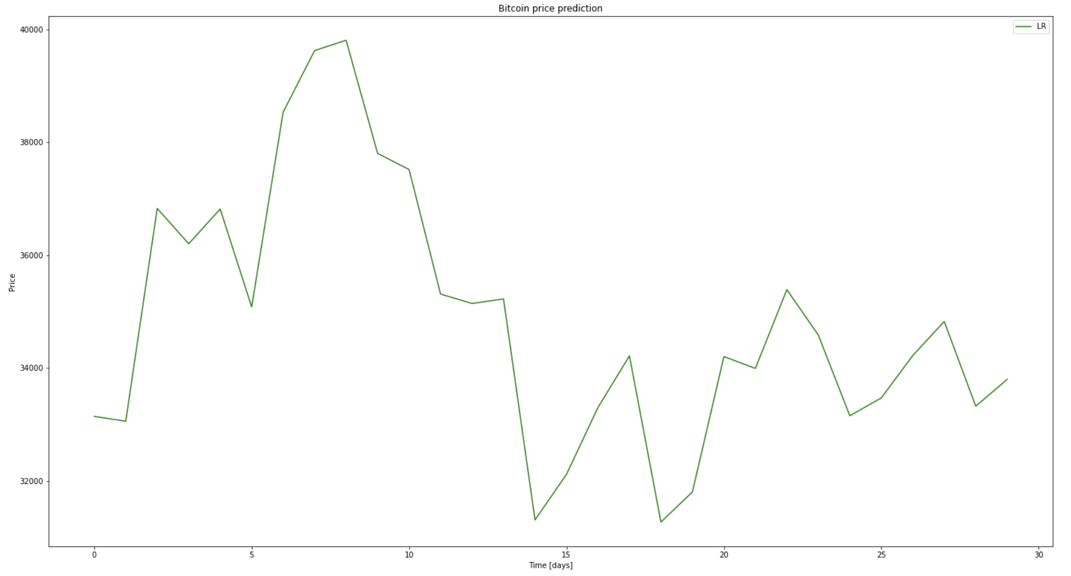
Results:
From the below chart, Bitcoin Price Prediction is very volatile for the next 30 days. Within the next 10 days the price is expected to reach around $40000 and then drop back to average of $35000. Bitcoin will be a good buy 2 weeks from now. Bitcoin price prediction is performed using Linear Regression model.

Slide 7



Cryptocurrencies
Overview
The main goal of this project is to show the graphical representation of historical cryptocurrencies data & top crypto’s future prediction for individual and Business growth/decisions.
Technologies used in this project:
Raw Data Source : csv Files
Database: Posgresql
Tools: Jupyter notebook, Pgadmin4, Tableau.
Languages: Python & sql
Library: Pandas

Slide 8
Design
23 CSV Files
Python Process to Concatenate all source files and store into DB
Database
posgresql
Tableau Dashboards
Bitcoin CSV Files
MLP to Predict next 30 days values for Bitcoin. & Python to store into DB
Source dataset has one csv file for each currency. Price history is available on a daily basis from April 28, 2013. This dataset has the historical price information of some of the top crypto currencies by market capitalization.

Slide 9

Data Mapping thru Python
S.No | DB Column Name
1 | S.No
2 | Name
3 | Symbol
4 | Date
5 | High
6 | Low
7 | Open
8 | Close
9 | Volume
10 | Marketcap
11 | Difference(High – low)
12 | Volatility_percent (Difference/close)*100
13 | Volatility (Low : <30%, Medium : 30-60%, High: >60%)
14 | Daily_Difference (Close – open)
S.No | CSV Column Name
1 | S.No
2 | Name
3 | Symbol
4 | Date
5 | High
6 | Low
7 | Open
8 | Close
9 | Volume
10 | Marketcap

Slide 10
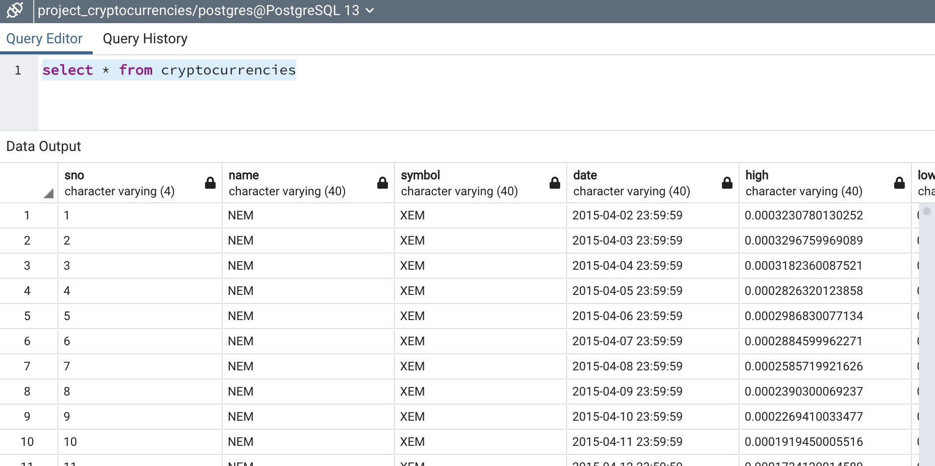
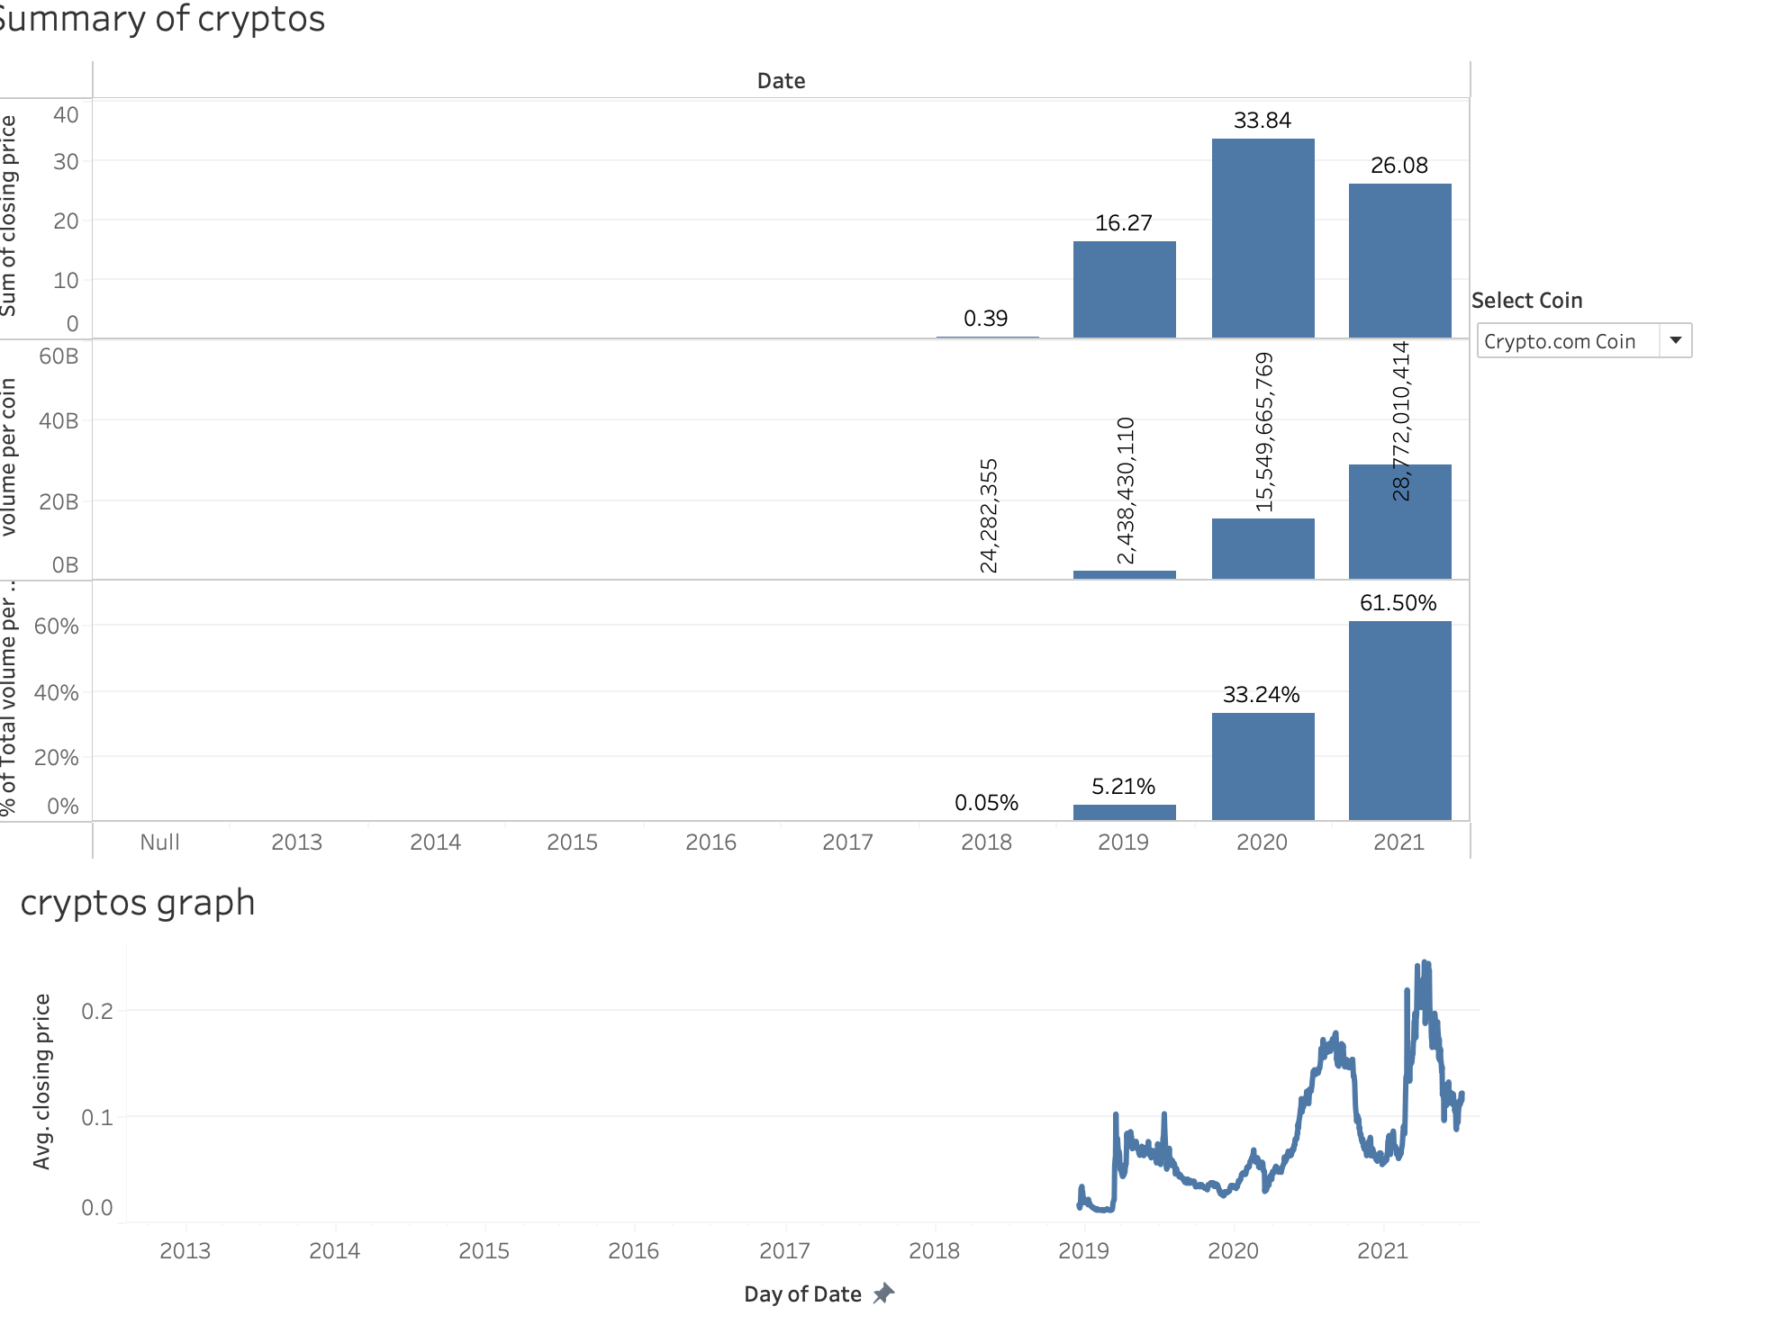
DEMO
Link to Dashboard :
https://public.tableau.com/app/profile/sowmya.vemulapalli4674/viz/Final_Project_Cryptocurrencies/Cryptocurrencies_Analysis?publish=yes
Screenshots –

Slide 11
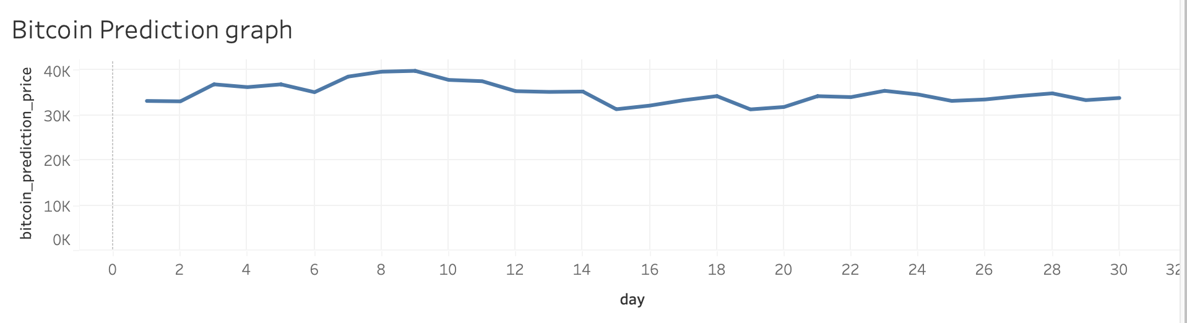
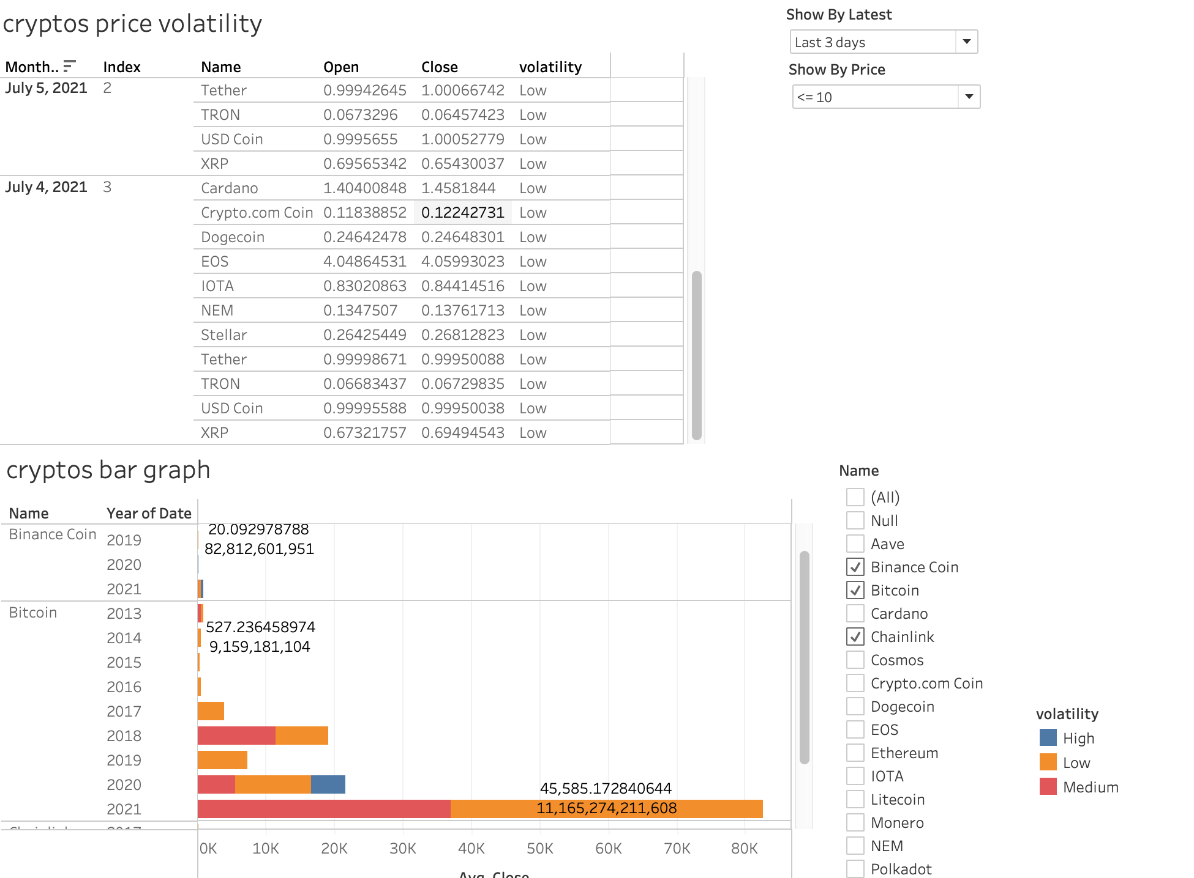
Crypto Price Volatility
Bitcoin Prediction Data

Slide 12
Future Enhancements –
Scheduling the source file reading process on daily basis & load it into DB
Make sure to have recent data till last an hour
3) Add More filters (ex – volatility) & visuals to Tableau UI
4) Future predictions for all coins
THANK YOU
Q&A

