Slide 1



Cryptocurrencies
Overview
The main goal of this project is to show the graphical representation of historical cryptocurrencies data & top crypto’s future prediction for individual and Business growth/decisions.
Technologies used in this project:
Raw Data Source : csv Files
Database: Posgresql
Tools: Jupyter notebook, Pgadmin4, Tableau.
Languages: Python & sql
Library: Pandas

Slide 2
Design
23 CSV Files
Python Process to Concatenate all source files and store into DB
Database
posgresql
Tableau Dashboards
Bitcoin CSV Files
MLP to Predict next 30 days values for Bitcoin. & Python to store into DB
Source dataset has one csv file for each currency. Price history is available on a daily basis from April 28, 2013. This dataset has the historical price information of some of the top crypto currencies by market capitalization.

Slide 3

Data Mapping thru Python
S.No | DB Column Name
1 | S.No
2 | Name
3 | Symbol
4 | Date
5 | High
6 | Low
7 | Open
8 | Close
9 | Volume
10 | Marketcap
11 | Difference(High – low)
12 | Volatility_percent (Difference/close)*100
13 | Volatility (Low : <30%, Medium : 30-60%, High: >60%)
14 | Daily_Difference (Close – open)
S.No | CSV Column Name
1 | S.No
2 | Name
3 | Symbol
4 | Date
5 | High
6 | Low
7 | Open
8 | Close
9 | Volume
10 | Marketcap

Slide 4
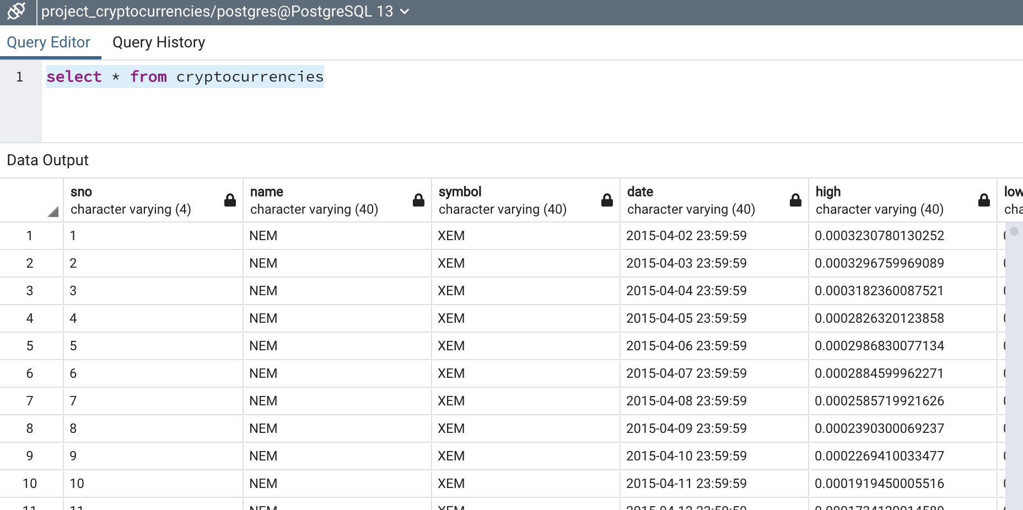
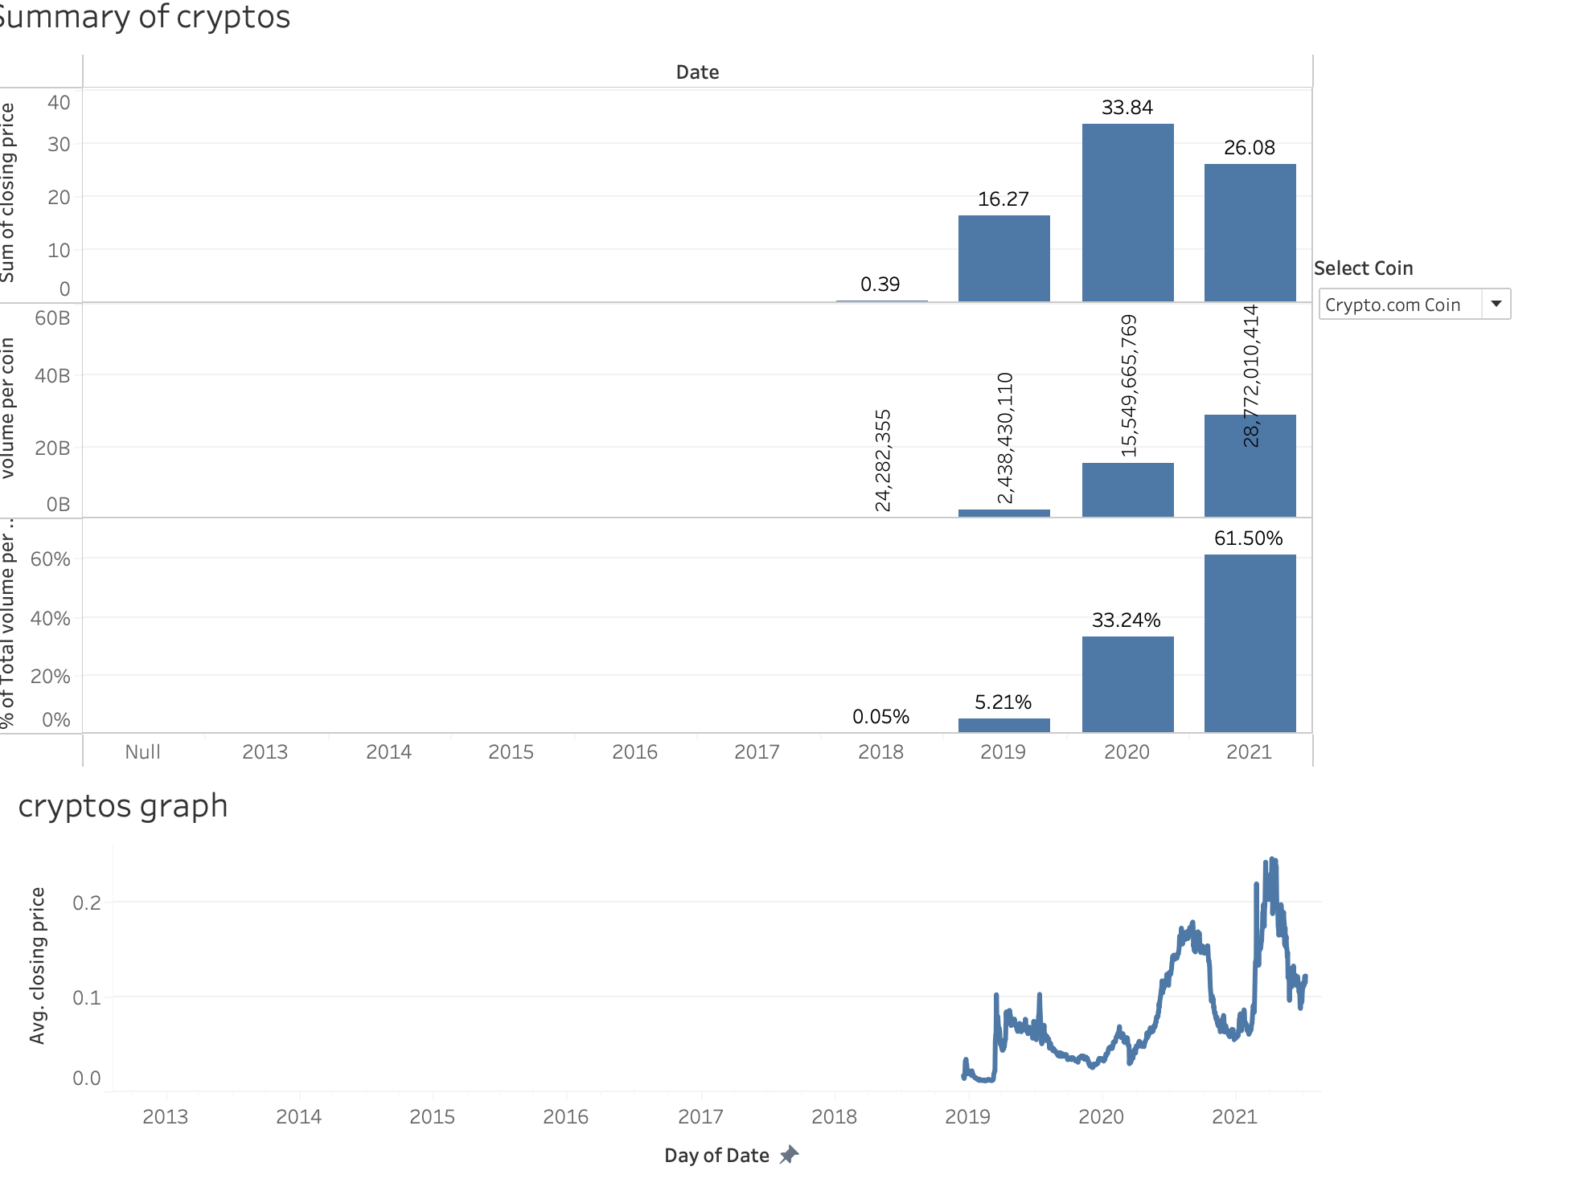
DEMO
Link to Dashboard :
https://public.tableau.com/app/profile/sowmya.vemulapalli4674/viz/Final_Project_Cryptocurrencies/Cryptocurrencies_Analysis?publish=yes
Screenshots –

Slide 5
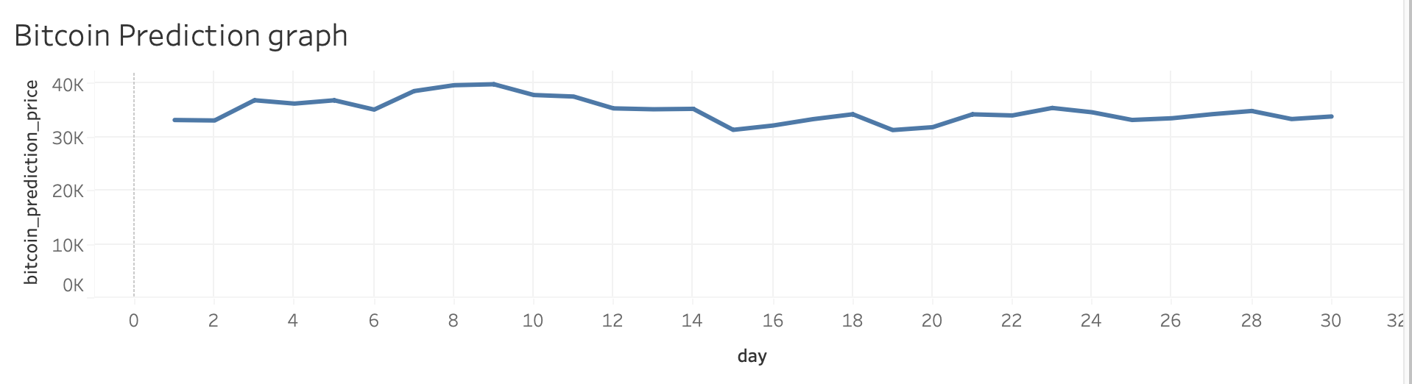
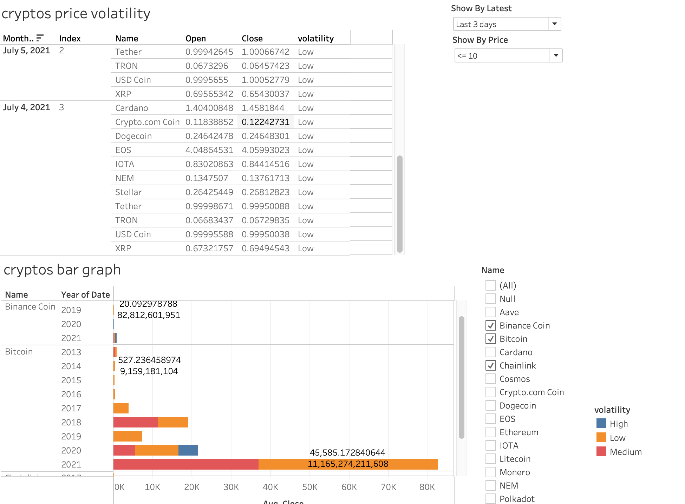
Crypto Price Volatility
Bitcoin Prediction Data

Slide 6
Future Enhancements –
Scheduling the source file reading process on daily basis & load it into DB
Make sure to have recent data till last an hour
3) Add More filters (ex – volatility) & visuals to Tableau UI
4) Future predictions for all coins
THANK YOU
Q&A

