Slide 1
ICAR–NIVEDI · GENOMIC SURVEILLANCE
G4-WATCH
Do G-quadruplex sites in livestock virus genomes behave differently
from the rest of the genome — and can that be used as an early warning?
How the pipeline works, and what it found across 11 pathogens and 6,485 genomes.
Research framework — not a validated diagnostic. No output here should drive a control decision on its own.

Slide 2
THE IDEA
A G-quadruplex is a structure, not just a sequence
▪ Four runs of guanine can fold the strand back on itself into a stacked four-stranded knot — a G-quadruplex, or G4.
▪ Where one forms, it physically obstructs the machinery that copies and reads the genome. Viruses that carry one are under pressure either to keep it or to lose it.
▪ That makes a G4 site a candidate place to watch: if a virus population starts losing or gaining structure at a known site, something about its biology is changing.
▪ The whole framework rests on one testable claim about that — stated on the next slide. It is stated as a claim precisely so it can fail.
WHAT THE PIPELINE STORES PER SITE
▪ Position on the reference genome
▪ G4Hunter score and predicted topology
▪ Gene feature and strand
▪ GC content of the flanking sequence
▪ Conservation across the phylogeny
▪ A structural-confidence tier
Together these are the G4 Reference Atlas. It is fixed before any
statistical test runs, so the loci cannot be chosen after seeing the answer.
Atlas schema: data/atlases/G4_Reference_Atlas_v*.tsv
2

Slide 3
THE CLAIM UNDER TEST
D.H1 — a directional hypothesis
G4 loci are disrupted LESS often than matched control regions of the same genome —
and that difference survives adjustment for GC content.
Three things have to be true at once, and each is a separate way to fail:
1 · A real difference
2 · In the right direction
3 · Not just GC
The locus disruption rate must differ from its matched controls by more than chance, after Benjamini–Hochberg correction across every locus tested.
Lower, not merely different. A locus that is significantly MORE disrupted contradicts D.H1 — it does not support it.
G4 sites are G-rich by definition, and GC-rich DNA mutates differently. The difference must survive GC adjustment or it is a composition artefact.
Each locus therefore returns one of six verdicts, not a yes/no: SUPPORTED, NOT_SUPPORTED, SIGNAL_OPPOSITE_DIRECTION,
SIGNAL_EXPLAINED_BY_GC, INSUFFICIENT_DATA, or UNDERPOWERED. The distinction between the last two and "no effect" is the point.
Implemented in g4watch/validation/dh1_gate.py; every verdict is written to an append-only ledger
3

Slide 4
HOW IT WORKS
Seven stages, in a fixed order
0 · Atlas
1 · QC + align
1.5 · Recombination
2 · Phylogeny
3 · Variants
4 · Metrics
predict G4 loci
on the reference
drop incomplete,
undated genomes
PHI test —
mandatory
ML tree,
time-scaled root
call against
the reference
per-locus disruption,
GC control gate
GATE · D.H1 must return SUPPORTED, and the config must set operational_mode: true
Both conditions, checked in code against a persisted ledger — editing the workflow cannot open the gate.
5 · Scoring
6 · Reporting
G4-EWS score, CUSUM / EWMA control limits, detection
report card, gate status, provenance — ALWAYS runs
Stage 1.5 has no skip flag. Reconstructing ancestral states across a recombinant alignment reconstructs a history that never happened, so the screen is
mandatory for every pathogen. Stage 6 runs whatever the gate says: a blocked run still produces a report explaining what blocked it.
Orchestrated with Nextflow DSL2. Tools: MAFFT · PhiPack · IQ-TREE 2 · TreeTime
4

Slide 5
BEFORE ANY TEST RUNS
A minimum-data floor, fixed in advance
A statistic computed on four sequences is not a weak result — it is not a result. Every locus is checked against these
thresholds first, and a locus that fails them returns INSUFFICIENT_DATA rather than a number nobody should read.
30
20
3
90%
3
sequences in the
analysis window
sequences in every
lineage
distinct sampling
timepoints
metadata
completeness
informative clades
per group
Why this is a threshold and not a list of exclusions
Writing down which lineages to drop AFTER seeing the corpus is selection on the outcome. A threshold is a property of sampling,
knowable before any test runs, and it lives in the config — so a run stays fully described by (commit, config, accession list).
g4watch/validation/minimum_data_gate.py — thresholds from Build Architecture Appendix C
5

Slide 6
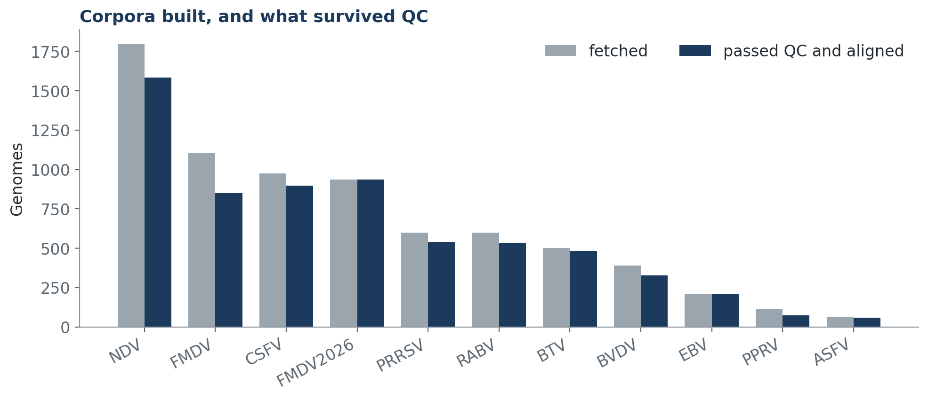
WHAT IT WAS RUN ON
Eleven pathogens, real GenBank corpora
Ten livestock viruses across four genome types — positive- and negative-sense RNA, segmented dsRNA, and large dsDNA — plus
Epstein–Barr virus as a cross-species check on a GC-rich human herpesvirus. No synthetic sequence appears in any of these counts; the
synthetic datasets used to test the software live separately under data/synthetic/ and are prefixed SYNTH-.
Counted from config/*.yaml and the aligned FASTA on disk by overview_assets/make_figures.py
6

Slide 7
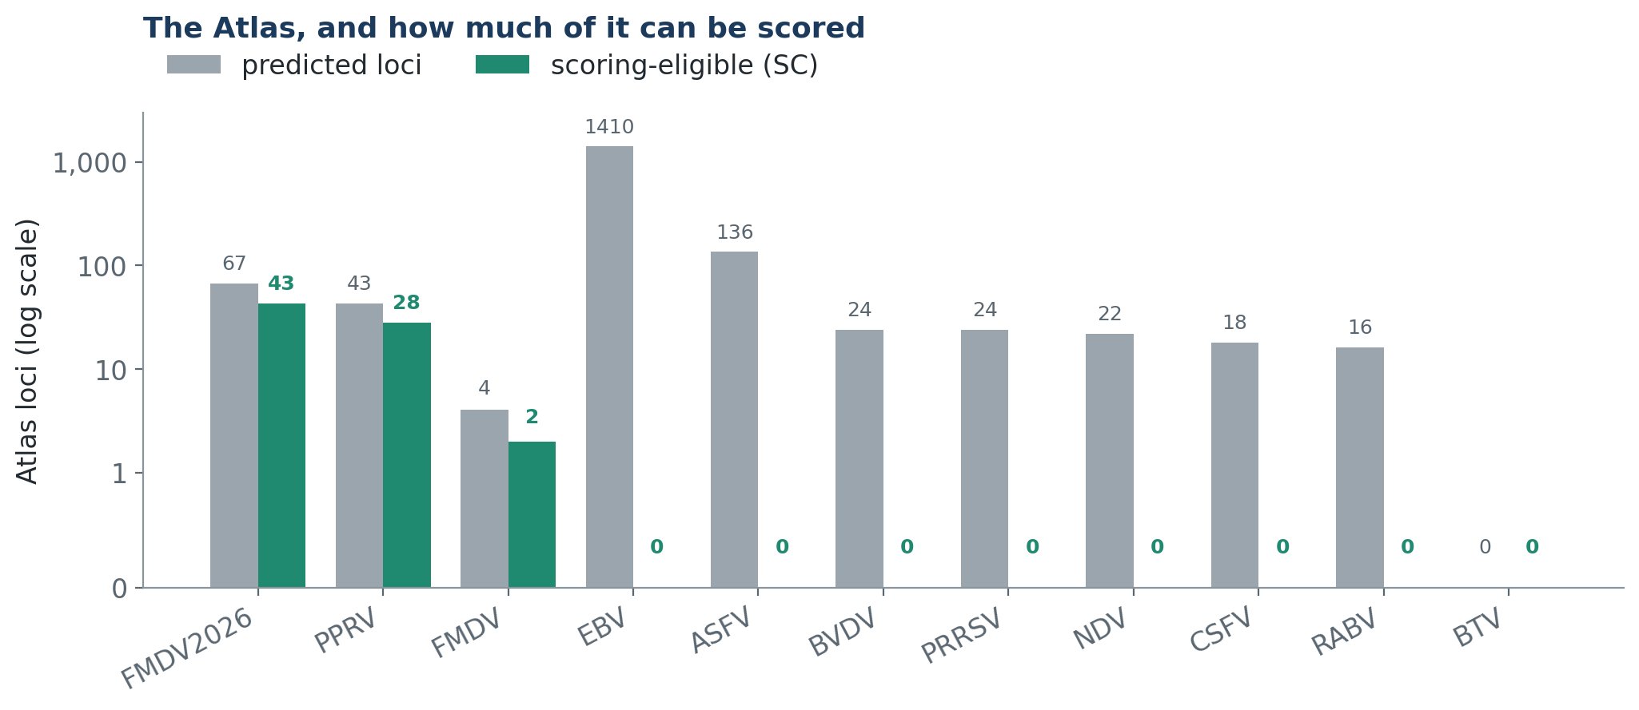
RESULT 1
The Atlas: plenty of predictions, little evidence
Prediction is cheap; evidence is not. A locus reaches SC only when its conservation across phylogenetically independent lineages
supports it, and that conservation is computed from the alignment — deliberately NOT from the disruption rate, which would make
eligibility restate the very outcome D.H1 is meant to test.
Tiers: EC / BC / SC / MC / WC / AA. Scoring eligibility is SC and above
7

Slide 8
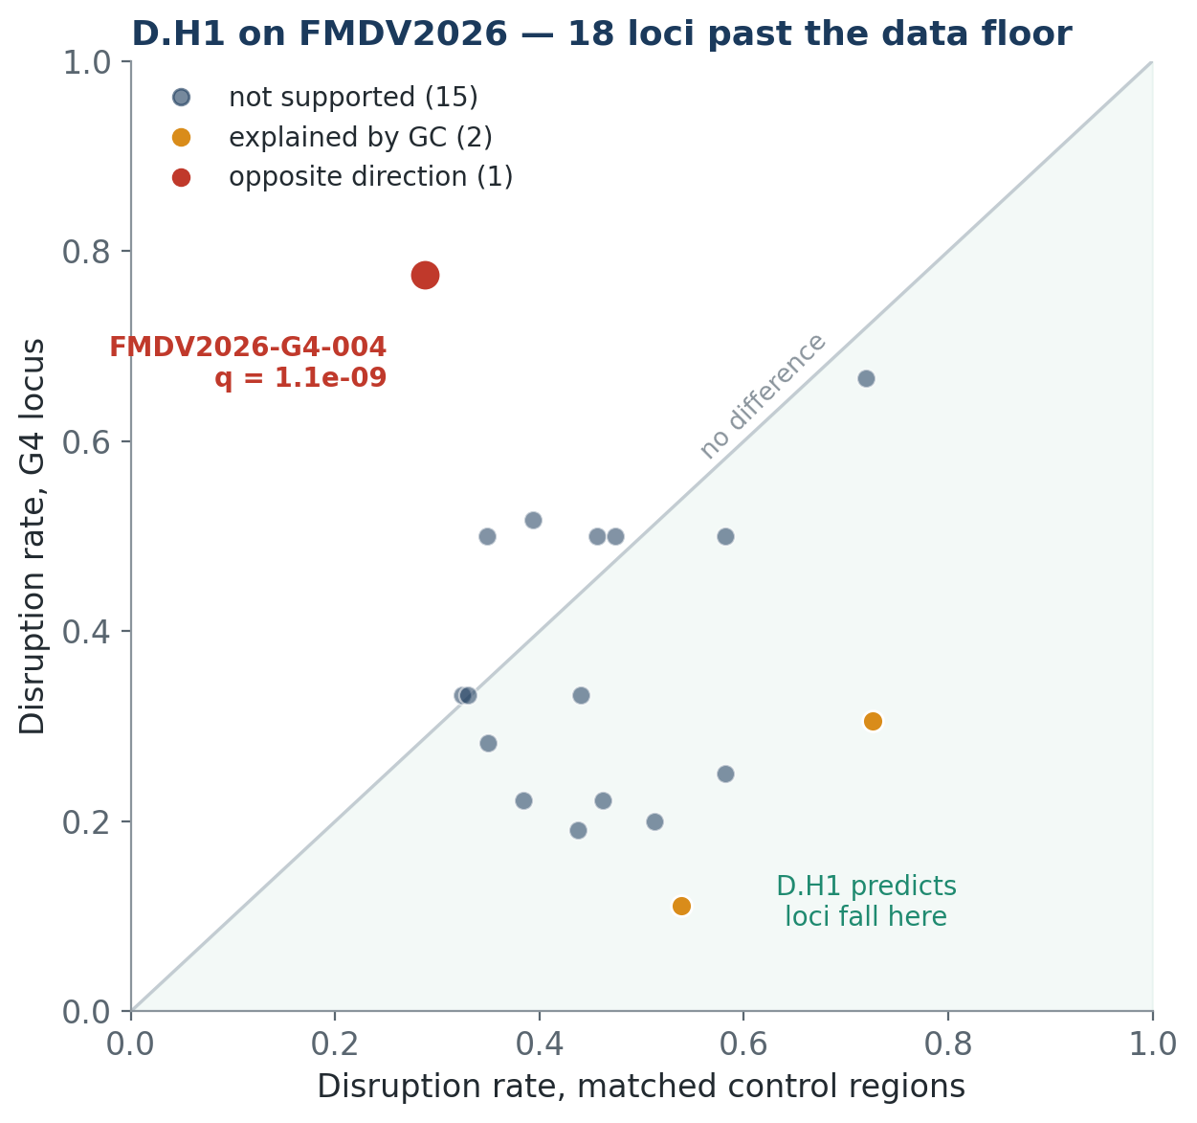
RESULT 2
The D.H1 test on its best-powered corpus
▪ 37 loci were tested on FMDV2026 (936 genomes, the deepest corpus here). 19 did not clear the data floor.
▪ Of the 18 that did: 15 NOT_SUPPORTED, 2 explained by GC, 1 significant in the opposite direction.
▪ Zero SUPPORTED.
▪ Most loci do sit below the diagonal — the direction D.H1 predicts — but none of those differences survive GC adjustment and FDR correction. A trend that does not reach significance is not a finding.
▪ The one locus that IS significant sits above the diagonal: more disrupted than its controls, not less.
data/atlases/testing_ledger.tsv, latest run per pathogen. q = Benjamini-Hochberg adjusted p
8

Slide 9
RESULT 3
The one locus that moved — and it moved the wrong way
FMDV2026-G4-004
0.775
0.288
1.08e-09
nt 4313–4337 · CDS (polyprotein) · RNA_G4
disruption, locus
disruption, controls
q, GC-adjusted + FDR
▪ Highly conserved: 94.86% across independent lineages — this is not a poorly aligned region.
▪ Not a GC artefact: flanking GC is 55.56%, and the signal STRENGTHENED when GC-matched controls were used.
▪ Not a control artefact either. When control selection was rebuilt to stop it collapsing onto the genome's 5' end, p moved from 0.14 to 1.08e-09.
THE CAVEAT THAT COMES WITH IT
Disruption at this locus is strongly serotype-structured — Asia1 is nearly invariant (0.03) while SAT2 is completely diverged (1.00). The pathogen-level verdict pools lineages that behave very differently. Before this locus is interpreted biologically, D.H1 must be run per serotype.
Read plainly: at the one locus in this study with a decisive signal, G4 sites are MORE labile than matched controls, not less.
That contradicts D.H1. It is a real measurement, and reporting it as anything else would be the only actual failure here.
Serotype breakdown recorded in docs/revision_log.md; the superseded verdict is kept in the ledger, not overwritten
9

Slide 10
SO WHAT DOES IT OUTPUT TODAY?
A closed gate, and the reason for it
Across all eleven pathogens, the testing ledger currently holds no SUPPORTED D.H1 verdict. So:
Produced
G4 Reference Atlas per pathogen · QC report · reference-anchored alignment · recombination screen · ML tree and time-scaled root · variant table · per-locus disruption rates · GC control gate · D.H1 verdict · report card · full provenance
NOT produced
G4-EWS surveillance score · CUSUM / EWMA control limits · detection calls · any statement that a pathogen is or is not changing at a G4 site
What the tool says when you ask it to score anyway:
FMDV2026: Stage 5 scoring is BLOCKED — at least one locus shows a real,
GC-adjustment-surviving effect that runs AGAINST D.H1: it is MORE disrupted than its
matched control, not less. This is evidence against the hypothesis, not an absence of
evidence for it, and it is reported separately for that reason.
This is the designed behaviour, not a broken run. A score computed from a hypothesis its own data does not support would be a
number with nothing behind it — and it would look exactly like a number with something behind it.
Quoted verbatim from `g4watch score --pathogen fmdv2026`, which exits 3 rather than emitting a score
10

Slide 11
LIMITS
What this does not yet establish
▪ Predictions, not structures.
Every locus here is computational. No G4 in this Atlas has been confirmed in vitro by CD spectroscopy or NMR.
▪ One test, one corpus.
Only FMDV2026 and its serotype-O subset have cleared the floor for enough loci to test. Eight pathogens have no D.H1 verdict at all.
▪ Lineage pooling.
The pathogen-level verdict treats each corpus as one population. G4-004 shows that can hide large between-lineage differences.
▪ Sampling is opportunistic.
GenBank is not a survey. Country and year distributions reflect who sequenced what, not where the virus was.
▪ The control-limit calibration is short.
Baselines are annual and few, so limits carry explicit uncertainty intervals rather than being quoted as exact numbers.
▪ No clinical or field validation.
Nothing here has been tested against outbreak outcomes. This is a hypothesis-testing framework, not a diagnostic.
None of these limits is a reason to distrust the negative result.
A framework that could not return a negative result would be the thing worth distrusting. What they do bound is how far it
generalises: one hypothesis, one well-powered corpus, computational predictions, and no field validation yet.
Recorded in docs/validation_report.md and docs/revision_log.md
11

Slide 12
REPRODUCIBILITY
A run is described by three things
1
The commit
2
The config
3
The accession list
Every stage records the git commit it ran under. Analysis code and configuration are versioned together.
One YAML per pathogen: reference accession, corpus paths, QC thresholds, model, seed, and every exclusion rule.
The exact GenBank records fetched. The acquisition step is a separate entry point so an analysis run can never silently re-fetch and change its own inputs.
Run it:
nextflow run workflow/main.nf --pathogen fmdv2026 -profile docker
g4watch gate-status --pathogen fmdv2026 # never blocked; reports why
1,199
11
6,485
append-only
automated tests passing
pathogens provisioned
genomes aligned
testing ledger
Profiles: docker · singularity · conda_free · slurm · awsbatch
12

Slide 13
The framework works. The hypothesis,
so far, does not hold.
Eleven pathogens, 6,485 genomes and an end-to-end pipeline that runs, records what it did, and refuses to score when its
own gate is closed. At the one locus with a decisive signal, G4 sites are more labile than matched controls — the opposite
of what D.H1 predicts. The next step is to test that per serotype, and to get more pathogens past the data floor.
ICAR–NIVEDI · G4-WATCH · research framework, not a validated diagnostic

