Slide 1
ICAR – NIVEDI
G4-WATCH
G-Quadruplex Genomic Early-Warning Surveillance for Livestock Viruses
How it works · the formulas and statistical tools · the workflow · the report card ·
how baseline, threshold and weights are derived · what the Early-Warning Score means
Technical briefing — all formulas and thresholds cited from the implemented codebase

Slide 2
MOTIVATION
Why a G-quadruplex-based early-warning layer
G-quadruplexes (G4s) are four-stranded DNA/RNA secondary structures formed by G-rich sequence. In several viruses they sit over functionally important genome regions and their disruption or loss has been linked to altered replication, translation, or immune evasion.
▪ The surveillance question:
  – Are conserved G4 motifs in a pathogen's genome being disrupted, lost, or newly gained at a rate that differs from background — and is that rate accelerating in specific lineages or geographies?
▪ Why this needs its own statistical framework, not a simple mutation counter:
  – G4 motifs are GC-rich by construction — any raw disruption signal is confounded with GC content and must be adjusted for it before it means anything.
  – A handful of tip sequences from one outbreak clade are not independent observations; naive per-genome counting manufactures false significance.
  – Not every computationally predicted G4 is real. The framework must separate "a motif that scores well" from "a motif with genuine evidence of forming and mattering".
▪ G4-WATCH is built to answer the question only after these three problems are handled — never before.
Framework: G4-WATCH Concept Paper v2 / architecture Sections 5–15
2

Slide 3
PIPELINE
End-to-end workflow — Stage 0 through Stage 6
Stage 0
G4 Reference
Atlas
Stage 1
Sequence QC
Stage 1.5
Recombination
screen (PHI)
Stage 2
Alignment +
phylogeny
Stage 3
Variant /
tip-state calls
Stage 4
Appendix C
data floor
Stage 4.5
D.H1 gate
(GC-adjusted)
Stage 5
G4-EWS score +
D.H2–D.H4
Stage 6
Report card +
dashboard
▪ The D.H1 gate is the single point of control: Stage 5/6 scoring is refused (exit code 3) unless D.H1 returns SUPPORTED for this pathogen and its config sets operational_mode: true.
▪ NOT_SUPPORTED and SIGNAL_EXPLAINED_BY_GC are not failures of the pipeline — they are documented scientific findings written to the append-only testing ledger.
Stages 1–3 build the evidence base • Stage 4/4.5 decide IF scoring is scientifically valid • Stage 5/6 produce the score, ONLY if permitted
14 Nextflow processes implement these 9 stages end to end (profiles: standard / slurm / awsbatch / docker / singularity)
3

Slide 4
TOOLS
What runs at each stage
Stage | Task | Tool(s)
0 | G4 motif scan, two-axis confidence classification | G4Hunter (custom), pattern-motif scanner, Biopython
1 | Sequence QC (completeness, N-content, date precision) | custom QC (g4watch.qc), Biopython
1.5 | Recombination screening (mandatory, gates the floor) | PhiPack (Phi test), vendored
2 | Multiple alignment; ML phylogeny; time-scaled tree | MAFFT 7.5; IQ-TREE2 2.3.6; TreeTime 0.11.4
2/4 | Ancestral state reconstruction on the rooted tree | R + ape 5.7.1 (Rscript)
3 | Variant calling vs. reference; per-genome tip states | custom (g4watch.variants), reference-pinned alignment
4/4.5 | Minimum-data floor; GC-confound-adjusted gate | SciPy (Fisher exact); pooled logistic regression + LRT
5 | Seven-term metrics; G4-EWS-core / integrated score; CUSUM/EWMA | NumPy/SciPy; custom scoring package
6 | Report card, gate-status dashboard, calibration check | custom reporting; FastAPI + SSE web dashboard
Container images: g4watch/core, alignment, phylogenetics, selection, statistics, g4prediction, variants, web-backend/db/proxy, acquisition
4

Slide 5
STAGE 0
The G4 Reference Atlas — two independent confidence axes
▪ Axis 1 — Structural Confidence
  – Is there real evidence this G4 forms at all? The ONLY axis that gates eligibility for scoring.
▪ Axis 2 — Functional Context
  – Does it sit in an annotated functional region? Reported for interpretation — never gates.
▪ Kept strictly independent by design
  – so a well-annotated but weakly-supported motif can never borrow credibility from its location, and a strong motif in an unannotated region is never discarded for that reason alone.
EC — Experimentally Confirmed
BC — Biophysically Confirmed
SC — Strong Computational Candidate
MC — Moderate Computational Candidate
WC — Weak Computational Candidate
SC rule (relaxed 2026-09; a judgment call, NOT a ROC fit — see R-11):
≥ 1 prediction tool
AND |G4Hunter score| ≥ 1.2
AND phylogenetic conservation ≥ 75%
Was ≥ 2 tools / 1.5 / 85%: 0% sensitivity to confirmed viral G4s.
G4Hunter's sign is strand, not quality — SC/MC compare |score|.
AA — Algorithm Artefact (gap / low-quality region)
g4watch/atlas/confidence.py — structural_confidence() / functional_context()
5

Slide 6
STAGE 4
The Appendix C minimum-data floor — 9 unconditional checks
Runs BEFORE the D.H1 gate, on every locus, and never short-circuits — every failing check is reported at once so a pathogen is told INSUFFICIENT_DATA for a specific, complete reason.
Check | Threshold
Sequences in window | ≥ 30
Sequences per lineage (smallest) | ≥ 20
Distinct timepoints | ≥ 3
Metadata completeness (date/host/country) | ≥ 90%
Informative clades — locus group | ≥ 3
Informative clades — control group | ≥ 3
Matched control region found | required
Alignment/QC pass fraction | ≥ 50%
Recombination screen completed | required
▪ Only the first three numbers (30 / 20 / 3) are stated in the architecture text as "the floor"; the remaining six are this project's own documented judgment call — pipeline-completeness preconditions later stages already depend on implicitly.
▪ INSUFFICIENT_DATA ≠ NOT_SUPPORTED
  – the floor firing means "cannot test yet"; D.H1 returning NOT_SUPPORTED means "tested, and found no effect". The dashboard must never conflate the two.
g4watch/validation/minimum_data_gate.py
6

Slide 7
STAGE 4.5
D.H1 — the gating hypothesis test
D.H1: "G4 Atlas loci show significantly
lower disruption than matched controls,
surviving GC-content adjustment."
Verdict | Meaning
SUPPORTED | Survives GC adjustment AND is LESS disrupted than its control
SIGNAL_OPPOSITE_DIRECTION | Real GC-adjusted effect, but MORE disrupted — against D.H1
SIGNAL_EXPLAINED_BY_GC | Raw effect present, explained away by GC (methods-null)
NOT_SUPPORTED | No significant difference at all (biological null)
▪ Step 1 — raw test (always computed, both rules)
  – Fisher's exact test on locus-vs-control disruption, per locus (2×2 table).
▪ Step 2 — GC-confound adjustment
  – ONE pooled logistic model across every locus and control simultaneously:
    · disruption ~ GC + locus_1_dummy + ... + locus_k_dummy
  – Each locus's dummy tested by likelihood-ratio test (full model vs. that dummy removed), then Benjamini–Hochberg FDR-corrected across all loci.
▪ Why pooled, not per-pair:
  – a single locus-control pair has only 2 distinct GC values — GC and locus identity are perfectly collinear and unidentifiable alone.
▪ Step 3 — direction, checked explicitly
  – Both tests above are TWO-SIDED — they ask “is this locus different?”, never “is it more conserved?”. D.H1 is directional, so locus_rate < control_rate is required separately. Without it a locus MORE disrupted than its control opens the gate.
▪ Two selectable decision rules
  – conjunction (default): raw Fisher AND GC-adjusted test must both be significant.
  – gc_adjusted: the GC-adjusted FDR test alone decides; raw Fisher is still computed and reported.
▪ Gate is the ONLY switch
  – No code downstream may treat a pathogen as scoreable without an actual SUPPORTED Dh1GateResult passed in explicitly.
g4watch/validation/dh1_gate.py, gc_confound_gate.py
7

Slide 8
STAGES 5–6
D.H2, D.H3, D.H4 — the three questions D.H1 unlocks
D.H2
D.H3
D.H4
Does G4 information add predictive value
beyond conventional genomic-epidemiology signals?
Do G4 state transitions (present→disrupted/gained)
occur more often in expanding clades?
Same question as D.H2, from the other direction:
does the G4 signal hold once conventional
signals are controlled for?
Nested model comparison M1→M4 (next slide). Answered conservatively: requires BOTH a significant likelihood-ratio gain of M4 over M2 AND M4 beating M2 on held-out AUC.
Fisher's exact test on (transition / no-transition) × (expanding / not-expanding), clade-level — NOT tip-level, which would treat one outbreak's 200 sequences as 200 independent events.
Answered by the same nested LRT + held-out-AUC test as D.H2 — reported together, since they are the two directions of one comparison.
Clade trajectory (D.H3) is a sampling-share estimate from tip collection dates — a claim about the sequenced record, not directly about transmission incidence.
g4watch/validation/dh3_test.py, phylo/clade_growth.py, validation/model_comparison.py
8

Slide 9
STAGE 5
The seven G.2 surveillance terms
Term | Definition | Formula (per surveillance window)
ΔG4C | Change in mean G4 conservation vs. rolling baseline | mean(conservation)ₜ − baseline mean
G4D | Mean weighted disruption frequency across loci | disrupted genomes ÷ assessed genomes
G4G | Proportion of genomes carrying a novel G4 gain | genomes with ≥1 novel G4Hunter hit ÷ N
ΔG4MB | Change in G4-associated mutation burden vs. baseline | Σ G4-locus SNPs ÷ Σ all SNPs, Δ vs. baseline
LF | Fastest-growing lineage frequency change | max over lineages of (freqₜ − freqₜ₋₁)
GE | Shannon entropy of the geography of G4-changed genomes | −Σ pᵢ·ln(pᵢ), countries of disrupted/gained only
TA | Temporal acceleration: recent vs. historical substitution rate | rate(recent) ÷ rate(history), clipped at 10
g4watch/metrics/surveillance_metrics.py — ΔG4C/G4D/G4G/ΔG4MB feed model M3; LF/GE/TA are added for M4 only
9

Slide 10
STAGE 5
How the baseline is set — and why z-scoring is mandatory
The seven raw terms live on incomparable scales — a proportion, an unbounded entropy, a ratio. Summing them with equal weight=1 would not be "equal weight" at all: it silently gives each term influence proportional to its own raw numeric range.
z = (raw_value − baseline_mean) / baseline_stdev
baseline_mean, baseline_stdev = mean, stdev(baseline_values)
"Baseline period" is a design commitment, not a knob:
the pre-surveillance window recorded once per pathogen (architecture Section 9.4), so a later window can never be scored against a baseline chosen to make it look calmer.
▪ Baseline values
  – the SAME metric's own values across the pre-surveillance-window baseline period, for THIS pathogen — never a cross-pathogen or literature default.
▪ Hard guards, not conventions
  – fewer than 2 baseline values → refuses (cannot estimate a standard deviation).
  – zero-variance baseline → refuses, rather than divide by zero or return a meaningless 0.
  – NormalizedMetric is a distinct type: every scoring function requires it as input, so a raw, un-normalized float cannot be passed in and silently distort a score.
g4watch/metrics/normalization.py — z_against_baseline()
10

Slide 11
STAGE 5
G4-EWS-core (model M3) — the G4-only score
G4-EWS-core = w1·ΔG4C + w2·G4D + w3·G4G + w4·ΔG4MB*
(every term a NormalizedMetric — already z-scored against its own baseline)
▪ Exactly 4 terms, by construction
  – This fixes a real defect found in Revision 1: its "G4-only" formula had quietly mixed in 3 conventional epidemiology terms, which made the whole point of the M1–M4 comparison — "does G4 information add value beyond conventional signals" — not well-posed. M3 is defined as exactly this function; there is no other "G4-only" formula anywhere else in the codebase for it to contradict.
▪ ΔG4MB* = orthogonalized excess mutation burden
  – residualized so it captures mutation burden IN EXCESS of what genome-wide mutation rate already predicts — not raw mutation count, which would double-count background evolution.
g4watch/scoring/g4_ews_core.py, metrics/mutation_burden_residual.py
11

Slide 12
STAGE 5
Integrated Surveillance Score (M4) and the nested model family
Integrated Score = G4-EWS-core + w5·LF + w6·GE + w7·TA
▪ Decision rule (D.H2/D.H4)
  – M4 significantly beats M2 by likelihood-ratio test
  – AND M4 beats M2 on held-out AUC
▪ Both required — deliberately conservative:
  – a likelihood gain that does not survive to held-out discrimination is overfitting, not evidence G4 information helps.
Model | Terms | Question it answers
M1 | LF only (null) | baseline signal from lineage frequency alone
M2 | LF + GE + TA | conventional genomic-epidemiology signal, no G4
M3 | ΔG4C + G4D + G4G + ΔG4MB* | G4-EWS-core — G4 signal alone
M4 | M3 + M2 (all 7 terms) | does G4 add value beyond conventional signals?
g4watch/scoring/integrated_score.py, validation/model_comparison.py — g4_adds_value()
12

Slide 13
WEIGHTS
How w1…w4 are actually fitted — regularized, never guessed
▪ Regularized logistic MLE, no intercept
  – no intercept because G4-EWS-core is a pure weighted sum with no constant term — fitting one would fit a model the score itself cannot represent.
▪ L2 penalty is the DEFAULT, not an option
  – the four core terms are correlated by construction (disruption and conservation-change measure overlapping aspects of the same locus history). An unregularized fit at this project's sample sizes gives large, unstable, sign-flipping coefficients that LOOK like findings. Setting strength=0 requires passing allow_unregularized=True explicitly.
Design rationale, verbatim:
"The optimiser is plain MLE with a penalty term, deliberately simple and readable, because the point of this module is auditability rather than speed."
objective(w) = −log-likelihood(w) + strength · ‖w‖²
▪ Mandatory prior-sensitivity report
  – the fit is re-run at 5 penalty strengths spanning two orders of magnitude (0.1, 0.5, 1.0, 5.0, 20.0). If the fitted weight DIRECTION barely moves across that range, the signal is in the data; if it swings, it is in the prior.
  – prior_dominated = True (cosine deviation > 0.2, or any sign flip) → the weights must NOT be reported as a finding, by rule, not by judgment call at report time.
g4watch/scoring/weight_fitting.py — fit_core_weights(), PriorSensitivityReport
13

Slide 14
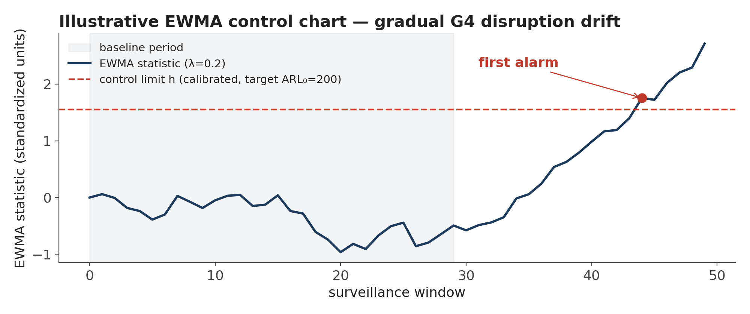
DETECTION
Turning a score series into an alarm — CUSUM & EWMA
CUSUM: Sₜ = max(0, Sₜ₋₁ + zₜ − k) alarm if Sₜ > h
EWMA: Eₜ = λ·zₜ + (1−λ)·Eₜ₋₁ alarm if Eₜ > h
▪ One-sided, upper only
  – the surveillance question is directional (an INCREASE in disruption); a two-sided chart would spend half its false-alarm budget on decreases nobody would act on.
▪ Why both charts
  – CUSUM accumulates evidence — strongest against a sustained step shift. EWMA's decaying weight tracks a gradual drift — the more plausible shape for a G4 locus eroding over successive seasons.
▪ λ = 0.2 (EWMA smoothing constant)
  – standard surveillance default balancing responsiveness against noise.
g4watch/scoring/cusum.py, ewma.py — chart is an illustrative synthetic series, not a real result
14

Slide 15
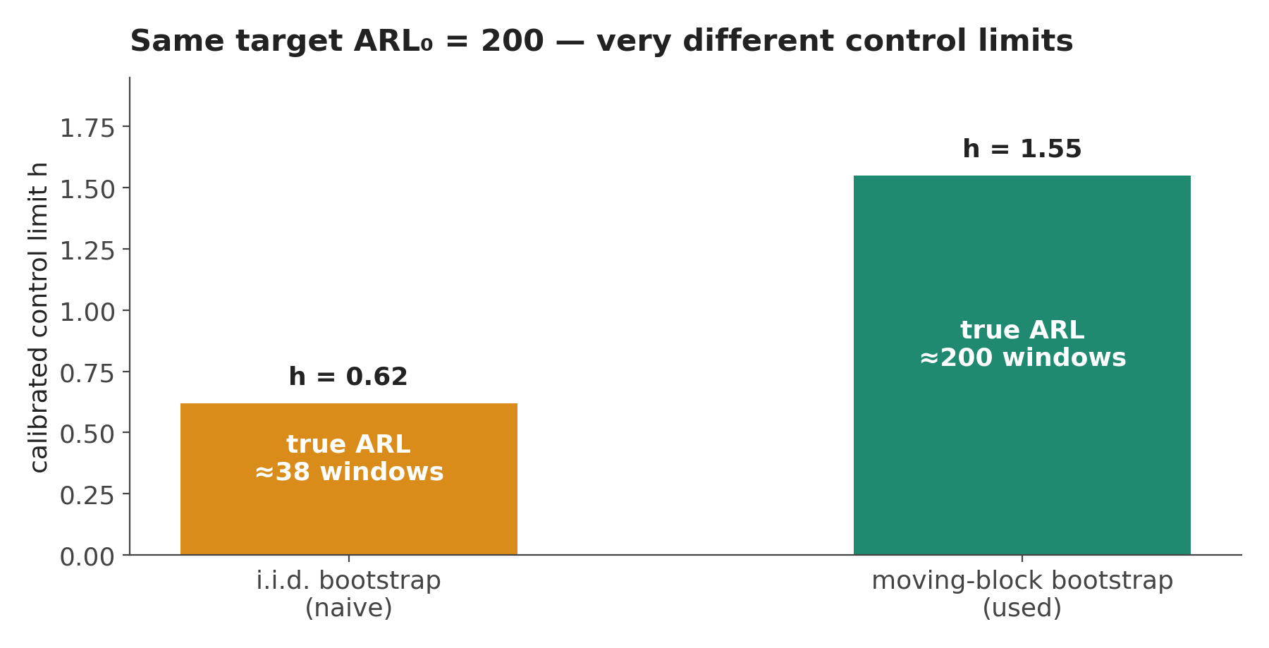
THRESHOLD
How the alarm THRESHOLD is calibrated — target ARL₀ = 200
▪ The problem being corrected
  – surveillance score windows share sequences, share clades, share the same slowly-changing viral population — consecutive scores are NOT independent draws. Calibrating a control limit under an i.i.d. assumption sets it far too low; in production the alarm rate comes out many times the nominal false-positive rate. "A system that cries wolf is worse than none."
▪ The fix — moving-block bootstrap
  – resample the BASELINE series in contiguous blocks (preserving its short-range dependence), then bisect on the control limit h until the target average run length (ARL₀ = 200 quiet windows per false alarm) is achieved on 500 such resamples.
Block length: n^(1/3) rule of thumb, doubled when lag-1 autocorrelation exceeds 0.5; bounded to [2, n/4]. Needs ≥20 baseline observations — fewer would let the limit be dominated by the baseline's own sampling noise.
g4watch/scoring/cusum.py — calibrate_cusum(), compare_iid_vs_block_calibration()
15

Slide 16
DETECTION
From alarms to a warning level an operator can act on
▪ Raw level = consecutive alarm windows
  – 1 → WATCH, 2 → ELEVATED, ≥3 → HIGH. Requiring persistence is the cheapest guard against acting on one transient in an autocorrelated series.
▪ Two caps enforced before a level is ever shown
  – Underpowered analysis → capped at INSUFFICIENT_EVIDENCE, always, whatever the chart did. An alarm from a test that could not have detected the effect is not evidence of it.
  – Structural-confidence cap → EC/BC can reach HIGH; SC caps at ELEVATED; MC and WC cap at WATCH; AA can never warn at all (NONE).
▪ gate_permitted = False (D.H1 not SUPPORTED)
  – → INSUFFICIENT_EVIDENCE unconditionally, before either cap is even checked.
▪ Every WarningAssessment states the binding cap by name
  – "chart alone indicated ELEVATED; capped by structural confidence WC (cap: WATCH)" — never a bare level with no way to see why.
HIGH
≥ 3 consecutive alarm windows
ELEVATED
2 consecutive alarm windows
WATCH
1 alarm window
NONE
no current alarm
INSUFFICIENT_EVIDENCE
gate closed, OR analysis underpowered
g4watch/warning/classifier.py — classify_warning(), CONFIDENCE_CAP
16

Slide 17
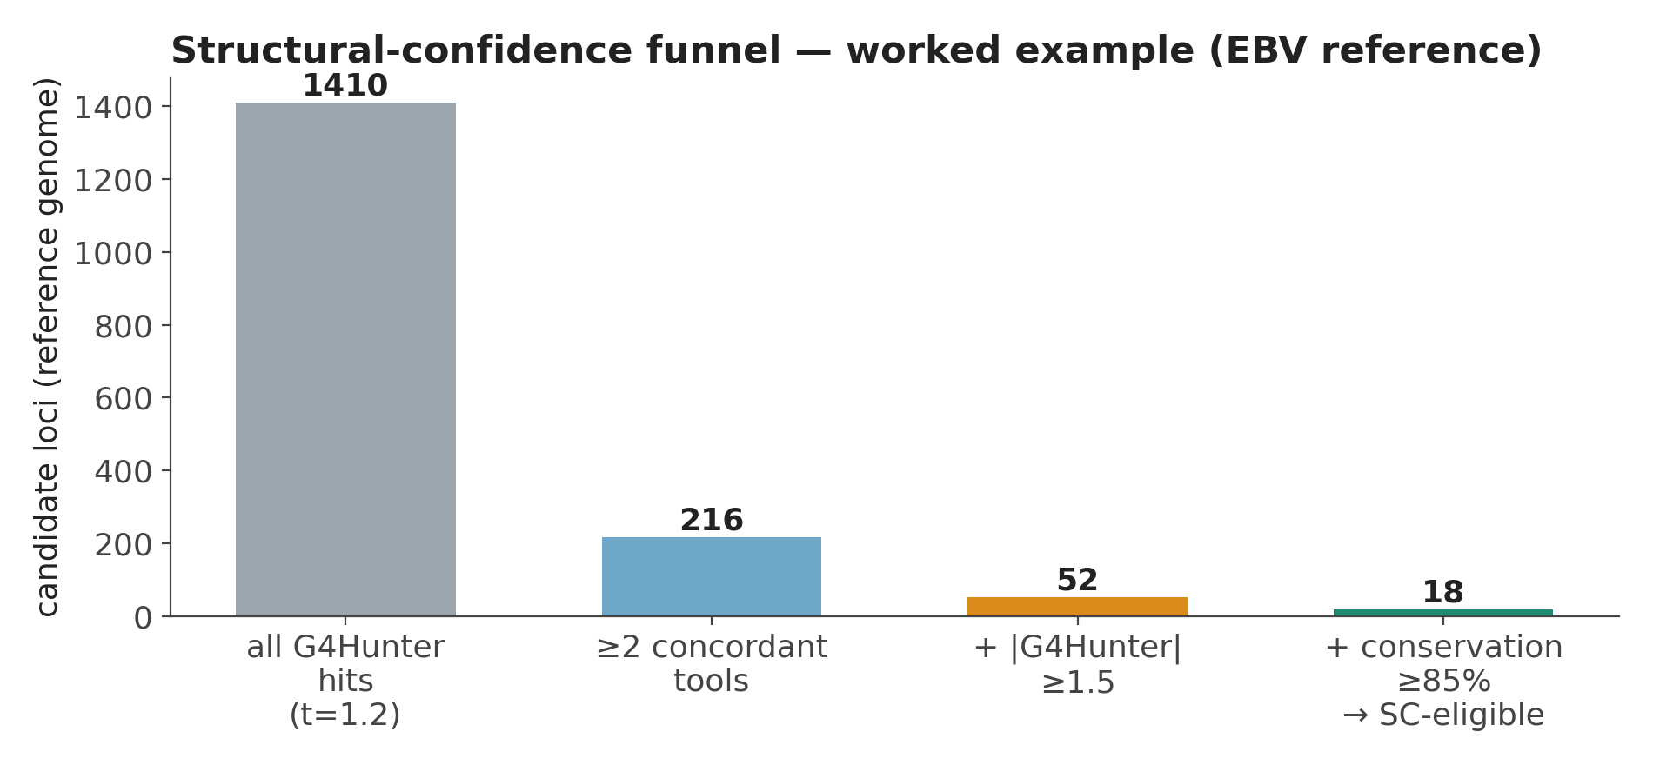
VISUALIZATION
Worked example — how many candidates actually reach SC
▪ Reading this funnel
  – Most raw G4Hunter hits (window=25, t=1.2) never reach SC eligibility — this is expected, not a defect: the SC bar is deliberately conservative.
▪ Cross-pathogen honesty check
  – This funnel varies enormously by pathogen. FMDV's reference genome (53.6% GC) yields only 4 raw G4Hunter hits genome-wide — it may genuinely lack canonical G4 structure.
  – Running this funnel before committing to a full pipeline run is now standard practice: it tells you in minutes whether a pathogen can ever reach a scoreable Atlas.
Illustrative worked example (EBV reference genome, NC_007605.1); numbers from this project's own runs
17

Slide 18
STAGE 6
The pathogen report card — one document per pathogen
Identity
Dataset
Quality (QC)
Genomic metrics (G.2 terms)
D.H1–D.H4 verdicts
Early-warning indicators
Score
Confidence
Validation status
Limitations
Interpretation
▪ Three rules enforced in code, not left to whoever assembles the report
  – Every section carries status reported / blocked / unavailable + a reason — a blank section and an absent one are never conflated.
  – Scored sections (score, warning level, EW indicators) appear ONLY when the D.H1 gate permits scoring; otherwise shown as blocked with the gate's own explanation.
  – A card built from synthetic/demonstration data is stamped non-authoritative at the top level — visible to every consumer without inspecting the underlying data.
g4watch/reporting/report_card.py — build_report_card()
18

Slide 19
VISUALIZATION
The web dashboard — what a user actually sees
▪ FastAPI + SSE, session-authenticated
  – PBKDF2-HMAC-SHA256 (600,000 iterations) local auth; secure, signed session cookies; a route allowlist gates everything else behind login.
▪ Per-pathogen dashboard page
  – gate status (never blocked — shows WHY scoring is or isn't permitted)
  – the Atlas, both confidence axes shown independently
  – recombination screen result, variant summary, molecular-clock diagnostics
  – score trend, warning-level history, calibration status
▪ Live updates over Server-Sent Events
  – a long pipeline run streams stage-by-stage progress to the page rather than the user polling or watching a terminal.
Route surface (abridged):
GET /
overview, all pathogens
GET /pathogen/{name}
per-pathogen dashboard page
GET /api/pathogen/{name}
full JSON payload
GET /api/pathogen/{name}/gate
D.H1 gate status only
POST /login POST /logout GET /whoami
TLS + HSTS + CSP at the nginx proxy
rate limits: 5 req/min login,
30 req/s general
web/backend/app.py, web/workstation/tracks.py, web/proxy/nginx.conf
19

Slide 20
VALIDATION
Current validation status — reported plainly, including the negative
▪ The D.H1 gate was opening on evidence that contradicted D.H1
  – D.H1 claims G4 loci are LESS disrupted than matched controls. Both underlying tests — Fisher and the pooled likelihood-ratio test — are two-sided, so neither could tell 'more conserved' from 'more variable'. Direction was never checked.
  – On the FMDV 2026 corpus the ONLY locus returning SUPPORTED, FMDV2026-G4-004, was more disrupted than its control (0.775 vs 0.545). It carried the entire pathogen verdict, and that verdict was what set operational_mode true. Fixed: direction is now required explicitly, and a wrong-direction effect gets its own verdict (SIGNAL_OPPOSITE_DIRECTION) rather than being reported as no effect.
  – Two unit tests asserted the inverted behaviour, so the suite agreed with the code and both disagreed with the hypothesis. Corrected together.
▪ The SC threshold was relaxed on cross-species evidence — a judgment call, not a ROC fit
  – Every confirmed viral G4 available (HIV-1 LTR and nef) classified as WC under the old ≥2-tool / ≥1.5 / ≥85% rule — 0% sensitivity against its own ground truth. Now ≥1 tool, ≥1.2, ≥75%. The confirmed set holds 3 loci from 1 virus with derived coordinates; calibration.py requires 30 across 4 families and refuses to report an operating point.
▪ Both findings are the framework working, not failing
  – A gate that blocks scoring, and a gate defect caught before it authorised one, are documented results. The FMDV 2026 verdict is now SIGNAL_OPPOSITE_DIRECTION and scoring stays blocked.
g4watch/validation/dh1_gate.py (direction); calibration.py — 30 positives / 4 families required, not met
20

Slide 21
Summary
▪ A gate, not a formula, is the core design decision
  – D.H1 must return SUPPORTED before ANY score is produced for a pathogen — an unsupported pathogen gets a documented negative result, never a number that looks like one.
▪ Every number in the score traces to a cited threshold or a fitted, auditable procedure
  – z-scored against a pathogen's own baseline; weights regularized with a mandatory prior-sensitivity check; alarm thresholds calibrated to a stated target ARL by block-bootstrap.
▪ Confidence caps make the warning level honest about its own evidence quality
  – a weak computational candidate cannot raise a HIGH alarm however cleanly its chart fires.
▪ Open, stated item: SC threshold recalibration against confirmed viral G4s
  – the operating point was relaxed on 3 confirmed loci from 1 virus. A defensible threshold needs 30 across 4 families with stated coordinates — the next required validation step, not yet performed.
▪ No pathogen currently has an open gate
  – FMDV: INSUFFICIENT_DATA. FMDV 2026: SIGNAL_OPPOSITE_DIRECTION. Every surveillance score in this deck is machinery described, not a result claimed.
G4-WATCH — ICAR-NIVEDI · technical briefing · all figures traced to the implemented codebase

