Slide 1

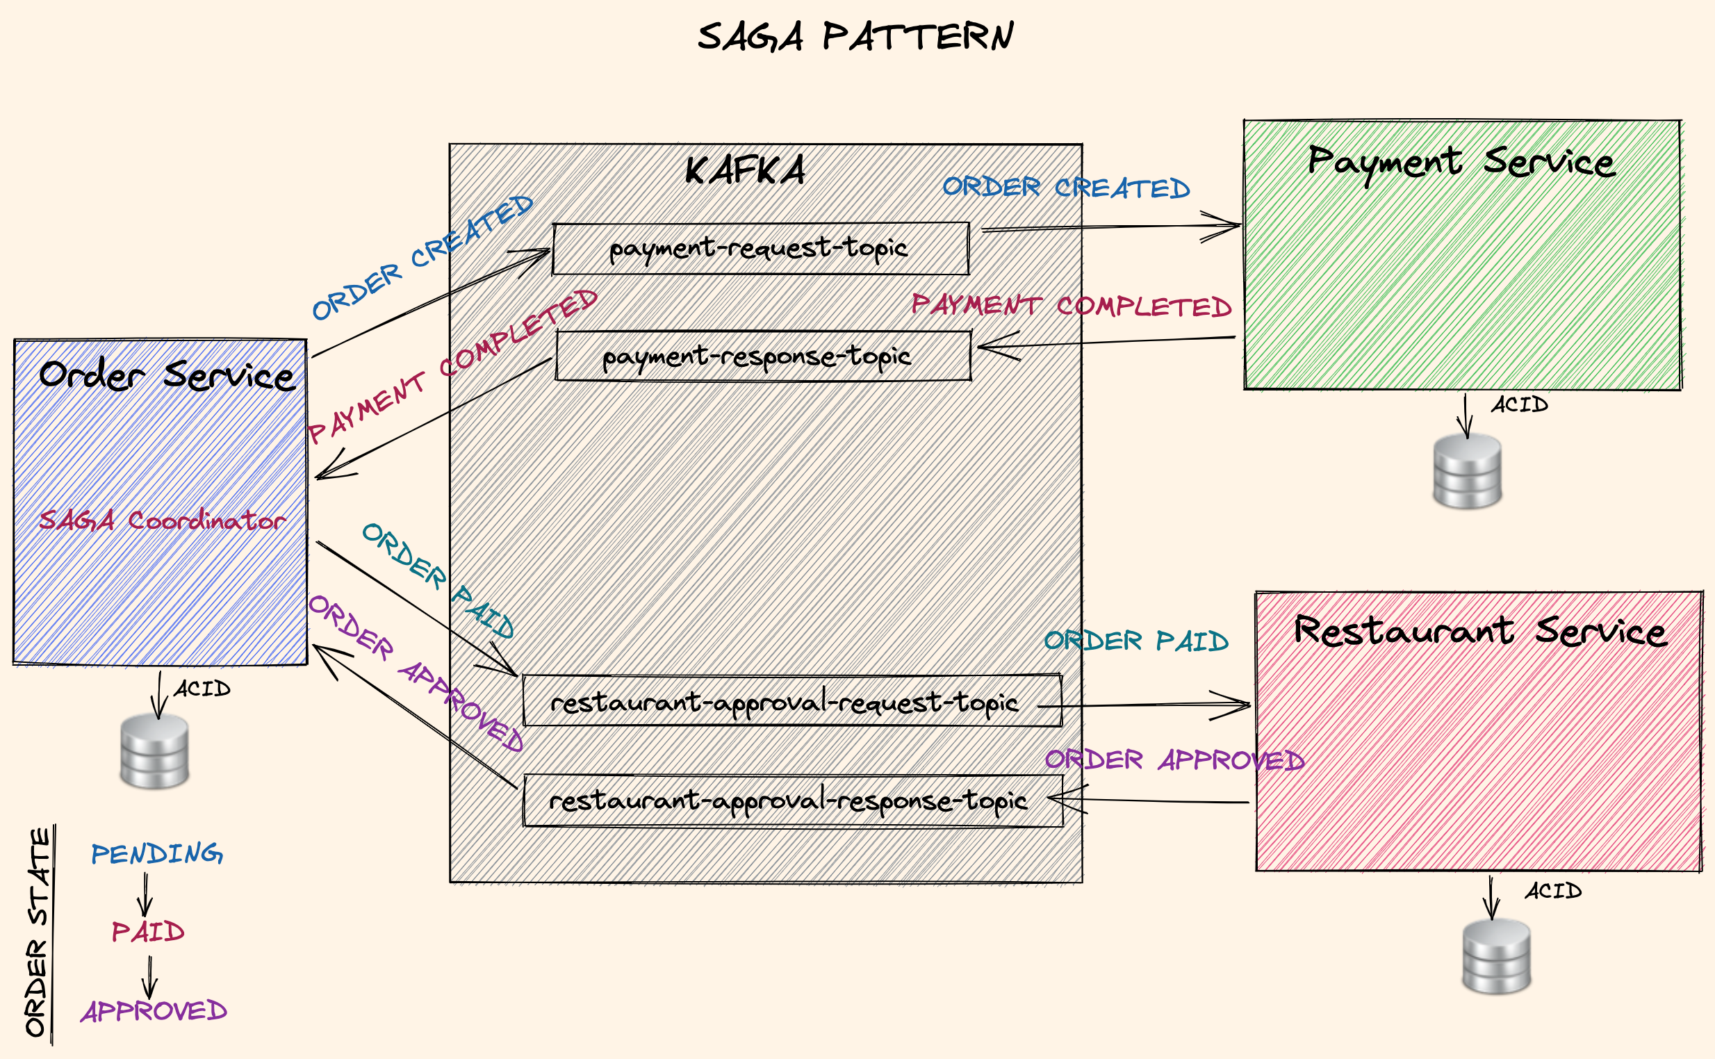
SAGA Pattern
SAGA: Distributed long running transactions across services.
Used for Long Lived Transactions (LLT). First invented in a
publication on 1987
https://www.cs.cornell.edu/andru/cs711/2002fa/reading/sagas.pdf
Chain of local ACID transactions to finalise a long running transaction across services.
Compensating transactions: Rollback in case of failure
Saga Step interface
public interface SagaStep<T, S extends DomainEvent, U extends DomainEvent> { S process(T data); U rollback(T data); }

